Slide 1
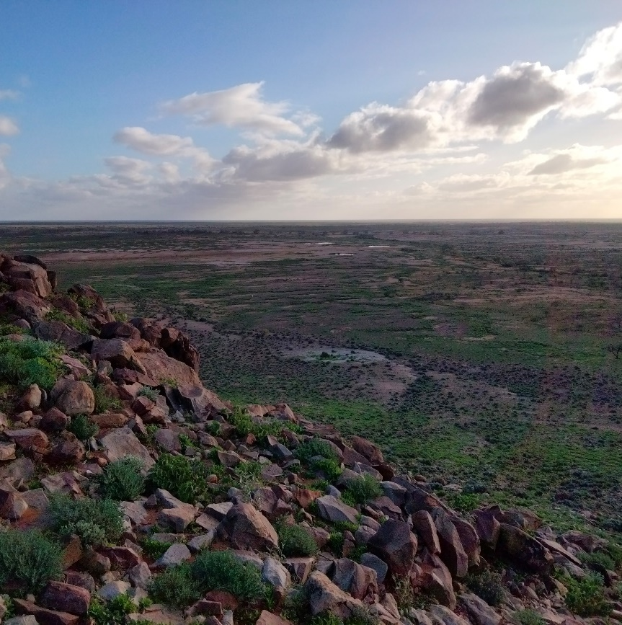
Target 2023 Workshop: A practical guide to exploration hydrogeochemistry – Exploration Toolkit
Dr Nathan Reid and Alex Hunt

Slide 2

I would like to begin by acknowledging the Whadjuk people of the Noongar Nation as the Traditional Owners of the land that we’re meeting on today, and pay my respect to their Elders past and present.
Notes:
Source: https://my.csiro.au/OrgInfo/Structure/Support/Indigenous/Resources

Slide 3

Introduction
Exits, alarms etc
Introduce yourself and what experience you have in hydro or exploration space

Slide 4
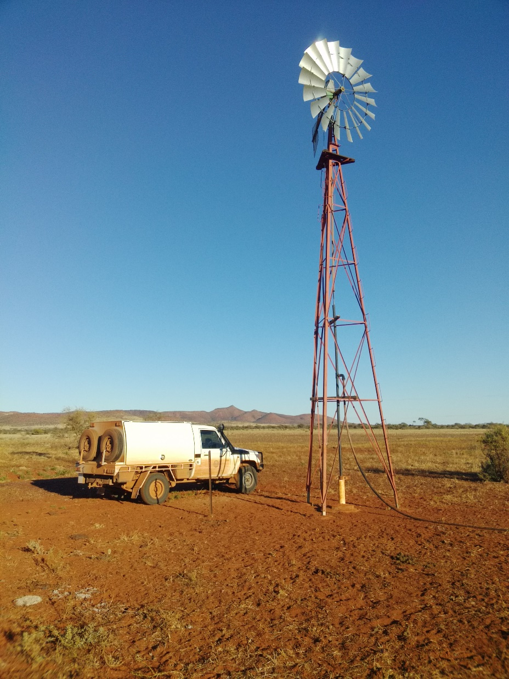
Introduction to hydrogeochemistry
What can it tell you about geology under cover, its strengths and weaknesses
Targeting mineral systems at regional and camp scales
How to collect consistent samples and the tools we can provide
What laboratory analyses are required and at what detection limits
How to check your data (QA/QC)
How to process data with XT Hydro
How to interpret your data within the regional context and tips for targeting

Slide 5
Hydrogeochemistry – where it works
Tenement Selection
Greenfields Exploration
Provides baseline environmental information
Near Misses
Moving into thicker cover/basins
Indications of alteration
Detects known mineral systems
Detects weathering sulfides
Trialled on many commodities (Au, Base Metals, U)
Notes:
Hydrogeochemistry is a regional detection tool. The sample spacing is generally not fine enough for ore body mapping but it can detect weathering sulfides at large scales and can determine what time of sulfides at smaller scales

Slide 6
Field sampling
Key gear and steps
Field meta and chemical data collection
Youtube video available https://www.youtube.com/watch?reload=9&v=73iBM6zmoTs
FAIMS 2 and 3

Slide 7
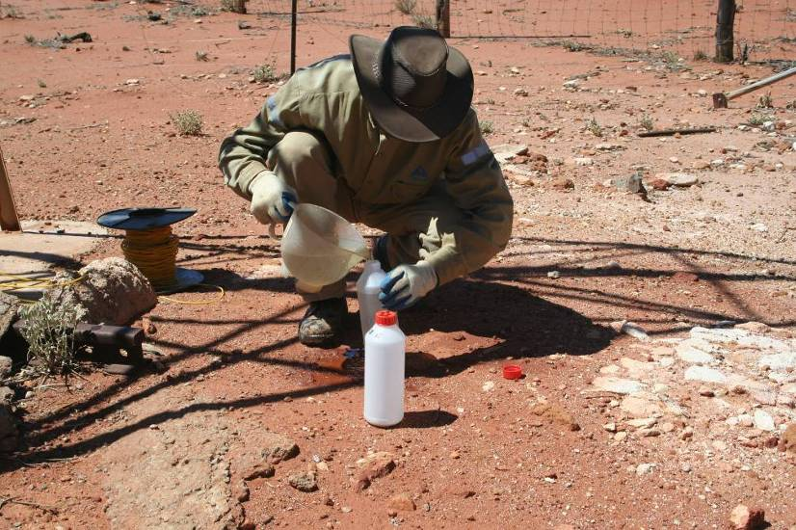
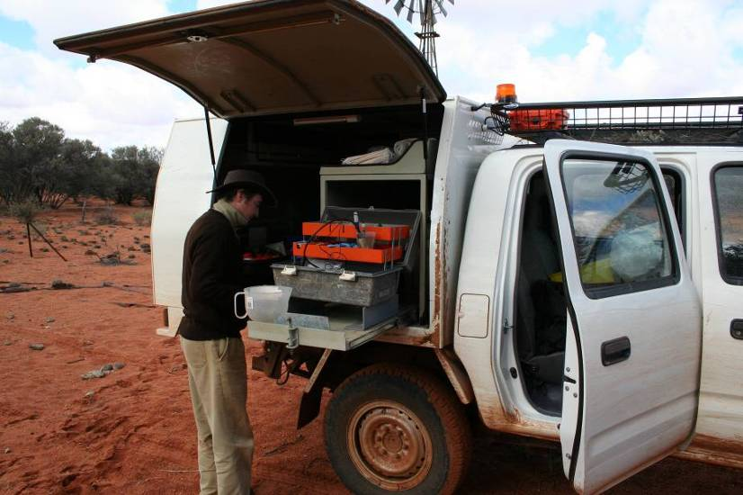
Field treatment
Eh, pH, temperature and conductivity measured immediately
Site details recorded
Water table depth
125 ml airtight sample collected for alkalinity
Filter (0.45 µm) ~ 300 ml
  100 ml for anions
  125 ml for cations (acidified - 2% concentrated HNO₃)
1000 ml placed with C sachet and ~10 g NaCl
15+ min

Slide 8
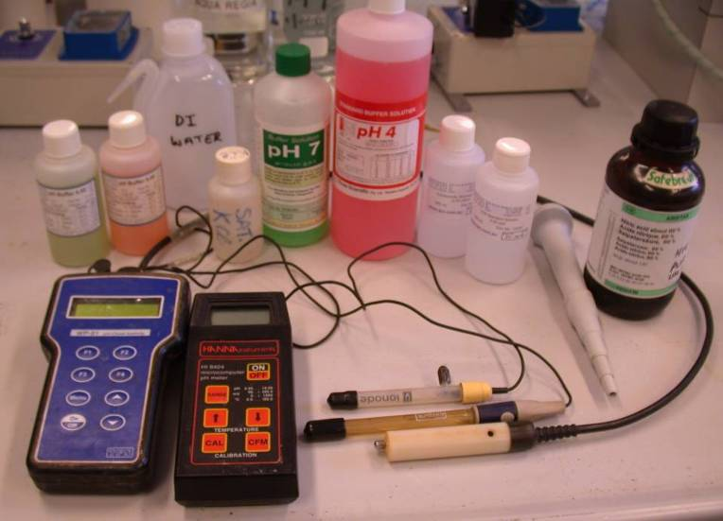
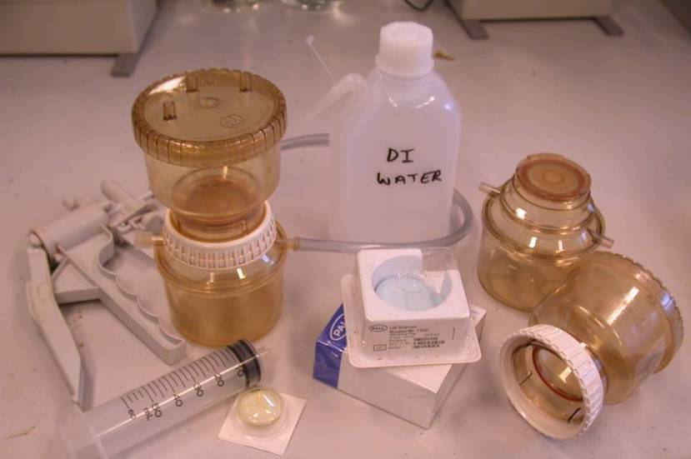
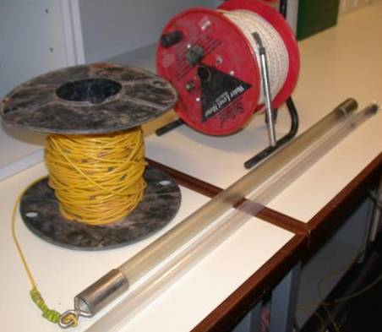
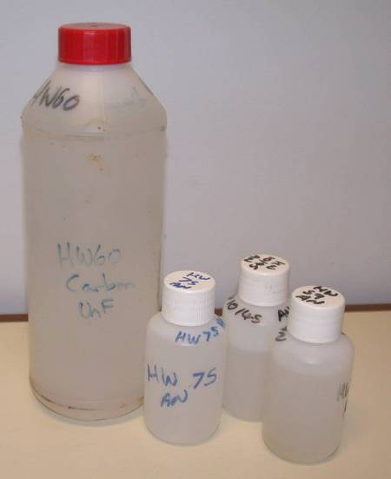
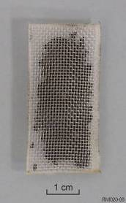
Equipment
Wear no jewellery
Or wear gloves
Cleanliness is key
Things which could be done in the field: Alkalinity titrations
Acidification
We don’t – carrying high purity acids in the field is problematic

Slide 9
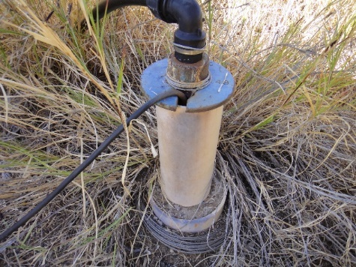
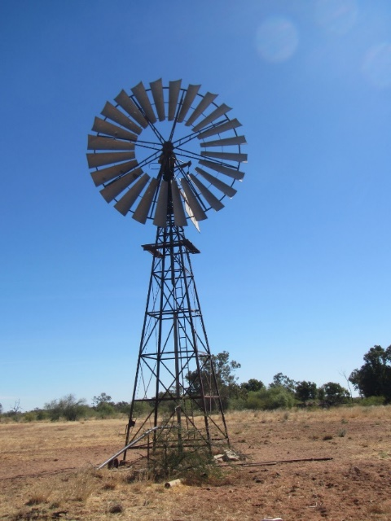
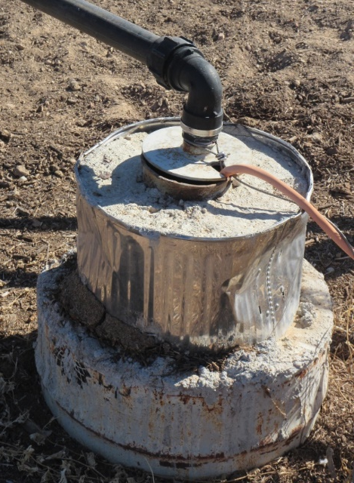
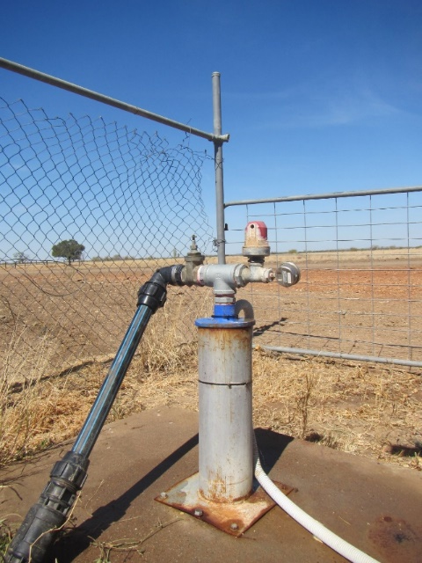
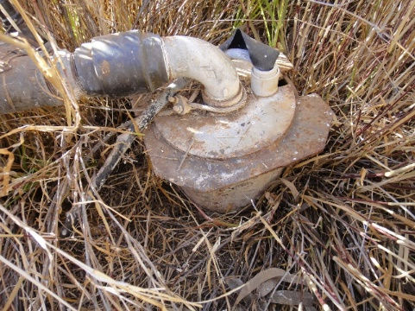
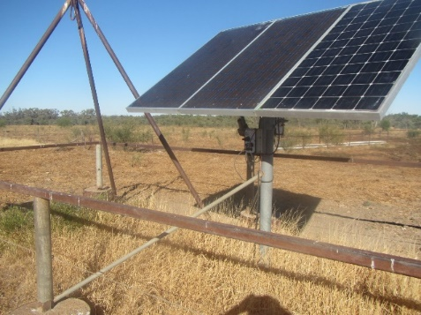
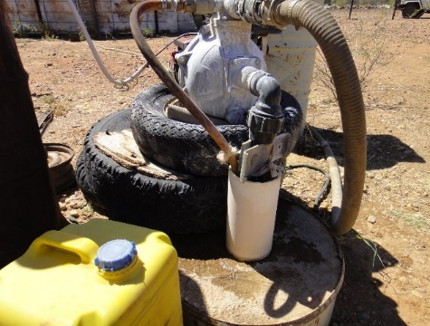
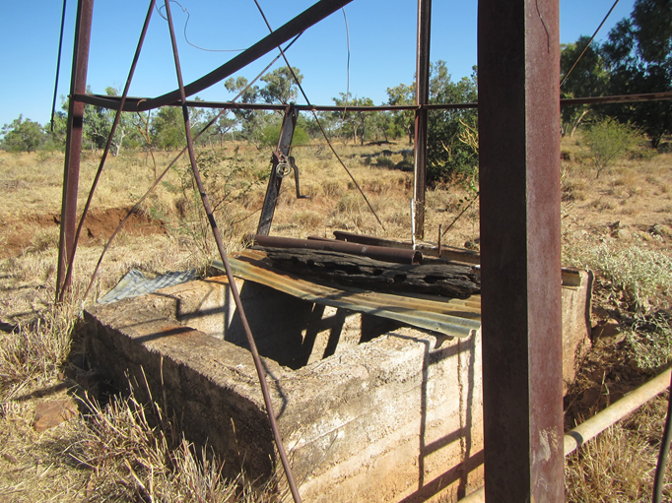
Boreholes
A mad array of bore types

Slide 10
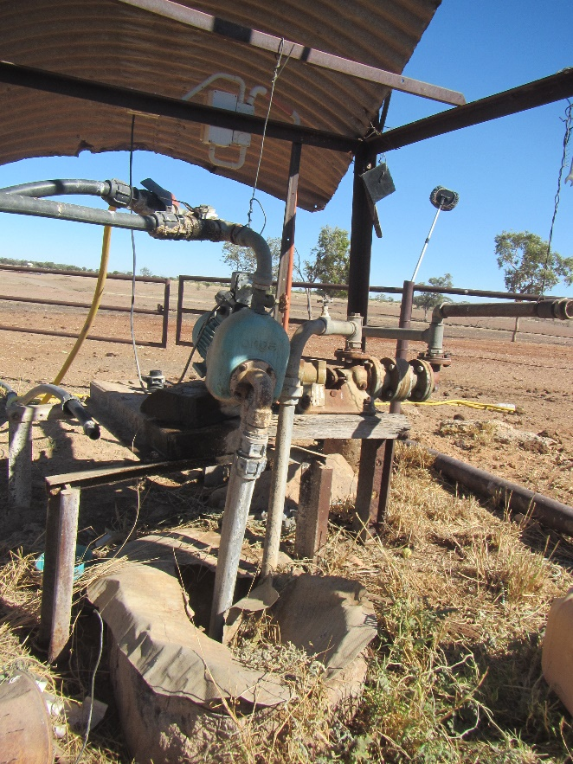
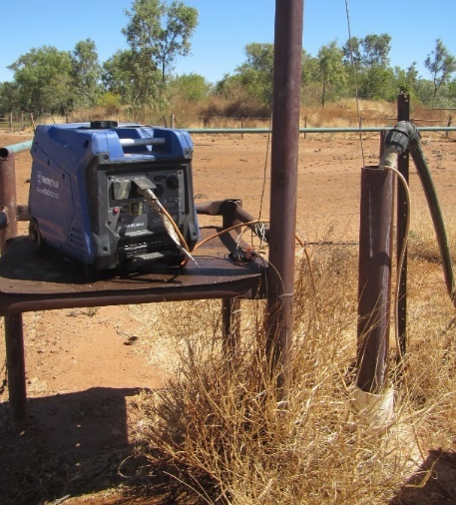
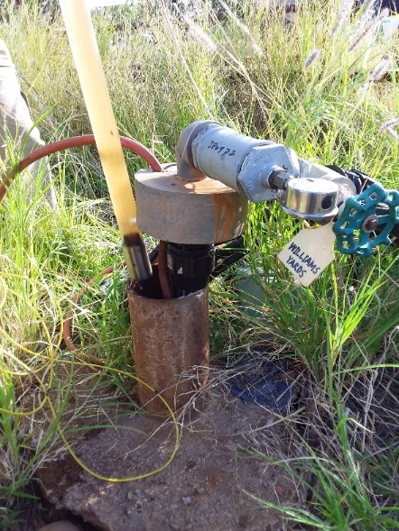
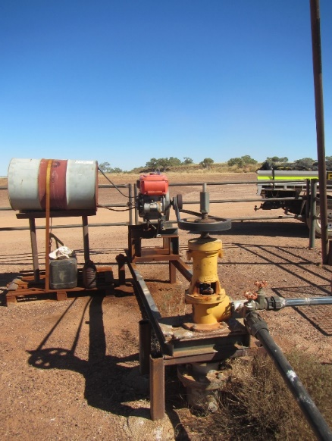
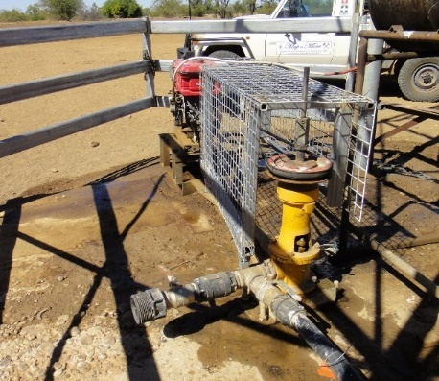
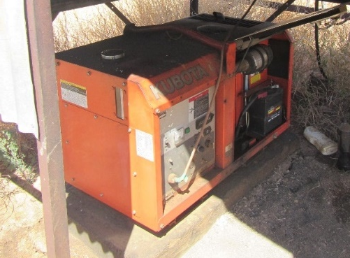
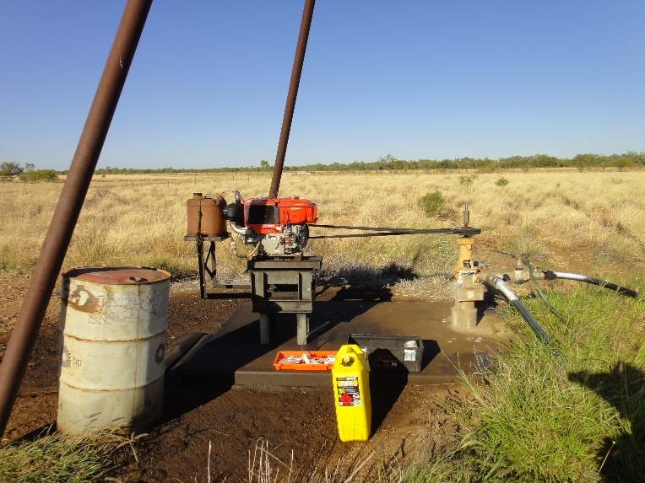
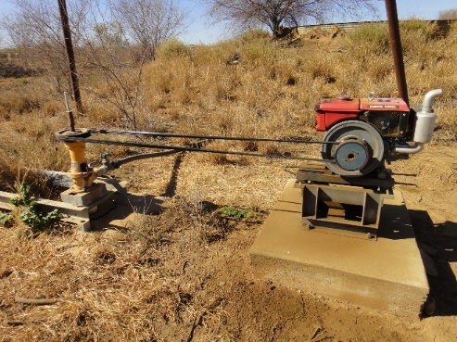
Pumps
Diversity of pumps

Slide 11
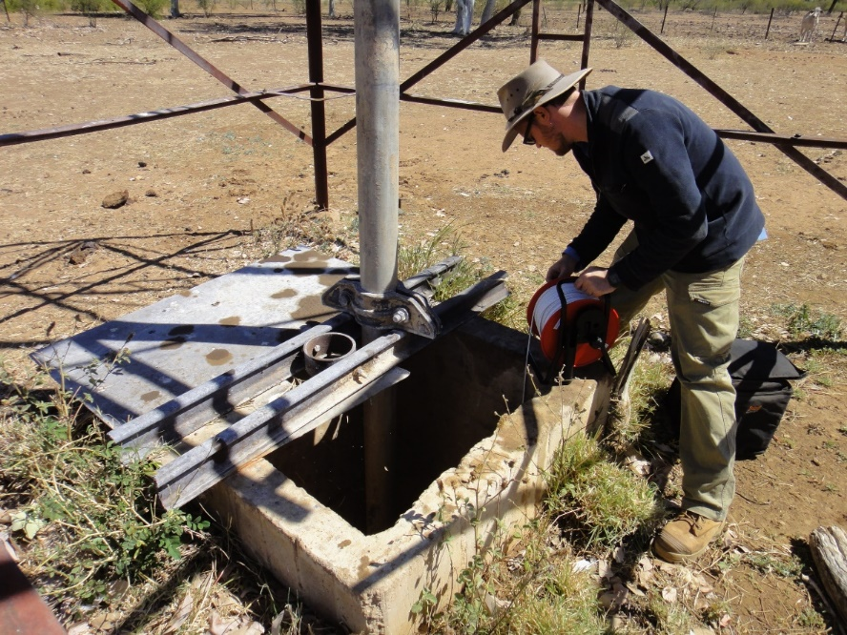
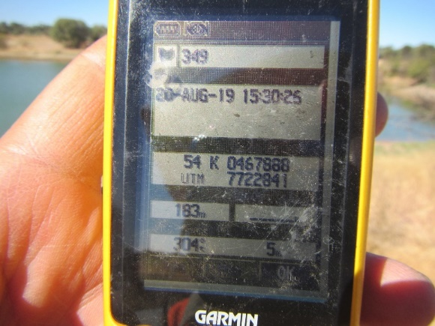
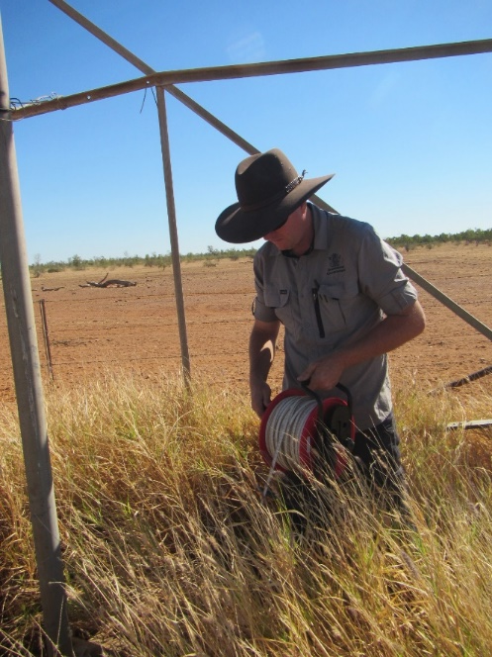
Site measurements and observations
Water table
Location
Site observation
Contamination

Slide 12
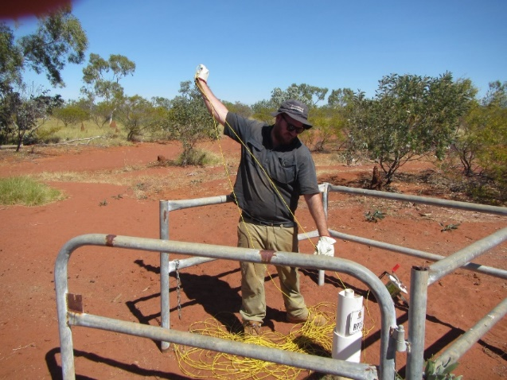
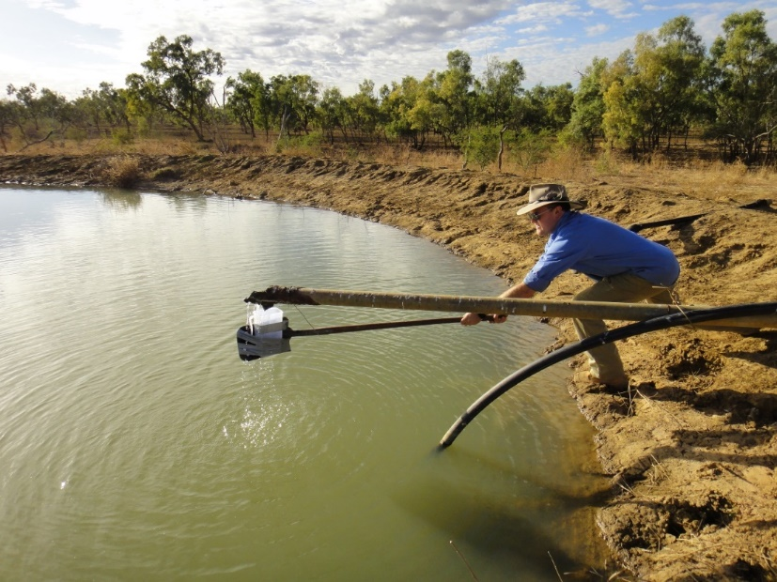
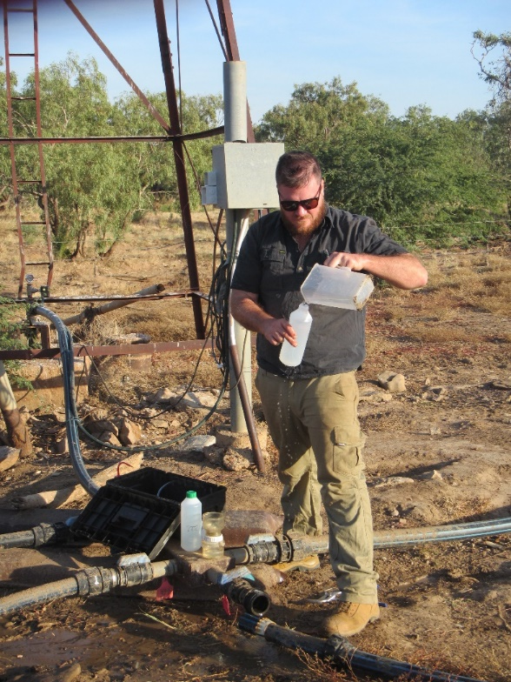
Sample collection
Bailing
Unorthodox
From pump

Slide 13
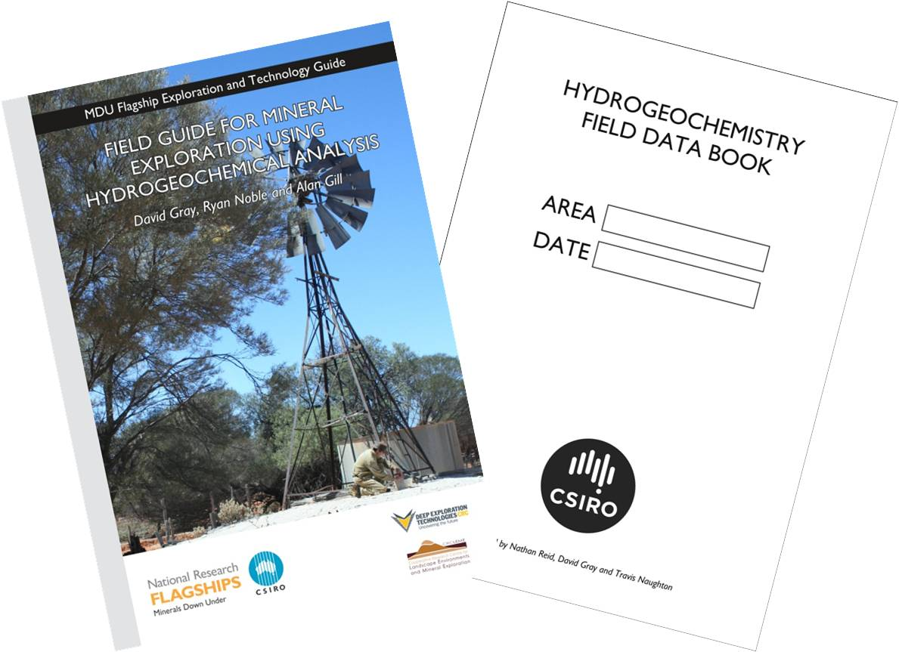
Sampling log books, training guides, tablet field app

Slide 14
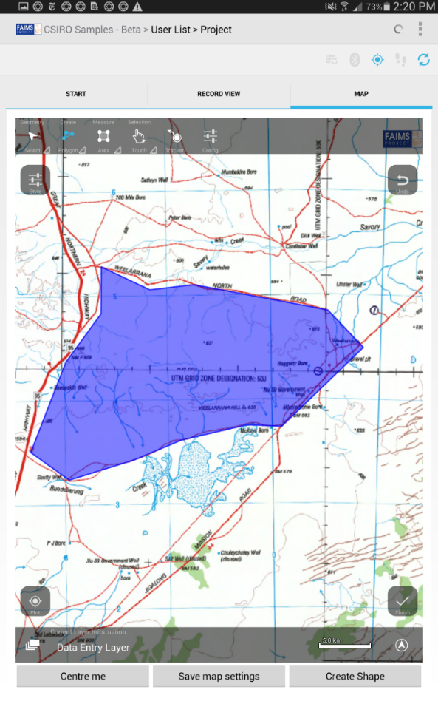
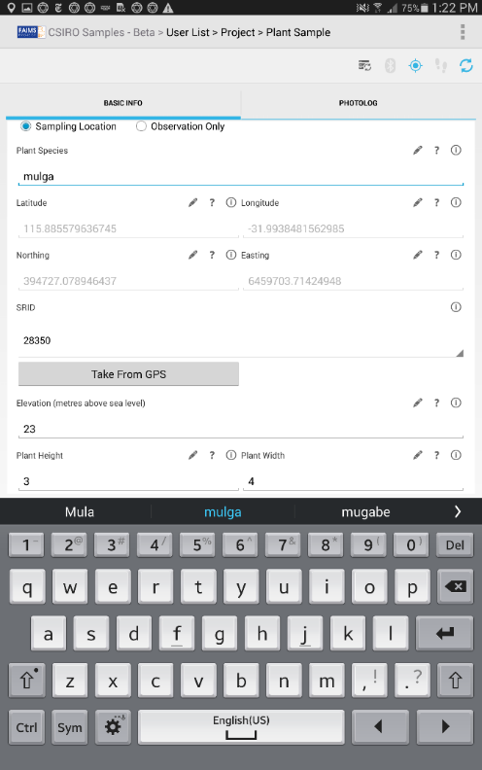
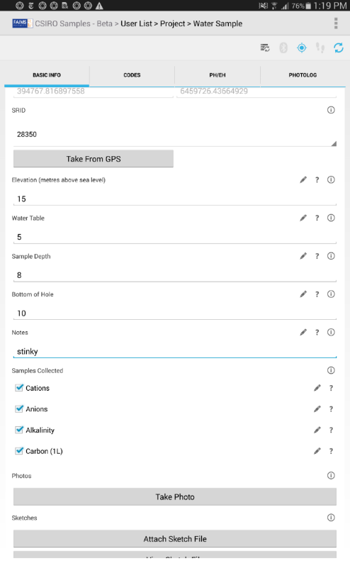
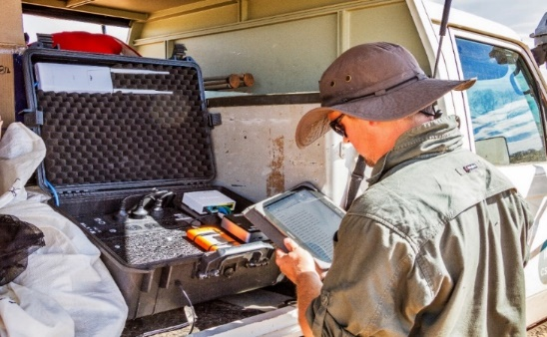
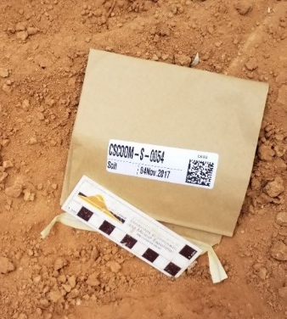

FAIMS 2.6 Android app –a CSIRO twist on time savings
Developed through Macquarie University Archaeology, open source, now adapted for CSIRO protocol geochemical sampling (hydro, soil, vegetation and rocks)
Can be used for mapping and tracking
Data Capture: auto GPS, dropdowns, tick boxes, photo tagging - Customizable
Field server: backs up multiple tablets in real time when in remote locations
Robust field printed labels with data matrix – IGSN linked
Future: Set up for labs, new designed field server, auto upload to DAP, design your own module, linked to field devices (pXRF)
Notes:
New sampling app – originally designed for hydro sampling – but now can be used for multiple media. Allows use of android tablet which is automatically linked to server in the vehicle –backs up data and contains large maps for download to tablet. Also can use maps – add polygons and sample points.

Slide 15
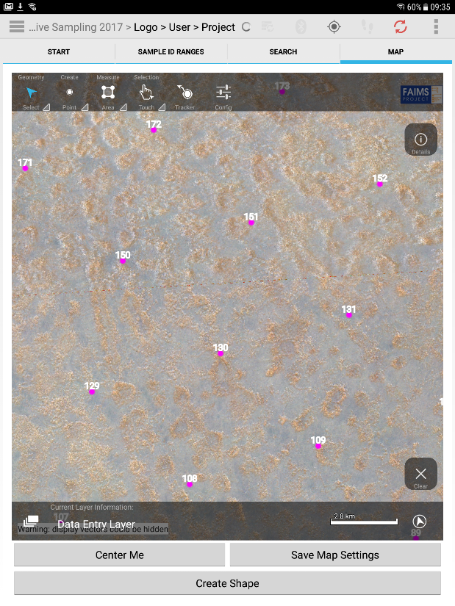
Basic mapping functionality
Mapping: water samples overlying the MrVBF imagery (left). Soil samples overlying satellite imagery (right)

Slide 16
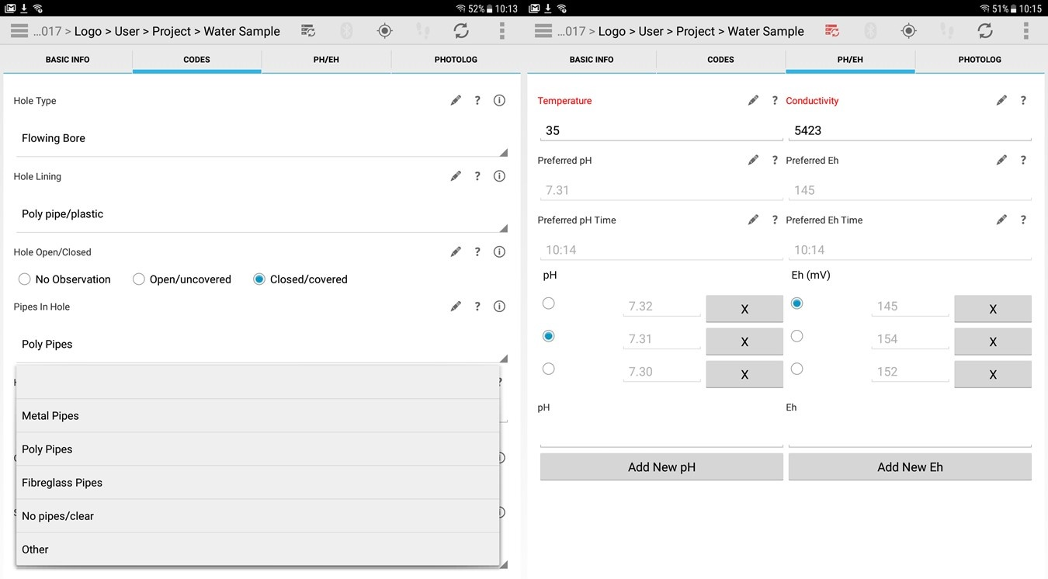
Dropdown menus and field measurements
Water sample site information with dropdown options (left) and field chemical parameters (right).

Slide 17
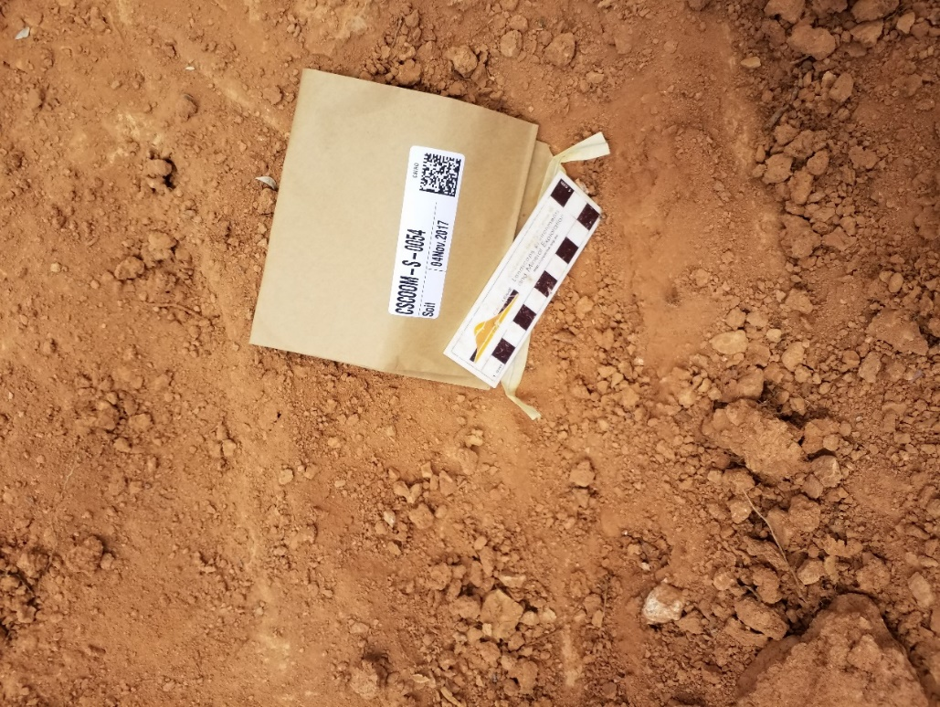
Time savings - optimisation
Soil sampling showing the field printed labels and data matrix for scanning into the application.

Slide 18
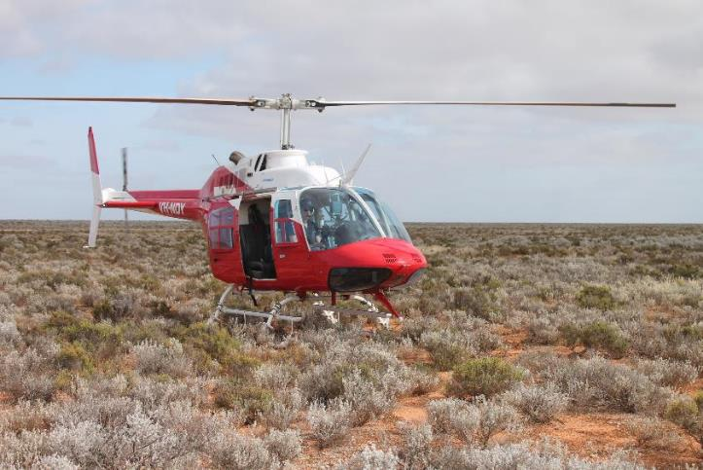
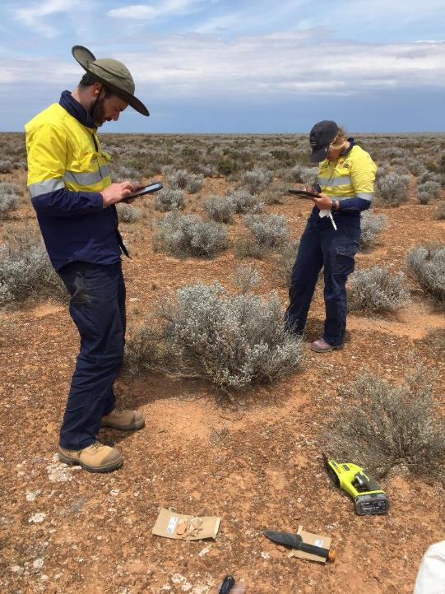
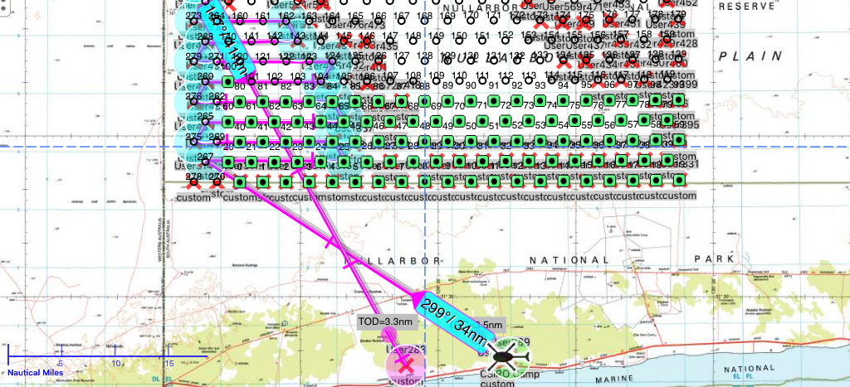
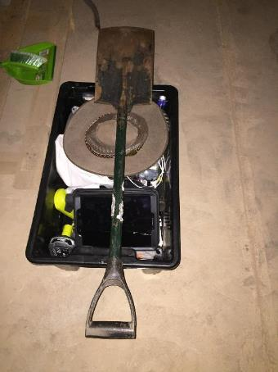
Optimised Sampling
6 mins per site (+4 mins travel/refuel)
280 samples on 4 km spacing 80 x50 km area
5 sample types (soil, rock, vegetation)
IGSN/FAIMS – all integrated in tablets and QR code labels

Slide 19
FAIMS 3.0: Electronic Field Notebooks
Shawn Ross, Penny Crook, Brian Ballsun-Stanton, Steve Cassidy, Jens Klump, Adéla Sobotkova and Nathan Reid

Slide 20


















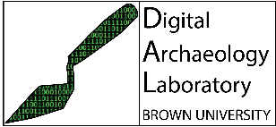

The FAIMS Project is proud to partner with the following organisations:
The FAIMS 3.0 Electronic Field Notebooks project received investment (doi: 10.47486/PL110) from the Australian Research Data Commons (ARDC). The ARDC is funded by the National Collaborative Research Infrastructure Strategy (NCRIS).
We actively collaborate with researchers and experts from the following organisations:

Slide 21

Introduction to the FAIMS Project
The Field Acquired Information Management Systems (FAIMS) Project began in 2012 as a national Australian information infrastructure project in archaeology.
Our core software FAIMS Mobile was developed for offline field data capture on Android devices.
Use expanded beyond archaeology to geoscience, ecology, ethnography, linguistics, oral history.
FAIMS Mobile is open-source (GPLv3); definition files shared on GitHub.
FAIMS Mobile has been customised for over 50 workflows at more than 40 projects.
FAIMS v2.6 is at the end of its useful life.
In 2020, ARDC Platforms and partners invested over $1.3 million to rebuild FAIMS using modern components.
Commercial open-source service (COSS) model for hosting services from 2023.

Slide 22
FAIMS 3.0: Technical Specification
Cross-platform (React Native): Android 11+, Desktop and iOS
Web application to provide GUI to produce definition files.
‘Real’ user management and security (SSO, institutional logins).
NoSQL datastores (Apache CouchDB / PouchDB).
Definition files in JSON rather than XML.
Javascript map tilers (OpenLayers).
API development.
Interoperability with VLs / Gateways, domain repositories.
Plugin architecture.
See FAIMS3 Elaboration Report (https://zenodo.org/record/4616766) for more info. Or follow the building on GitHub: https://github.com/FAIMS/FAIMS3.

Slide 23
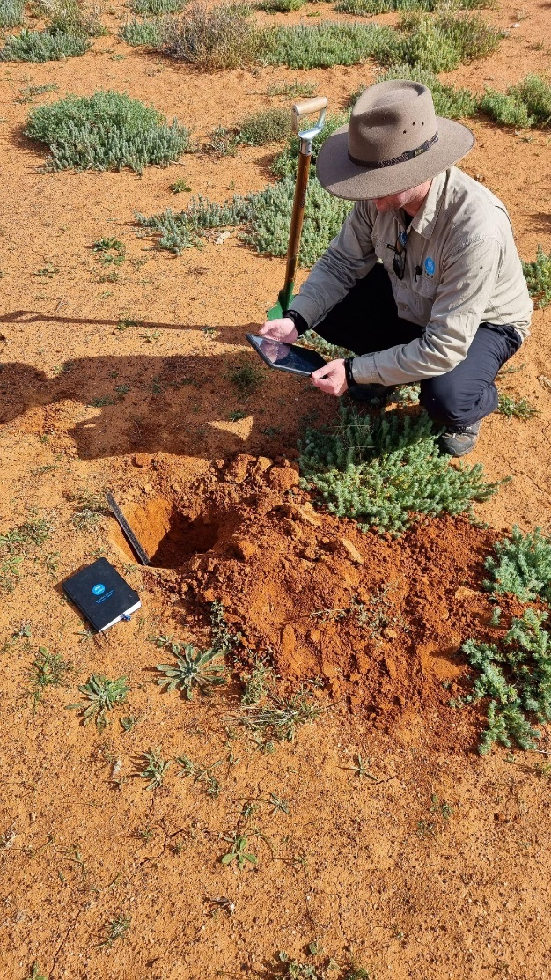
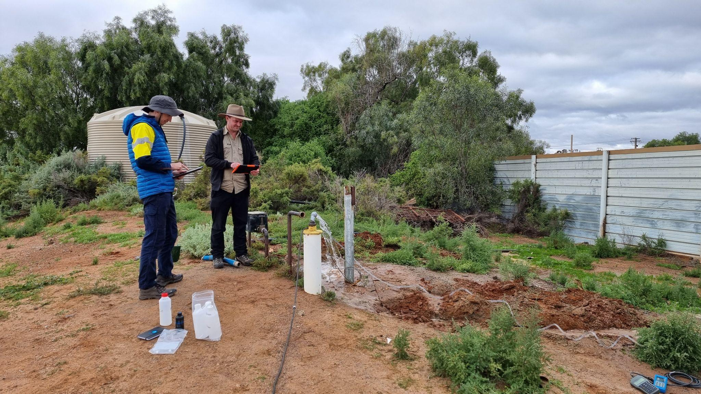
Beta testing in Broken Hill (June 2022)
FAIMS 2.6 and FAIMS 3 being tested side by side in the Enhanced Mundi geochemistry project, Broken Hill June 2022. Left) Nathan Reid collecting soil sample metadata for Ultrafine+ sampling. Right) Chris Folkes (GSNSW) using FAIMS 2.6 and Nathan Reid using FAIMS 3 to test meta data capture while sampling waters at Broken Hill

Slide 24
More Information
FAIMS 3.0 project website: http://faims.edu.au/.
FAIMS Project software, customisation library, and documentation can be found at: https://github.com/faims.
FAIMS Project OSF archive: https://osf.io/mqk45/.
FAIMS Project Zenodo community: https://zenodo.org/communities/faims/?page=1&size=20.
Contact
For more information contact info@faims.edu.au.

Slide 25
Morning Tea

Slide 26
Field sampling demo

Slide 27
Analyses
A full suite is ideal
Anions – Cl, Br, F, SO4, NO3
Cations – Majors (Ca, Mg, Na, etc), Minors (Cu, Zn, W, U, REEs etc)
Alkalinity – HCO3 by titration
PO4, TN, DOC – from anions bottle
Precious metals – Au, Ag, Pt, Pd from carbon bottle
Isotopes – O, H from Anions bottle

Slide 28
Gold hydrogeochemsitry
Au and precious metals are present naturally in concentrations of ng/L (ppt)
Pre-concentration steps are required to be able to accurately analyse especially in salty waters

Slide 29


Pre-concentrate precious metals
Known volume of water = 1L
Au and other precious metals Ag, Pt and Pd
Challenge associated to low concentrations in groundwater
Pre-concentration step added in the 1980s to overcome limits linked to analytical detection
Adsorbent: Used to be
1.2 g of K- or Na-Cyanide
Now 10 g NaCl

Slide 30
Lab data integration and QA/QC

Slide 31
Lab integration
If you have sent samples off consistently this should be easily managed from the Sample IDs
Make sure duplicates and standards are interspersed at the same spots in the sample run to save time here

Slide 32
QA/QC
Blanks – 1 in 20 in the field, 1 in 20 in the lab
Field duplicates – 1 in 20
Laboratory duplicates – 1 in 20
Certified Reference Materials (CRMs) – Matrix matching – 1 in 20

Slide 33
QA/QC
Statistics and error calculations – choose your own adventure but I use % difference, 95% confidence and Half Relative Difference (HRD)
% difference error = ((assay1 - assay2) / maximum (assay1 or assay2)) x 100
Half relative difference = ((assay1 - assay2) / (assay1 + assay2)) x 100
Simple checks – Na vs Cl vs EC, S vs SO4, Sr OES vs Sr MS
where 1.96 is the 95th percentile of a normal distribution with a mean value of 0 and a standard deviation of 1, σ is the standard deviation of all assay1-assay2 values, and n is the number of replicates.

Slide 34
Data checking - QA/QC
Collate report details
Integrate detection limits usefully
If (early) datasets have higher detection limits remove data.
  Samples at detection will appear highly anomalous
Removal of spurious data, e.g.:
  pH values less than 2.5 and greater than 10.5
  Alkalinity > 0 when pH < 4.5
  Alkalinity > 50 when pH < 5 ...
  Si > 60 mg/L
  Have they corrected Eh to SHE (plot against pH should tell)
Check Ionic Balance ...
Correct for analysis of unfiltered waters

Slide 35

Calculations
Ionic Balance – sum of ions (+ and -) should be zero
$\frac{\left({Na}/{22.99}+K/{39.1}+{Mg}/{12.15}+{Ca}/{20.04}\right)−\left({Cl}/{35.45}+{{SO}_{4}}/{48.03}+{{HCO}_{3}}/{61.02}\right)}{\left({Na}/{22.99}+K/{39.1}+{Mg}/{12.15}+{Ca}/{20.04}\right)+\left({Cl}/{35.45}+{{SO}_{4}}/{48.03}+{{HCO}_{3}}/{61.02}\right)}$
Contamination Factor/Value – accounts for organic contamination and pipe corrosion
TDS – from sum of ions
Ratios/Indices/Exploration indices – XT Hydro

Slide 36
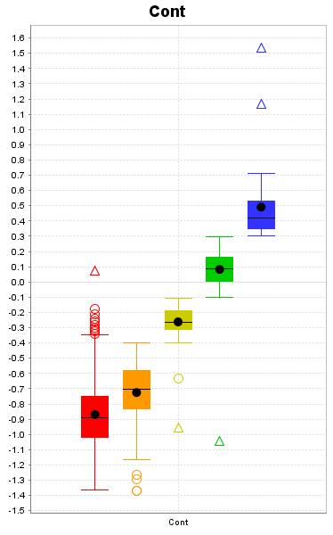
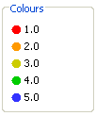
Contamination factor (shallow groundwater)
Fe, PO₄, DOC, Mn, Zn: major difference between bailed & flowing samples → derive contamination parameter
Then group, from:
up to
5
98th percentile from flowing (uncontaminated) samples
Flowing (1)
Bailed & uncontaminated (2)
Highly contaminated (5)
This now goes to 6

Slide 37
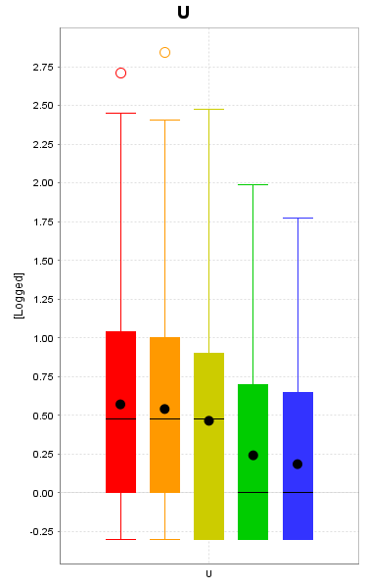

Culling contaminated data
Removed 4 and 5 from mapping

Slide 38

Element index creation
Elements scaled: 0 -1, using 1st and 99th percentile of the data
Lithology Index (V, Cr, U)
Various exploration indices:
Sulfide deposits (Ni, VMS):
  FeS index = pH-Eh+Fe+Mn
  AcidS index = Mo+Ba+Li+Al
  Ni Min index = Ni+Co+W+Pt
  Ni Min – FeS
  Ni Min – AcidS
Au Min index = Au+Ag+As (also used (As+Bi)/2)
NO₃ and SO₄ excess and depletion based on ratios with Cl or Br
Mineral Saturation calculated using GWB (most useful for Uranium)
1
0

Slide 39
Lunch

Slide 40



Upload data
Map the columns
Process the indices
Explore the results
Multi-element indices and element ratios from hydrogeochemistry data.
Tenement Selection
Greenfields Exploration
Provides baseline environmental information
Near Misses
Moving into thicker cover/basins
Indications of alteration
Detects known mineral systems
Detects weathering sulfides
Trialled on many commodities (Au, Base Metals, U)

Slide 41


Pre-Prototype
Prototype
Research Ready
Industry Ready
https://research.csiro.au/xt/
Notes:
BACKGROUND CONTEXT
Strategic Project: Exploration Toolkit
New way of delivering science
Digital + Domain
Discovery Program’s Exploration Toolkit Project is split up into multiple sprints of work
It allows us to provide researchers within the program with Engineering and Data Science resources to help them progress their research through to industry ready products.
First significant sprint was working with Nathan Reid to improve how we produce our exploration indices from hydro data
An example of a industry ready product we have helped with is Data Mosaic which is used for interpreting drill hole data which is also being workshopped today by Dr June Hill

Slide 42




Motivation: Why did we do this?
Existing process was slow.
Researchers wanted to spend less time processing data and more time investigating the results.
The complicated Excel Spreadsheet made it difficult to interrogate the implementation of the indices.
Onboarding new researchers was difficult.
Notes:
What was our motivation?
Existing process – while it worked – was slow and manual
Too much time spent processing and preparing data
Not enough time spent investigating results and developing new ways of producing results
Training other researchers on how to do the process end-to-end was difficult
Easier training helps to prevent loss of knowledge

Slide 43




Deciphering the spreadsheet: Before…
Notes:
Reverse engineering constants
Tracing through spreadsheets to understand the process
Up on the screen is the Excel formula for the “Contamination Value” when formatted into something readable instead of the long string of text you normally see in Excel.
“Some people sure do go to extreme lengths to avoid writing code”

Slide 44

Deciphering the spreadsheet: After…
Written in Python
Clear input arguments
32 Lines documenting it
10 Lines implementing it
Notes:
169 lines of formatted Excel formula becomes 45 lines of documented python
We can leverage the full python ecosystem like pandas, numpy, visualisation libraries, etc
If other researchers are doing the same thing, then it makes combining some of these techniques and processes far easier.
We can do more, with less effort.

Slide 45


Welcome to Jupyter
Easy way to make the newly developed Python library accessible internally
Python Notebooks are great for demonstrating how to use the code
Easy to generate visualisations
Notes:
Our hydro indices are now available as a Python library
At this stage we have a very solid prototype
We can now do the processing using Jupyter Notebooks and this can be done via the browser using the EASI Platform
We can use plotly, matplotlib, geopandas to visualise our data easily
Pandas lets us write our processed data to almost any format we want

Slide 46



Next Step: Improve the User Experience
Upload data
Map the columns
Process the indices
Explore the results
Notes:
We’ve wrapped the science in an easy to use web app
We’ve progressed to the Research Ready stage and our researchers don’t need to write a single line of python code anymore.
Researchers can upload their hydro data, map the columns from their data into the tool, process the data to get all the indices, and then visualise the results right there in the app and then download them as a csv, geopackage, Excel Spreadsheets, etc.
when they download that data it’s in a sane and consistent format which means if they want to pull it into another tool like ioGAS or ArcGIS they can do that without pulling their hair out.
Giving researchers more time to work on the interesting research challenges
After we have incorporated changes based on user feedback we can look at what would be required to make it available to the industry

Slide 47

Future Work
Combine the process with other analytical tools/pipelines
Trialling other geochemical data types (soils, vegetation, etc)
Provide additional context by integrating with the Australian Continental Scale Hydrogeochemistry dataset
Current Features
Calculation of hydrogeochemistry describers
Calculation of element and exploration indices
Easy mapping of input data (csv/spreadsheets)
Geospatial visualisation of calculated indices

Slide 48


XT Hydro
Free to sign up and try!
https://apps.exploration.tools/xt-hydro

Slide 49

XT Hydro: Home

Slide 50

XT Hydro: Upload
Option 1: Use the example dataset from East Isa
Option 2: Upload your own dataset (CSV, Excel)

Slide 51


XT Hydro: Map Columns
Map the columns from your dataset to the schema used by XT Hydro
It will warn you about optional columns which are missing

Slide 52


XT Hydro: Explore Data
Download as CSV, GeoPackage, GeoJSON
Display output dataset with basic filtering/sorting

Slide 53

XT Hydro: Explore Data
If lat & long coordinates are available you can plot the data on a map

Slide 54

Using XT Hydro - Compilation
Notes:
Many data sources
Not just compilation!
QA/QC and validation
Other datasets have more extensive element suites –
different data densities
Our goal is to make as much of this data readily available in a consistent format that explorers can use

Slide 55

Continental Scale Hydrogeochemistry
Finally a single dataset that we can use

Slide 56
Interpretation
How do we visualise the data?
How do we interpret the data?
What tools are available?
  The Geochemist’s Workbench
  ioGAS
There is a nice set of useful data and an ArcMap file

Slide 57

Continental Scale Hydrogeochemistry
Major parameters can show craton boundaries, major aquifer systems, and landscape system changes (Menzies line)
No other geochemical data set has this coverage and seamless integration

Slide 58



Continental Scale Hydrogeochemistry
Different elements have different data densities

Slide 59
Mineral Saturations
Calculations performed using GWB or PHREEQE (or others)
Can give potential that mineral phases are dissolving or precipitating (if present)
Very useful for U systems – primary (Autinite) or secondary (carnotite)
Can provide additional hints of mineral systems (not to be used in isolation)

Slide 60


Water types: Piper Diagrams
Can be easily constructed in IoGas.
Helps to pick different aquifers within a region
Once clusters of samples are identified – this can be used as a baseline for checking anomalism or lithology changes

Slide 61


Metal anomalism and water types

Slide 62

Isotopes – O and D
Continental evaporation trend pervasive
Variations from this trend can indicate different water sources
Isotope index coming soon to XT hydro

Slide 63
Lithology mapping

Slide 64
Scale is Critical
  What is the scale of your system, and its sub-components?
  What is the scale of the dispersion?
  Which elements work better a varying scales, with varying cover?
  The same element / or index can be telling different things at different scale:
    Sr:Ca high Sr is denoting acid vs basic rocks at > km scale, and mineral system effects at < 100 m scale
    At < 100 m scale SO₄ anomalism is correlated with sulfides. At > km scale with fracturing and groundwater upwelling, and potentially with large Iron systems

Slide 65


Relevance of scale
Left) Continental scale SO4:Cl ratio, showing large scale lithology changes and Right) at smaller scale showing areas of weathering sulfides at the Jaguar/Teutonic Bore/Bentley VHMS ore bodies, this data was collected prior to the Bentley discovery. Far Right) new data from the Dugald River region highlighting anomalies near mines

Slide 66
Element Ratios - examples
KNaSW = [2 x (K - 0.0363 x Na)]/[0.0363 x (Na + 500)] ... Na < 500 mg/L
= [K - 0.0363 x Na]/[0.0363 x Na] ... Na ≥ 500 mg/L
SrCaSW = [2 x (Sr - 0.0195 x Ca)]/[0.0195 x (Ca + 20)] ... Ca < 20 mg/L
= [Sr - 0.0195 x Ca]/[0.0195 x Ca] ... Ca ≥ 20 mg/L
SO₄ClSW = [2 x (SO₄ - 0.1396 x Cl)]/[0.1396 x (Cl + 500)] ... Cl < 500 mg/L
= [SO₄ - 0.1396 x Cl]/[0.1396 x Cl] ... Cl ≥ 500 mg/L

Slide 67
Ca excess (to Sr)
Maps most greenstones in the Yilgarn
There is more Ca and Sr data across the country than there is Cr, V, Ni etc

Slide 68



Lithology mapping (under cover?)

Slide 69
Uranium systems

Slide 70
Secondary Uranium - acid/saline systems
Acid groundwaters interacting with granites and other felsic rocks can generate extremely high dissolved U
These groundwaters are also saline,
high Ca, Fe, Pb etc
Ca (& Fe) → low dissolved PO4
Fe (& Pb) (& low pH) → low dissolved V
Uranium will only be immobilised by reduction → lignites or sulphides (e.g., Beverley)

Slide 71
Secondary Uranium - neutral/fresh systems
Despite lower uranium fluxes, much more prospective for secondary uranium
Unravelling complex direct, and indirect controls
Low Ca → high dissolved PO₄, and higher
dissolved U
Mixing with oxidised V-containing groundwaters
→ Carnotite. Observed using Saturation analyses
Major variation in size
Able to see mineralised areas at > 4 km sampling

Slide 72
Example Uranium Chemistry
1
[U] = 10⁻⁹ M
[V] = 10⁻¹⁵ M
[P] = 10⁻⁵ M
[K] = 0.001 M
[Si] = 0.0015 M
[C] = 0.002 M
(T = 25 °C, P = 1.013 bars)
UO₂(H₂PO₄)(H₃PO₄)⁺
0
UO₂(H₂PO₄)₂
.5
0
UO₂HPO₄
Eh (volts)
Carnotite [KUO₂VO₄]
Geochemists Workbench ® (thermo.com.v8.r6+.dat)
2-
UO₂(CO₃)₂
0
UP₂O_{7(C)}
4-
UO₂(CO₃)₃
Coffinite [USiO₄]
–.5
25°C
0
2
4
6
pH
8
10
12
14

Slide 73

Uranium solution chemistry

Slide 74
Carnotite Saturation + U:Th Radiometrics

Slide 75
Base metals – Its all about pathfinders
All of these have several examples we could look at across Australia, or have a play with the continental data at your leisure

Slide 76




Direct metals not great indicators:
Jaguar area
Kilometres
0
Kilometres
0
0.5
1
0.5
1
Cu ^{(mg/L)}
Zn ^{(mg/L)}
< 0.003
0.00 - 0.02
0.004
0.02 - 0.04
0.006
0.04 - 0.08
0.055
0.09 - 0.13
0.30
0.13 - 0.18
0.19 - 0.37
Dissolved base metal data very patchy! – If you have any at all in some areas
Geology
0.40 - 0.84
Felsic rocks
0.93 - 18
Granitic rocks
Geology
Mafic intrusive
Felsic rocks
Mafic rocks
Granitic rocks
Mafic intrusive
Mafic rocks

Slide 77
Ni
Direct detection in acid or neutral waters
Its just the size of the footprint that changes
Ni, Co, Cr, W, PGEs

Slide 78




Slide 79








Using metals etc to find sulphides:
FeS Index (pH-Eh+Fe+Mn)
Harmony System
NW sulphide area - strong anomaly
Southern ore body – weak. Implies less
Fe-rich S
Emphasizes barren over mineralised sulphides
pH
-
Eh+Fe+Mn
Index
0.72
-
0.79
0.59
-
0.72
0.44
-
0.58
0.29
-
0.44
0.00
-
0.29
Kilometres
0
Kilometres
0
0.5
0.5
1
1
2
2
3
3
4
4

Slide 80
Finding Ni sulphides - Harmony
NiS Index
(Ni+Co+W+Pt)
NiS Indicators
Southern deposit strongly delineated
Northern deposit moderately delineated
West only weakly anomalous
Ni+Co+W+Pt
Index
0.76
-
0.80
0.58
-
0.75
0.42
-
0.58
0.27
-
0.42
0.00
-
0.26
Kilometres
0
Kilometres
0
0.5
0.5
1
1
2
2
3
3
4
4

Slide 81
Finally correct for NiS
(NiS – FeS) .
Harmony deposit strongly anomalous
Anomalies along strike
Northern prospect delineated
West less anomalous
Min
-
FeS
Index
0.15
–
0.37
0.00
-
0.15
-
0.15
–
0.00
-
0.30
-
-
0.15
-
0.75
-
-
0.30
Kilometres
0
Kilometres
0
0.5
0.5
1
1
2
2
3
3
4
4

Slide 82



Various Indices → targeting at Regional & Prospect Scale
Honeymoon Well
6935000
0
1
2
km
additional anomalies along strike
Works very well at 10m – km scale
7000000
6930000
Yakabindie
6950000
Harmony Ni deposit
6925000
265000
270000
6900000
NiS Index
Waterloo
> 0.85
0.75 - 0.85
0.60 - 0.75
0.40 - 0.60
0
10
20
km
Jaguar
< 0.40
6850000
250000
300000

Slide 83
Pb-Zn
Direct detection and a swathe of associated pathfinders
However, ore is often not very soluble
Carbonates are easier than sulfides
Pb, Zn, Cd, Tl

Slide 84
Cu
Cu – direct in acid waters, its all about proxies and associated elements in neutral waters
  Cu is adsorbed onto Fe-Oxides/Clays readily
Acid waters – Cu, Au, Fe – but hard to pick against a high background
Neutral waters –Au, As, Fe, Mo, W, S isotopes, maybe Cu
Bottom line – look for sulfides, then try and work out what type you have

Slide 85
Sulfide detection
Waters around sulfides can have one or more of the following properties:
1. Low Eh, and/or low O₂ saturation;
2. Moderate to extremely high dissolved Fe content;
3. Low pH;
4. High concentrations of elements normally characteristic of acid lithologies (Ba, Li, Mn, Mo, V, W);
5. More rarely, detectable Al and REE (La, Ce, etc.), even in groundwater above pH 6, despite these elements normally only being soluble below pH 5.5.

Slide 86
Acid production
1
Pyrite
Acanthite
Villamaninite
Pyrrhotite
Chalcopyrite
H⁺/Metal
(O₂ oxidant)
0
H⁺/Metal (NO„ oxidant)
1
2
3
4
Covellite
Chalcocite
Sphalerite
-1
Using pH alone will more easily detect pyrite than other sulfides
Galena
-2

Slide 87
Modelling Sulfide Systems – Example from NiS ore bodies
1600
Violarite → Ni silicate
Pyrite → Fe oxide with NO₃⁻ as oxidant
2FeS₂ + 6NO₃⁻ + 4H₂O → 4Fe(OH)₃ + 4SO₄²⁻ + 3N₂ + 2H⁺
1200
Enrichment
SO₄ (mg/L)
800
400
Pentlandite → violarite
Pyrrhotite → /pyrite/hematite with SO₄²⁻ as oxidant
2FeS + 0.4SO₄²⁻ + 1.6H₂O → 0.8Fe(OH)₃ + 1.2FeS₂ + 0.8OH⁻
Depletion
0
0
1
2
3
4
5
6
Br (mg/L)

Slide 88
SO₄, NO₃ and FeS Indices – Jaguar VMS
0
Kilometres
Kilometres
Kilometres
0.5
1
0
0.5
1
0
0.5
1
SO₄ Anomaly
NO₃ ^{(mg/L)}
FeS Index
0 - 2
0.72-0.79
High
3 - 4
0.59-0.72
Medium
5 - 20
0.44-0.58
Low
21 - 50
0.29-0.44
None
51 - 80
Geology
81 - 135
0.04-0.29
Felsic rocks
Geology
Geology
Known ore bodies
Granitic rocks
Felsic rocks
Felsic rocks
Mafic intrusive
Granitic rocks
Granitic rocks
Mafic rocks
Mafic intrusive
Mafic intrusive
Mafic rocks
Mafic rocks
Fe gossan
Exploration sites

Slide 89
Deep Processes - Pyrrhotite/pentlandite alteration
20
Pentlandite
Violarite
Pyrrhotite
Pyrite
15
2FeS + 0.4SO₄²⁻ + 1.6 H₂O Ý 0.8Fe(OH)₃ + 1.2FeS₂ + 0.8OH⁻
Hematite
This will cause SO₄²⁻, HCO₃⁻ and NO₃⁻ DEPLETION in deep groundwaters contacting sulphides
Minerals (grams x 100)
10
5
Magnetite
Geochemists Workbench ® (thermo.com.v8.r6+.dat) + Warner et al. (1996)
0
0
0.2
0.4
0.6
0.8
1
Reaction progress

Slide 90
Shallow Processes – Pyrite / violarite oxidation
Violarite
200
Hematite
Pyrite
150
SO₄²⁻ ENRICHMENT and NO₃⁻ DEPLETION in shallow groundwaters contacting sulphides
Minerals (grams)
100
Polydymite
Ni₂SiO₄
50
Geochemists Workbench ® (thermo.com.v8.r6+.dat) + Warner et al. (1996)
0
0
0.2
0.4
0.6
0.8
1
Reaction progress

Slide 91


Gypsum Saturation
Gypsum SI is another way that excess sulfate can be expressed
And Ba, Barite, Jarosite and Alunite

Slide 92

Anomalous Sulfate - Exploration
Mangroves?
Paulsen
Newman
Take away SO₄ from gypsum and alunite effects
This excess SO₄ shows reasonable spatial correlation with mineralised systems
Uses major element data alone
?
?
Cairn Mining
?
Peak Hill
Plutonic
Jundee
Mine
Sulfides → Oxides e.g.:
FeS₂ → Fe(OH)₃ + 2SO₄²⁻
Mine
+
Honeymoon Well
Yeelirrie
Mt Keith
Mines
Mine
Sulfide Alteration, e.g.:
FeS + 0.2SO₄²⁻ →
0.6FeS₂ + 0.4Fe(OH)₃
Mine
-
Erlistoun
Garden Well
Mt Magnet
Mines
Mines
Mine
Sth Windarra Mine
Teutonic
“Diorite Well”
Leonora
Murrin
Mines
Mines
Sunrise

Slide 93
Gold
Least amount of data available
Need preconcentration step and specific analysis
Direct detection in acid or neutral waters
Key pathfinders: Au, Ag (primary), As, Sb, Bi, W, Mo, Te

Slide 94

Gold exploration
Gold Exploration
Au is the best pathfinder
Challenges:
Not part of traditional water analysis (fewer data points)
“Nugget” effect still possible
Detection limits

Slide 95

Gold
This is a compilation and ~20 years of work/sampling
Notes:
Raw Au concentrations pick up most major Au systems – when samples are within ~1 km

Slide 96


Gold hydrogeochemsitry
Anomaly to background contrast in all primary pathfinders is strong

Slide 97


Gold hydrogeochemsitry
Notes:
Less data as analytical accuracy was not good enough in the older data

Slide 98

Indices from XTHydro - AuMin
AuMin = Normalised (Au+Ag+As)

Slide 99



Gold Case Studies - Agnew
Notes:
Primary Au near surface, everything shows up as anomalous

Slide 100



Gold Case Studies – Garden Well
Notes:
Primary mineralisation at depth, secondary enrichment near surface – this is what is expressed in the groundwater (very shallow)

Slide 101
Key Points
Au can be detected in natural waters but they are at low conc
Pre-concentration is necessary – INAA or ICP-MS analysis
Au systems often (but not always) have associated pathfinders in waters (Ag, As, Sb, W, Mo)
The AuMin index can improve halo size but can miss secondary Au
More data is always wanted and needed

Slide 102
Li
Still early days
We don’t have key data around known mineral systems
Many anomalies can be generated but what do they mean
More research required

Slide 103
Rare Earth Elements
In acid waters REEs are in high concentrations everywhere
  So what is anomalous? What is a trap for mineralisation
In neutral waters most samples are below detection
  But using the U exploration methods could pay off

Slide 104
Hydrogeochemistry Bottom Line (Australia)
  Based on size of mineral system / anomalism for various elements
Archaean Lode Gold: 10 km’s → 10 m’s
Calcrete Uranium: 10 km’s → 100 m’s
(Any) Sulfides: km’s → 100 m’s
Ni-S: 100 m’s → 10 m’s
VHMS: km’s → 10 m’s
IOCGs: alteration systems at km’s
Cu Porphyrys: km’s → 100 m’s
Effective for residuum in (semi-)arid Australia
Harder for acid and saline areas of southern Australia – backgrounds are so much higher

Slide 105

Outputs

Slide 106
So how can hydro help exploration?
The regional data can provide new areas of interest for picking tenements
New samples collected can be placed in context with the regional background – please talk to us
Understanding hydrogeochemical signatures of lithology and mineralisation at both regional and camp scales
Support using the FAIMS field app for sample collection

Slide 107



Hydrogeochemistry
New or Existing projects
Field apps/tools
Quality time for interp. & interrogation
Baseline integration
Come talk to us
Faster processing
Continental Hydrogeochemistry

Slide 108
Thank you
Mineral Resources
Nathan Reid and Alex Hunt
Nathan.Reid@csiro.au
Alex.Hunt@csiro.au

