Slide 1
Digital Tech Foresight
Ishtar Vij, Head of Public Policy & Government Relations
Notes:
Notes here:
https://docs.google.com/document/d/1gEJb24kK-pBoG0NvOjw80Iz_vEff1pmFVKI0BVGKqi4/edit

Slide 2
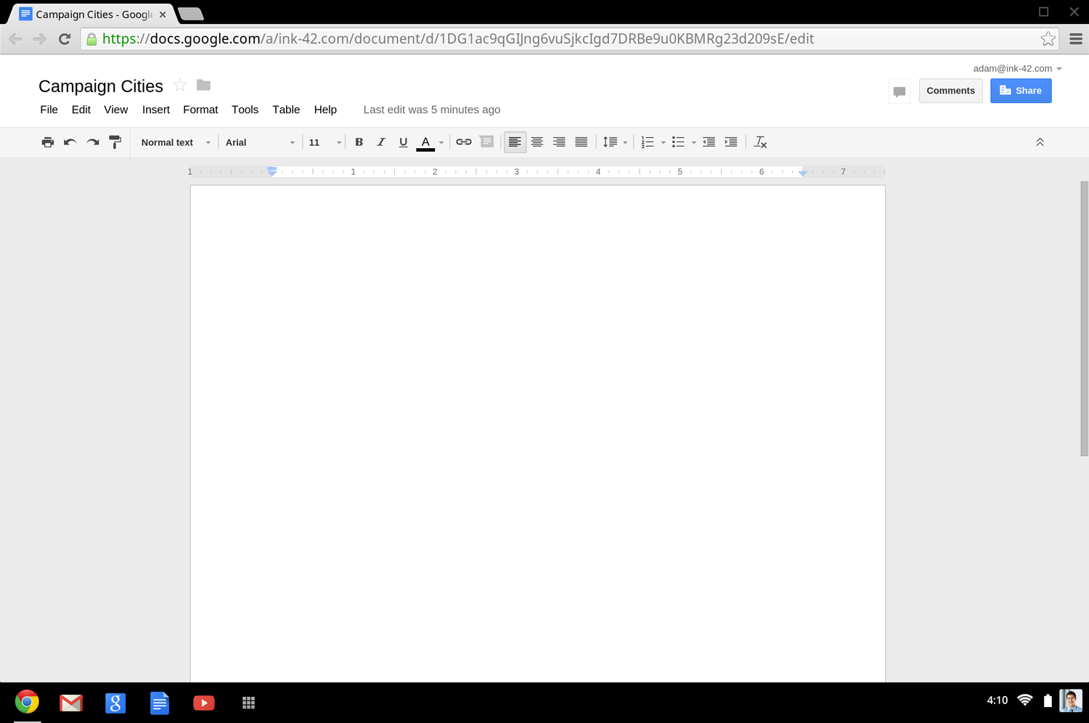
Project Everest
Campaign City Ideas
Project Everest
Campaign City Ideas

Slide 3
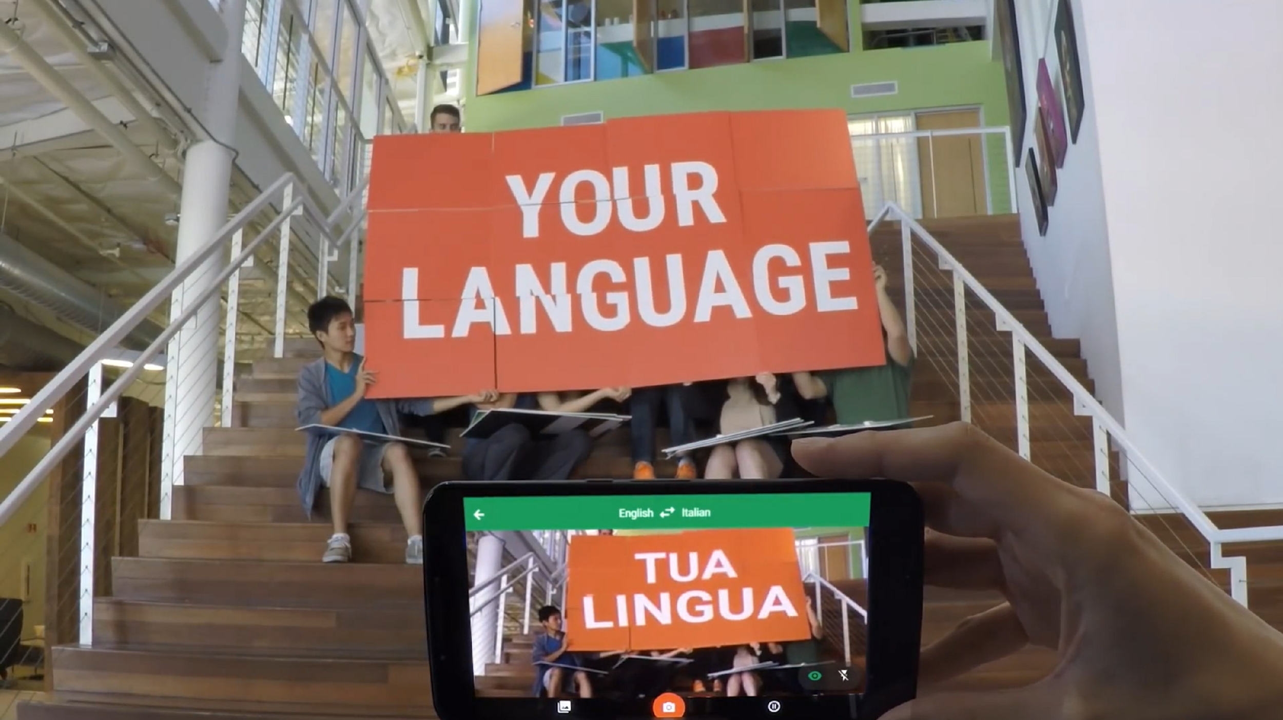
Notes:
1. Make your organisation faster and more efficient through technology
(consider Google Enterprise solutions to benefit from the full suite of Google products in your business - Gmail, Google Calendar, Google Drive, Hangout video-conferencing/messaging, Chromebox for meetings, etc)
2. Embed digital into your organisation by choosing best model for your structure
(3 main models by order of digital advancement: 1. Central digital acceleration team, 2. Digital expert in every team/market, 3. Digital as required component of every activity/project/brief)
3. Create global/regional executional hubs to increase your executional efficiency
(e.g., big companies are structured for traditional media, typically local focused, but 1. digital is cross border - brands need to have flawlessly consistent executed campaigns across countries ) and 2. digital is complex and evolves fast making it more efficient to have central executional expertise in hubs vs in all local markets)
4. Promote innovation and risk taking: try, learn, scale... FAST!
(and always champion successes)

Slide 4
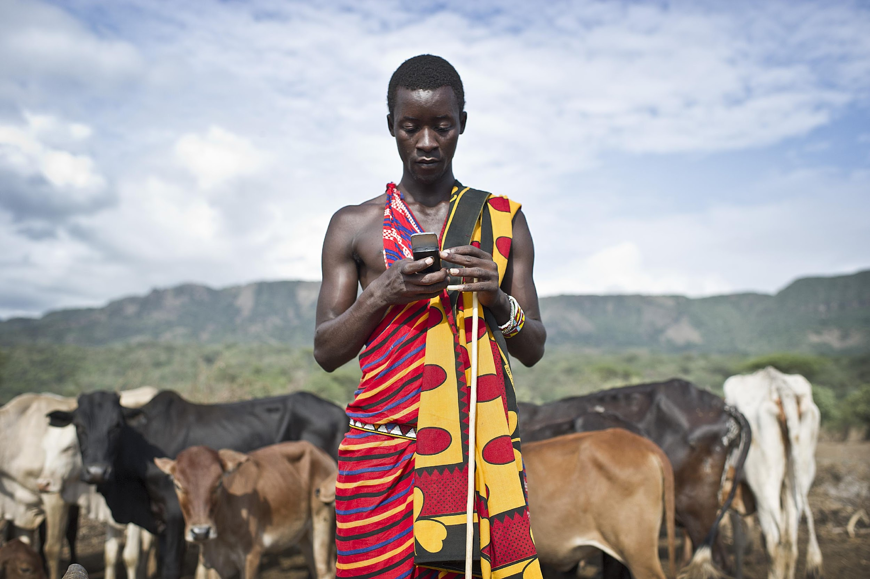

Slide 6
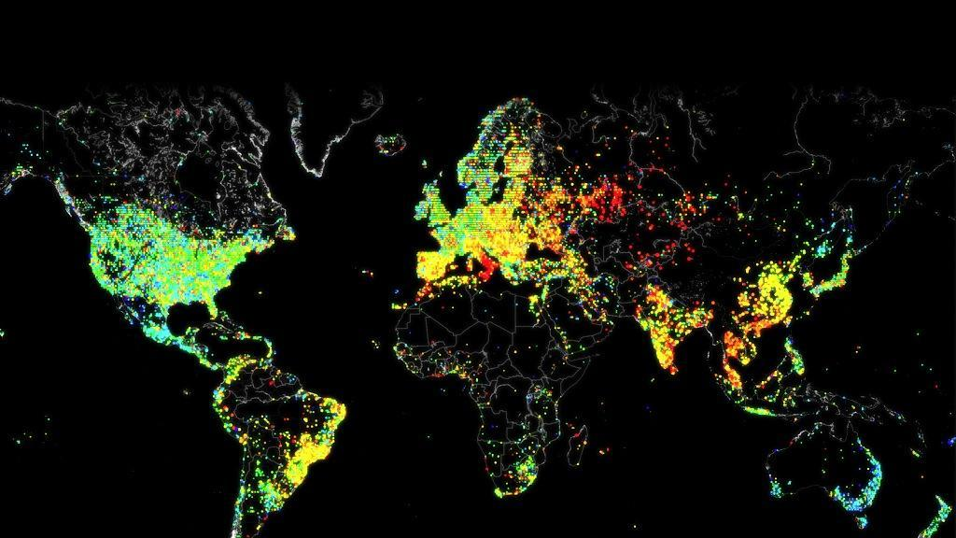
Data. Knowledge. Insight.

Slide 7
Machine Learning

Slide 8
How can I help you?

Slide 9
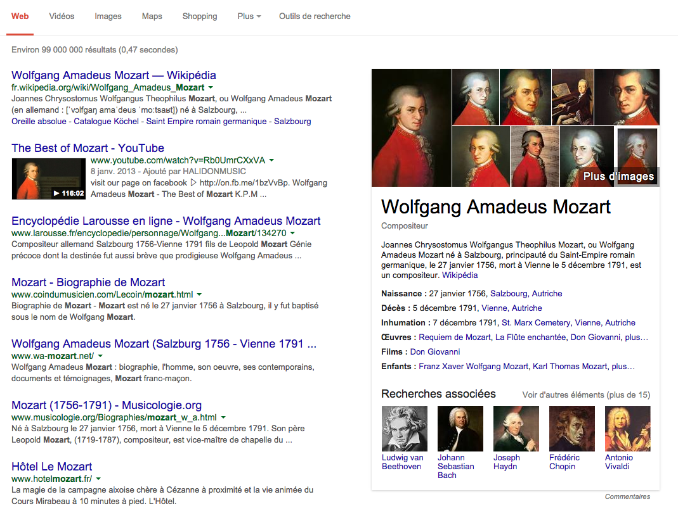
Voice
Intelligent Answers

Slide 10
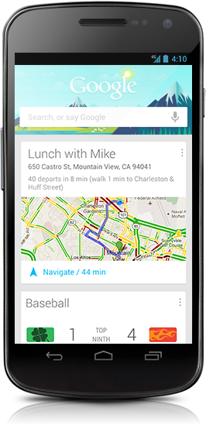
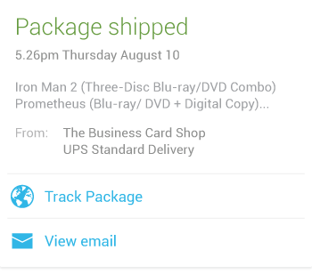
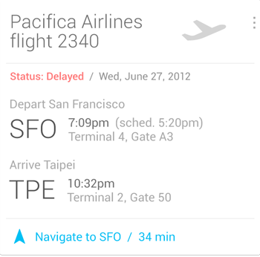
Anticipate your needs

Slide 11
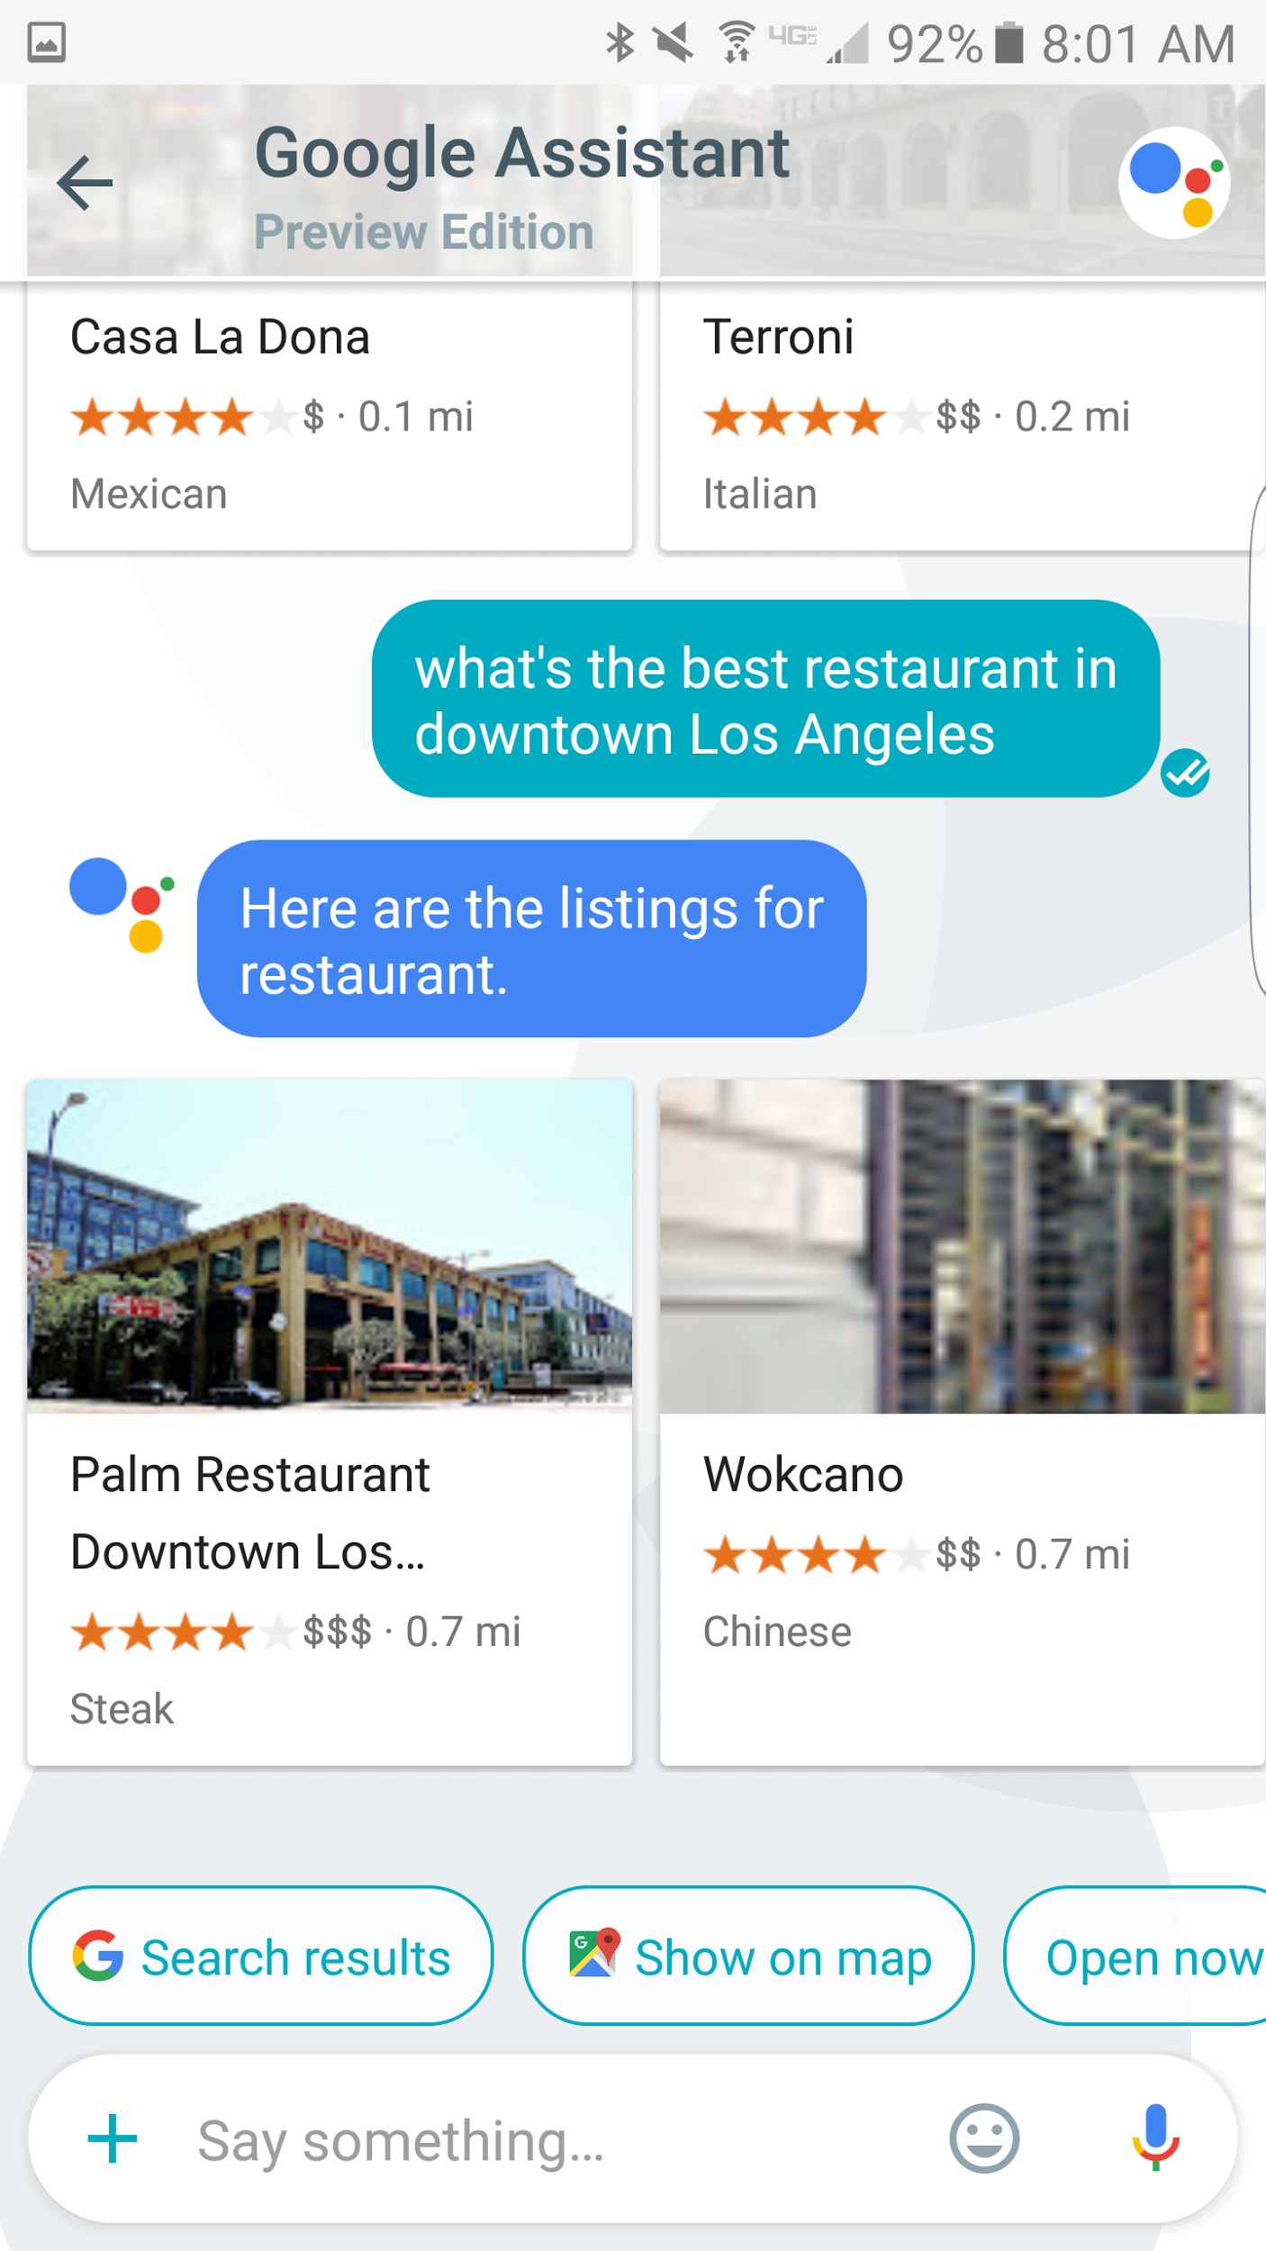

Slide 12
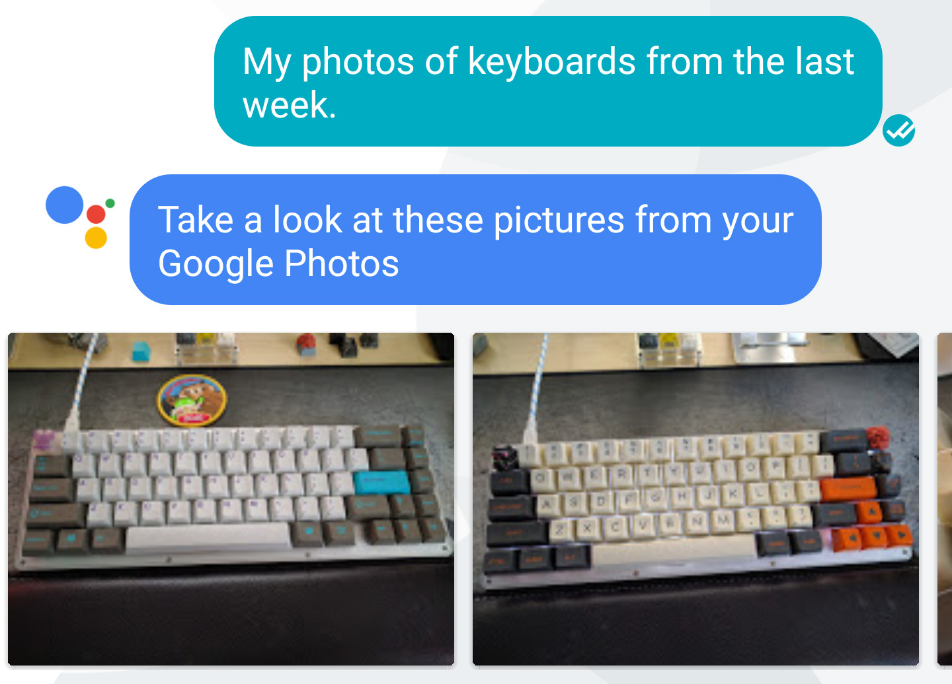

Slide 13
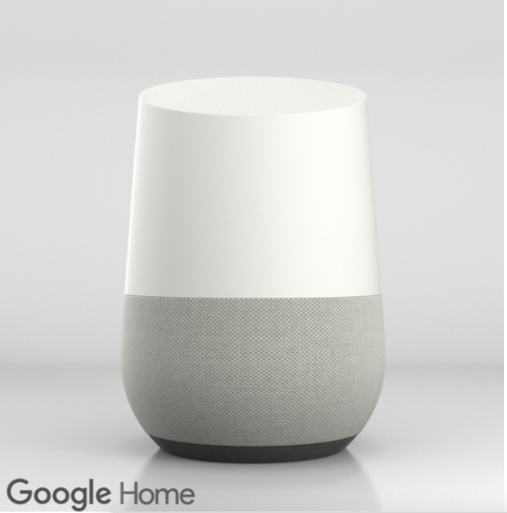

Slide 14
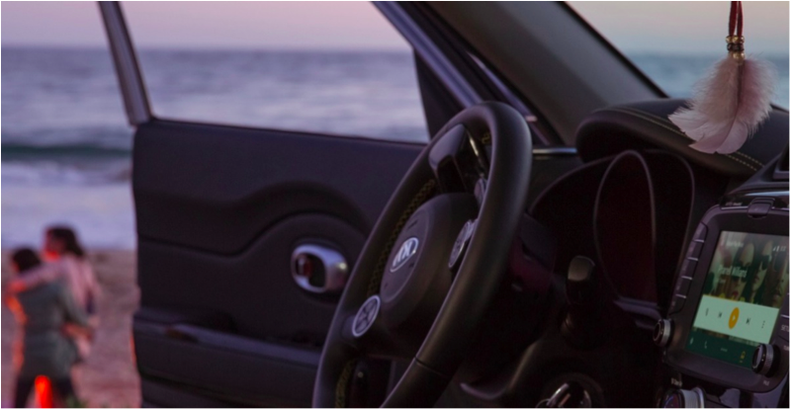

Slide 16
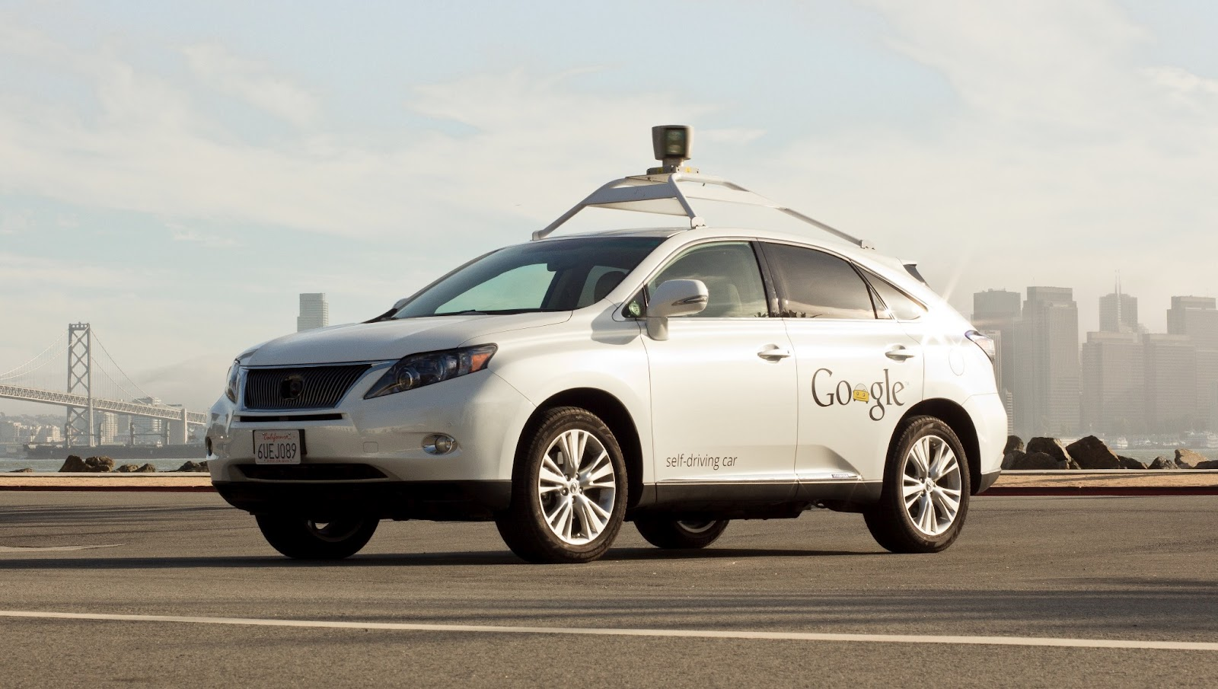
[x]

Slide 17
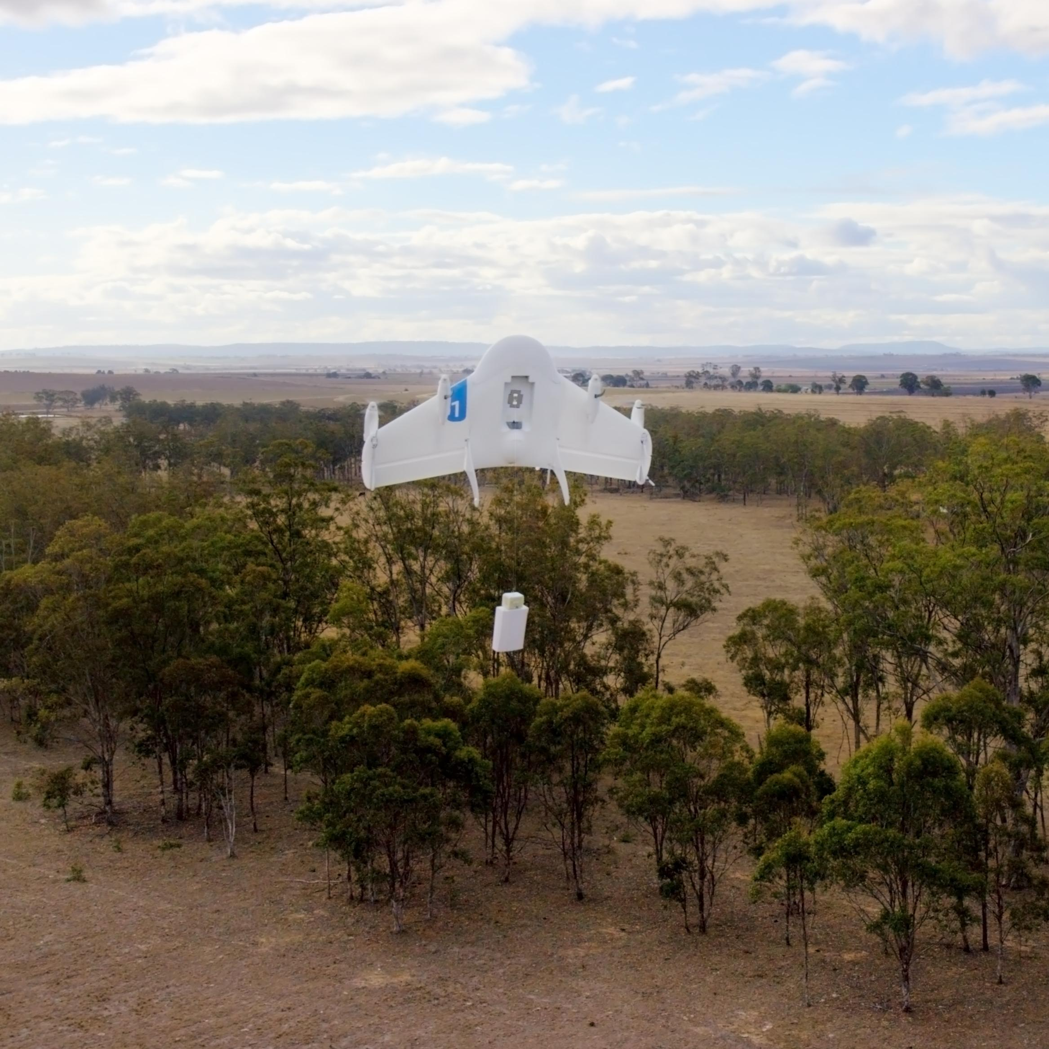

Slide 18
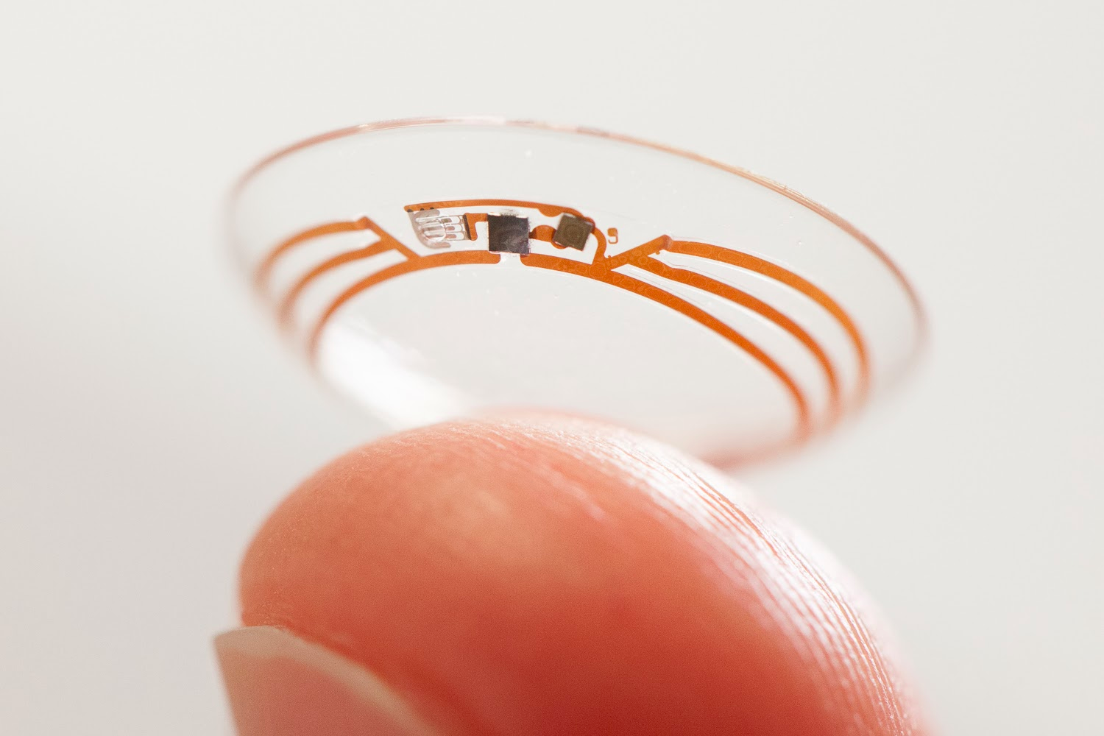

Slide 20
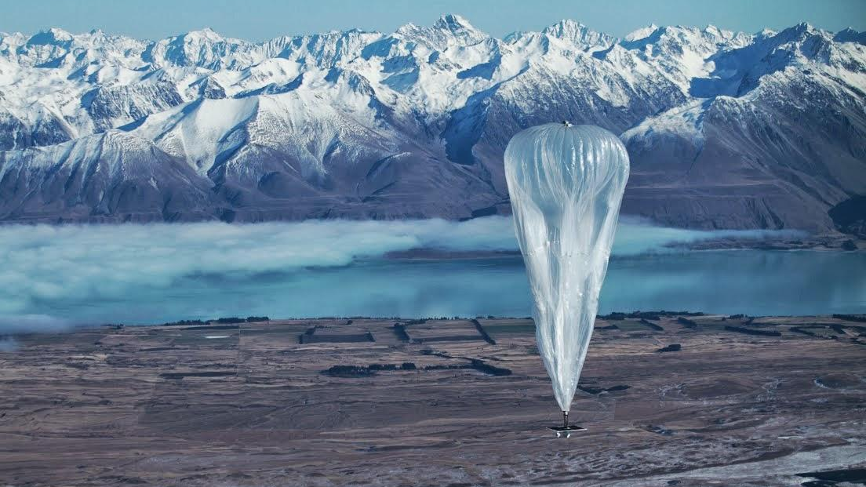

Slide 21
Thank you

