Slide 1
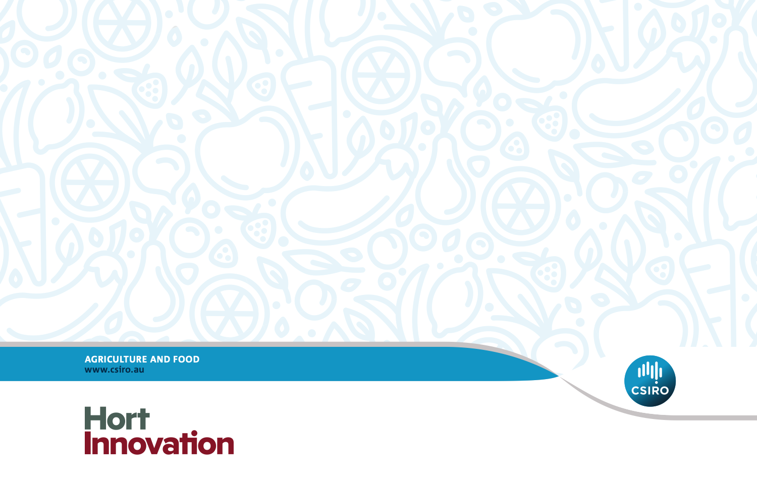
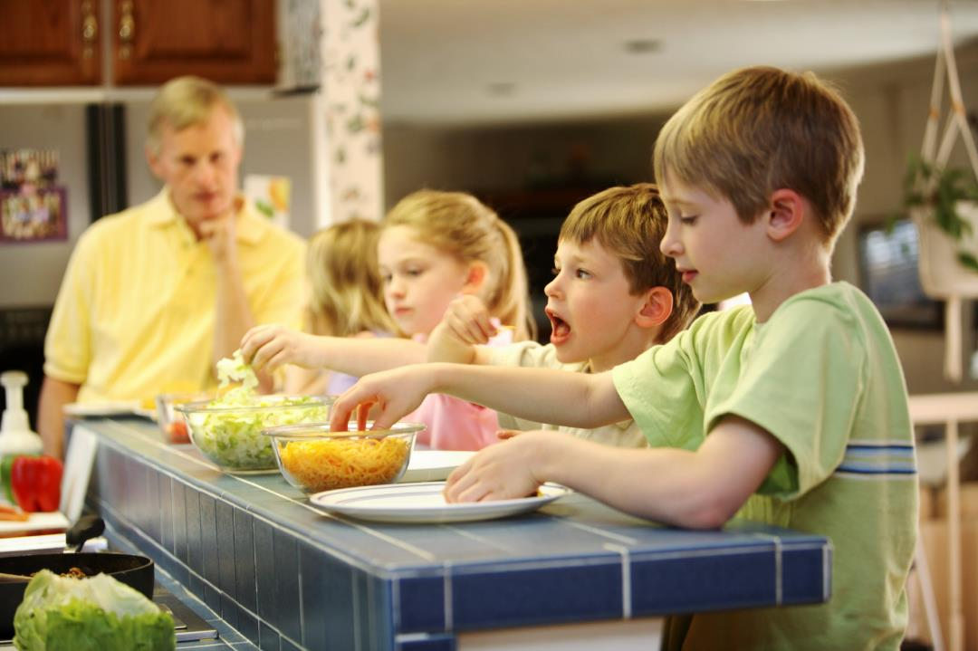

Vegetable Education Program
Taste & Learn™
Teacher resource:
Electronic whiteboard support
Unit 3: Year 5 – Year 6
Teacher resource: Electronic whiteboard support
Unit 3: Years 5 – 6
AGRICULTURE AND FOOD

Slide 2
Lesson 1:
How the senses interact

Slide 3
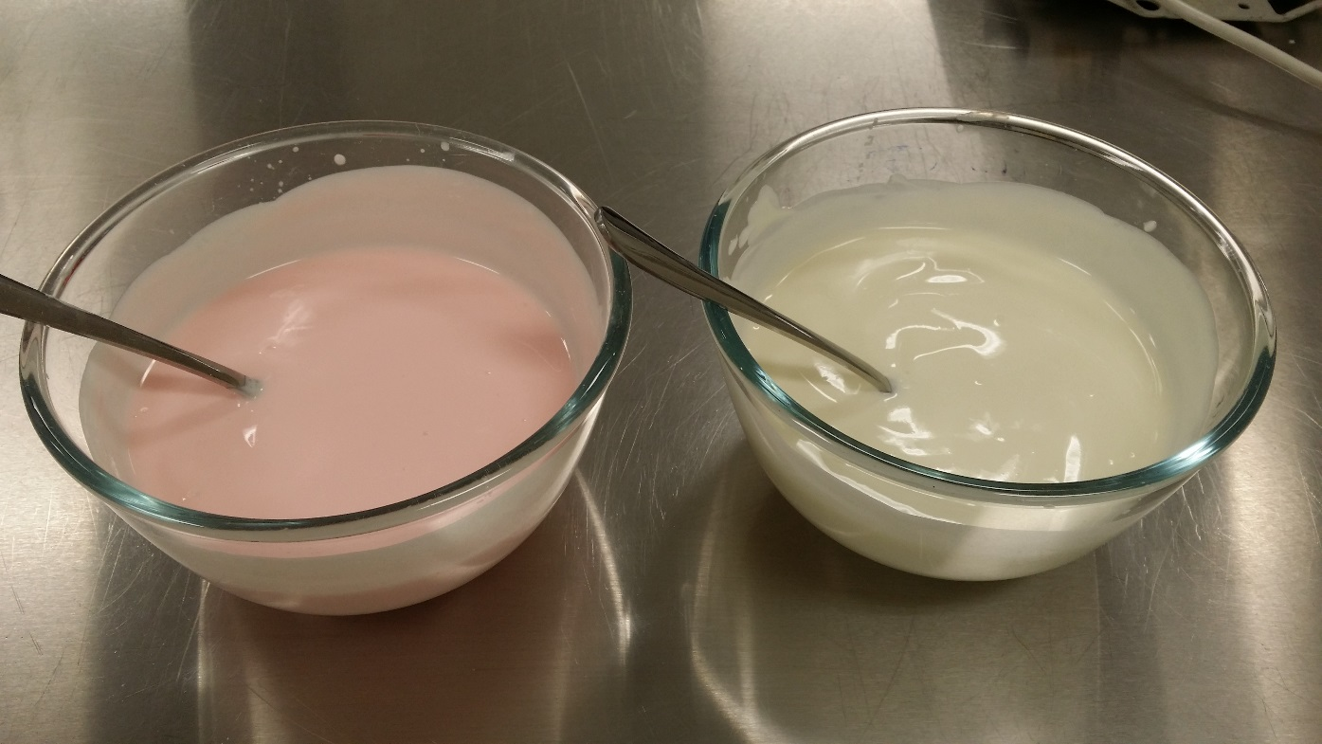
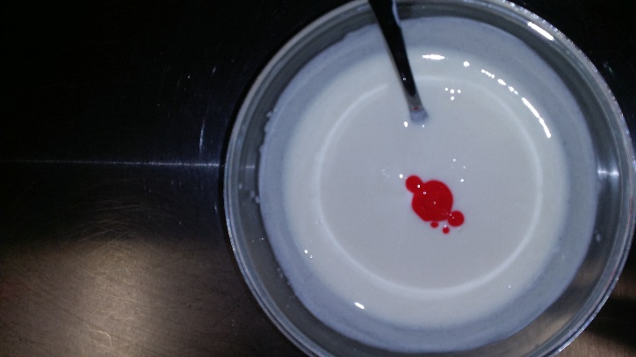
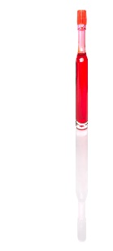
What are these products?
Do you think they taste the same?

Slide 4
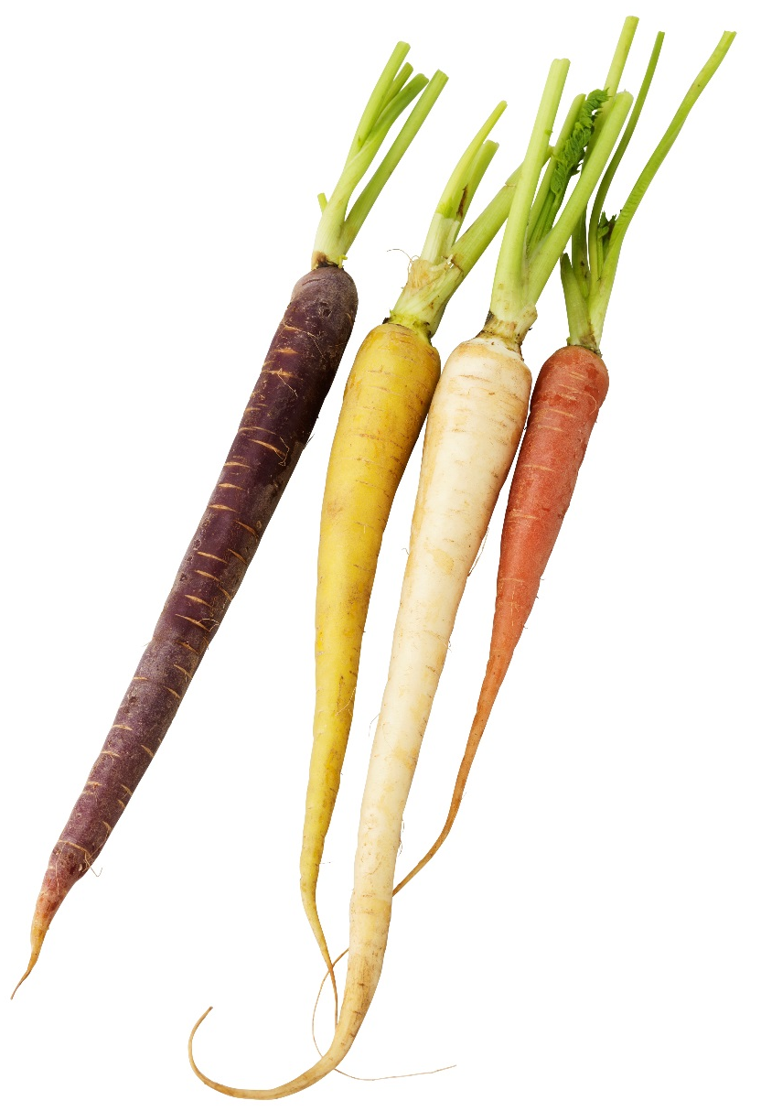
Which vegetable is this?
Do you think they taste the same?

Slide 5
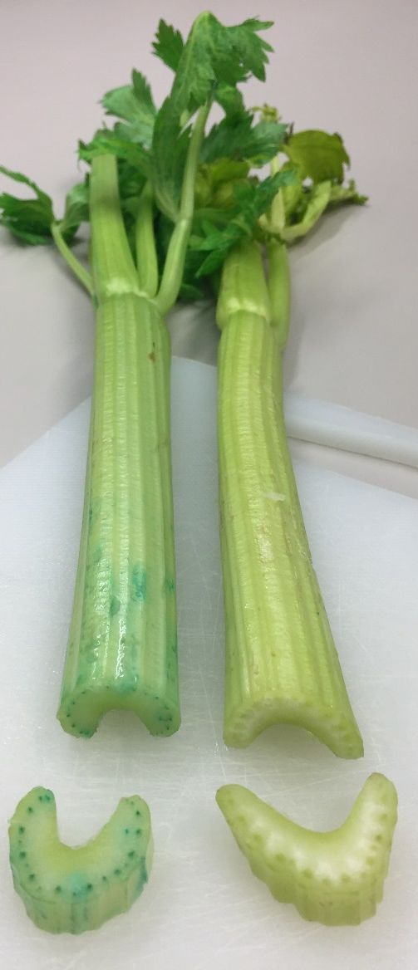
Which vegetable is this?
Do you think they taste the same?

Slide 6
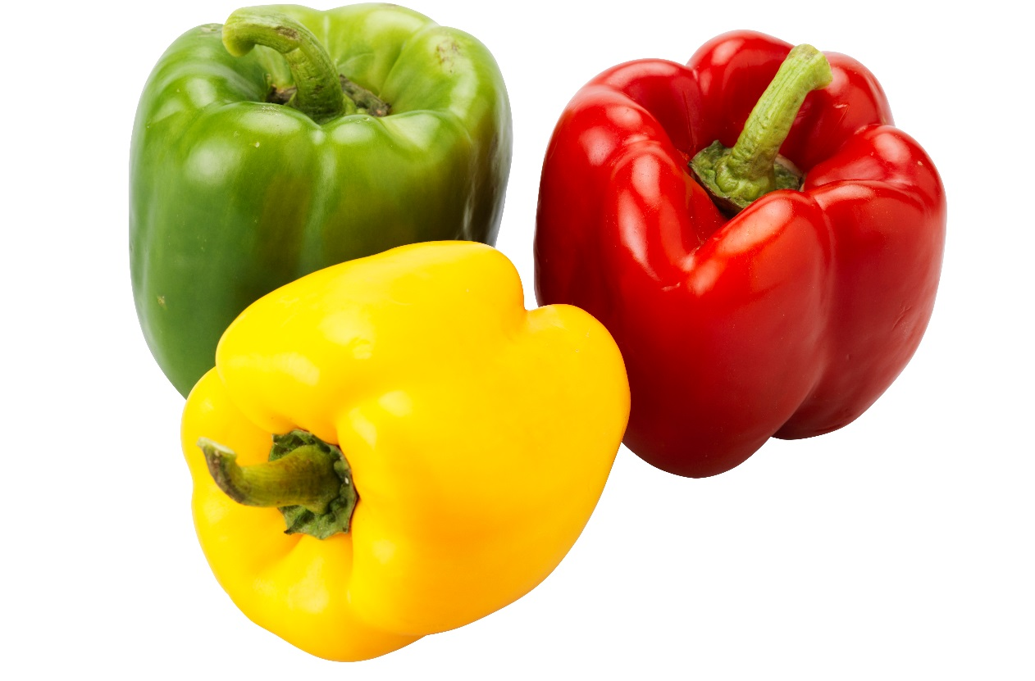
Which vegetable is this?
Do you think they taste the same?

Slide 7
Lesson 2:
A science experiment on taste of vegetables.
Planning your own experiment.

Slide 9
Investigation planner (part 1)
Title of the investigation: .........
Date.........
The investigative question. What I am going to investigate?
My hypothesis (educated guess, theory). What I think will happen.
Why I think this will happen.
The variables – things in the experiment that can be changed, kept the same and measured or observed. What one thing am I going to change during the experiment? What thing/s am I going to keep the same during the experiment? What will I observe/measure? How am I going to observe/measure?

Slide 10
Investigation planner (part 2)
Safety precautions I need to take.
Equipment.
Procedure. What I will do.
The results. What happened?
Why I think this happened.
If this experiment was done again, what could be changed to make it better?
Conclusions:

Slide 11
Lesson 3:
Vegetables from farm to plate

Slide 12
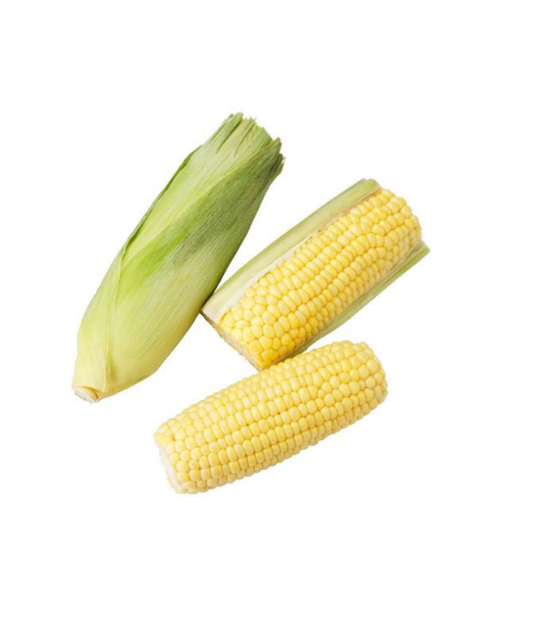
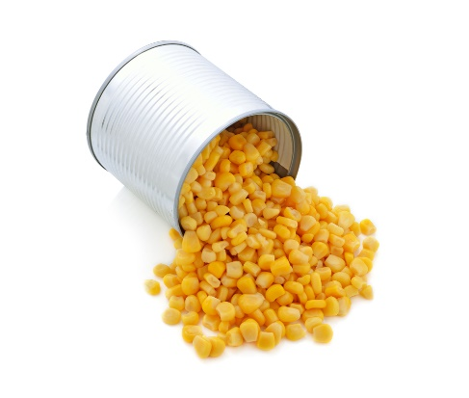
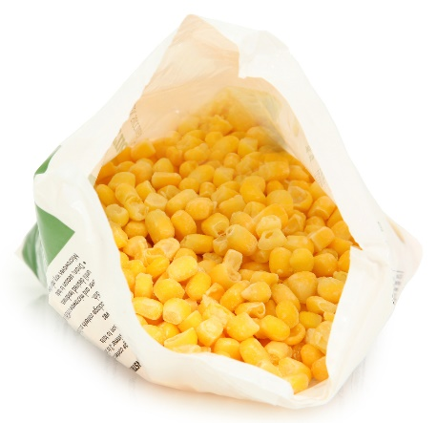
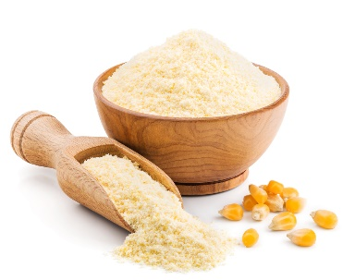
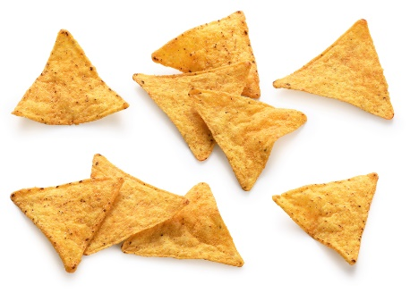
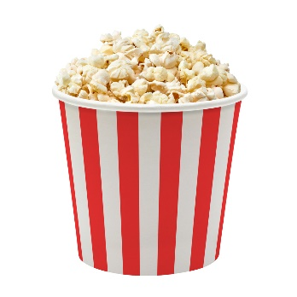
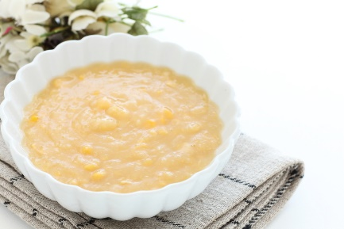
Corn
Fresh produce
Processed products
cornflour

Slide 13
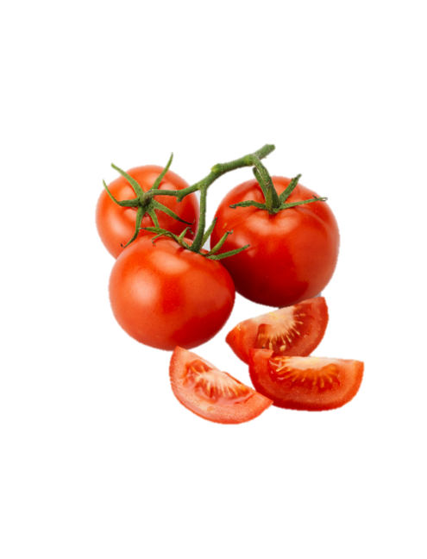
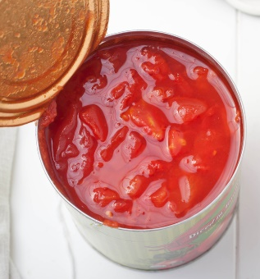
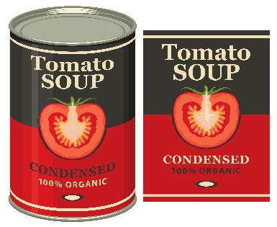
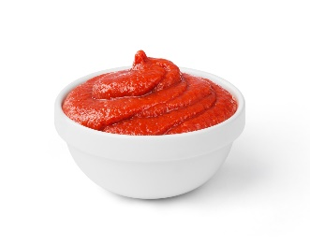
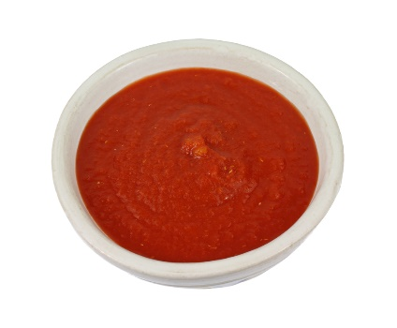
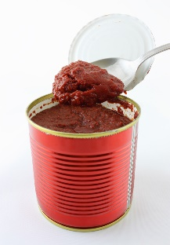
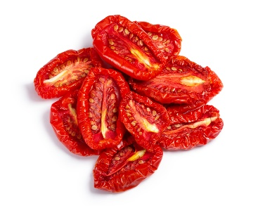
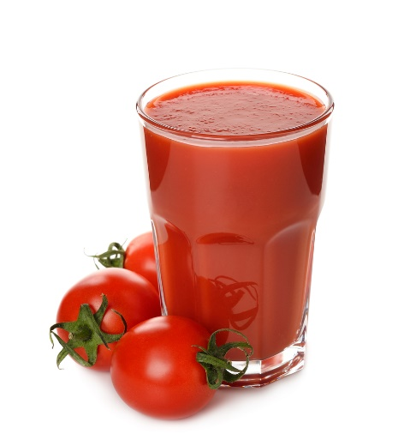
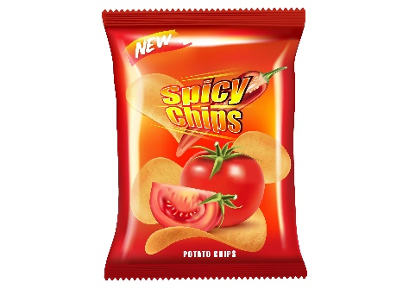

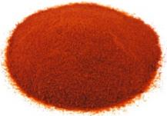
Tomato
Fresh produce
Processed products
Tomato sauce
Diced tomatoes
Tomato paste
Tomato puree

Slide 14
Can you think of reasons to process vegetables?
Convenience/practicality
Extended shelf life
Availability all year round
Availability everywhere
Facilitated transport
Different taste and texture
...

Slide 15
What are the different ways to preserve vegetables?
Canning/bottling
Drying
Pickling/fermenting
Freezing
Addition of preservatives

Slide 16
Lesson 4:
Vegetables and cultural diversity

Slide 17
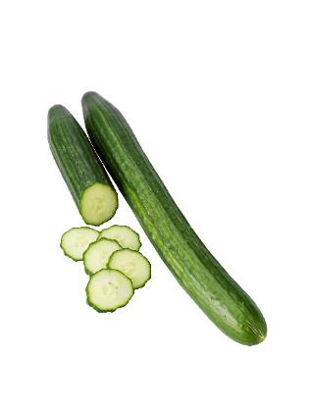
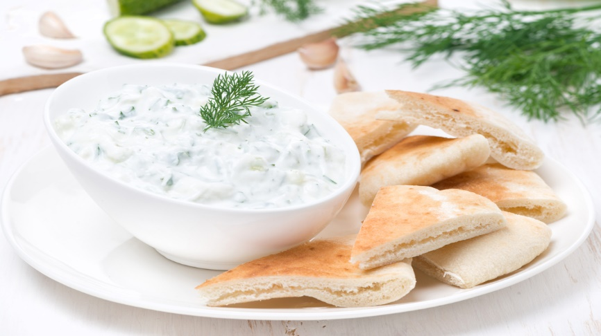

What is this dish?
What is the vegetable used in this dish?
Tzatziki
Is a dip from Greece
Cucumber

Slide 18
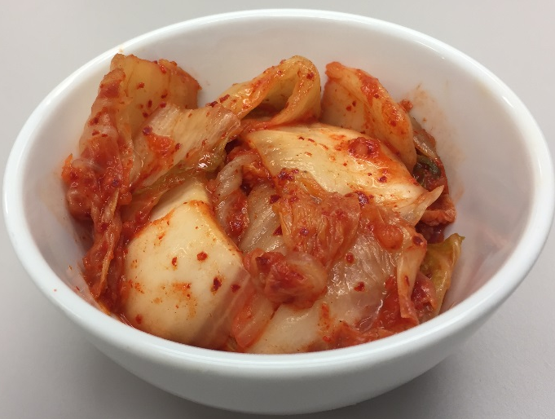
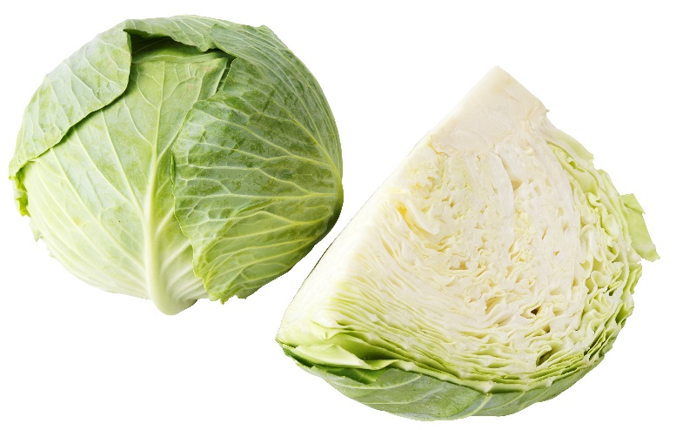

What is this dish?
What is the vegetable used in this dish?
Kimchi
Is a hot dish from Korea
Cabbage

Slide 19
Cucumber: How common is it to you? Do you like it?
Common
Yes No
[number of students] | [number of students]
[number of students] | [number of students]
Yes
No
Like

Slide 20
Zucchini: How common is it to you? Do you like it?
Common
Yes No
[number of students] | [number of students]
[number of students] | [number of students]
Yes
No
Like

Slide 21
Fennel: How common is it to you? Do you like it?
Common
Yes No
[number of students] | [number of students]
[number of students] | [number of students]
Yes
No
Like

Slide 22
Lesson 5:
The Vegetable Dip Challenge

Slide 23
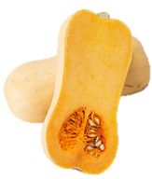
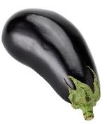
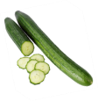
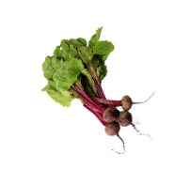
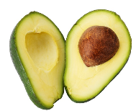
Key flavour / taste character
Eggplant
Mild, can be slightly bitter or nutty
Pumpkin
Sweet
Cucumber
Mild, green, fresh
Beetroot
Avocado
Earthy, sweet
Mild, nutty

