Slide 1

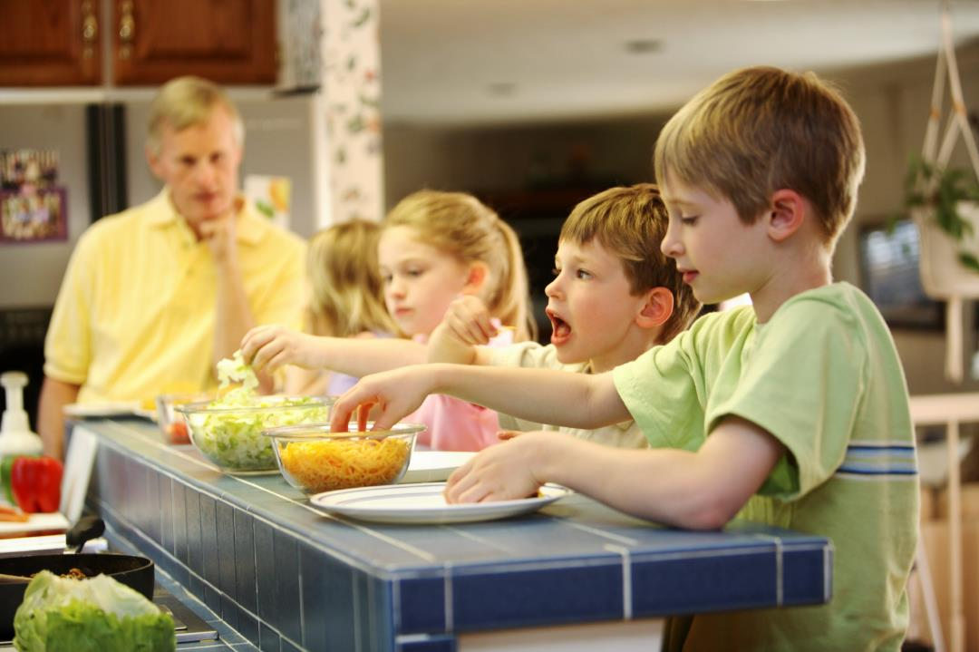

Vegetable Education Program
Taste & Learn™
Teacher resource:
Electronic whiteboard support
Unit 1: Foundation – Year 2
Teacher resource: Electronic whiteboard support
Unit 1: Foundation – Year 2
AGRICULTURE AND FOOD

Slide 2
Lesson 1:
The five senses

Slide 3
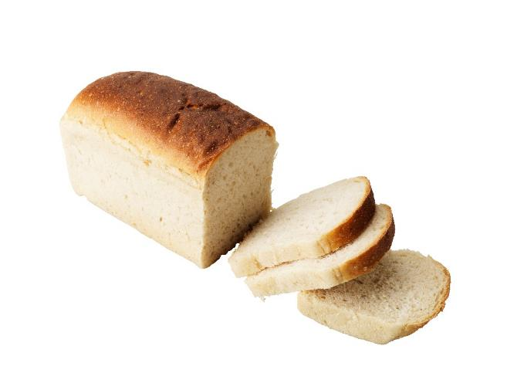
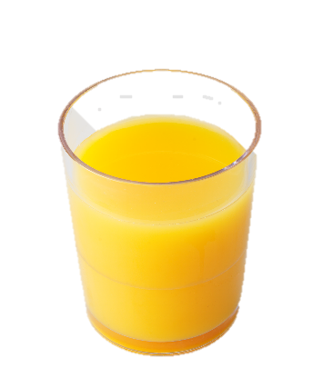
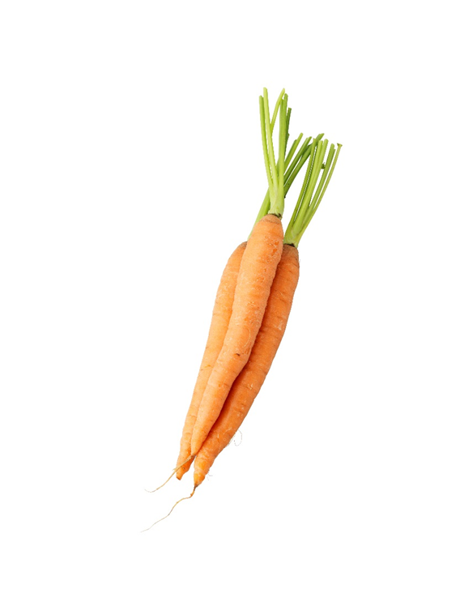
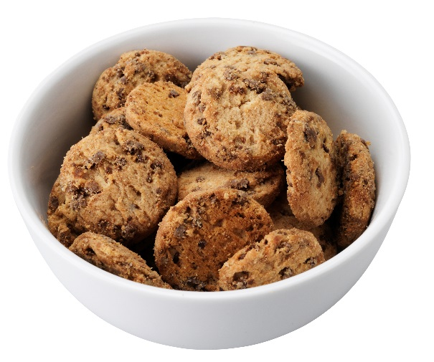
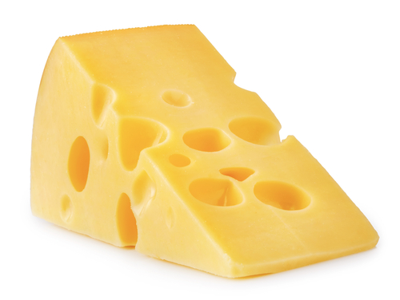

Slide 4
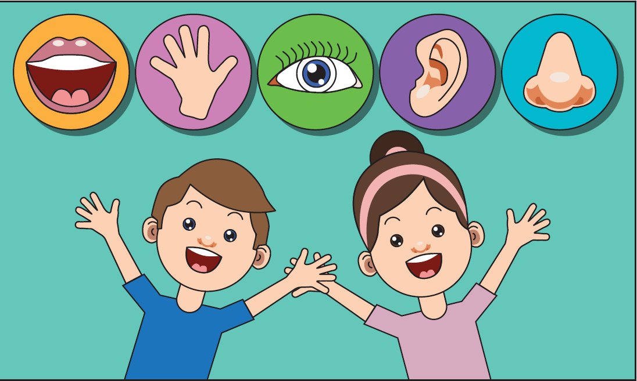
The five senses

Slide 5
Classroom record:
Liking of vegetables Day 1

Slide 6
Lesson 2:
From seed to vegetable

Slide 7
What does a plant need to grow?
Sunlight
Air
Water
Nutrients

Slide 8
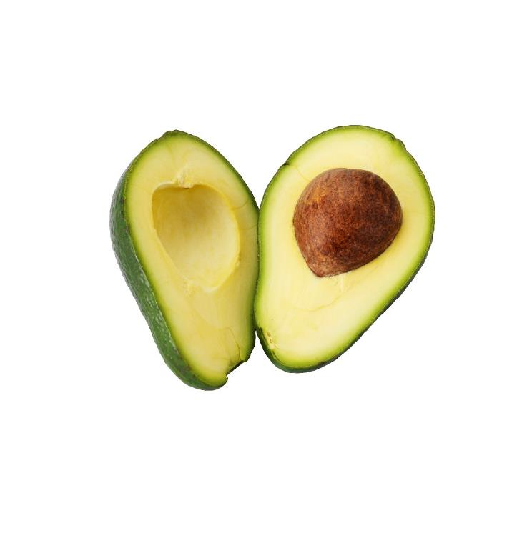
Avocado

Slide 9
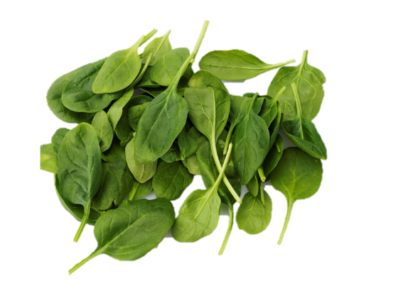
Baby spinach

Slide 10
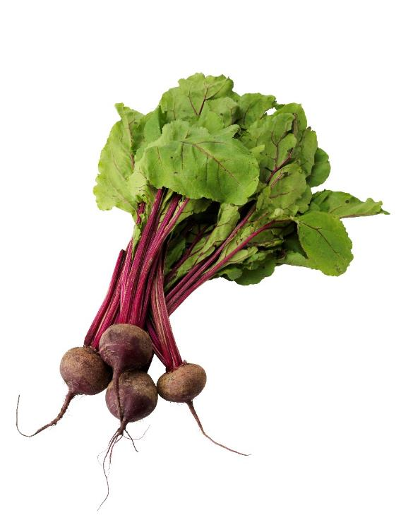
Beetroot

Slide 11
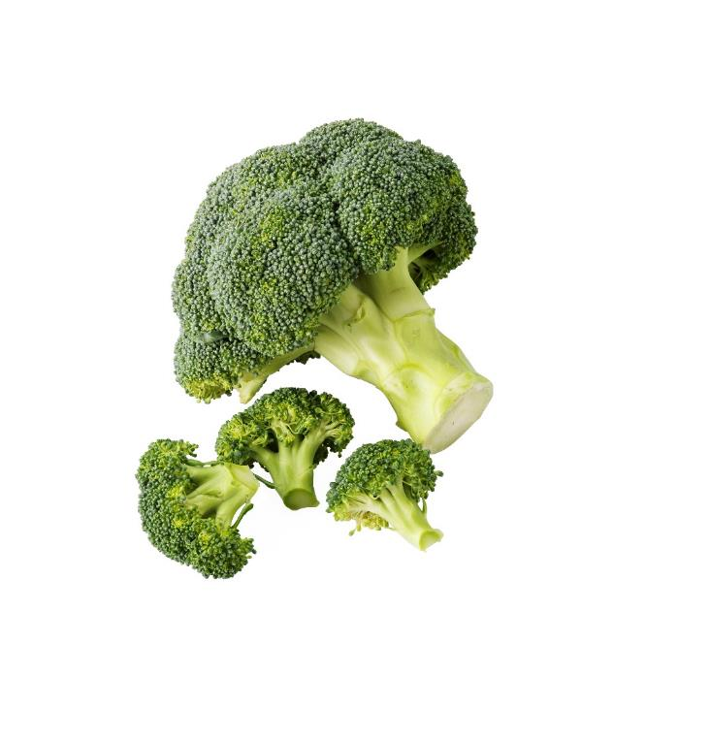
Broccoli

Slide 12
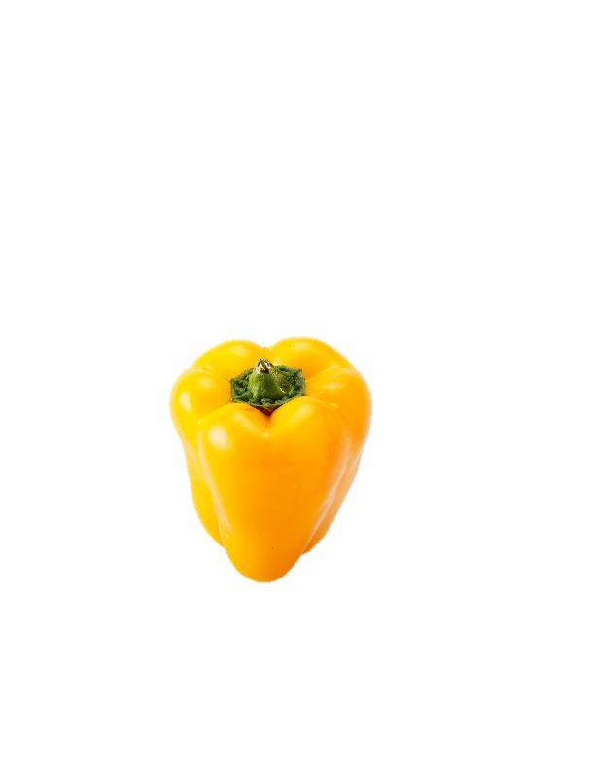
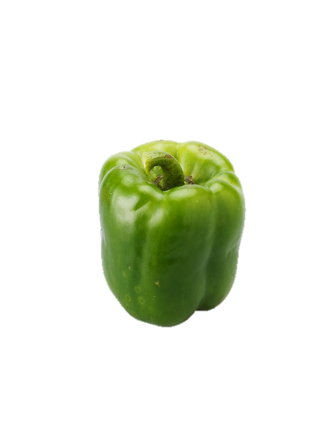
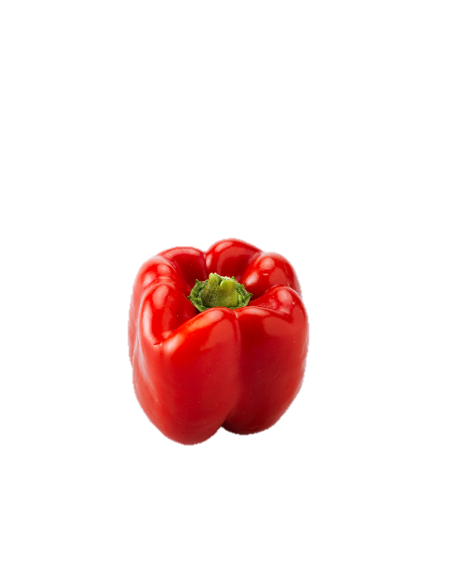
Capsicum

Slide 13
Carrot

Slide 14
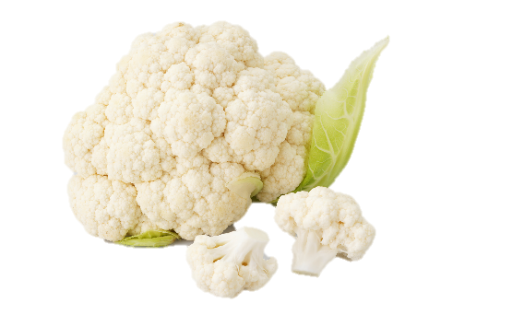
Cauliflower

Slide 15
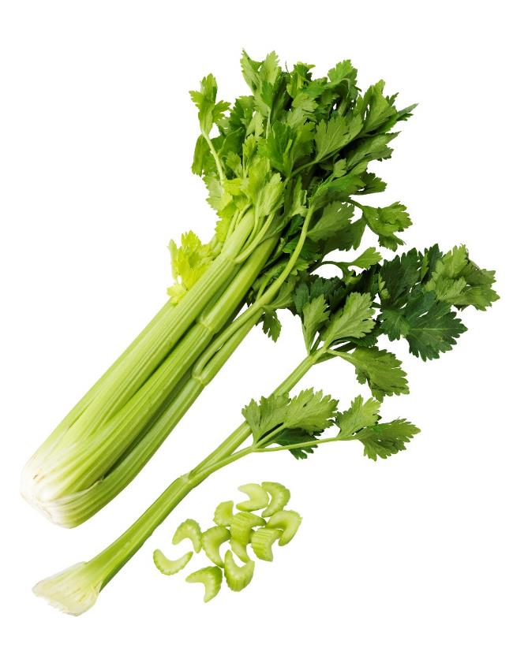
Celery

Slide 16
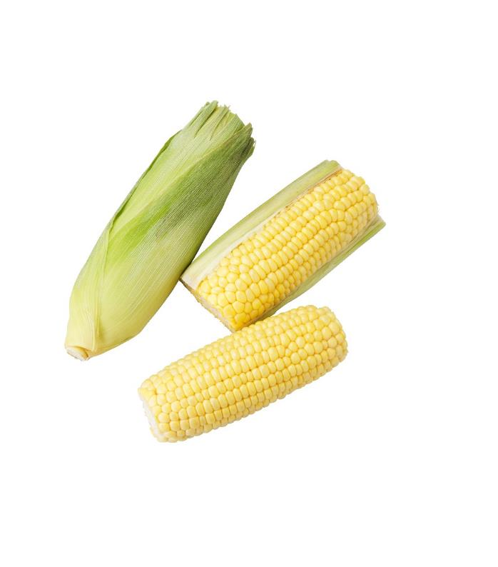
Corn

Slide 17
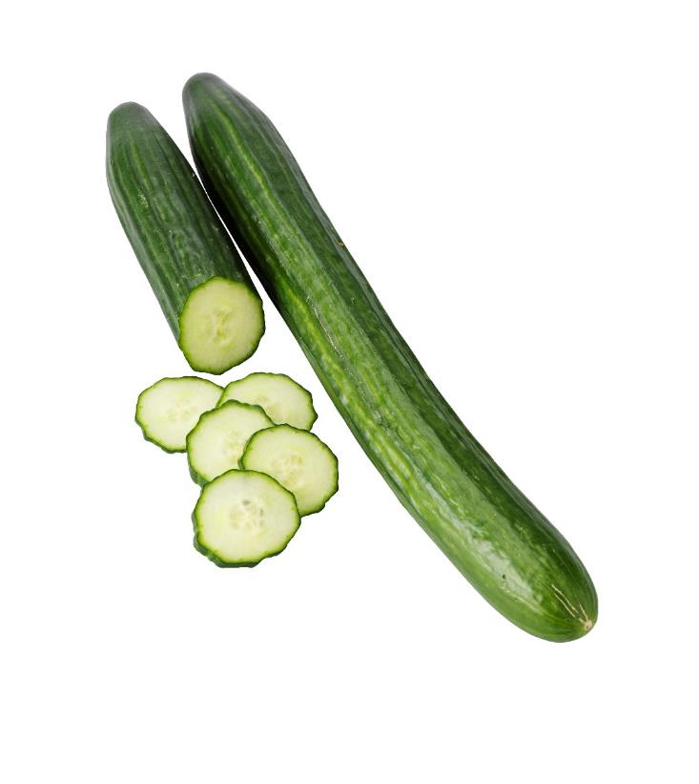
Cucumber

Slide 18
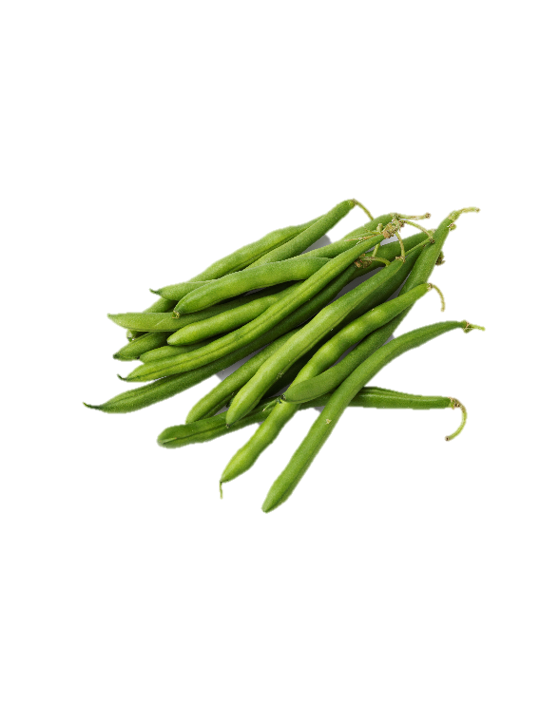
Green beans

Slide 19
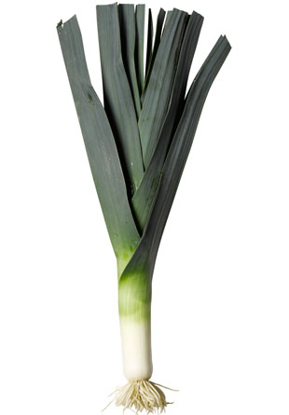
Leek

Slide 20
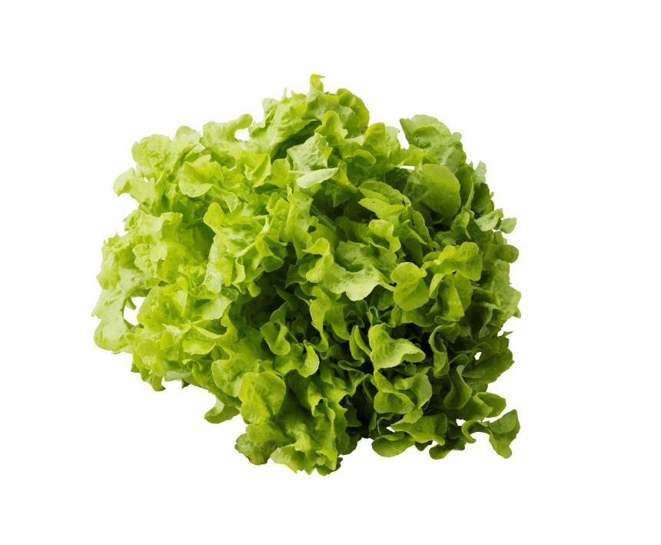
Lettuce

Slide 21
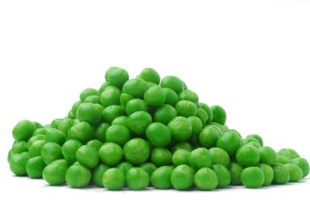
Peas

Slide 22
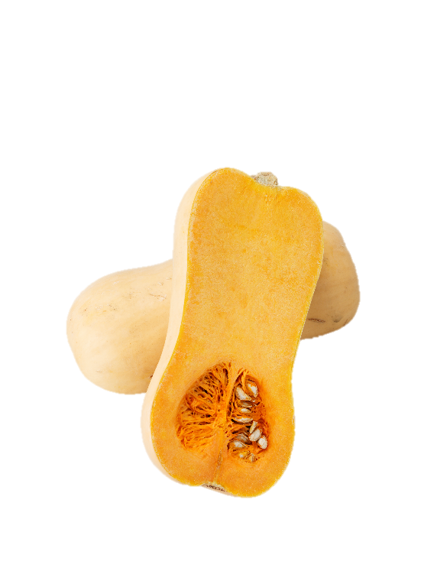
Pumpkin

Slide 23
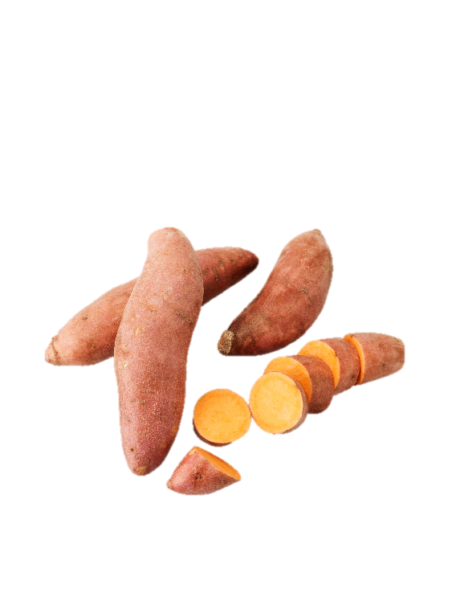
Sweet potato

Slide 24
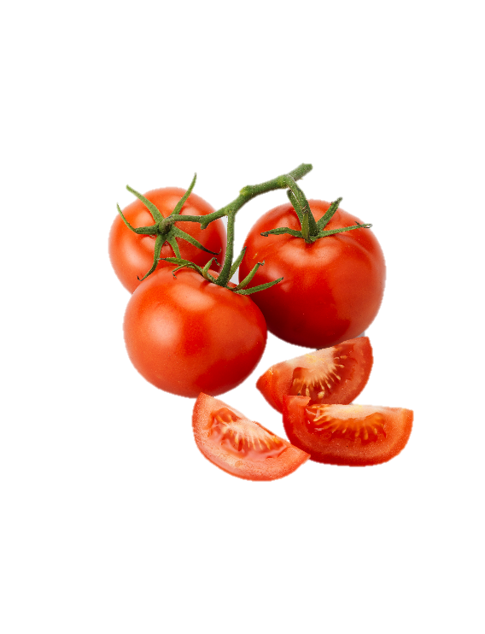
Tomato

Slide 25
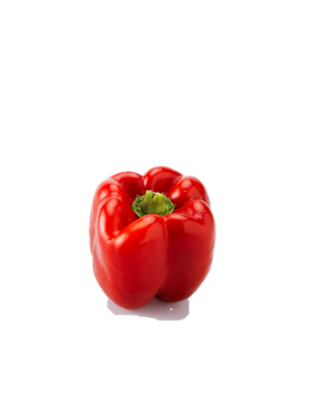
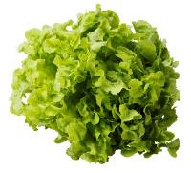
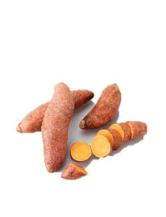
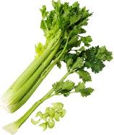
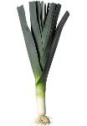
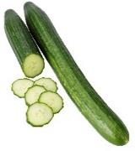
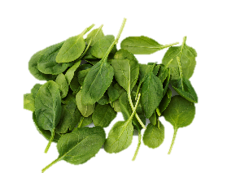
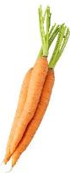
I can eat the whole plant
Fruits
Stems
Leaves
Roots

Slide 26
Lesson 3:
The basic tastes

Slide 27

What do you taste?
Answer
1
Sweet
Sour
Bitter
Salty
Sour
2
Sweet
Sour
Bitter
Salty
Sweet
3
Sweet
Sour
Bitter
Salty
Salty
4
Sweet
Sour
Bitter
Salty
Bitter

Slide 28
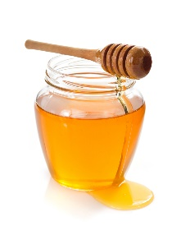
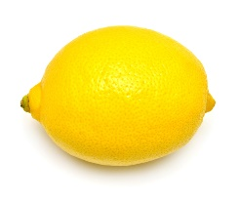
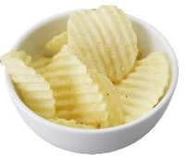
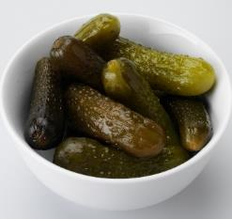
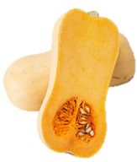
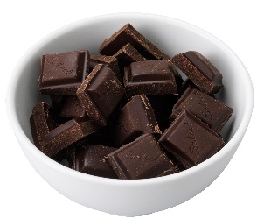
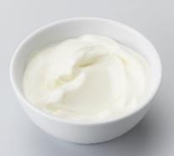
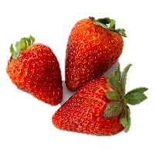
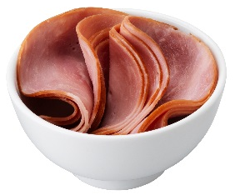
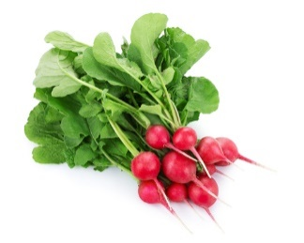

How do these foods taste?
Sweet | Salty
Sour | Bitter

Slide 29
Lesson 4:
Becoming a food adventurer

Slide 30
Classroom record:
Liking of vegetables Day 8

Slide 31
How do we like the vegetables now?

Slide 32
Lesson 5:
Picnic in class

Slide 33
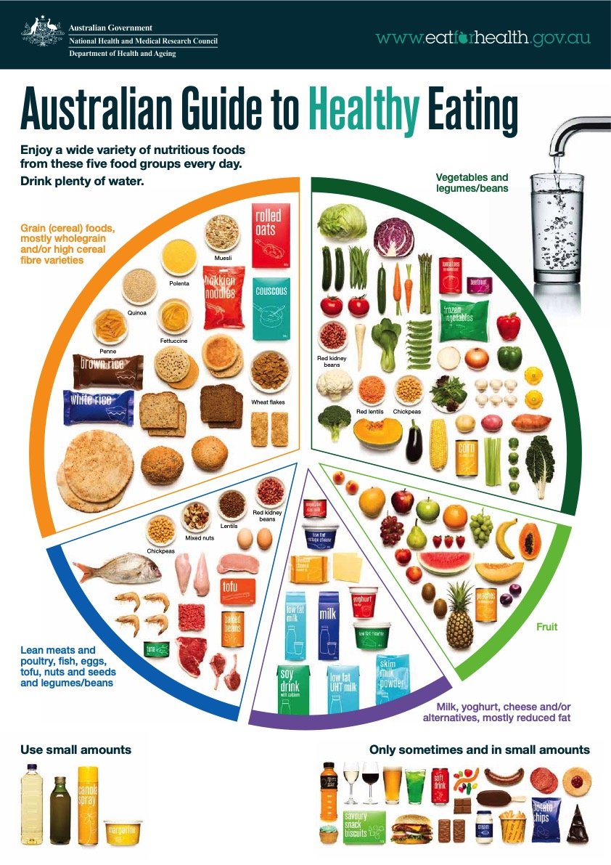
Picnic in class
Mustard
Pickles
...
Wholegrain slice
…
Beetroot
Carrot
Cucumber
Spinach
Lettuce
…
Tuna
Egg
...
Cheese
Spread
...
Source: National Health and Medical Research Council

Slide 34
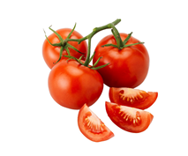
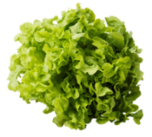
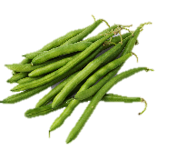
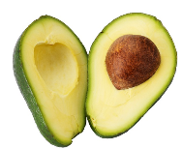
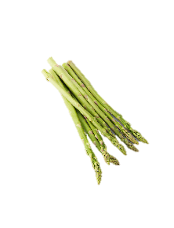
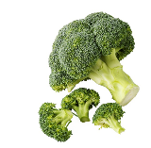






Can I be eaten on a sandwich?

Slide 35









Can I be eaten on a sandwich?

