Slide 1
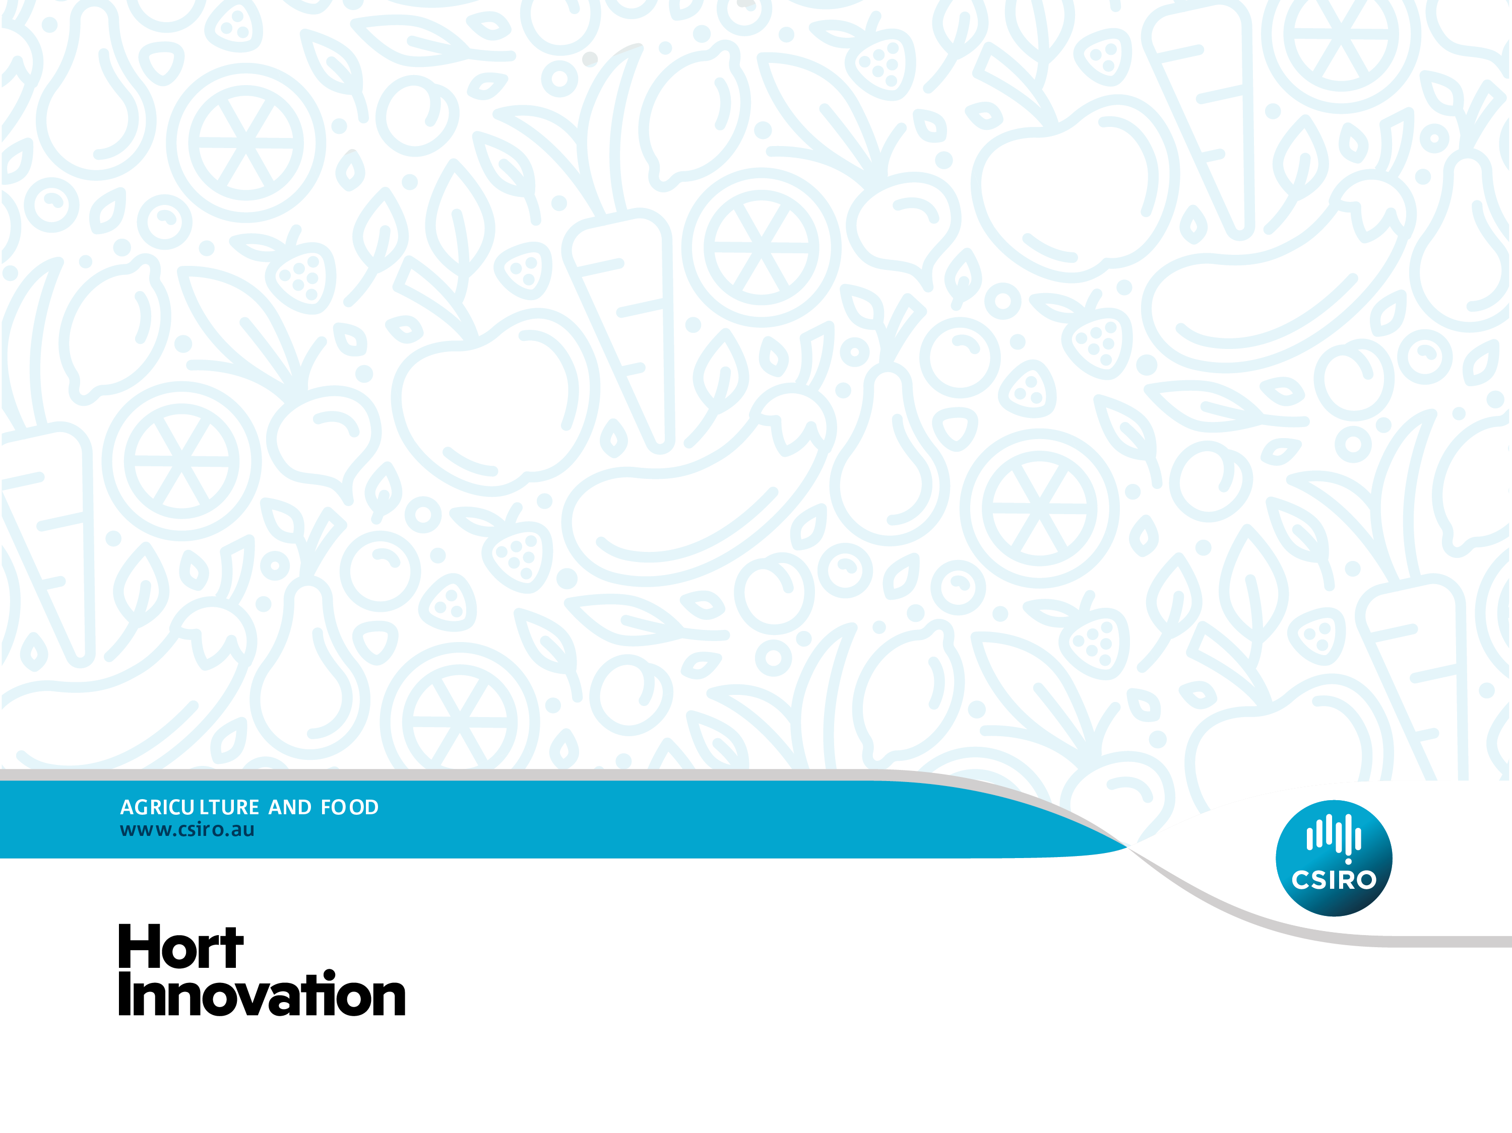
Taste & Learn™
Teacher resource:
Electronic whiteboard support
Unit 2: Year 3 – Year 4

Slide 2
Lesson 1:
Discover vegetables through the senses

Slide 3
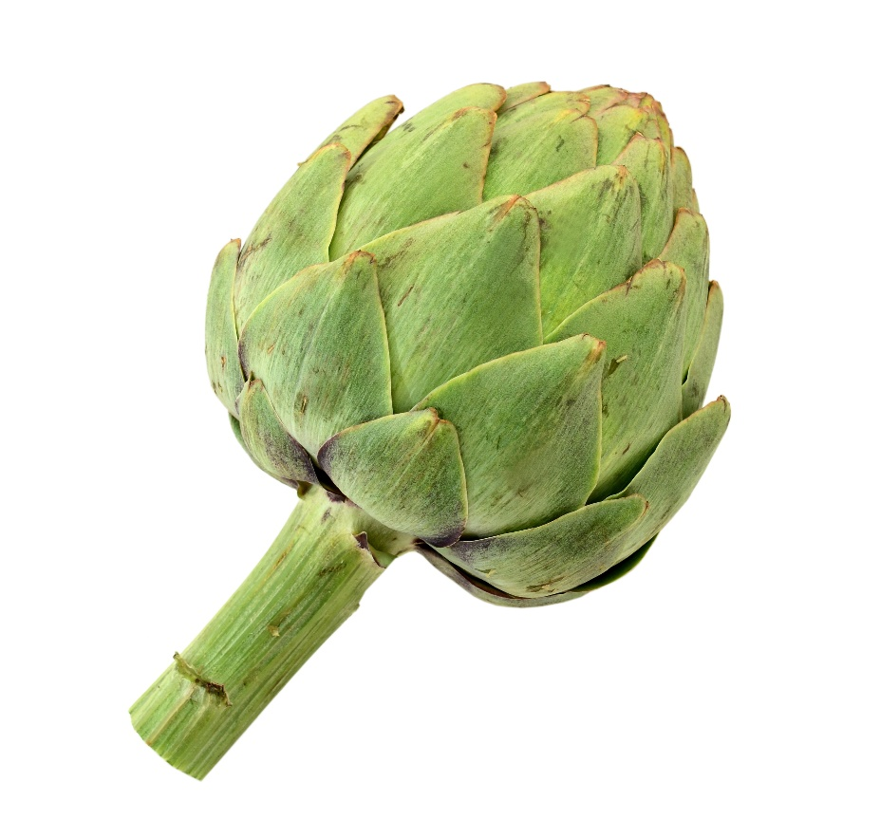
Artichoke

Slide 4
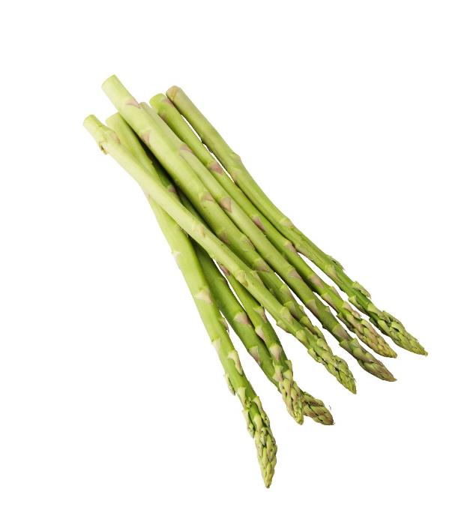
Asparagus

Slide 5
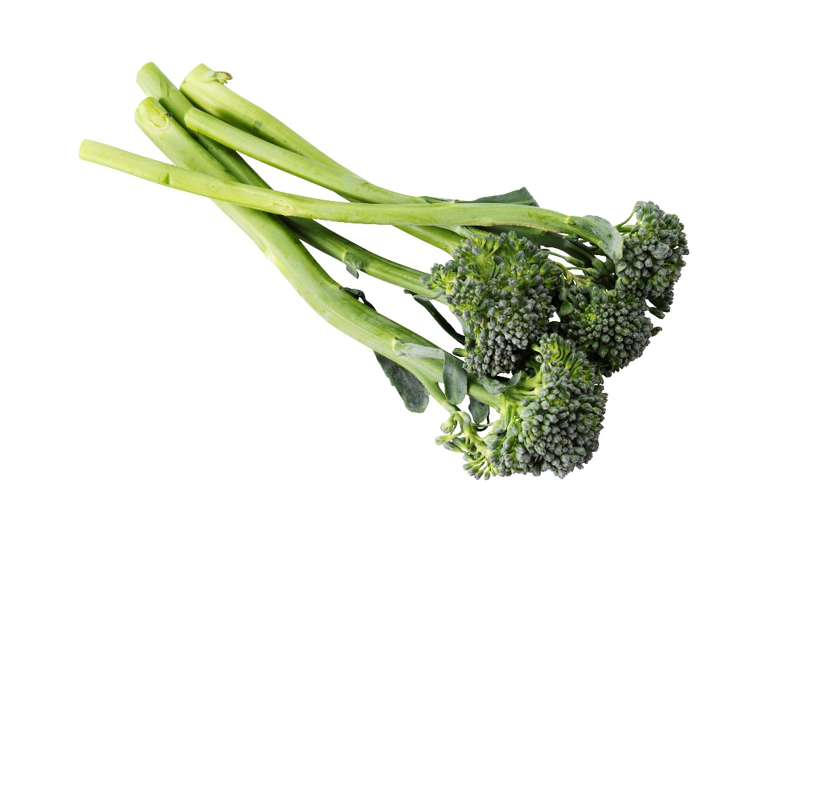
Broccolini

Slide 6
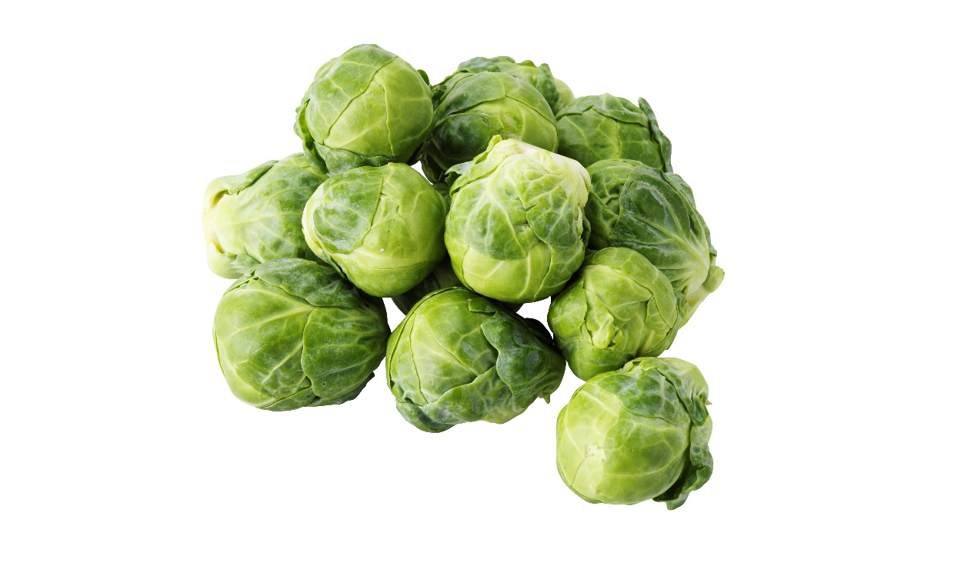
Brussels sprouts

Slide 7
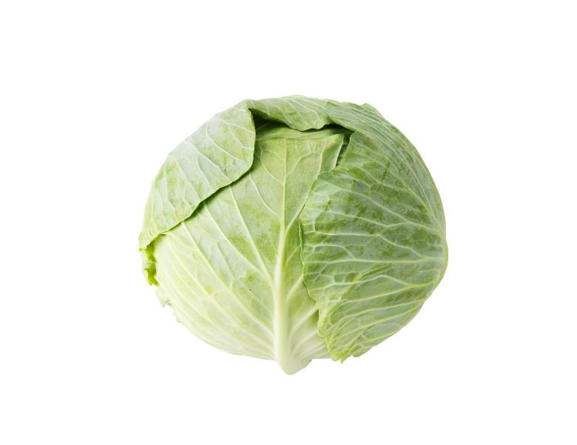
Cabbage

Slide 8
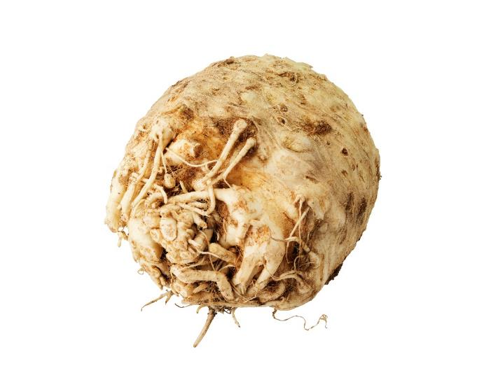
Celeriac

Slide 9
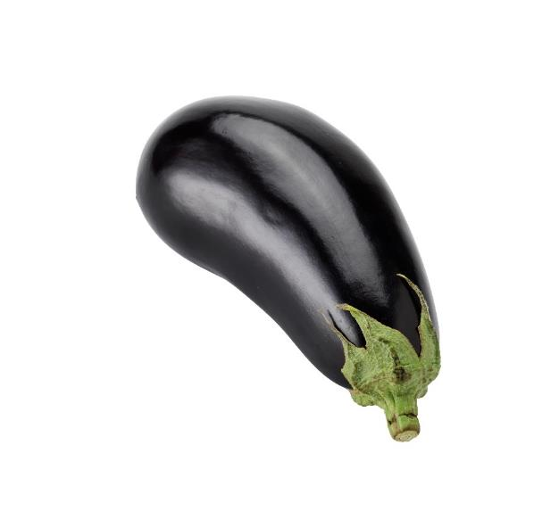
Eggplant

Slide 10
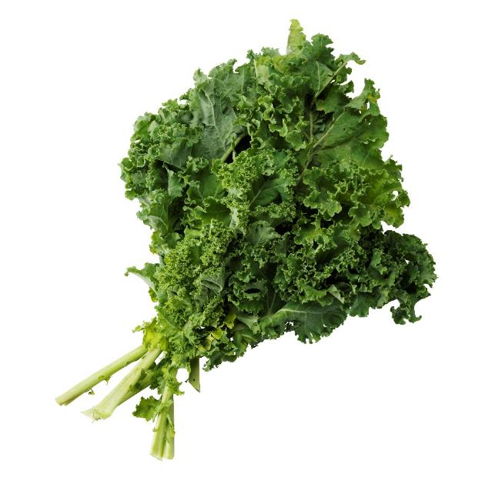
Kale

Slide 11
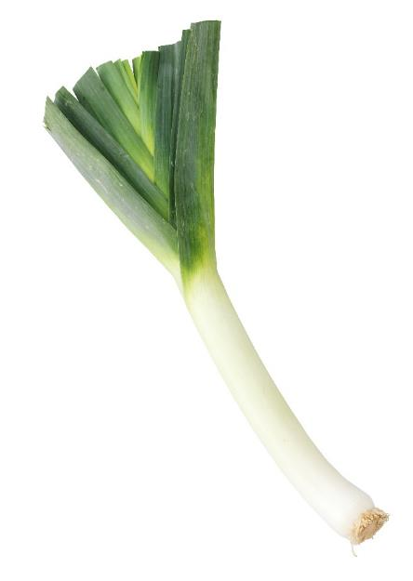
Leek

Slide 12
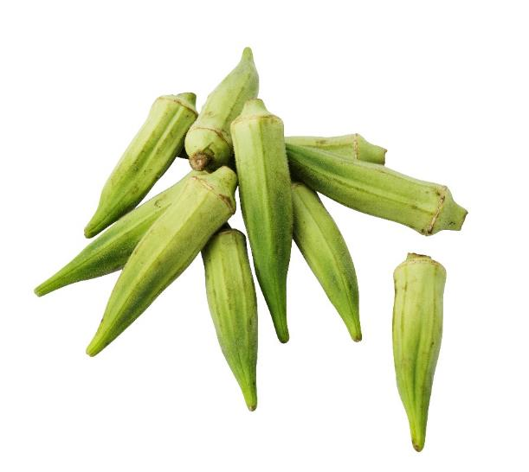
Okra

Slide 13
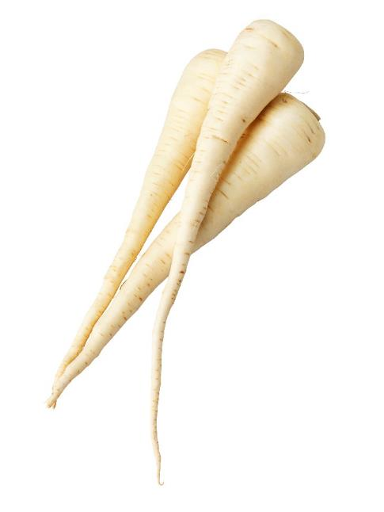
Parsnip

Slide 14
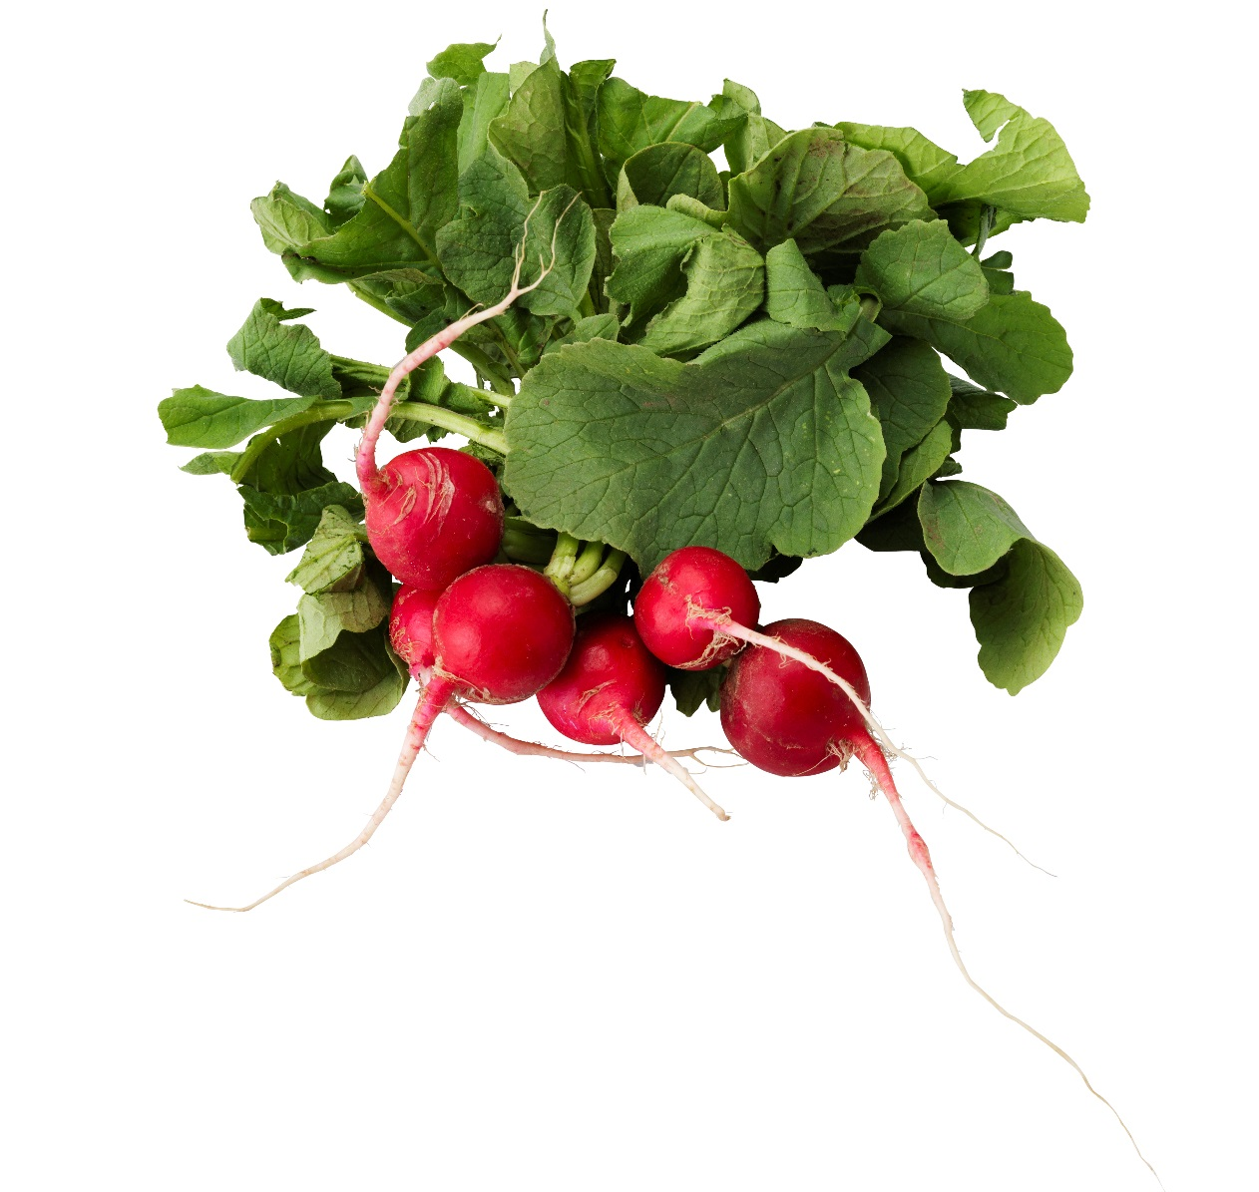
Radish

Slide 15
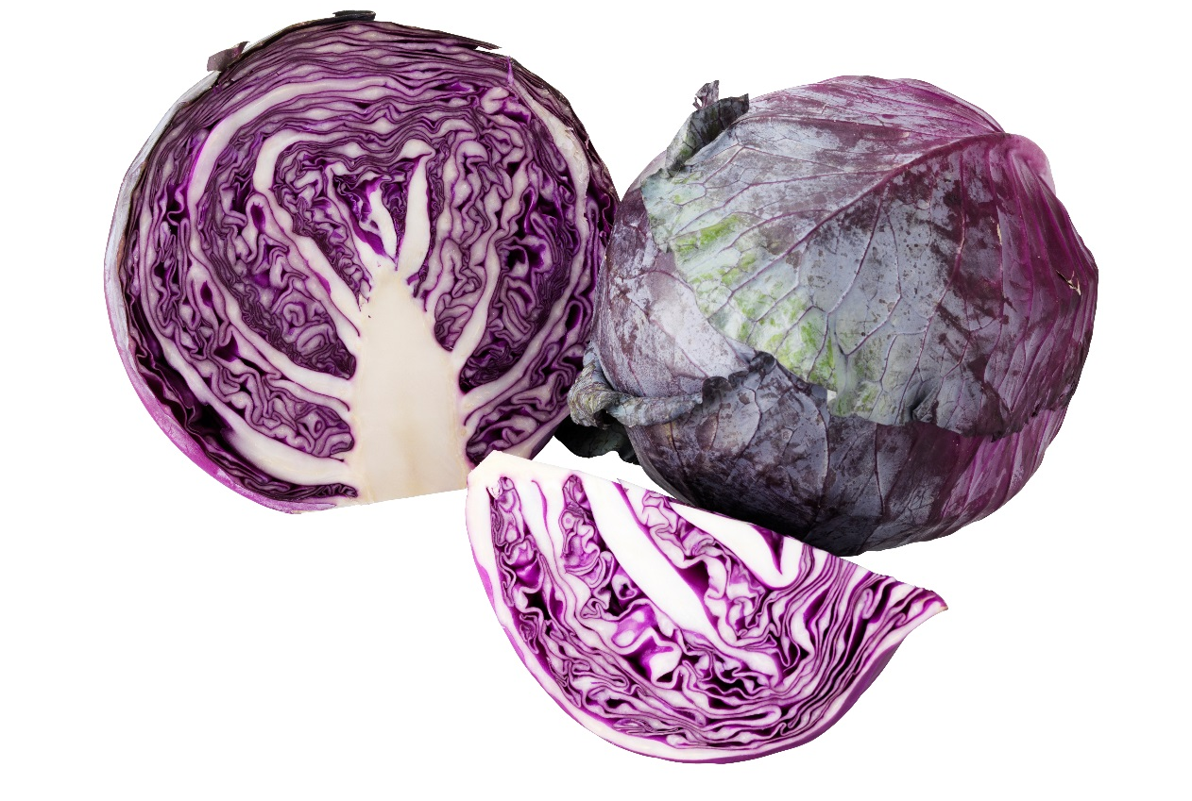
Red cabbage

Slide 16
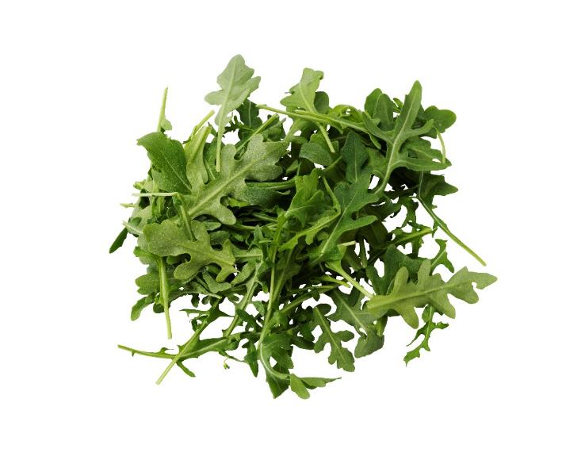
Rocket

Slide 17
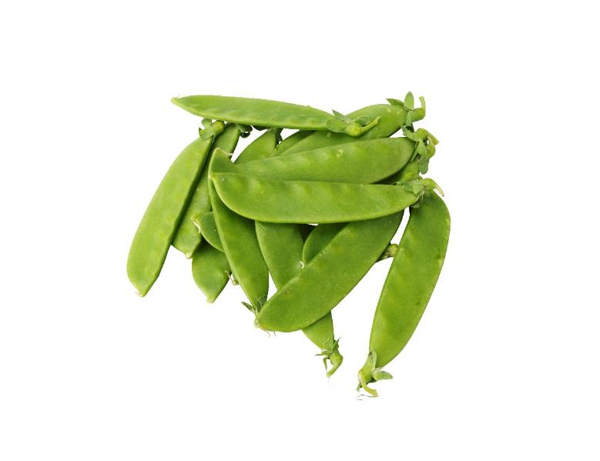
Snow peas

Slide 18
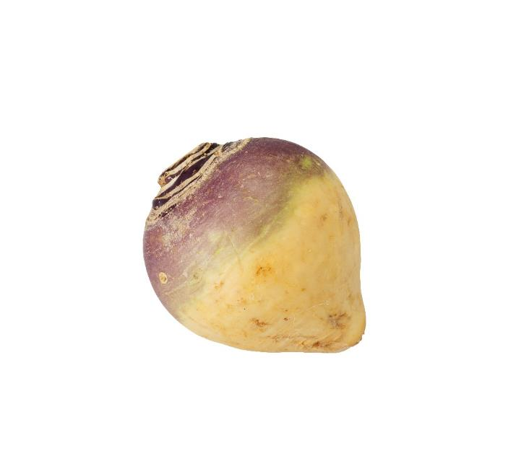
Turnip or Swede

Slide 19
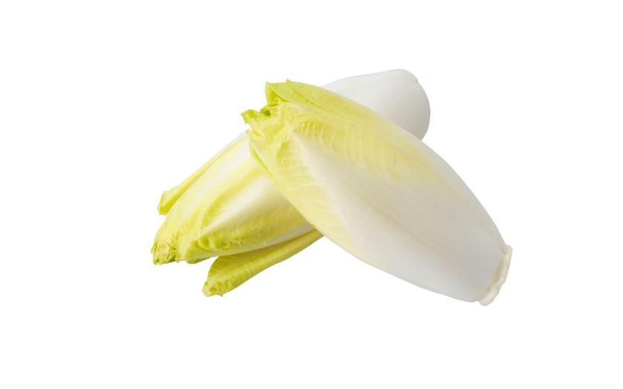
Witlof

Slide 20
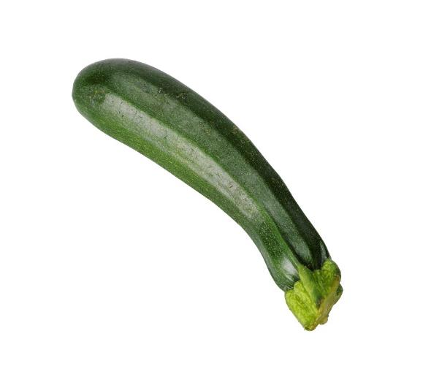
Zucchini

Slide 21
Do you know how people eat vegetables around the world?

Slide 22
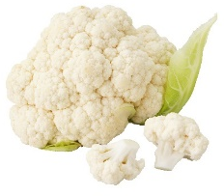
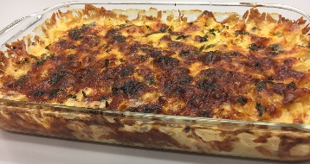
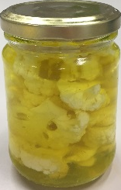
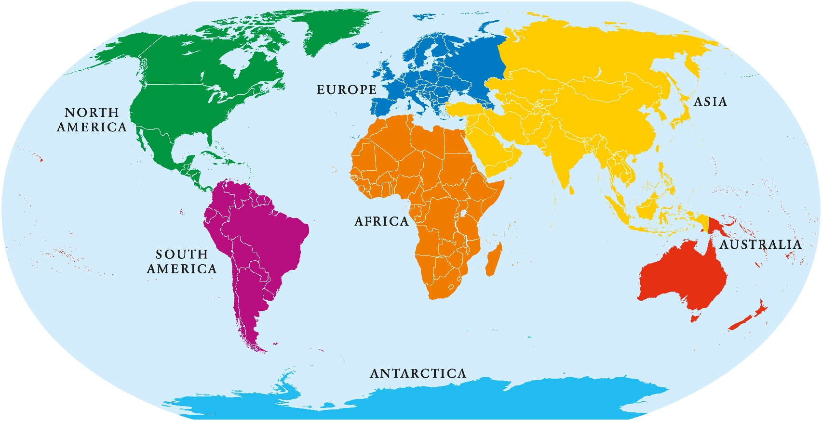
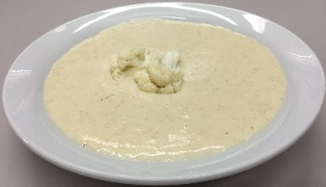
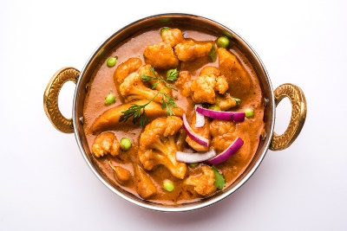
Cauliflower
Cauliflower gratin with white sauce and cheese on top.
Pickled cauliflower
Cauliflower cream soup
Cauliflower massala with green peas, spices and herbs.

Slide 23
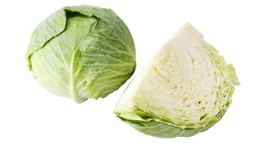
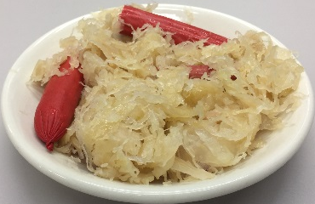
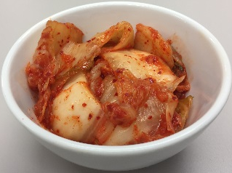
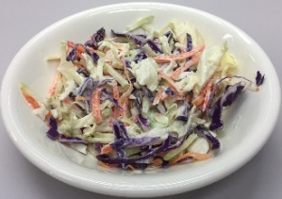
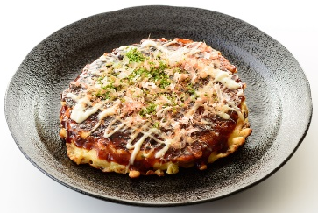
Cabbage
Sauerkraut: fermented cabbage with sausages and potatoes.
Kimchi: fermented cabbage with chillies
Coleslaw: cabbage and carrot salad with creamy dressing.
Okonomiyaki: egg omelette with cabbage

Slide 24
Extension activity
Match the vegetable with the recipe and country of origin

Slide 25

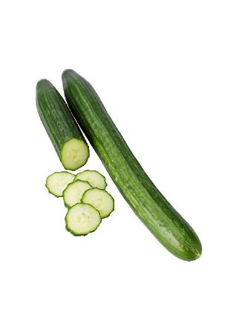
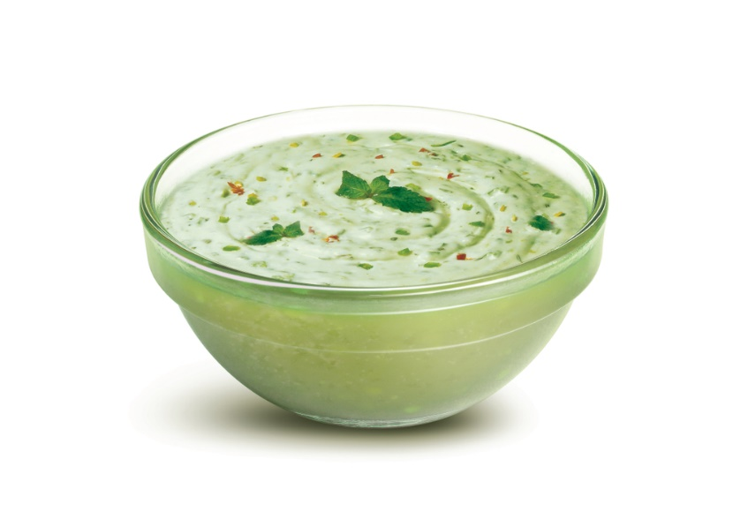
Raita
Is a dip from India
What is the vegetable used in this dish?
Cucumber

Slide 26


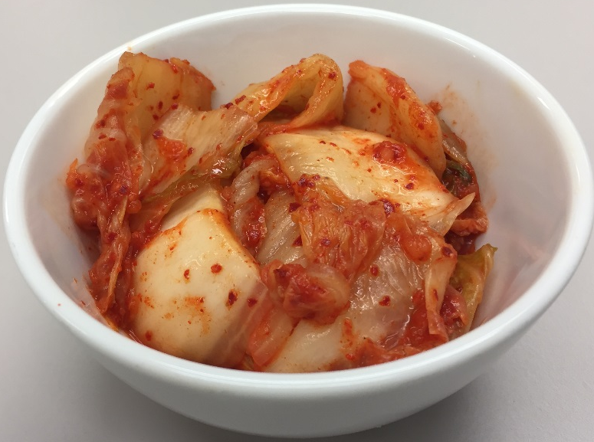
Kimchi
Is a dish from Korea
What is the vegetable used in this dish?
Cabbage

Slide 27

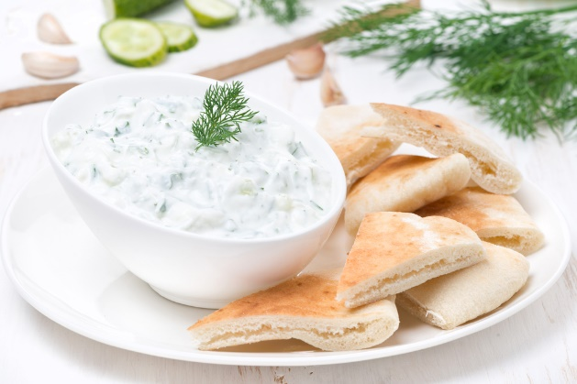
Tzatziki
Is a dip from Greece
What is the vegetable used in this dish?
Cucumber

Slide 28

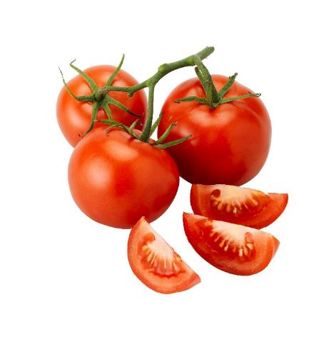
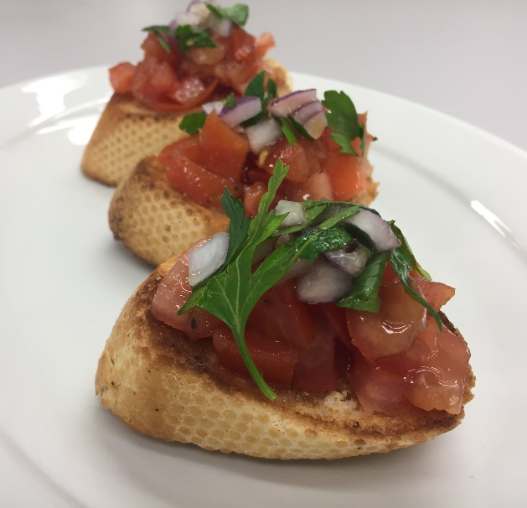
Bruschetta
Is an appetizer from Italy
What is the vegetable used in this dish?
Tomatoes

Slide 29

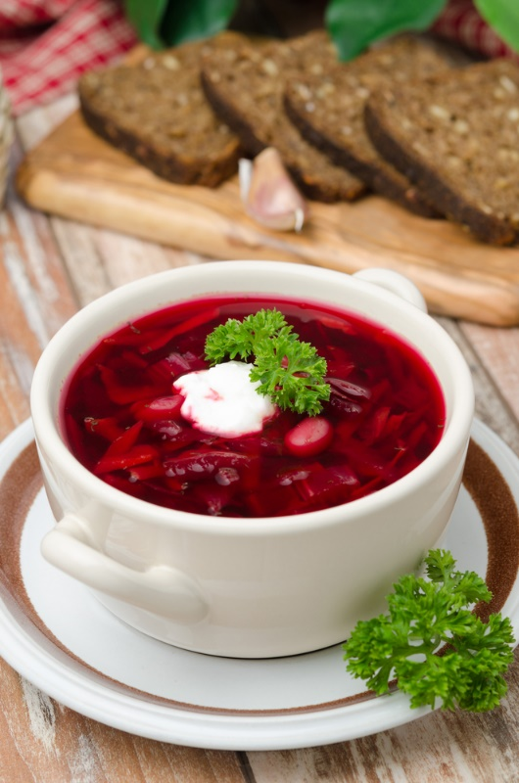
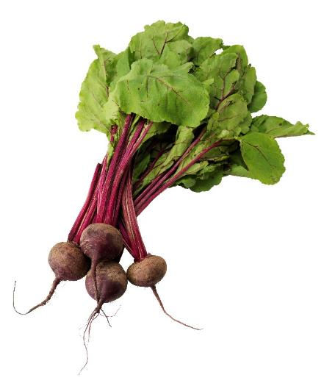
Borscht
Is a soup from Russia
What is the vegetable used in this dish?
Beetroot

Slide 30

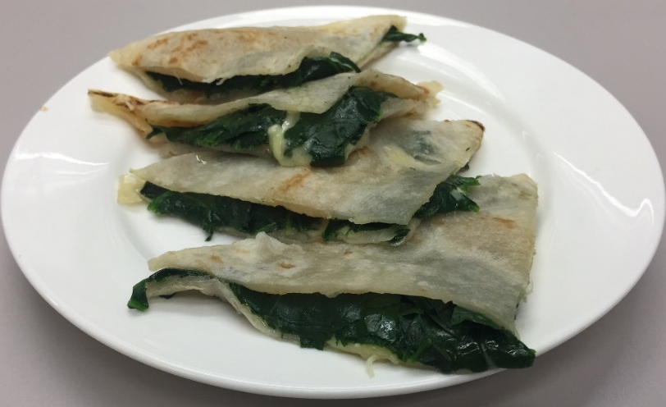
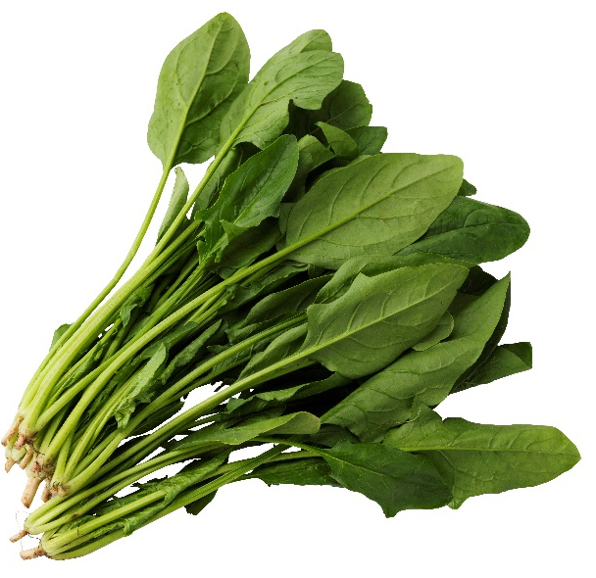
Gozleme
Is a dish from Turkey
What is the vegetable used in this dish?
Spinach

Slide 31

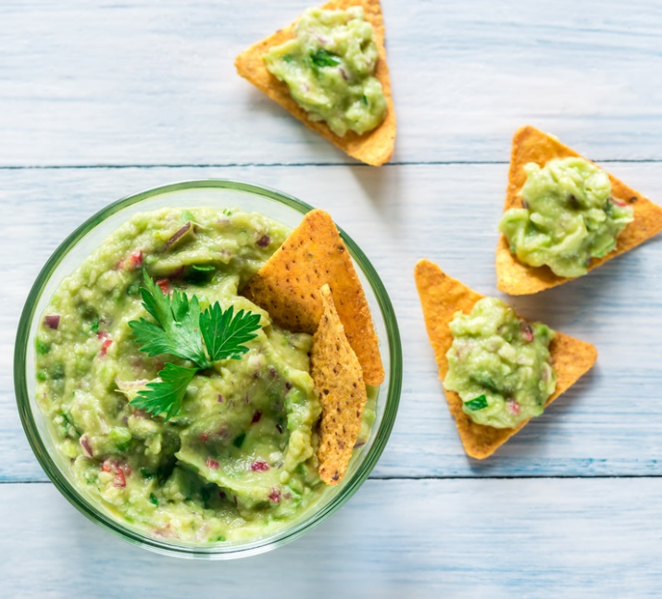
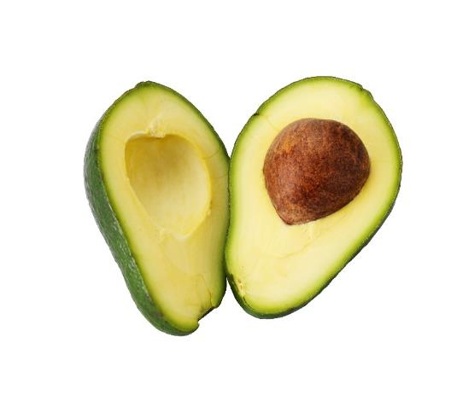
Guacamole
Is a dip from Mexico
What is the vegetable used in this dish?
Avocado

Slide 32

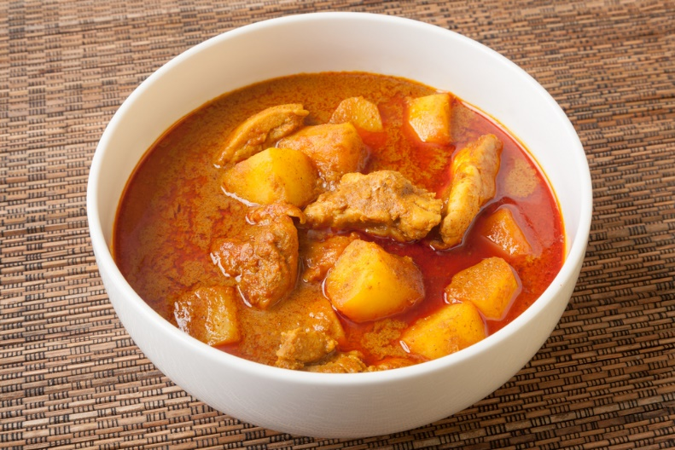
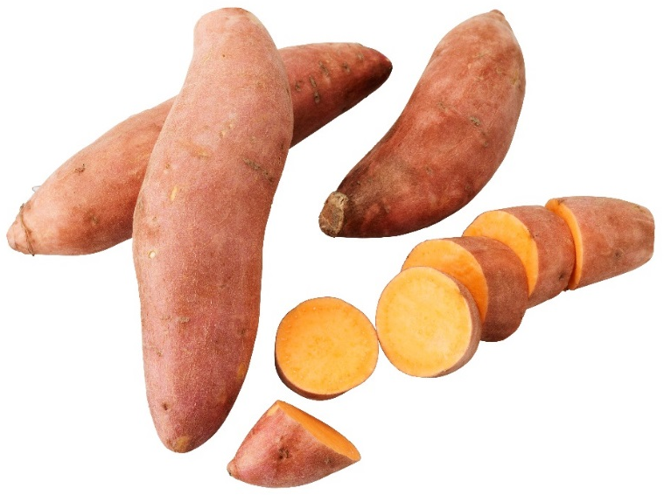
Massaman curry
Is a dish from Thailand
What is the vegetable used in this dish?
Sweet potato

Slide 33
Lesson 2:
Vegetables grow in different climates

Slide 34
What does a plant need to grow ?
Sunlight
Air
Water
Nutrients

Slide 35
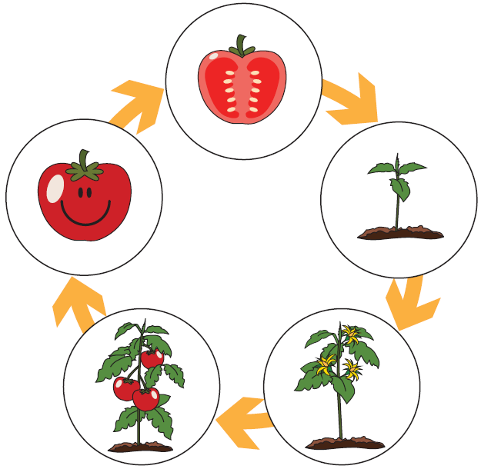
The example of the tomato life cycle

Slide 36
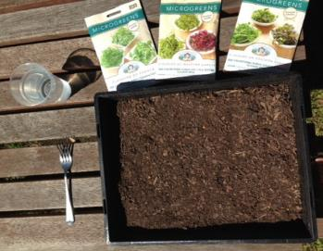
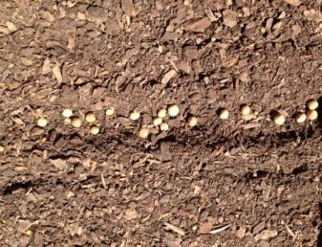
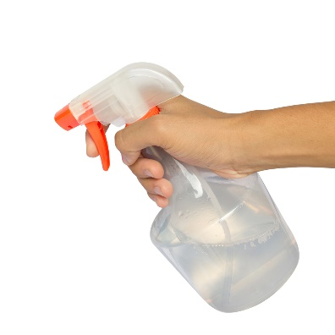
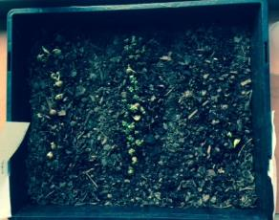
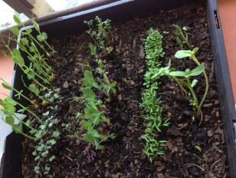
Growing your mini herbs
Starter pack
Sprinkle the seeds and push them lightly into the soil
Spray water and regularly repeat
After 1 week
After 2 weeks = ready for harvest

Slide 37





Let’s see the Australian climates
https://www.abc.net.au/gardening/vegie-guide

Slide 38
Browse through the different climates.
To find out what you can plant in each area at different times of the year, click here.

Slide 39

Did you find where you can grow Sweet potato?
Sweet potato needs a hot climate!
https://www.abc.net.au/gardening/vegie-guide

Slide 40


Did you find where you can grow English spinach?
English spinach needs a cooler climate!

Slide 41

Did you find where you can grow Carrot?
Carrots are grown in different climates depending on the season

Slide 42



There is a science called Agronomy
It is the science of growing plants
‘Agronomists’ have developed many ways to grow vegetables so that we can eat them any time of the year.
Greenhouses to maximize sunlight.
Irrigation systems to bring water to the plants.
Fertilizers to improve the soil quality

Slide 43





A science for the consumer
‘Agronomists’ are quite inventive and have created novel products to avoid preparation time and storage problems.
They have created;
Easy to store and prepare square watermelons
Mini versions of vegetables
Single clove garlic
Mini, no pip avocados

Slide 44



Hybrids
They also tried to produce ‘hybrids’, mixing two vegetables that together could give a nice combination of tastes and/or textures.
Broccolini
Gai Lan x Broccoli
Broccoflower
Broccoli x Cauliflower
Rabbage
Raddish x Cabbage

Slide 45
Be an Agronomist
Your group’s task - to invent your own
hybrid of two vegetables
Here are some ideas:
Hybrids of two vegetables that you think the taste will go well together
  Vegetable 1 because you like the taste, vegetable 2 because you like the texture
  Vegetable 1 because you like the taste, vegetable 2 because you like the shape.
  Vegetable 1 because you like the texture, vegetable 2 because you like the colour.
Describe it, draw it and give it a name!

Slide 46
Lesson 3:
Preparing vegetables – a science experiment

Slide 47






Vegetable cooking and preparation techniques
 | Method | Principle – how it works | Advantages/ Disadvantage | Vegetables it can be applied to
 | Steaming | Uses the water vapour to cook the vegetables | Short cooking time, retention of nutrients and colour | Most vegetables except cucumber, capsicum, okra, tomato…
 | Stir-frying | Uses high contact heat through a pan or wok with a small quantity of oil to cook the vegetables | Short cooking time, retention of bright colours, nutrients and crunch | Most vegetables in particular broccoli, cauliflower, Asian vegetables …
 | Oven-baking | Uses hot air and a small quantity of oil to cook vegetables | Tenderise vegetables while making available fibres and energy. Caramelisation | Root vegetables, sweet potatoes, pumpkin…
 | Boiling | Uses a large amount of boiling water to cook vegetables | Loss of nutrients and texture | Carrots, swedes, corn, sweet potato, zucchini
 | Microwaving | Uses microwaves to heat the water inside the vegetables | Not much evidence on the benefits of using microwave on vegetables | Carrots, cauliflower, celeriac, fennel, kale, leek, peas, parsnip pumpkin, swede, corn, sweet potato…
 | BBQing | Uses direct heat from fire/coal to cook vegetables | Maintain crunchiness. Gives a smoky flavour | Asparagus, capsicum, cauliflower, eggplant, tomato…
Adapted from www.veggycation.com.au

Slide 48
Lesson 4:
Perfectly imperfect vegetables

Slide 49






Which of those would you eat?

Slide 50

Poster (1 of 7) from Intermarché, the third largest supermarket chain in France
Intermarché launched a campaign called:
‘Inglorious Fruits and Vegetables’

Slide 51






Write a persuasive dot point text to champion an ‘ugly’ vegetable.

Slide 52




Which ones could you safely eat?

Slide 53




Which ones could you safely eat?

Slide 54


Which one could you safely eat?

Slide 55




Which ones could you safely eat?

Slide 56




Which ones could you safely eat?

Slide 57
Lesson 5:
Masterchef in class: The salad

Slide 58




In what recipes are vegetables the main ingredient?
Dips
Soups
Mashes
Salads

Slide 59

Can you describe your favourite salad?

Slide 60




What are the elements that compose a salad?
Vegetables
Dressing
You can also add pasta, rice, legumes, ham, cheese, tuna, eggs...

Slide 61

What vegetables can you put in a salad?

Slide 62

Herbs are a fun and excellent way to enhance the appearance, taste, texture and nutritional value of a salad
Micro herbs
Micro herbs 2 weeks after planting: Ready to harvest

Slide 63




How to prepare vegetables for a salad?
Safety rules
Start by washing your hands
Remove any bruised, skin, damaged or non-edible parts.
Wash the vegetables under running tap water to remove any traces of soil.
Use a clean and dedicated cutting board to place the vegetables on. Use appropriate knives. Be careful and do not injure yourself. Then, cut them up in the shape that you want.
Assemble the salad in a bowl.
Keep covered in the fridge until use.

Slide 64



How to cut up vegetables for a salad
Here are some examples...
Carrots can be shredded, sliced or in julienne.
Cucumber can be sliced or diced
Beetroot can be sliced, served whole, diced or shredded.
But... There are many possibilities to cut up each vegetable - the texture will vary depending on what you choose. You can even be creative and cut them in any shape that you like...

Slide 65

How big should my salad be?
If you only eat a small portion to accompany your meal at lunch:
➔ 1 portion of vegetables
If you eat it as a whole meal
for dinner:
➔ 2-3 portions of vegetables

