Slide 1
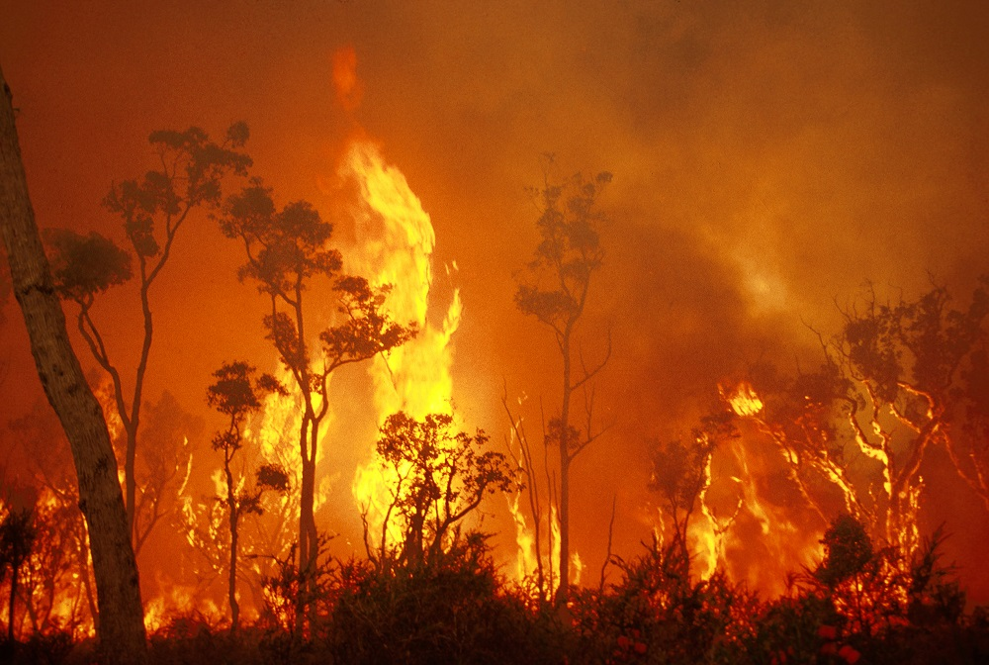
Spark
May 2023

Slide 2
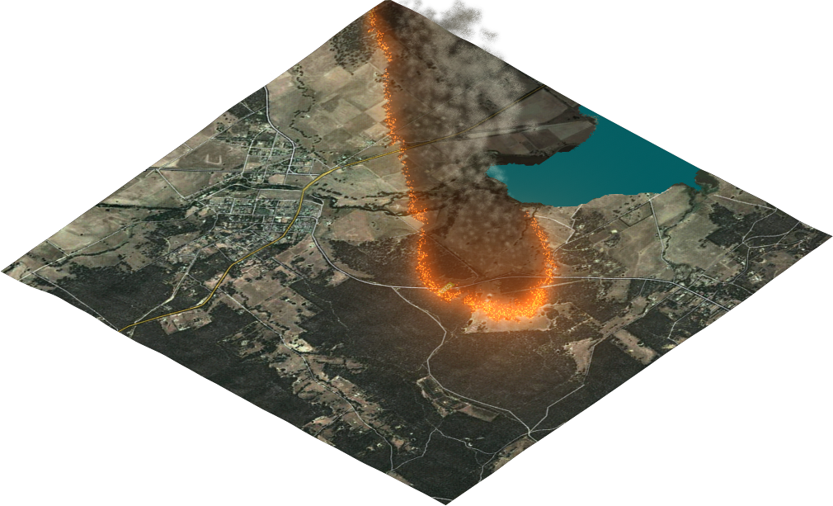
Introduction
Need to simulate wildfires for risk modelling and operational management
Given:
Ignition conditions (points, lines or areas)
Information on the fuel and landscape
Weather data
Firebreaks and suppression
We need:
Where the fire will go
The intensity of the fire
Heat flux on structures
Where firebrands will land
…
All of these elements must be included in a computer model
Computer model must be rapid enough for operational prediction
Rate-of-spread

Slide 3
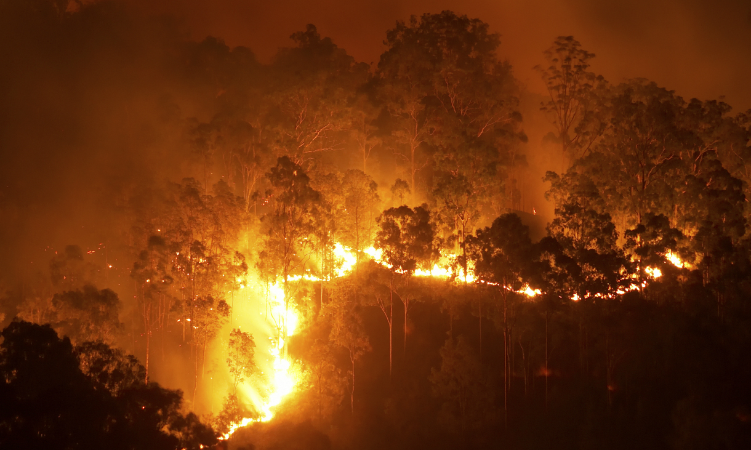

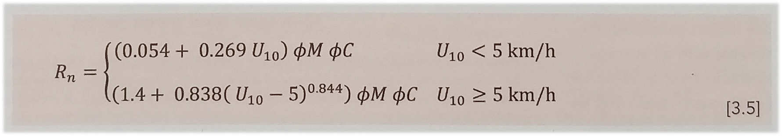
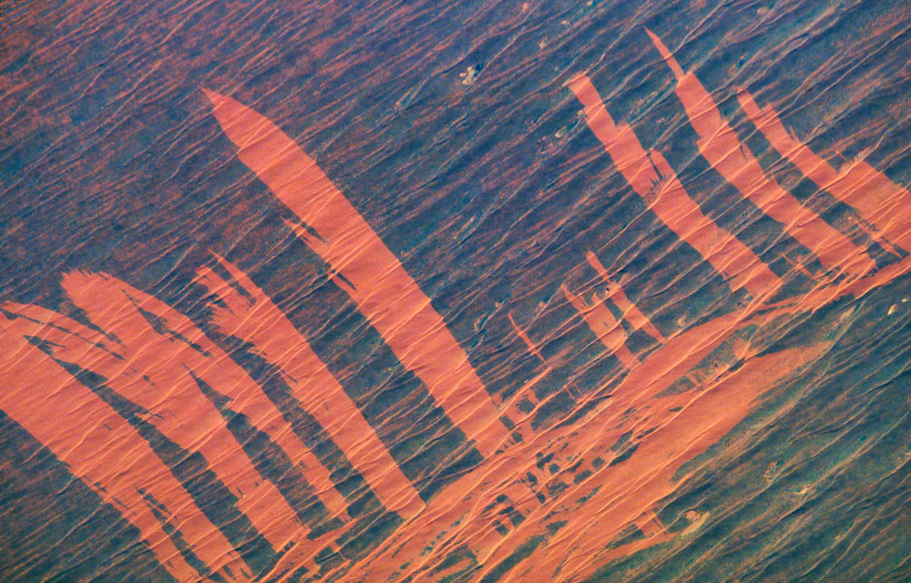
Introduction
The rate-of-spread depends on:
The type of fuel
The condition of the fuel (amount, moisture level, …)
Empirical rate of spread models developed from experiments
Mathematical function for rate-of-spread
Need to use many different models for fire prediction
Each model may require different data
Eucalypt fire. Source: RMIT
Spinifex fire. Source: NASA Earth Observatory

Slide 4

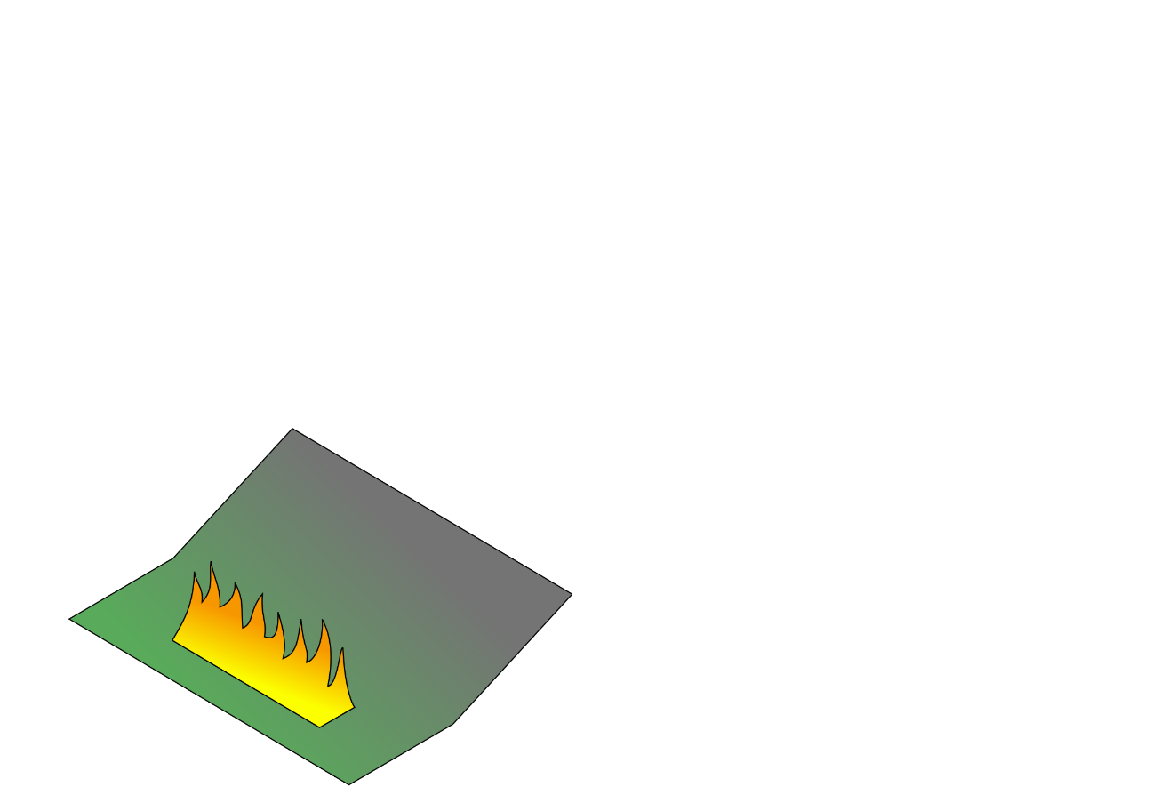

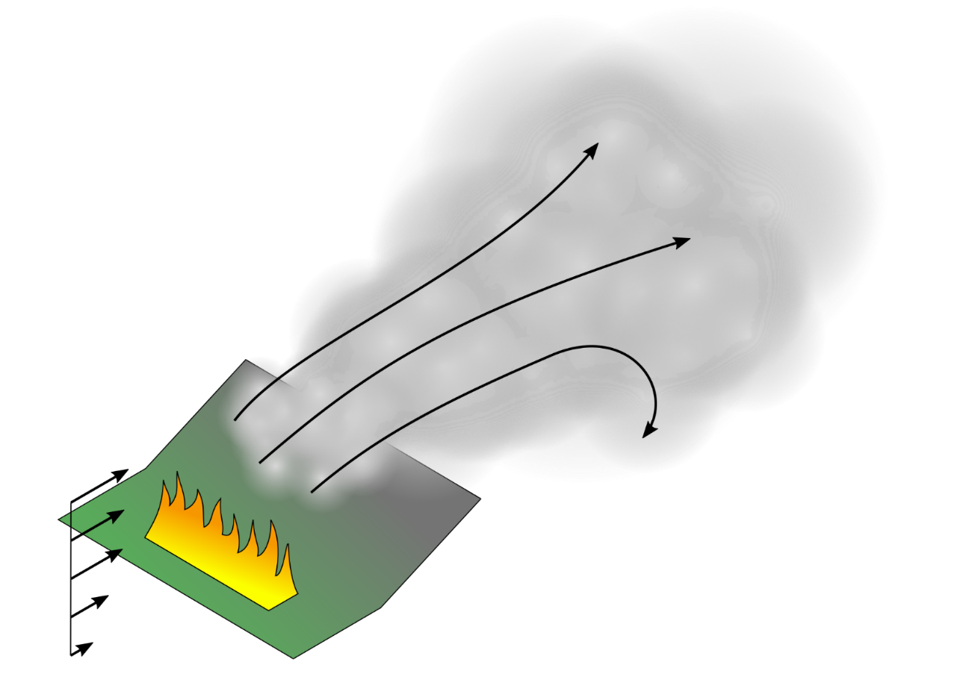



Introduction
In addition to the rate of spread the following must also be considered:
Terrain - fires move faster uphill
Local wind effects - channelling and lateral spread
Smoke - long range effect
‘Near-field’ - fire interacts with itself
Radiation - cause structure damage
Firebrands - create unpredictable new fires
Ongoing worldwide research into all of these areas

Slide 5

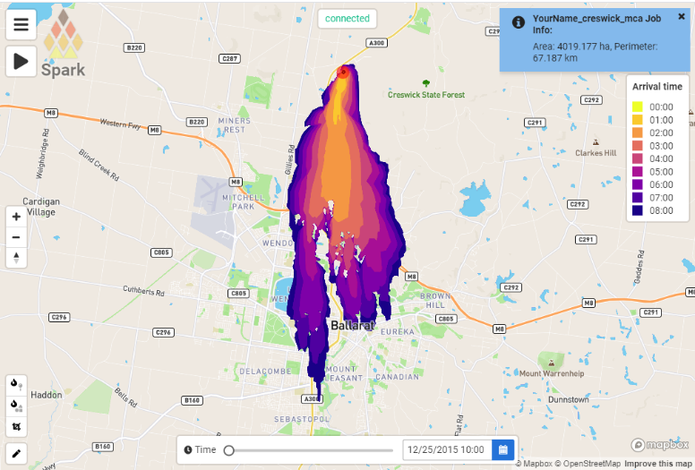



Spark
Spark is a wildfire prediction framework:
Based on configurable scripts wherever possible
Rate-of-spread based on input data – wind, fuel, terrain
Compatibility with all common geospatial data types
Plug-ins for firebrands, radiant heat flux, terrain, fire feedback
Python-based for further customisation
Web front end (SparkWeb) and server (Spark server)
SparkWeb
Spark server
Geostack
Spark

Slide 6
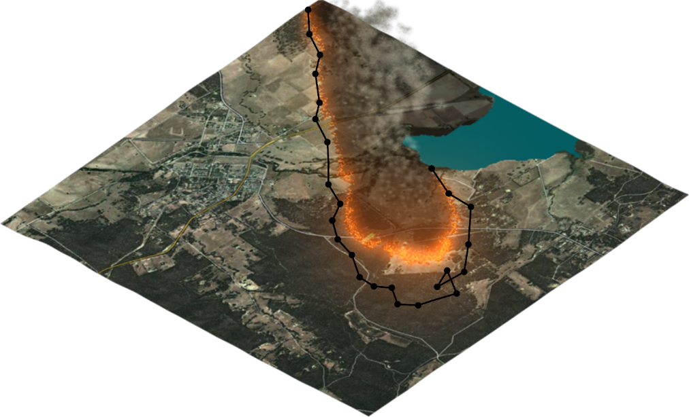
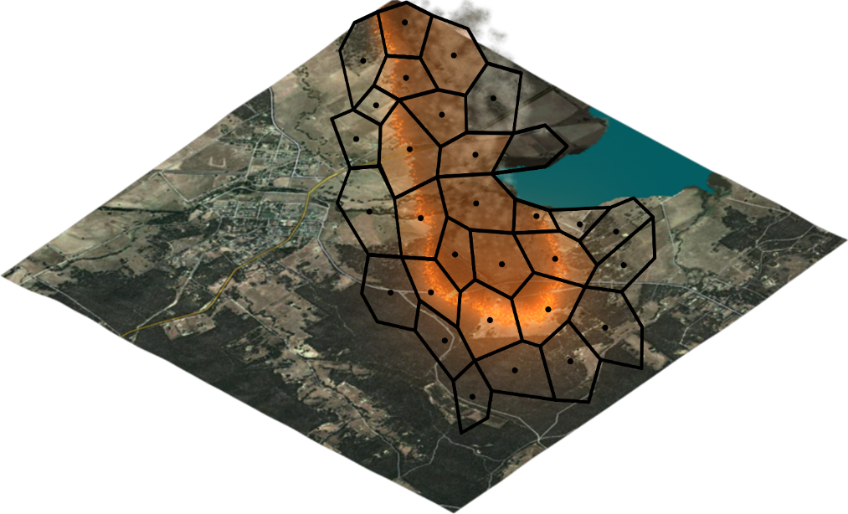
Modelling
Computational wildfire models:
Front tracking
Cellular
Front tracking
Represents perimeter as line
Very efficient to update node positions
Need to filter nearby points
Lines can get tangled after update/merging
Cellular methods
Domain is a set of cells
Fire spreads from cell to cell
Extremely efficient processing
Cell geometry affects simulation

Slide 7
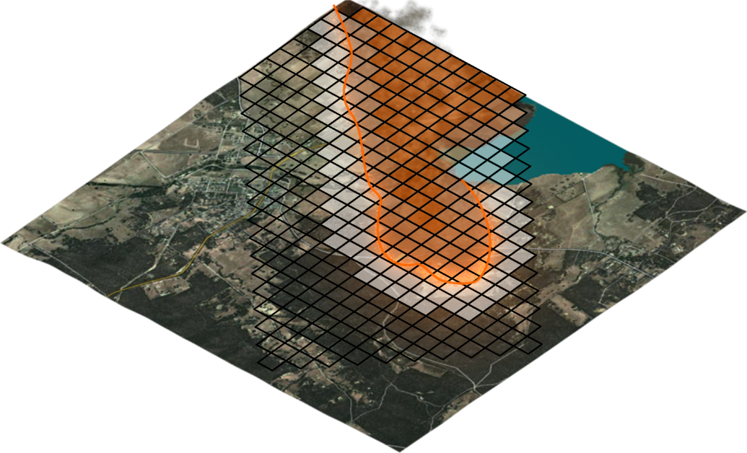
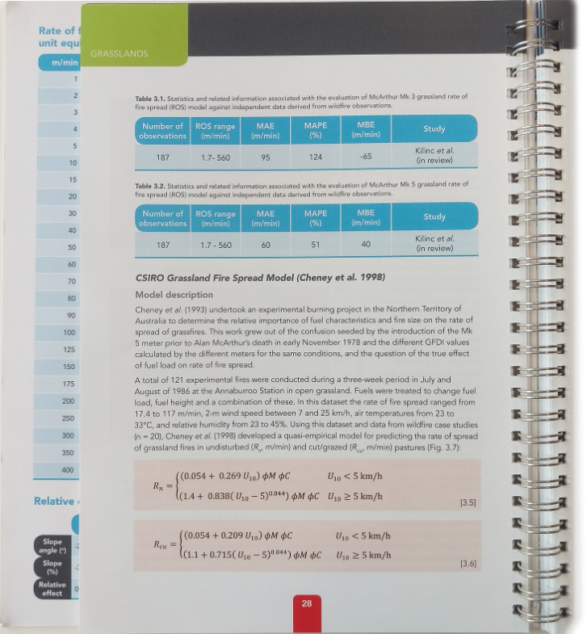
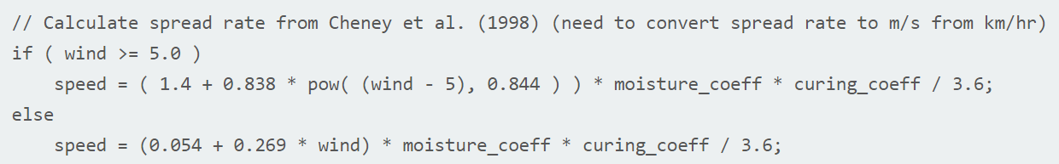
Modelling
Spark model
Level set method:
Precise control of rate-of-spread in each cell
Automatically handles merging fires
Efficient and scalable on new computer hardware
Models:
Defined using scripts, not hard-coded
Inputs and output layers can be referenced and used
All projections, spatial and temporal sampling transparently handled
Level set method
Script for grassland fires in Spark

Slide 8
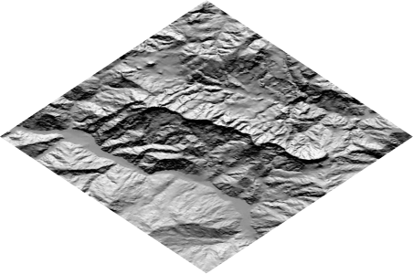
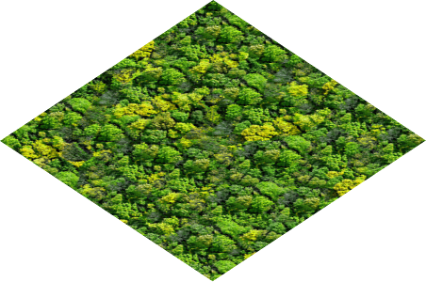
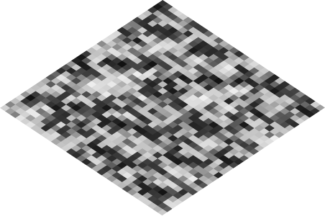
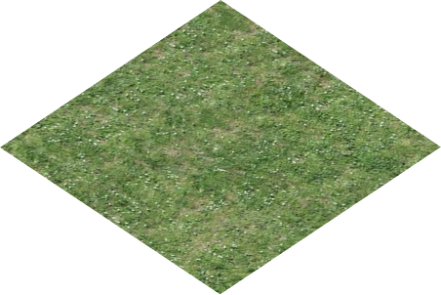
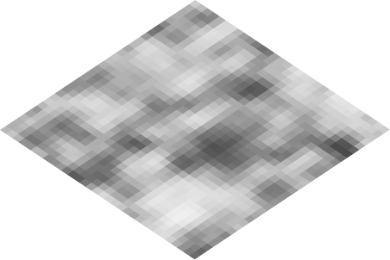
Data
Any user-defined variables, layers or series can be used
System handles spatial and temporal sampling
Integration to support any geospatial data type
‘elevation’
Forest model
RoS(elevation, fuel load)
‘fuel_load’
Grassland model
Ros(elevation, curing)
‘curing’
Other models
Any combination of input spatial layers

Slide 9
SparkWeb

Slide 10
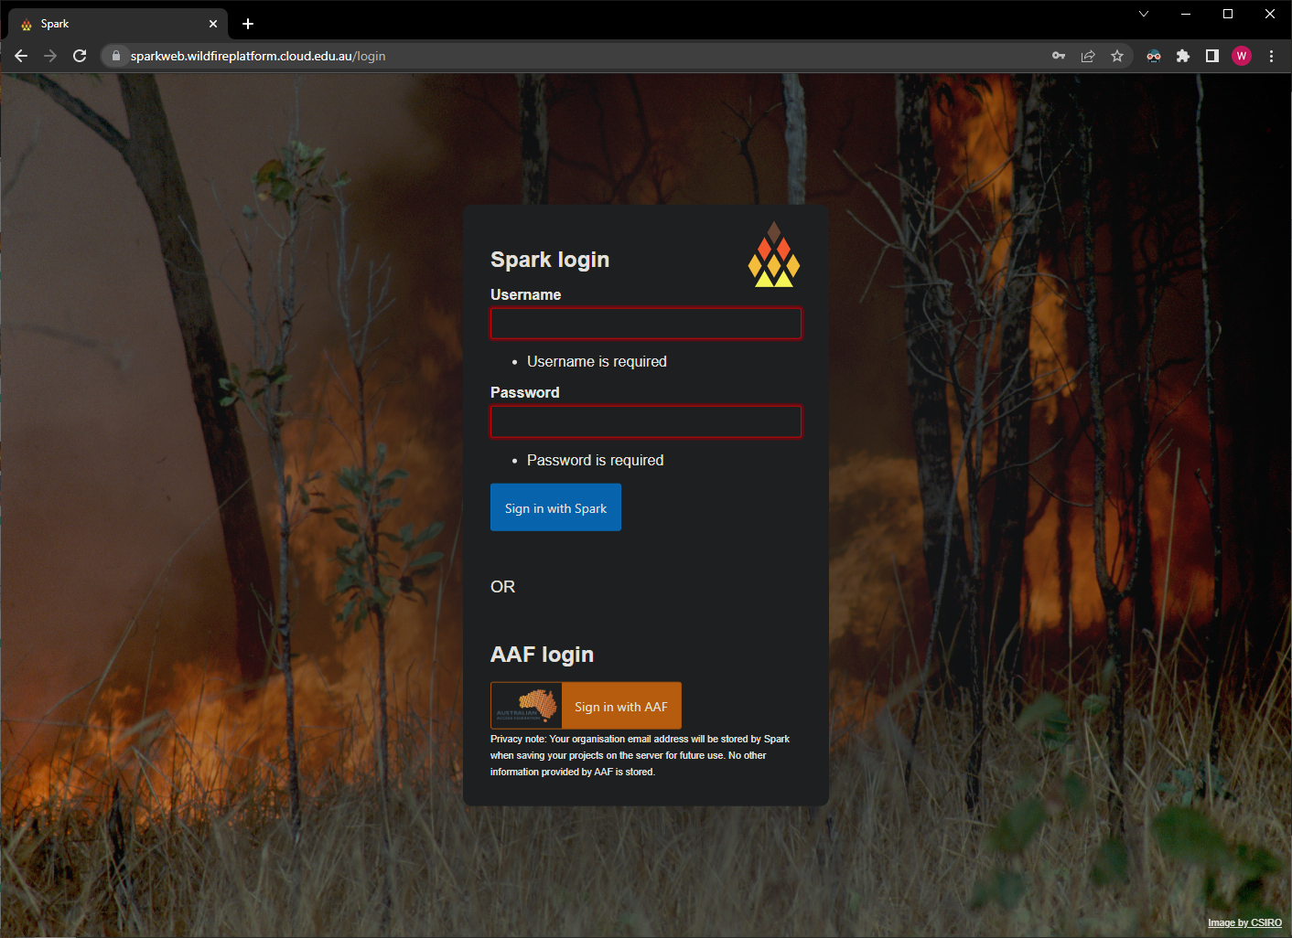
SparkWeb
Usage
Authentication required

Slide 11
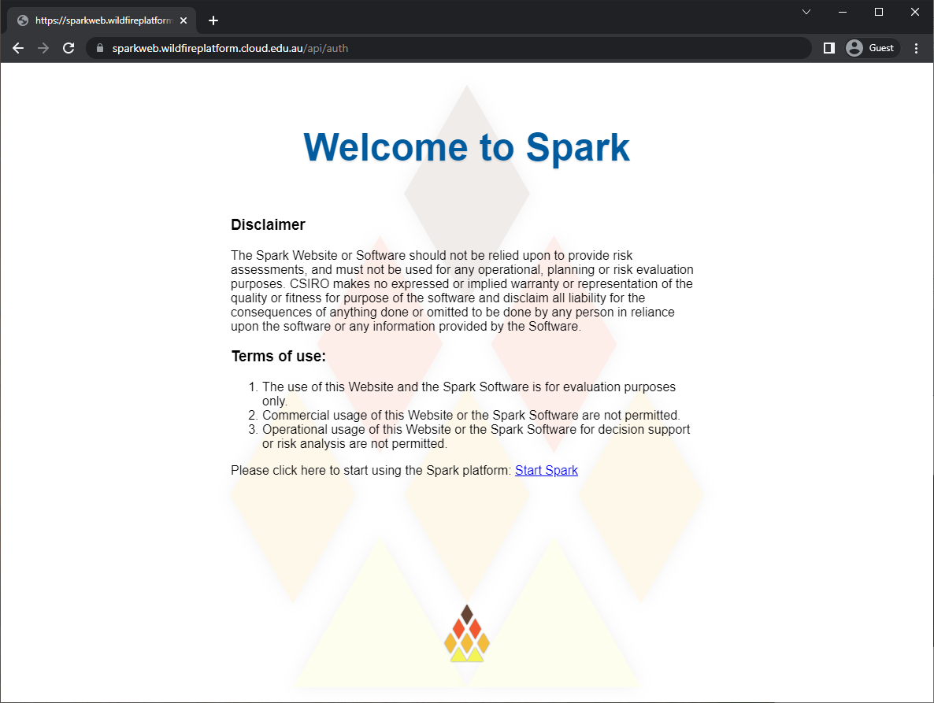
SparkWeb
Usage
Authentication required
Terms of use

Slide 12
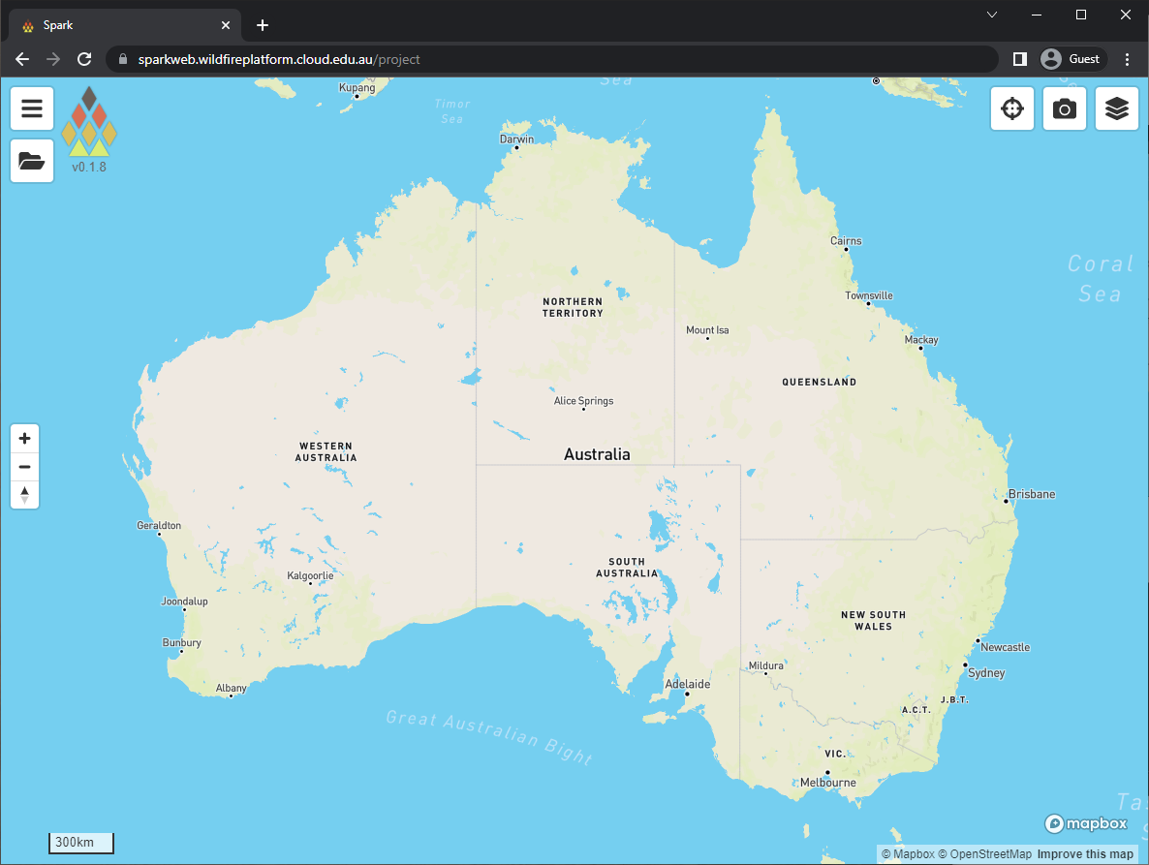
SparkWeb
Usage
Authentication required
Terms of use
Create a new project

Slide 13
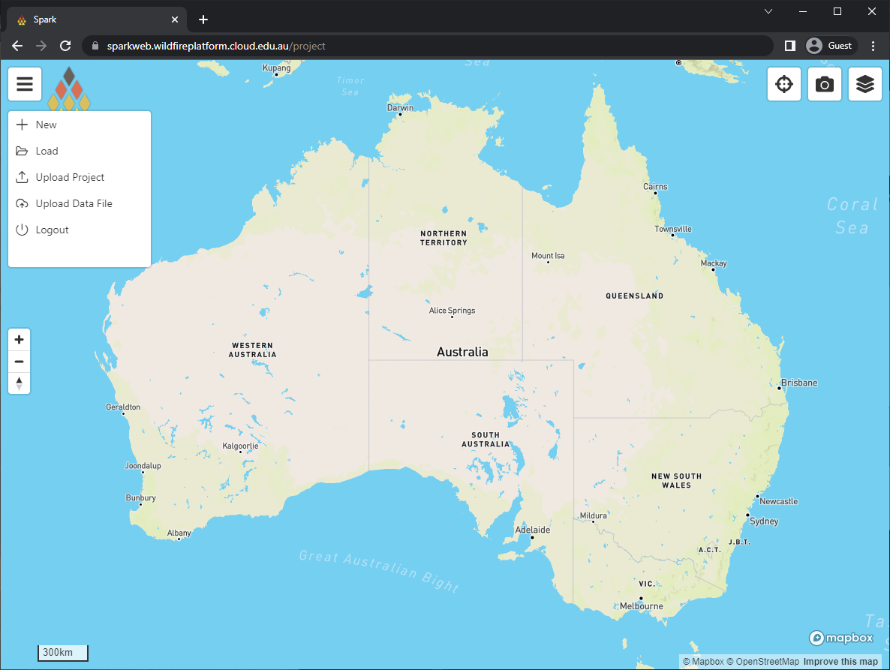
SparkWeb
Usage
Authentication required
Terms of use
Create a new project

Slide 14
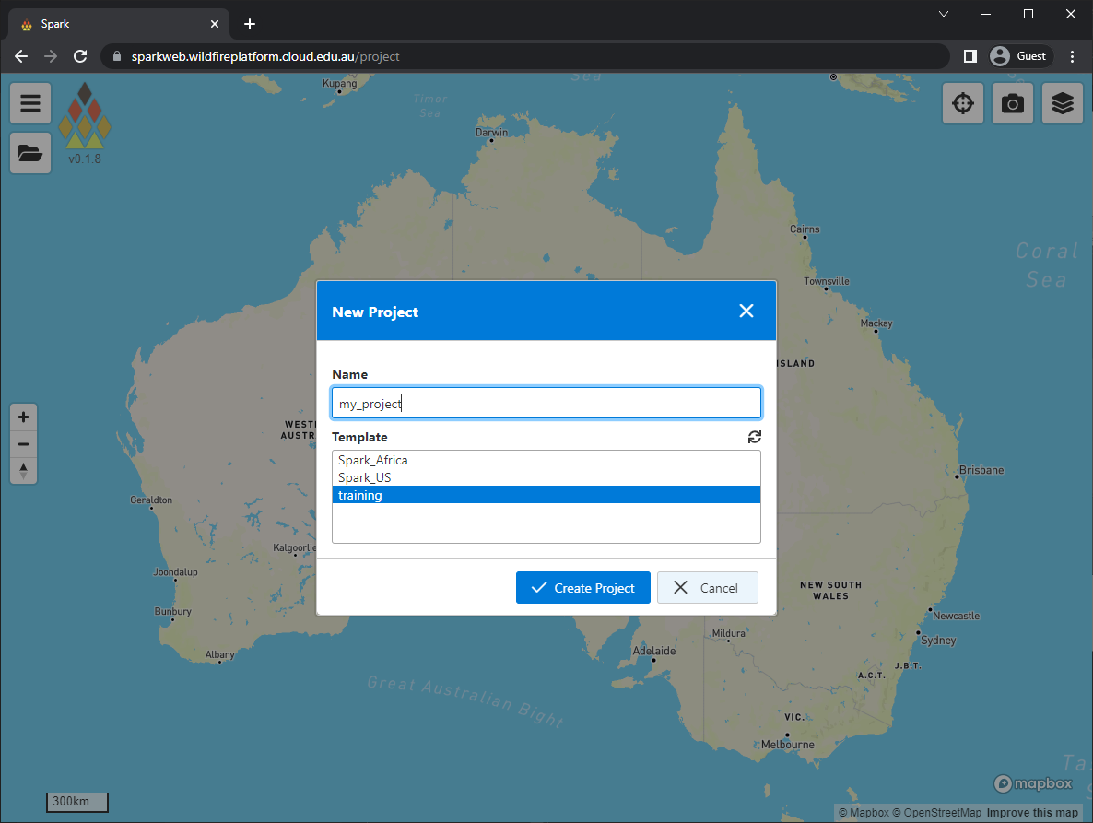
SparkWeb
Usage
Authentication required
Terms of use
Create a new project
  Projects must be named
  Pre-populated templates

Slide 15
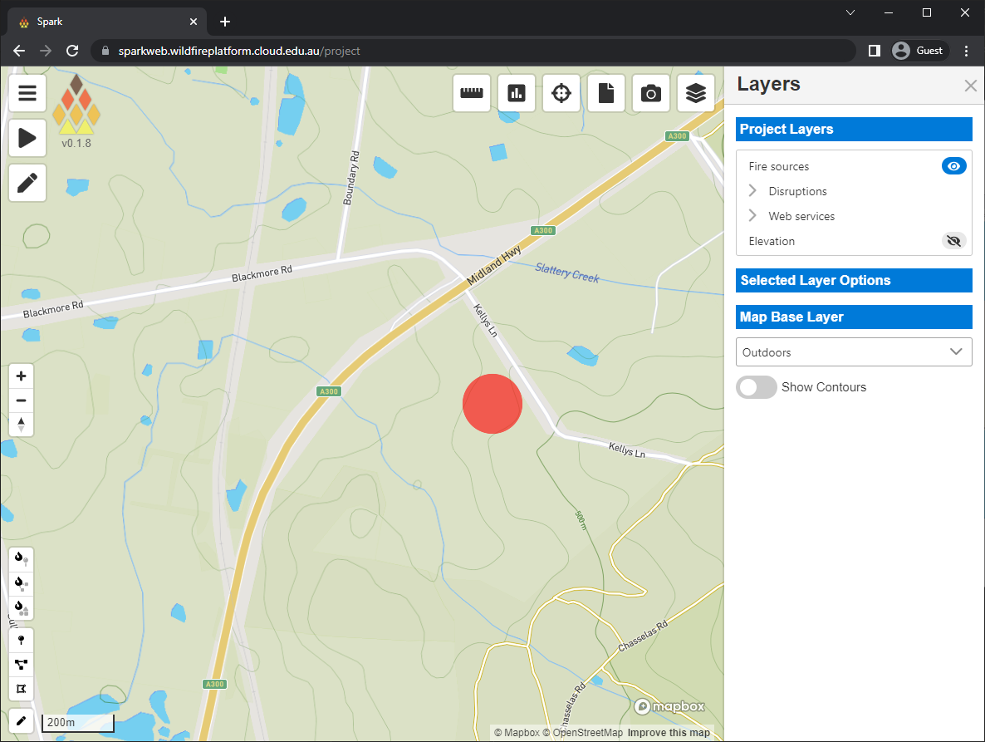
SparkWeb
Usage
Authentication required
Terms of use
Create a new project
  Projects must be named
  Pre-populated templates
Layer panel on right-hand side

Slide 16
SparkWeb
Usage
Authentication required
Terms of use
Create a new project
  Projects must be named
  Pre-populated templates
Layer panel on right-hand side
Fire input conditions
  Tools on lower left
  Point tool

Slide 17
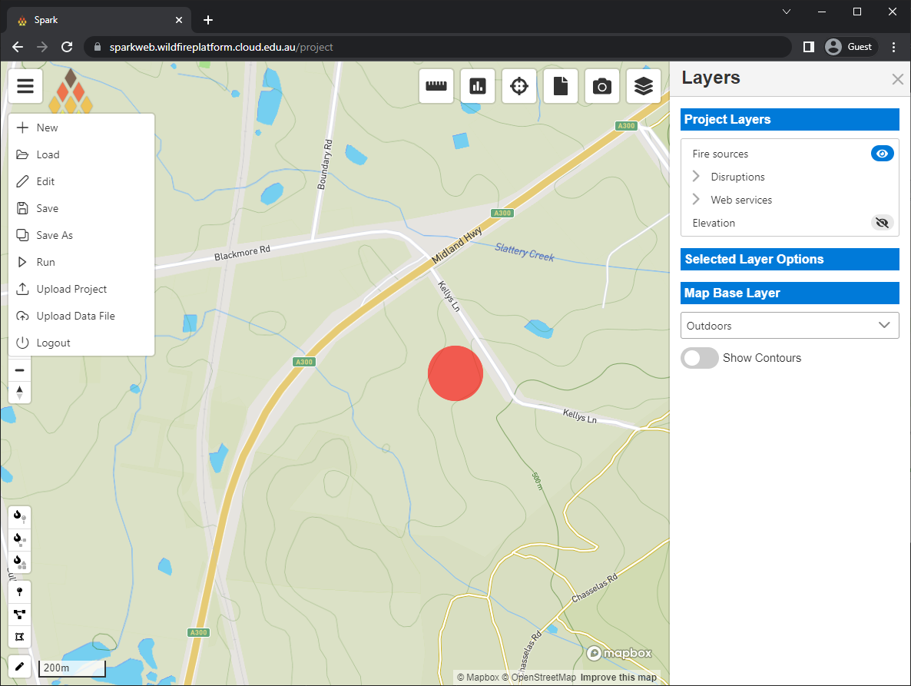
SparkWeb
Usage
Authentication required
Terms of use
Create a new project
  Projects must be named
  Pre-populated templates
Layer panel on right-hand side
Fire input conditions
  Tools on lower left
  Point tool
Basic simulation parameters

Slide 18
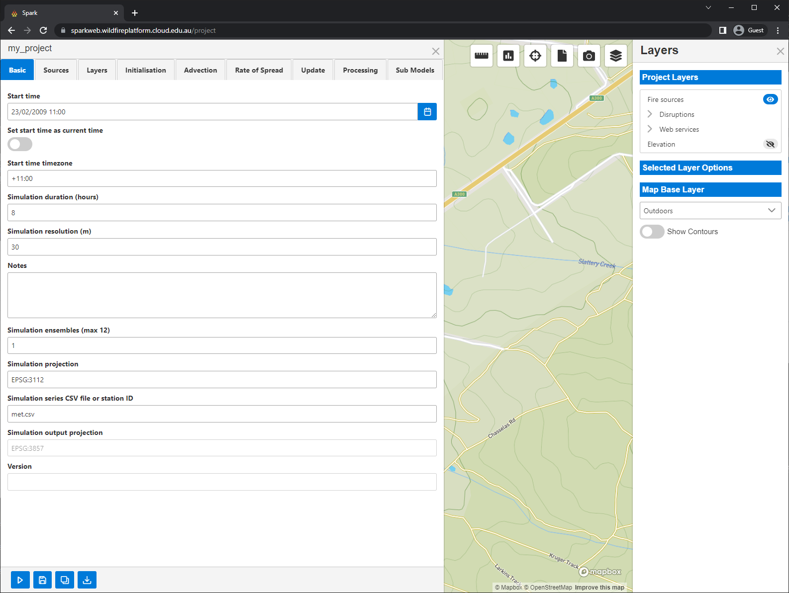



SparkWeb
Usage
Authentication required
Terms of use
Create a new project
  Projects must be named
  Pre-populated templates
Layer panel on right-hand side
Fire input conditions
  Tools on lower left
  Point tool
Basic simulation parameters
  Start date and time
  Time zone
  Simulation duration
  Simulation resolution
Project controls
  Run
  Save
  Download

Slide 19
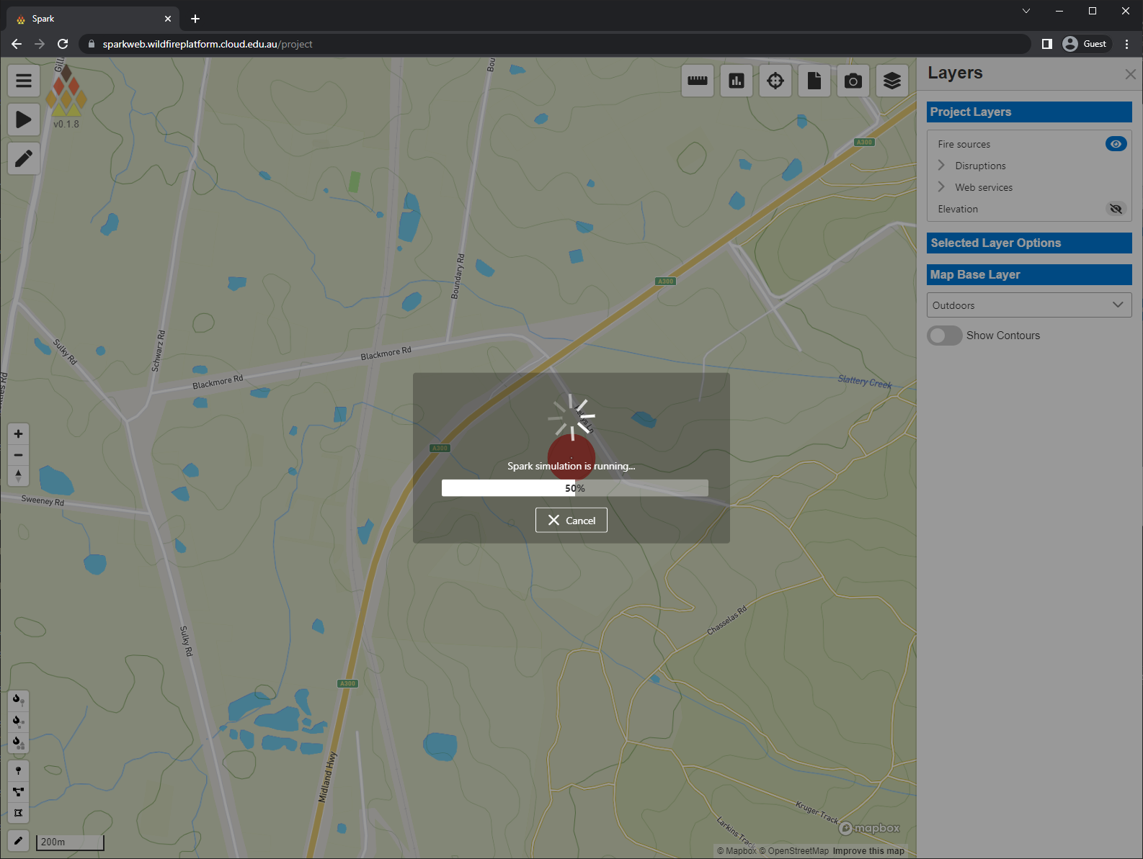
SparkWeb
Usage
Authentication required
Terms of use
Create a new project
  Projects must be named
  Pre-populated templates
Layer panel on right-hand side
Fire input conditions
  Tools on lower left
  Point tool
Basic simulation parameters
  Start date and time
  Time zone
  Simulation duration
  Simulation resolution
Project controls
  Run
  Save
  Download
Progress
  Any errors reported at this stage

Slide 20
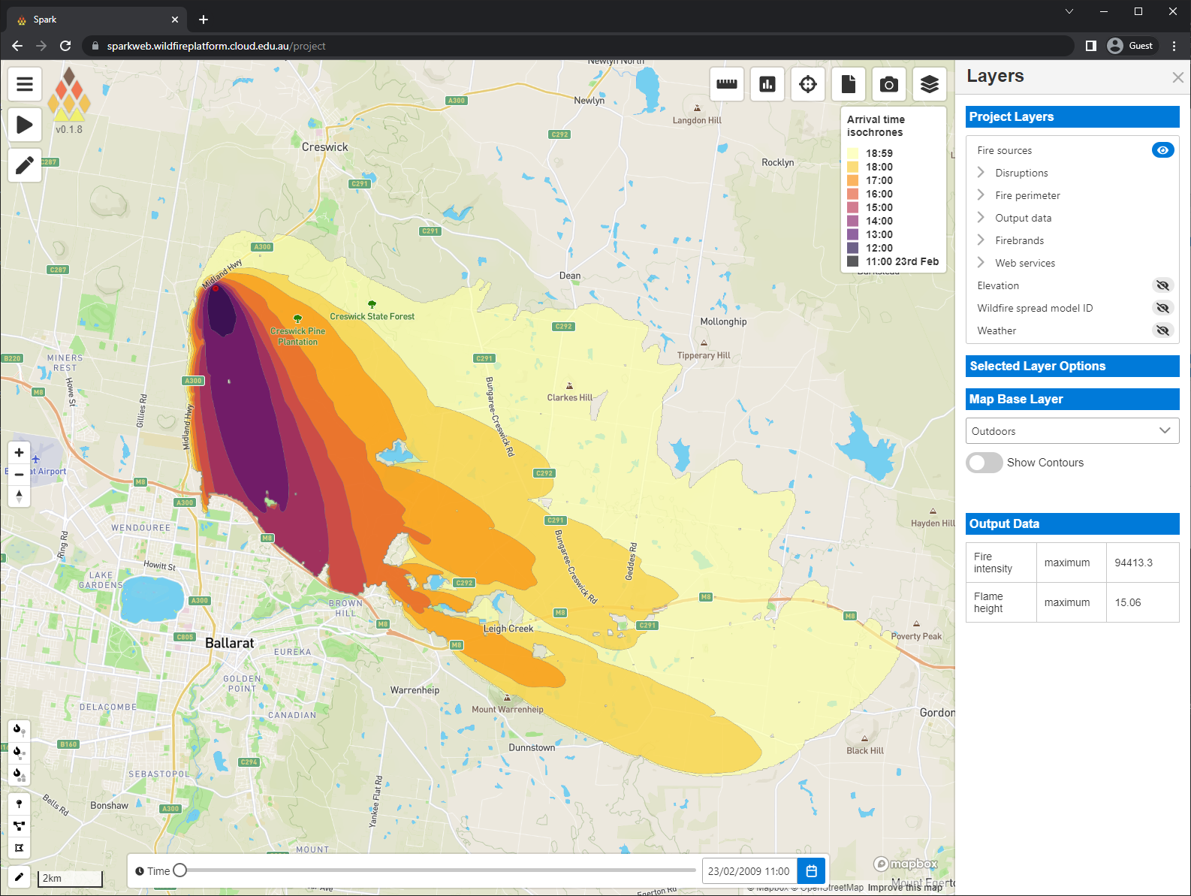
SparkWeb
Usage
Authentication required
Terms of use
Create a new project
  Projects must be named
  Pre-populated templates
Layer panel on right-hand side
Fire input conditions
  Tools on lower left
  Point tool
Basic simulation parameters
  Start date and time
  Time zone
  Simulation duration
  Simulation resolution
Project controls
  Run
  Save
  Download
Progress
  Any errors reported at this stage
Output of fire simulation
  Colours represent hourly progress

Slide 21
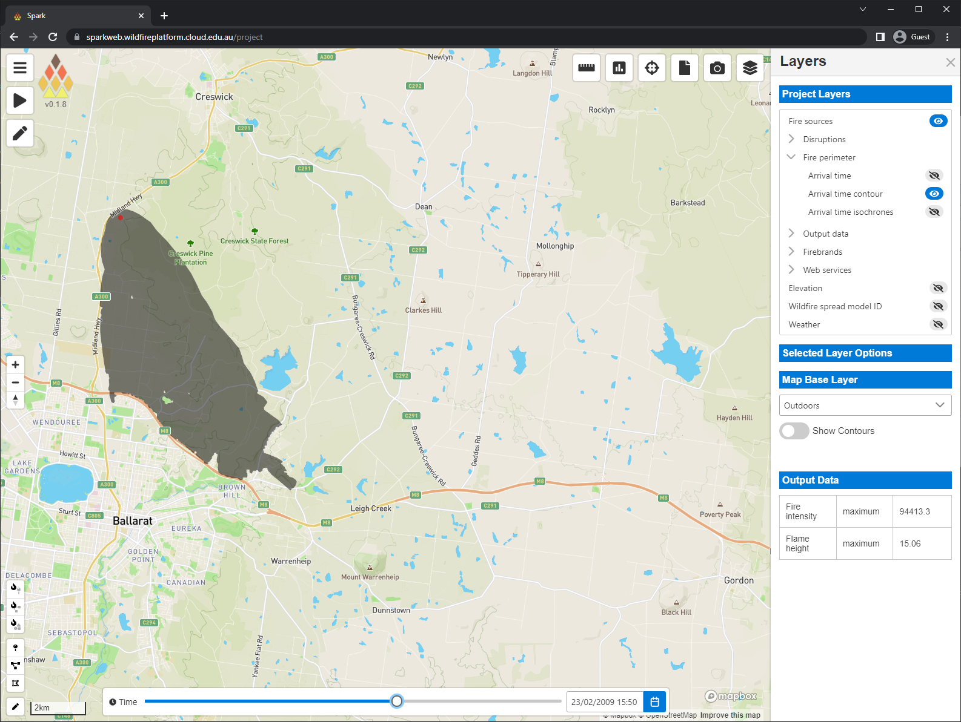
SparkWeb
Results and visualisation
Layers
  List on right-hand side
  Visibility controlled by view icons
Shaded fire contour
  Dynamic outline based on time slider

Slide 22
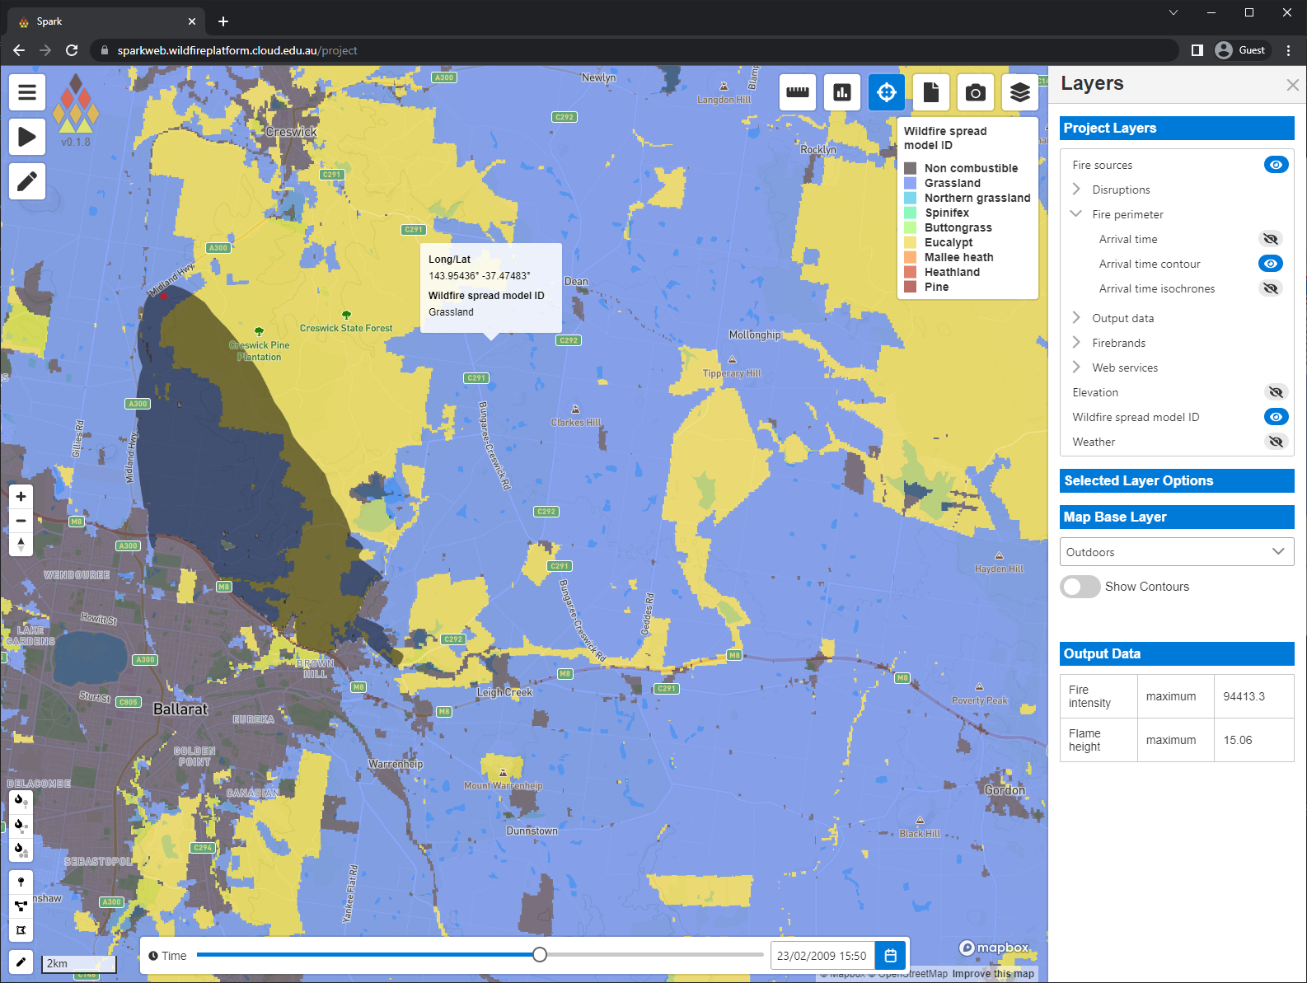
SparkWeb
Results and visualisation
Layers
  List on right-hand side
  Visibility controlled by view icons
Shaded fire contour
  Dynamic outline based on time slider
Wildfire model layer
  Cell evaluation using inspection tool
  Current value of all layers under mouse

Slide 23
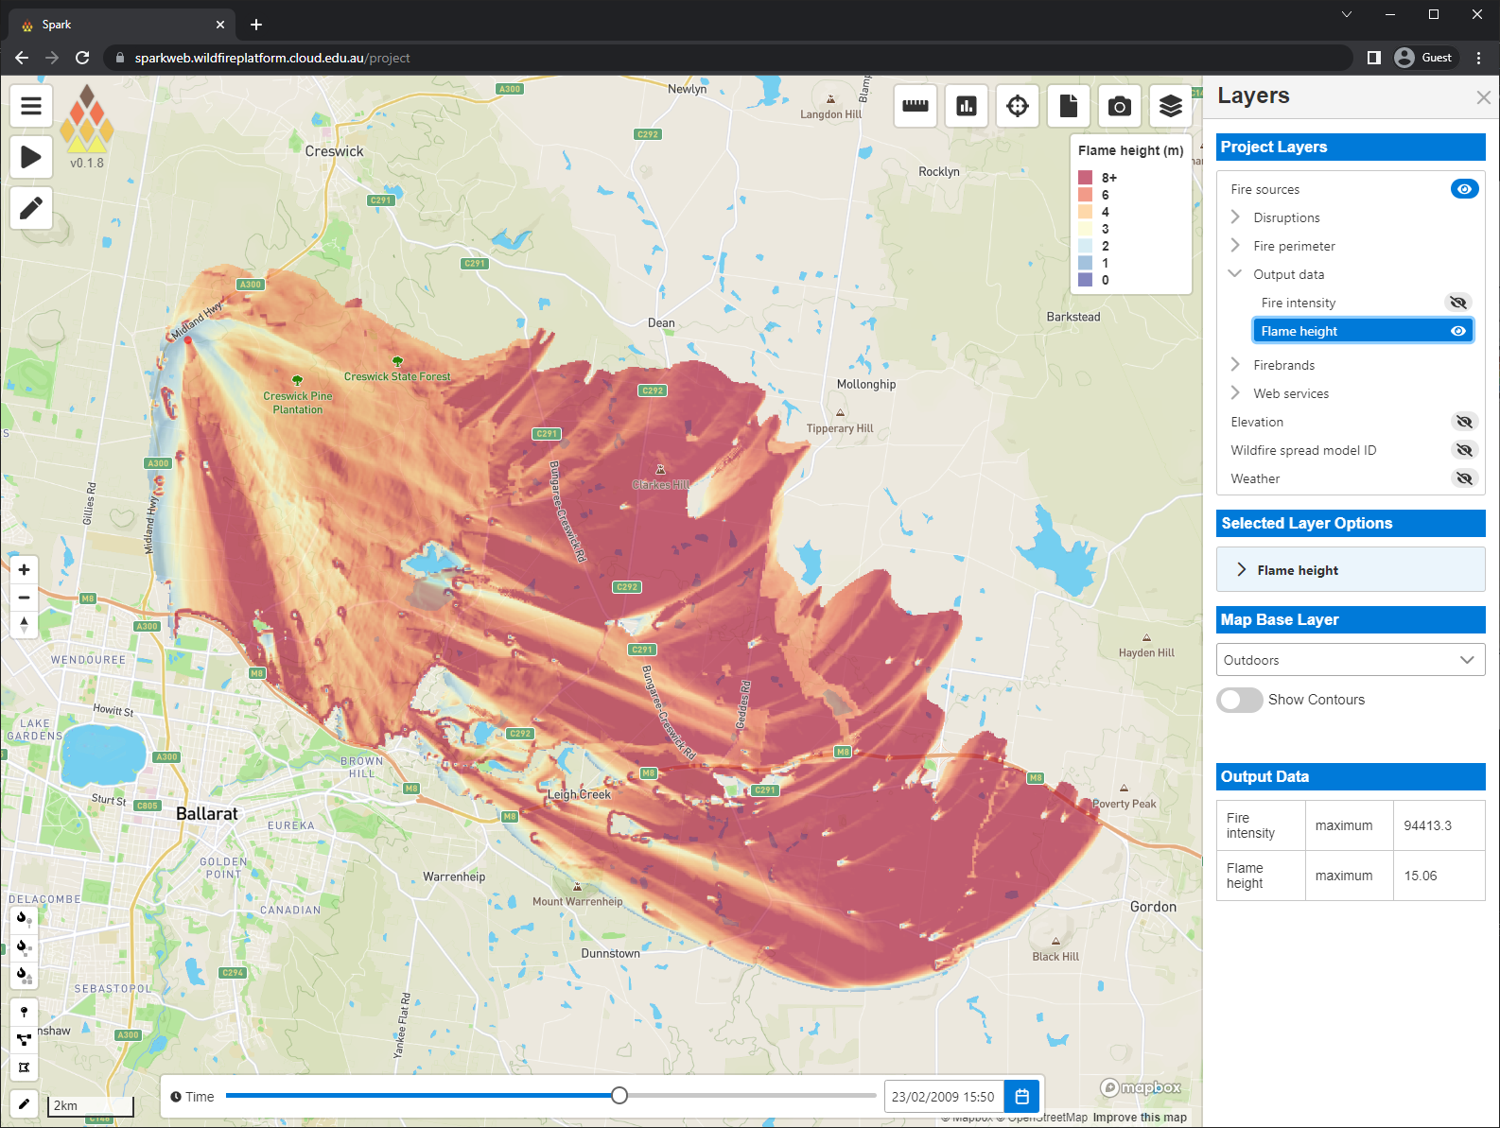
SparkWeb
Results and visualisation
Layers
  List on right-hand side
  Visibility controlled by view icons
Shaded fire contour
  Dynamic outline based on time slider
Wildfire model layer
  Cell evaluation using inspection tool
  Current value of all layers under mouse
Flame height layer

Slide 24
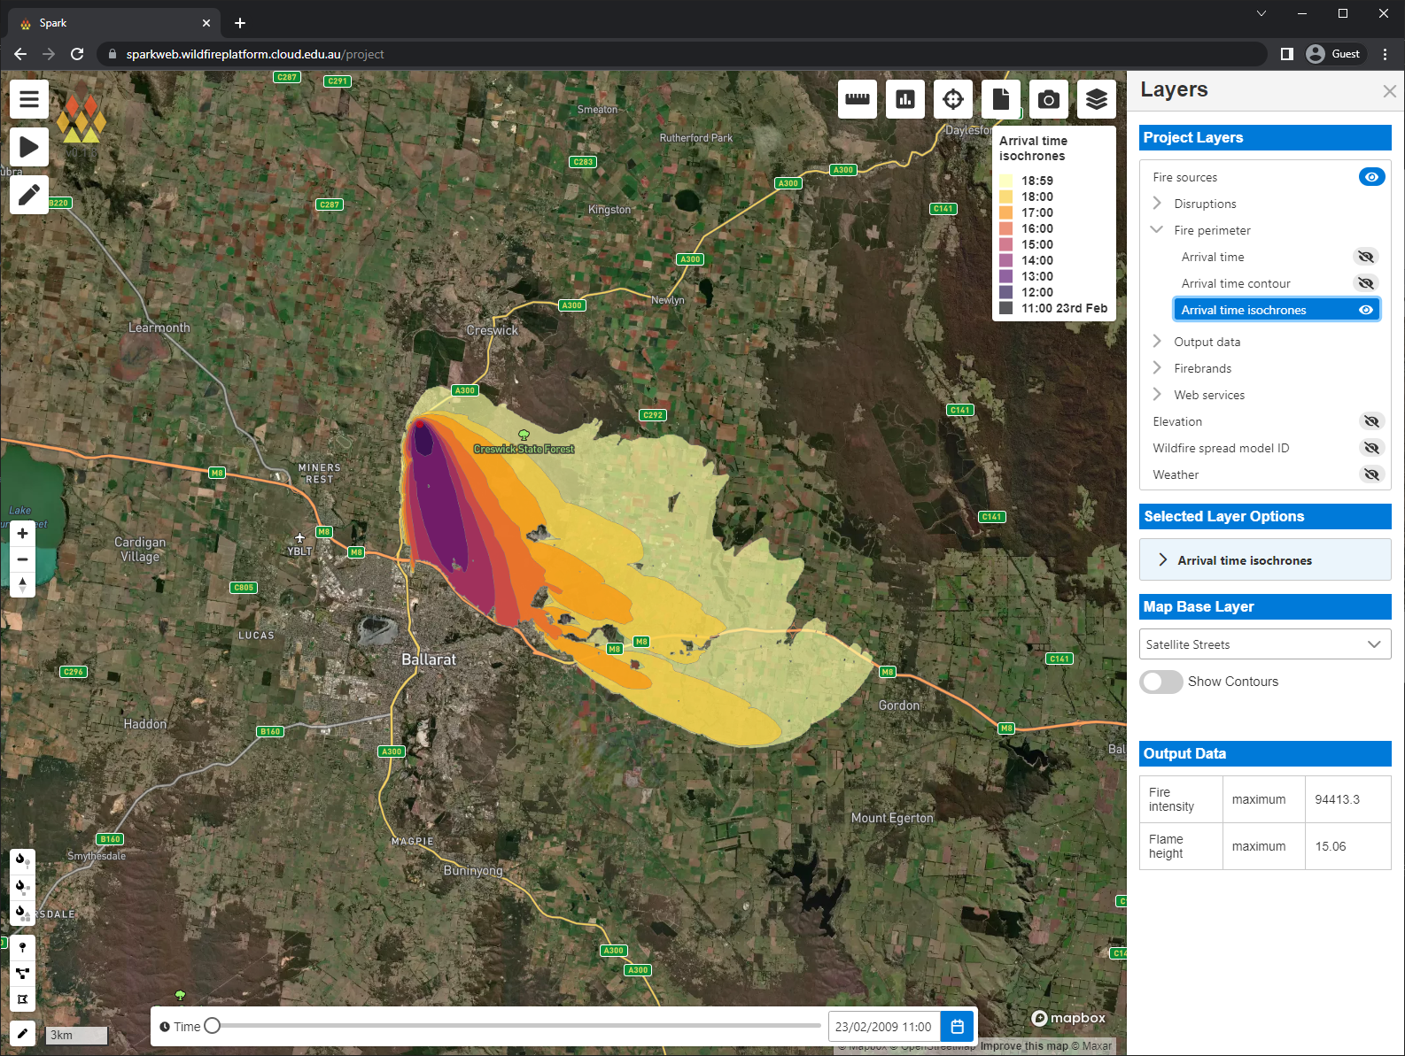
SparkWeb
Results and visualisation
Layers
  List on right-hand side
  Visibility controlled by view icons
Shaded fire contour
  Dynamic outline based on time slider
Wildfire model layer
  Cell evaluation using inspection tool
  Current value of all layers under mouse
Flame height layer
Base map
  Various base map options

Slide 25
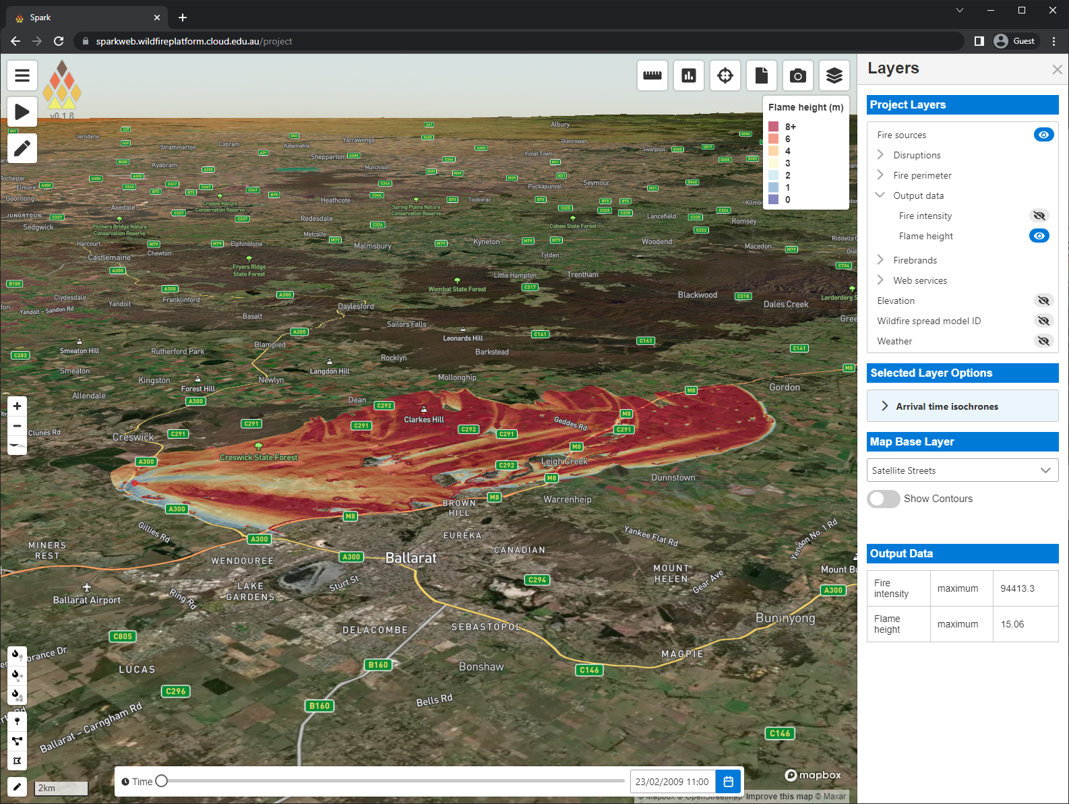
SparkWeb
Results and visualisation
Layers
  List on right-hand side
  Visibility controlled by view icons
Shaded fire contour
  Dynamic outline based on time slider
Wildfire model layer
  Cell evaluation using inspection tool
  Current value of all layers under mouse
Flame height layer
Base map
  Various base map options
3D view
  Right mouse or ctrl+left mouse to rotate view
  Mousewheel to zoom
  View reset using compass button

Slide 26
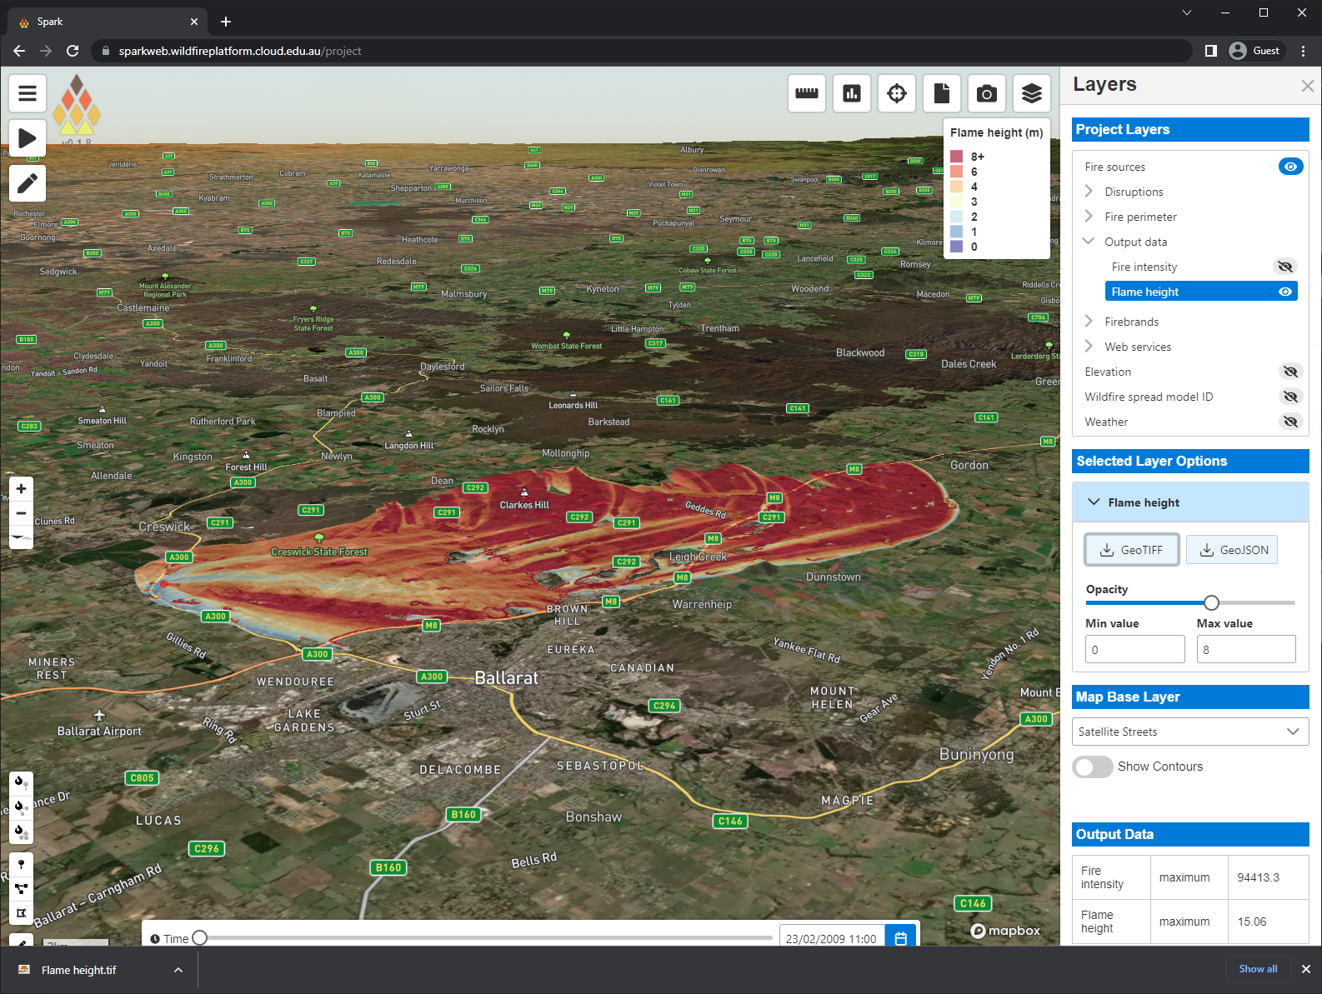
SparkWeb
Results and visualisation
Layers
  List on right-hand side
  Visibility controlled by view icons
Shaded fire contour
  Dynamic outline based on time slider
Wildfire model layer
  Cell evaluation using inspection tool
  Current value of all layers under mouse
Flame height layer
Base map
  Various base map options
3D view
  Right mouse or ctrl+left mouse to rotate view
  Mousewheel to zoom
  View reset using compass button
Layer options
  Layer download buttons
  Opacity slider
  Colour map
  Colour range
Layer download

Slide 27
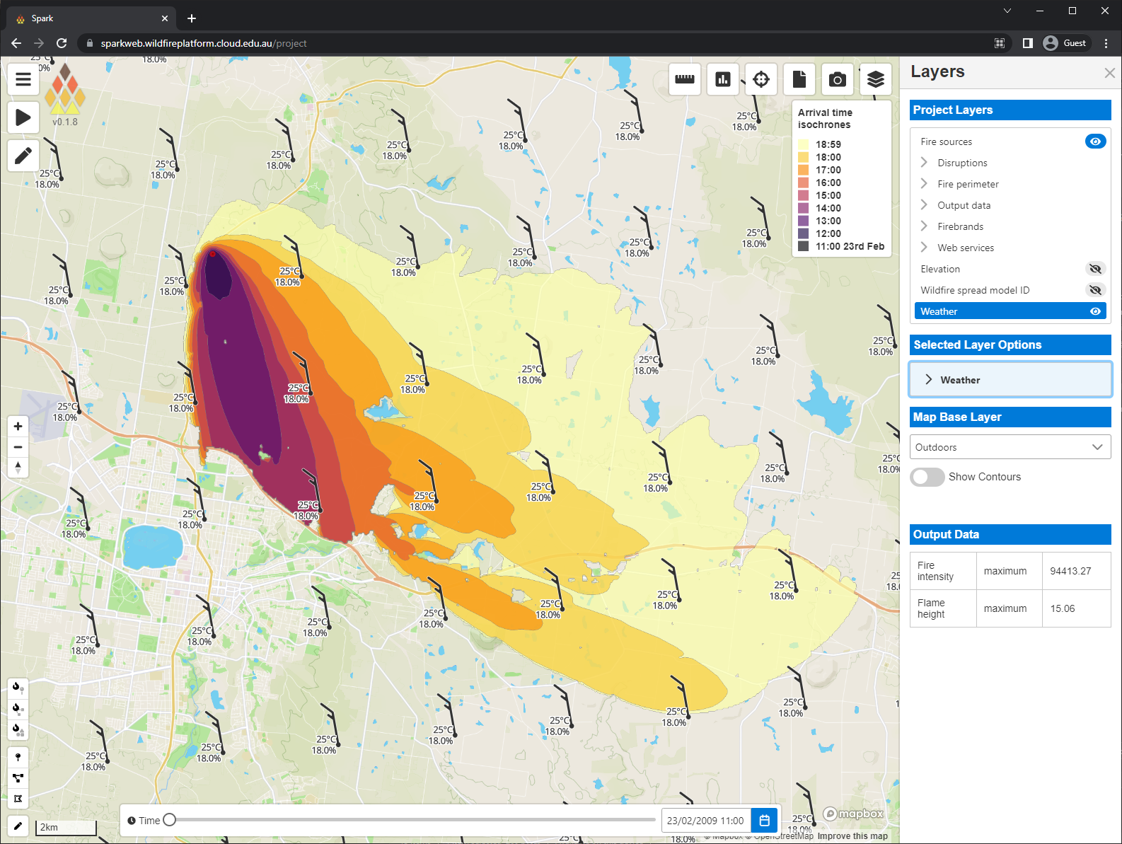
SparkWeb
Results and visualisation
Layers
  List on right-hand side
  Visibility controlled by view icons
Shaded fire contour
  Dynamic outline based on time slider
Wildfire model layer
  Cell evaluation using inspection tool
  Current value of all layers under mouse
Flame height layer
Base map
  Various base map options
3D view
  Right mouse or ctrl+left mouse to rotate view
  Mousewheel to zoom
  View reset using compass button
Layer options
  Layer download buttons
  Opacity slider
  Colour map
  Colour range
Layer download
Weather
  Changes with time slider

Slide 28
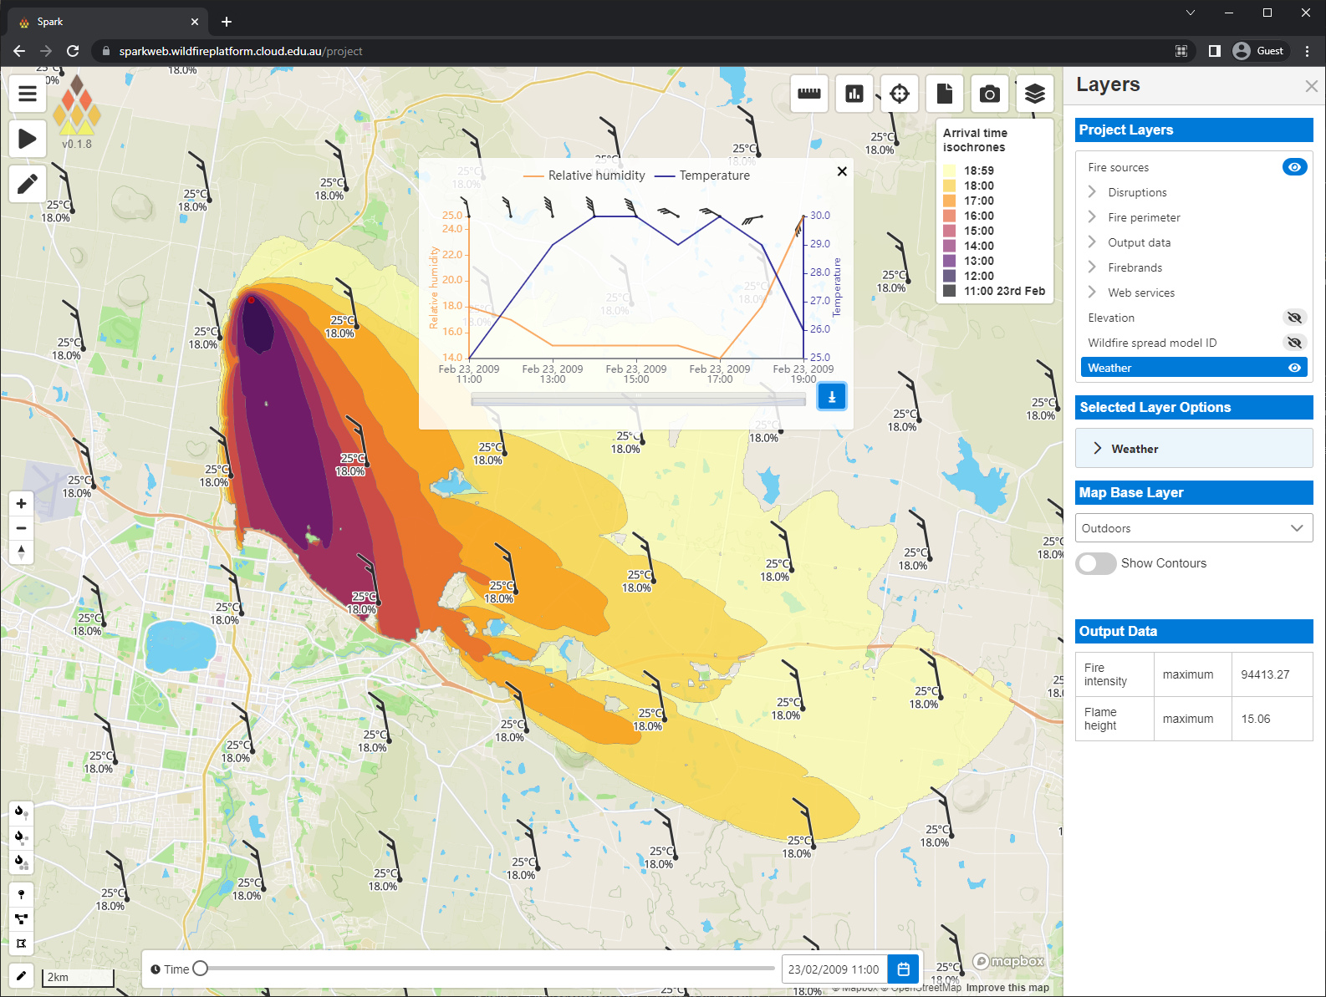
SparkWeb
Results and visualisation
Layers
  List on right-hand side
  Visibility controlled by view icons
Shaded fire contour
  Dynamic outline based on time slider
Wildfire model layer
  Cell evaluation using inspection tool
  Current value of all layers under mouse
Flame height layer
Base map
  Various base map options
3D view
  Right mouse or ctrl+left mouse to rotate view
  Mousewheel to zoom
  View reset using compass button
Layer options
  Layer download buttons
  Opacity slider
  Colour map
  Colour range
Layer download
Weather
  Changes with time slider
  Shows time series chart when icon is clicked

Slide 29
SparkWeb
Results and visualisation
Layers
  List on right-hand side
  Visibility controlled by view icons
Shaded fire contour
  Dynamic outline based on time slider
Wildfire model layer
  Cell evaluation using inspection tool
  Current value of all layers under mouse
Flame height layer
Base map
  Various base map options
3D view
  Right mouse or ctrl+left mouse to rotate view
  Mousewheel to zoom
  View reset using compass button
Layer options
  Layer download buttons
  Opacity slider
  Colour map
  Colour range
Layer download
Weather
  Changes with time slider
  Shows time series chart when icon is clicked
  Can be downloaded as a csv

Slide 30
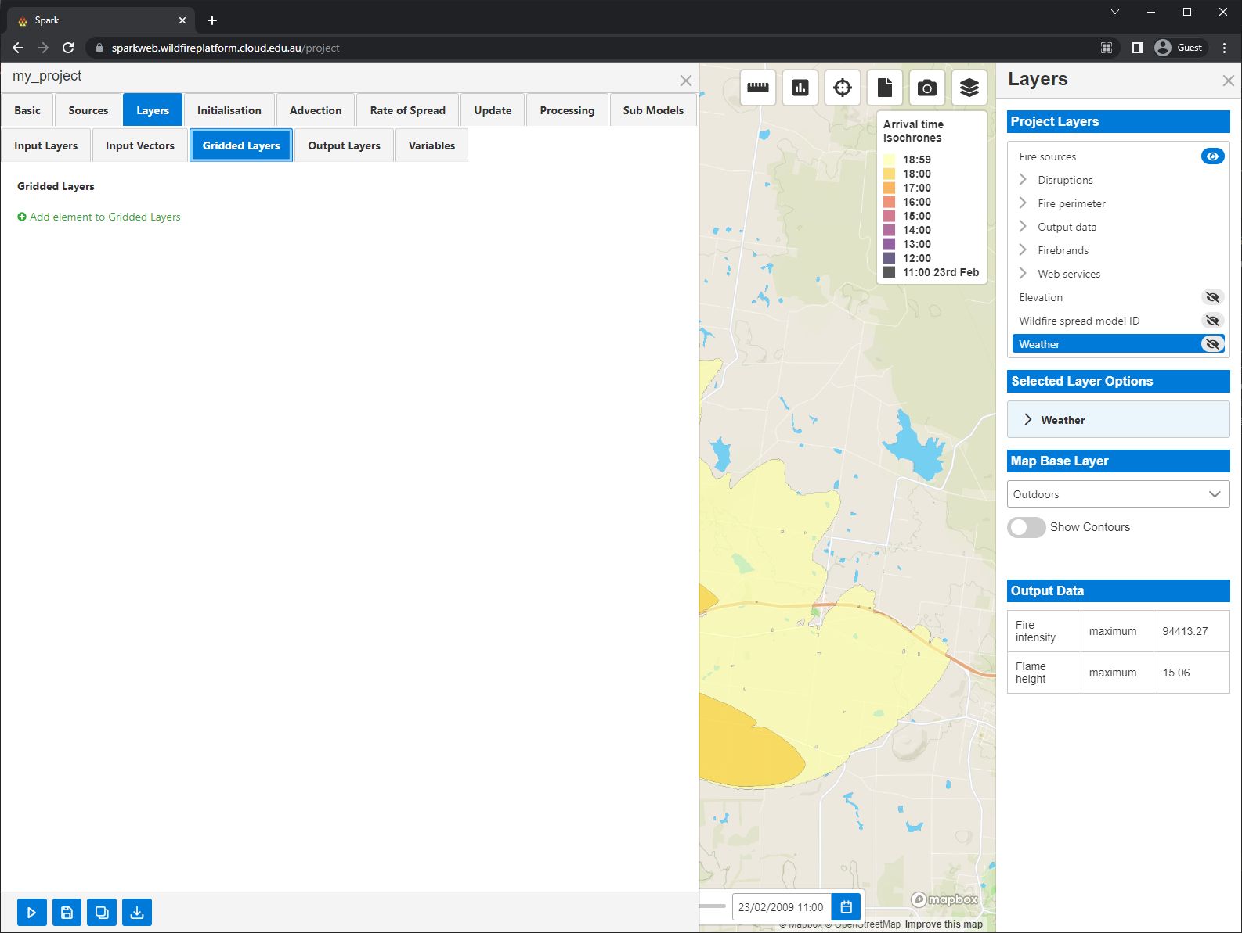
SparkWeb
Advanced usage
Weather inputs
  Spark requires whatever weather variables your rate of spread models use as inputs
  Generally wind speed and direction, relative humidity and temperature
  Could also include drought factor, dew temperature, curing
  Can be uploaded as a set of gridded netcdf files

Slide 31
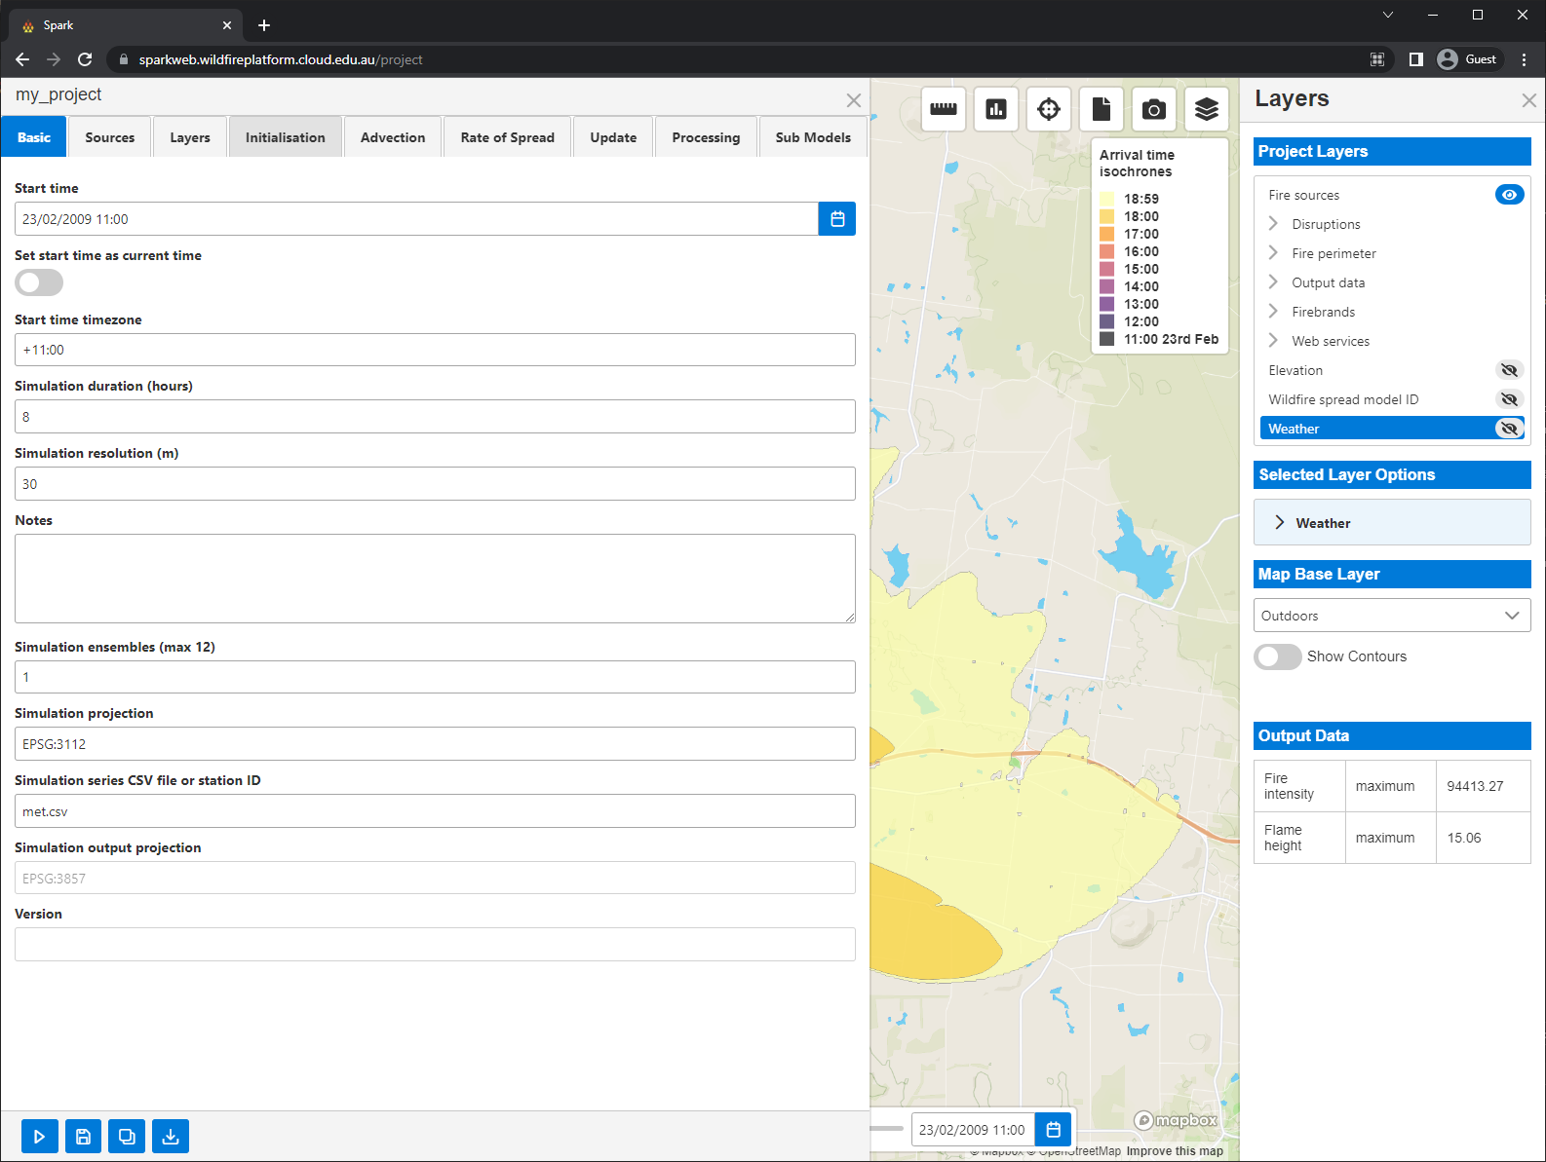
SparkWeb
Advanced usage
Weather inputs
  Spark requires whatever weather variables your rate of spread models use as inputs
  Generally wind speed and direction, relative humidity and temperature
  Could also include drought factor, dew temperature, curing
  Can be uploaded as a set of gridded netcdf files
  Or a suitable weather csv file can be dragged and dropped into the ‘Simulation series CSV’ input
  Example csv format:

Slide 32
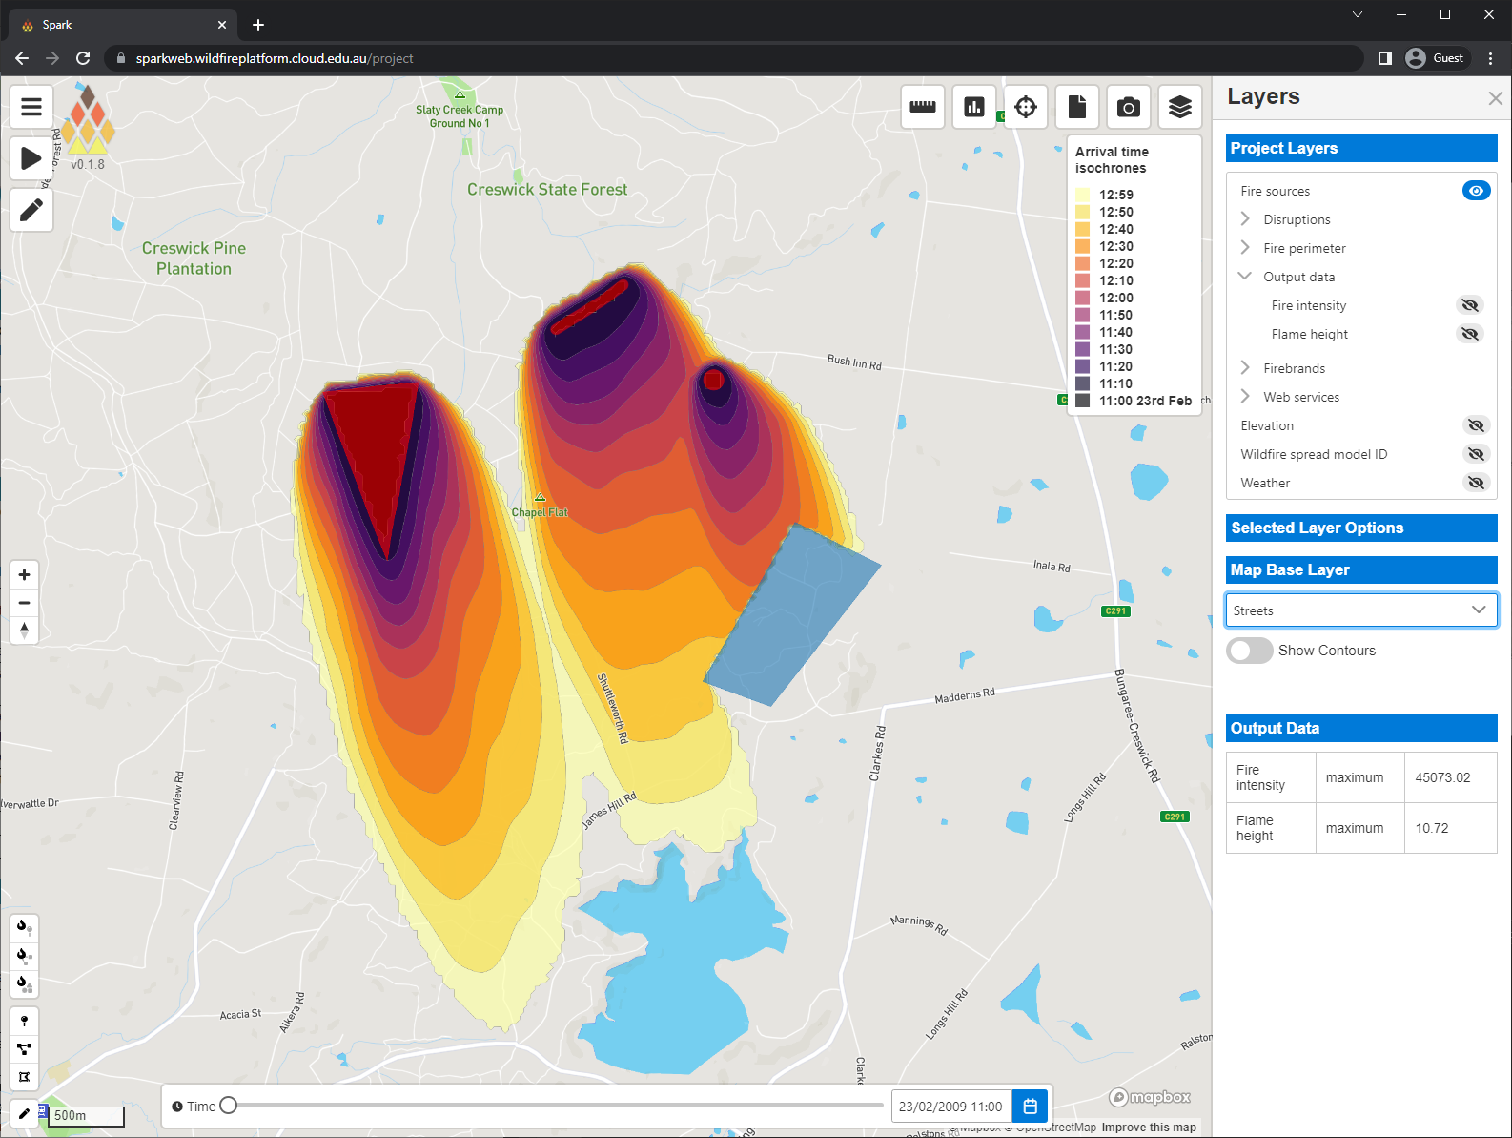
SparkWeb
Advanced usage
Input tools
  Point fire creation
  Line fire creation
  Polygon fire creation
  Mask (un-burnable) creation

Slide 33
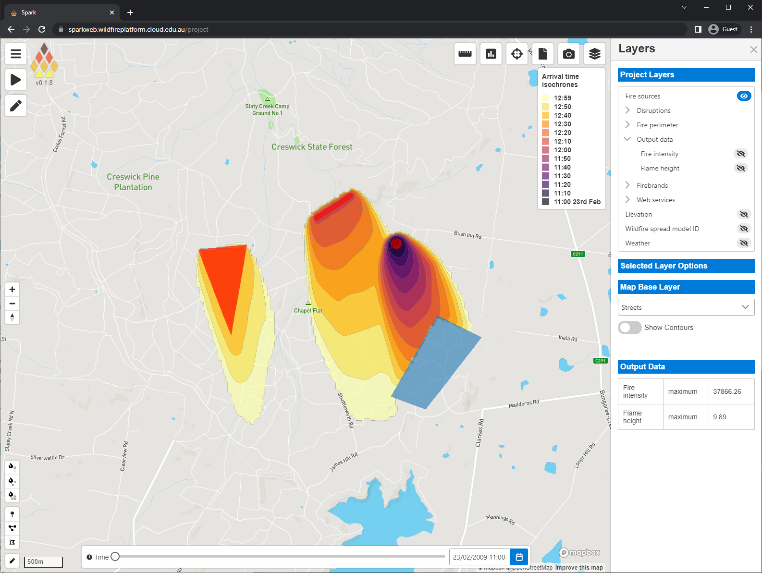
SparkWeb
Advanced usage
Input tools
  Point fire creation
  Line fire creation
  Polygon fire creation
  Mask (un-burnable) creation
Multiple geometries
  Different start times

Slide 34
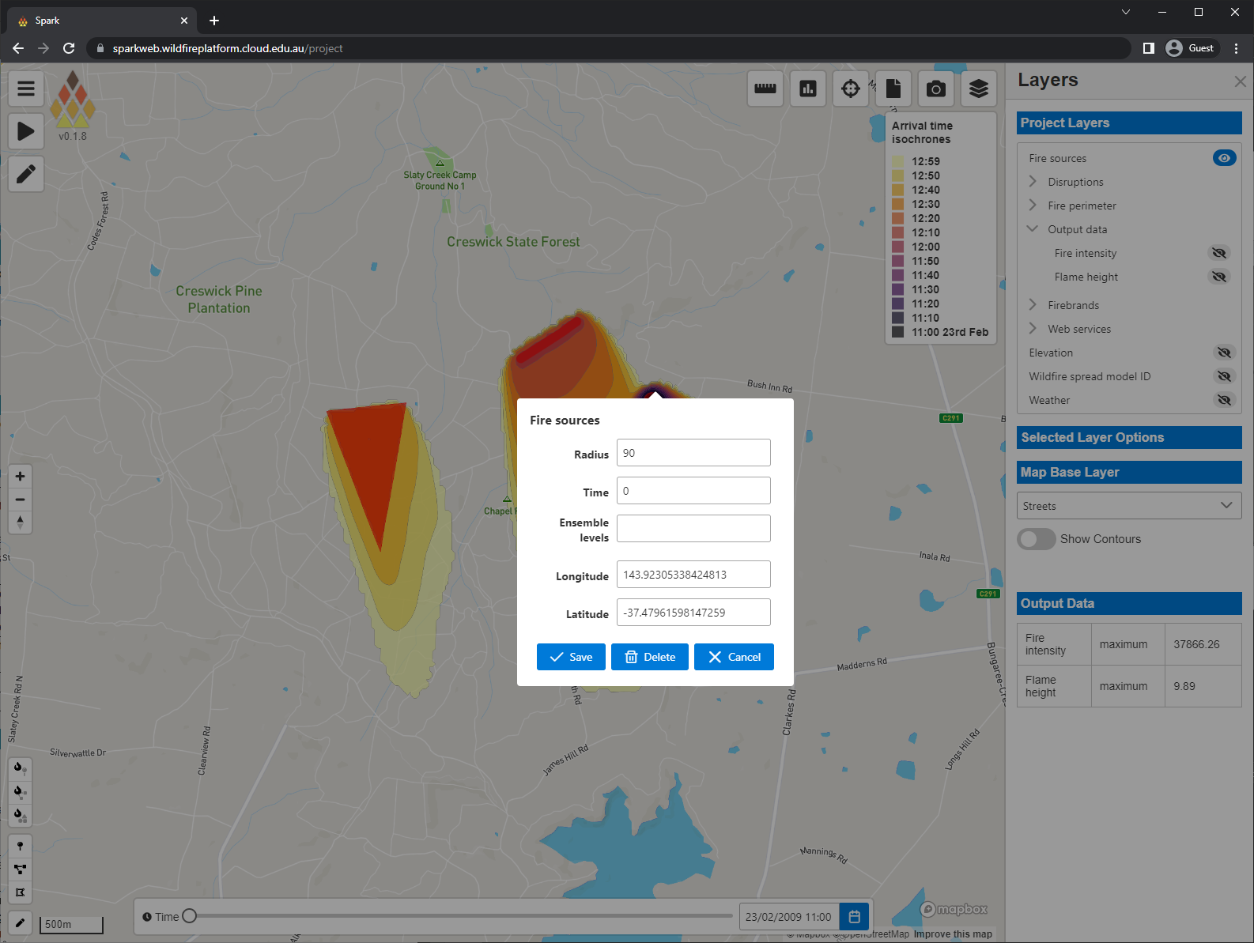
SparkWeb
Advanced usage
Input tools
  Point fire creation
  Line fire creation
  Polygon fire creation
  Mask (un-burnable) creation
Multiple geometries
  Different start times
  Left-click to configure
  Set geometry properties
  Set ignition time
  Set position

Slide 35
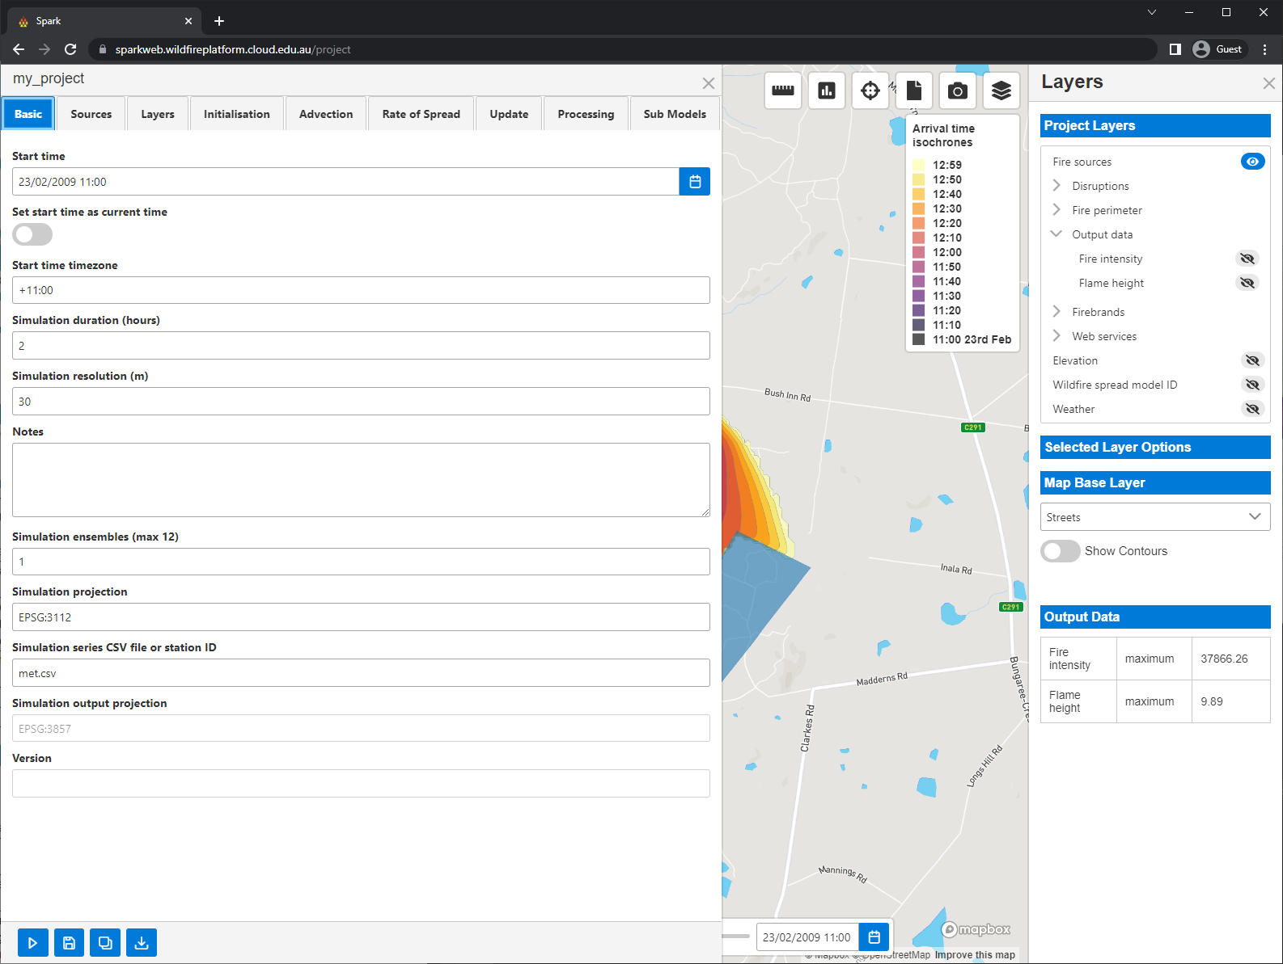
SparkWeb
Advanced usage
Advanced options
  All layers and options available

Slide 36
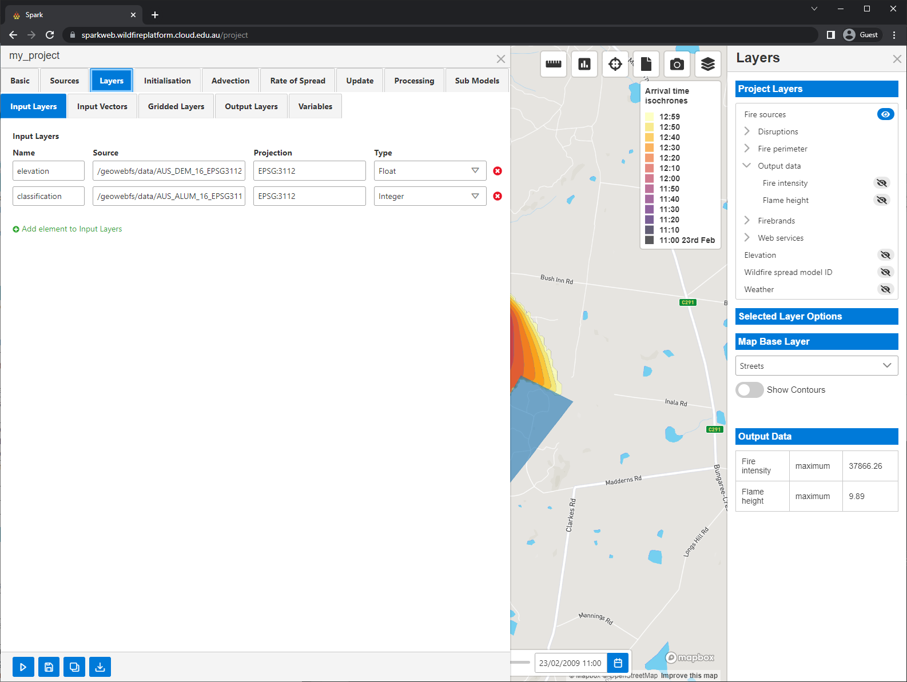
SparkWeb
Advanced usage
Advanced options
  All layers and options available
Layers

Slide 37
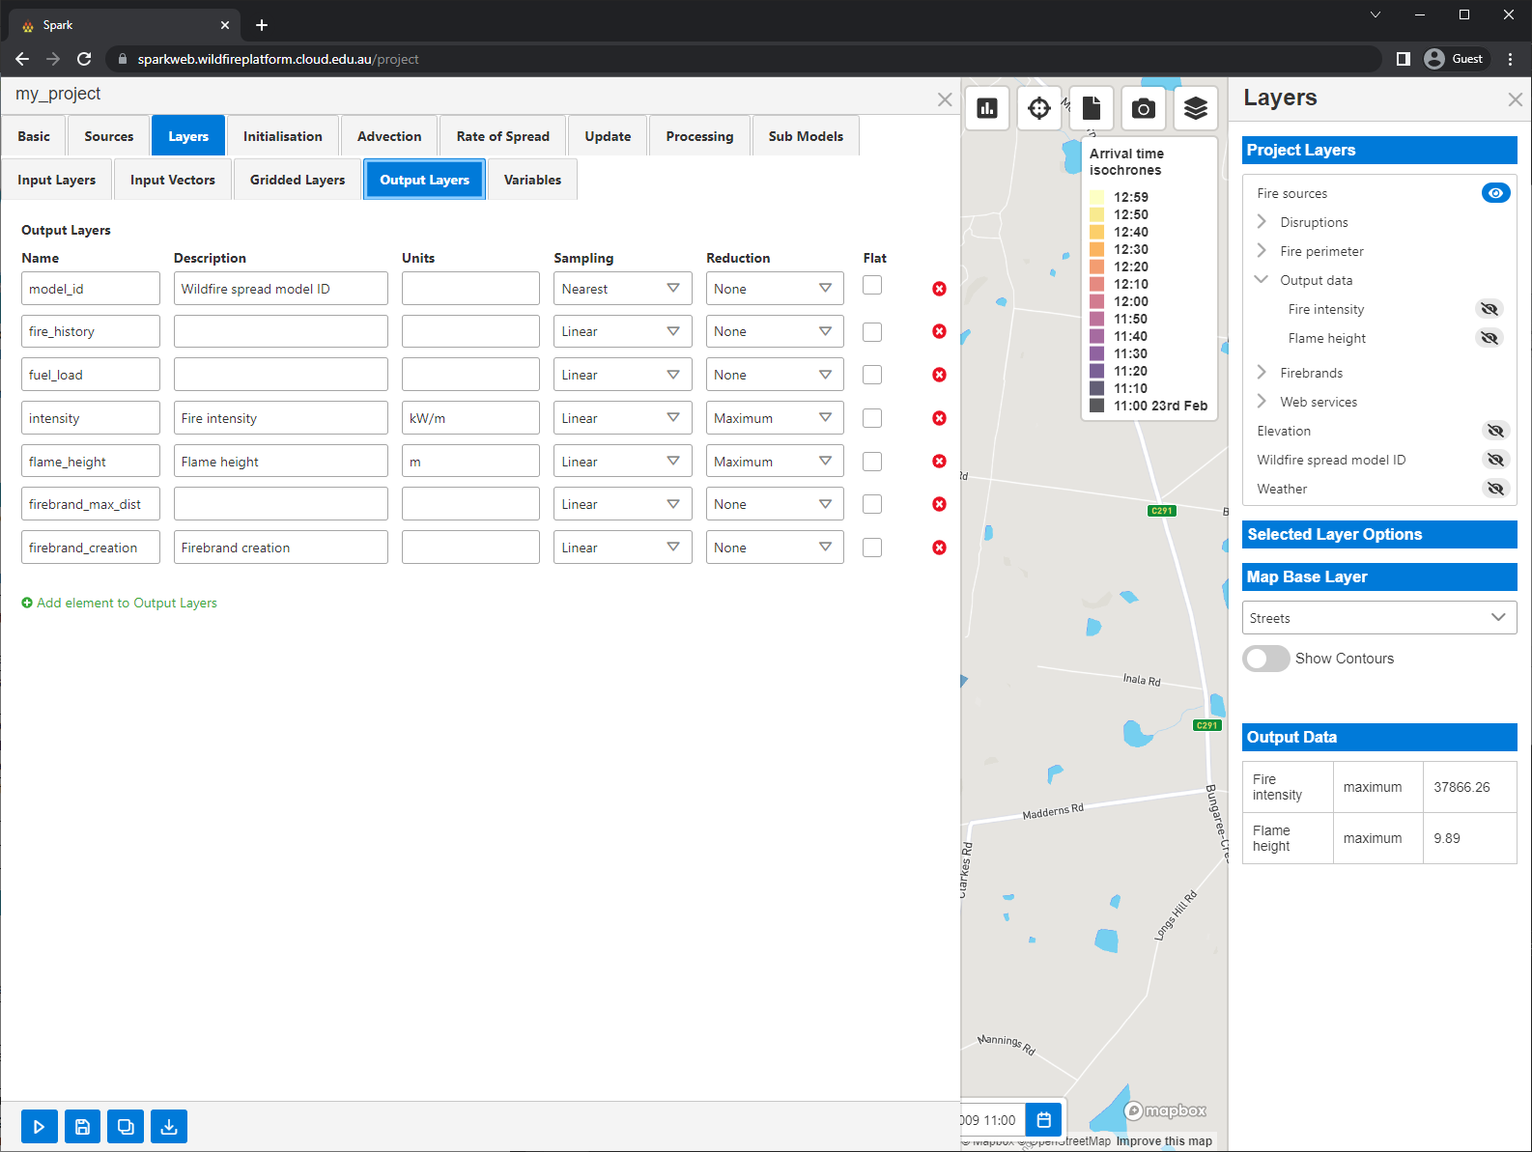
SparkWeb
Advanced usage
Advanced options
  All layers and options available
Layers
  Vector layers
  Gridded weather layers (NetCDF)
  Output layers, any with descriptions are visualised

Slide 38
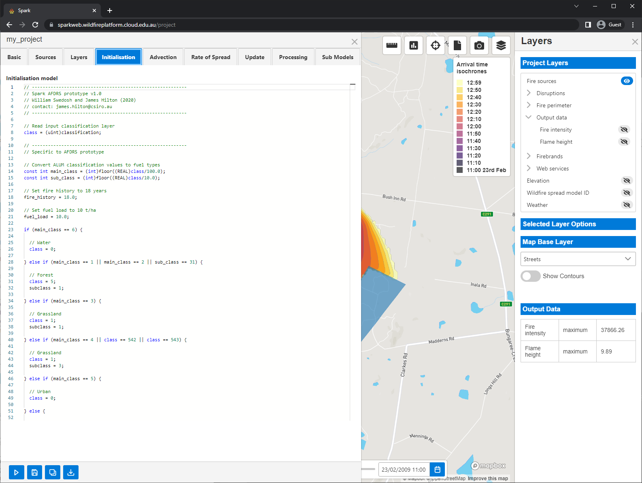
SparkWeb
Advanced usage
Advanced options
  All layers and options available
Layers
  Vector layers
  Gridded weather layers (NetCDF)
  Output layers, any with descriptions are visualised
Models
  Initialisation, run once per cell

Slide 39
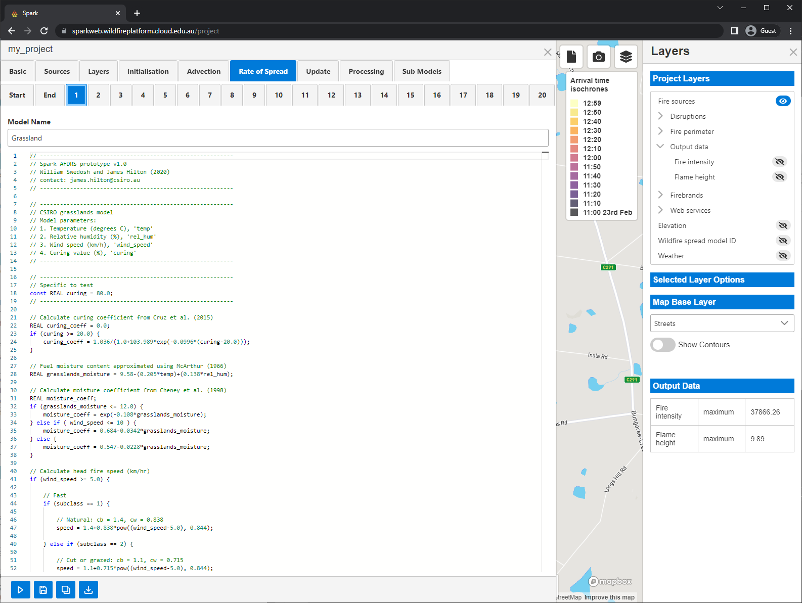
SparkWeb
Advanced usage
Advanced options
  All layers and options available
Layers
  Vector layers
  Gridded weather layers (NetCDF)
  Output layers, any with descriptions are visualised
Models
  Initialisation, run once per cell
  Advection, used to modify wind field
  Rate-of-spread, run to determine outward speed

Slide 40
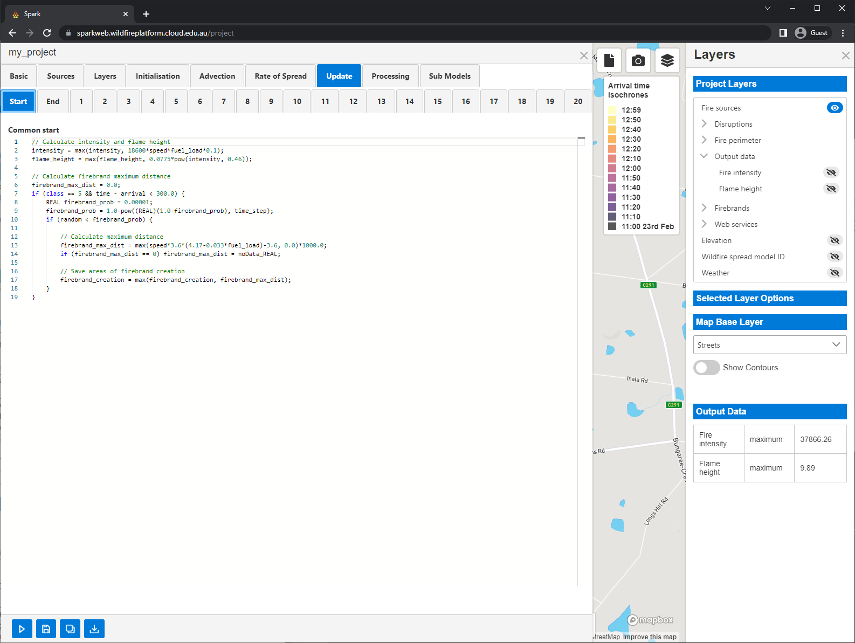
SparkWeb
Advanced usage
Advanced options
  All layers and options available
Layers
  Vector layers
  Gridded weather layers (NetCDF)
  Output layers, any with descriptions are visualised
Models
  Initialisation, run once per cell
  Advection, used to modify wind field
  Rate-of-spread, run to determine outward speed
  Update, run within burnt regions

Slide 41
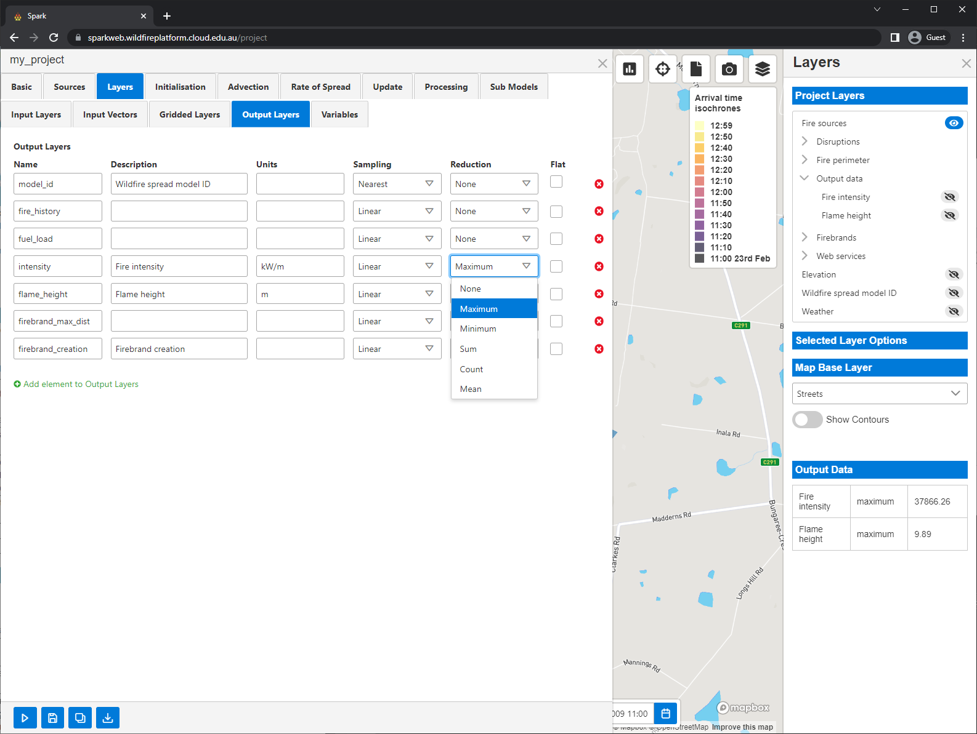
SparkWeb
Advanced usage
Advanced options
  All layers and options available
Layers
  Vector layers
  Gridded weather layers (NetCDF)
  Output layers, any with descriptions are visualised
Models
  Initialisation, run once per cell
  Advection, used to modify wind field
  Rate-of-spread, run to determine outward speed
  Update, run within burnt regions
Reductions
  Reduces output to single value
  Set per-layer
  Value shown in summary table

Slide 42
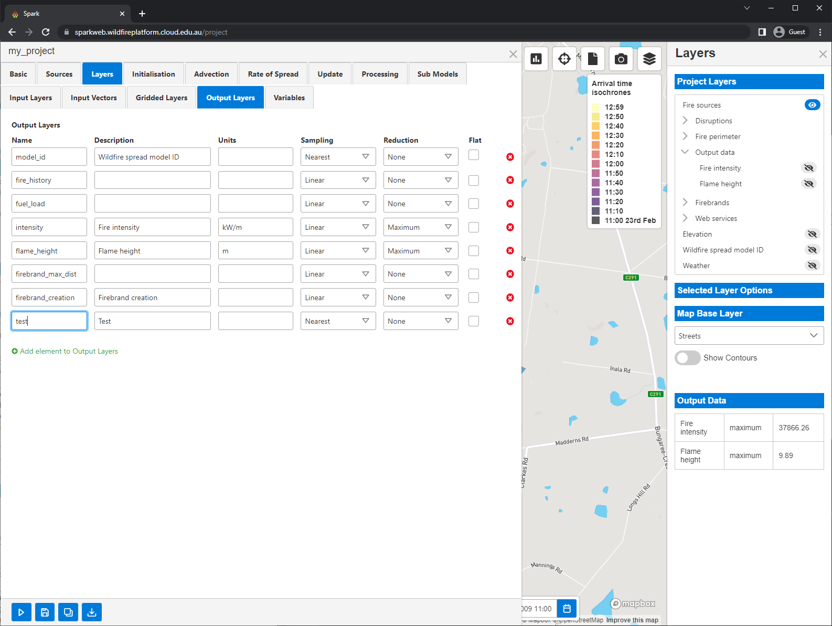
SparkWeb
Advanced usage
Layer creation
  Any number can be created
  Name available in model scripts for reading/writing
  Must have description to be visualised
  Example ‘test’ layer created called ‘Test’

Slide 43
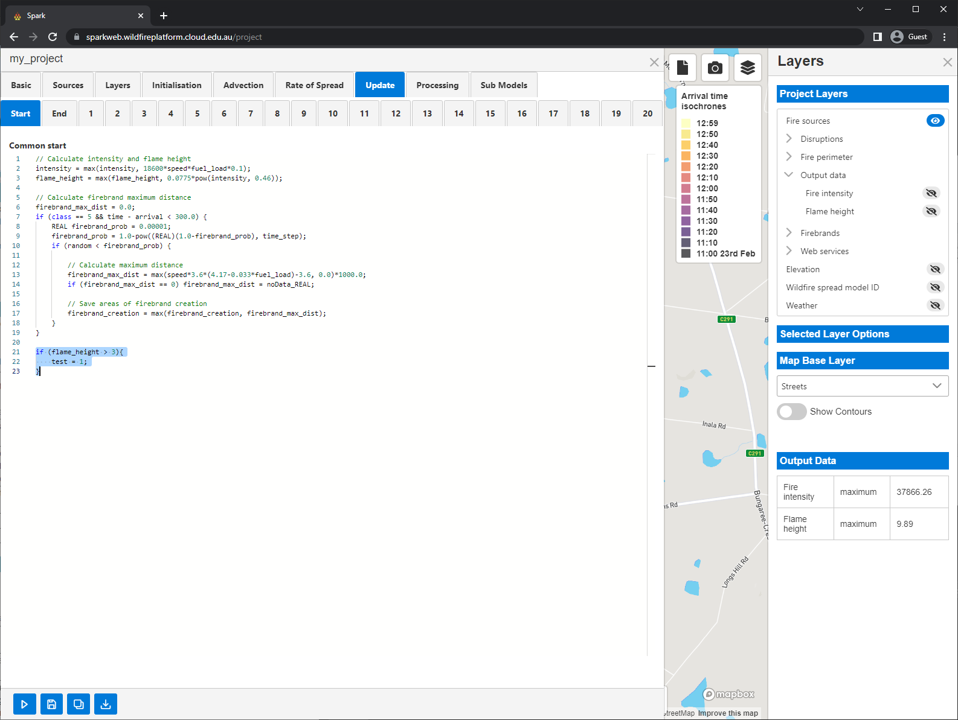
SparkWeb
Advanced usage
Layer creation
  Any number can be created
  Name available in model scripts for reading/writing
  Must have description to be visualised
  Example ‘test’ layer created called ‘Test’
Scripting
  Layer is written in update model
  Anywhere where flame height > 3 test is 1
  Elsewhere test is null

Slide 44

SparkWeb
Advanced usage
Layer creation
  Any number can be created
  Name available in model scripts for reading/writing
  Must have description to be visualised
  Example ‘test’ layer created called ‘Test’
Scripting
  Layer is written in update model
  Anywhere where flame height > 3 test is 1
  Elsewhere test is null
Visualisation
  Data from ‘Test’ shown in green after simulation is run again

Slide 45

SparkWeb
Advanced usage
Layer creation
  Any number can be created
  Name available in model scripts for reading/writing
  Must have description to be visualised
  Example ‘test’ layer created called ‘Test’
Scripting
  Layer is written in update model
  Anywhere where flame height > 1 test is 1
  Elsewhere test is null
Visualisation
  Data from ‘Test’ shown in green after simulation is run again
Errors
  Errors appear in a red box
  Script errors trigger ‘Spark simulation failed’
  Reported as a ‘clBuildProgram: -11’ exception
  We will make this more intelligible!
  The full error log is available in the API response

Slide 46

SparkWeb
Advanced usage
Rate-of-spread scripts
  Script for each fuel classification type
  Each type is an integer identifier ‘class’
  Zero is reserved for un-burnable
  Classes can be named

Slide 47

SparkWeb
Advanced usage
Rate-of-spread scripts
  Script for each fuel classification type
  Each type is an integer identifier ‘class’
  Zero is reserved for un-burnable
  Classes can be named
Example 1
  Script “speed = 0.5;”
  Sets outward speed to 0.5 m/s
  Resulting fire is circular

Slide 48

SparkWeb
Advanced usage
Rate-of-spread scripts
  Script for each fuel classification type
  Each type is an integer identifier ‘class’
  Zero is reserved for un-burnable
  Classes can be named
Example 1
  Script “speed = 0.5;”
  Sets outward speed to 0.5 m/s
  Resulting fire is circular
Example 2
  Script “speed = 0.1+0.02*wind;”
  Adds component in wind direction
  Resulting fire grows outwards and moves with wind

Slide 49

SparkWeb
Advanced usage
Firebrand model
  McArthur firebrand model
  Requires script to determine creation

Slide 50

SparkWeb
Advanced usage
Firebrand model
  McArthur firebrand model
  Requires script to determine creation
Sub models
  Currently only firebrand transport model
Firebrand model
  Models for all firebrand stages
  Creation script, sets new firebrand positions
  Initialisation script, creates firebrands
  Advection model, controls air flow
  Update model, controls firebrand changes
  Transport model, controls interaction with air flow
  Basic spot fire creation only required one model

Slide 51

SparkWeb
Advanced usage
Firebrand model
  McArthur firebrand model
  Requires script to determine creation
Sub models
  Currently only firebrand transport model
Firebrand model
  Models for all firebrand stages
  Creation script, sets new firebrand positions
  Initialisation script, creates firebrands
  Advection model, controls air flow
  Update model, controls firebrand changes
  Transport model, controls interaction with air flow
  Basic spot fire creation only required one model
Visualisation
  Firebrands which cause spot fires are visualised with yellow lines from generation to landing points

Slide 52

SparkWeb
Advanced usage
Uploading user data layers
  Note, the wildfire platform is currently open. Do not upload any sensitive data as other users will be able to use it. Please use specific filenames to ensure no duplicates (e.g. MY_USER_land_classification_EPSG_XXXX_v1.tiff)

Slide 53

SparkWeb
Advanced usage
Uploading user data layers
  Note, the wildfire platform is currently open. Do not upload any sensitive data as other users will be able to use it. Please use specific filenames to ensure no duplicates (e.g. MY_USER_land_classification_EPSG_XXXX_v1.tiff)
  File is uploaded with the path: /geowebfs/uploads/FILENAME
  Input the correct projection and data type as well as a name which can be referred to in the model scripts.

Slide 54

SparkWeb
Advanced usage
Uploading user data layers
  Note, the wildfire platform is currently open. Do not upload any sensitive data as other users will be able to use it. Please use specific filenames to ensure no duplicates (e.g. MY_USER_land_classification_EPSG_XXXX_v1.tiff)
  File is uploaded with the path: /geowebfs/uploads/FILENAME
  Input the correct projection and data type as well as a name which can be referred to in the model scripts.
Visualising user data layers
  Create an output layer

Slide 55

SparkWeb
Advanced usage
Uploading user data layers
  Note, the wildfire platform is currently open. Do not upload any sensitive data as other users will be able to use it. Please use specific filenames to ensure no duplicates (e.g. MY_USER_land_classification_EPSG_XXXX_v1.tiff)
  File is uploaded with the path: /geowebfs/uploads/FILENAME
  Input the correct projection and data type as well as a name which can be referred to in the model scripts.
Visualising user data layers
  Create an output layer
  Write to the output in a model script

Slide 56

SparkWeb
Advanced usage
Uploading user data layers
  Note, the wildfire platform is currently open. Do not upload any sensitive data as other users will be able to use it. Please use specific filenames to ensure no duplicates (e.g. MY_USER_land_classification_EPSG_XXXX_v1.tiff)
  File is uploaded with the path: /geowebfs/uploads/FILENAME
  Input the correct projection and data type as well as a name which can be referred to in the model scripts.
Visualising user data layers
  Create an output layer
  Write to the output in a model script
  Run simulation again to view output
  Your layer name can be used in Initialisation, Rate of Spread and Update models

Slide 57
SparkWeb
Advanced usage
Uploading user data layers
  Note, the wildfire platform is currently open. Do not upload any sensitive data as other users will be able to use it. Please use specific filenames to ensure no duplicates (e.g. MY_USER_land_classification_EPSG_XXXX_v1.tiff)
  File is uploaded with the path: /geowebfs/uploads/FILENAME
  Input the correct projection and data type as well as a name which can be referred to in the model scripts.
Visualising user data layers
  Create an output layer
  Write to the output in a model script
  Run simulation again to view output
  Your layer name can be used in Initialisation, Rate of Spread and Update models

Slide 58

SparkWeb
Spark server
Web API
  Services calls from SparkWeb
  Can be called directly to run simulations/serve outputs
  All models sent to server

Slide 59


SparkWeb
Spark server
Web API
  Services calls from SparkWeb
  Can be called directly to run simulations/serve outputs
  All models sent to server
API calls
  Documentation and examples available
  /spark - Initialise solver
  /spark/sources – Set sources (geojson)
  /spark/initialise_solver – Initialise solver
  /spark/run_solver – Run solver
  /spark/process_output – Custom post-processing
  /spark/raster_output – Get gridded output (tiff/json)
  /spark/vector_output – Get vector output (shp/geojson)
  Success codes 200/201

Slide 60
SparkWeb
Spark server
Web API
  Services calls from SparkWeb
  Can be called directly to run simulations/serve outputs
  All models sent to server
API calls
  Documentation and examples available
  /spark - Initialise solver
  /spark/sources – Set sources (geojson)
  /spark/initialise_solver – Initialise solver
  /spark/run_solver – Run solver
  /spark/process_output – Custom post-processing
  /spark/raster_output – Get gridded output (tiff/json)
  /spark/vector_output – Get vector output (shp/geojson)
  Success codes 200/201
requests.post(f"http://localhost:{port}/spark/sources", headers=headers, json={
"sources" : {
"features" : [
{
"geometry" : {
"coordinates" : [ 150.342, -33.6 ],
"type" : "Point"
},
"properties" : {
"radius" : 120,
"time" : 0
},
"type" : "Feature"
}
],
"type" : "FeatureCollection"
}
})

