Slide 1
Biometrics-based Recognition System on Wearable Devices
Weitao Xu
University of Queensland
Supervisor: Prof. Neil Bergmann
Dr. Wen Hu
Notes:
Good afternoon, everyone, welcome to attend this seminar. My name’s weitao, and I’m a PhD student from University of Queensland. Currently, I’m visiting UNSW. Today, I’m going to talk about my research about the topic biometrics-based recognition system on wearable devices.

Slide 2
Outline
Introduction
Project 1-Face recognition
Project 2-Key generation
Project 3-Gait recognition
Conclusion
Notes:
Here is the outline of this talk. First I’ll introduce the background. Then I would like to introduce my three biometrics-based recognition systems respectively. They are face recognition, key generation and gait recognition. Finally I will conclude this presentation.

Slide 3
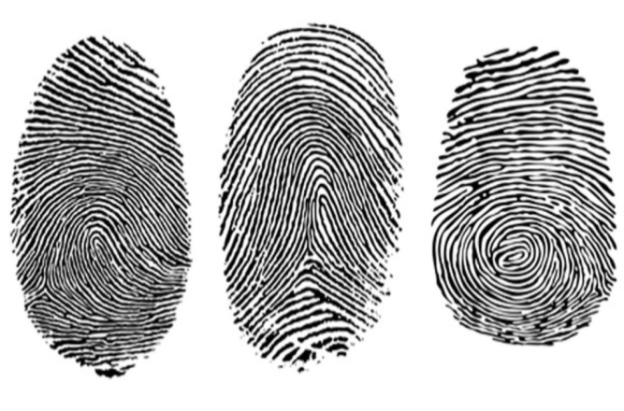

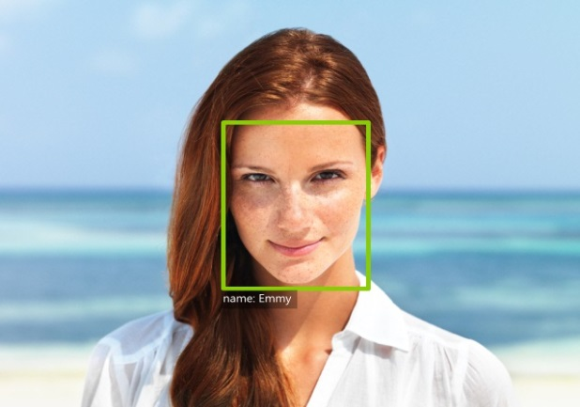
What is biometrics?
Introduction
The user’s behavioral or physiological characteristics
to determine or verify an identity.
Fingerprint
Handwritten signature
Face
Notes:
What is biometrics? Biometrics refers to our behavioral or physiological characteristics such as our fingerprint, signature and face.

Slide 4
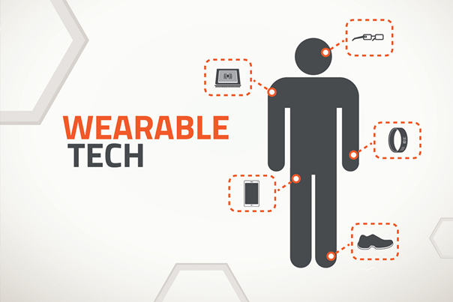
Introduction
Wearable devices
  Smart watch
  Smart glass
  Smart wristband
Notes:
With the development of technology, wearable devices such as smart watch and smart glass is becoming more and more popular. They will play a significant role in our daily life.

Slide 5
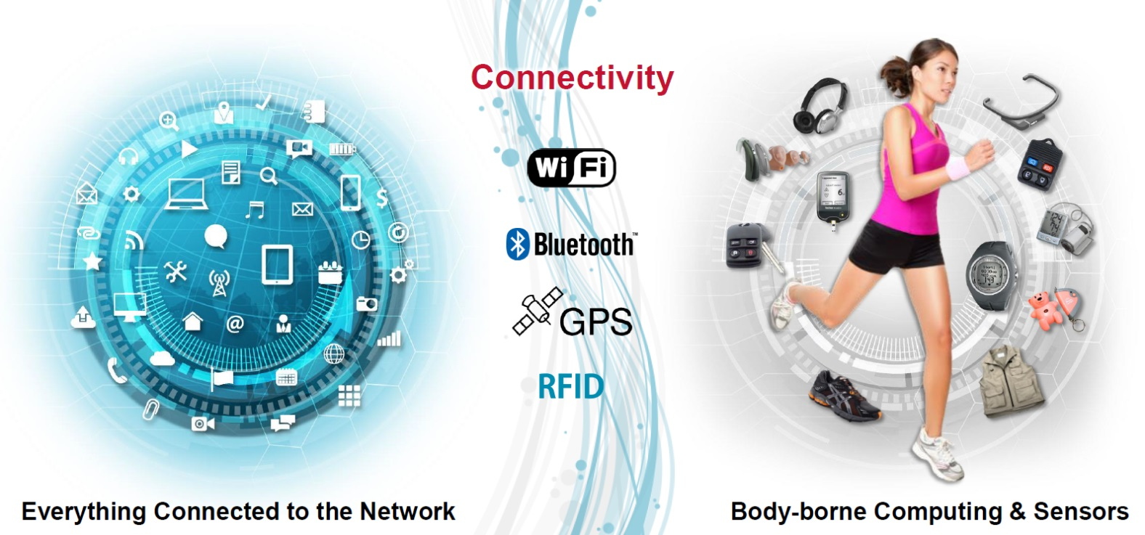
Introduction
Sensors
  Accelerometer
  Gyroscope
  Compass
  Camera
  Micphone
  GPS
  Bluetooth
Applications
  Navigation
  Localization
  Health monitoring
  Tracking
  Remote control
Notes:
Wearable devices usually equip with a variety of sensors like accelerometer, gyroscope, camera and so on. These sensors can help wearable devices enable a wide range of applications such as navigation and localization.

Slide 6
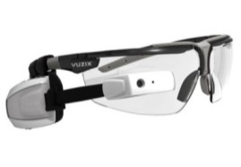
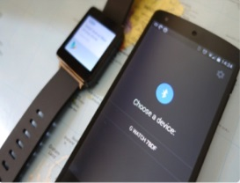
Research projects
Biometrics
1
face recognition on smartglass
2
Key generation system for wearable devices
Wearable device
3
Gait recognition system using energy harvester
Notes:
My research projects focus on inventing novel systems on wearable devices using biometrics. So far I’ve completed three research projects: face recognition on smartglass. Key generation system for wearable devices. Gait recognition system using energy harvester. Next, I will discuss these three projects in turn.

Slide 7
Research project 1
Sensor-assisted face recognition system on smartglass

Slide 8
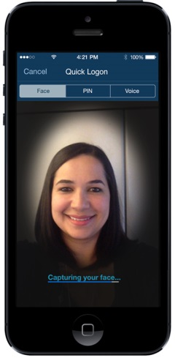
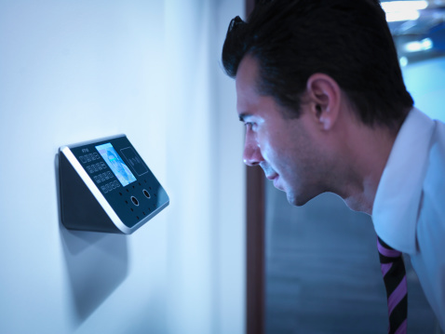
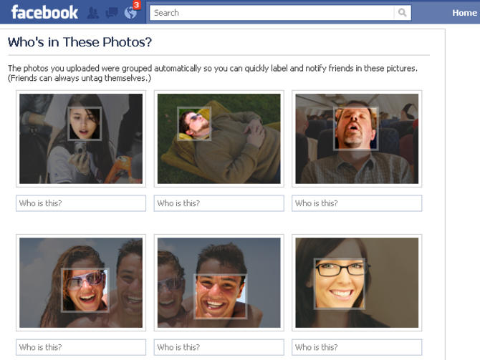
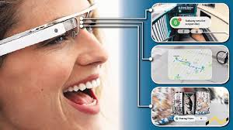
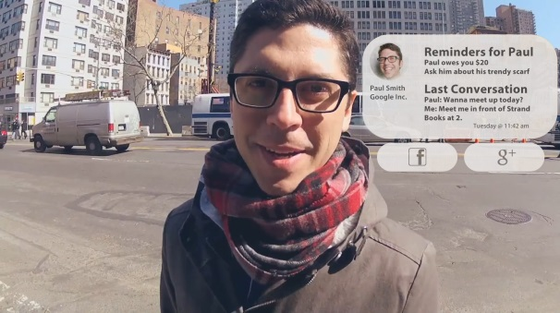
Background
Face recognition
Smart glasses: a “third eye”
Security
Friends Tagging
Face Unlock
Notes:
Face recognition is a popular research topic and has been studied for decades. It has been widely applied in our daily lifes, such as security, friends tagging and face unlock. With the advent of smart glass, we believe that face recognition on smartglass can improve the user experience significantly as smart glass can be used as a third eye. So our goal is to build a face recognition system on smart glass.

Slide 9


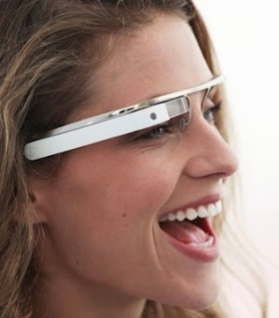
Main Challenges
Challenges
Short battery life
Limited processing capability
Possible Solution
Depend on cloud architecture
Wireless transmission is expensive
Our goal
Robust and efficient in-situ face recognition system on smart glass
Notes:
However, there are several challenges. The smart glass has short battery life and limited processing ability. A possible solution is offloading strategy. We offload the tasks to a cloud server, and the cloud server sends the results back to the glass. However, this method depends on cloud architecture and also wireless transmission is expensive. So our goal is to achieve a robust and efficient in-situ face recognition system on smart glass.

Slide 10
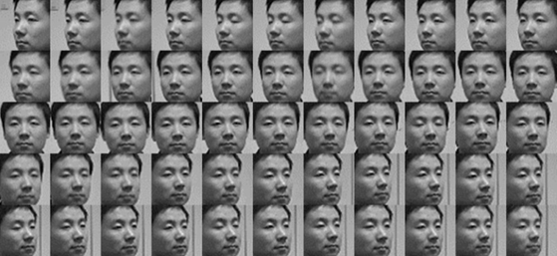


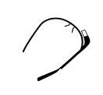
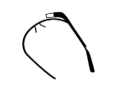
System Architecture
Step 1: capture multi-view face images
Step 2: sampling optimization
MASO
Step 3: face recognition
MVSRC
ID
User
User
MASO: Max Accuracy Sampling Optimization
MVSRC: Multi-view Sparse Representation Classification
Notes:
Here is an overview of our system. The first step is to capture multi-view face images. In this step, we request the user walks several steps around the target to capture face images from multi-views. In step 2 we perform sampling optimization to choose the optimal face image subset. And finally, we perform multi-view sparse representation classification on the subset and obtain the final identity.

Slide 11
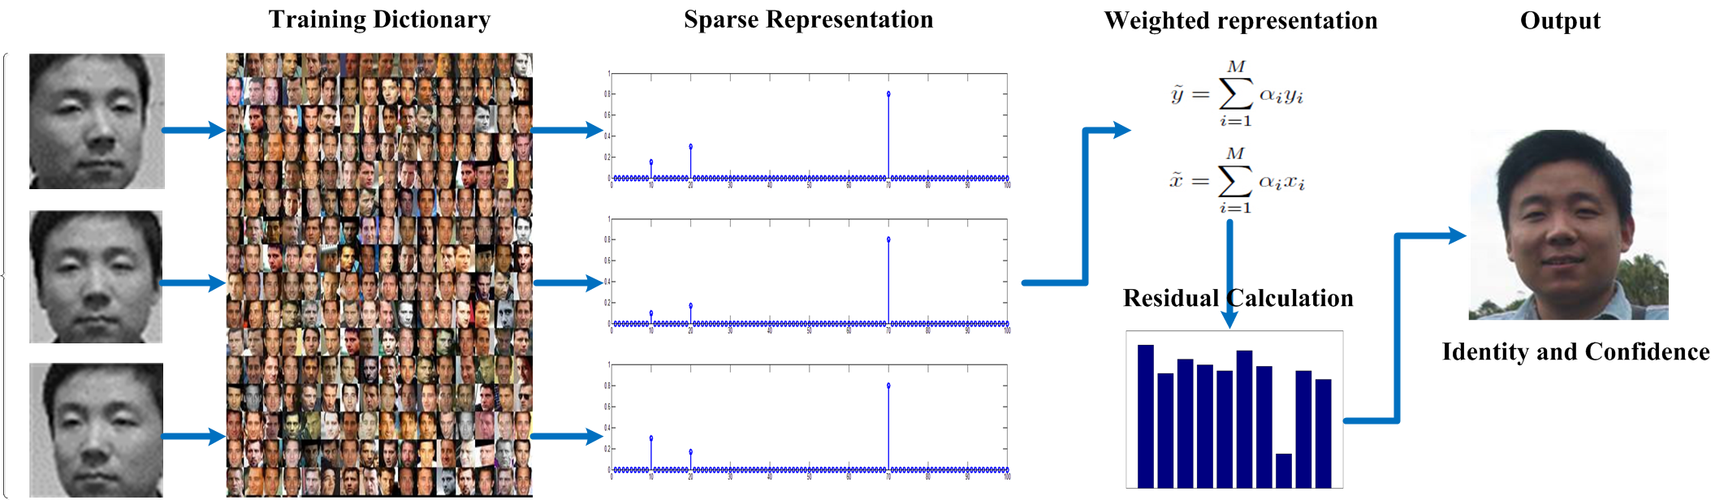
MVSRC
MVSRC exploits the sparsity of face images from different views and apply a weighted model to improve accuracy.
Notes:
According to sparse representation theory, if the captured face images belongs to the same person, the sparse representation should be highly correlated. Therefore, we use a weighted representation to combine several face images together to obtain the final identity.

Slide 12

Max Accuracy Sampling Optimization
Problem: applying MVSRC directly on a face image sequence is expensive
Observation: adjacent frames are similar
Solution: downsample a face image sequence
What is a good down sampling strategy?
Notes:
One problem of MVSRC is applying MVSRC directly on a face image sequence is expensive. Therefore, we need a more efficient method. We observed that adjacent frames are similar, that is to say, adjacent frames doesn’t provide more information for recognition. Therefore, we aim to find a good down sampling strategy. The question is what is a good downsampling strategy.

Slide 13
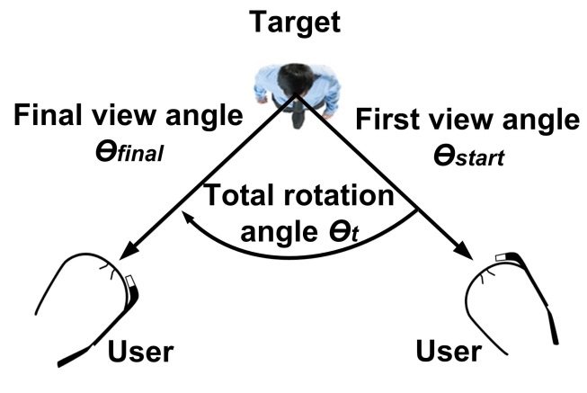
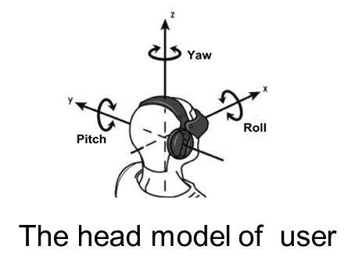
Max Accuracy Sampling Optimization
We propose an optimization strategy based on machine learning.
We relate the face recognition accuracy with angles of face images
We use IMU sensors(accelerometer, gyroscope, magnetometer) to estimate the angles of the face images
We use support vector regression (SVR) to downsample face images.
Recognition process
Notes:
We transfer the downsampling strategy to an optimization problem. The optimization goal is to find an optimal subset of face images to achieve the highest recognition accuracy under a given energy budget. To solve this problem. We propose a downsampling strategy based on machine learning techniques. We first relate recognition accuracy with a list of parameters. The parameters are shown in the figure, they include the rotation angle, the first viewpoint and so on. Then we apply machine learning techniques to train a prediction model based on these parameters. And finally, given a new input, the model can choose the optimal face image subset.

Slide 14
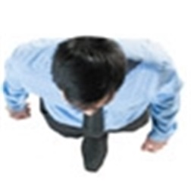




Obtain Angle Information
User
User
……
ϴstart
ϴ1
ϴ2
ϴk
ϴfinal
.
Notes:
Now I’m going to conclude the recognition process. First, the user look at the target from a certain angle, say theta start. This angle can be obtained by detecting facial features. And then, when the user is moving around the target, the smartglass estimates the angles of each face image based on IMU sensors. And finally when the user stops moving, we can obtain the angles of all the face images. And these angle information are used in the downsampling strategy to choose the best face image subset.

Slide 15
Evaluation
Datasets
  Honda/UCSD dataset:
    20 subjects
    59 image sequences
    Frames of each video clip vary from 12 to 645
  Private dataset:
    10 subjects (2 females and 8 males)
    9 different combinations of expressions and environments
    10.8K face images
Notes:
Now we come to the evaluation. We evaluate the system on two datasets: one is a public dataset it contains 20 subjects and 59 image sequences. The private dataset is collected by smartglass. It contains 10 subjects and it’s collected under different expressions and environments.

Slide 16
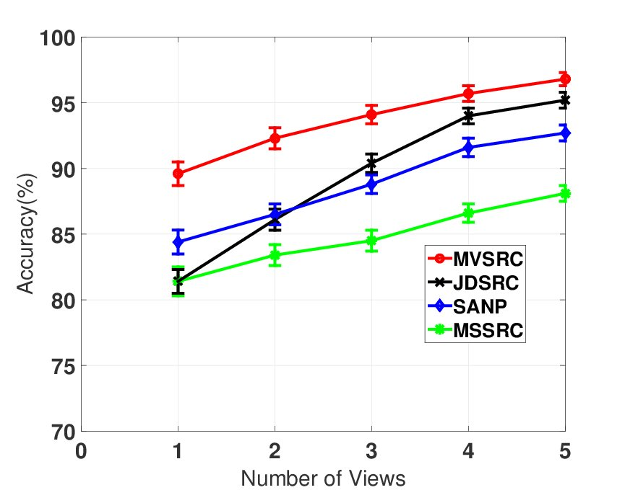
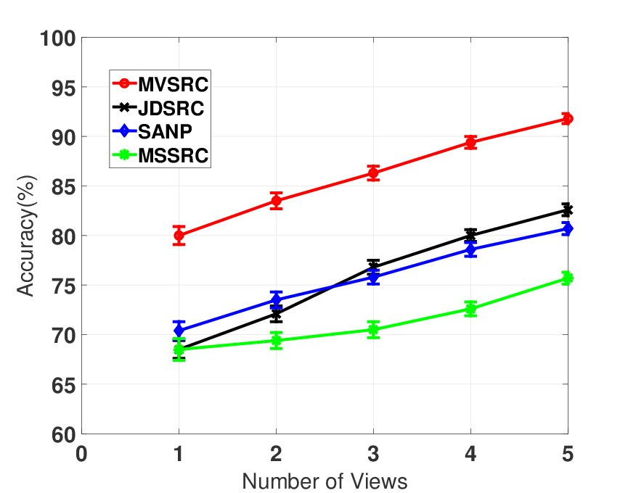
Evaluation of MVSRC
Comparison with competing multi-view face recognition methods
Private dataset
Honda dataset
MVSRC is 5%-10% more accurate than other methods
Notes:
First of all, we compare MVSRC with several other multi-view face recognition methods on two datasets. From the results, we can see that MVSRC is 5%-10% more accurate than other methods.

Slide 17

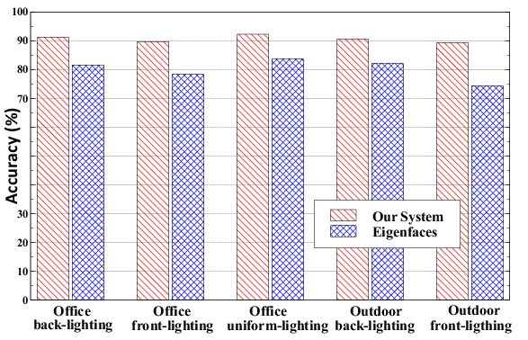
User study
Implementation: Vuzix M100 Smart glass
5 users, 10 subjects
Different environments
Comparison with OpenCV face recognition methods
7%-15%
Statistic | Our system | Eigenfaces
Computation time | 516-582 ms | 247-331 ms
Energy consumption | 506-535 mJ | 316-410 mJ
Expected battery life | ≈0.28 hr | ≈0.37 hr
Memory Usage | 55-64 MB | 38-44 MB
Same level
Notes:
We implement the system on Vuzix M100 smartglass, and employ 5 users to recognize 10 subjects. We do the experiments in different environments and compare it with OpenCV face recognition methods. From the result, we can see that our system improves face recognition accuracy from 7%-15%. This table shows the system cost of different methods. We can see that our system achieves same level as Eigenfaces.

Slide 18
Demo
https://www.youtube.com/watch?v=lVRS4e3Glho

Slide 19
Research project 2
Key generation system for wearable devices

Slide 20

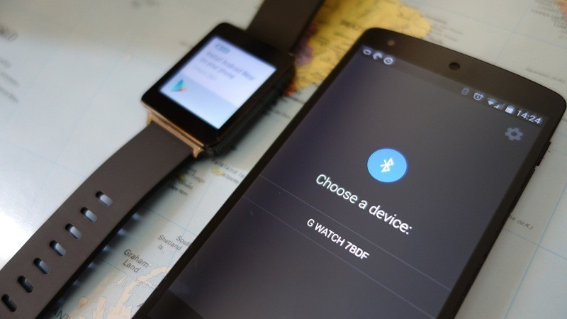
Background
Wearable devices
  smartphone, smart glass, smart watch etc.
Wearable devices pairing
  Data exchange
Notes:
Wearable devices such as smartphone and smart glass are becoming more and more popular. One common problem is to pair two devices. Such as pair a smartwatch with a smartphone to exchange data.

Slide 21
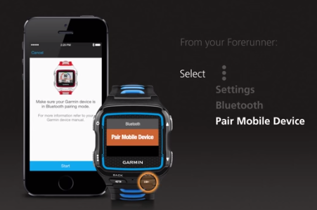
Traditional Methods
Explicit Input
  Labor-intensive
  Small form factor
Notes:
There are three types of traditional methods: explicit input, Key exchange method and static key. For explicit input, it’s labor-intensive, we need to pair every device by hand. This method is not suitable for some wearable devices such as smart glass and pacemaker because they have small form factor. For key exchange method, it needs public key infrastructure and it can’t distinguish legitimate devices and attackers. Another common method is static key. We pair two devices for once, and key is stored in each device. This method is vulnerable to attackers and doesn’t include key revocation.

Slide 22
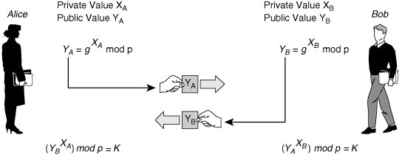
Traditional Methods
Key Exchange
(D-H protocol)
  Public key infrastructure
  Cannot distinguish legitimate devices and attackers
Notes:
There are three types of traditional methods: explicit input, Key exchange method and static key. For explicit input, it’s labor-intensive, we need to pair every device by hand. This method is not suitable for some wearable devices such as smart glass and pacemaker because they have small form factor. For key exchange method, it needs public key infrastructure and it can’t distinguish legitimate devices and attackers. Another common method is static key. We pair two devices for once, and key is stored in each device. This method is vulnerable to attackers and doesn’t include key revocation.

Slide 23
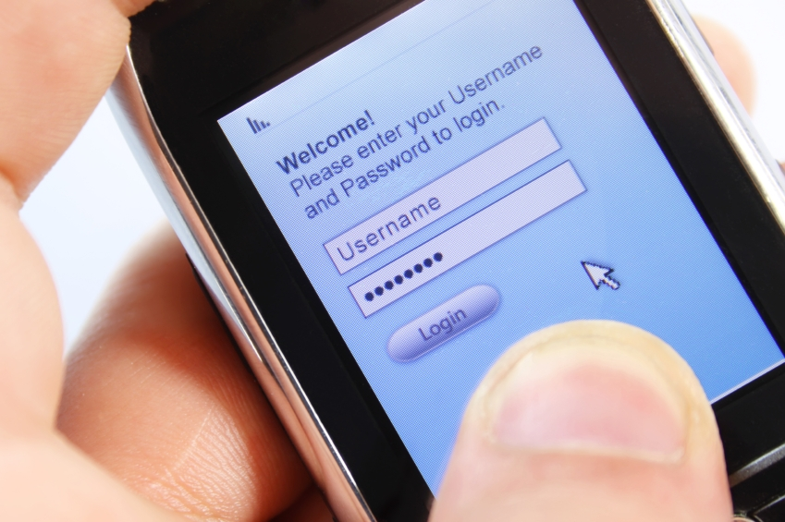
Traditional Methods
Static key
  Vulnerable to attackers
  Key revocation
Notes:
There are three types of traditional methods: explicit input, Key exchange method and static key. For explicit input, it’s labor-intensive, we need to pair every device by hand. This method is not suitable for some wearable devices such as smart glass and pacemaker because they have small form factor. For key exchange method, it needs public key infrastructure and it can’t distinguish legitimate devices and attackers. Another common method is static key. When we pair two devices for the first time, the key is stored in the device. Then the key is used forever. This method is vulnerable to attackers and doesn’t include key revocation.

Slide 24
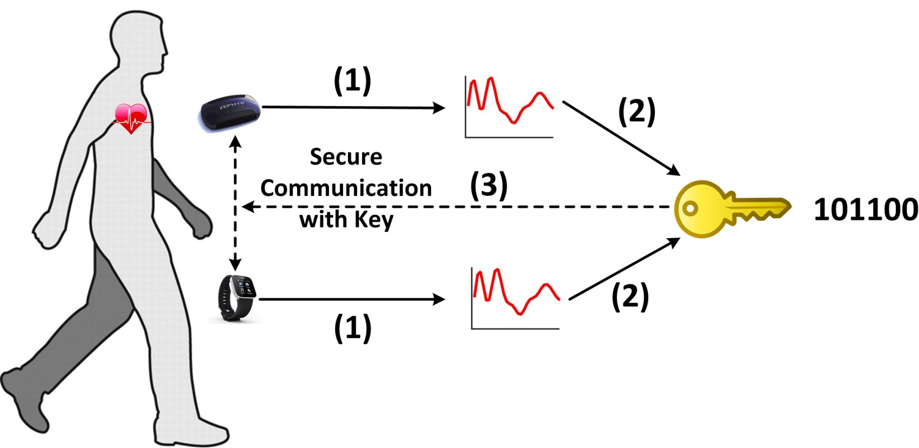
System Overview
Walkie-Talkie:
On-body Authentication
Automatic Secure Pairing
Spontaneous Key Generation
Devices on the same body measure the same gait signals
Notes:
Our system Walkie-Talkie can offer on-body authentication, automatic secure pairing and spontaneous key generation. The key principle of walkie-talkie is devices on the same body measure the same gait signals, and the gait signals can be used as a common signal to generate a key. The key can be used to secure the communication between these two devices.

Slide 25
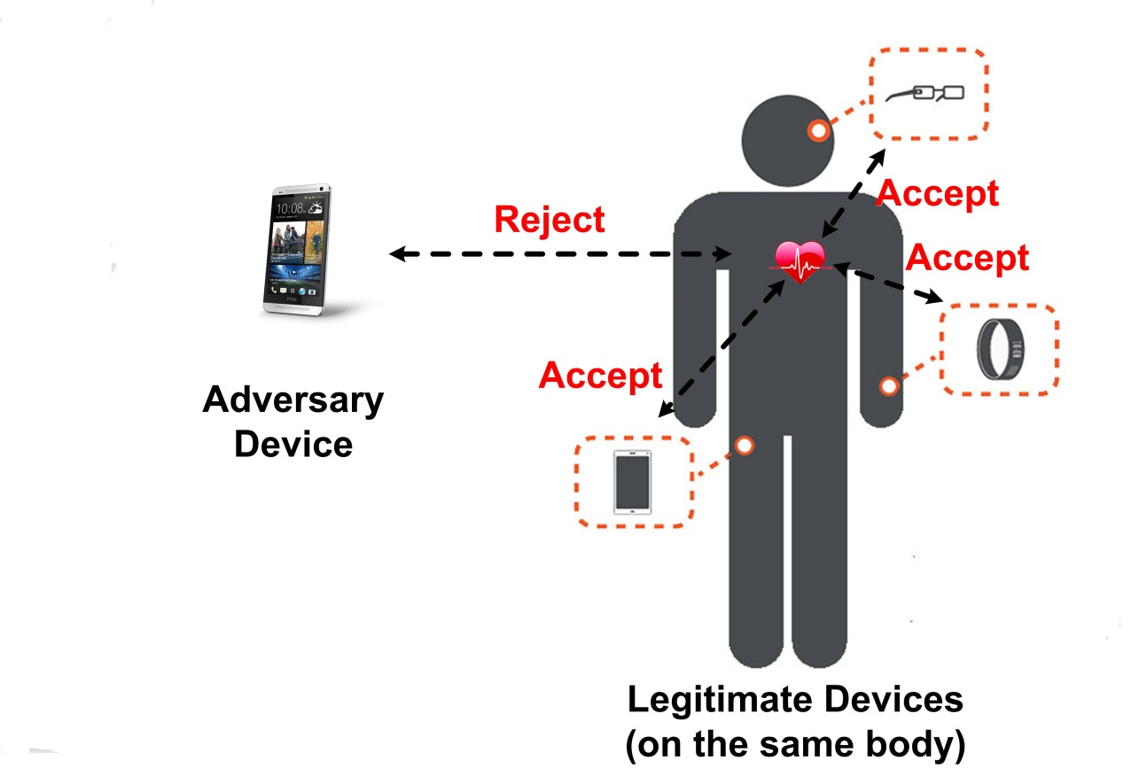

Model
User model:
  only the devices on the same body can be paired together
Adversarial model:
  Active imposter
  Passive imposter
Notes:
Before talking about our system, I’d like to introduce the user model and adversarial model. For the user model, we think only the devices on the same body can be paired together. There are two types of imposters: active imposter and passive imposter. The active imposter tries to pair an adversary device to legitimate devices by mimicking the user’s walking styles. The passive imposter tries to pair an adversary device to legitimate devices by using his own walking styles.

Slide 26

Design details
Alice
Signal Processing
Key generation
REQ
Secure
Communication
RSP
Bob
Source
Separation
Signal
Alignment
Quantization
Reconciliation
Privacy
Amplification
Notes:
Now, I’m going to talk about our protocol. Say Alice is a smartglass and Bob is a smartwatch, Alice wants to pair with Bob to exchange data. First, Alice sends a REQ to Bob and Bob sends a RSP back to Alice, After receiving the response Alice and Bob starts to collect acceleration data. And then they perform signal processing and key generation to generate a common key. The key is then used to secure the communication between Alice and Bob. Signal processing contains two steps: source separation and signal alignment. Key generation contains three steps: quantization, reconciliation and privacy amplification. I’ll discuss details in the next part.

Slide 27
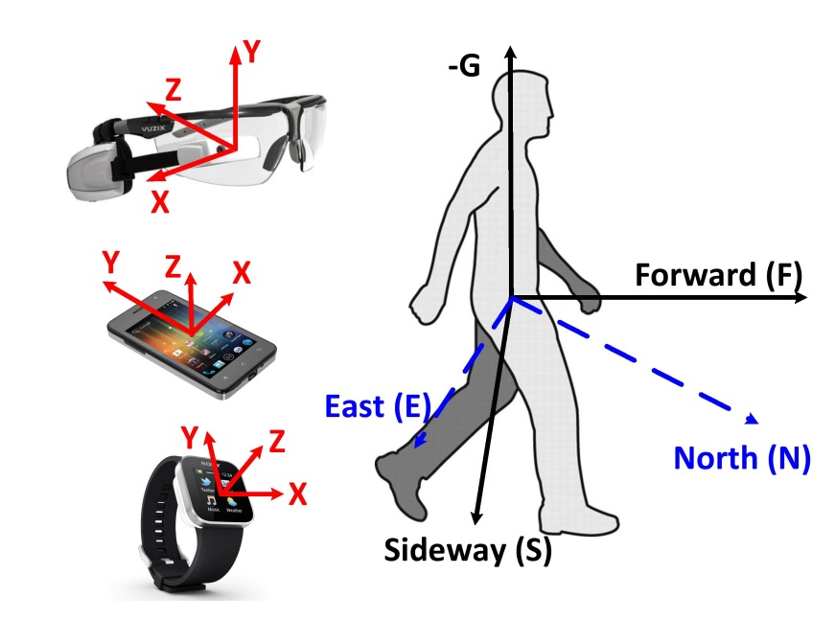
Signal processing- signal alignment
Space alignment
-Coordinate system of different system are not the same
-We transform the acceleration signal to body reference system
Notes:
It contains temporal alignment and space alignment. For temporal alignment, we use heel strikes as a anchor point. Because when our foot touch the ground, it generates a peak on the acceleration along gravity direction. Therefore, we use this peak point to synchronize signals recorded on two devices. As different devices are worn on different body positions, we transform the acceleration in the device coordinate system to a common body reference system. Specifically, we define the body reference system as –G, forward and sideway.

Slide 28
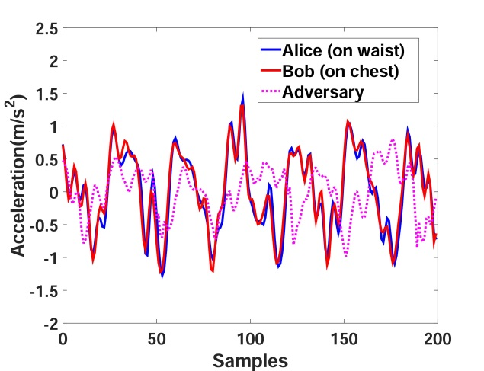
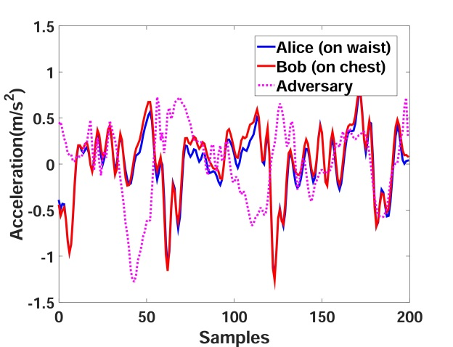
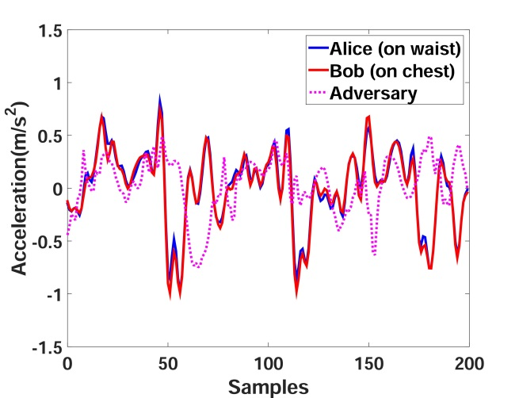

Key Generation
Key Generation
Gravity direction
Sideway direction
Walking direction
Privacy
Amplification
Acc
Quantization
Reconciliation
Notes:
After signal alignment, we obtain acceleration along three directions in the body reference system. From this three figures, we can see that, devices on the same body measures the similar acceleration. As different people has different gait patterns, an adversary can not produce the similar signal as the user. We use the acceleration along this three directions to generate keys. The key generation includes quantization, reconciliation and privacy amplification.

Slide 29
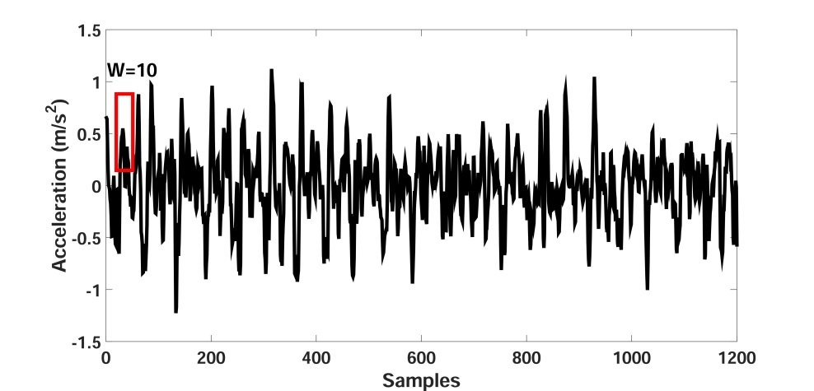


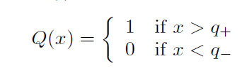
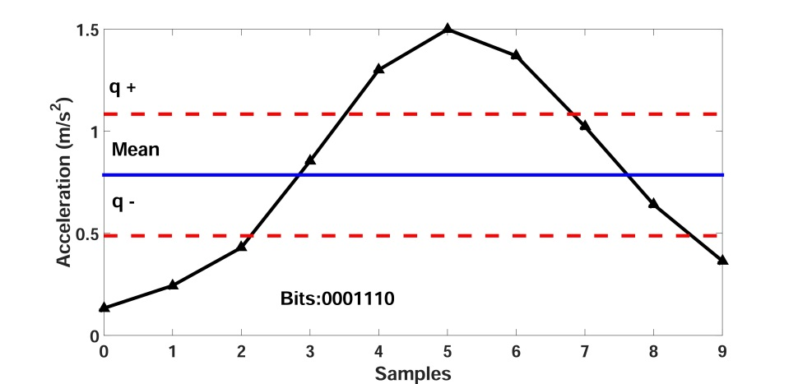
Key Generation-quantization
Segmentation
Calculate
boundaries
Quantization
K₁,K₂,K₃
K_{Alice}=[K₁,K₂,K₃]
Notes:
The first step of key generation is quantization, quantization is used to generate bits from the acceleration signal. We first segment the acceleration into small windows. For each window, we calculate two boundaries, q plus and q minus. Then if the acceleration value is greater than q plus, it will be encoded as 1, otherwise it’s encoded as 0.
After quantization, we obtain three independent keys K1 K2 and K3 along three directions. We combine them together to obtain Kalice.

Slide 30
Key Generation-reconciliation
Reconciliation:
  Error-correcting phase
Steps:
  Exchange key indexes
  L_{Alice}=[1,3,5,6,7,9,10]
  L_{Bob}=[1,2,5,6,8,9,10]
  Reserve common indexes
  L=[1,5,6,9,10]
  Reserve key generated at same index
  K_{Alice}=1101001
  K_{Bob}=1001101
K_{Alice}=1101001
K_{Alice}≈ K_{Bob}
K_{Bob}=1001101
K’_{Alice}=10101
K’_{Bob}=10101
Notes:
The second step of key generation is reconciliation. After obtaining Kalice and Kbob, we often have Kalice approximately equals to Kbob because of noise. For example, Klice is 1101001, and Kbob is 1001101, there are two bits are different. Reconciliation is a error-correcting phase. It contains three steps, first Alice and Bob exchange their indexes of keys. For example if Alice generates key at 1,3,5,6,7,9 and 10 and Bob generates keys at these positions. The next step is to reserve the common indexes, in this example, the index 3, 7, 2 and 8 is removed. And Finally, Alice and Bob reserve keys generated at the same index. In this way, Kalice becomes 10101 and Kbob also becomes 10101.

Slide 31
Key Generation-privacy amplification
Privacy amplification:
  Correlation exits as walking is repetitive
  Reconciliation reveal information to attackers
Steps:
  Segmentation
  Perform XOR
  K’’_{Alice}=[(K¹_{Alice} XOR K²_{Alice}) ,(K³_{Alice} XOR K⁴_{Alice}),…….]
K¹_{Alice}(30bits)
K²_{Alice}
…..
K’_{Alice}=1101001…10110………………01011………………….
Notes:
After reconciliation, we obtain Kalice equals to Kbob, however, as correlation exists as walking is repetitive, and also reconciliation reveal information to attackers, The final step privacy amplification is used to improve the randomness of the final key. Privacy amplifcation contains two steps: first, we segment Kalice into small windows, each windows contains 30 bits. Then we perform XOR between two adjacent windows to obtain the final key.

Slide 32
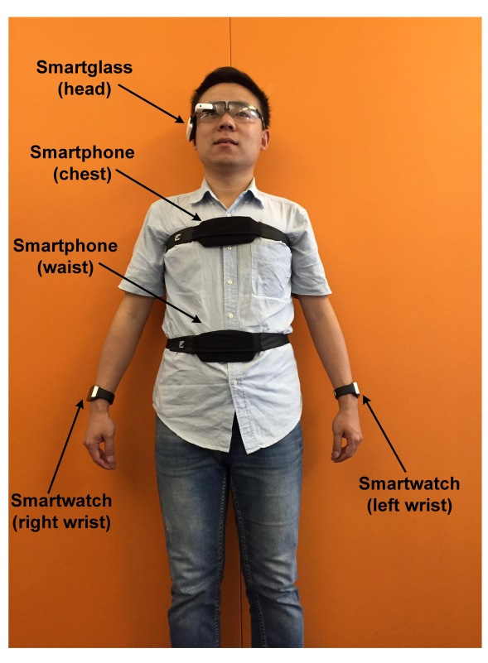
Evaluation
Dataset
  20 subjects (14 males, 6 females)
Notes:
Now we come to the evaluation, the evaluation metrics include bit agreement rate, bit rate and shannon entropy of the key. Bit agreement rate refers to how many bits are equal between Kalice and Kbob. Bit rate means how many bits can alice and bob generate in one second. Shannon entropy measures the randomness of the key. We collect data from 20 subjects. During the data collection phase, the volunteers are asked to wear the devices as shown in the graph and walk for several minutes.

Slide 33
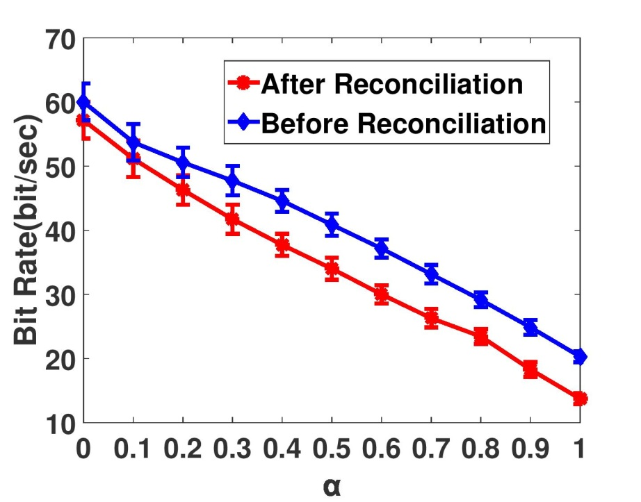
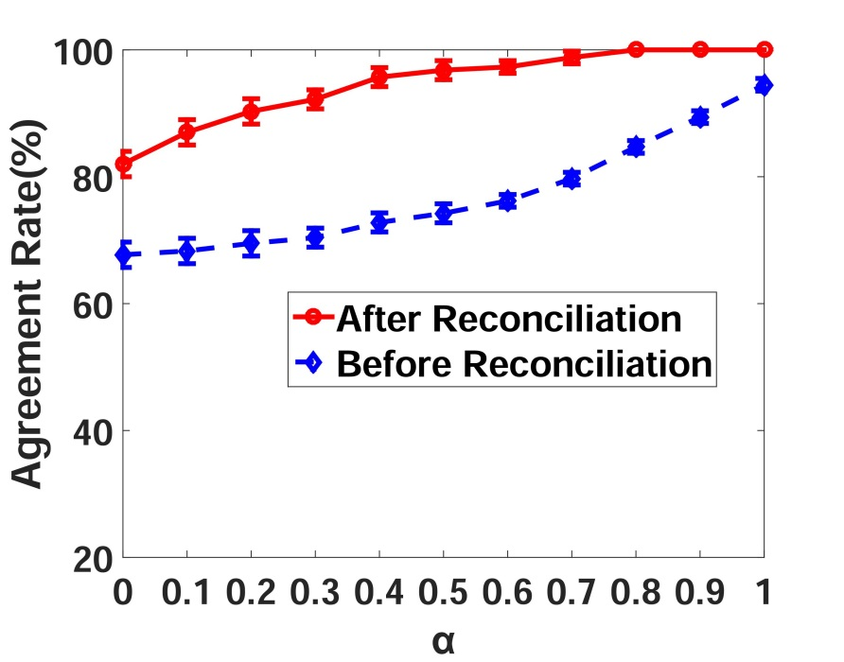
Evaluation
Impact of reconciliation
Reconciliation reduces bit rate, however it can improve bit agreement rate up to 100%.
Notes:
First, we evaluate the performance of reconciliation, as shown in this figure, when alpha increases, the bit rate decreases, this is because more bits are discarded. However, in this figure, the bit agreement rate increases when alpha increases, this is because when more bits are discarded, more errors also are discarded. So we can see that reconciliatoin reduces bit rate, however it can improve bit agreement rate up to 100%, that is to say, alice and bob can generate the same key.

Slide 34
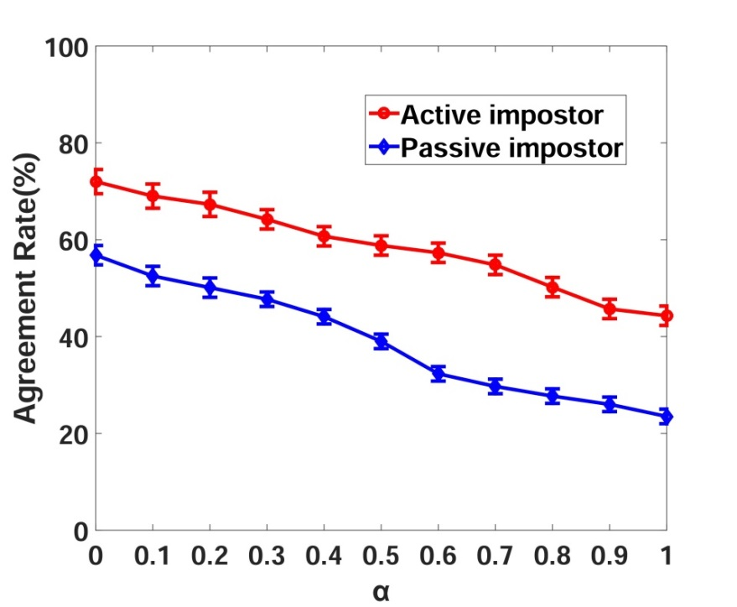

Evaluation
Security analysis
  Passive imposter
  Active imposter
Mutual Information among different devices
An active imposter can only achieve approximately 50% bit agreement rate (α=0.8)
Notes:
We also perform an imposter test to evaluate the security of Walkie-Talkie. The passive imposter means the adversary use his own signal to pair with the user’s device, an active imposter means the imposter try to mimic the user’s walking style and try to pair with user’s device. From the graph, we can see that an active imposter can only achieve approximately 50% bit agreement rate (α=0.8).

Slide 35
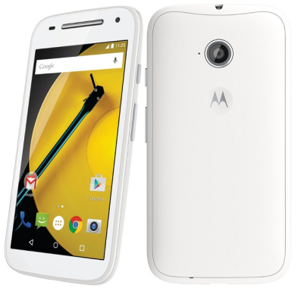
System Implementation
Implementation
  Moto E2 smartphone
  Bluetooth Low Energy (BLE) mode
  AES encryption/decryption
 | Computation Time (ms) | Energy Consumption (mJ)
Signal processing | 108.3 | 71.2
Key generation | 208.1 | 12.7
AES encryption | 0.2 | 0.1
AES decryption | 0.2 | 0.1
Total | 316.8 | 85.6
Account to 0.002 ‰ of the battery supply only
Notes:
We implement walkie-talkie in Moto E2 smartphone and employ Bluetooth low energy mode to enable communication. We use AES to encrypt and decrypt the messages. This tables shows the system cost of walkie-talkie. We can see that the processing time only needs 316 ms, and it requires very little amount of energy.

Slide 36
Demo
https://www.youtube.com/watch?v=YBFBJrNZy48

Slide 37
Research project 3
Gait recognition system for wearable devices

Slide 38
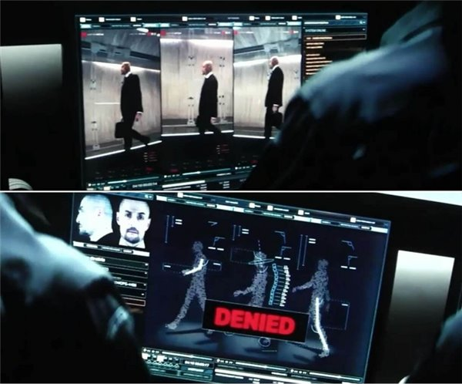
Background-gait recognition
Gait recognition refers to identify an individual by his/her unique walking pattern.
【Mission: Impossible】
Notes:
Gait recognition refers to identify an individual by his unique walking patter. Extensive studies have shown different people have different walking pattern.

Slide 39
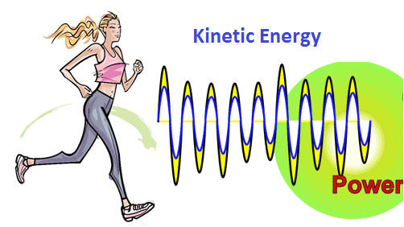
Background-energy harvester
Kinetic energy harvester (KEH):
- generate power from kinetic motions like walking, running
Notes:
Kinetic energy harvester means we can generate power from kinetic motions.

Slide 40
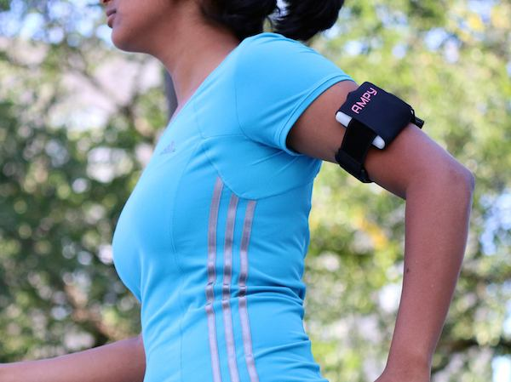
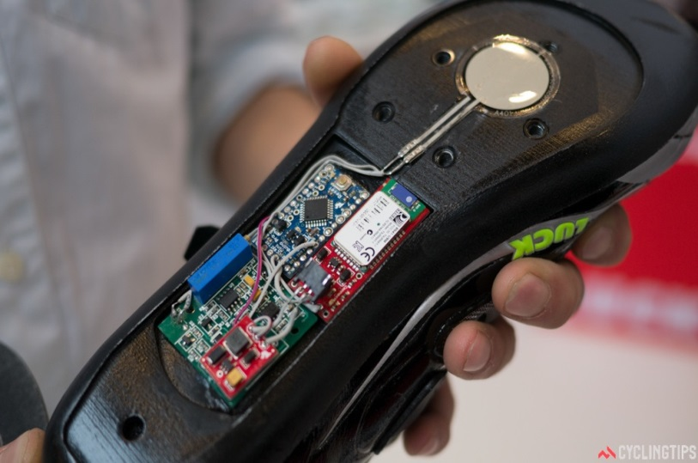
Background-energy harvester
AMPY-world's first wearable motion-charger
SolePower-self-sustaining smart boot
Notes:
There are many commercial energy harvesting products. For example, AMPY has released worlds’s first wearable motion charger. It can be used to charge your phone when you’re walking. SolePower develops a self-sustaining smart boot.

Slide 41
Motivations
Accelerometer-based gait recognition
  - continuous sampling consumes a lot of energy
Our goal:
- use generated voltage as source signal to realize gait recognition

Slide 42
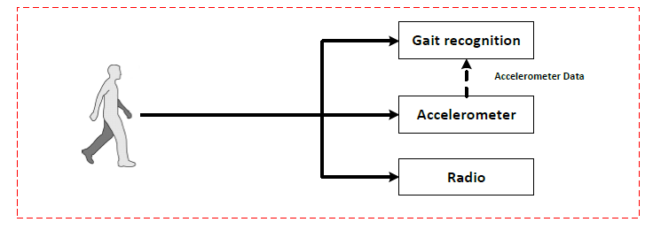
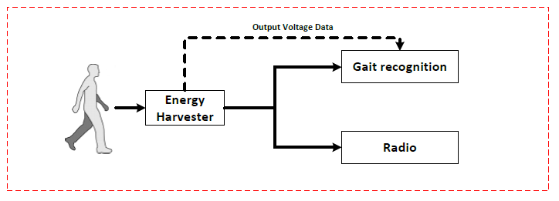
System overview
Traditional accelerometer-based gait recognition system:
Proposed KEH-based gait recognition system:
Accelerometer
Save energy
Notes:
Here is a comparison between accelerometer-based gait recognition system and KEH-based gait recognition system. In accelerometer-based system, accelerometer data is used for gait recognition. However, in KEH-based gait recognition, the output voltage data is directly used for gait recognition.

Slide 43
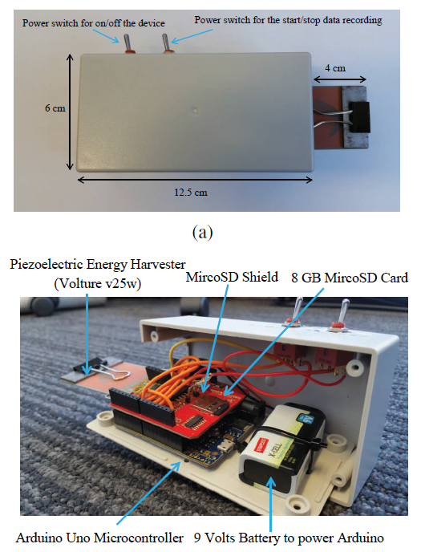
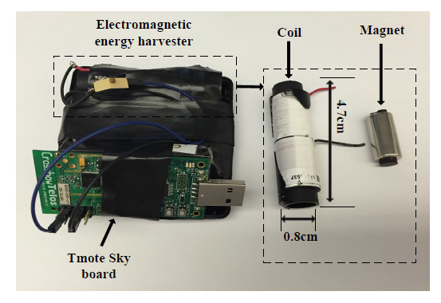
Prototype design
Piezoelectric energy harvester (PEH)
Electromagnetic energy harvester (EEH)
Notes:
In order to demonstrate the feasibility of using energy harvester for gait recognition, we have designed two prototypes. One is based on piezoelectric, and another one is based on elctromagnetic.

Slide 44
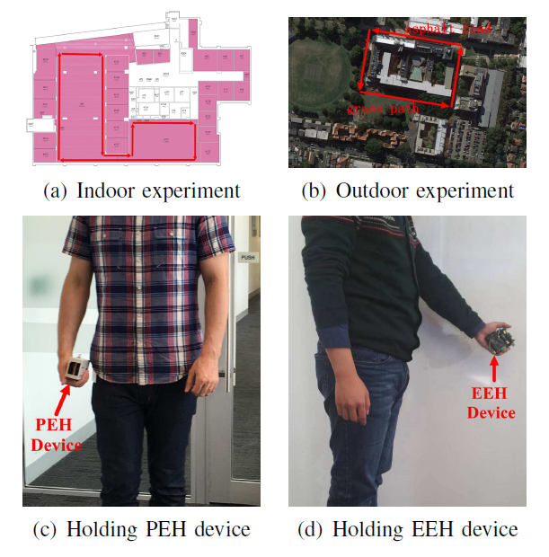
Data collection
Dataset
  20 subjects (14 males, 6 females)
  Indoor, Outdoor
Notes:
We collect data from 20 subjects from both indoor and outdoor environments.

Slide 45
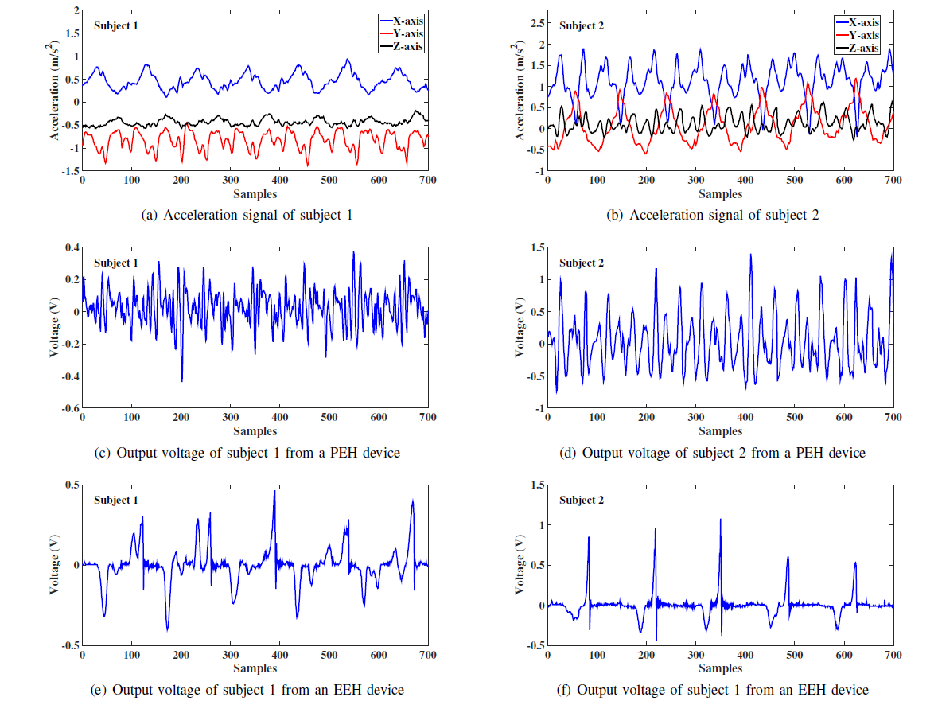
Feasibility study
Notes:
This figure shows the gait data of two different subject from accelerometer, PEH and EEH. We can clearly see that different people have different walking patterns. It not only holds for accelerometer data but also for voltage data.

Slide 46

Evaluation results
Comparison with accelerometer-based system
KEH-Gait can achieve comparable recognition accuracy when we use more than 5 gait cycles.
Notes:
We compare the recognition accuracy of our system with accelerometer-based system. From this figure we can see when we only use 1 gait cycles, there is a gap between these two systems. However, when we use more than 5 gait cycles KEH-gait can achieve comparable recognition accuracy.

Slide 47

Energy consumption analysis
Our system can reduce energy consumption by 75.88%.
Notes:
This figure shows the power consumption of accelerometer and KEH.

Slide 48
Demo
https://www.youtube.com/watch?v=LOqSq28oexA

Slide 49
Conclusion
We implement three biometrics-based recognition system on
wearable devices
We conduct extensive evaluations to evaluate their performance
and security.
We implement the systems on commercial devices to demonstrate
the feasibility.
With the ubiquity of wearable devices, more security and privacy
issues will arise. Future work will focus on addressing these
challenges on emerging wearable devices.

Slide 50
References
Weitao Xu, Yiran Shen, Neil Bergmann,Wen Hu. “Sensor-assisted Face Recognition System on Smart Glass via Multi-view Sparse Representation Classification” IPSN’ 2016 (CORE A*)
Weitao Xu, Girish Revadigar, Chengwen Luo, Neil Bergmann,Wen Hu.“Walkie-Talkie: Motion-Assisted Automatic Key Generation for Secure On-Body Device Communication” IPSN’ 2016 Best paper runner-up award (CORE A*)
Weitao Xu, Guohao Lan, Qi Lin, Sara Khalifa, Neil Bergmann, Mahbub Hassan, Wen Hu. “KEH-Gait: Towards a Mobile Healthcare User Authentication System by Kinetic Energy Harvesting” conditionally accepted by NDSS' 2017 (CORE A)
Notes:
We’ve published three papers corresponding to these three projects. Two of them are published in IPSN which is a top-rated international conference. The other one has been conditionally accepted by NDSS.

Slide 51
Questions and suggestions?
Thanks for your attention!

