Slide 1
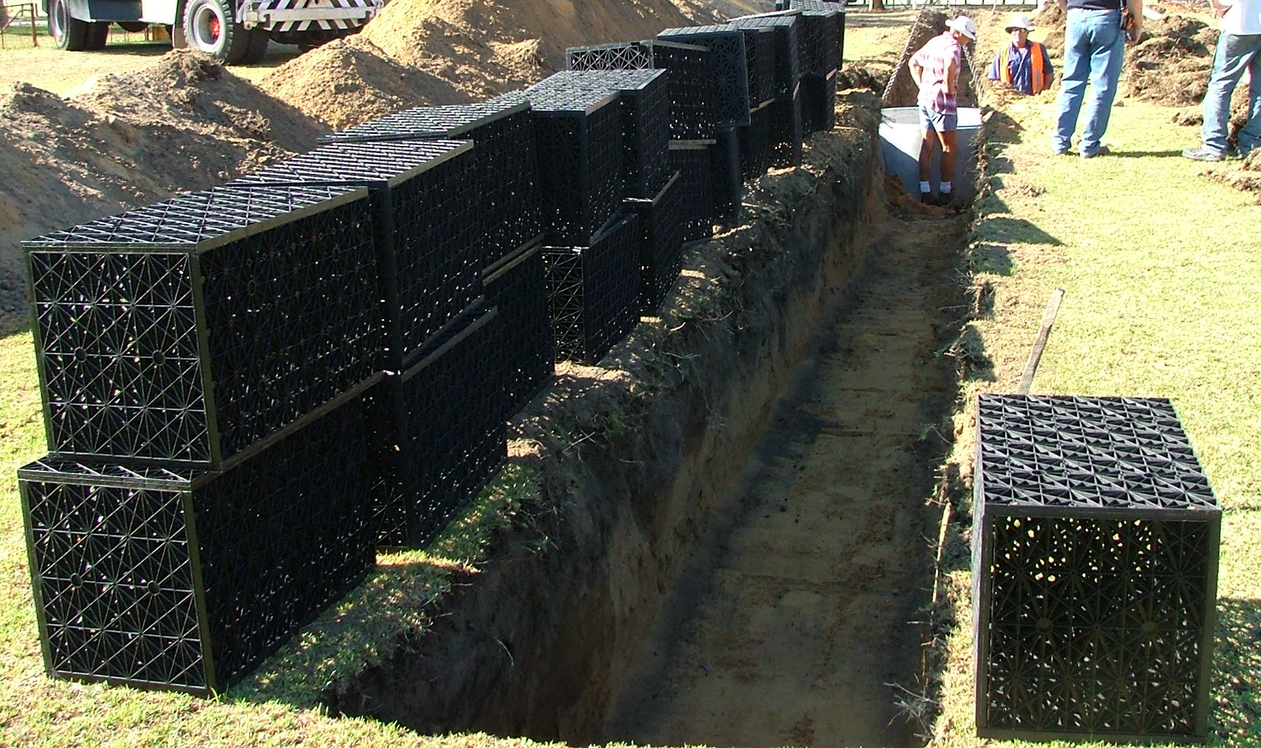
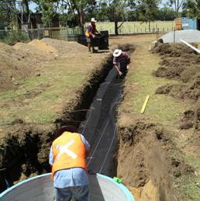
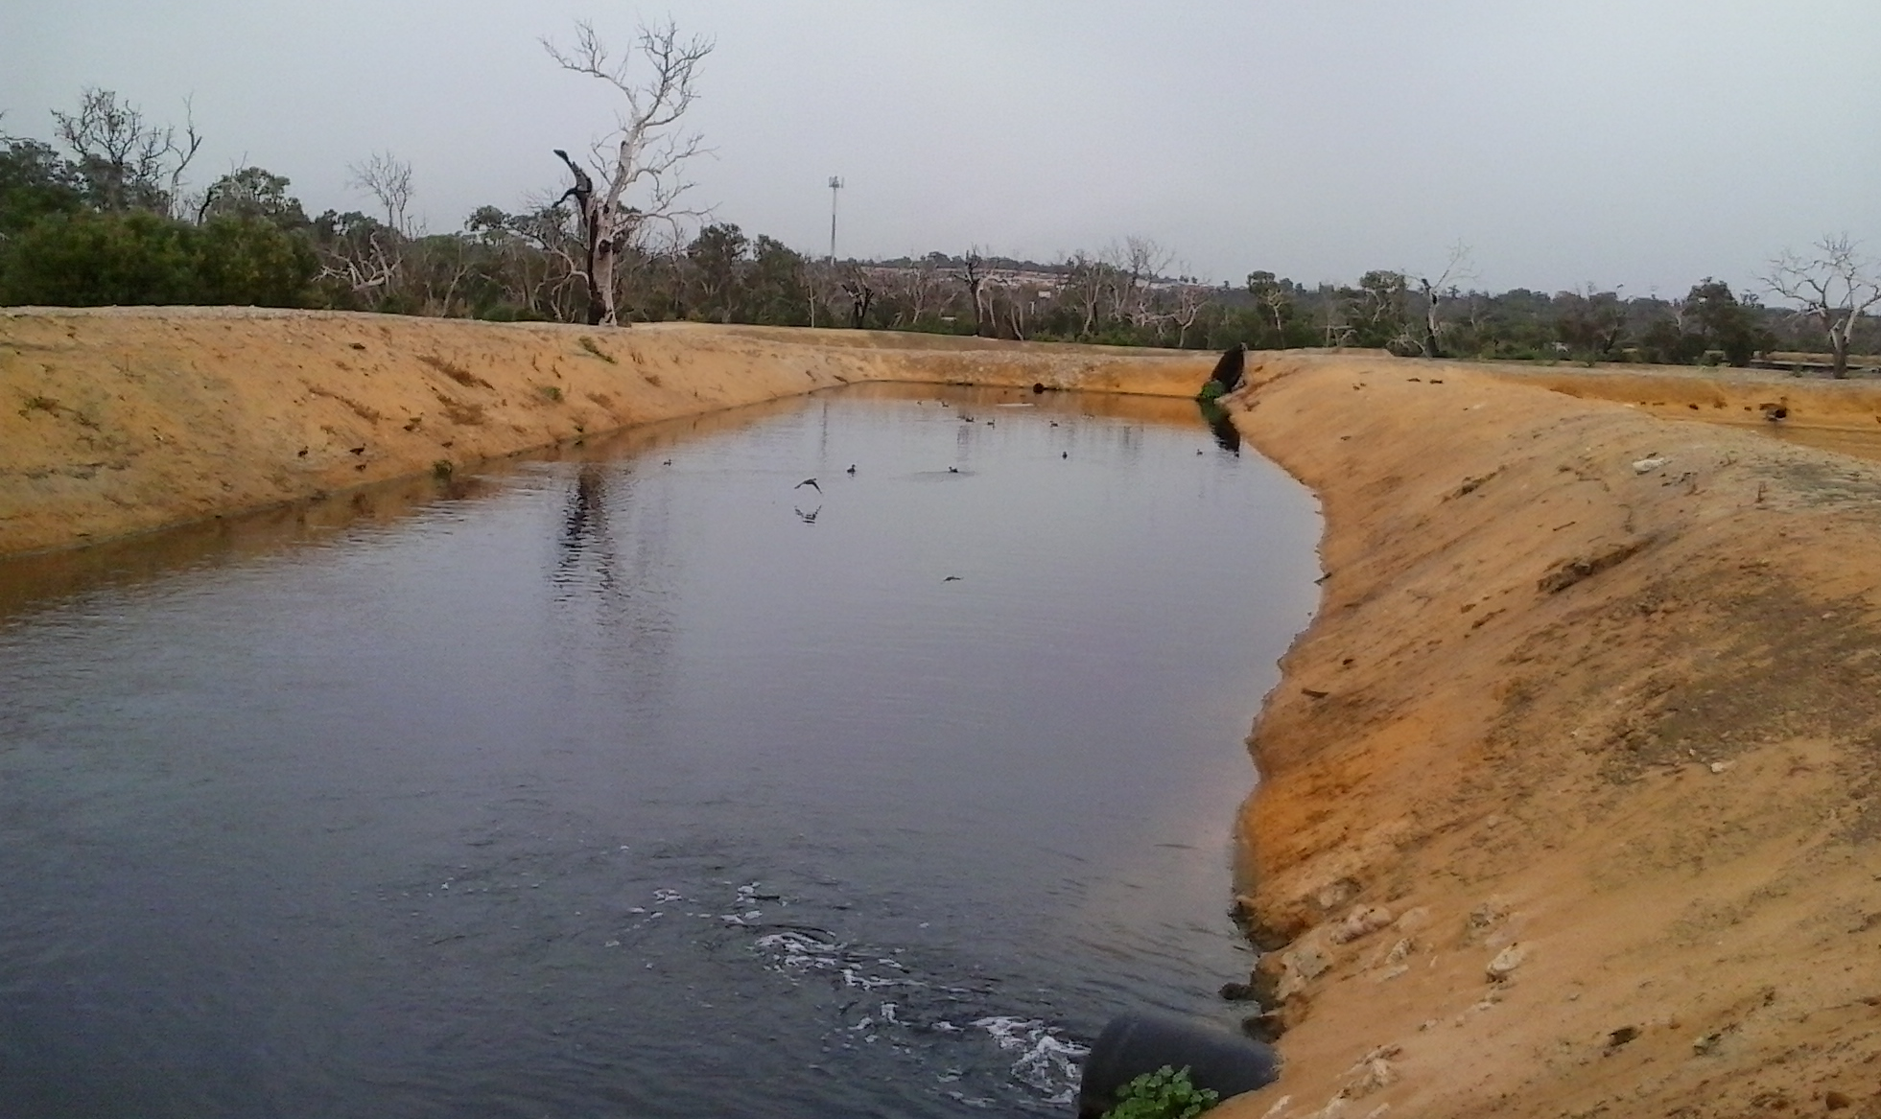
Why managed aquifer recharge suits south-west Western Australia so well
Don McFarlane, Groundwater Hydrology Team Leader
28th July 2016
CSIRO Land and Water
Notes:
The left two photographs show an infiltration gallery at CSIRO’s Floreat Laboratories being prepared to receive treated wastewater from the Subiaco WWTP.
On the right is the infiltration basin used by Water Corporation at the Kwinana WWTP.
The experience at both is that the Spearwood Dune System is able to accommodate several metres of infiltration per day without serious clogging. Being exposed to sunlight, basins grow algae and are more likely to clog, but they are also the easiest to clean using a bobcat
Rapid infiltration is also experienced in the many stormwater absorption basins around the metropolitan area. JDA and others have measured these rates to size basins able to accommodate storm flows.
MAR experts from around the world view our aeolian sands as being an ideal medium for MAR. provided the watertable isn't near or at the surface. Yellow Karrakatta Sands like those shown above in particular act like a deep sand filter to remove suspended solids as well as phosphorus on goethite (iron oxyhydroxide) crystals

Slide 2
Emphasis of the talk is on:
‘Non-potable’ water (not Groundwater Replenishment)
Superficial Aquifer (unconfined)
Stormwater and treated wastewater additions to the Spearwood Dunes; and then to the Tamala Limestone or Safety Bay Sand aquifers
Areas with both a groundwater need and the availability of suitable water for MAR
Notes:
To cover the topic in the time available the scope of the talk has been limited to certain aspects of MAR
The coastal dunes are targeted because they are closest to the treated wastewater sources after inland WWTPs weer closed after causing problems with disposal. The ‘inland’ Bassendean Sends also have less attenuating properties (as shown by Brian Whelan and others in the 1980s) and there is less capacity in the Superficial Aquifer to accept TWW

Slide 3
The values that the shallow groundwater supports are:
13% of our drinking water supply, now mostly from under urban areas
About 176,000 unlicensed backyard bores irrigates one-in-four private gardens. Bores reduce the demand for drinking water
Irrigation of local government parks, golf clubs, school ovals, special rural areas. $500m capital investment by LGAs in bores; $250m+ in reticulation systems
Most urban wetlands rely on groundwater. Their values include
  Increase in surrounding land values by over $4 billion
  Amenity for people outside this 5 to 10 km proximity zone
  Habitat in a drying climate for waterbirds, estuarine birds, tortoises etc.
Irrigation and evaporation from lakes help reduce the urban heat island by evaporative cooling => energy saving on air conditioners
Peri-urban horticulture – fresh fruit and vegetable
Industrial use – e.g. 70% of water used in the Kwinana industrial area
Cheap disposal of stormwater; flushing of salts; preventing salt water intrusion in ocean and river. Some cheap disposal of treated wastewater; septic tanks in unsewered areas
Starting to be used for thermal regulation of buildings (heat pumps) and super computers

Slide 4
1 Why Managed Aquifer Recharge is needed

Slide 5
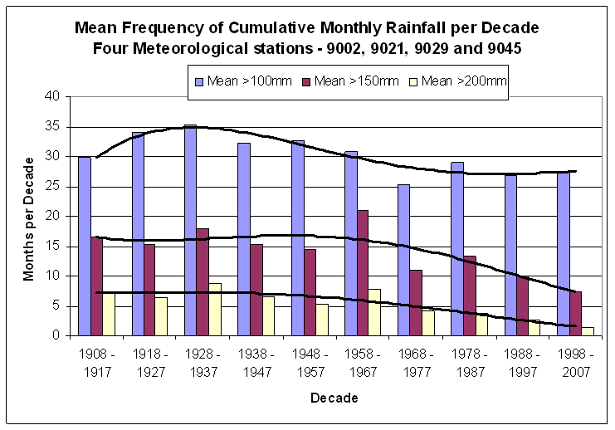
Wet months are now rare
Gnangara Situation Statement (DoW 2009)
Notes:
The number of very wet months (>200mm) over the Gnangara Mound has decreased from about 7 to 2, and of wet months (> 150mm) from 16 to 7
Recharge decreases proportionally more than decreases in rainfall so it is now a lot less; particularly when rain comes in showers with intermittent sunny and windy periods which dries soil and vegetation before the next shower

Slide 6
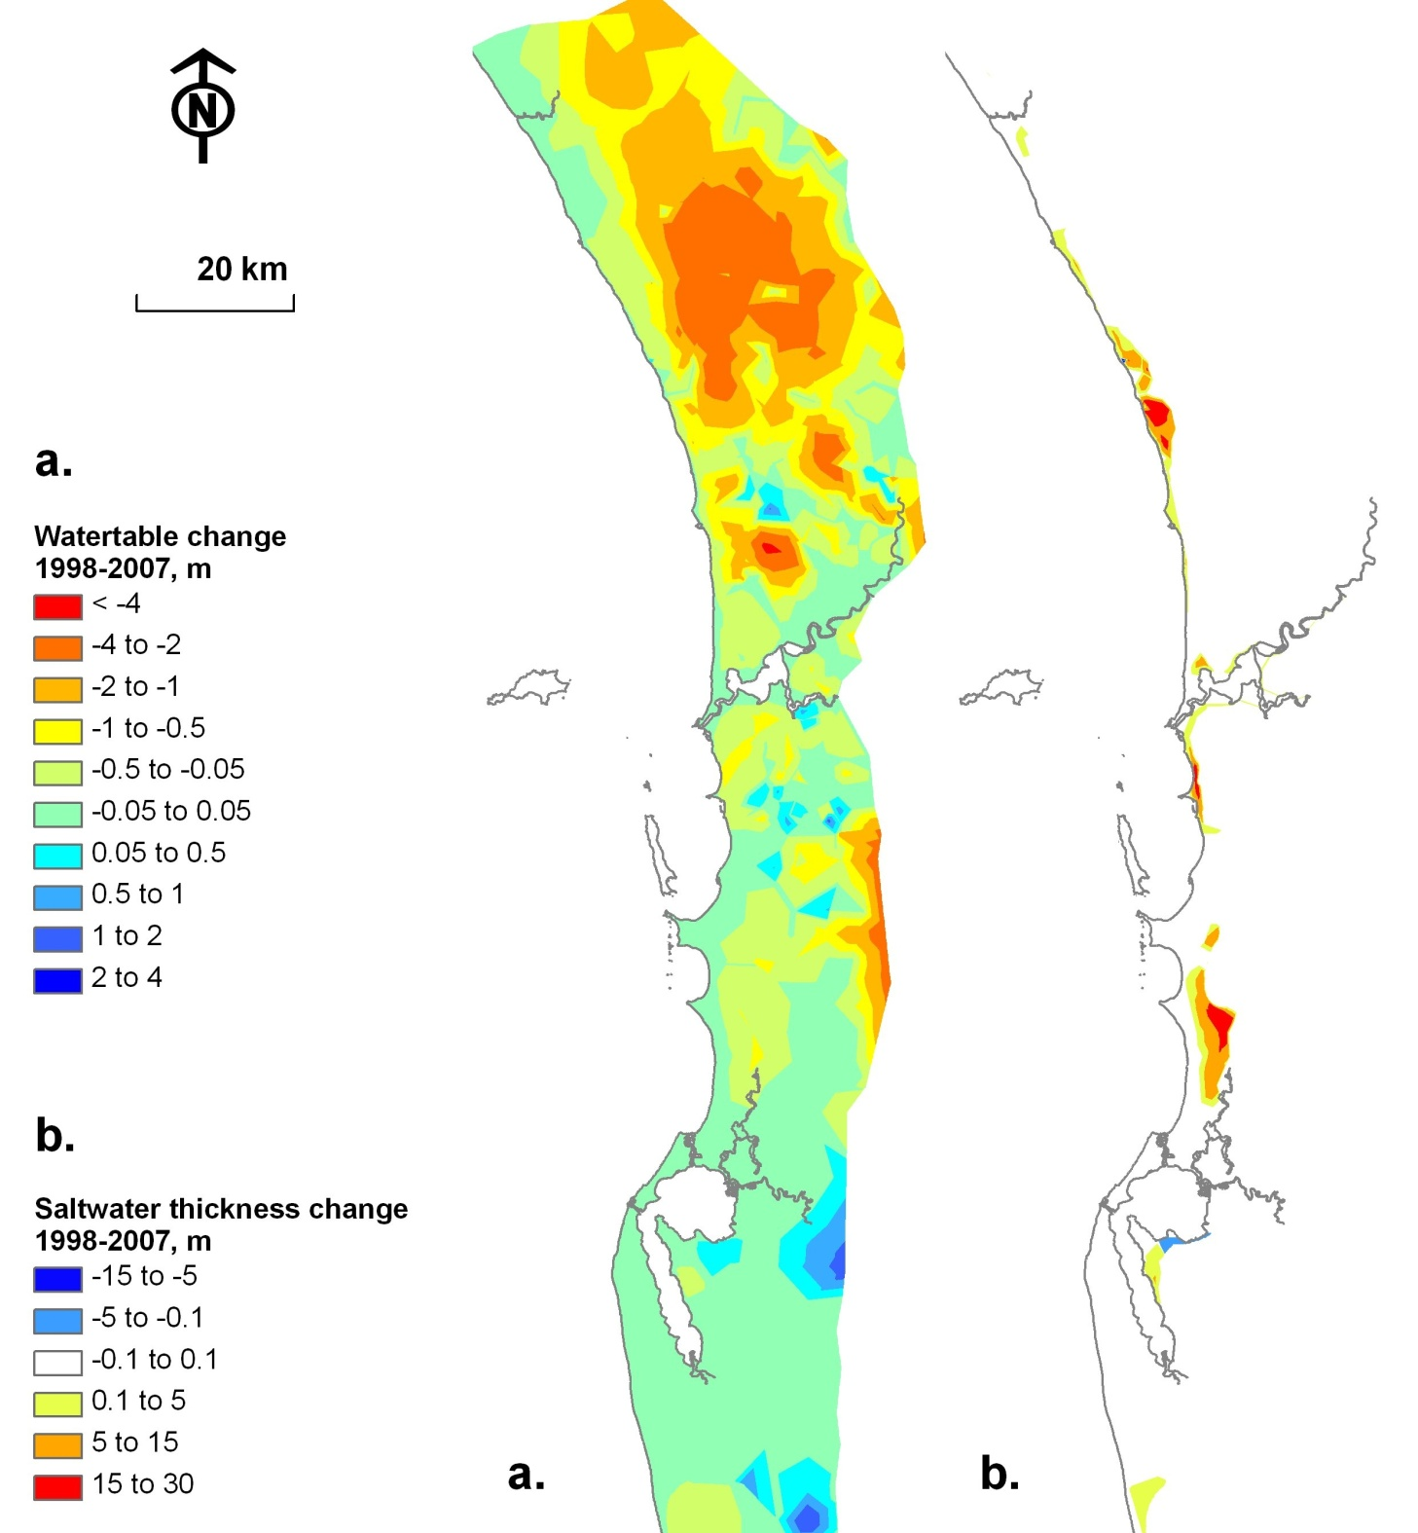
Decline in groundwater levels in the Superficial Aquifer between 1998 and 2007
Freshwater thickness change between 1998 and 2007
A fall of 0.1m = reduction of 4 m in freshwater thickness in areas underlain by a salt water interface
Smith and Pollock (2010)
Notes:
Loss in groundwater levels mainly on Gnangara Mound associated with less rainfall, pines and areas of abstraction
Salt water intrusion an emerging issue in the NW coastal strip around Ocean Reef, Coogee and west of Mandurah Road around Lakes Cooloongup and Walyungup

Slide 7
Seawater interface in bore YSI1 located 550 m from the Yanchep coast
Kretschmer, P & Kelsey, P 2016, Loch McNess hydrogeology and causes of water level decline (1975–2011), Hydrogeological record series, HG60, Department of Water, Western Australia
Notes:
A small fall in groundwater level in areas underlain by a salt water wedge can disguise a much larger loss in freshwater thickness.
These data from a bore located more than half a km from the Yanchep coast shows a progressive increase in salinity which accelerated since 2009

Slide 8
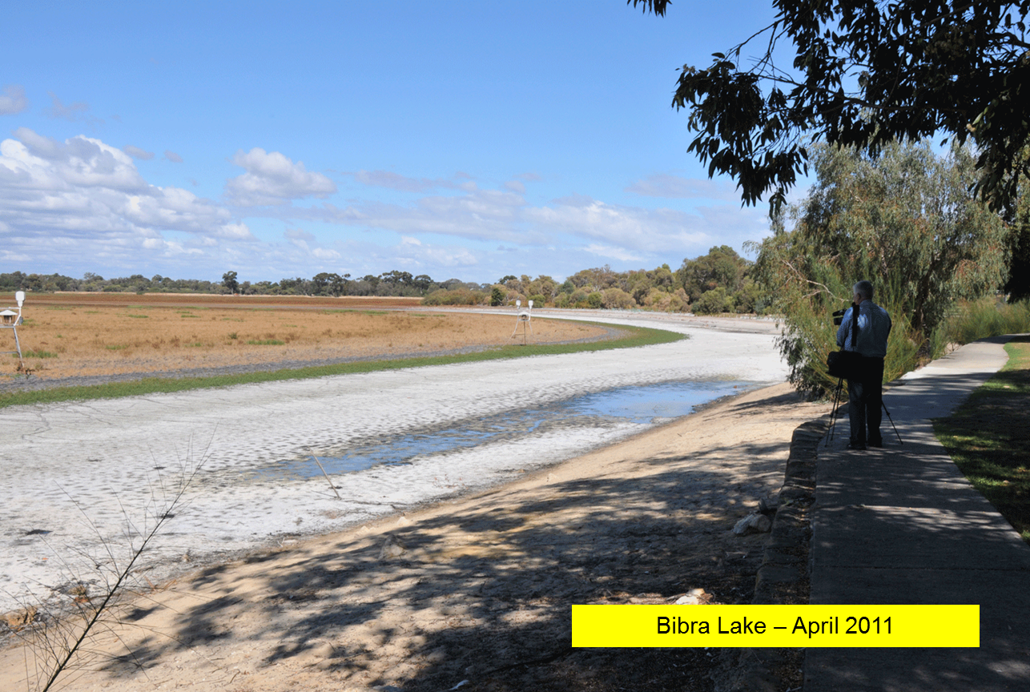
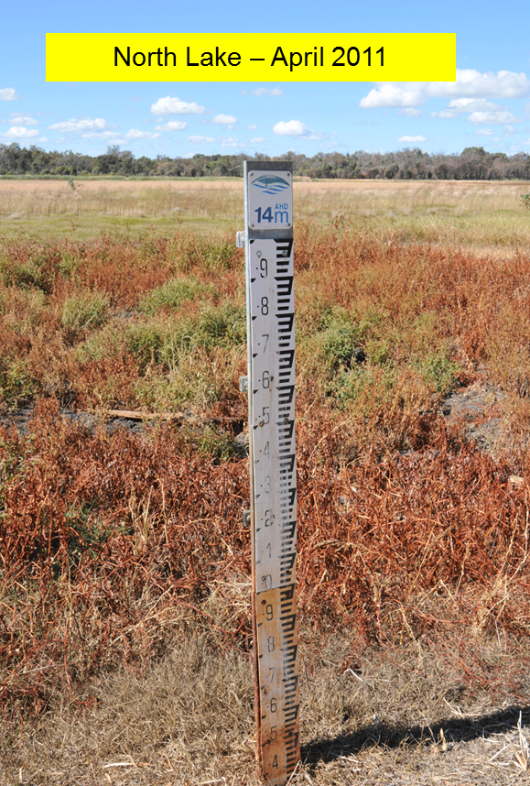
Throughflow lakes are drying as groundwater levels fall
Photography: Bob Humphries
Notes:
Wetlands have been progressively lost on the coastal plain with those nearest the mound to be lost first (Pinjar, Gnangara etc)
While they retain some ecological function, the loss of free water in summer from all lakes will seriously affect breeding
Permanent wetlands can have a drought refuge function for waterbirds and provide resources for estuarine waterbirds (such as nesting sites and access to freshwater) – Mike Bamford. Therefore their loss would have wider implications than first appreciated.

Slide 9
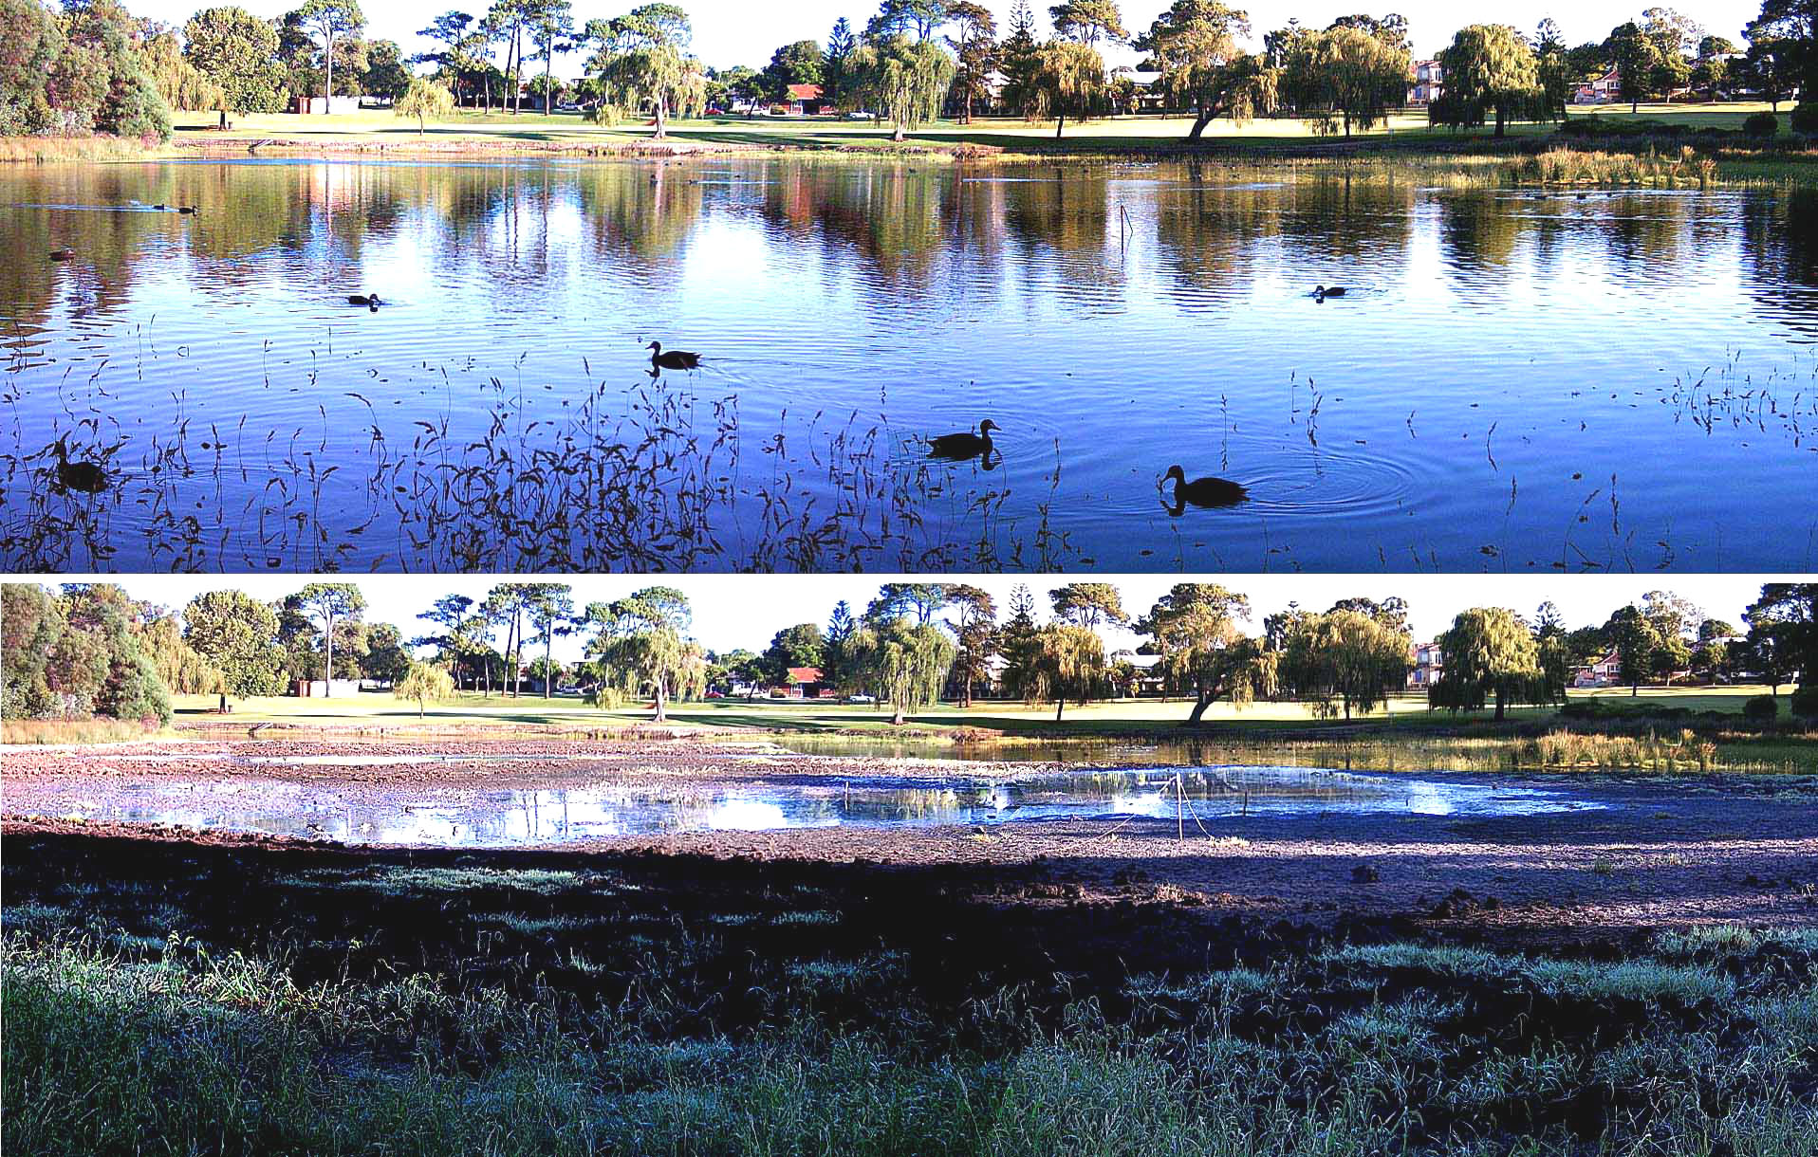
Lake Jualbup has considerable aesthetic, ecological and economic values when full as it was more often in the 1980s
Photographs by Geoffrey Dean
Notes:
Local communities are going to great lengths to retain open water in urban wetlands.
Lake Jualbup was frequently full in the 1980s but is now dry each summer unless it receives water from de-watering at QE2

Slide 10
Direct (soil infiltration) and indirect (discharge from roofs and roads) recharge in urban areas

Slide 11
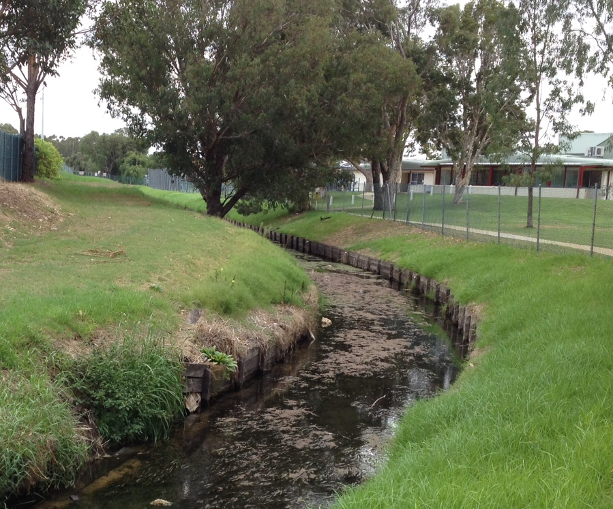
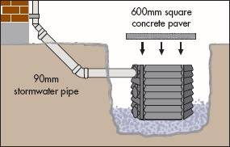
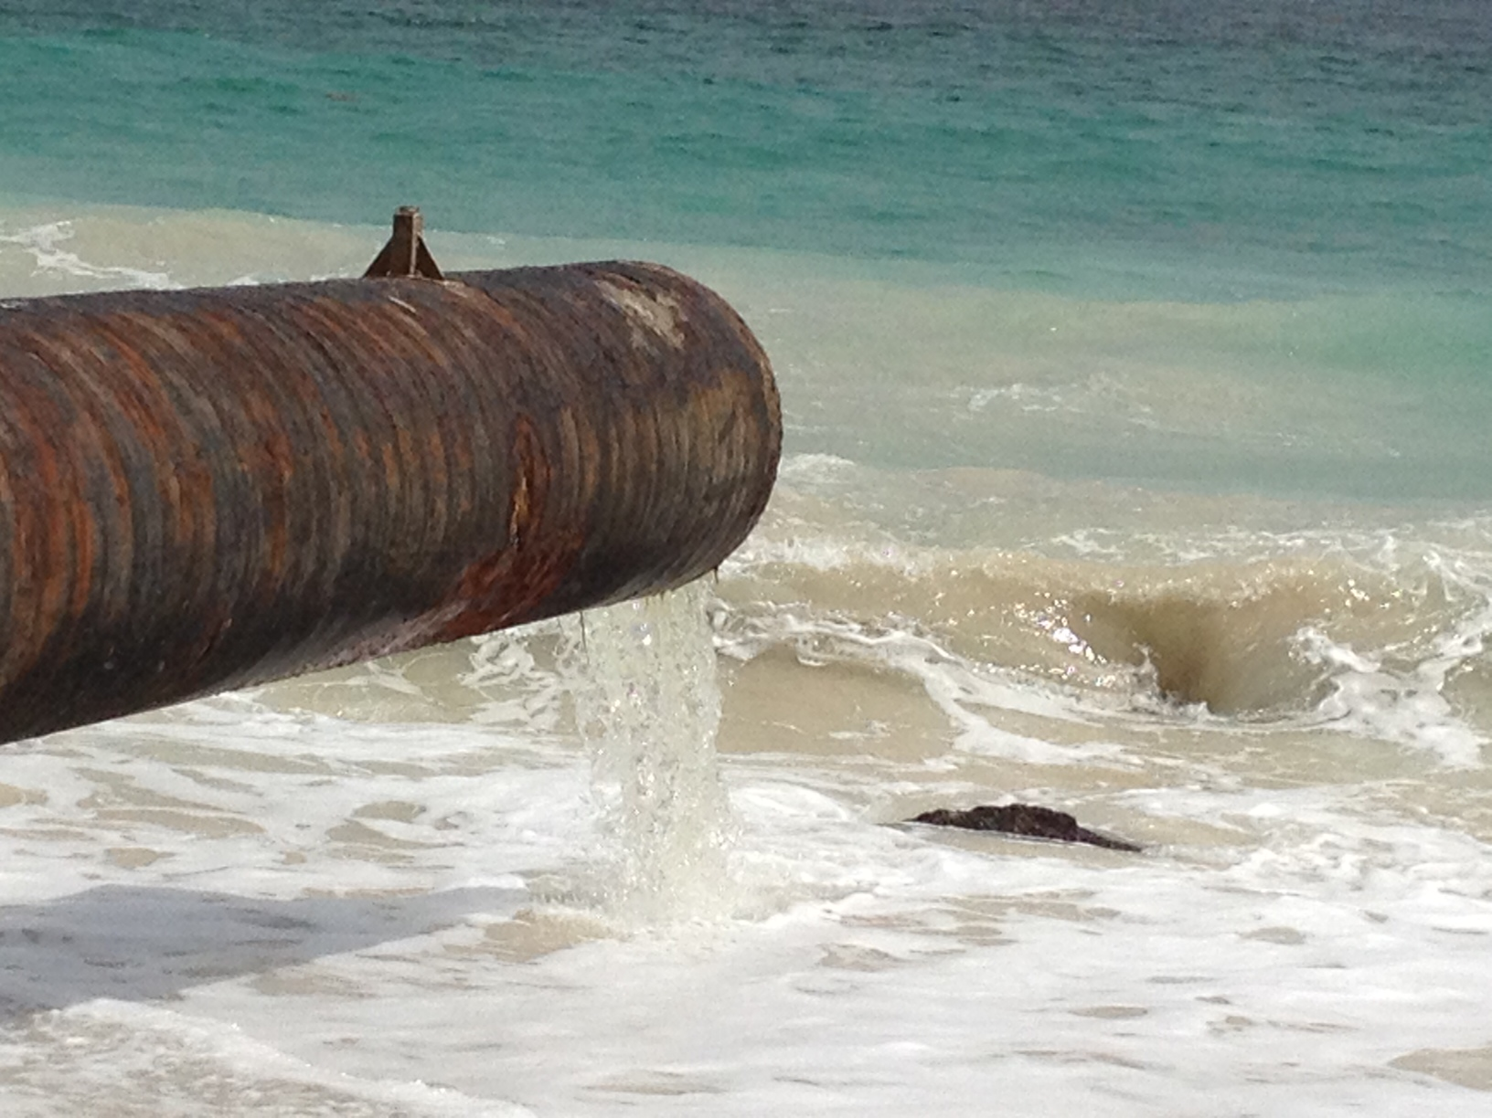
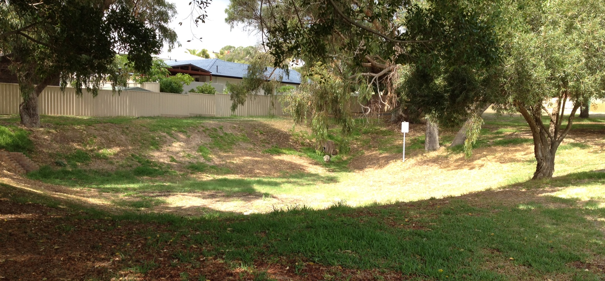
Herdsman main drain discharging to Floreat Beach - left
Roof and paving runoff recharges the aquifer via soak wells - upper right
Suburban absorption basin for road runoff - lower right
Notes:
On the left is an example of a main drain operated by the Water Corporation – Herdsman which discharges to Floreat Beach
On the right is a cross section of a soak well for discharging roof runoff (upper right) and an absorption basins for local government road runoff (lower right)

Slide 12
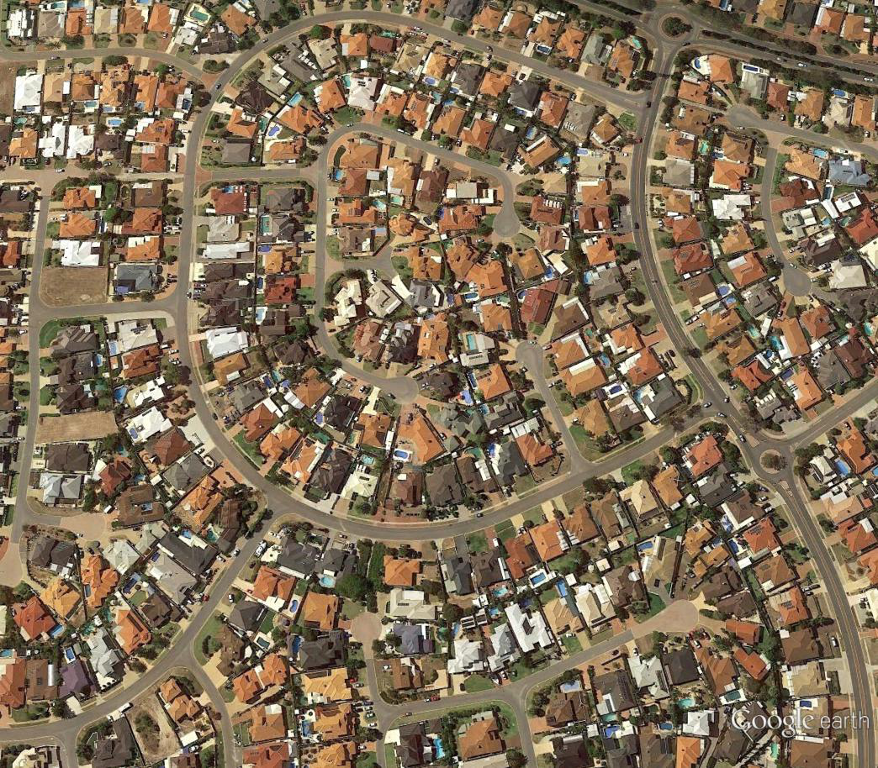
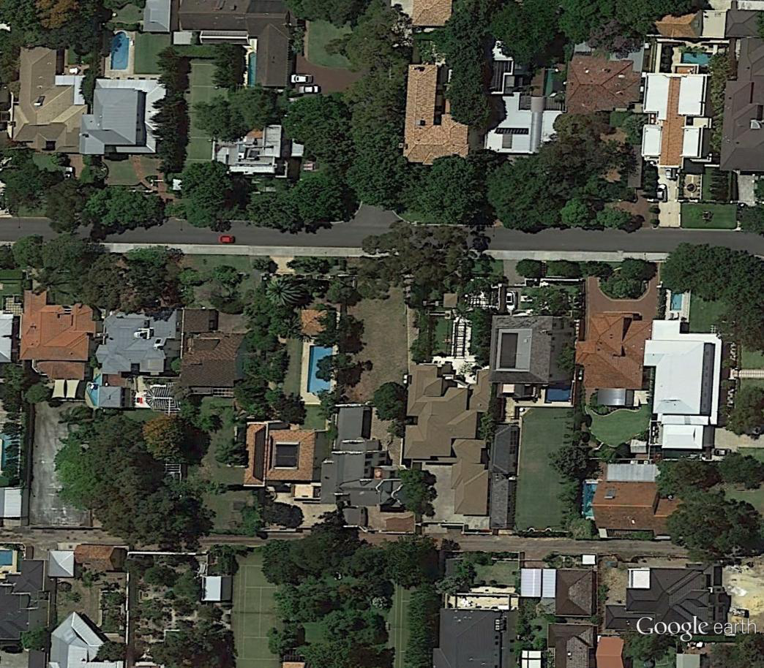
The higher the urban density the:
  greater the roof (and often road) area
  more indirect recharge from roofs and roads
  less the direct recharge from lawns and gardens
  less the demand for groundwater discharge by backyard bores
  less the demand for potable water on a per-household basis
  greater the wastewater volumes on an area basis
  What urban density just maintains groundwater levels in the current climate?
Notes:
The average block size was 1000 m² (quarter acre) – left
It is now more like 350 m² – right

Slide 13
Nedlands Dalkeith catchment (~ R 10) November 1981 – October 1882
Recharge from roofs and roads = 138 mm
Discharge by private and public bores = 228 mm Net = - 90 mm
Source: McFarlane 1984
Notes:
The water balance of a 1000 m² (quarter acre) block area in the early 1980s shows that recharge from roofs and roads is unable to replace the water extracted by bores despite a 850 mm rainfall

Slide 14
Subiaco Shenton Park catchment (~ R 17.5) November 1981 – October 1882
Recharge from roofs and roads = 196 mm
Discharge by private and public bores = 38 mm Net = + 158mm
Notes:
The water balance of a ca. 570 m² block area in the early 1980s shows that recharge from roofs and roads exceeded water extracted by bores and about 100 mm was discharged through a main drain to the ocean

Slide 15
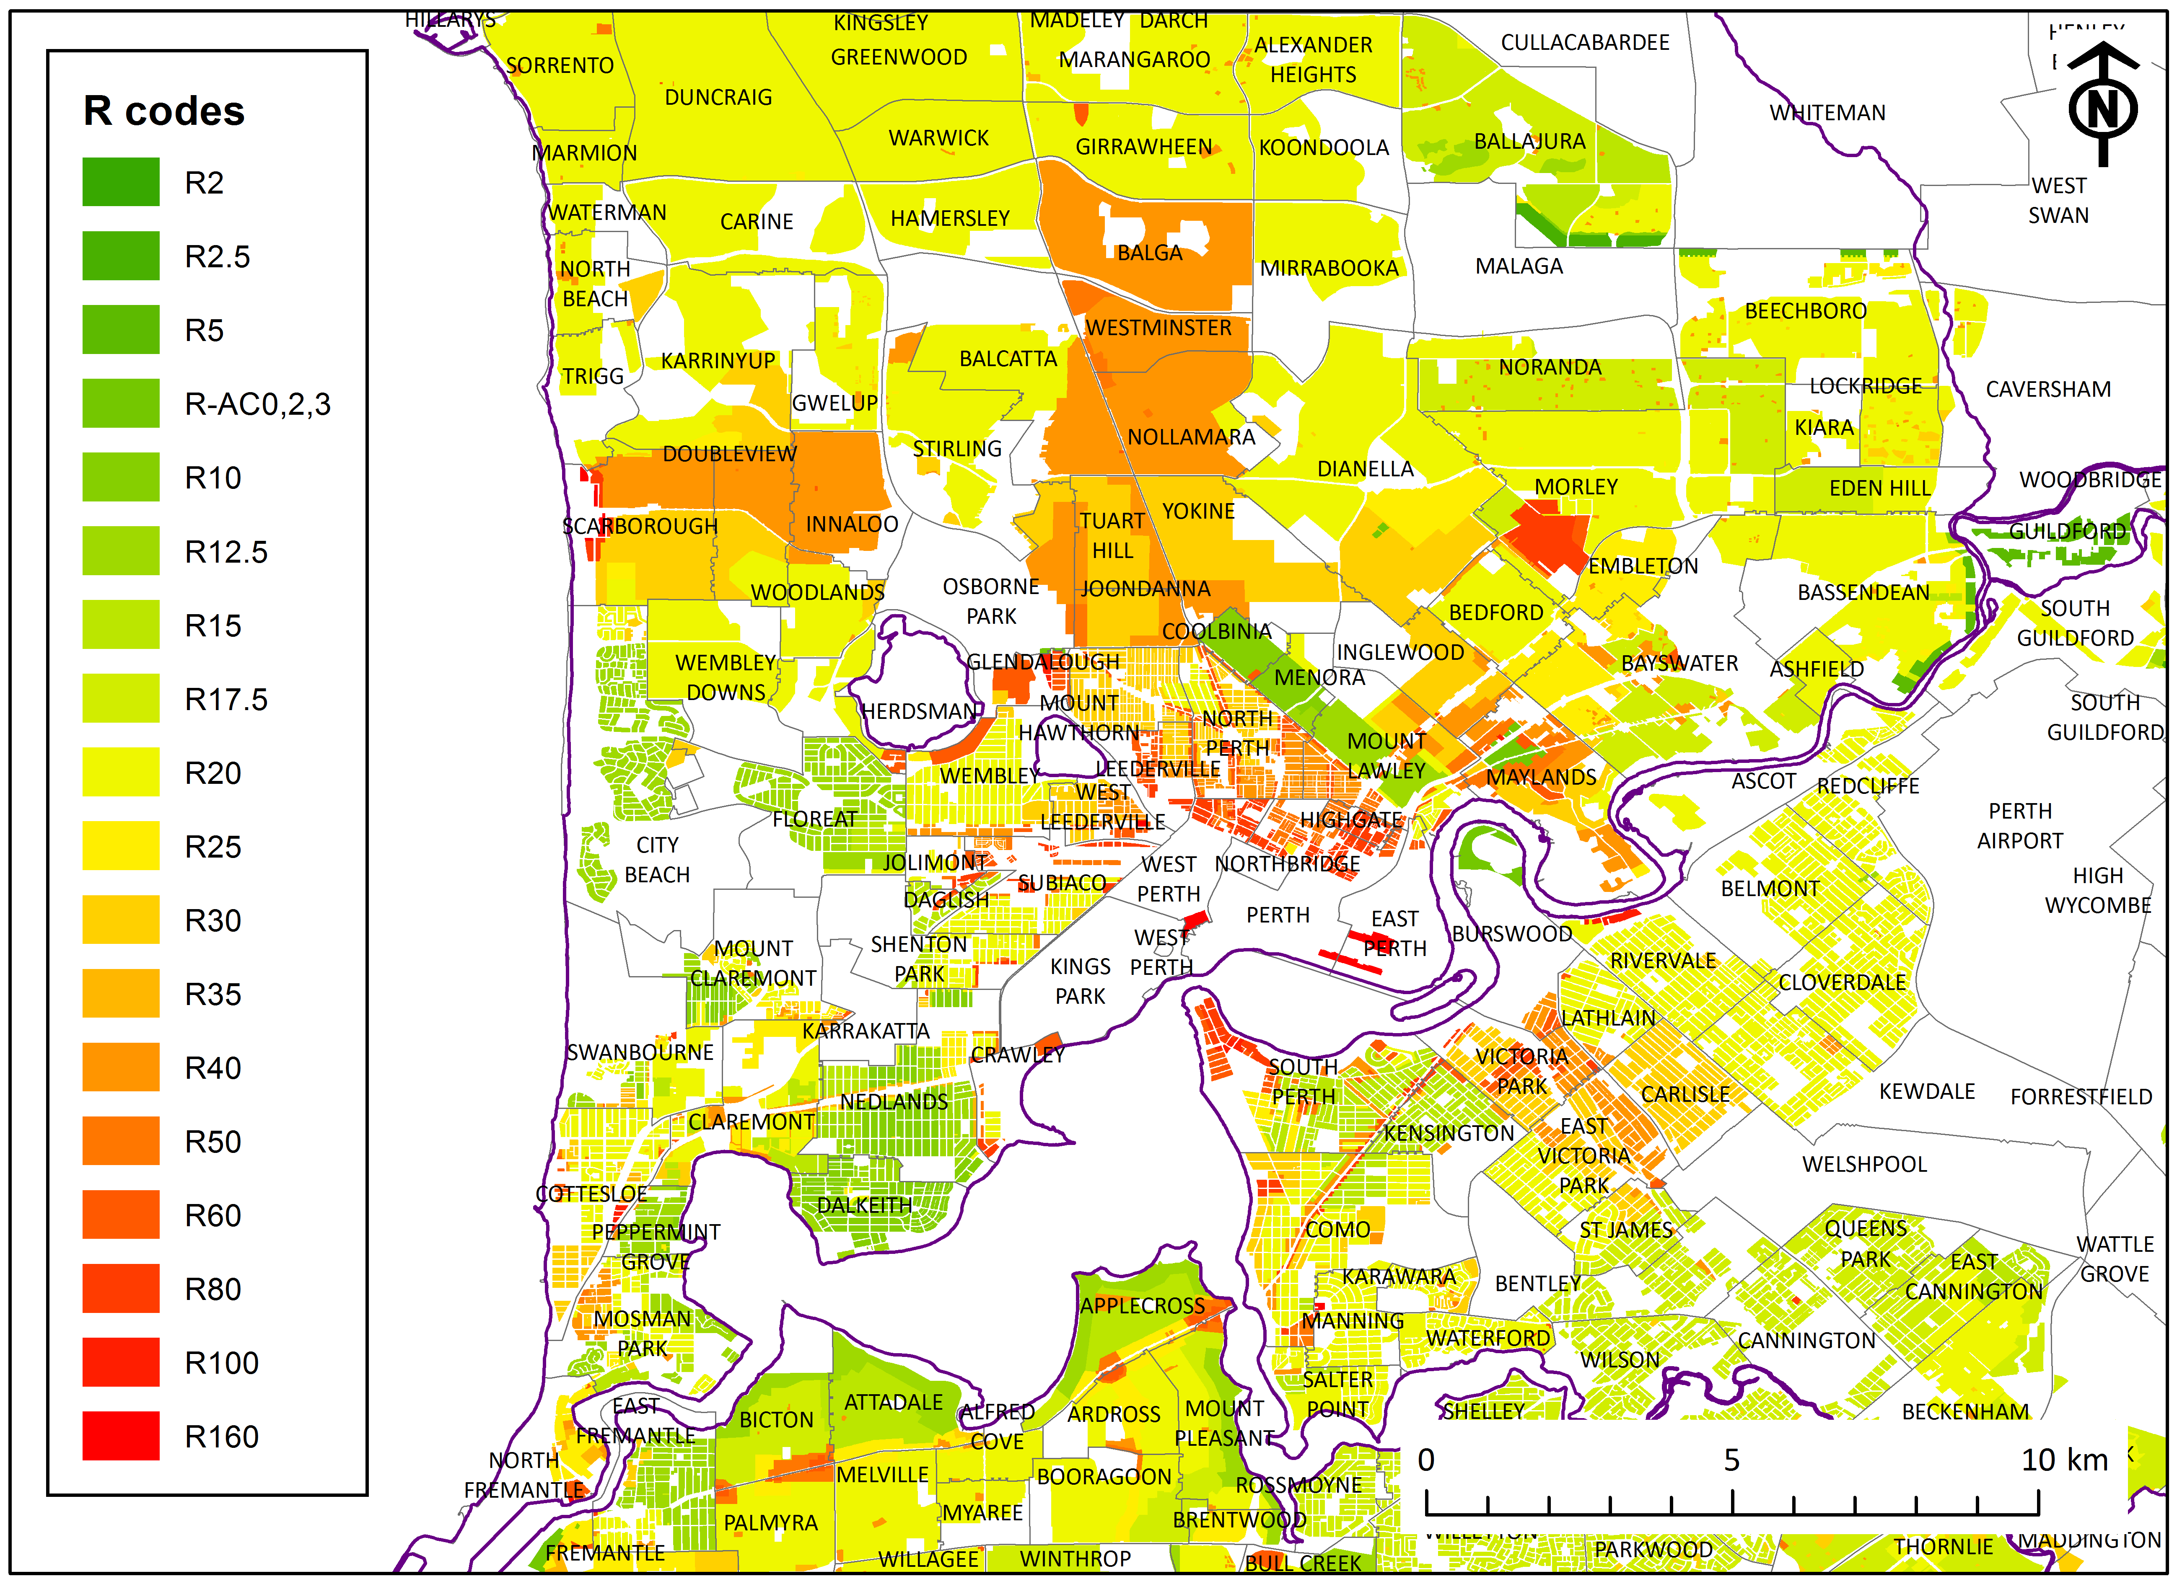
R ca. 20 is probably in balance in the current climate
Notes:
The green areas which areas with relatively few roofs and large areas requiring irrigating
Yellow, orange and especially red areas are more likely to be net recharge sites

Slide 16
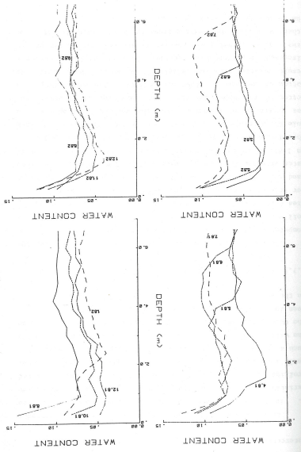
Wetting fronts no longer go deep in dry years like 2001, 2006, 2010
6m
August
6m
July
Kings Park
Lawn
6m
August
July
6m
Notes:
An example of computer plotting from 1983 – 33 years ago!
The depth of wetting front penetration in urban areas in dry years has net been measured to my knowledge but lake and watertable responses seem to reflect the dominance of indirect recharge from shedding areas over slow seepage through deep sands

Slide 17
2 Stormwater quantities, quality and impact on the Superficial Aquifer

Slide 18
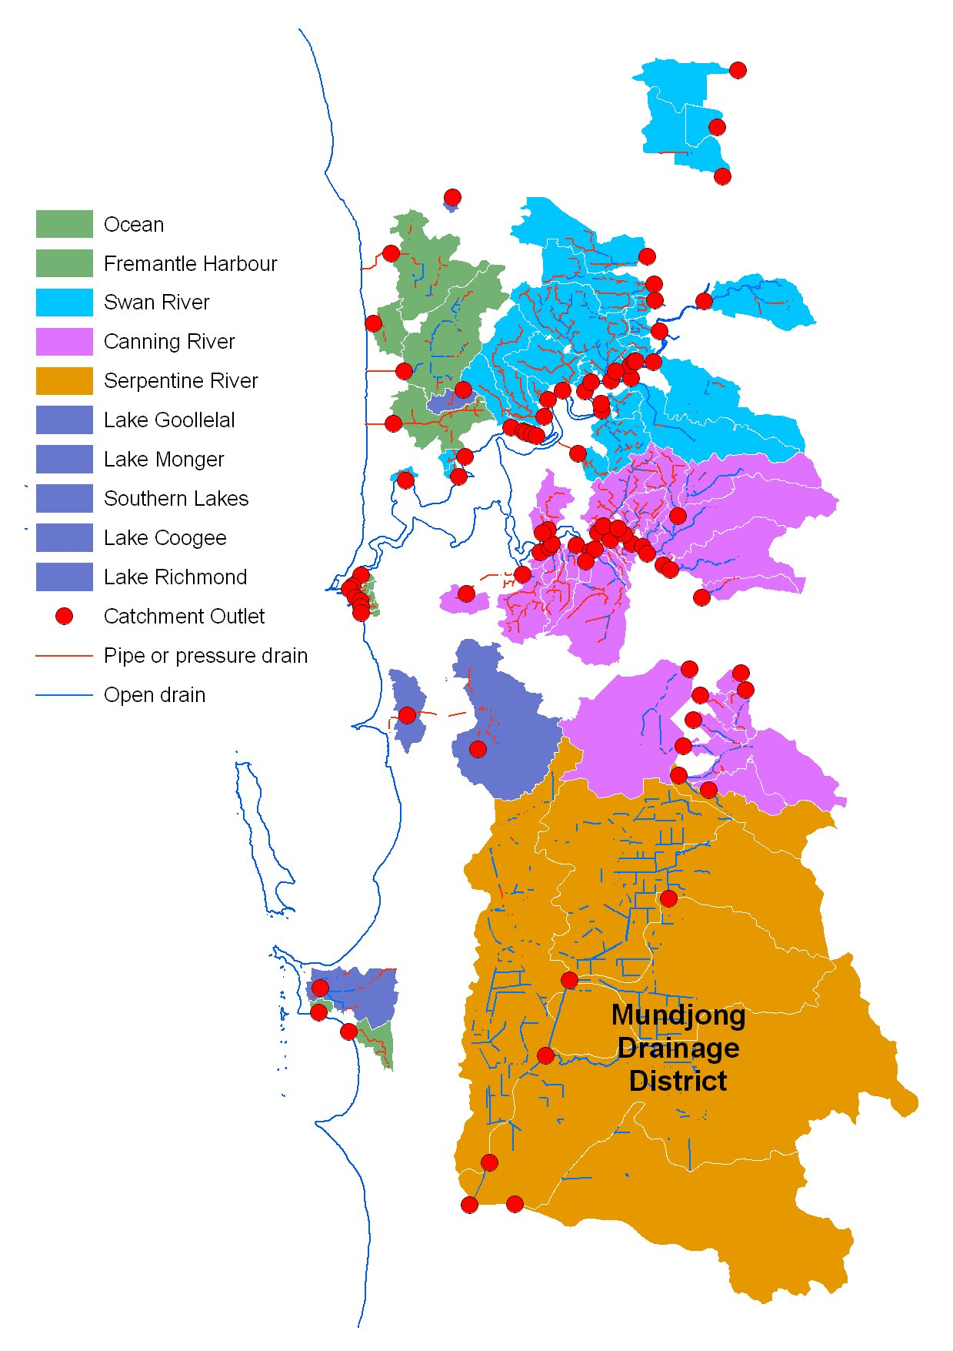
Estimation of flows from main drains
Data from GDH (2008) and Geoff Hughes (Water Corporation, 2007)
Outlets
  Swan – Canning 80 GL/yr
  Ocean 18 GL/yr
  Peel 21 GL/yr
  TOTAL ~120 GL/yr
Rainfall runoff (~ 40%)
Groundwater discharge (~ 60%)
Need both a source and a sink
Increasing interest by coastal shires in diversion to the aquifer
Volumes are decreasing rapidly
Notes:
Estimates made by GHD and the Water Corporation.
Estimates include stormwater runoff and groundwater drainage.
Values are based on catchment area, annual rainfall amount, and run-off and groundwater drainage coefficients

Slide 19
Stormwater quality
Contaminants in stormwater discharge and associated sediments at Perth’s Marine Beaches (DoW 2007)
  Main contaminants are microbes and heavy metals (Al, Cu, Fe, Pb)
  Nutrient concentrations were generally low with a few exceptions
Non-nutrient contaminants in the Swan Canning River System (SRT 2009)
  The levels in water and sediments were typical for urbanised catchments
  Organochlorine pesticides (eg dieldrin) and metals are the main issues
  Polycyclic aromatic hydrocarbons, herbicides, petroleum hydrocarbons and anionic surfactants may also be high
In-stream processes also affects main drain water quality (Donn and Barron 2012)
Impacts of stormwater MAR on groundwater quality
  McFarlane (1983) and Appleyard (1993) reported reduced salinity and increased oxygenation in groundwater near infiltration basins. When oxygen levels are low in wetlands before stormwater enters, iron can be leached from unsaturated yellow sands resulting in intense iron staining when used for irrigation
  Appleyard found no fecal coliforms, streptococci or Salmonella organisms in the groundwater near infiltration basins
Notes:
Microbes – enterococci used as an indicator of fecal contamination

Slide 20
Herdsman to Floreat main drain diversion GHD report 2010
Cost ca. $220K. Flow as 9.8 GL/y in 1993-1999
Notes:
An example to the feasibility of diverting main drain water to the aquifer is the Herdsman to Floreat drain near Newman College, Empire Avenue in Wembley Downs.
It would cost about $220K to construct a diversion into the Wembley Golf Course and it would operate at no cost while diverting 4-5 GL/y (down form the 10 GL in the 1990s). This is much more that the Golf Club use so the diversion would benefit a number of private parties as well

Slide 21
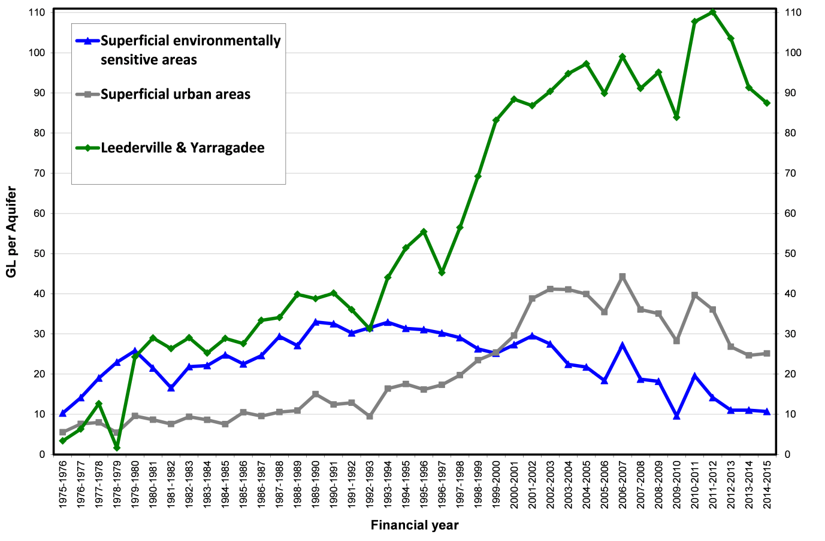
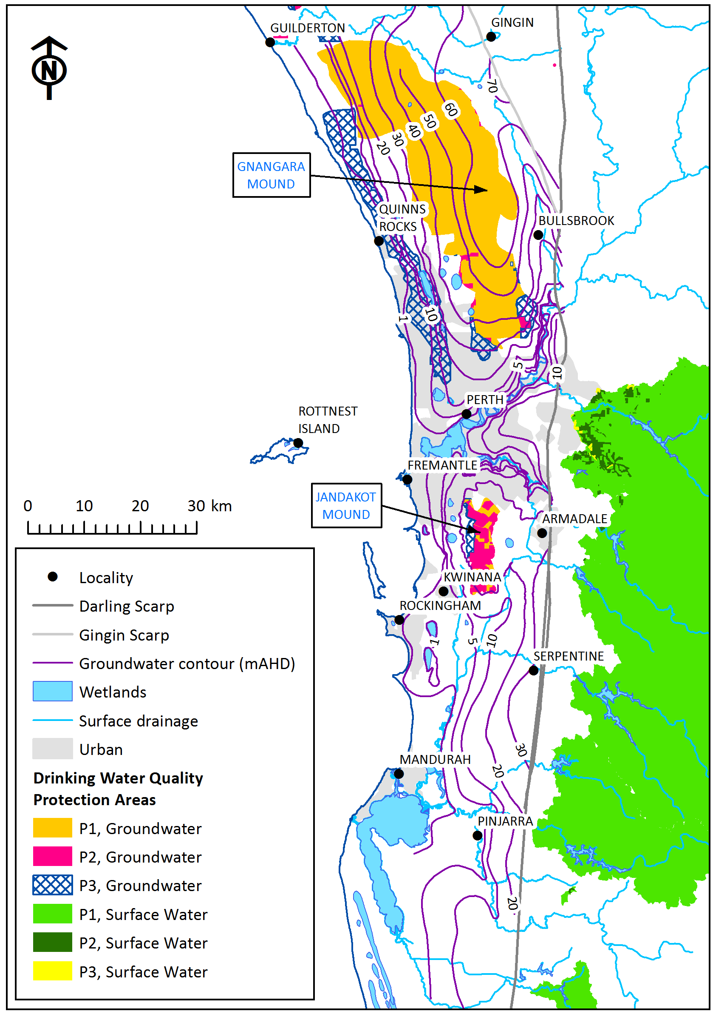
The Superficial Aquifer under ‘high urban density’ parts of Perth has become a significant drinking water source compared with the mounds i.e. stormwater is contributing to our drinking water supplies
Notes:
The left hand graph shows that the use of shallow groundwater for drinking from under urban areas (P3) surpassed that under P1 protection mounds in 2000. This indicates that stormwater is considered a very safe source of water for Perth
The rest of this talk will concentrate on wastewater

Slide 22
Treated wastewater as a source of MAR water

Slide 23
Wastewater discharge to the ocean and aquifer in 2013
Source: Water Corporation
Wastewater discharge 2013
  Ocean outfalls
    Alkimos 2
    Beenyup 49
    Subiaco 24
    Cape Peron 57
    Total 132 GL/yr
  Coastal infiltration sites
    Yanchep 0.23
    Kwinana 1.70
    Gordon Rd 3.45
    Halls Head 0.90
    Caddadup 0.54
    Total 6.82 GL/yr
  Groundwater replenishment trial
    Beenyup 1.40 (14 GL/y by end 2016; 28 GL/y just approved)
Two Rocks
WWTP
Yanchep
WWTP
Alkimos WWTP
Bullsbrook
WWTP
ALKIMOS
OUTFALL
2 GL/yr
Bullsbrook
BEENYUP
OUTFALL
49 GL/yr
Beenyup
WWTP
Mundaring
WWTP
SUBIACO
OUTFALL
24 GL/yr
Mundaring
Subiaco
WWTP
Woodman Pt
WWTP
Kwinana
WWTP
Point Peron
WWTP
Proposed
East Rockingham
WWTP
CAPE PERON
OUTFALL
57 GL/yr
Gordon Rd
WWTP
Halls Head
WWTP
Caddadup
WWTP
Pinjarra
WWTP
Notes:
Potential source of MAR (see outfall list);
Analogs for MAR in the infiltration basin sites
The idea of disposing of wastewater to the aquifer is commonly used on the Swan Coastal Plain. Focus will be on this area (and the SDOOL).
In 2013 about 132 GL per annum was discharged to the ocean at 4 ocean outfalls and over 6.8 GL per annum was infiltrated in to the aquifer.
Treated wastewater grown by about 3 GL/y so is a growing resource in a drying, but expanding city
SDOOL = Sepia Depression Ocean Outlet Landline

Slide 24
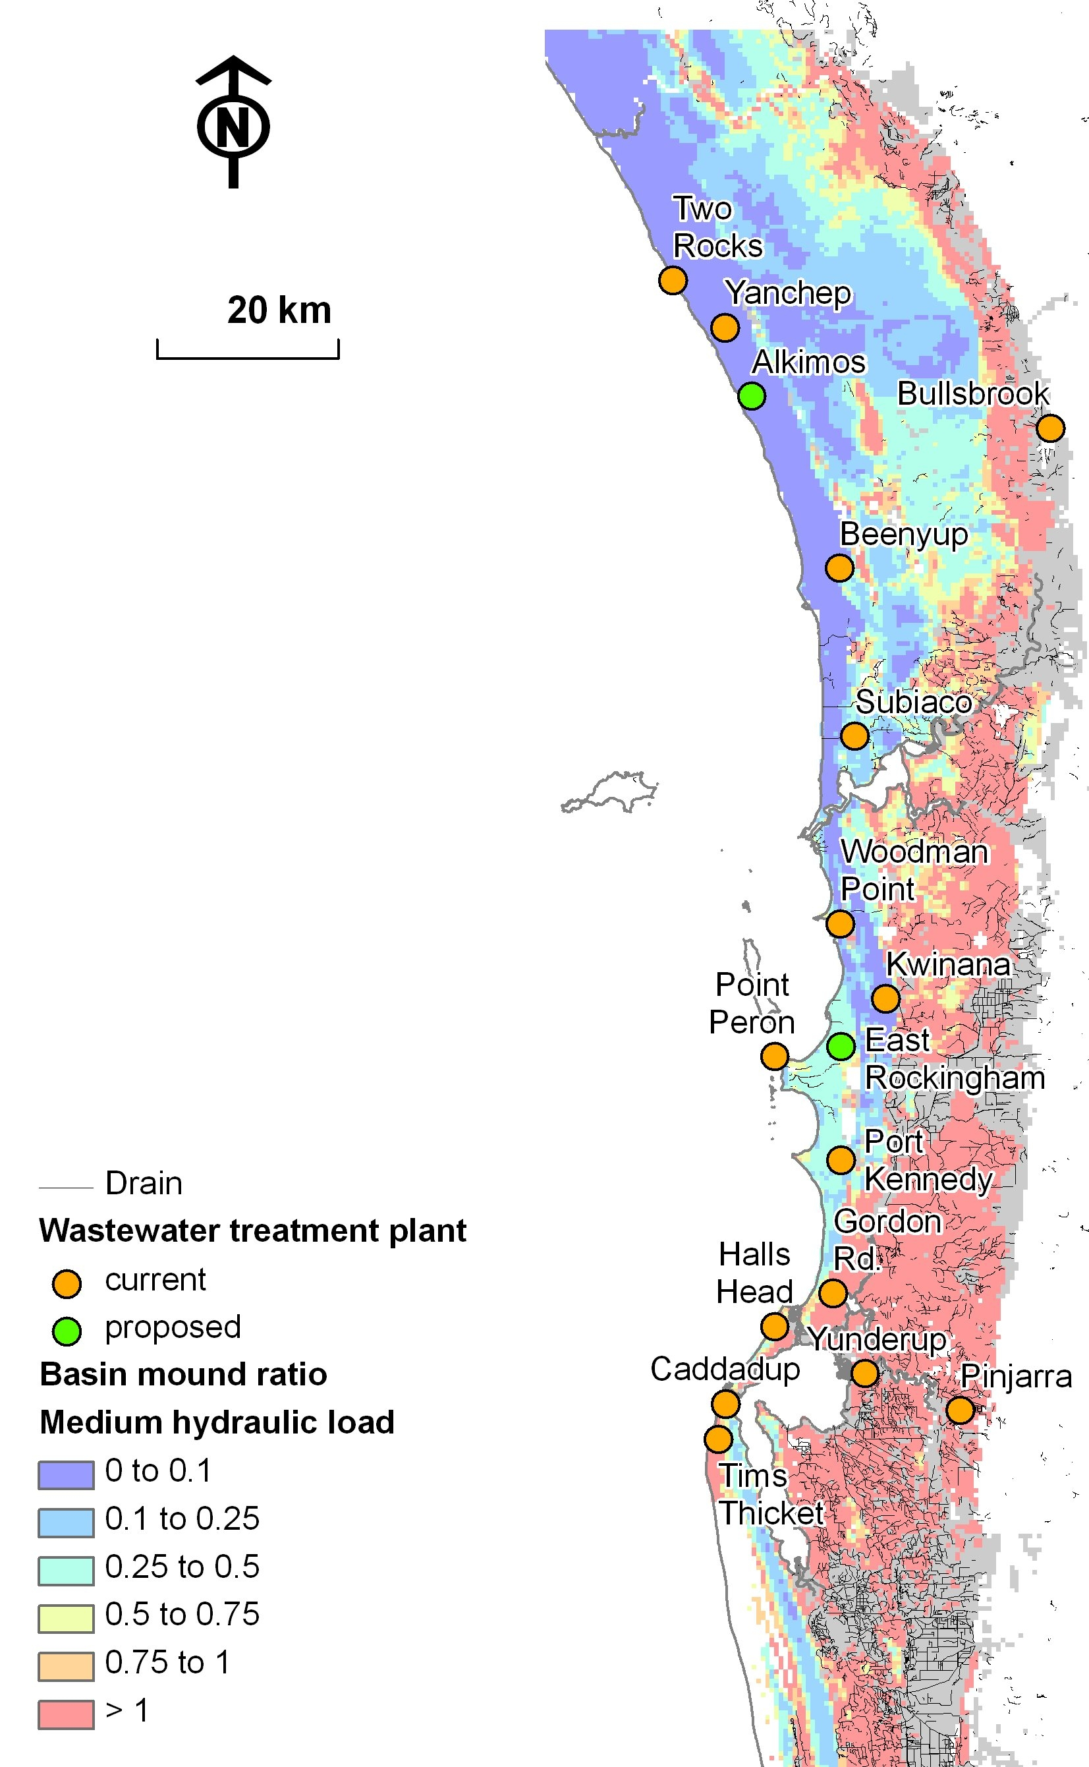
Suitability for MAR
Basin infiltrating 5 ML/d
Smith and Pollock 2010
Grey – infiltration rates very poor
Pink – high watertable and low transmissivity means that the infiltrated water may reach the surface
Light blue – suitable; may enhance wetlands by raising groundwater levels
Dark blue – suitable; no impact on wetlands; may help prevent salt water intrusion
Notes:
Where physically could you infiltrate stormwater or wastewater ? You need permeable soils, a transmissive aquifer and a reasonable depth of the watertable to prevent the water reaching the soil surface

Slide 25
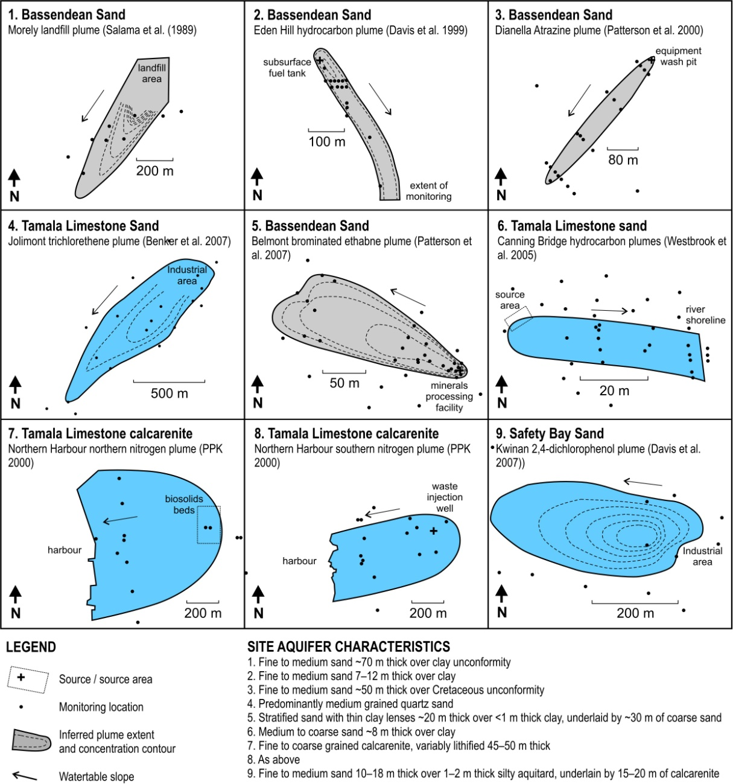
Regular plume geometries and other evidence suggests the risk of conduit flow in Tamala Limestone is low
Suggestive of larger lateral dispersion in Tamala Limestone
93% of bores with no mention of secondary porosity in Tamala Limestone
Tamala Limestone in the Perth region contains a predominantly diffuse-flow aquifer rather than one dominated by conduits and cavern flow; with the exception of cave areas
Dual porosity due to partial dissolution
Source: Is the Tamala Limestone aquifer safe for managed aquifer recharge? Tony Smith, Sylvain Massuel and Daniel Pollock (IAH Conference, 2013)

Slide 26
Managed aquifer recharge at the Floreat Infiltration Gallery site
Five fold recovery from 50m results in 70 day residence time (model)
Groundwater + Effluent Pumped to Sewer (250 KL/day)
Treated Sewage Effluent (50 KL/day)
Inflow
Distance of 50 m
Spearwood Sand
Tamala Limestone
Water Table
Depth (m)
Base of the Tamala Limestone
Slide from Elise Bekele
Notes:
The water takes a couple of days to go through the yellow sand and another 70 or so days to be recovered from a pumping bore located 50 m down gradient

Slide 27
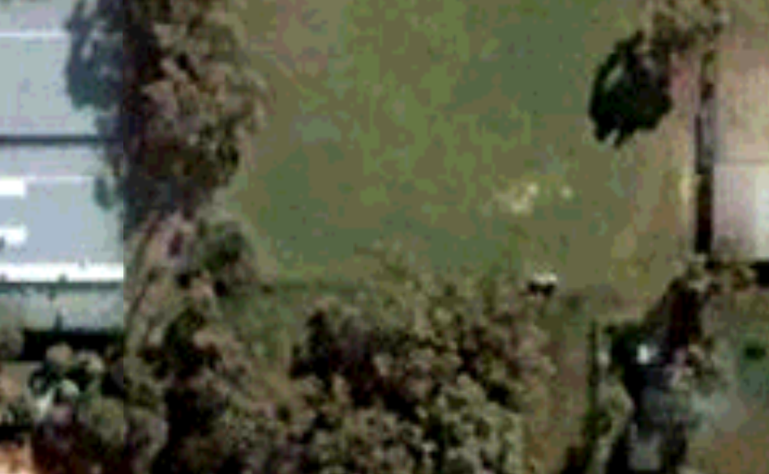
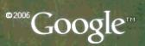
Floreat Infiltration Galleries – Groundwater Quality
Data from Oct. 2005 to Dec. 2006
Total Nitrogen
Groundwater Flow
2
10
Recovery bore
3
5
8
6
1
W Lake
Gallery West
Gallery East
Recovery bore
Bores 1& 2
Sites at Perry Lakes
Bore 10
Bore 8
Background bore 1
Bore 3
Bore 6
Bore 5
Slide modified from Elise Bekele
Notes:
Nitrogen levels are reasonably high – but they are also high in the groundwater around the lakes nearby and further south down gradient from the old Brockman Road tip.

Slide 28
Floreat Infiltration Galleries – Groundwater Quality
Data from Oct. 2005 to Dec. 2006
Phosphate
Groundwater Flow
2
10
Recovery bore
3
5
8
6
1
Gallery West
Gallery East
Recovery bore
Bores 1& 2
Background bore 1
Bore 10
Bore 8
Bore 3
Bore 6
Bore 5
Slide modified from Elise Bekele
Notes:
Phosphate is removed by both the yellow sand and especially the limestone aquifer

Slide 29
Floreat Infiltration Galleries – Groundwater Quality
Data from Oct. 2005 to Dec. 2006
Thermotolerant coliforms
Groundwater Flow
2
10
Recovery bore
3
5
8
6
1
Gallery West
Gallery East
Recovery bore
Bores 1& 2
Background bore 1
Bore 10
Bore 8
Bore 3
Bore 6
Bore 5
(from Dr Elise Bekele)
Slide from Elise Bekele
Notes:
Thermotolerant coliform bacteria and lost within 5 to 10 metres of the gallery.

Slide 30
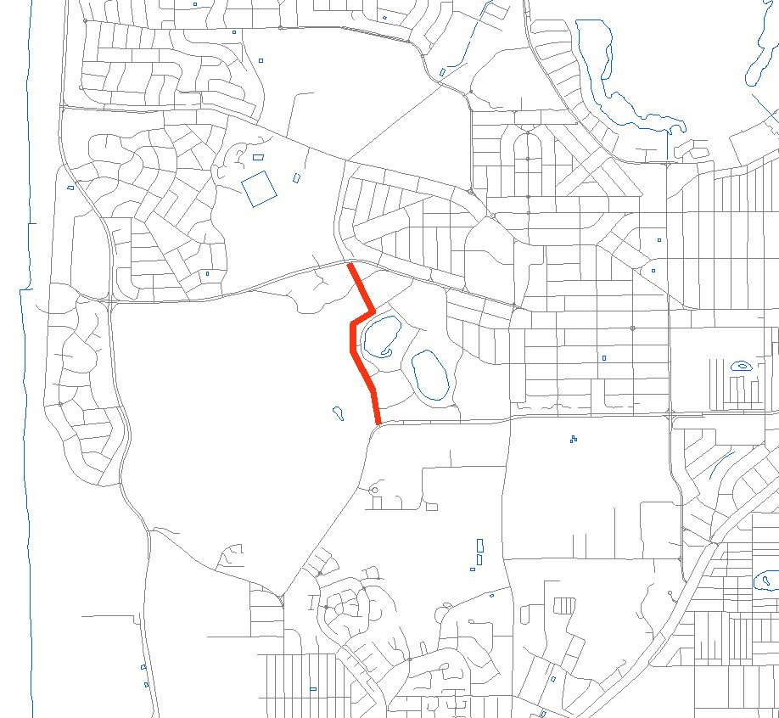
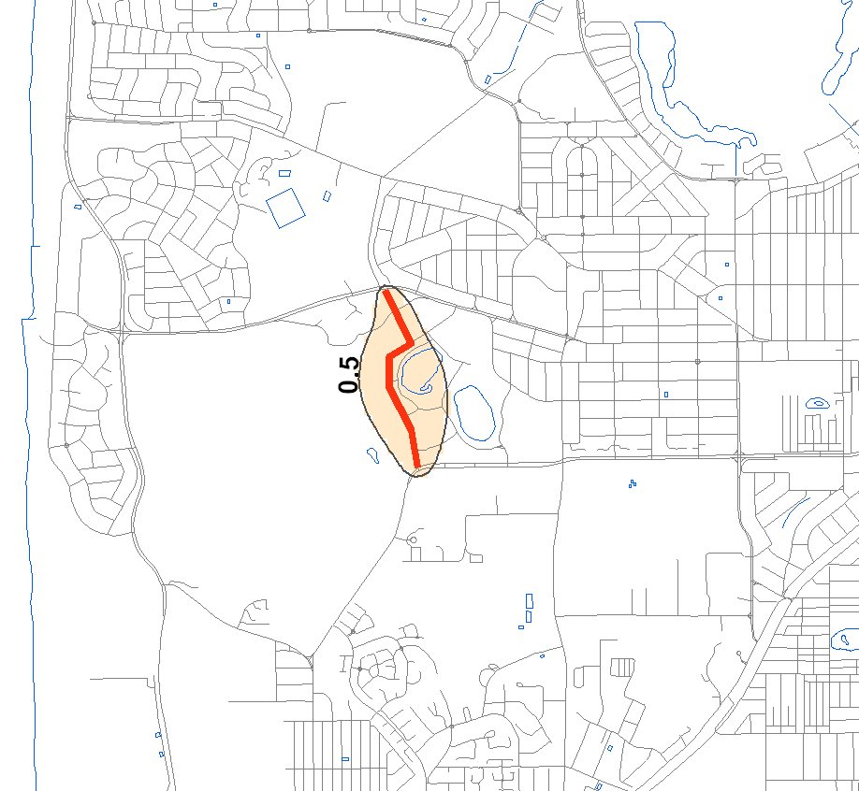
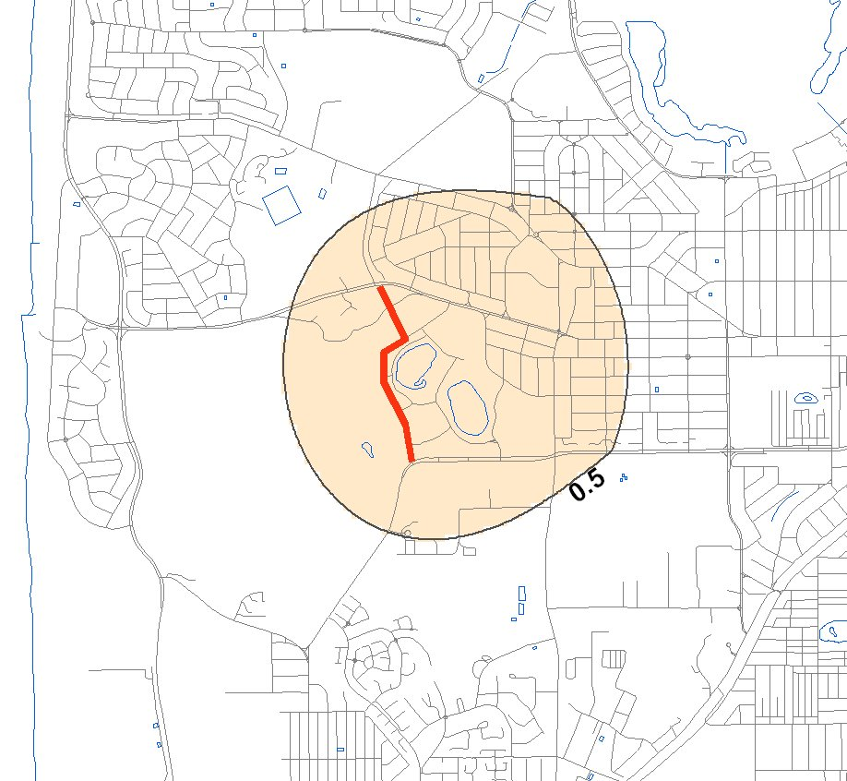
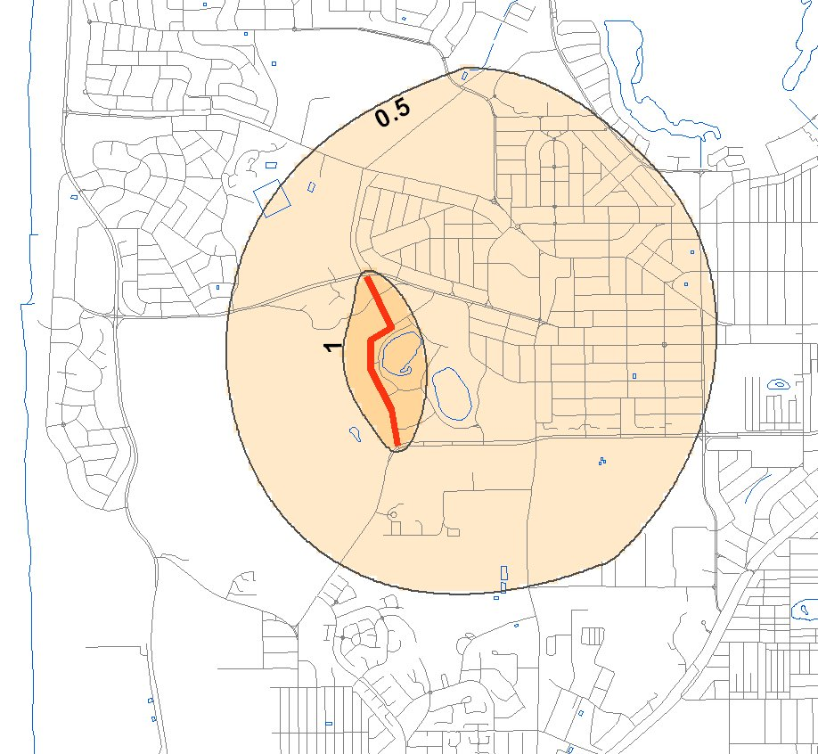
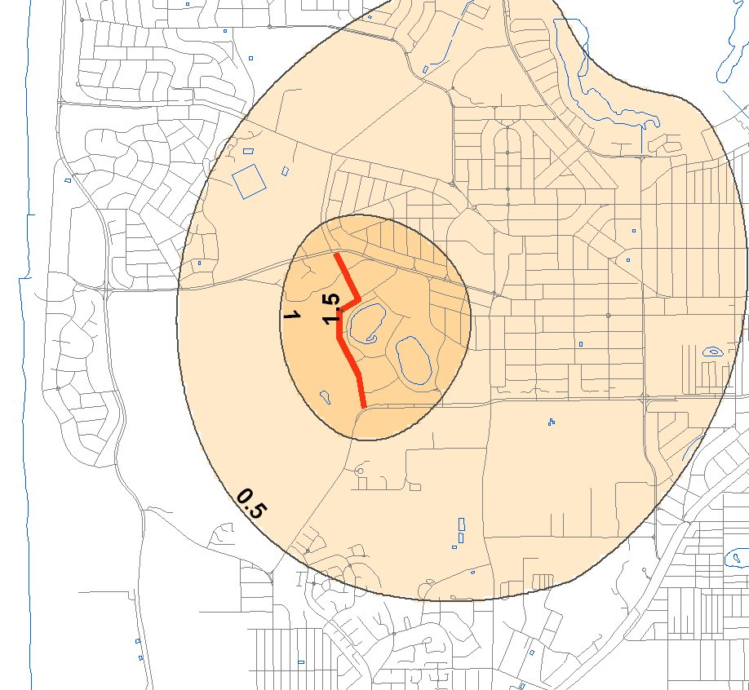
Model results for a 1.3km gallery along Perry Lakes Drive
Infiltration: 1 m/d
1.3 ML/d
Infiltration: 2 m/d
2.7 ML/d
Infiltration: 3 m/d
4 ML/d
Infiltration: 4 m/d
5.3 ML/d
Infiltration: 5 m/d
6.7 ML/d
Direction of groundwater flow
Most of the raised groundwater levels are up-gradient of the point of infiltration – ‘underground dam’ effect
Notes:
When added the greatest groundwater response is often up-gradient because the normal flow of groundwater is disrupted
The rise should not be mistaken for treated wastewater reaching these areas however as will be shown later

Slide 31
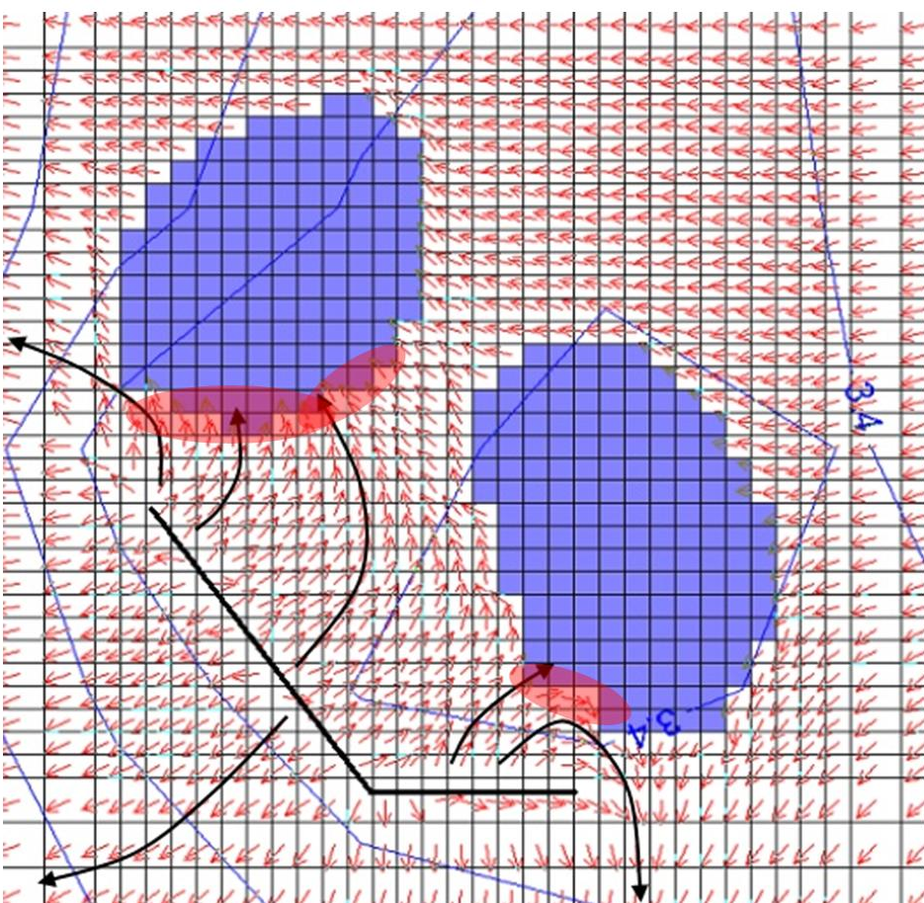
Groundwater modelling of gallery options at Perry Lakes
(Drummond et al. 2011)
≈ 80 days for infiltrated water to reach both lakes under high infiltration scenario
Full response within 1 year
Could be finessed to reduce risk of lake ingress and achieve desired lake levels over time
Notes:
Detailed modelling of infiltration basins down gradient of the two Perry Lakes shows water will reach them in about 11 weeks if a high recharge rate is used. If this were to cause eutrophication problems then the additions could be reduced, but this also reduces the time for full recovery to more than 1 year

Slide 32
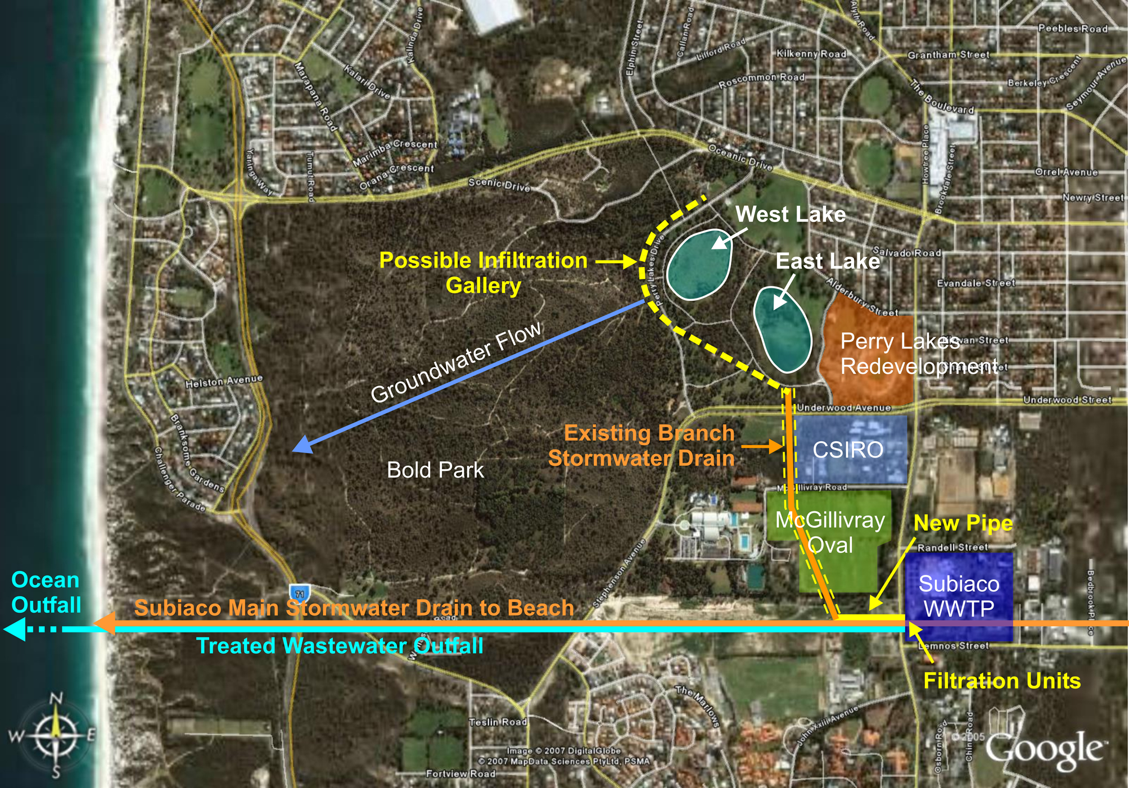
New option
Notes:
There is almost a complete pipe network to bring treated wastewater from the Subiaco WWTP to Perry Lakes Reserve
The two additional pipes are 150 m to connect the WWTP with the stormwater system and one from the stormwater system inside the Reserve to the point of injection. This could be a simple as a basin in the SW corner of the Reserve as shown by the yellow arrow. The effectiveness of this arrangement is still to be modelled

Slide 33
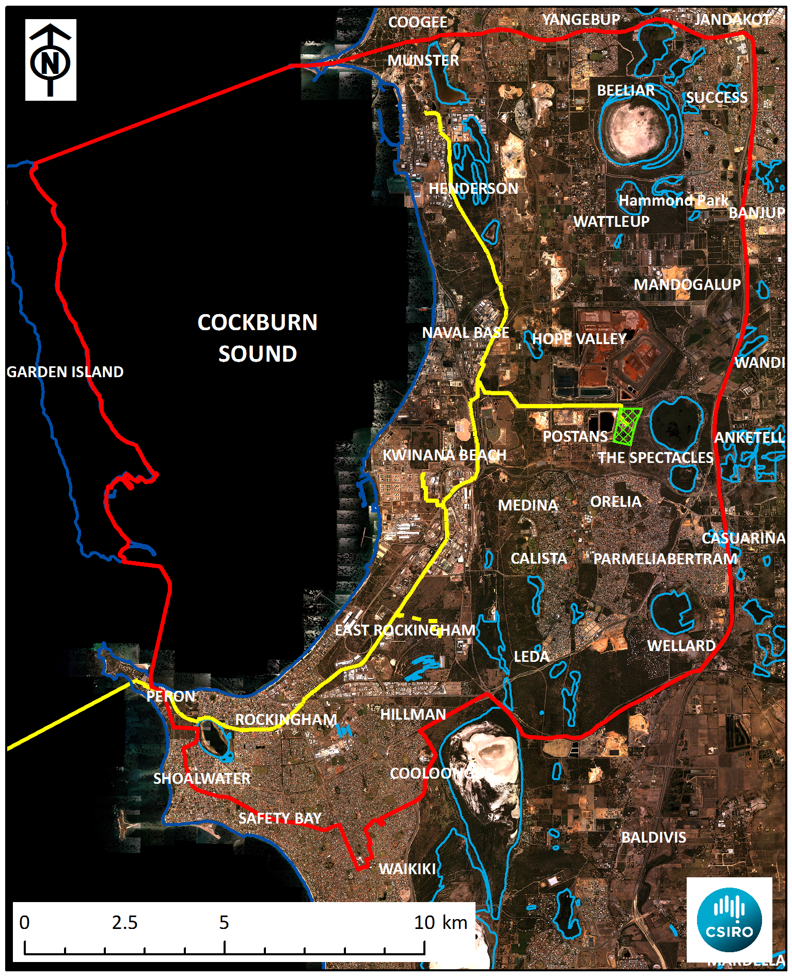
Study to identify the feasibility of diverting some treated wastewater to the Superficial Aquifer in the Cockburn Sound Catchment
Opportunities include:
non-potable water source for industry, councils, residents, horticulturalists
reverse salt water intrusion
recover wetlands and stop the release of N and acidity from drying peat
help clean up contamination
proof-of-concept for other areas
Main risks are:
increased N loads into Cockburn Sound
mobilising pollutants
surface expression of infiltrated water
Notes:
Refer to wetlands and Plant and SDOOL, boundaries

Slide 34
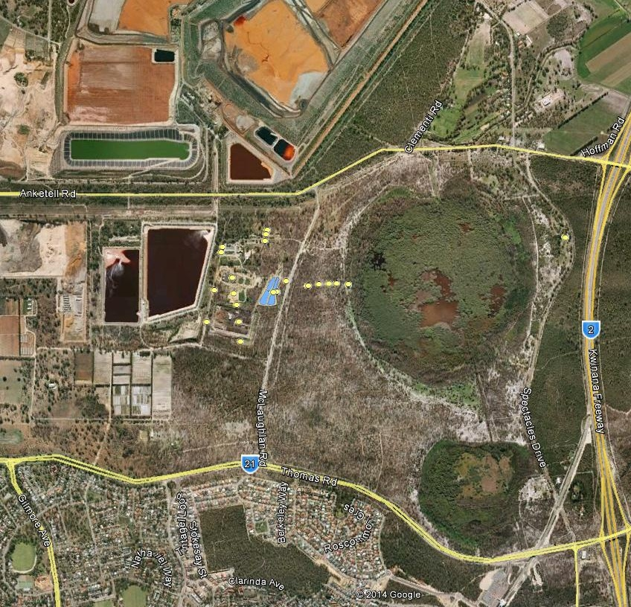
Case Study of Kwinana WWTP – The Spectacles
Basin infiltration of treated wastewater since 1975
Now 4.7 million litres per day (1 metre through basins)
Analogous to Managed Aquifer Recharge (MAR) within a few hundred metres of a groundwater- dependent wetland
Used to measure the impact on groundwater levels and quality
What would happen if it was replicated at other sites in the catchment ?
SPECTACLES
SWAMP (Nth)
Infiltration
basins
Notes:
Why this site?
Long-term
MAR near wetland, so get idea of interactions.
We wanted to have a case study of gw response to infiltration because that’s what we’re doing elsewhere with model. This will be a “validation”

Slide 35
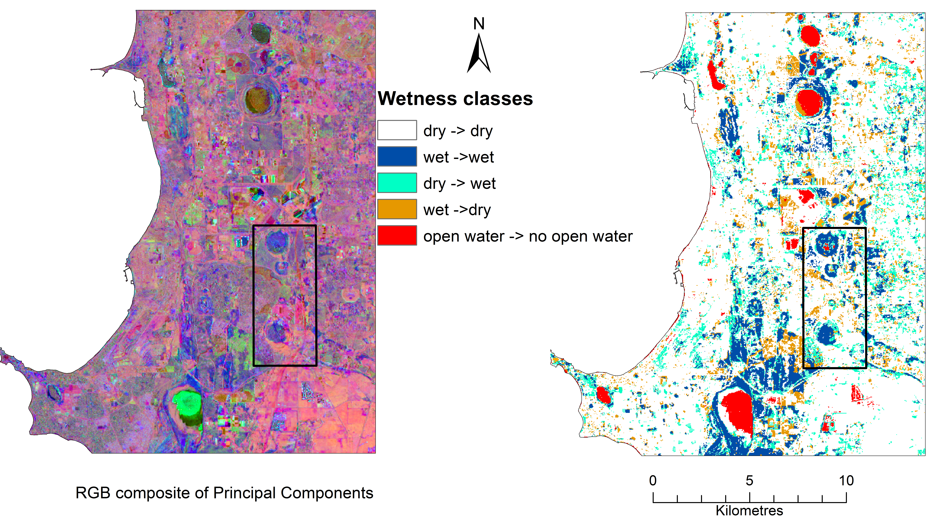
Remote sensing analysis of wetlands by Dr Irina Emelyanova
Wetness changes between 1990 and 2012
The Spectacles wetland group have remained wet while most others have dried
The Spectacles
Wetlands
Group
Notes:
The remote sensing quantifies what people have experienced in the catchment
More representative years may need to be analysed to define the effect of drying and wastewater infiltration on the three wetlands around The Spectacles

Slide 36
Groundwater levels
Groundwater levels increasing in vicinity of basins
Magnitude greater near basins
Groundwater levels stable at bores distant from basins (north, south and east of wetland)
APRIL 2014
KW14
SP1-1D
KW15
KW11
Recycled water for heavy industry and preventing seawater intrusion | 'Kwinana MAR'
Notes:
Water levels in KWTP1-1S = 13.8 mAHD Apr 2014 & 13.7 mAHD
Gradient towards lake but break in slope

Slide 37
Groundwater total N – Effect of WWTP upgrade
BASIN
Spectacles Swamp
SP1-1D
WWTP effluent
KW11
KW15
KWTP1-S
KWTP2-S
Treatment plant upgrade
Treatment plant upgrade
Recycled water for heavy industry and preventing seawater intrusion | 'Kwinana MAR'

Slide 38
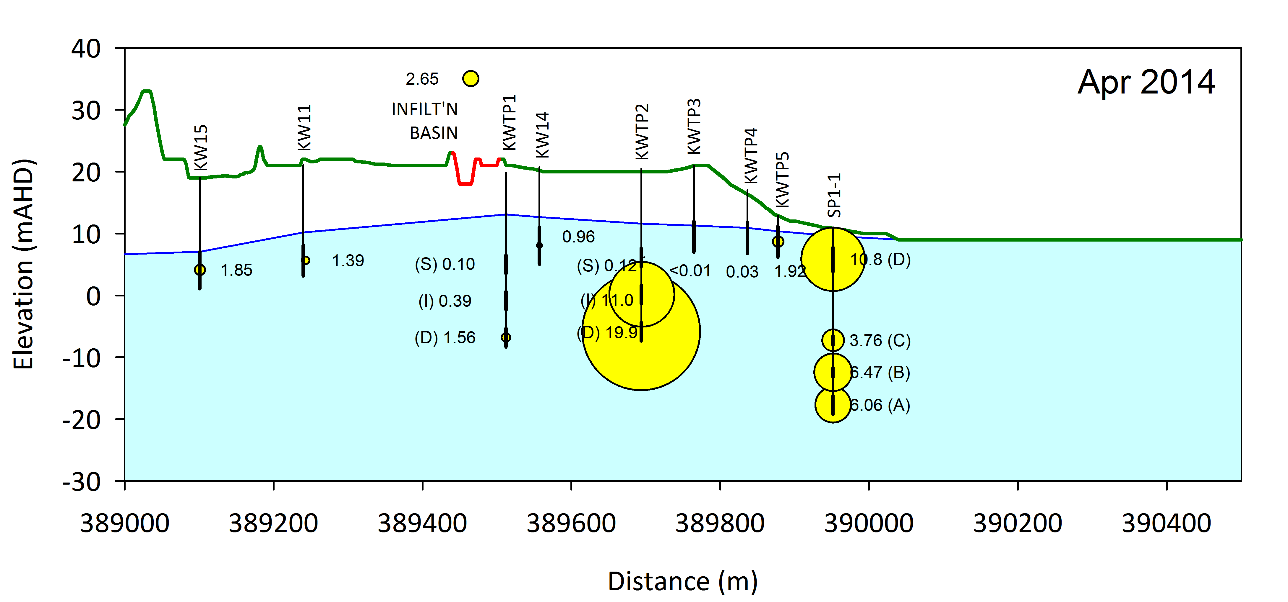
Ammonium in GW under the Kwinana WWTP and The Spectacles
Spectacles Wetland
GW flow
Regional groundwater flow is from the right (east) to the left (west)
Concern that ammonium (NH₄) may travel from the WWTP into the up-gradient wetland
Wetland is a source of NH₄ as well as salinity (resulting in flow going to the bottom of the aquifer), confirmed by stable isotope sampling
Groundwater NH₄ under the ponds has decreased because of the WWTP upgrade
Recycled water for heavy industry and preventing seawater intrusion | 'Kwinana MAR'
Notes:
Note small input N compared with very large groundwater N, mainly form mineralisation of the peat in the lake

Slide 39
Acid sulphate risk in drying wetlands
Appleyard and Cook (2008)
Appleyard et al. (2006)
Arsenic, aluminium, iron
Notes:
Oxidation of pyrite on drying produces sulphuric acid and the mobilisation of heavy metals

Slide 40
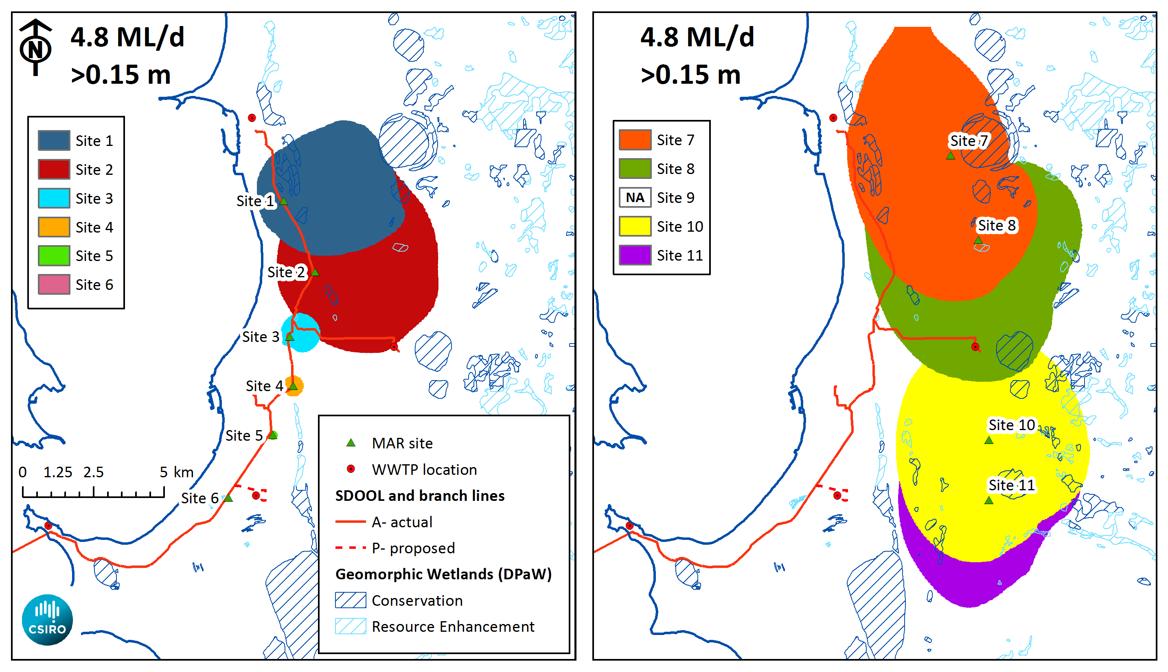
Evaluation of groundwater response of 4.8 ML/d at 11 sites
Northern and eastern sites have much more response because of aquifer properties
Notes:
Examples of the damming effect of MAR when added to the Superficial Aquifer – and the impact of very transmissive aquifers in the south west of this catchment (no mounds form)

Slide 41
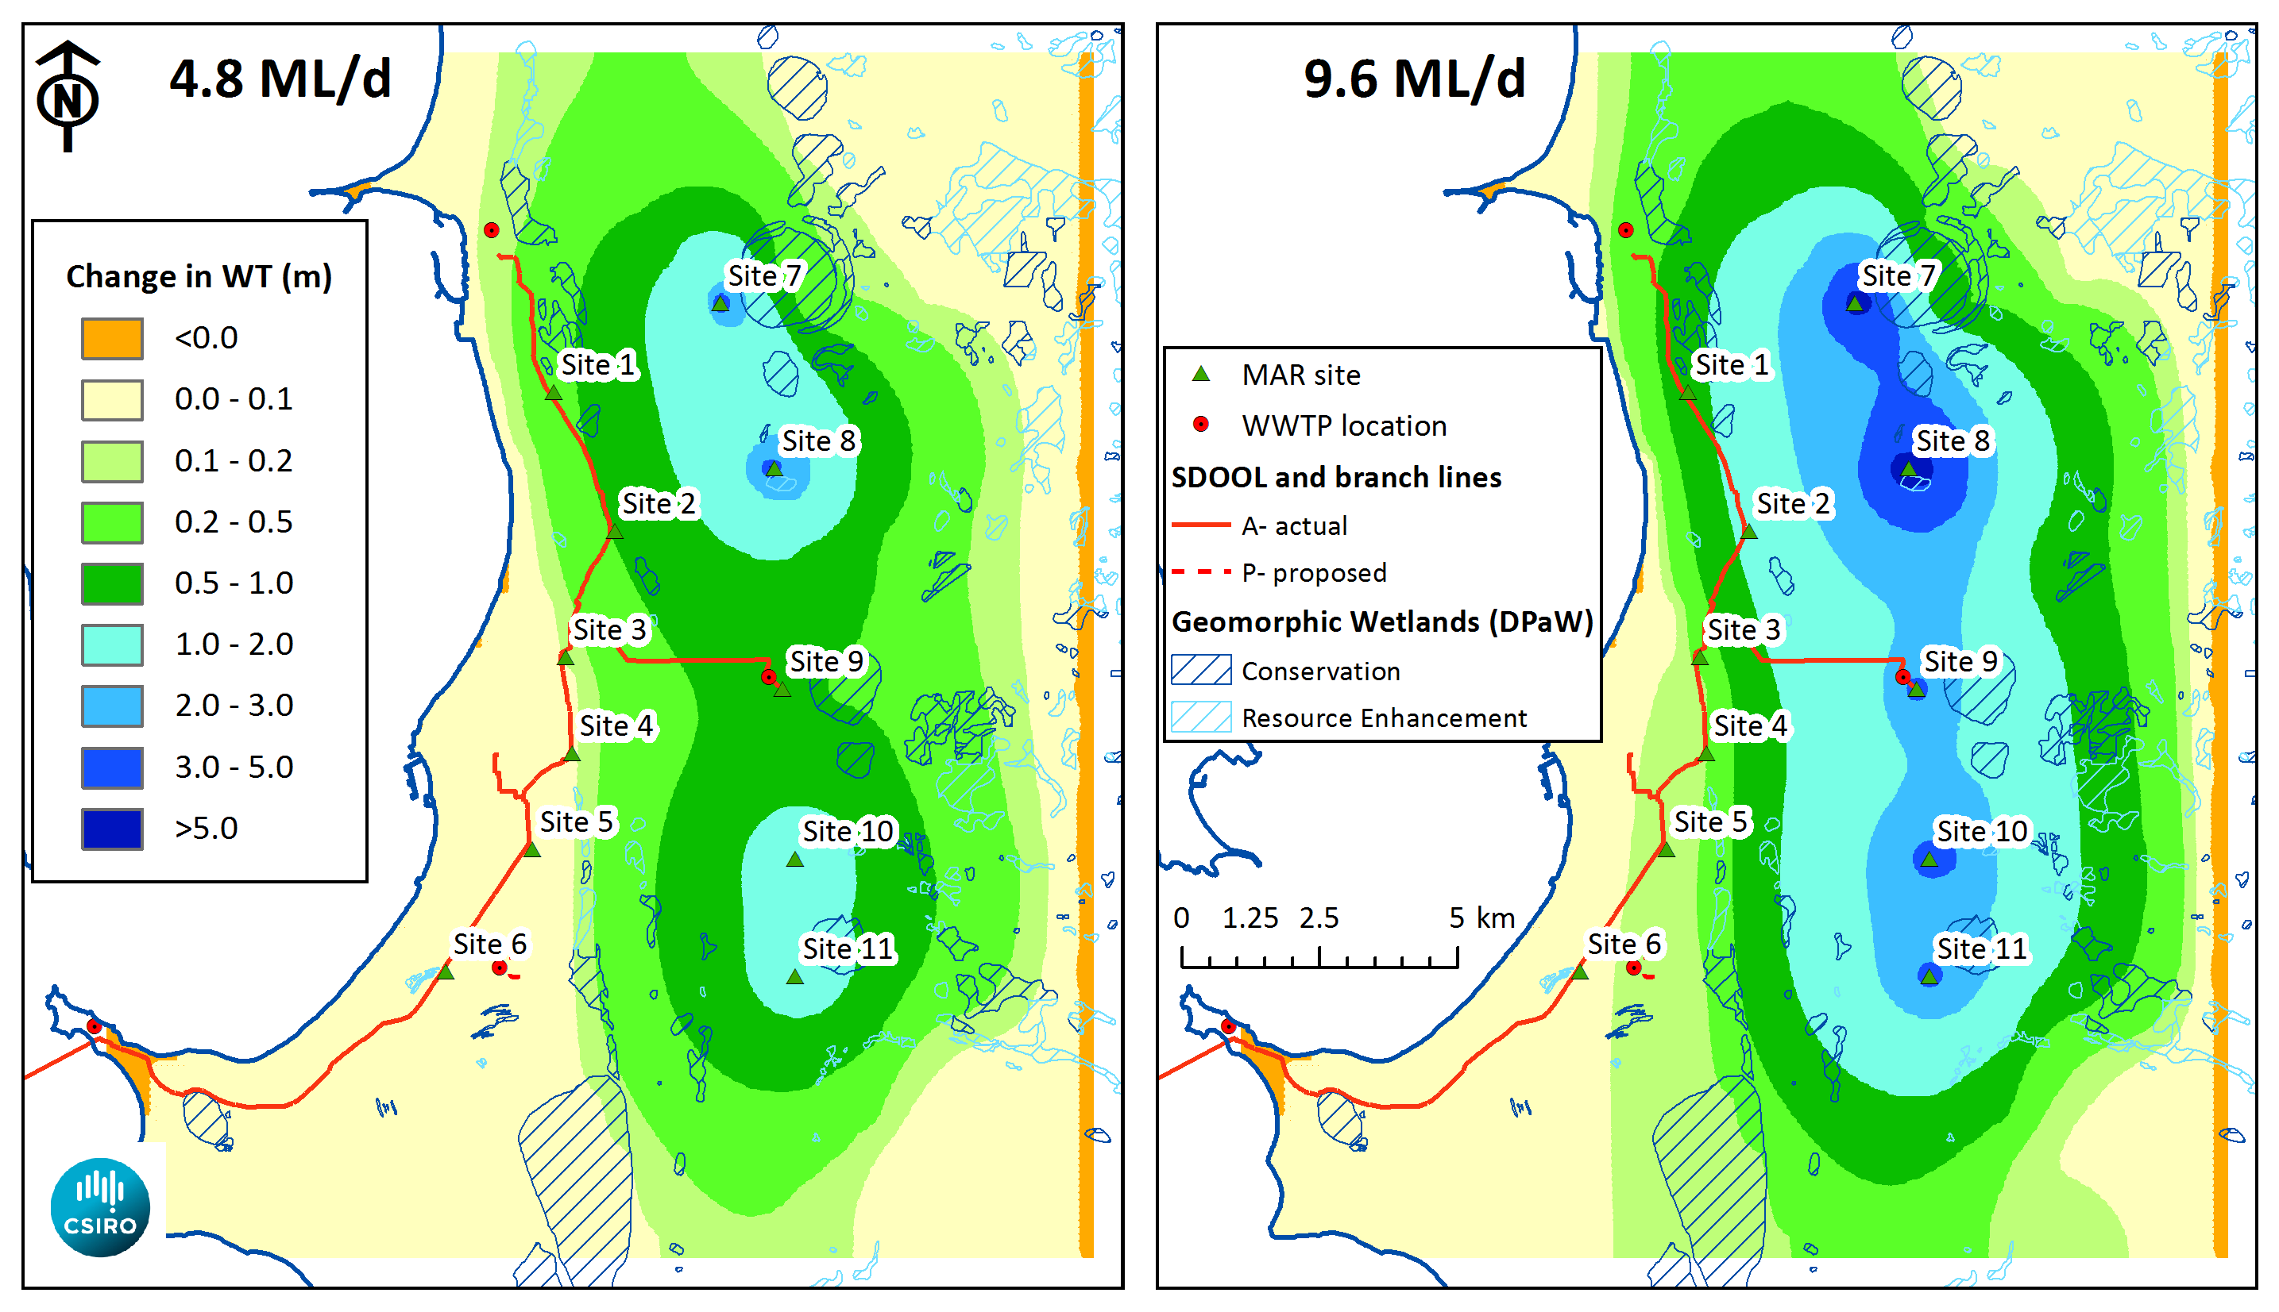
It is possible to manipulate groundwater levels over large areas with multiple applications using a proportion of SDOOL flows
4.8 ML/d uses 17% of current available wastewater; 11% of the 2032 available wastewater volumes
Notes:
It is feasible to raise levels by several metres using less than a fifth of the available wastewater that is going to the ioean (or a tenth in 2032)

Slide 42
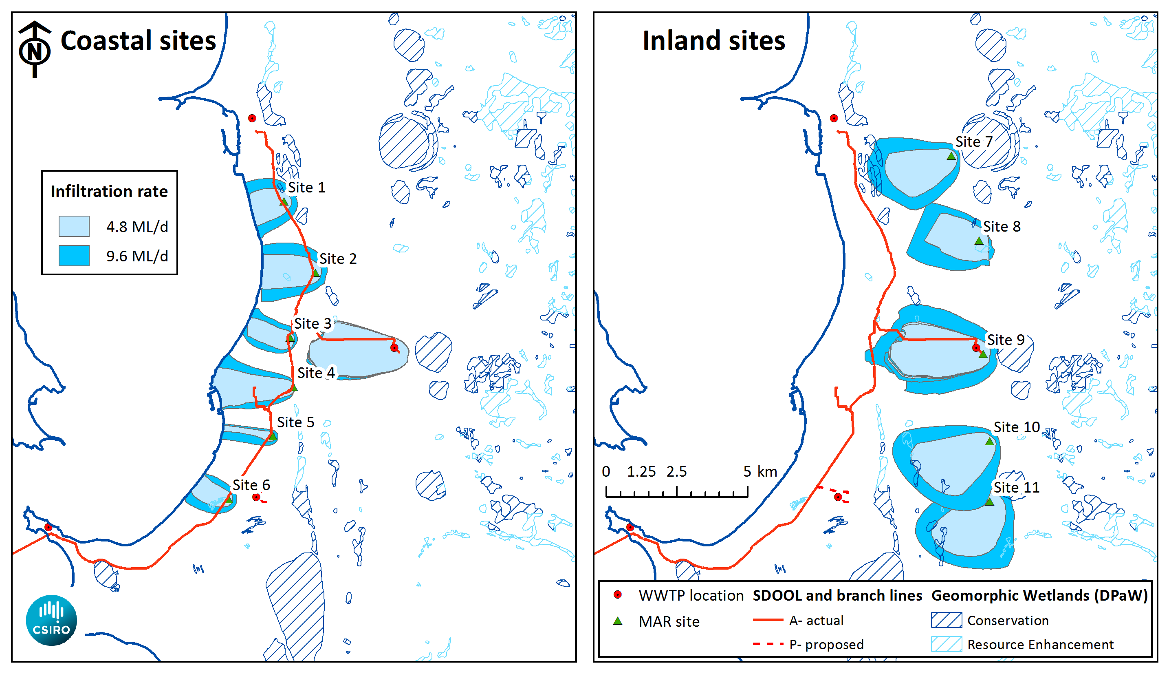
The maximum areal extent of particle tracking pathways over the 20 year period, 2013 to 2032
Notes:
The extent of treated wastewater plumes is only a small fraction of the area affected by increased levels. This assumes that industry doesn't target these plumes for extraction – as in the case for the Kwinana WWTP where no treated wastewater has reached the coastline after > 40 years of infiltration

Slide 43
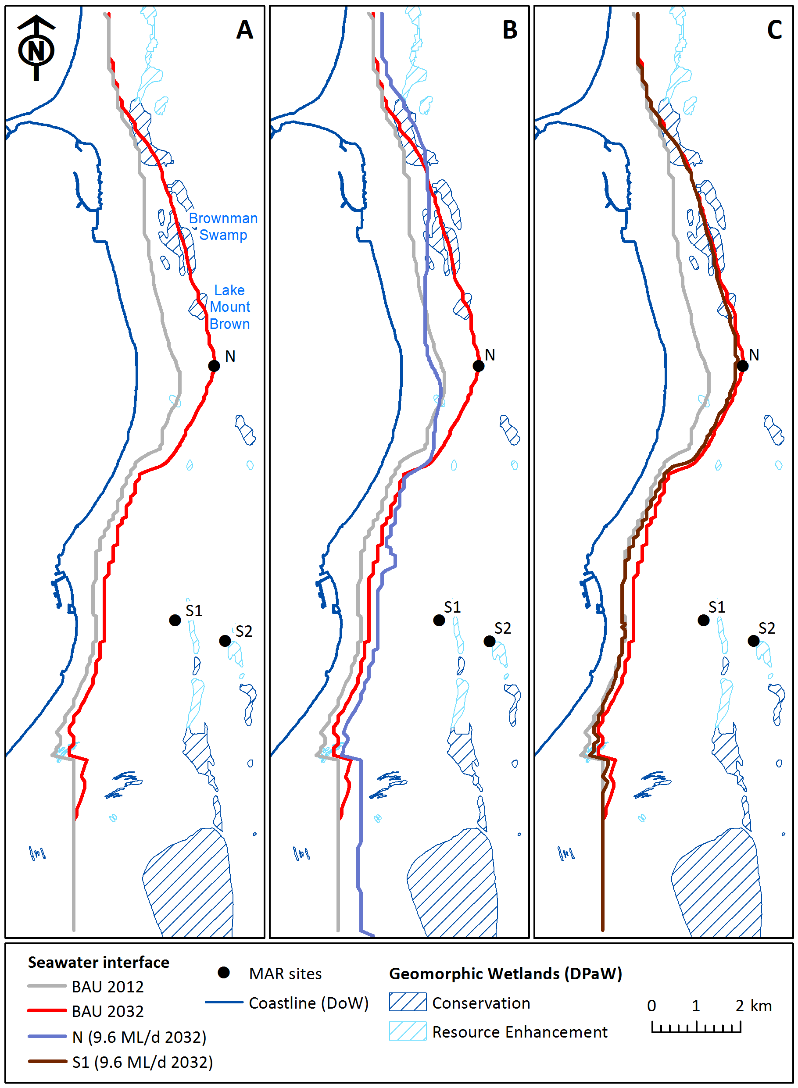
Calculated locations of the seawater interface using the Ghyben-Herzberg approximation and simulated freshwater heads from the model
SWI location in the business as usual scenario between 2012 and 2032 – additional intrusion by about 0.92km
2032 SWI location for 9.6 ML/d (2 m/d) MAR infiltration at site N and - maintenance of existing location and 1.1 km further west than BAU
2032 SWI location for 9.6 ML/d (2 m/d) MAR infiltration at site S1 – 0.3m further west than BAU and similar to 2012
Notes:
SWI can be managed using MAR by adding water close to the toe of the wedge

Slide 44
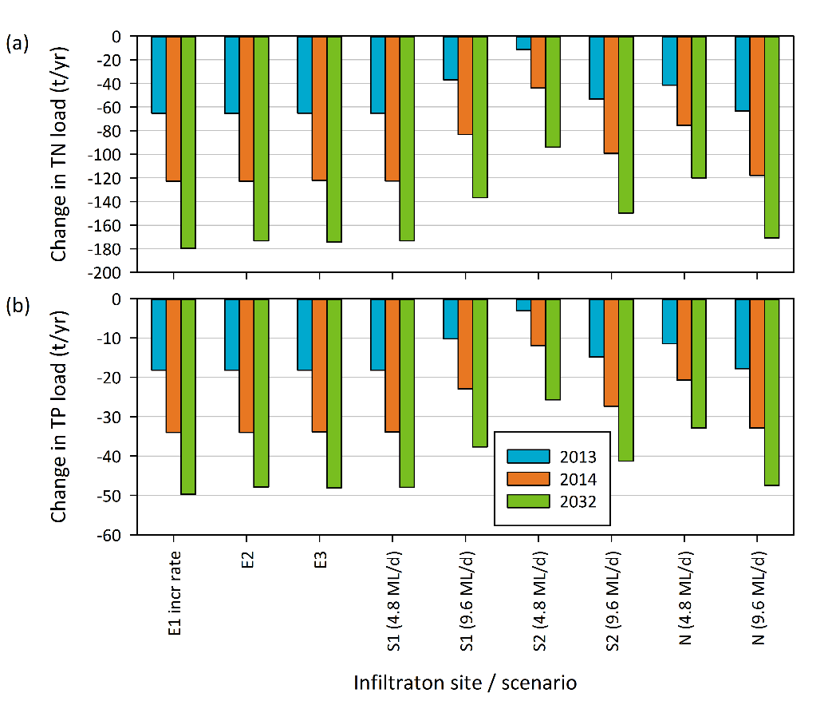
Change in total nitrogen and total phosphorus loads in submarine groundwater discharge relative to the business-as-usual case in 2012
Climate scenarios are the dominant factor in determining loads
all future SGD volumes being less than in 2012
despite additions of TN and TP from treated wastewater additions and extra groundwater fluxes which assume no additional pumping to intercept the added water
Notes:
While MAR increases both N and P concentrations and loads, the effect of the drying climate results in a net decrease in loads entering Cockburn Sound

Slide 45
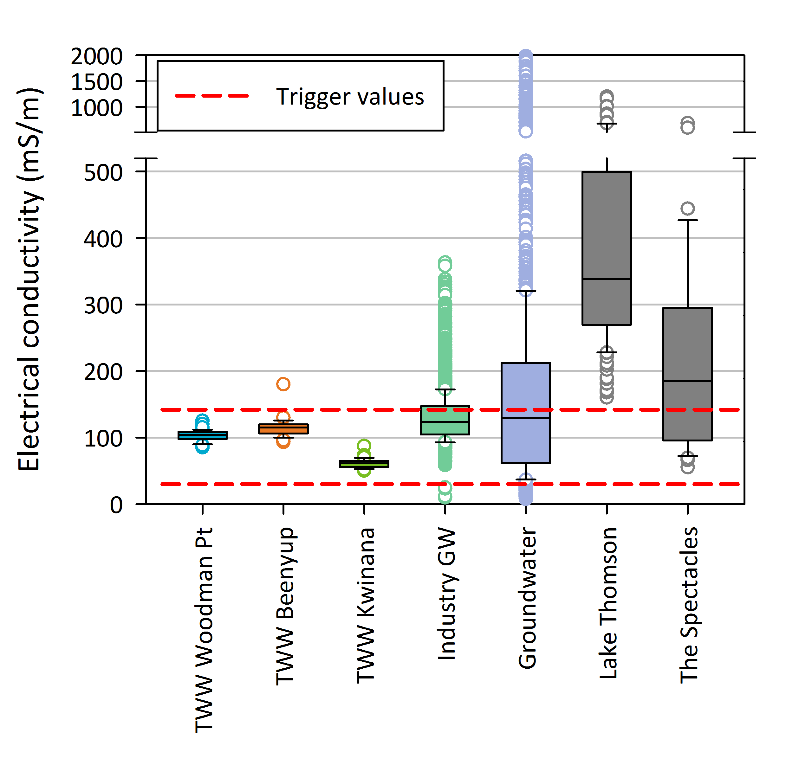
Comparison of TWW and environmental receptor
water quality
Added TWW is likely to reduce GW salinity, especially in the vicinity of wetlands which produce down-gradient saline plumes because they evaporate GW
Mineralising peat in drying wetlands can also release nutrients, acidity and heavy metals (including arsenic and aluminium)
Trigger values wetland aquatic ecosystems (south-west Australia, ANZECC-ARMCANZ, 2000)
Notes:
Salinity of TWW is slightly lower than the ambient groundwater, and much lower tan the wetlands where salts get concentrated by evaporation

Slide 46
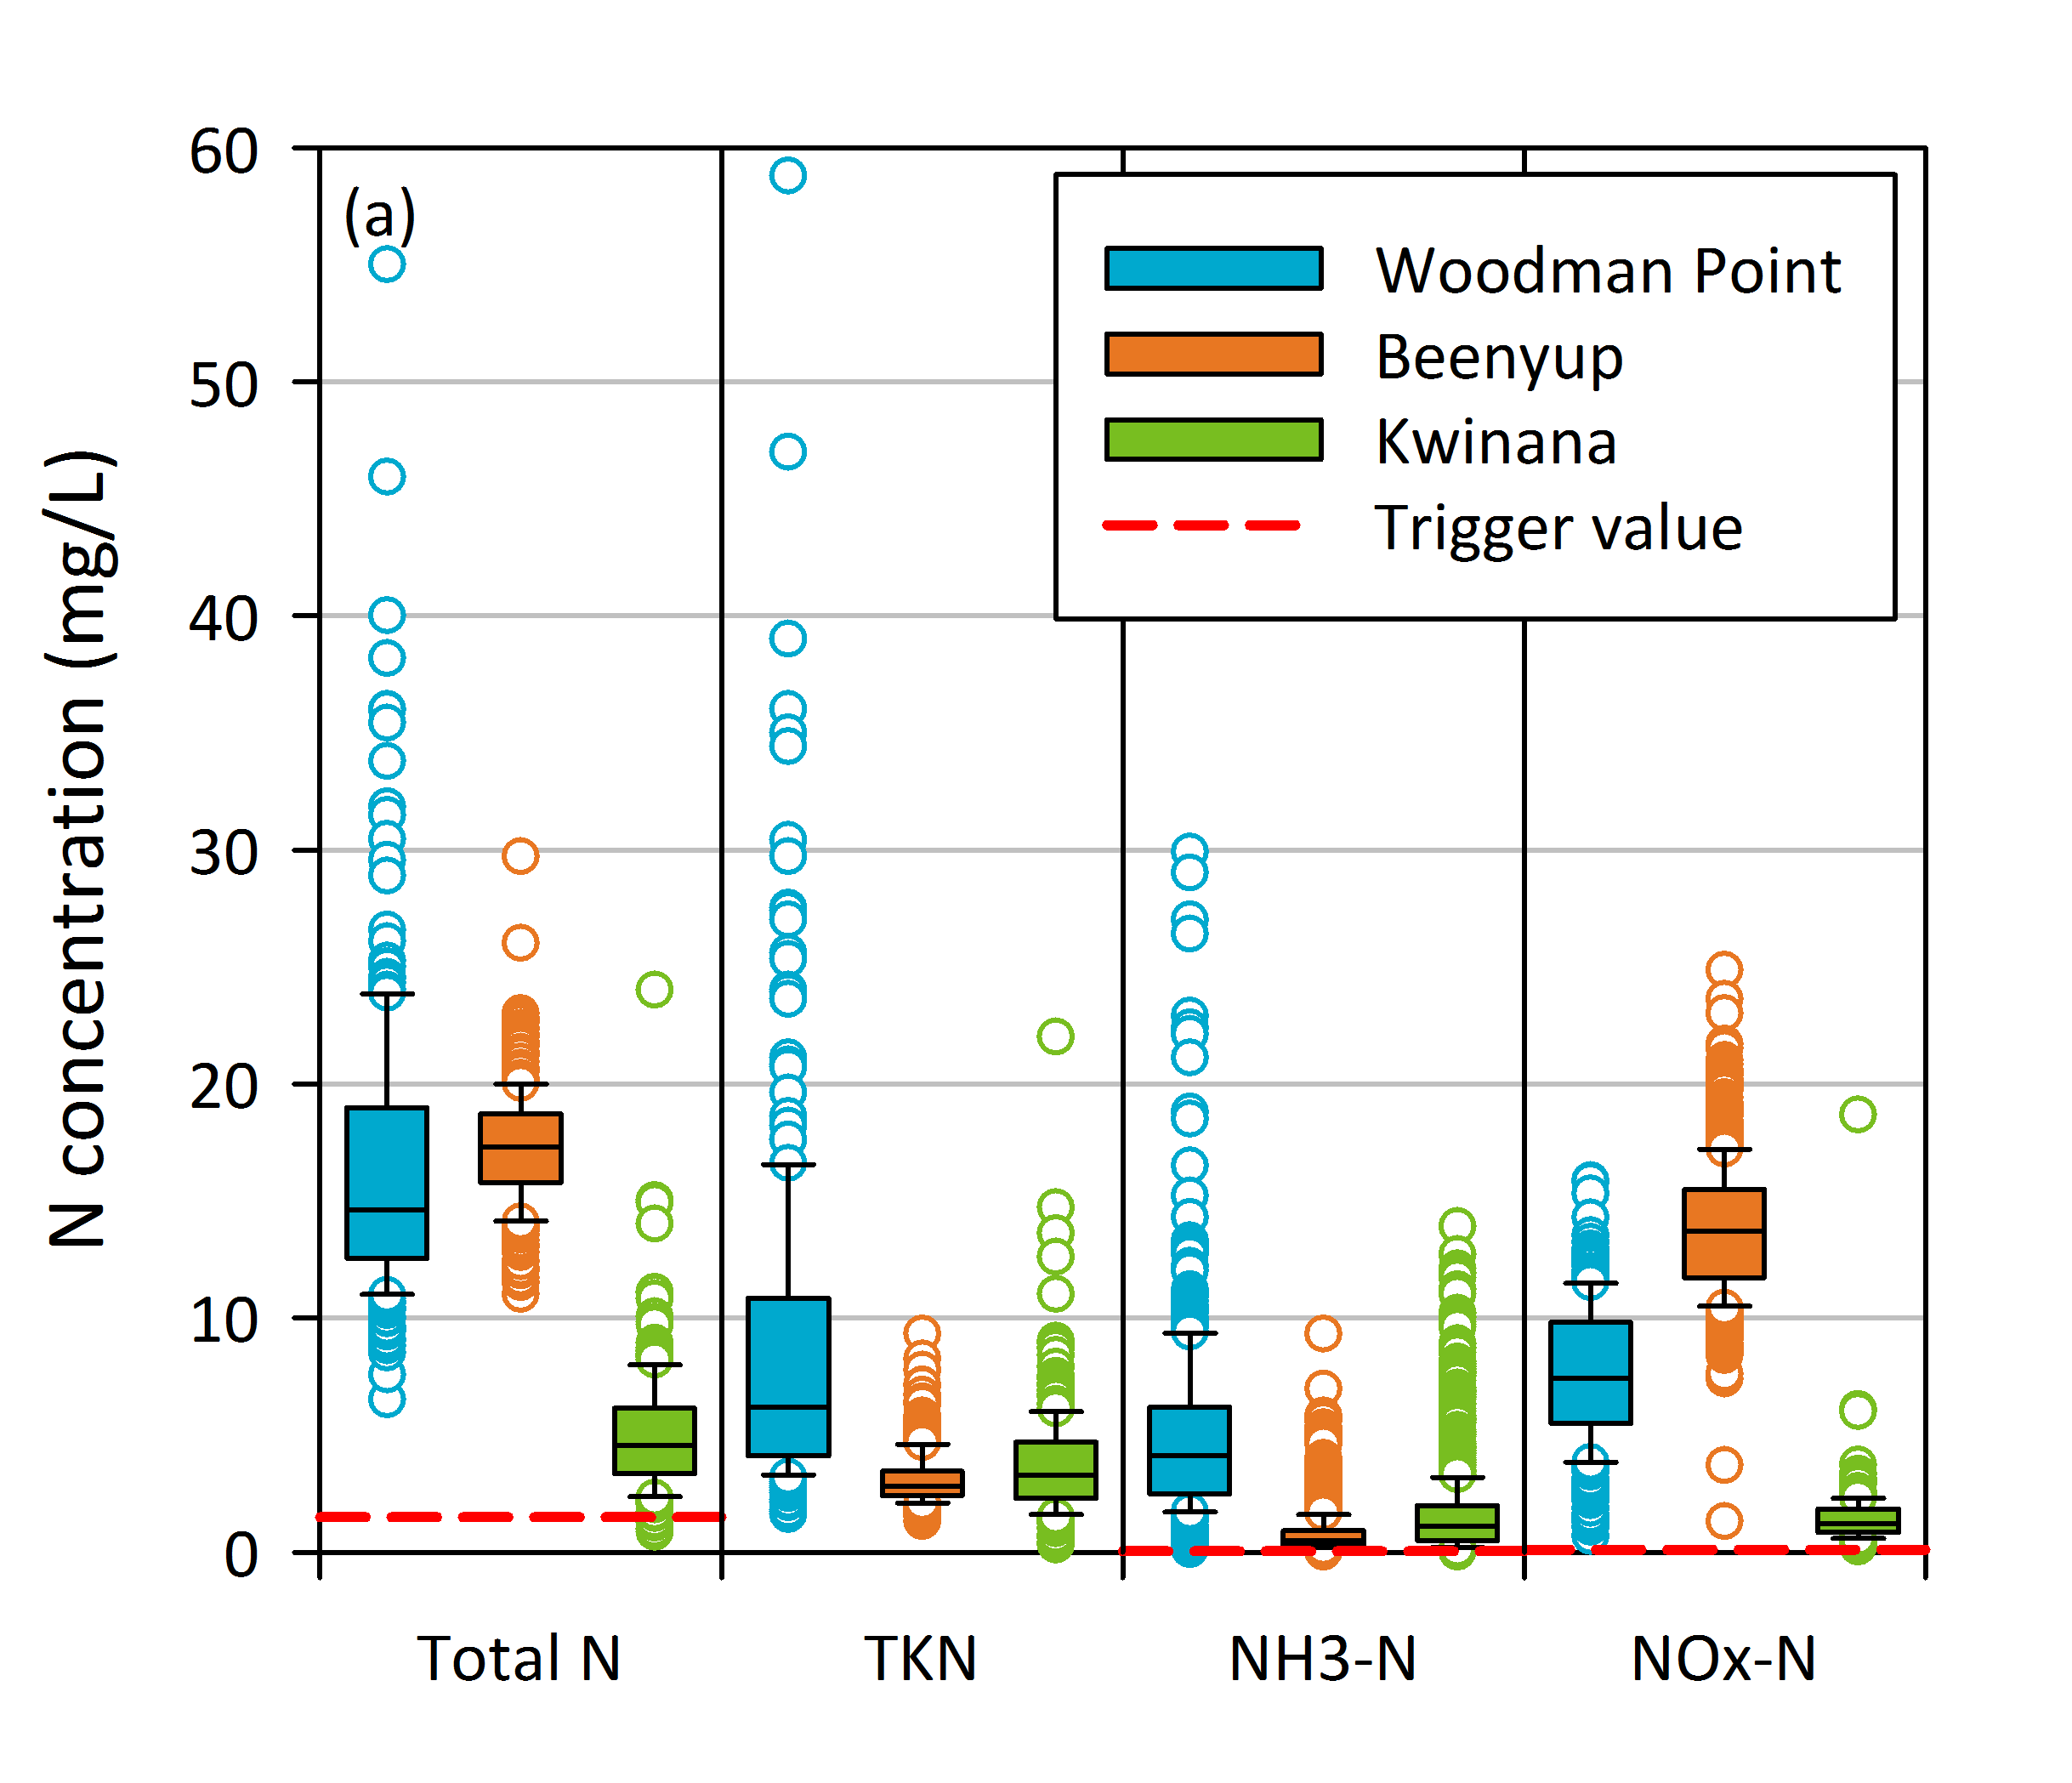
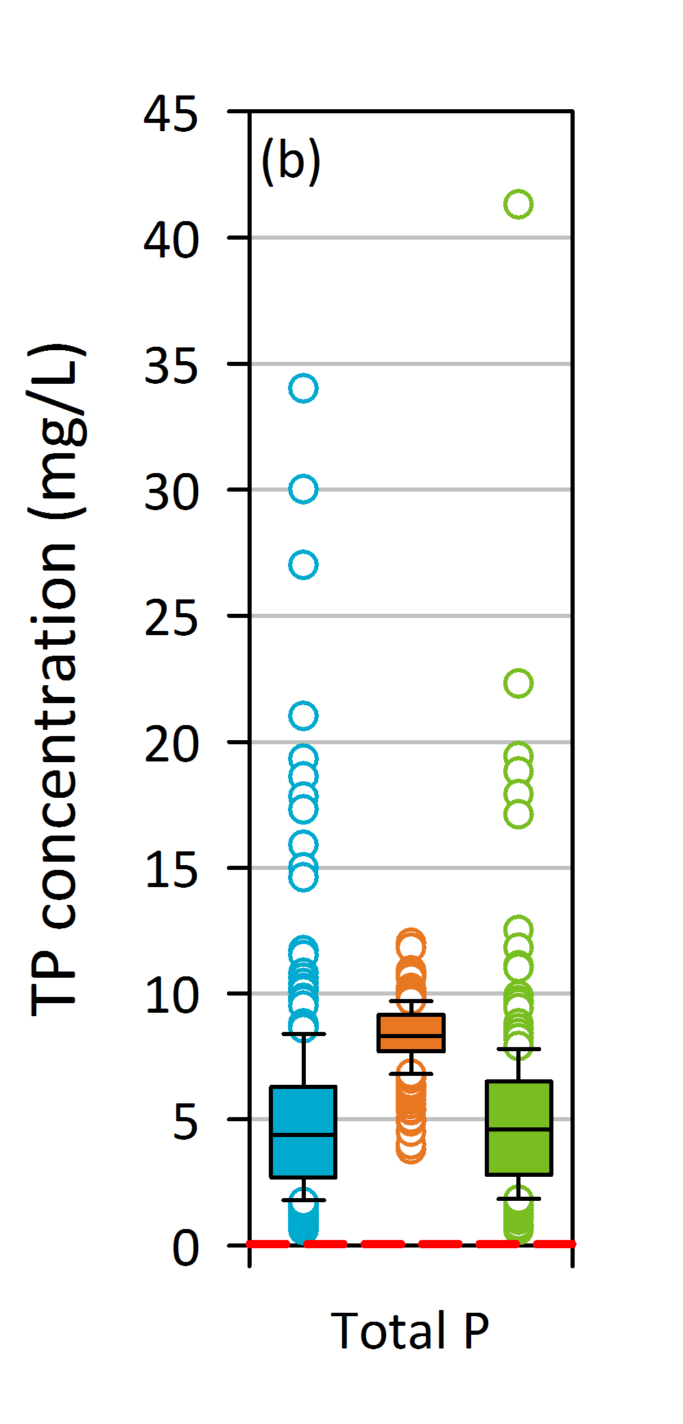
Nitrogen and phosphorus concentration in treated wastewater (2010-2013)
Woodman Point and Kwinana WWTPs (Beenyup WWTP)
Trigger values wetland aquatic ecosystems (south-west Australia, ANZECC-ARMCANZ, 2000)
Notes:
N levels at Kwinana (oxidation ditch) are much lower than at the Woodman Point WWTP (which is about to be upgraded)
P levels are also higher than trigger values but as shown later, are removed in limestone-rich aquifers

Slide 47
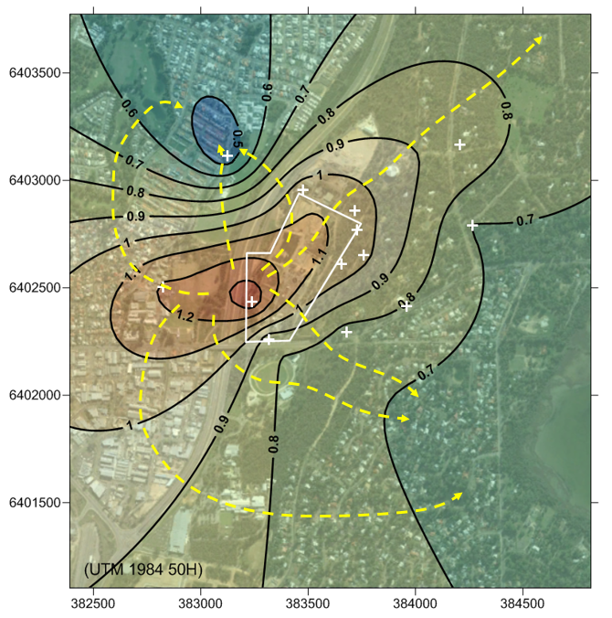
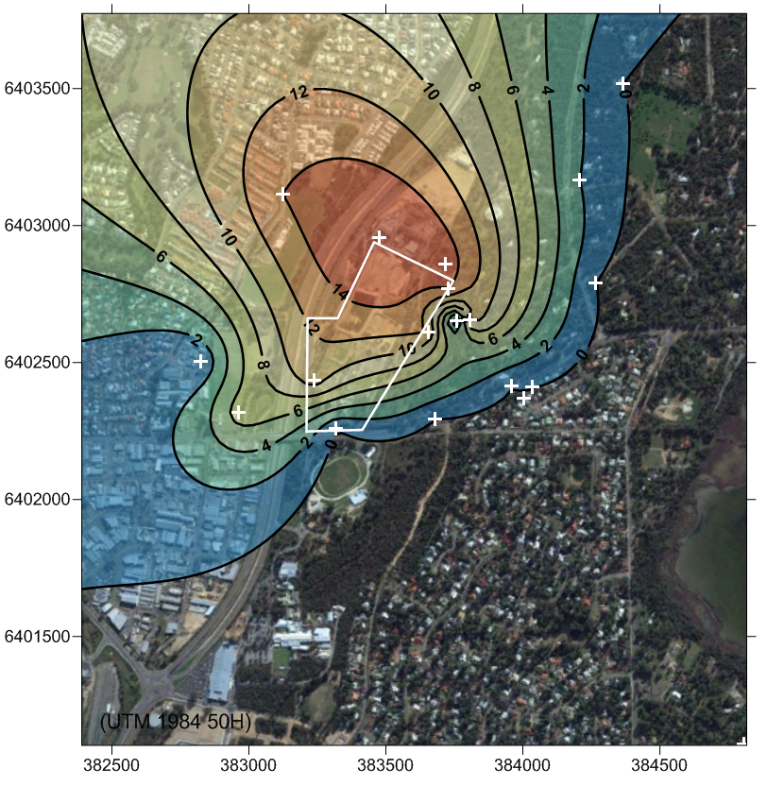
Infiltration from basins at the Gordon Road WWTP
Rob Pavlov MSc Thesis (2015)
Groundwater levels (m AHD)
Sucralose (µg/L)
Notes:
Left hand map shows the mound created by 3.5 GL/y of TWW being infiltrated into the aquifer at Gordon Road, Mandurah. The low zone to the NW of the WWTP (boundary is shown in yellow) probably results from pumping bores used to irrigate nearby POS and the Meadow Springs golf club
Sucralose is an indicator of TWW and this show that most of the infiltrated water flows to the NW, away from Lake Goegrup, an towards the areas of greatest extraction

Slide 48
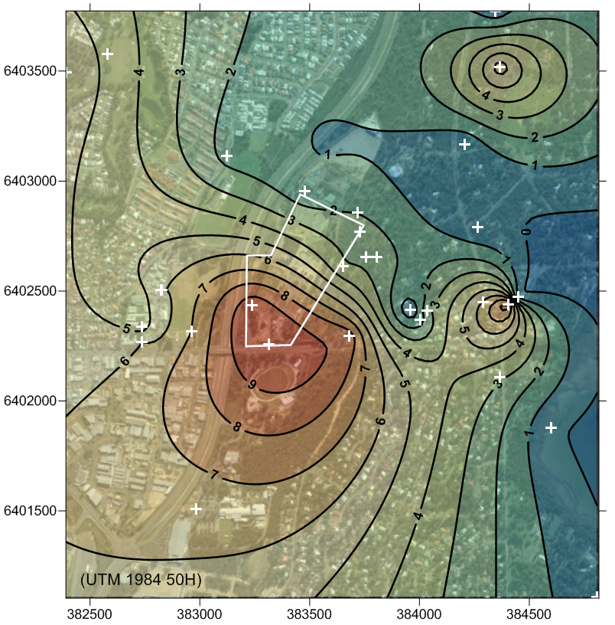
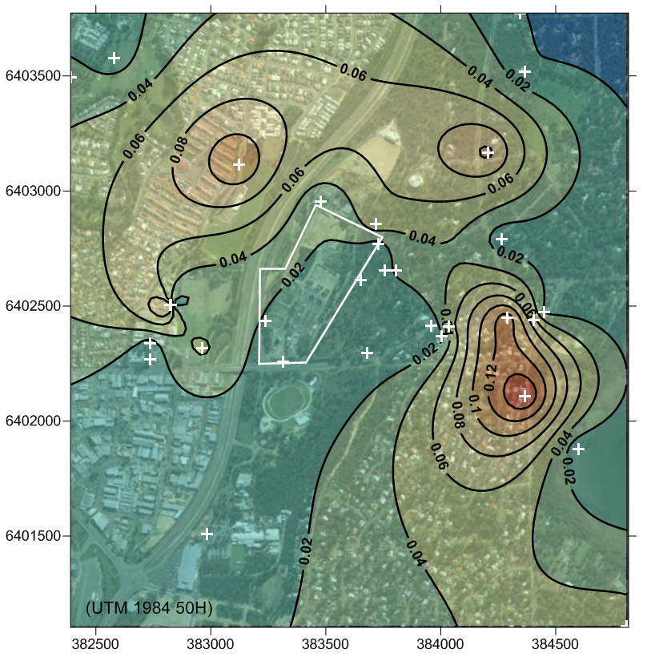
Nutrients in groundwater around the Gordon Road WWTP
Rob Pavlov MSc Thesis 2015
Total Nitrogen mg/L
Total Phosphorous mg/L
Notes:
By contrast, nitrogen is highest in the SW as a result of biosolids that used to be dried in eth southern part of the WWTP.
P levels are low, indicating removal by eth limestone aquifer

Slide 49
Direct use of treated wastewater
or indirect use via Managed Aquifer Recharge?

Slide 50
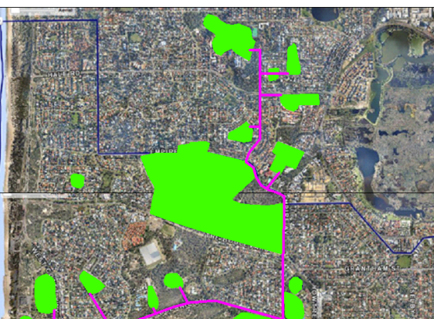
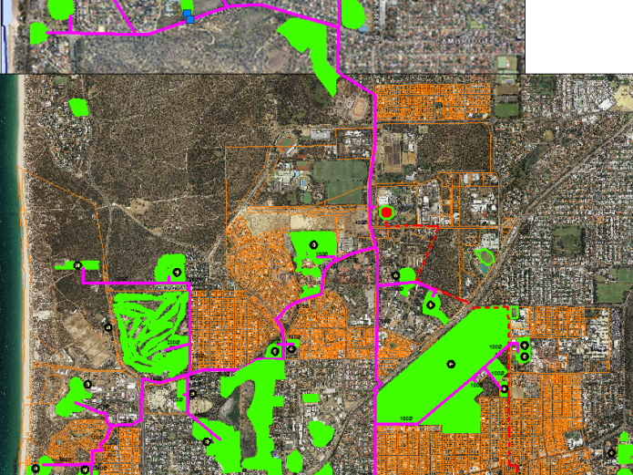
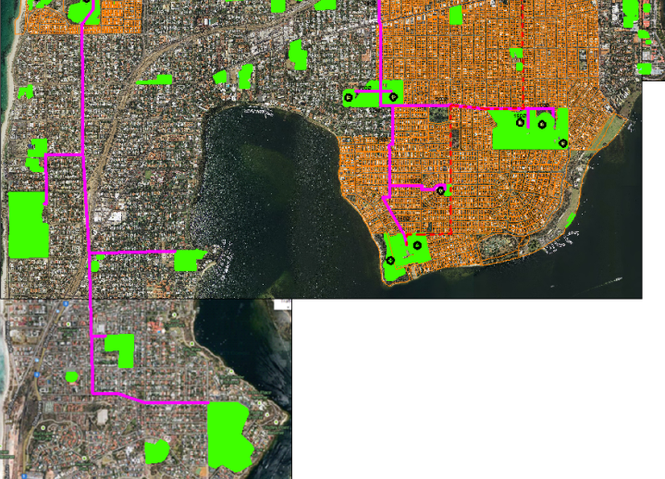
Western Suburbs
Recycled Water Scheme
Mark Goodlet 2015
Northern
Line
Subiaco Wastewater
Treatment Facility
Southern
Line
Western
Line
Extension
Notes:
A more extensive scheme for the WESROC and adjacent LGAs has also been designed on paper

Slide 51
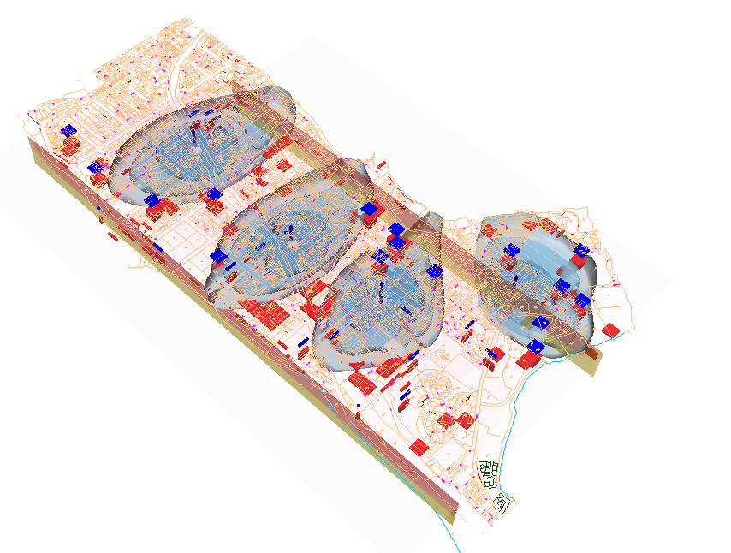
Modelled nitrogen flows through proposed MAR sites on the Mosman Peninsula Prommer et al. 2004
Swan River
B
A
B´
Indian Ocean
A´
Notes:
Water Corporation commissioned a study of adding TWW directly to the aquifer in the Mosman Peninsula in late 2004. This was criticised for adding excessive N to the Swan estuary and was shelved

Slide 52
Managed aquifer recharge has some benefits over direct piping of treated wastewater to local government reserves
Raising groundwater levels also benefits wetlands and private bore users
It can help manage salt water interfaces around the river and ocean
Water can be added year round
No need for tanks, less need for treatment, no chlorination costs
MAR water flows to existing extraction bores reducing costs
The distribution network can be very simple
Advantages of a piped scheme to POS are:
More control over water quality (chlorination)
Directly targets individual reserves
Easier to get community acceptance
WESROC and the Department of Water are evaluating both options

Slide 53
Conclusions
The western coastline between Yanchep and Halls Head (and probably Bunbury-Busselton) seems well suited to MAR due to the presence of wastewater streams, permeable soils and a transmissive and alkaline aquifer able to do further treatment
This same area has an emerging need for increased water supplies for irrigation, industry, wetland rehabilitation, sea water intrusion reversal and residential use
Further research on sites where treated wastewater is already disposed to the aquifer is warranted
The lowest hanging fruit appears to be further drain diversions, and MAR trials of treated wastewater at the Kwinana Industrial Area and Perry Lakes
Social science research is needed to help communicate the multiple values of the Superficial Aquifer as well as the risks of ‘business as usual’ in our drying climate

Slide 54



Thank you
Lake Claremont March 2016
  Don McFarlane
  Team Leader, Groundwater Hydrology
    t +61 8 9333 6215
    e don.mcfarlane@csiro.au
    w http://www.csiro.au/people/Don.McFarlane.html
Land and Water

Slide 55


Slide 56
Group polarisation (definition)
The tendency for a group to make decisions that are more extreme that the initial inclination of its members
..made towards greater risk if individuals initial tendency are to be risky
..made towards greater caution if individuals initial tendencies are to be cautious
We need a mix of people keen on increasing water reuse and regulators interested in ‘never having anything go wrong on their watch’ to avoid these extremes
Notes:
There appears to be differences between groups in acceptance of treated wastewater as a suitable source of water for recharging the Superficial Aquifer
Having all regulators meet to discuss standards can result in them being more cautious than any one was at the start of the process
Likewise having only people who are interested in promoting reuse can result in extreme risks being taken
All parties need to be present to get a balanced outcome.
The s16e advice given by the EPA in md 2000s may be a case of the former

