Slide 1
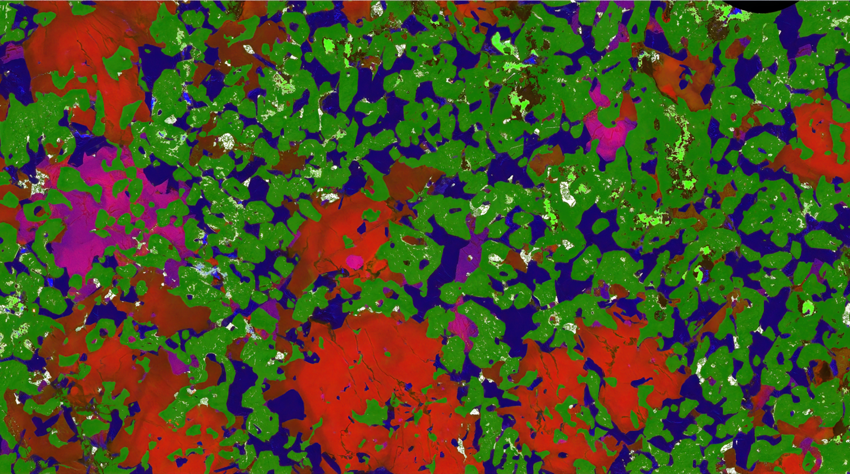
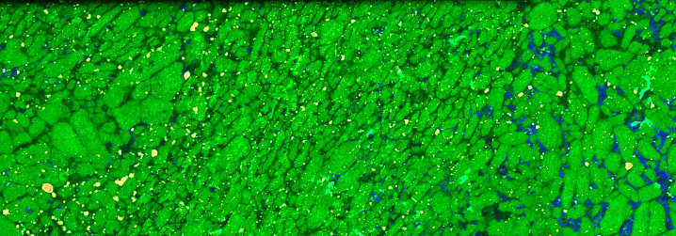
Lithogeochemistry in exploration for intrusion-hosted magmatic Ni-Cu-Co-PGE deposits: identifying cumulate rocks and chalcophile element backgrounds
Mineral Resources
Steve Barnes V1.0 May 2022

Slide 2
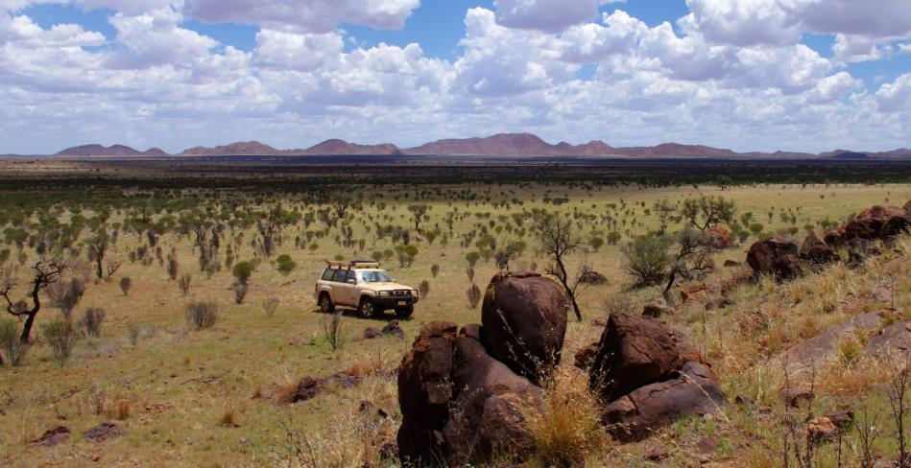
What do we want lithogeochemistry to do?…
~100 m of channel-fill cover
Reliable inference from geographically sparse data sets
Notes:
It is well known that most of the surface deposits have already been found.
Australia specifically has large sections that are undercover
How will we find new nickel deposits?
I think indicator minerals can help

Slide 3
What do we want geochemical exploration tools to do?…
Prediction
“Fertility” – fertile magma suites
Favourable tectonic/magmatic settings
Detection
Distal indicators – edges of mineral systems
Vectors within mineral systems
We want them to be
Routine, easily collectable reproducible data
Minimal false positives, false negatives
Reliable inference from geographically sparse data sets
Notes:
It is well known that most of the surface deposits have already been found.
Australia specifically has large sections that are undercover
How will we find new nickel deposits?
I think indicator minerals can help

Slide 4
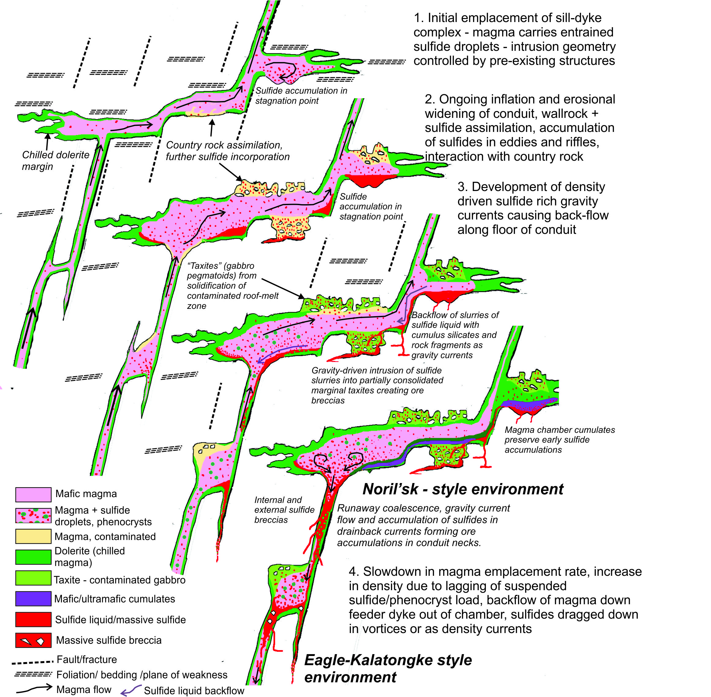
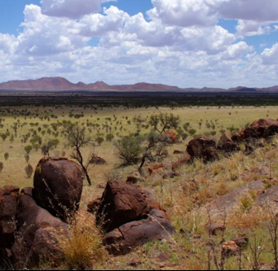
If we’ve only got THIS
Can we predict presence of THIS

Slide 5
Magma
out
2
Sulfide droplets mix with magma & scavenge metals
1
Immiscible sulfide liquid forms via assimilation of S-rich wall rocks
+S
3
Droplets (now enriched with metals) separate from magma and form deposit.
+S
Magma
in
4
Sulfide differentiation, migration, recycling, sulfide-silicate interactions

Slide 6
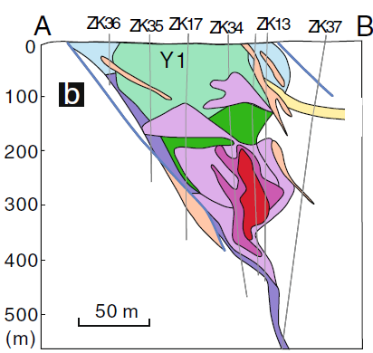
Chalcophile depletion
in outflow
Kalatongke, NW China
Identifying cumulates
(especially ultramafic)
Trace CPE enrichment halo in flanking sills
Barnes et al., OGR, 2016

Slide 7
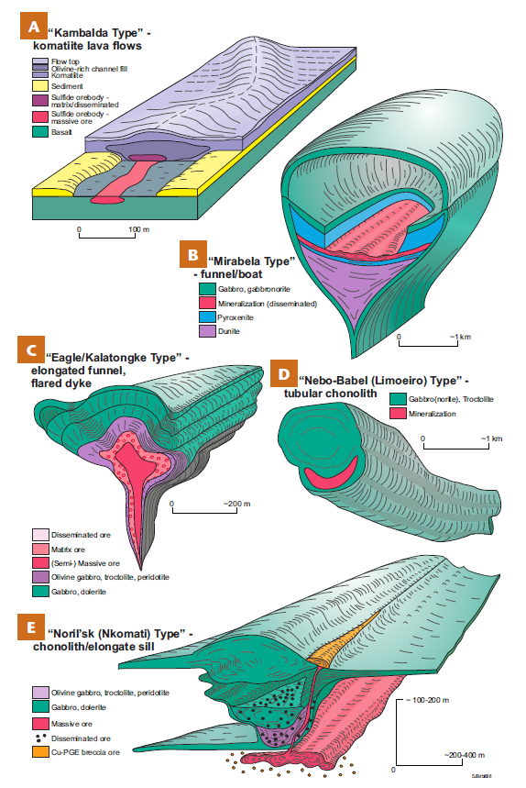
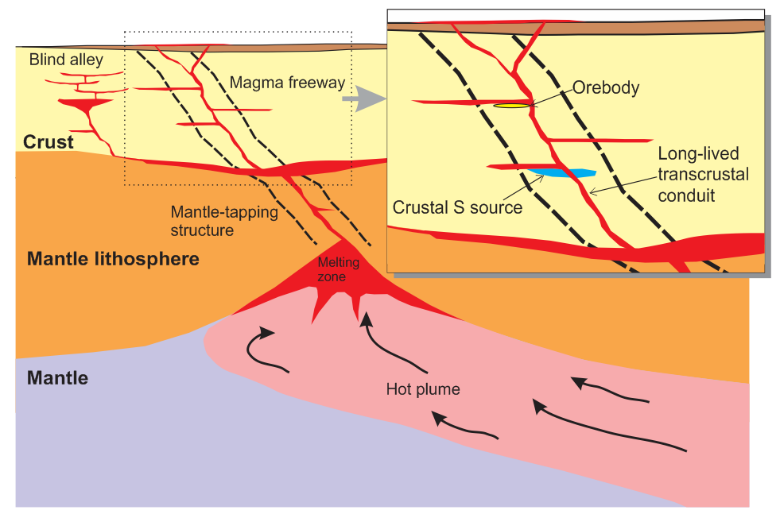
Deposition sites are characterised by the presence of cumulates – usually but not always ultramafic cumulates.

Slide 8


Cumulate rocks – what are they?
The solid products of fractional crystallisation of magmas
cooling
magma2
magma1
+
magma2 + crystals
Products of sorting of crystals from magmas
cumulates

Slide 9
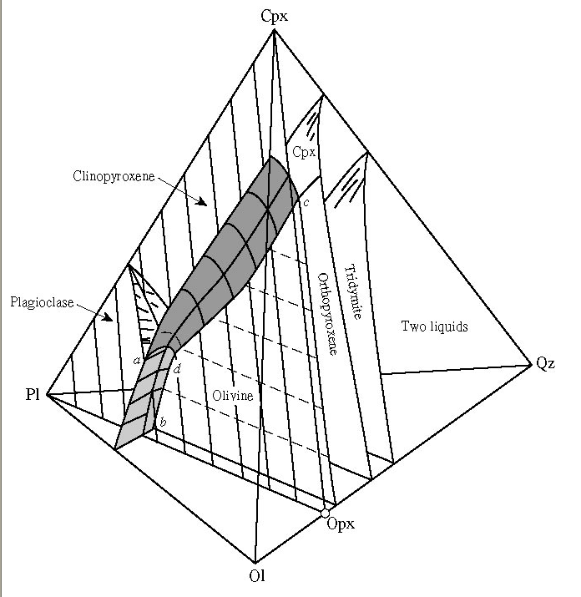
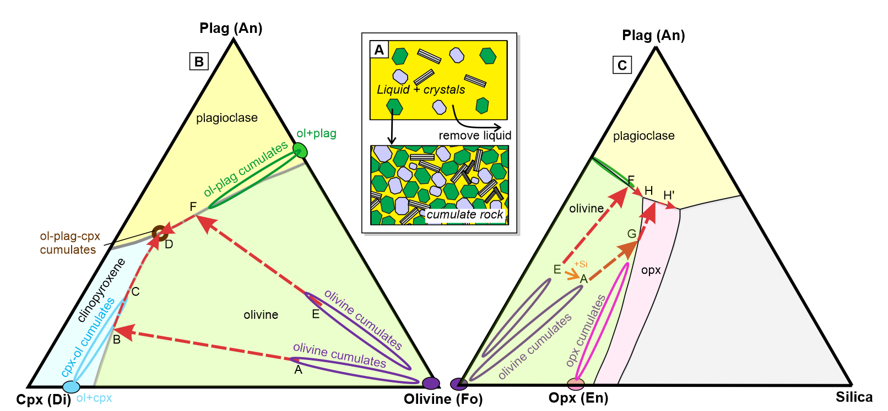
Most of the cumulate rocks we find in ore-hosting intrusions can be explained by reference to phase relations in a four component system-
Olivine (Forsterite) – Clinopyroxene (Diopside) – Plagioclase (Anorthite) – Silica

Slide 10

Most of the cumulate rocks we find in ore-hosting intrusions can be explained by reference to phase relations in a four component system-
Olivine (Forsterite) – Clinopyroxene (Diopside) – Plagioclase (Anorthite) – Silica

Slide 11
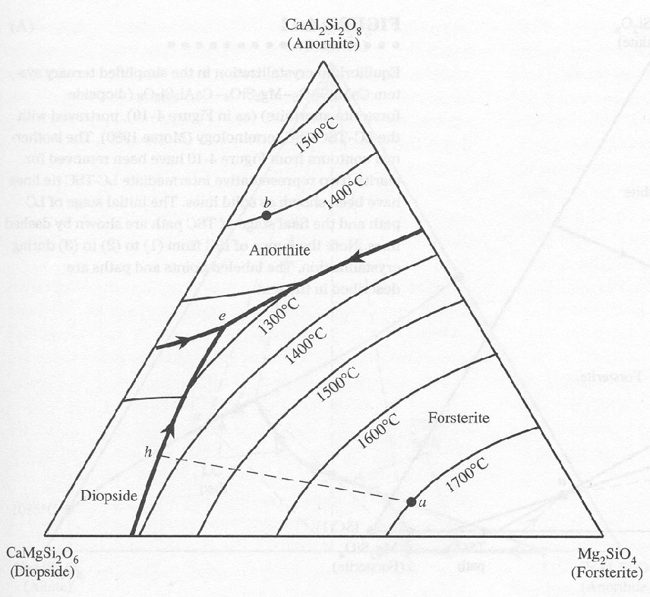
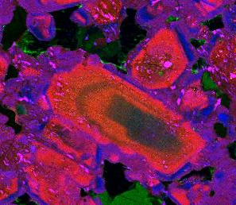
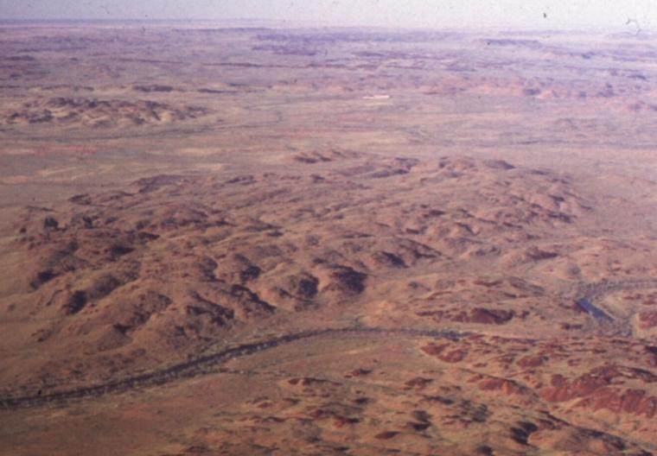
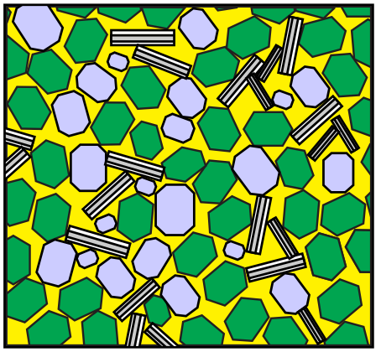
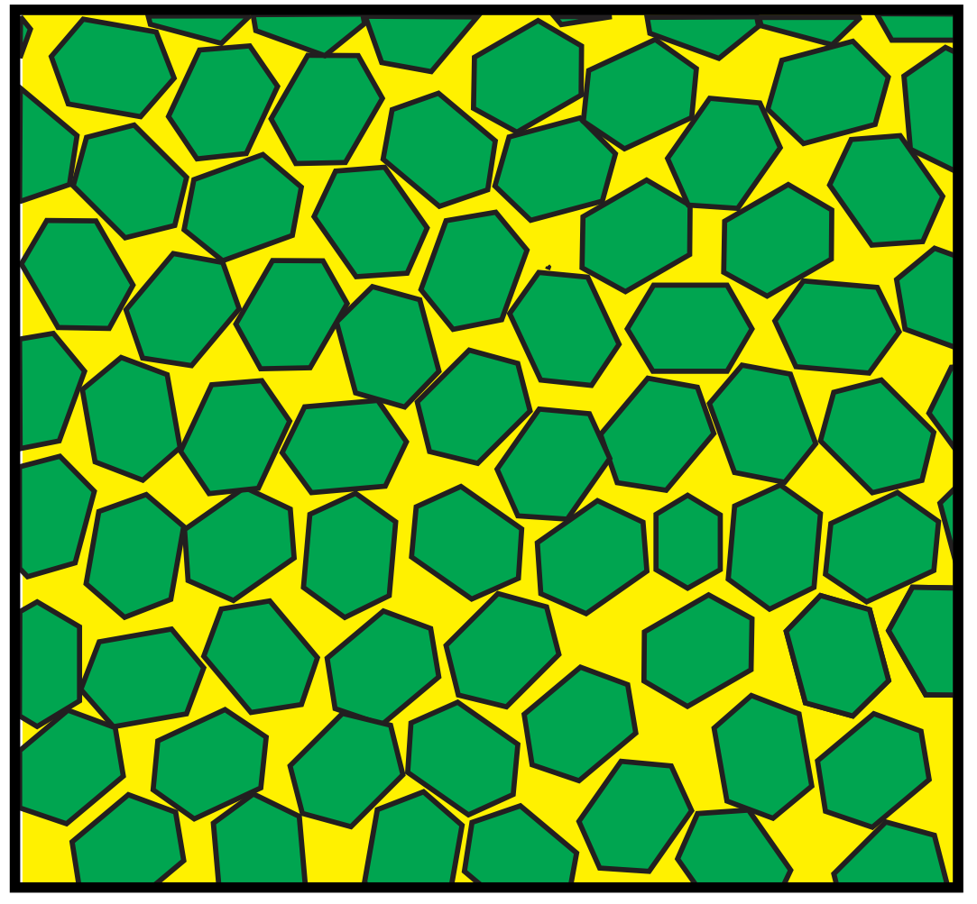
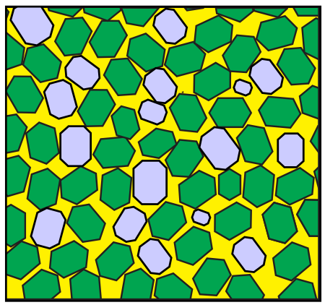
Olivine-cpx cycles
Olivine-cpx cumulate layering, Munni Munni
Oscillatory-zoned cpx in cpx-olivine cumulate, Kevitsa, Finland
Olivine-cpx cycles
Plag
Ol gabbro
(Ol+Plag+Cpx)
Olivine
Cpx
olivine
Ol + Cpx cumulates
Ol cumulates
Olivine + Cpx

Slide 12
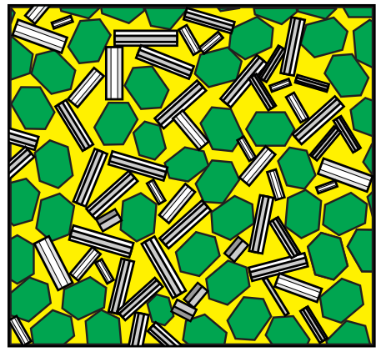
Olivine-cpx cycles
Messages:
A small change in the parent magma composition can produce a really big change in the major-element composition of the cumulates
This can also result in big changes in the compatible trace elements
Ultramafic cumulates don’t require ultramafic magmas
Olivine + Plag
Plag
Ol + Plag cumulates
Ol gabbro
(Ol+Plag+Cpx)
Olivine
Cpx
Ol cumulates
olivine

Slide 13
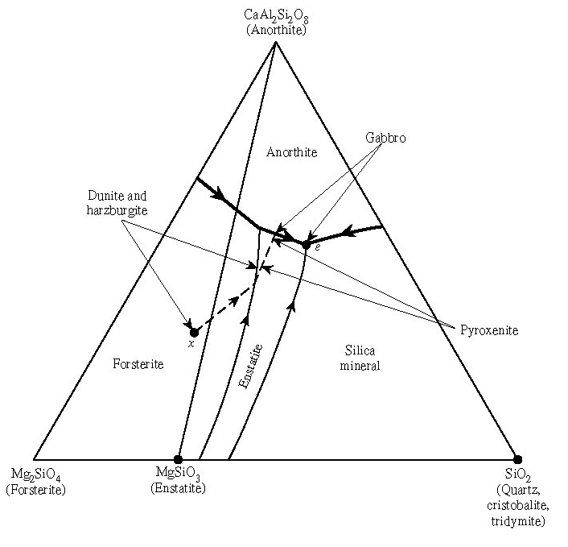
Olivine + Plag
Troctolite – signature rock type of Voisey’s Bay
Add silica

Slide 14
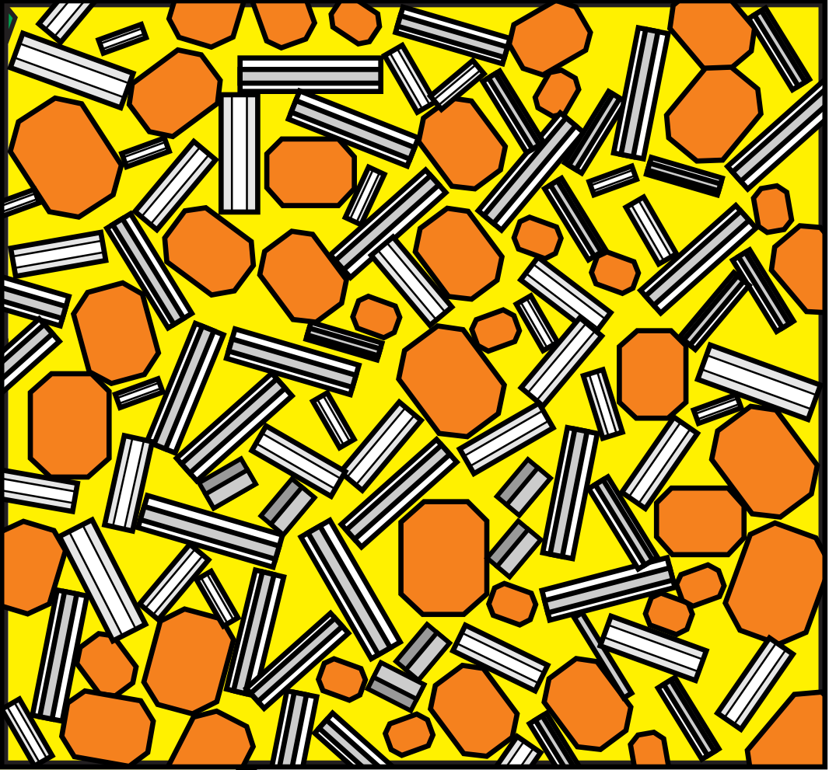
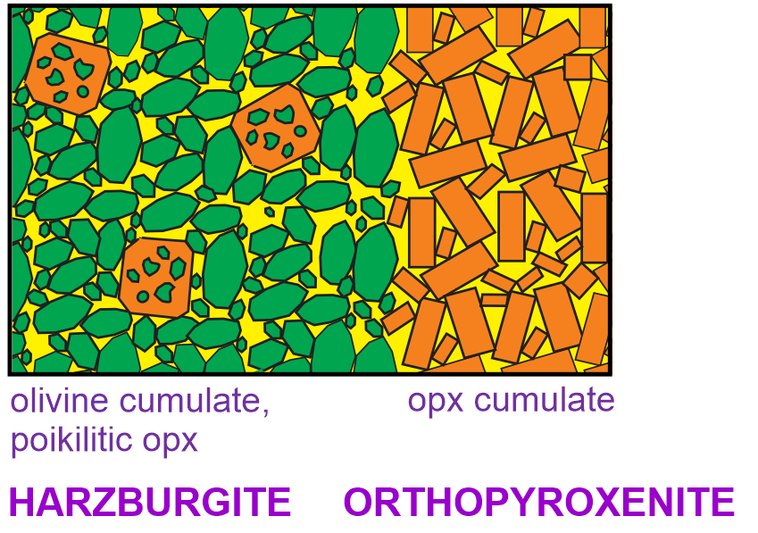
Adding silica during contamination commonly causes mafic magmas to crystallise orthopyroxene (enstatite) instead of olivine.
Norite
Poikilitic
Harzburgite

Slide 15
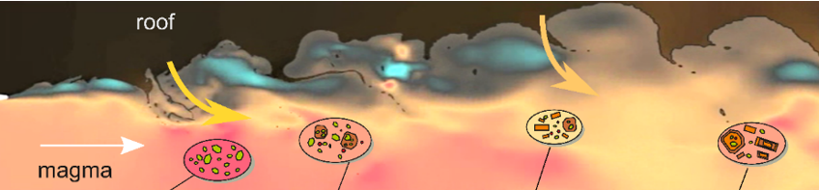
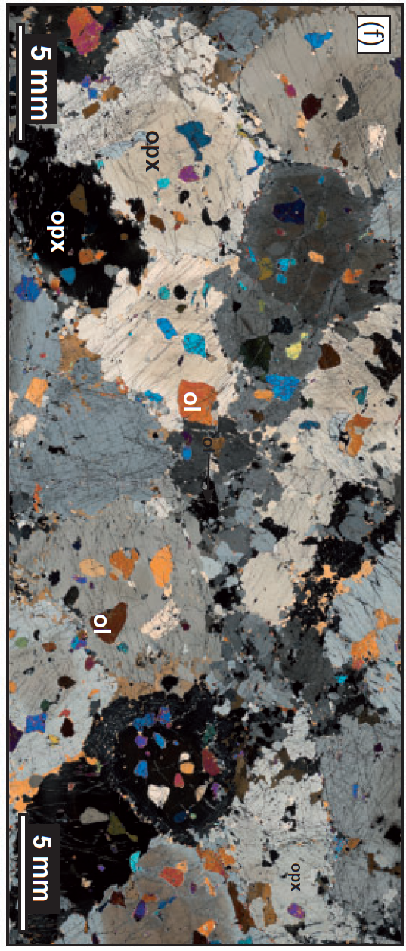
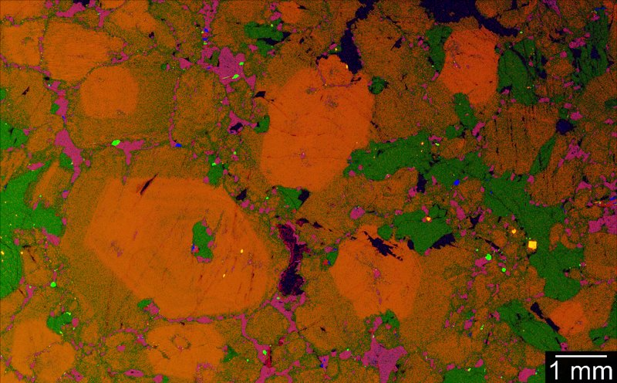
Dynamic contamination → opx cumulates, “oikocrystites”, complex Cr zoning.
Add silica
Ntaka, Tanzania. Barnes et al., 2016, J Pet. doi:10.1093/petrology/egw036

Slide 16
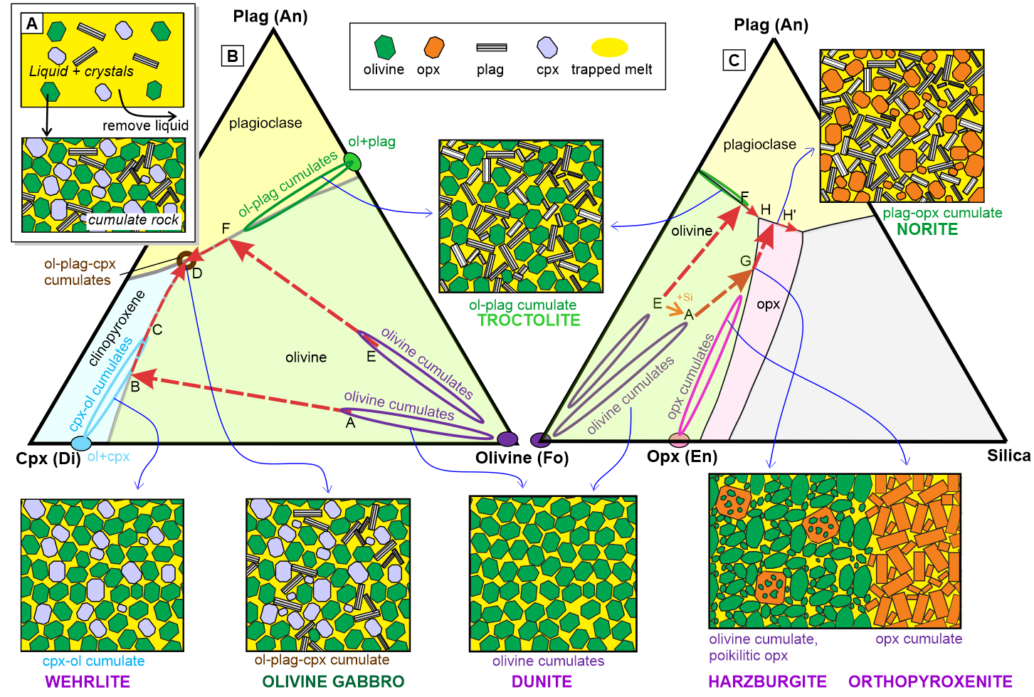

Slide 17
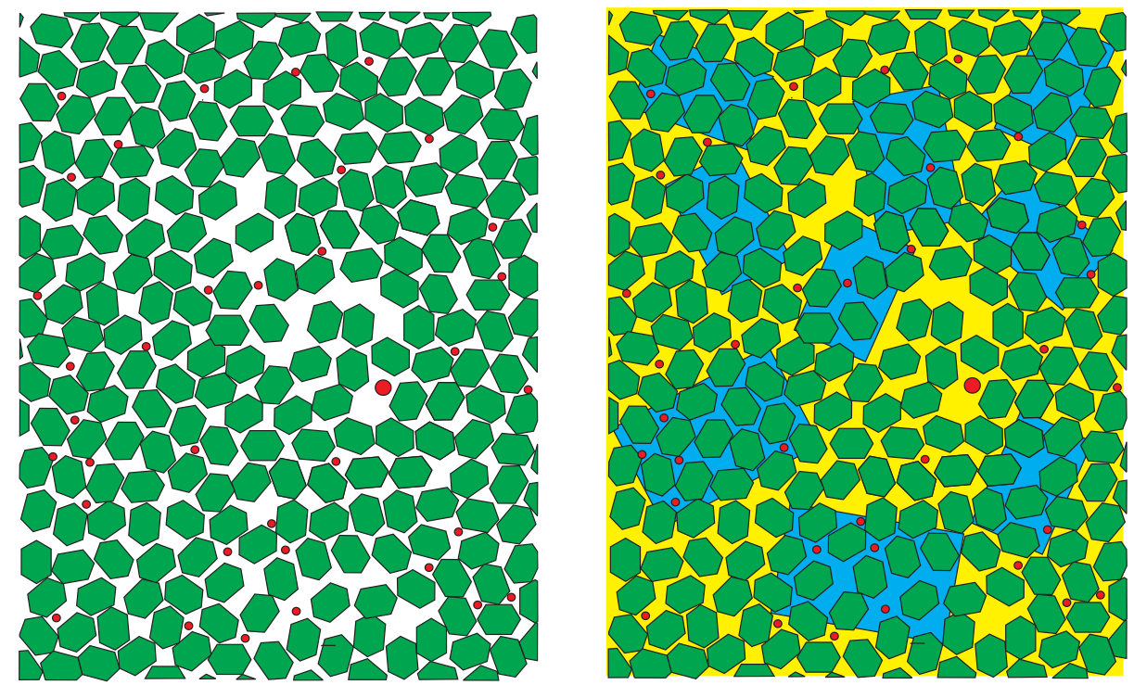
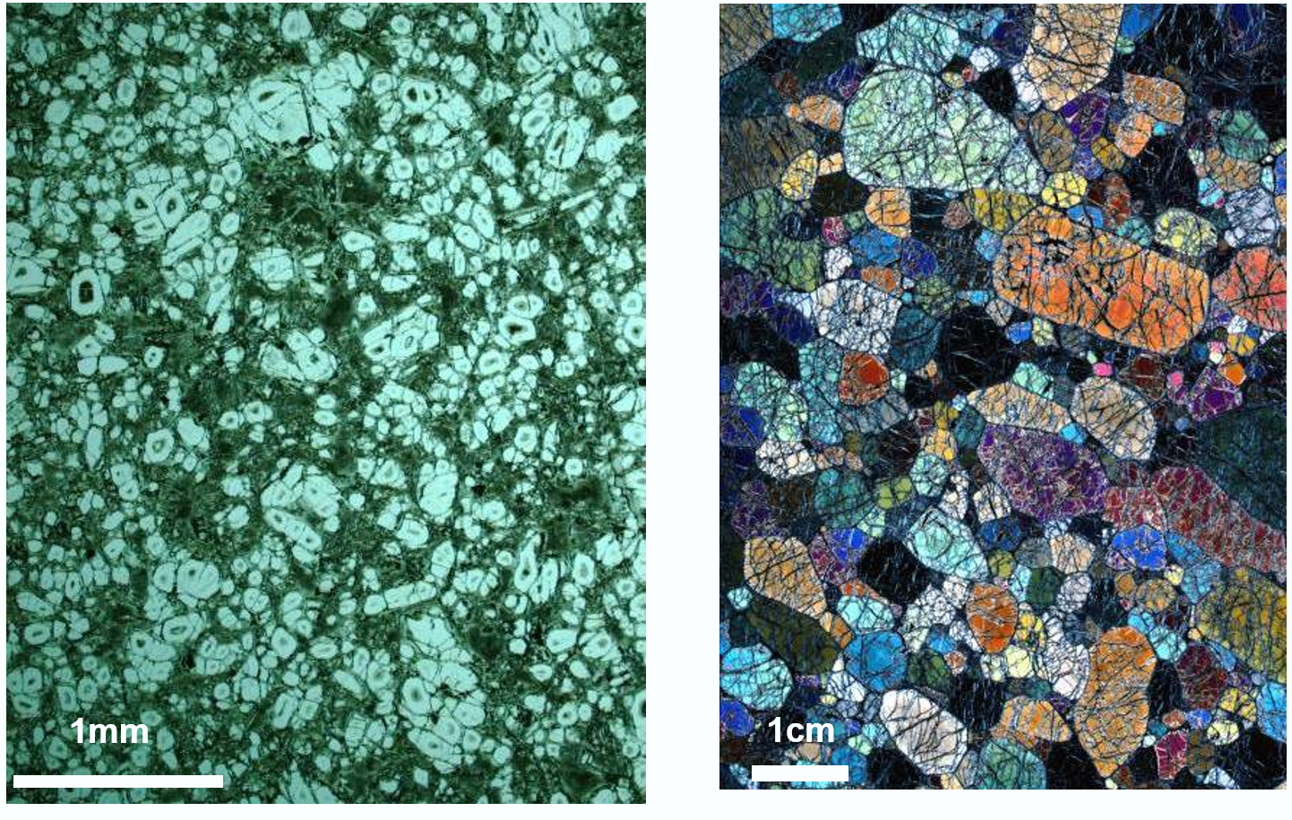
In a cumulate rock, the cumulus mineralogy determines the whole rock composition.
In a non-cumulate rock, the bulk composition determines the mineralogy
Olivine + liquid
Liquid crystallises to form intercumulus phases, + overgrowth on cumulus phases
Orthocumulates are somewhere in between
Mixture of cumulus mineral plus liquid compositions
Orthocumulate, ~50% trapped liquid
Adcumulate, <5% trapped liquid

Slide 18
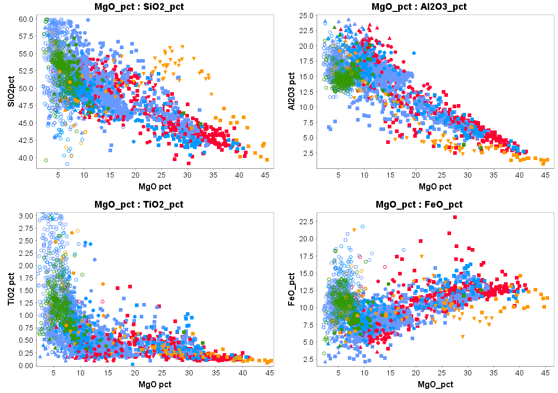
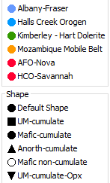
Mafic non-cumulates
Opx-bearing
Mafic cumulates
Mafic non-cumulates
Standard Geochem two-oxide plots
Mafic cumulates
Olivine cumulates
Olivine cumulates
Opx-bearing
Big overlap between mafic cumulates and non-cumulates
Mafic non-cumulates
Mafic non-cumulates
(fractionated liquids)
Olivine cumulates
Olivine cumulates
Opx-bearing
Mafic cumulates
Mafic cumulates

Slide 19
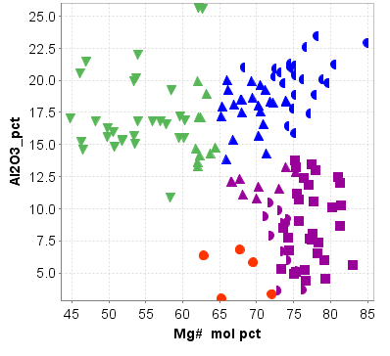

Lithogeochem discrimination of cumulates
Cumulates are mixtures of
Cumulus minerals (olivine, pyroxene, plag, sulfide liquid
Intercumulus silicate liquid
Mg# = Mg/(Mg+Fe) (molar values)
Mg mol = MgO/40.3,
Fe mol = FeO/71.9
Variation due to different proportions of cumulus plagioclase to olivine +pyroxene
Variation due to increasing proportion of intercumulus liquid
Cumulus olivine + sulfide + silicate liquid
Cumulus olivine + sulfide + intercumulus minerals
Most potential targets contain a high proportion of olivine or olivine+pyroxene cumulates.
Which ones don’t? Norilsk and Voisey’s Bay…
Savannah (Sally Malay)

Slide 20
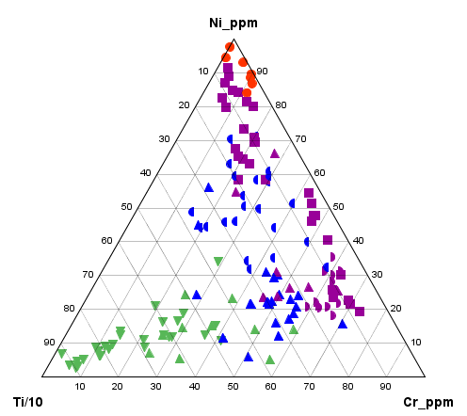
Lithogeochem discrimination of cumulates
Mg# = Mg/(Mg+Fe) (molar values)
Mg mol = MgO/40.3,
Fe mol = FeO/71.9
Same data, alteration-robust “pXRF elements”
Peridotites (olivine cumulates)
Pyroxenites
Savannah (Sally Malay)

Slide 21
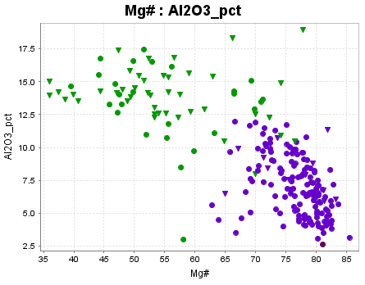
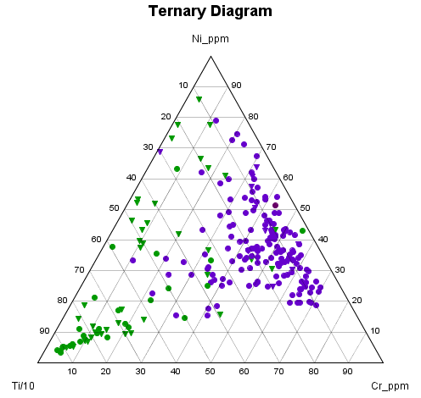
Ntaka Hill (Tanzania – high Mg basalt parent magma)
Non-cumulates
Opxnite cumulates
Mostly metamorphic amphibolite/metapyroxenite
Some igneous-textured pyroxenites and peridotites
(very few plag cumulates)

Slide 22
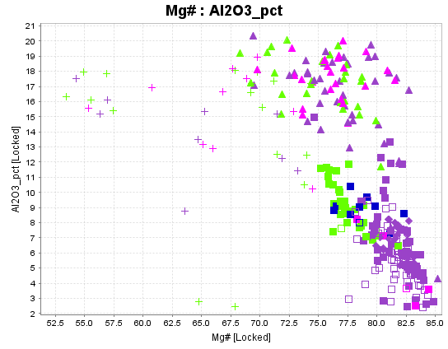
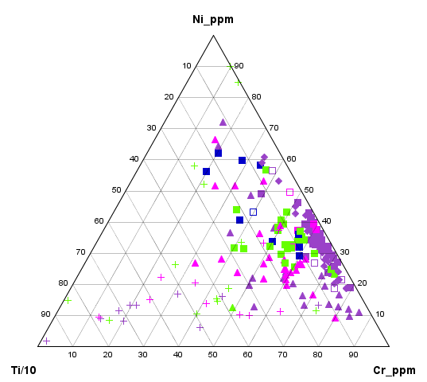
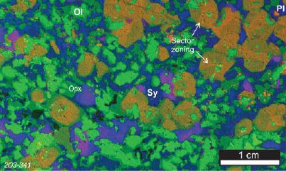
Nova
Norite/G’norite cumulates
Very small proportion of non-cumulate rock
Host intrusion
Ol+Opx
orthocumulates

Slide 23
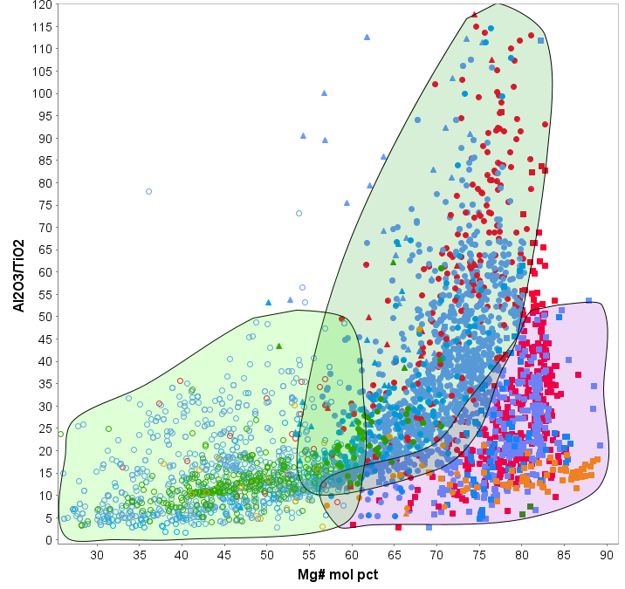
Mg# vs Al/Ti plots
Accumulation of plagioclase
Ultramafic cumulate – no plag, therefore should have same Al/Ti as parent magma (not exact due to presence of Al in spinel, pyroxene)
Mantle value
Fractional crystallisation of plagioclase + px/ol

Slide 24
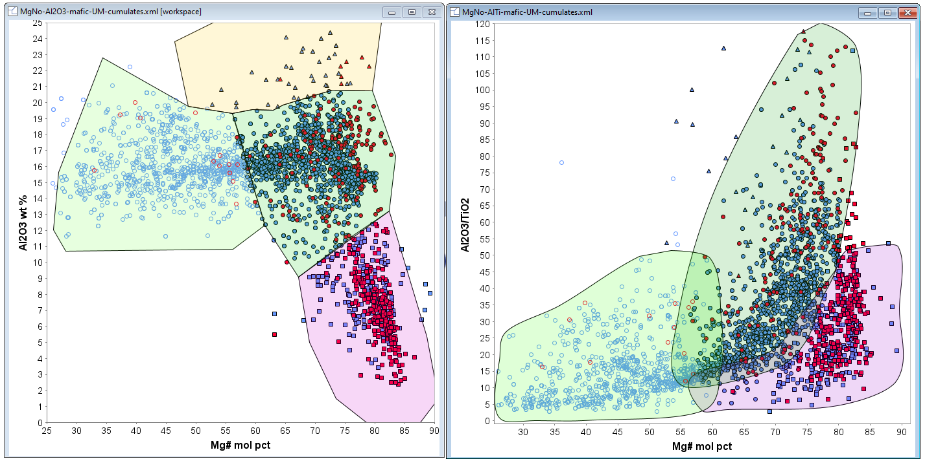
Albany-Fraser Orogen, Fraser Zone Nova
Maf-c
Maf-c
Maf non-c
Maf non-c
UM-c
UM-c

Slide 25
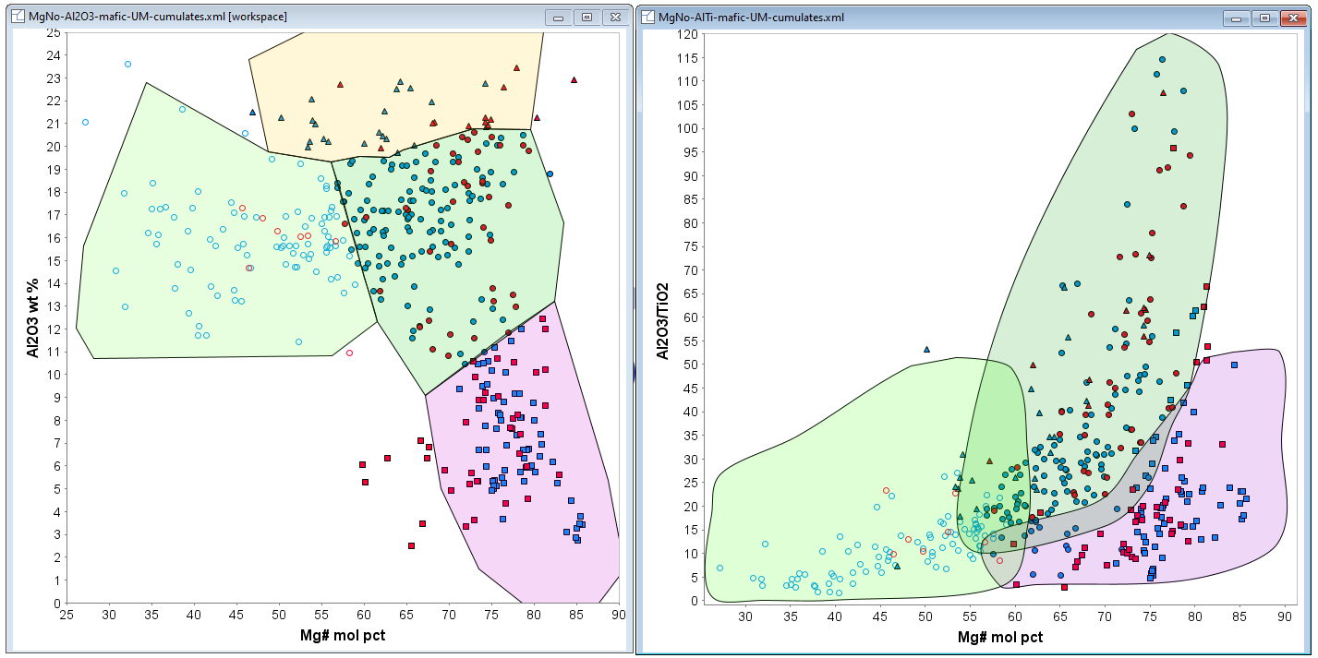
Kimberley- Halls Creek Orogen Savannah
Maf-c
Maf-c
Maf non-c
Maf non-c
UM-c
UM-c

Slide 26
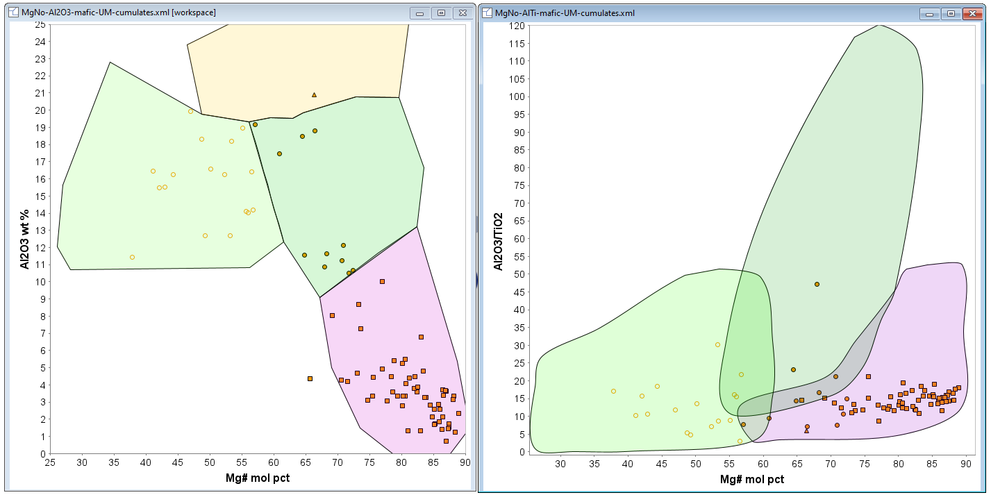
MozMB - Ntaka
Maf-c
Maf-c
Maf non-c
Maf non-c
UM-c
UM-c

Slide 27
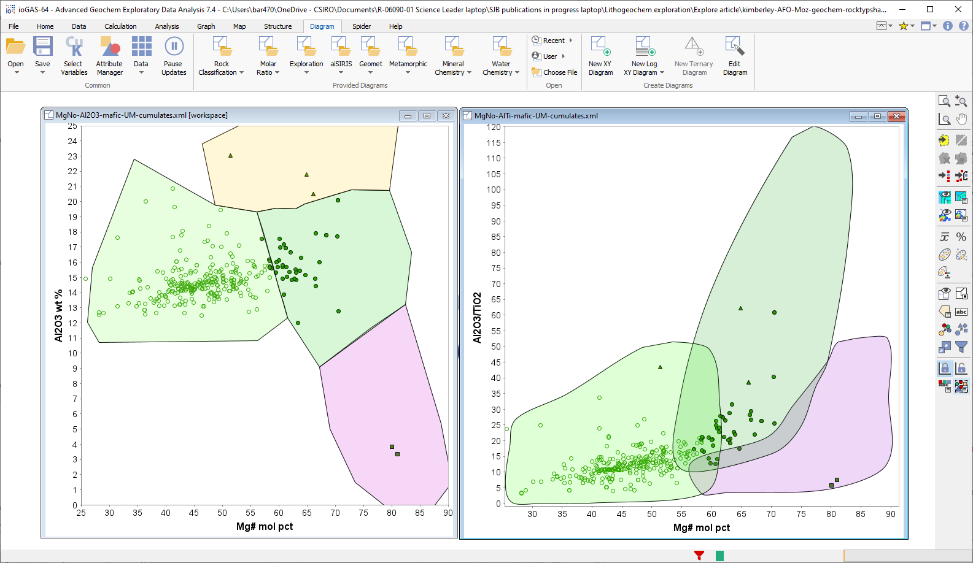
Kimberley - Hart Dolerite
Maf-c
Maf-c
Maf non-c
Maf non-c
UM-c
UM-c

Slide 28
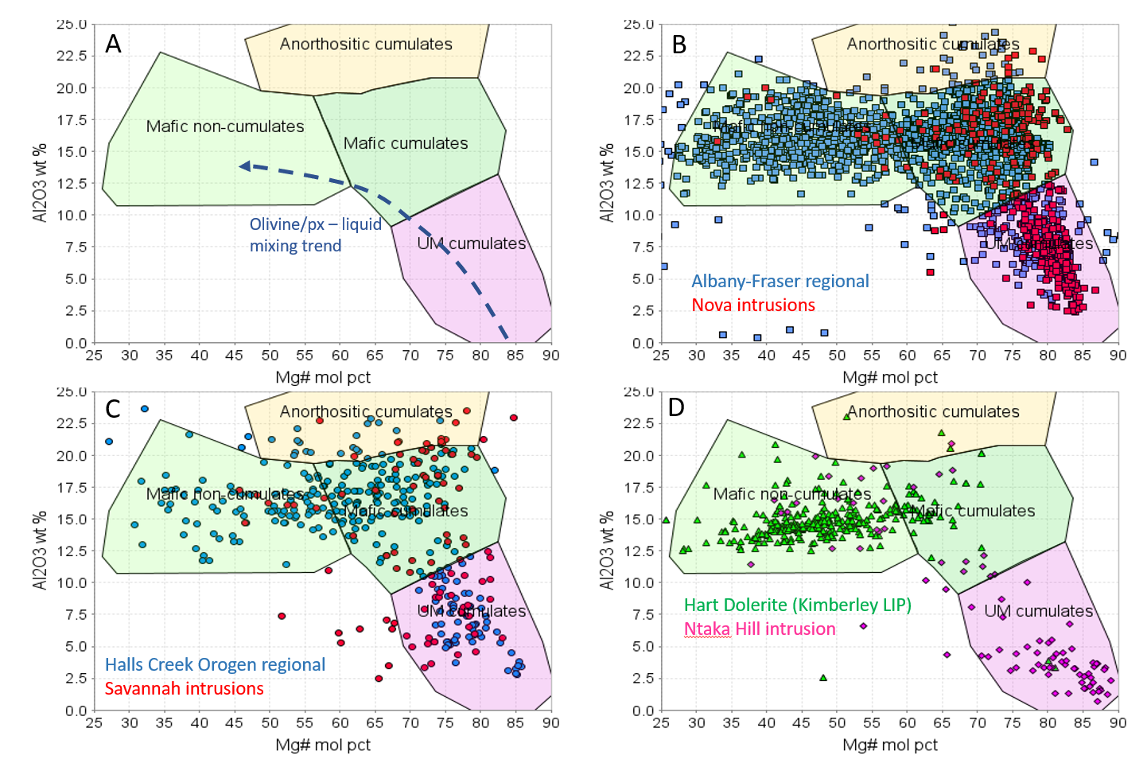
Summary:
identifying cumulate-dominant units picks out host intrusions
Sill complexes dominated by non-cumulates are low-potential targets

Slide 29
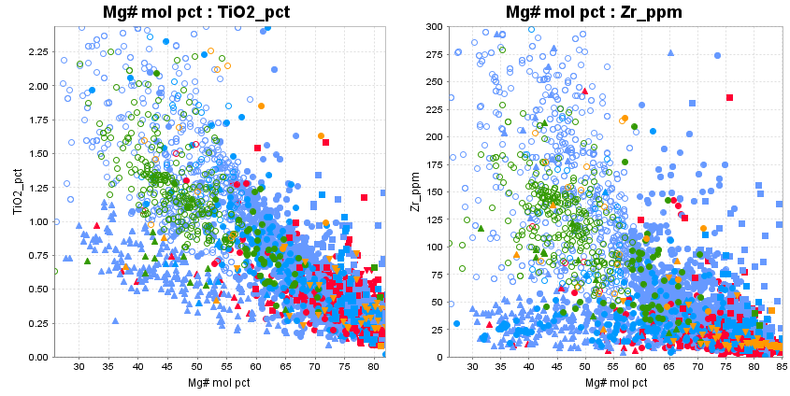
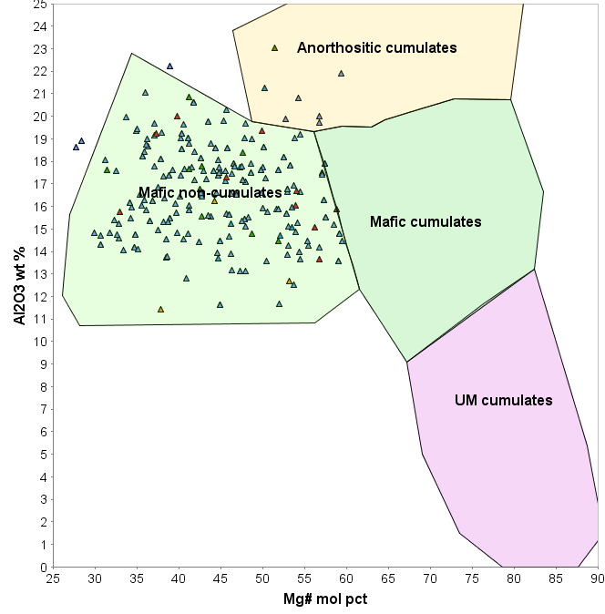
Caveat: some closed-system intrusions can contain low Mg# cumulates from highly fractionated liquids. Identify with incompatible elements – Zr, Ti
Intrusions with a high proportion of these rocks are generally less prospective.
Message: multi-variate data needs multiple discriminants – no simple “dartboards”
Weight of evidence approach is needed

Slide 30
Caveat: some closed-system intrusions can contain low Mg# cumulates from highly fractionated liquids. Identify with incompatible elements – Zr, Ti
Intrusions with a high proportion of these rocks are generally less prospective.
Message: multi-variate data needs multiple discriminants – no simple “dartboards”
Weight of evidence approach is needed

Slide 31
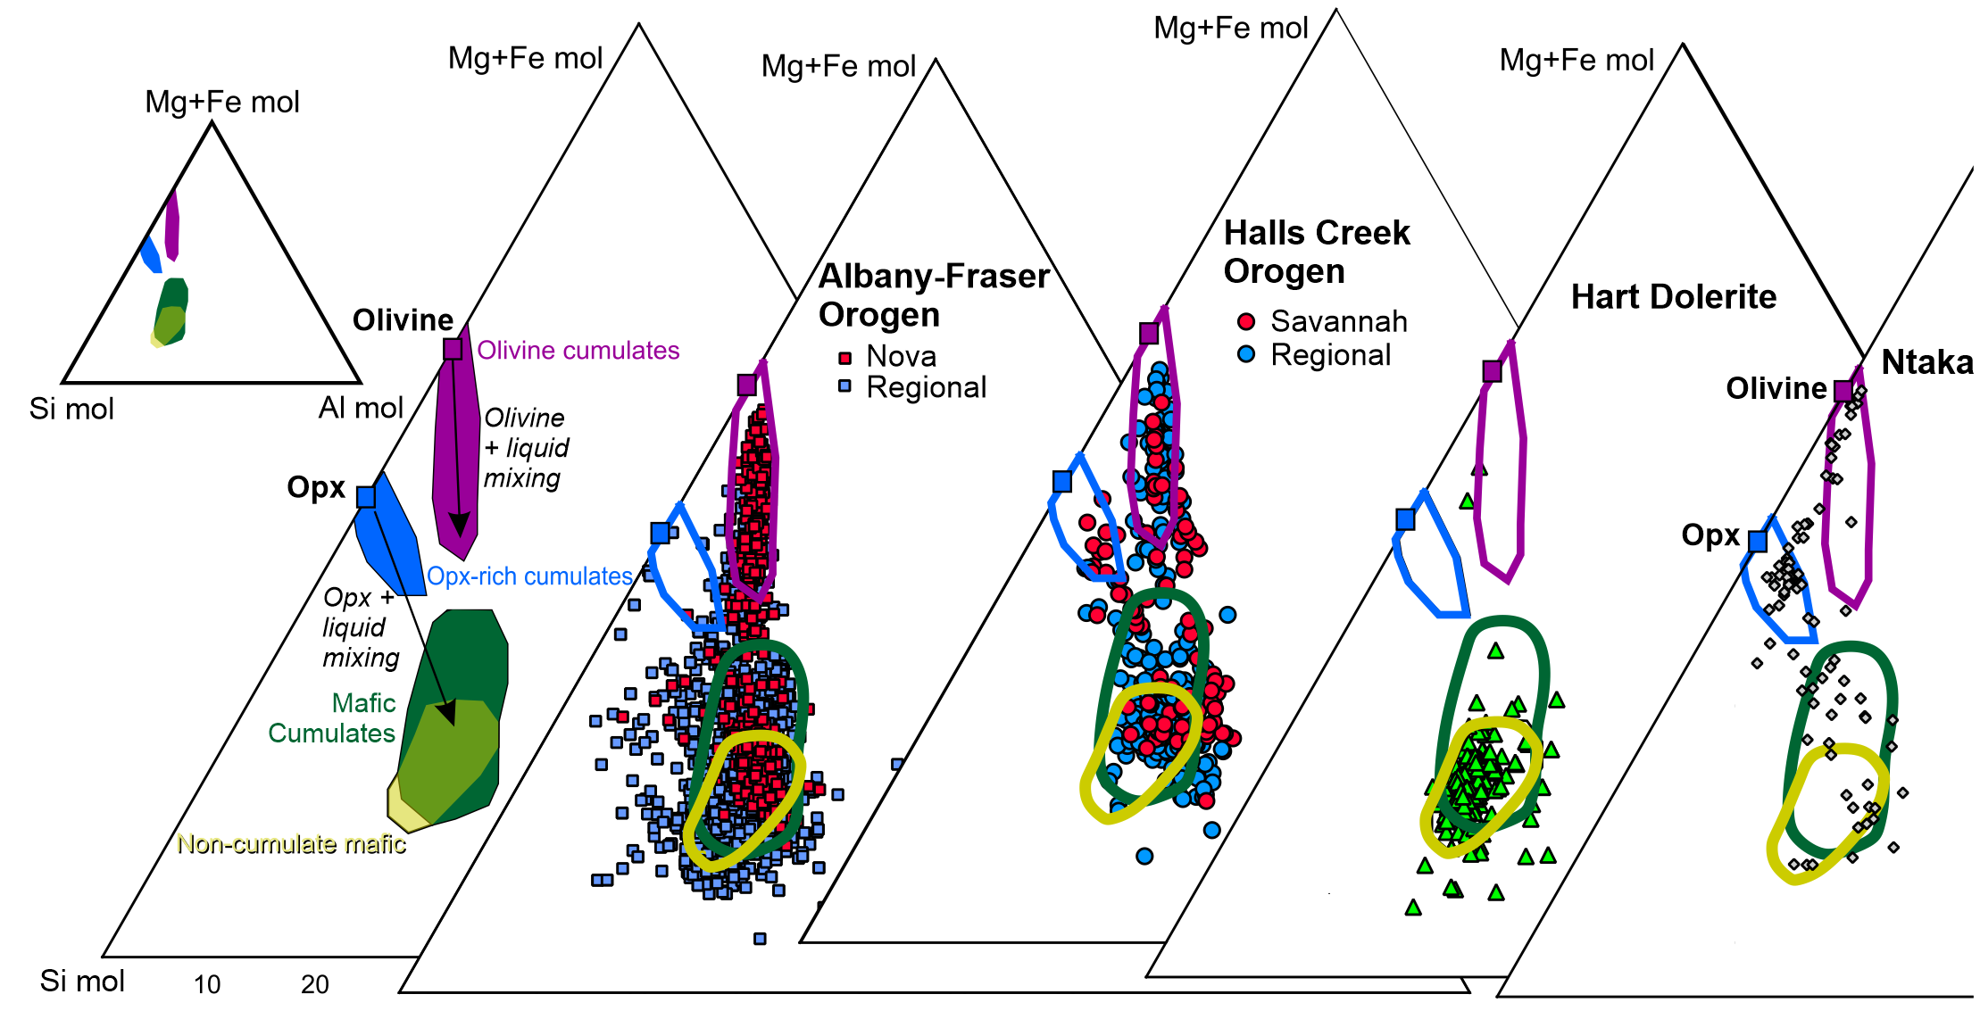
Olivine or orthopyroxene cumulates?
Triangular plots using molar proportions
Mg+Fe mol = MgO/40.3 + FeO/71.9 Si mol = SiO2/60.1 Al mol = Al2O3/51

Slide 32
Formulae for calculating molar components from whole rock geochemical analyses
Mg mol MgO/40.3
Fe mol [Total Fe as FeO*]/71.9
Si mol SiO₂/60.1
Al mol Al₂O₃/51
Ti mol TiO₂/79.9
Mg# Mg mol/[Mg mol + Fe mol]

Slide 33
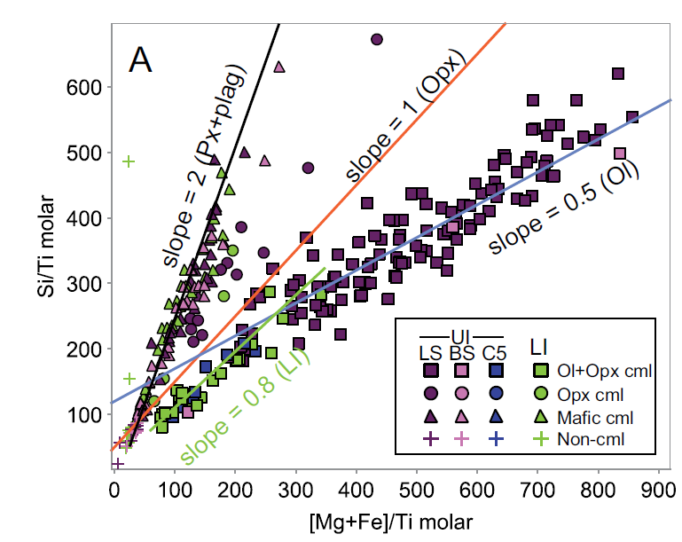
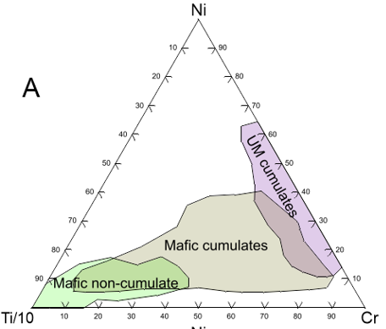
The diagrams shown here are available as IoGas Diagram templates. You will need the following columns, named exactly as shown: MgO_pct, Al2O3_pct, SiO2_pct, FeO_pct, Mg# mol pct, TiO2_pct.
Download the zip file and save the individual xml files to:
C:\Users\USERNAME\AppData\Roaming\ioGAS\cache\iod\DiagramAndCalc

Slide 34
Identifying cumulus phases from Lithochem
Conserved element ratios
Method for recognising accumulation of olivine, pyroxene, plagioclase
Process: calculate molar MgO, FeO, SiO2 (oxide weight pct/molecular weight)
MgO/40.3 = m
FeO/71.9 = f
SiO₂/60.1 = s
Divide by oxide/mol.wt of a component excluded from all these phases – Ti is ideal,
TiO₂/79.9 = t
Plot s/t vs (m=f)/t
Olivine has formula (Mg,Fe)₂SiO₄ so addition of olivine produces a line with slope 0.5 (adding one mole of Si for every 2 of Mg+Fe
Opx is (Mg,Fe) SiO₃ so addition produces a line with slope =1
Adding pyroxene = plagioclase in cotectic proportion produces slope ~=2
(Nova data from Taranovic et al., Econ Geol 2022)

Slide 35
Identifying cumulus phases from Lithochem - Conserved element ratios
Method for recognising accumulation of olivine, pyroxene, plagioclase
Process: calculate molar MgO, FeO, SiO2 (oxide weight pct/molecular weight)
MgO/40.3 = m
FeO/71.9 = f
SiO₂/60.1 = s
Divide by oxide/molwt of a component excluded from all these phases – Ti is ideal,
TiO₂/79.9 = t
Plot s/t vs (m=f)/t
Olivine has formula (Mg,Fe)₂SiO₄ so addition of olivine produces a line with slope 0.5 (adding one mole of Si for every 2 of Mg+Fe
Opx is (Mg,Fe) SiO₃ so addition produces a line with slope =1
Adding pyroxene = plagioclase in cotectic proportion produces slope ~=2
Position along line depends on trapped liquid proportion – low=adcumulate, high=orthocumulate
More adcumulate
More orthocumulate
(Nova data from Taranovic et al., Econ Geol 2022)

Slide 36
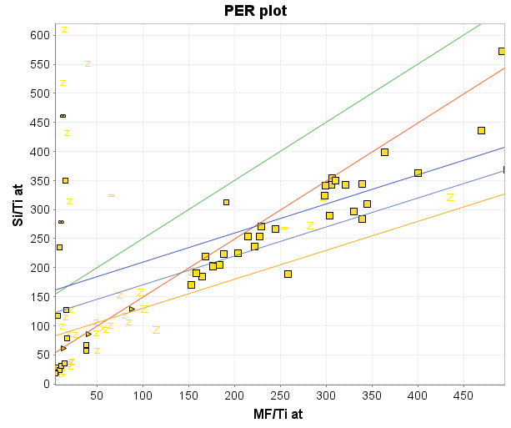
Identifying cumulus phases from Lithochem
Conserved element ratios
Lower (host) intrusion at Nova –
slope = 0.8 (oliv + opx)
Ntaka (pyroxenite host)
Slope = 1 (opx)
Full details: Stanley and Russell 1989 CTMP DOI:10.1007/BF00371366

Slide 37
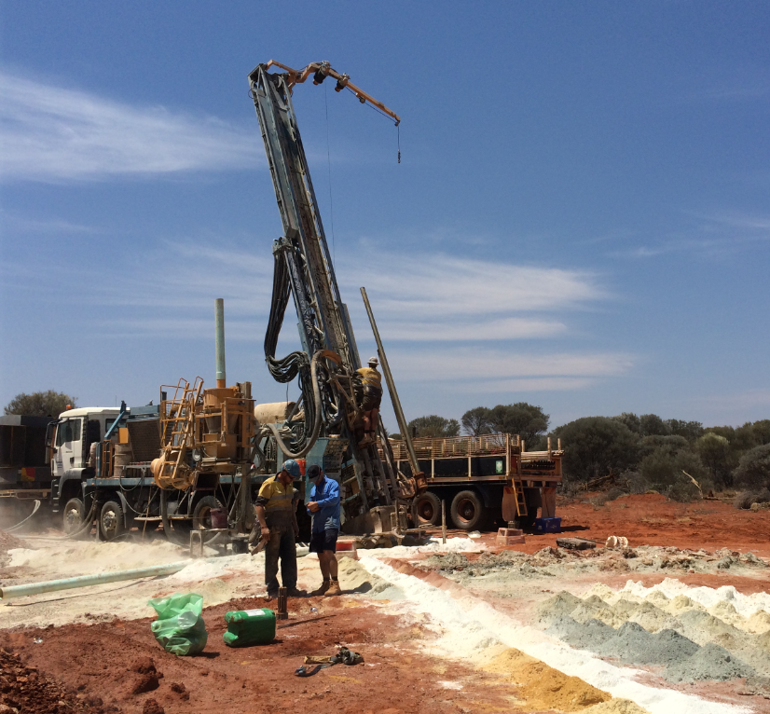
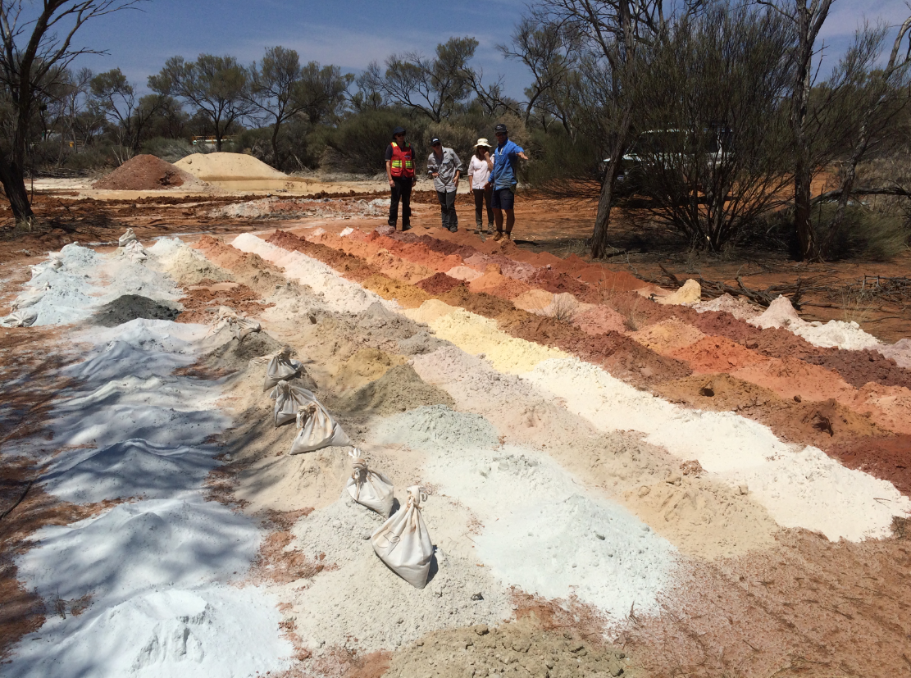
Lithogeochemistry in weathered materials – what can we use?

Slide 38
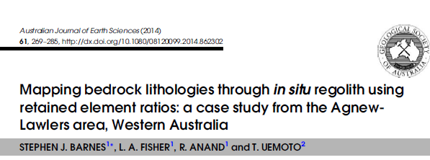

Lithogeochemistry in weathered materials – what can we use?
“Saprock” (typical TOFR in RC holes)
Ratios of any of these elements – e.g. Ni-Cr-Ti triangular plot - can be used in saprock or altered rock

Slide 39
Lithogeochem discrimination of trace cumulate sulfide
Cumulates are mixtures of
Cumulus minerals (olivine, pyroxene, plag, sulfide liquid
Intercumulus silicate liquid
Intercumulus liquid might contain (say) 500 ppm S, 200 ppm Cu
So an olivine orthocumulate (50% liquid) has 250 ppm S, 100 ppm Cu
So what is an anomaly?
Cumulus olivine + sulfide + silicate liquid
Cumulus olivine + sulfide + intercumulus minerals

Slide 40
Lithogeochem discrimination of trace cumulate sulfide
Look for
Anomalous high Ni (but silicate Ni background is highly variable
Low level Pt-Pd (corrected for cumulus/trapped liquid proportion)
Anomalous Cu (but can be highly mobile in altered rocks) – also has trapped liquid effect
Cumulus olivine + sulfide + silicate liquid
Cumulus olivine + sulfide + intercumulus minerals

Slide 41

Mafic-ultramafic rocks in Proterozoic mobile belts
Mantle ratio
Enriched due to sulfide addition
Enriched due to sulfide addition
Depleted due to sulfide extraction

Slide 42


Remove the purple M&Ms – the concentration of the yellow and blue ones increases but their PROPORTION stays the same
So Cu/Zr unaffected by silicate fractionation

Slide 43

DEPLETED
Albany-Fraser
Nova
ENRICHED

Slide 44

Halls Creek
Savannah
Hart Dolerite

Slide 45

Albany-Fraser
Nova
Combine Cu/Zr with trace element ratio proxies for crustal contamination – e.g. Th/Nb
mantle
Sulfide addition
mantle
Crustal contamination

Slide 46

Kimberley, WA
Halls Creek
Savannah
Hart Dolerite
Pr-mantle
Pr-mantle
Crustal contamination

Slide 47

Ntaka (Mozambique Belt)
mantle
mantle
Crustal contamination

Slide 48



Why can’t we just look for Ni anomalies?
Prot. mobile belt data (all)

Slide 49


Olivine cumulates
Opx cumulates
Gabbros, troctolites
Prot. mobile belt data (Cu- and Cu-Ni anomalous rocks removed)

Slide 50


What is the threshold for anomalous Ni in an ultramafic rock?
Ntaka, Tanzania (high-Mg basalt parent magma)
Samples with >0.5% S

Slide 51

Can we use PGEs?
Work well in komatiites. Subtle positive and negative anomalies in PGE (Pd-Pt in particular) in komatiite host units (100’s m scale vectoring) using ratios Pt/Ti, Pd/Ti (invariant to olivine fractionation)
→ Example at Long Victor, Kambalda:
Enriched
Enrichment due to trace sulfide
Can we do the same in mafic systems?
Depleted
Depletion due to sulfide extraction
Heggie et al., 2012 Econ Geol
Barnes et al., 2013 Econ Geol
Nancy SGA2015 workshop Aug. 2015 I Margaux Le Vaillant
51

Slide 52

Can we use PGEs in mafic systems? Difficult due to wide variability in background
Komatiites consistent, mainly undepleted
Pd/Ti
Pt/Ti
Basalts widely variable – Sulfides in source

Slide 53


