Slide 1



AFV: Enabling Application Function Virtualization and Scheduling in Wearable Networks
Harini Kolamunna
Yining Hu
Diego Perino
Kanchana Thilakarathna
Dwight Makaroff
Xinlong Guan
Aruna Seneviratne

Slide 2
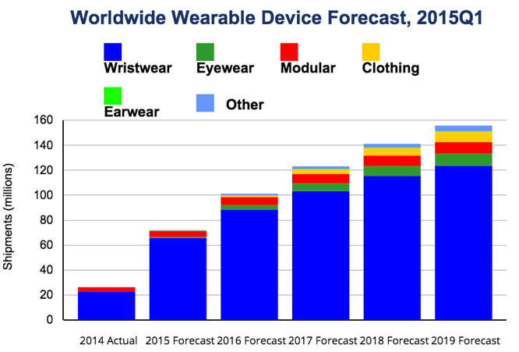
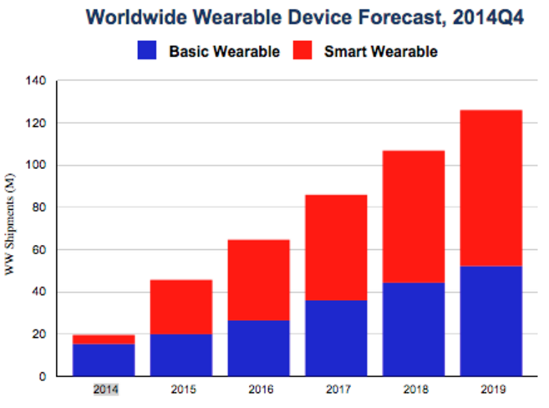

Observations and Predictions
Basic Wearables
Smart Wearables
Shipments (millions)
Shipments (millions)
2014
2015
2016
2017
2018
2019
2014
2015
2016
2017
2018
2019
  Popularity for smart wearables is growing fast.
  Personal usage of smart wearables will be more than the basic wearable usage.
Source : International Data Corporation
Notes:
validate the source
An American market research, analysis and advisory firm, specializes in information technology, telecommunications, and consumer technology, Software Development.
Since 1964

Slide 3
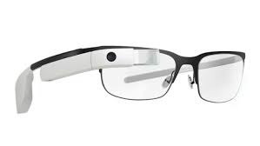
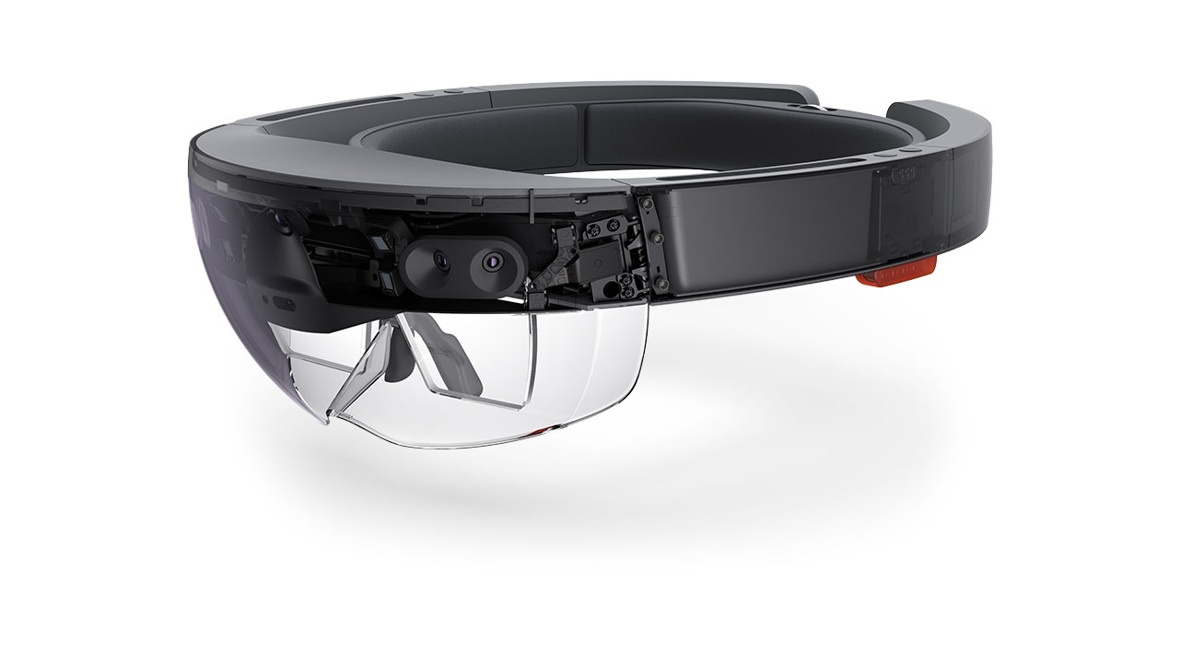



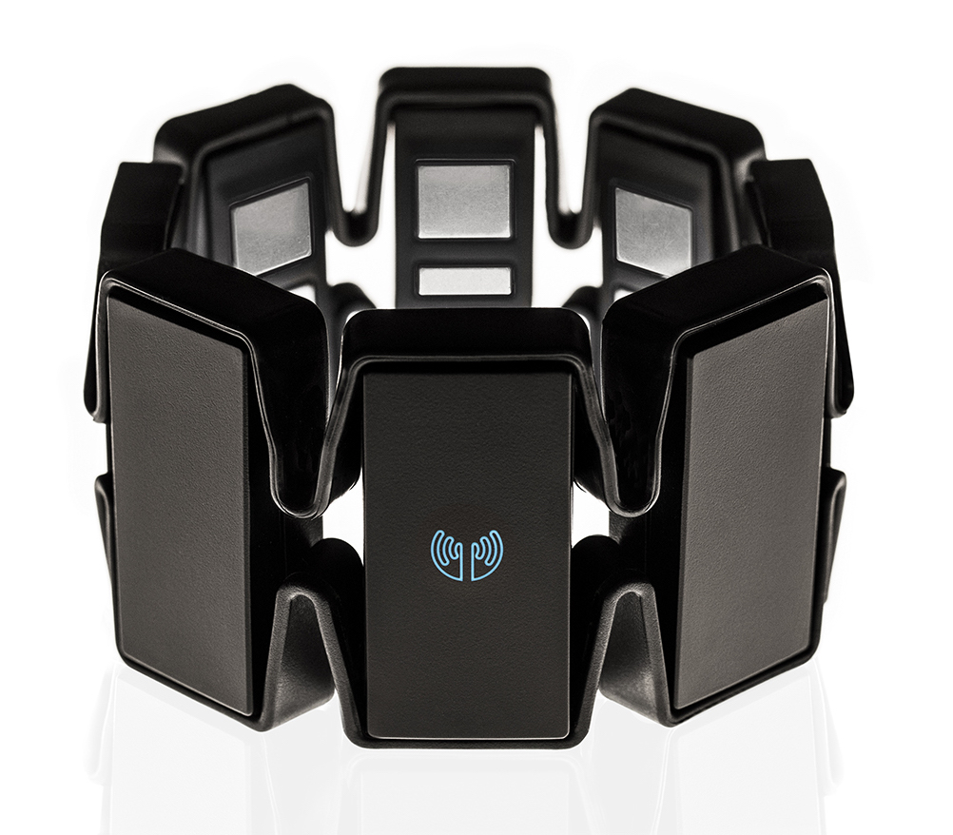


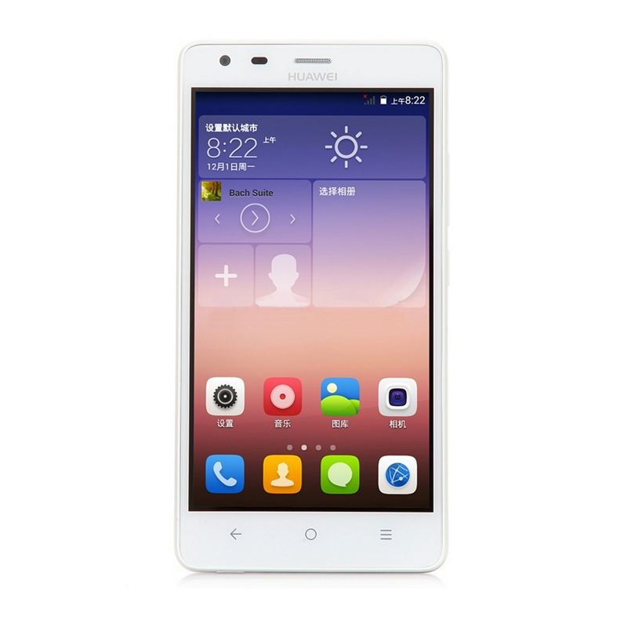
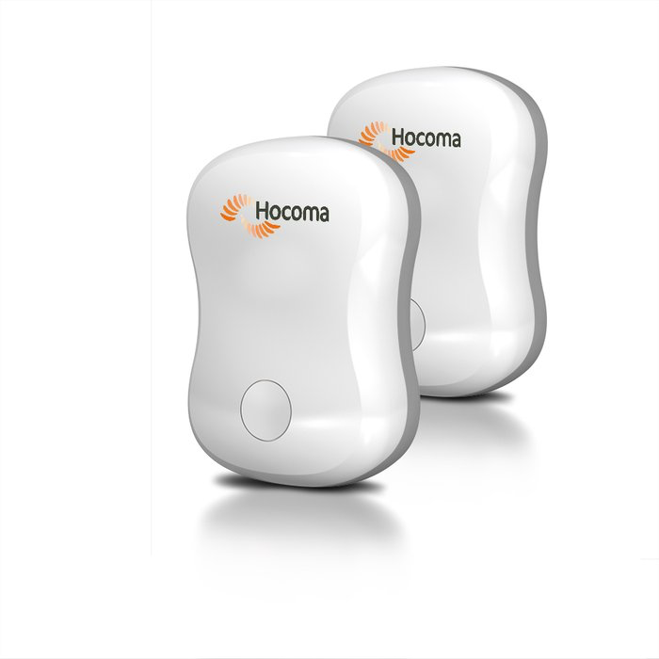

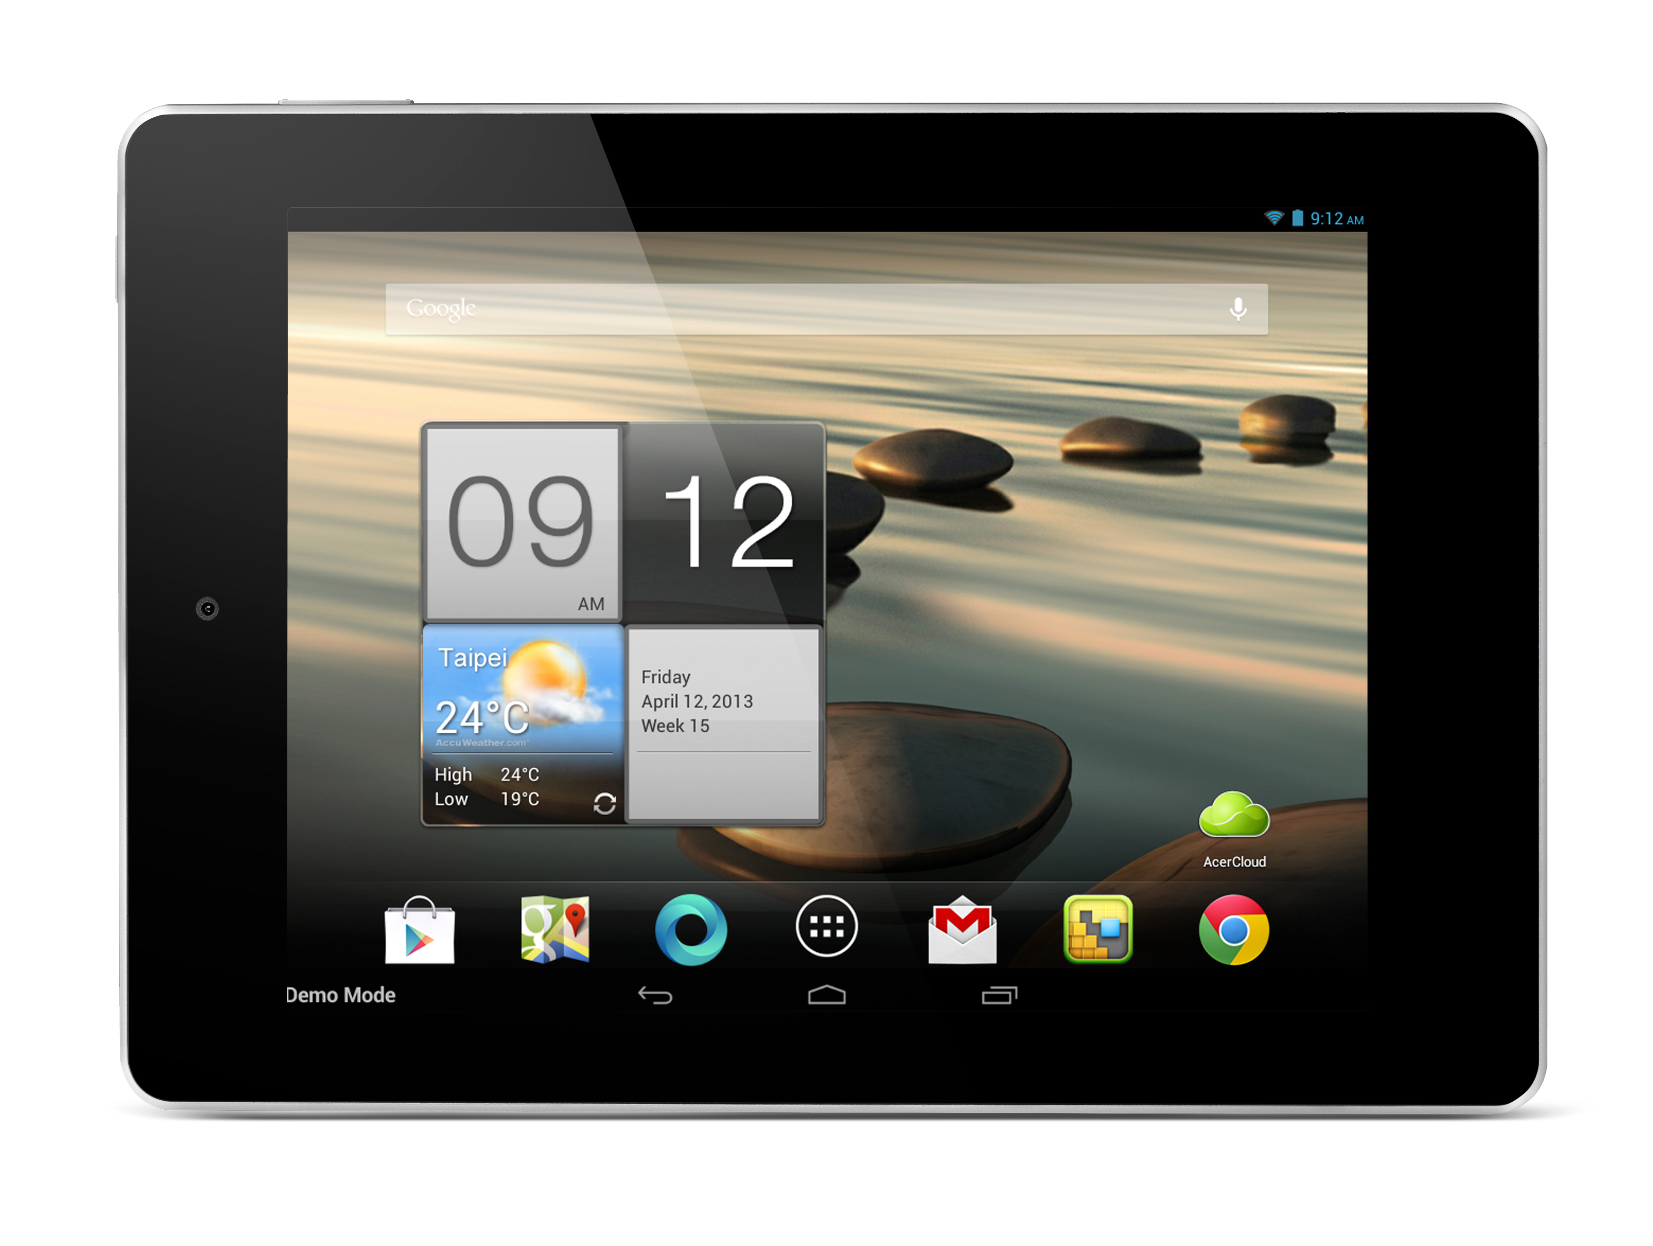
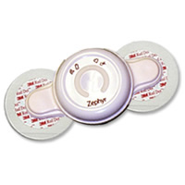
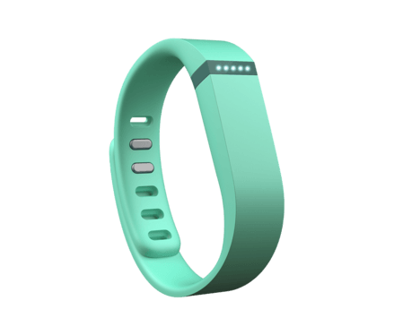
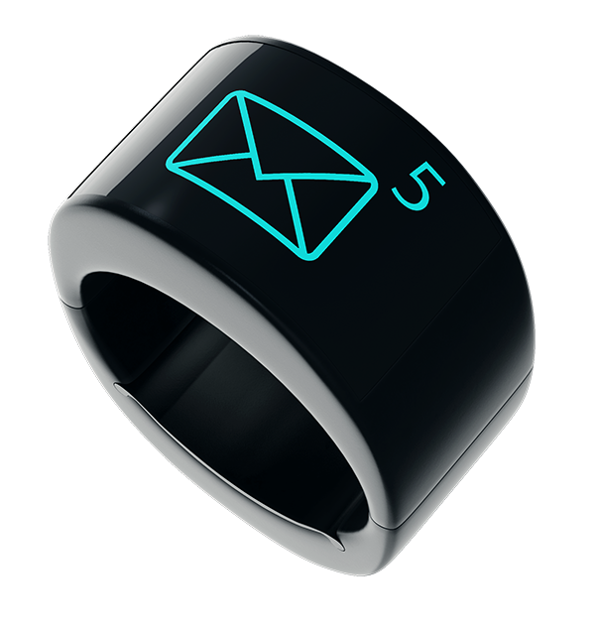
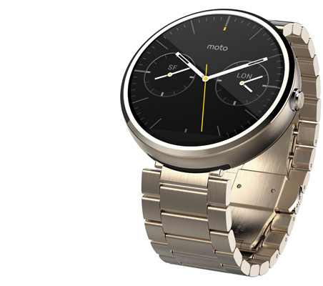
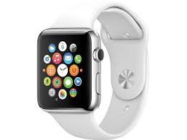

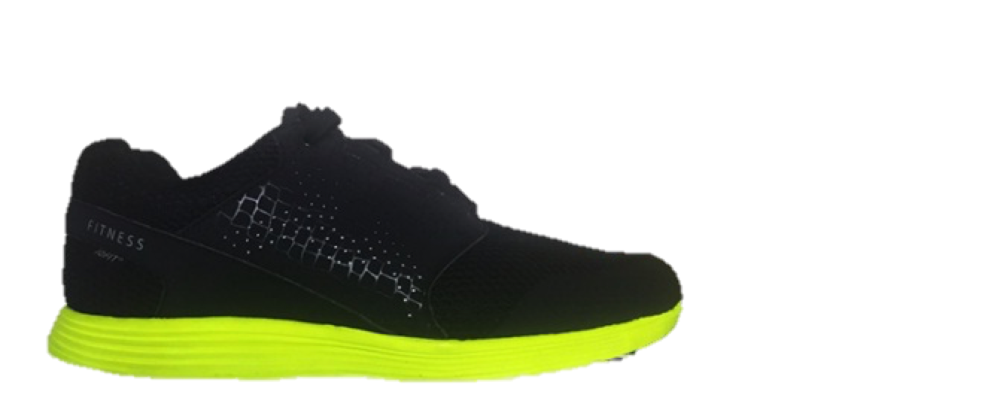



Observations and Predictions
Ear buds
Glasses & Lenses
Armbands
Internet
Tablets & Phones
Bio-patches & e-textile
Wristbands & Rings
Watches
Shoes & Soles
Laptops & Computers
Tier 1 Devices
Tier 2 Devices
Extended PAN
Personal Area Network (PAN)
  Practical situation in near future.
  Network of low-resource devices on your body.
  Lower and comparatively higher capable devices.
Notes:
Considering that, This would be the practical scenario in near future
A person would have a network of low resource devices (energy, computation complexity, memory) on his body.
Low capable devices
fewer tasks
Higher capable devices
multiple tasks
possible internet connection
low capable devices are connected

Slide 4
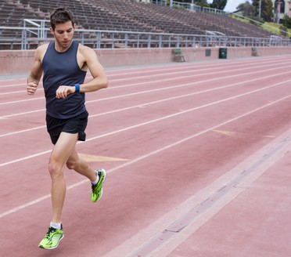
Motivation
  Common functions are available in PAN devices.
  Non-optimal utilization depending on the context:
    Waste of the limited resources.
    Poor functionality.
Step counter
Are we optimally utilizing the available resources in a PAN?
Notes:
Explain our motivation with a simple example
Assume a person is running with three devices watch, phone and shoes
All 3 have the common function which is step counting
Non optimal usage of common functions would result in wasting limited resources available
The basic question is are we…
Analysis of popular fitness tracking apps gives the answer NO

Slide 5
Motivation
Are we optimally utilizing the available resources in a PAN?
  Popular fitness tracking applications (smartphone, smartwatch)
  – UP – Sleep
  – MyFitnessCompanion – Cardiograph
  – WearRun
  Function Allocation
    Random → One of the arbitrary selected device by the end user runs the function.
    ALL → All the devices run the function.
  Context Awareness
    Do not provide context monitoring or dynamic adaptation to context changes.
Knowledge about PAN
Complexity during application development
Notes:
Random
ALL

Slide 6
Goal
Utilize the common functionalities available in a PAN
Optimality
&
Adaptability
Resource constraints
Ease of use
Optimally adapting to context changes.
Implementable in low resource PAN devices.
Easier for
app developers and end users.
Notes:
Motivated by this scenario, the research challenge is how to effectively use the….
With having the constraints of

Slide 7
Approach
V_{x} – Function, R_{x} – Request
R_{x} → V_{x}
Step counter
D₁
A₁
R₁
D₁
V₁
V₂
Smartphone
Requesting Step count
D₂
V₁
V₂
Smartwatch
.
.
D_{n}
V₁
Smartshoes
  Request (R_{x}) is mapped to device (D_{x} have V_{x}).
  Considering context;
    Capability of the D_{x} to perform the function V_{x}
    Requirements of R_{x}
    User’s preference
Automatic
Dynamic
Notes:
This challenge/problem can be formulated as a functions allocating problem where requests are mapped to a particular device
We consider context of both request and function

Slide 8
AFV
(Application Function Virtualization)
A framework enabling automated dynamic function virtualization/
scheduling across devices,
simplifying context-aware application development

Slide 9
AFV
(Application Function Virtualization)
AFV Architecture
Function allocation problem (FAP)
Validation and benefits to AFV users

Slide 10
AFV Architecture
  AFV APIs
  Function Manager
    Knowledge about PAN
    Manages the requests
  Context Monitoring
  Decision Engine
    Functions Allocation Problem (FAP)
  Communication Manager
    Manages all AFV communication in the PAN
  Function Execution
Apps
app 1
app 2
app 3
AFV
Framework
Apps
OS
AFV APIs
Tier 1 - Device 3
Apps
Decision Engine
Function Manager
Communication Manager
AFV Framework
AFV
Framework
OS
Context Monitoring
Function Execution
Tier 1 - Device 2
OS APIs
OS
Tier 2 - Devices
Tier 1 - Device 1

Slide 11
AFV
(Application Function Virtualization)
AFV Architecture
Function allocation problem (FAP)
Validation and benefits to AFV users

Slide 12
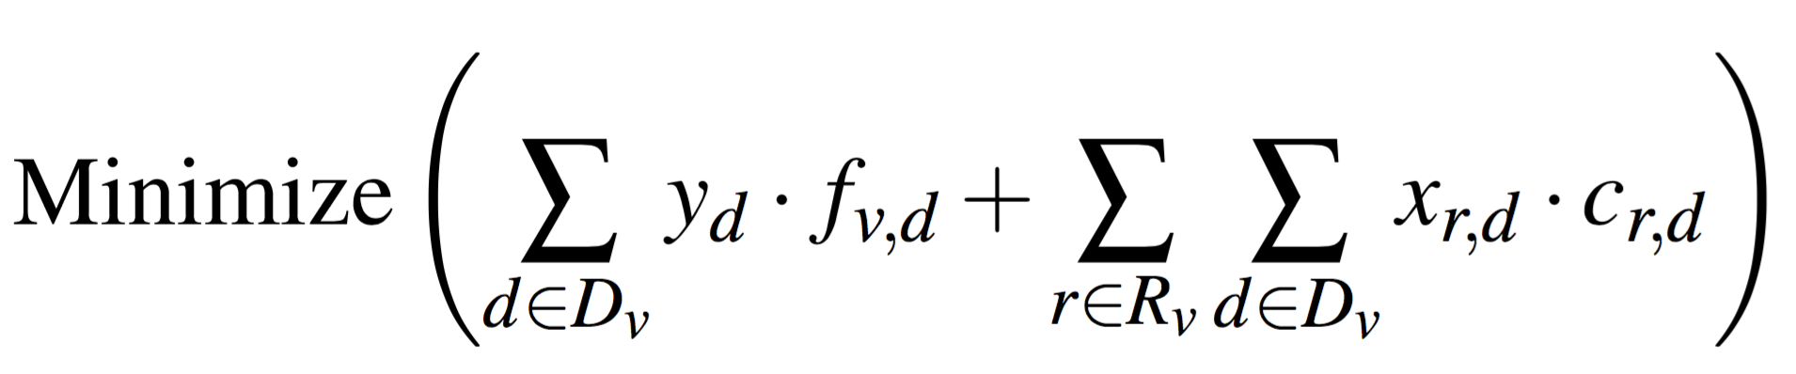
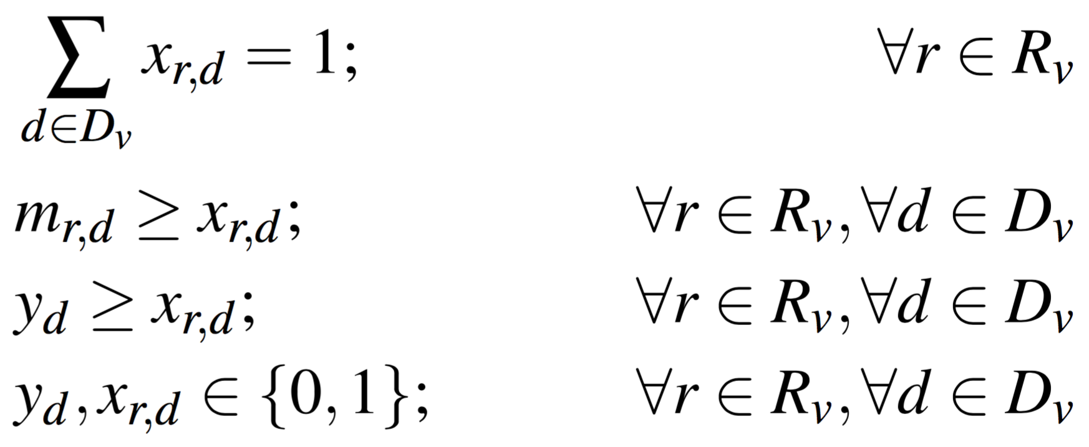
Functions Allocation Problem Formulation
Functioning
Cost f_{v,d}
Transfer Cost c_{r,d}
R₁
V₁
Objective:
Minimize the total cost of the PAN
Objective :
D₁
D₁
R₂
V₂
R₁
V₃
D₂
D₂
R₂
V₁
.
.
.
.
R₂
V₁
D_{n}
D_{n}
R₃
V₂
Functions Allocation Problem (FAP) is equivalent to
standard Uncapacitated Facility Location Problem (UFLP)
Notes:
Simplify the explanation

Slide 13
Functions Allocation Problem Formulation
Solutions to UFLP is NP-Hard.
Adopting the available greedy solution for UFLP.
Solutions to FAP is to be taken at resources–restricted PAN devices.
We chose the simplest greedy method.

Slide 14
AFV
(Application Function Virtualization)
AFV Architecture
Function allocation problem (FAP)
Validation and benefits to AFV users

Slide 15
Evaluation of FAP
Evaluating the optimality of the method of solving FAP
    5 devices, each have the function and request
    Costs are considered where σ= 0.1 *μ
  compared against
  Optimal – Results obtained using optimization problem solver, Gurobi.
  Random – One of the randomly selected device will run the function.
  ALL – All the devices run the function
Error of FAP is less than 1% irrespective of the cost ratio
ALL – FAP %
FAP
Notes:
Gurobi – commercial available optimizer

Slide 16
AFV is Implementable
  Implementation of the framework
  Implemented on Android OS and Android Wear OS
Integration of AFV in to kernel | User-level application
All the applications can take the service with minor changes. | Applications need to compile the library and service is requested via IPC calls.
Need special access to the OS for the installation. | No special access is needed for the installation.
Notes:
We chose user level implementation due to it’s flexibility.
We can further improve by integrating AFV in the kernel.

Slide 17
An Example Use Case
Function allocation for information accuracy.
  Fitness tracking application requesting accelerometer data.
    Sitting → Smartwatch
    Walking → Smartphone
Notes:
Hypothetically

Slide 18
Conclusion
Current applications do not utilize the common functionalities optimally due to the complexity during the development.
AFV: enables automated dynamic function virtualization /scheduling across devices, simplifying context-aware application development.
Objective for the optimization : Minimizing the total cost.
Implemented AFV as a user-level application.
Showed the use cases of AFV.
We are in the process of releasing AFV as an SDK.
Notes:
Details are in the paper
In the process of releasing the code. Administrative process

Slide 19
Thank you
  Harini Kolamunna
  UNSW & Data61-CSIRO
    harini.kolamunna@data61.csiro.au

Slide 21
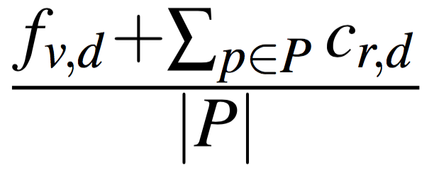
Functions Allocation Problem Formulation
Greedy method
  Selects the set of requests P to a particular function V such that,
  is minimized.
  Remove P and V form further considerations.
  Continue until all the requests are allocated.

Slide 22
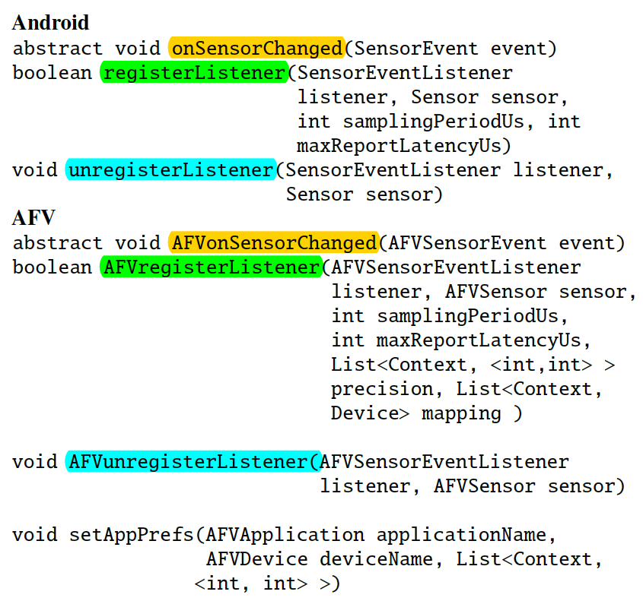
AFV Architecture: AFV APIs

Slide 23
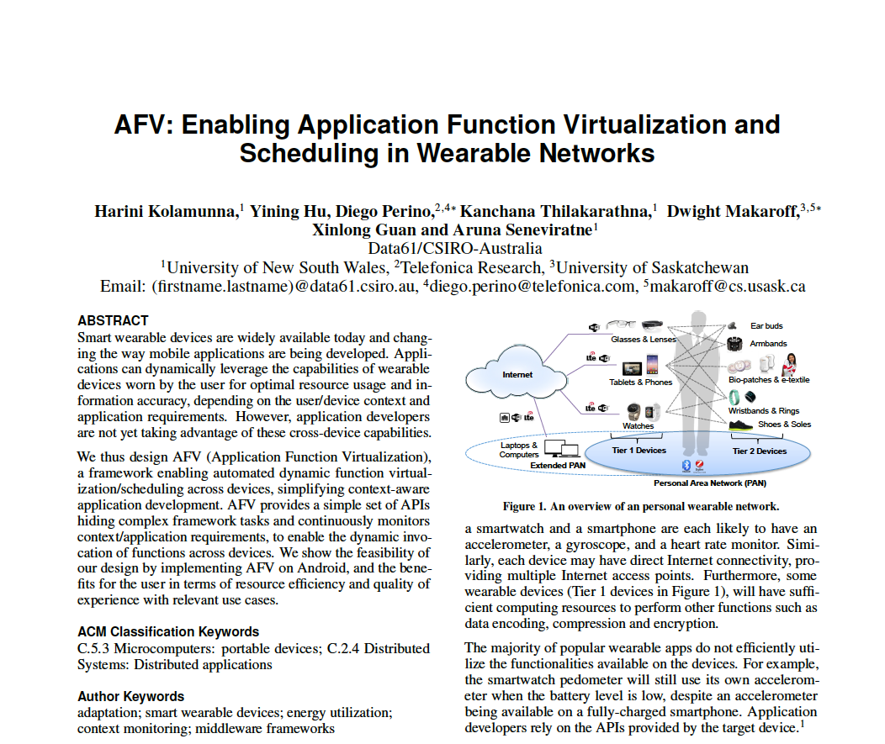
The Paper

