Slide 1
Social inclusion in Australia’s aid program
Sophie McPhate, Third Secretary (Economic) Australian Embassy in the Philippines
25 February 2020

Slide 2
Australia mainstreams diversity and inclusion across our aid program in the Philippines
TOPICS:
Disability inclusive development
Social inclusion in education
Inclusive economic growth
Women’s economic empowerment

Slide 3
Disability inclusive development

Slide 4
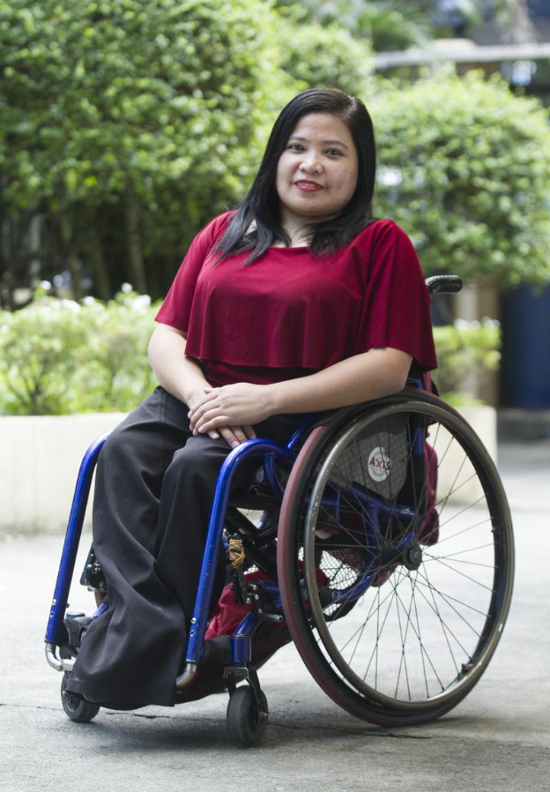
Disability inclusive development

Slide 5
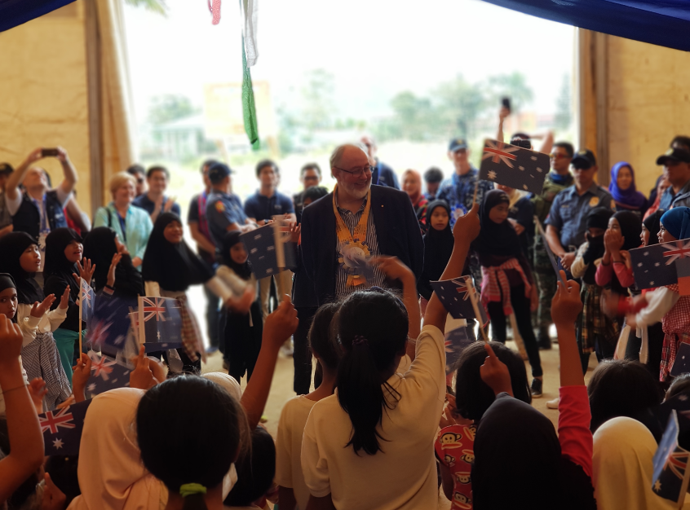
Social inclusion in education

Slide 6
Inclusive economic growth

Slide 7
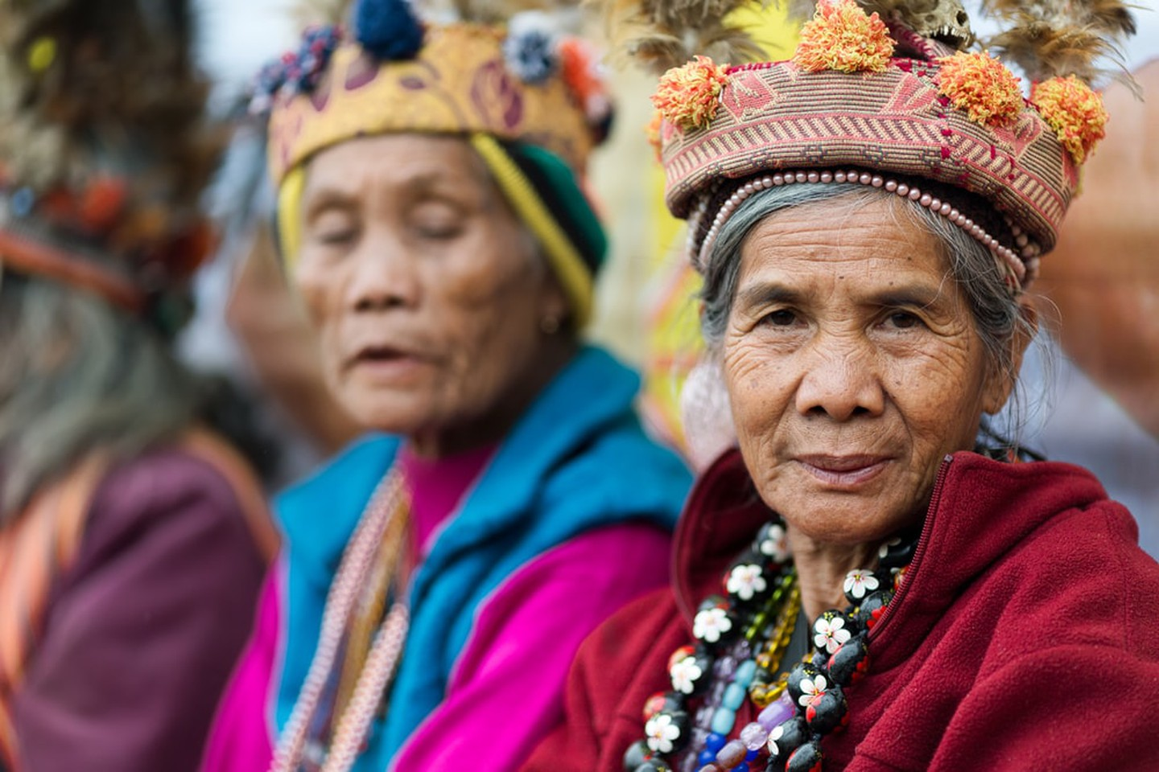
Inclusive economic growth

Slide 8
Women’s Economic empowerment

