Slide 1
FAIR
Findable
Metadata (= data descriptions) and data should be easy to find for both humans and computers.
Machine-readable metadata are essential for automatic discovery of datasets and services, so this is an essential component of the FAIRification process
Notes:
CONTENT from: FAIR Principles - GO FAIR (go-fair.org)
The first step in (re)using data is to find them
F1: unique persistent identifier
F2: Rich metadata: detailed descriptions with KEYWORDS (preferably standardised) and text documentation
F3: ensure link between metadata and dataset is specified and clear
F4: indexing of resources (DB, Repo) makes it findable

Slide 2
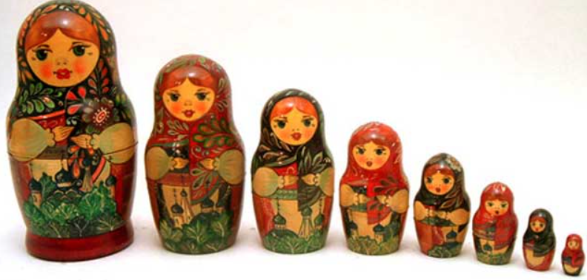
Data: What are they?
Findable means:
The data can be identified and found at each level
Usually research data are nested in a hierarchical structure
Project / Research survey / Campaign
Sampling gear / equipment: e.g. camera
Operation / Deployment / Event
Sample: e.g. Image, Video
FOCUS OF WS
Sample content: e.g. fish in image
Additional detail: fish behaviour
Etc…

Slide 3
F1. (Meta)data are assigned a globally unique and persistent identifier
Many data repositories automatically generate globally unique and persistent identifiers to deposited datasets at the level they expose the data. (e.g. a doi)
Services exist that supply globally unique and persistent identifiers
Within a relational database
Mary
1-i
What makes a good identifier?
Jane
1-j
of Mary i
Talia
1-k
of Jane j
Louise
1-l
of Talia k
It is unique to each concept
Is not being reused
Sandy
1-m
of Louise l
Lola
1-n
of Sandy m
Chiara
1-o
of Lola n
Heidi
1-p
of Chiara o
Notes:
Globally unique and persistent identifiers:
are essential to the human-machine interoperation
will help others to properly cite your work when reusing your data.

Slide 4
F2. Data are described with rich metadata
Metadata describes the data
Machine-readable metadata are essential for automatic discovery of datasets and services
context, quality and condition, or characteristics of the data
spatial extent to allow spatial searches
Metadata types:
‘intrinsic’ metadata
e.g., the data captured automatically by machines that generate
data (e.g. DICOM information for image files)
‘contextual’ metadata:
e.g., the protocols and methods, linkages to other data
Metadata formats:
HUMAN READABLE: include descriptions, links to reports / publications
MACHINE READABLE: use keywords and standard vocabularies

Slide 5
F3. Metadata clearly and explicitly include the identifier of the data they describe

Slide 6
F4. (Meta)data are registered or indexed in a searchable resource
Notes:
Red boundary – include image…

Slide 7
FAIR
Findable
Unique persistent identifier
Rich metadata
Clear link between identifier and metadata
Registered in searchable repository
F
Notes:
In summary
F1: unique persistent identifier
F2: Rich metadata: detailed descriptions with KEYWORDS (preferably standardised) and text documentation
F3: ensure link between metadata and dataset is specified and clear
F4: indexing of resources (DB, Repo) makes it findable

