Slide 1
FAIR
Reusable
Standards
R1. Data and metadata have a plurality of accurate & relevant attributes
R1.1. Data and metadata are released with a clear and accessible data usage license
R1.2. Data and metadata are associated with their provenance
R1.3. Data and metadata meet domain-relevant community standards
Rules
No loss of data richness
Notes:
The last part of the FAIR acronym is Reusable
This is about the standards that ensure R1. meta(data) have accurate recorded and relevant attributes.
R1.1. (meta)data are released with a clear and accessible data usage license.
R1.2. (meta)data are associated with their provenance.
R1.3. (meta)data meet domain-relevant community standards.
Rules
No loss of data richness

Slide 2
Source: Elements required for reusability (AIMS-FAO, 2020)
Notes:
Here’s a visual way to lock it into your mind To sum up reusability relies on the findabilitiy, accessibility and interoperatability working synergistically together to achieve reusability.
Reusability provides one way in which experiments can be replicated by other researchers. This is benefits the entire scientific community in terms of science quality through repeatability.

Slide 3
https://www.youtube.com/watch?v=bbsLmy3Njv4
Notes:
identifiers are needed for findability all these four elements show – data, its identifiers that mean the imagery data can always be found, plus standards that give us open and documented formats suitable for machine learning, plus the metadata – all of these come together and provide the ability for the data to be reused.

Slide 4
Licences enable reusability
Creative Commons licensing
ability to aggregate licences disparate datasets and software
Source: https://www.slideshare.net/AustralianNationalDataService/4-fair-provenance-as-an-element-of-fair-data-principles-200917

Slide 5
Robust metadata, comprehensive provenance information & clear licences conditions for usage that specify attribution
FAIR
Reusable
Reusable by other researchers
Reusable by the public
metadata standards and rules
persistent identifiers (e.g. DOI – digital original identifier)
DOI can be minted through CSIRO DAP
standards and code – agreed formats

Slide 6
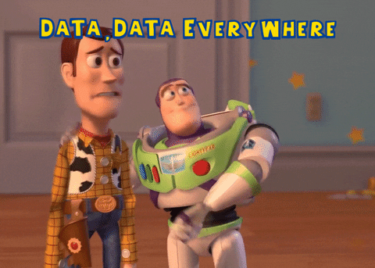
Opportunities and Questions
What data might we want to reuse?
Reusable data sets can be used for comparing new data to previous baselines
In the future, what might we look back and wish we had done or collected?
Possibilities for collaboration
Human centred design
Notes:
It really doesn’t matter what type of imagery data we are thinking of, photos, 360 degree images, audio-visuals, multimedia, there are many opportunities to collaborate based on the reusability of our data sets. Baselines for future comparison are an important part of the challenge. As is storing the imagery data itself.
Woody is right to be worried! It’s not as easy as Buzz is making out – but it is worth it!

