Slide 1
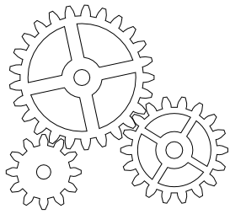
FAIR
Interoperable
“The data usually need to be integrated with other data. In addition, the data need to interoperate with applications or workflows for analysis, storage, and processing”
- https://www.go-fair.org/fair-principles/
Notes:
I is for Interoperable, meaning that data can be integrated with other data, and vice-versa.
Data is also interoperable between various database and annotation platforms, including, applications, work flows for analysis, storage, and processing…
So how do we make our data interoperable?

Slide 2
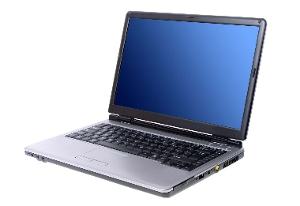
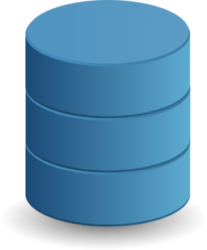
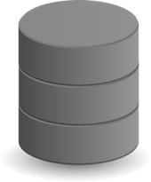
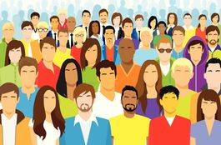
1. (meta)data use a formal, accessible, shared, and broadly applicable language for knowledge representation.
Machine Learning
Various databases
Public
Researchers
Notes:
1. Interoperable includes the metadata and the data itself, where the data use a formal, accessible, shared and broadly applicable language for knowledge representation.
Data stakeholders include both humans and machines. Human data users are not limited to researchers, they also include students, the public, and citizen scientists. Machine data users include various databases and machine learning.
Interoperability maximises knowledge and research potential by bringing data together, allowing for new knowledge discovery, new relationships, and new patterns.
To facilitate this, we need standard languages and standard frameworks. Data needs to be compiled in a certain way that it can be pulled into various platforms using standardised end-points and terminology.
Basically, databases, machine learning, and human data users need to be able to ‘talk’ to each other.

Slide 3
1. (meta)data use a formal, accessible, shared, and broadly applicable language for knowledge representation.
Machine Learning
Various databases
Public
How could your research be benefited by accessing other data and ML capabilities?
Researchers

Slide 4
2. (meta)data use vocabularies that follow FAIR principals.
Body of standards (taxonomy) e.g.
Notes:
2. In order for data to be interoperable, it is recommended to use existing vocabularies agreed on by the community. This vocabulary should also follow FAIR principals. An example is DarwinCore, a body of standards used for biological observations that provides stable terms and vocabularies for sharing biodiversity data.

Slide 5
2. (meta)data use vocabularies that follow FAIR principals.
Body of standards (taxonomy) e.g.
What body of standards does your research discipline use?

Slide 6
3. (meta)data include qualified references to other (meta)data.
Author ------------------------
Publication ---------------------------------
Another data set -----------------------
Software ------------------------------------
Organisation ------------------------
Grant -----------------------
Projects ------------------------
Notes:
Lastly, point 3. Metadata include qualified references to other metadata.
Referenced metadata includes established identifiers that allows referenced data to be findable and accessible. It is not just a reference to the other dataset, but explains what the relationship is.
e.g. ORCID (Open Researcher and Contributor ID), DOI (Digital object identifier), GRID (Global Research Identifier Database), Grant ID (funding identifier), and RAID (Research Activity Identifer)

Slide 7
3. (meta)data include qualified references to other (meta)data.
Author ------------------------
Publication ---------------------------------
Another data set -----------------------
Software ------------------------------------
Organisation ------------------------
Do your references include identifiers?
What is the relationship?
Grant -----------------------
Projects ------------------------

Slide 8
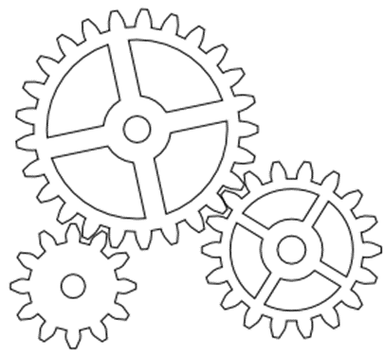
Interoperable
Use a formal, accessible, shared, and broadly applicable language to describe and attach to your data
Make sure the vocabularies you use are established and accepted among the community, and align with FAIR principals
Attach identifiers to any other data used, and describe the relationship of that data to your research.
Notes:
To make your data Interoperable, they keys points include
-
-
-

