Slide 1
FAIR
Accessible
“Data retrieval should be mediated without specialised or proprietary tools or communication methods”
- https://www.go-fair.org/fair-principles/
Notes:
The letter “A” in fair stands for ACCESSIBLE

Slide 2
Notes:
This principle focuses on HOW data and metadata can be retrieved from their identifiers (applied in the Fair step)

Slide 3
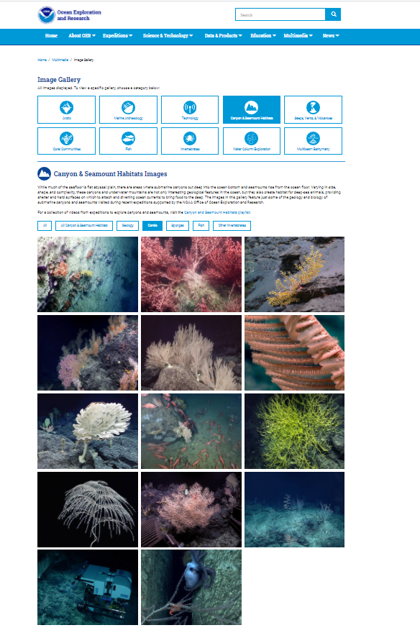
A1: (Meta)data are retrievable by their identifier using a standardised communication protocol
A1.1: The protocol is open, free and universally implementable
Facilitate global uptake
Maximise data reuse
Notes:
A commonly misunderstood element of Accessibility is that it does not necessarily mean ‘open’ or ‘free’ data but rather specifies that you need to provide details of the conditions under which data are accessible. So even heavily protected and confidential data can be FAIR.
Under this principle data and metadata should be easy to retrieve and protocols should be open and free, for example anyone with a computer and an internet connection should be able to access the data, facilitating global implementation and maximising data reuse.

Slide 4
Notes:
For example image data analysed in this publication are accessible through the aodn platform by clicking on this link, a, a standard, open and free web-based protocol.

Slide 5
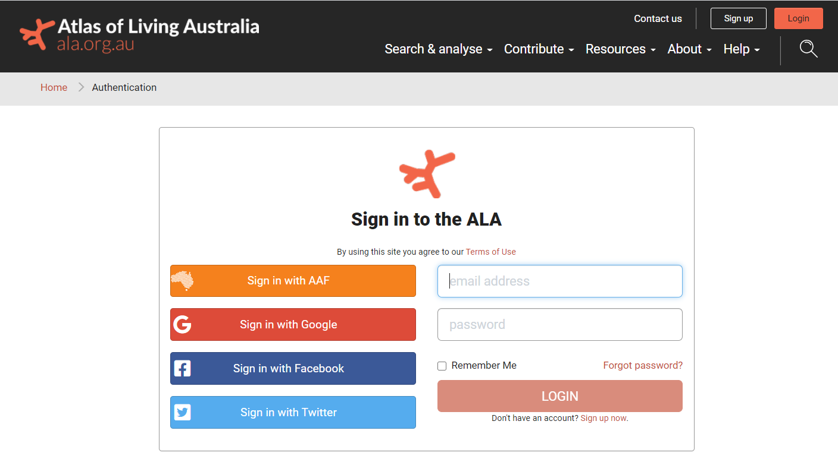
A1: (Meta)data are retrievable by their identifier using a standardised communication protocol
A1.2: The protocol allows for an authentication and authorisation where necessary
Notes:
Access can be open to anyone or, more commonly mediated though an authentication protocol where users are requested to create an account for a repository or use an existing social media account. This allows for the authentication of users and contributors, and to potentially set user-specific access rights.

Slide 6
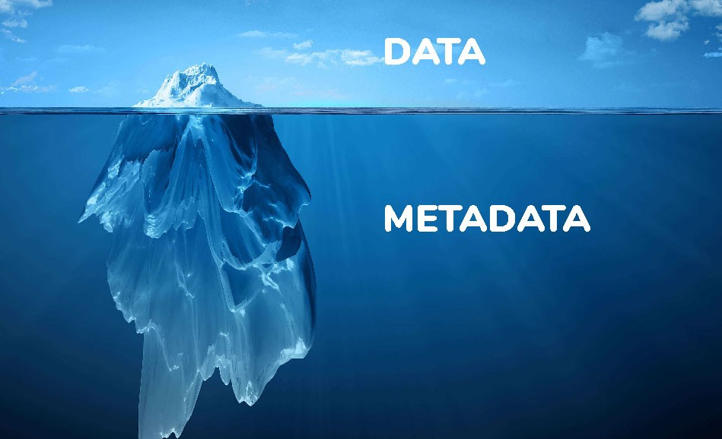
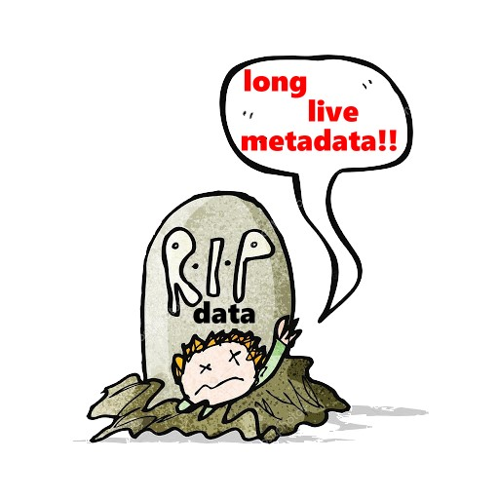
A2: Metadata should be accessible even when the data is no longer available
Notes:
Datasets tend to degrade or disappear over time because there is a cost to maintaining an online presence for data resources. When this happens, links become invalid and users waste time hunting for data that might no longer be there. Storing the metadata generally is much easier and cheaper and metadata should persist even when the data are no longer available.

Slide 7
FAIR
Accessible
A1: (Meta)data are retrievable by their identifier using a standardised communication protocol
A2: Metadata should be accessible even when the data is no longer available
Notes:
To make your data accessible, you should be able to access the data by using their identified and through standard web-based protocols and that access to metadata should persist beyond the life of a project.

Slide 8
Notes:
So that people get access to your data and you get access to their data and everybody gets access to the data!

