Slide 1
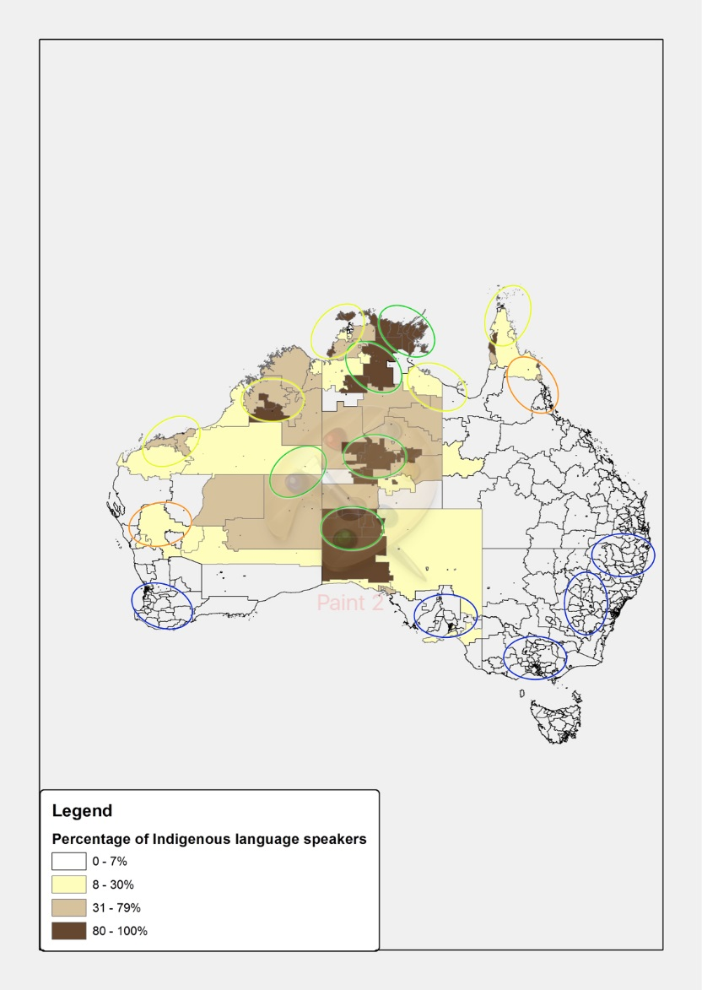
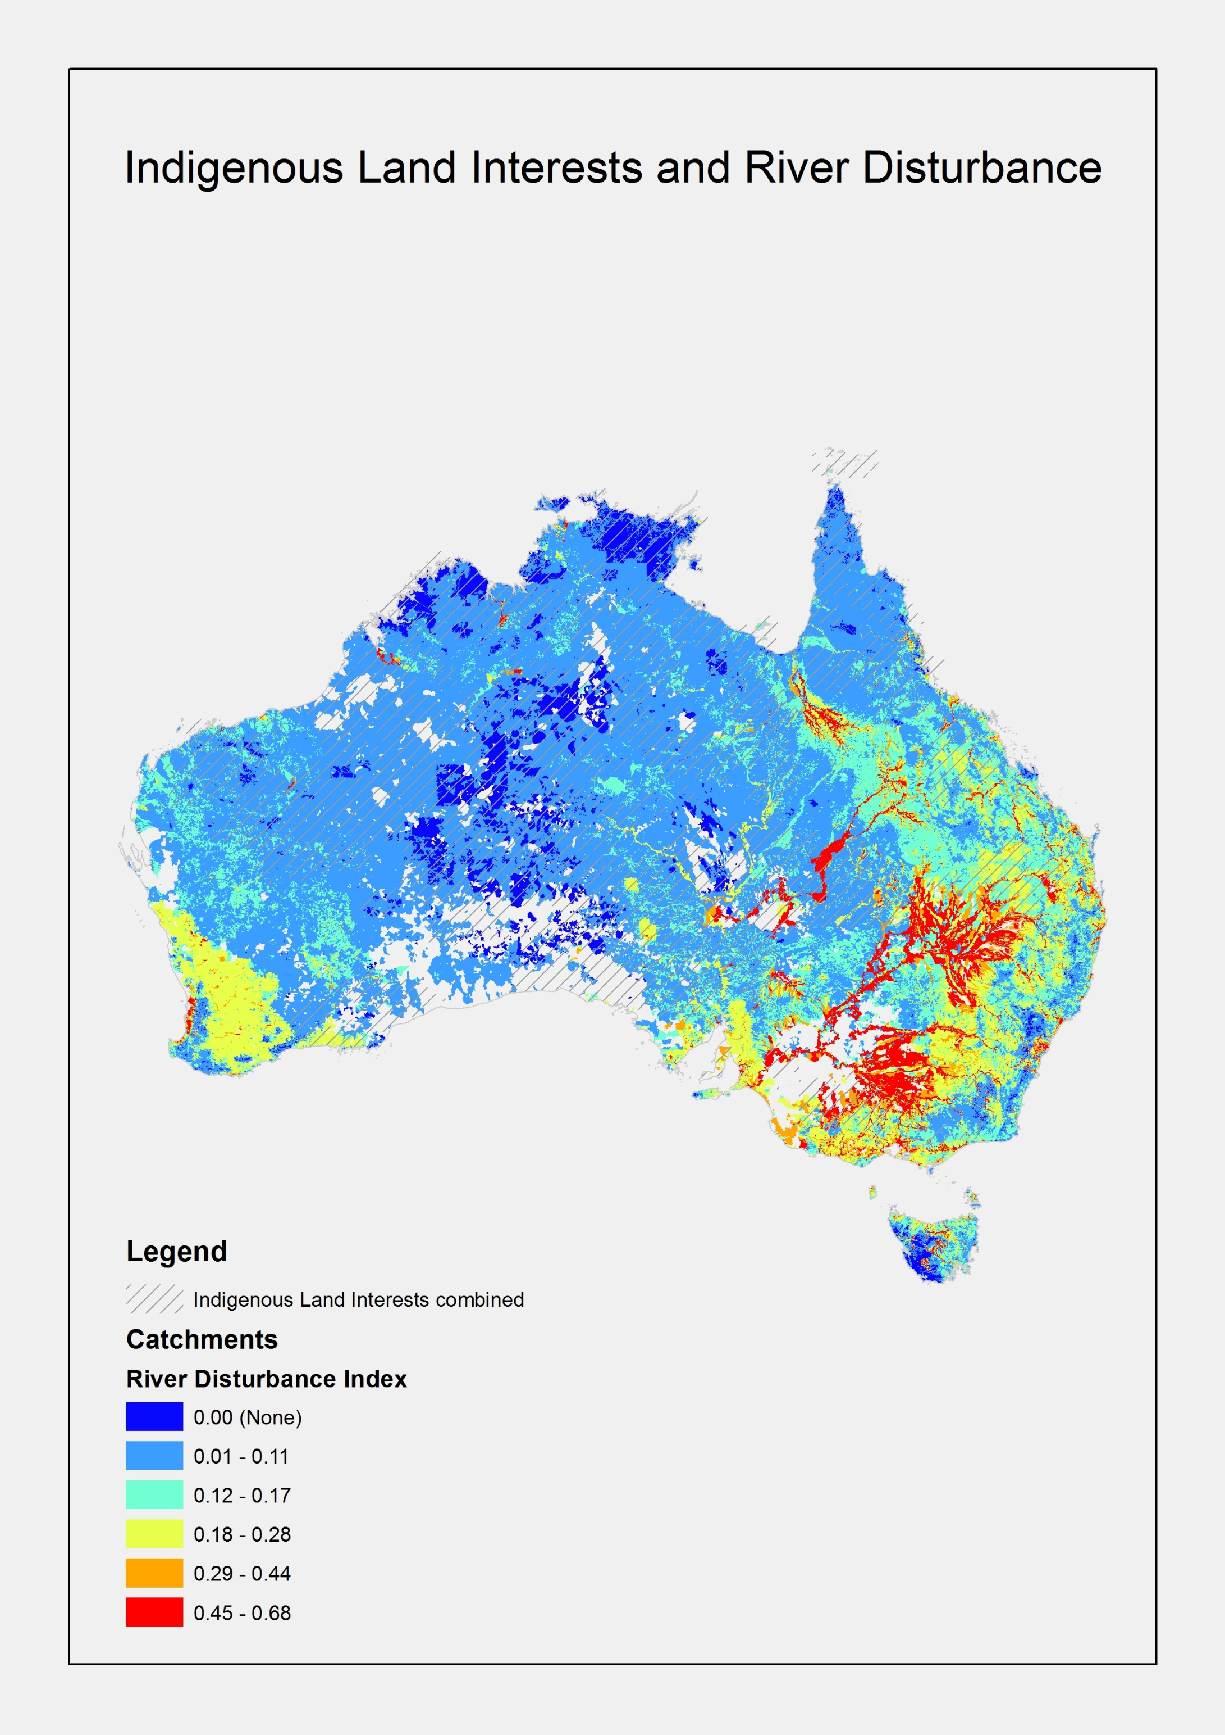
Biocultural Indicators:
Can we transform the way we talk about the state of our environment?
Lyons, I ¹., Pert, P ¹. and Turpin, G.² ¹CSIRO Land and Water ² Department of Environment and Science
Biocultural diversity is one approach to conceiving and managing the inter-dependent relationship of human and ecological systems. One way of measuring biocultural diversity is to look at the relationship between species and language diversity.
Approach: How we investigated biocultural diversity
In this work, we measure biodiversity by using ‘intactness’ based on Stein’s (2002) river disturbance index that categorises river networks from ‘near-pristine to highly degraded’. We use this as an inverse measure of biodiversity. Rivers system processes that have not been significantly changed by the settler state have a lower disturbance index value and are more likely to support healthier aquatic fauna, habitats, and ecosystem connectivity. We draw on the AITSIS 2004 national Indigenous language survey results to map and represent the state of language use as one indicator of cultural diversity. We explore the relationship between river ‘intactness’ and language use as a potential measure of biocultural diversity.
Figure 2: Proportion of Indigenous language speakers across that Nation based on 2011 ABS Census
data with circle overlays of state of language use from the AIATSIS 2004 language survey.
How to read the language map
areas where languages are predominantly strong, i.e. they are being passed on to children as a matter of course.
represent areas where languages are endangered, i.e. few if any children are now acquiring them so they are mostly spoken by adults and old people. In the Daly River/Tiwi islands is a complex mix with some very strong languages and some highly endangered ones); Barkly region in the NT (endangered and highly endangered); Kimberley in WA (a fair number of endangered languages, but some have a fair number of children learning them); Pilbara in WA (a large number of endangered languages).
ovals indicate regions with numerous highly endangered languages, i.e. typically only spoken by old people.
blue ovals indicate where language revival work is well established, with large numbers of children learning their ancestral languages, although in recent times they have had very few or no speakers.
Figure 1: River disturbance and Indigenous land interests
What we found
Using this approach, the regions with higher levels of river ‘intactness’ (lower disturbance) are also where the states of language use are strongest. These are in Arnhem land and Central Australia. Areas with least ‘intactness’, or greatest degradation, in the Murry Darling Basin and urban settings, are where Indigenous groups are actively pursuing language revival work. We posit that biocultural indicators are increasingly needed to transform dialogue about conservation practices, to bring greater focus to place-based assessments that incorporate dimensions of wellbeing and social justice and highlight the social impacts of national policies.
FOR FURTHER INFORMATION
Peci Lyons (Pethie)
Land and Water
Pethie.Lyons@csiro.au
csiro.au/Land and Water
References
AITSIS, 2005. National Indigenous languages survey report 2005. Commonwealth of Australia, pp255.
Stein, J.L., Stein, J.A., and Nix, H.A. 2002 Spatial analysis of anthropogenic river disturbance at regional and continental scales: identifying the wild rivers of Australia. Landscape and planning. 60, 1-25.
Acknowledgements
Australian Institute of Aboriginal and Torres Strait Islander Studies
Dr Doug Marmion, Research Fellow, Linguistics, AIATSIS

