Slide 1
Privacy Preservation in Data Life Cycle
Presenter: Zhikun Zhang
Stanford
2023.09.12 @ CSIRO
Notes:
Thanks for Jason’s introduction! I am very glad to share my recent research on data privacy. For better presentation, I organize my research through the lens of data life cycle. If you have any questions, feel free to interrupt me anytime.

Slide 2

About Me
Research Interests:
Machine Learning Privacy + Differential Privacy
Career Highlights:
16 papers in big four security conferences
USENIX Security (’23c, ’23b, ’23a, ’22b, ’22a, ’21)
ACM CCS (’23, ’22c, ’22b, ’22a, ’21c, ’21b, ’21a, ’18)
NDSS (‘24b, ’24a)
4 awards in differential privacy competitions
2nd x 4, best overall performance
National Scholarship for Excellent Ph.D. Student
Nomination Award for Outstanding Doctoral Thesis of Zhejiang University and Zhejiang Province
Zhikun Zhang
Visiting Assistant Prof. @ Stanford
Research Group Leader @ CISPA
PostDoc @ CISPA
Visiting Scholar @ Purdue
Ph.D. @ ZJU
Notes:
As Jason mentioned, my current research is mainly about machine learning privacy and differential privacy, and I published some papers in both these two fields.
First, I will give a brief introduction about myself. I am currently a postdoc at CISPA and I obtained my Ph.D. degree from Zhejiang University. I am also a visiting scholar in Purdue University in my Ph.D. phase. My current research mainly concentrates on machine learning privacy, differential privacy, and their interactions. I have published 7 related papers in the big four security conferences and obtained 4 awards in differential privacy competitions.

Slide 3












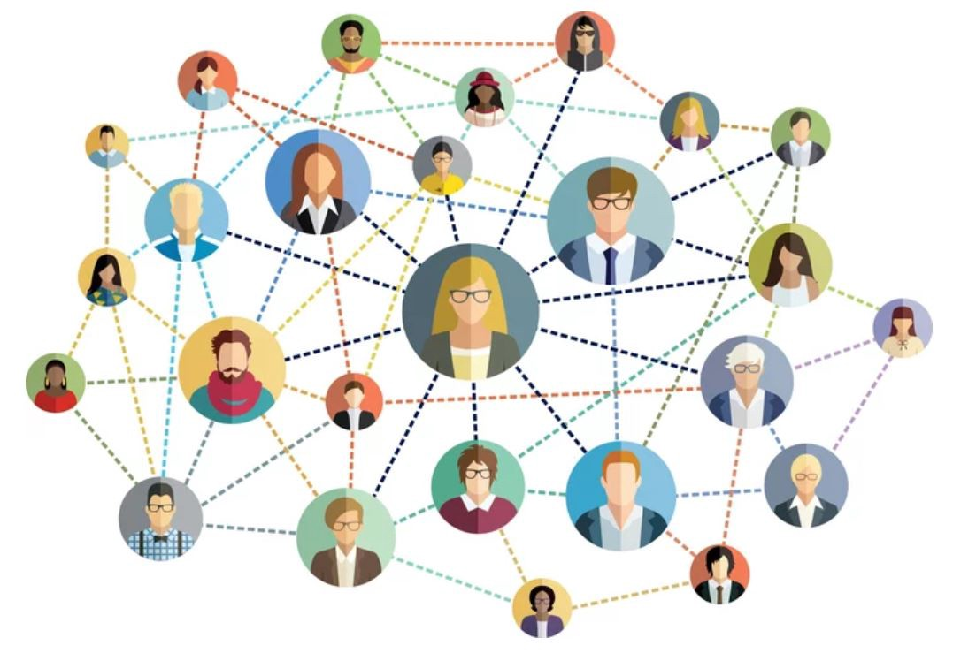






Privacy Preservation in Data Life Cycle
Data Regulation Entities
Data
Consumption
Data
Publication
Medical Data
Data
Collection
Data Statistic Information
Social Data
Data
Analysis
Mobile Data
Data Source
Data Center
Machine Learning Models
Notes:
There are various types of data in the world, such as medical data, social data, and mobile data.
For the mobile data, data center such as Google and Apple directly collect them from the individual users’ mobile devices, to do recommendation or improve the quality of services. However, the individual users’ privacy is not well protected, they will be reluctant to share their data. Therefore, it is very important to protect individual users’ privacy when directly collect data from them.
For other types of data such as medical data and census data, the data center does not directly collect them from individual users’ devices. For example, the hospitals inherently have the patients’ data, the census bureau have the census data. In this case, the data center often want to publish these data to the public for the public benefit. However, directly publish these data can also leak individual users’ privacy. It is important to protect individual users’ privacy in the data publication phase.
In other scenarios, the data centers do not directly publish the datasets themselves; instead, they use the data to train machine learning models and release the model for public use. However, a number of research have shown that machine learning model can also leak information about individual users. It is important to protect privacy of the ML models.
Recent years, many countries and regions have enacted various privacy-related regulations, such EU’s GDPR, California’s CCPA, and Brazil’s LGPD. These regulations make various rules when the data center process individual users’ data. In this case, the data centers need to consider how to technically design their product to conform with the privacy-related laws.

Slide 4
Data Collection: Local Differential Privacy
Data Regulation Entities
Data
Consumption
Data
Publication
Medical Data
Data
Collection
Data Statistic Information
Social Data
Data
Analysis
Mobile Data
Data Source
Data Center
Machine Learning Models

Slide 5
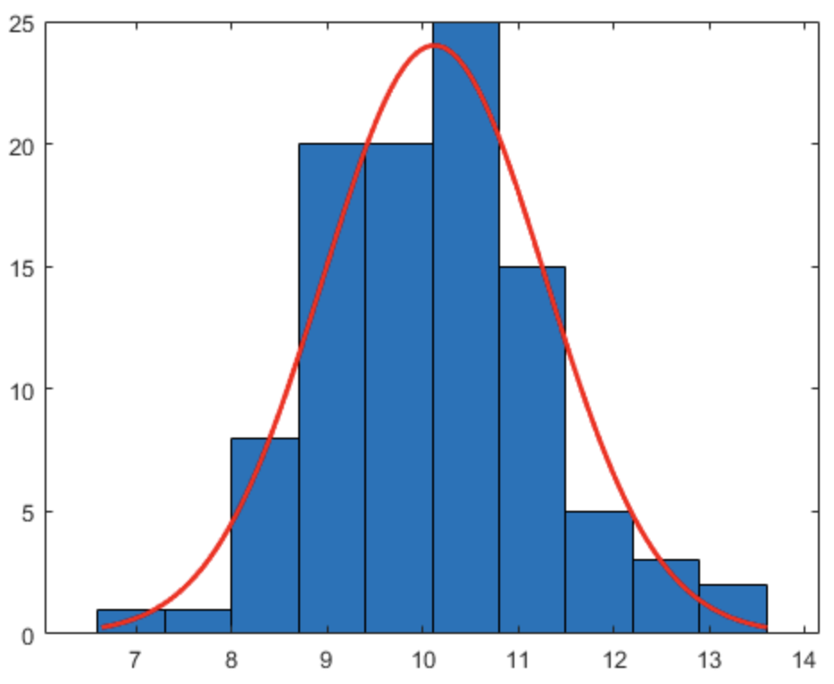
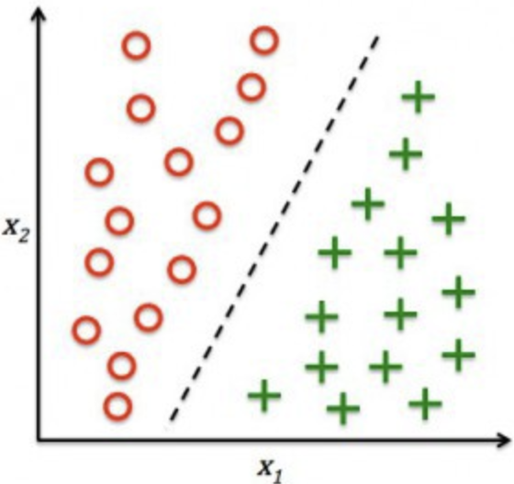
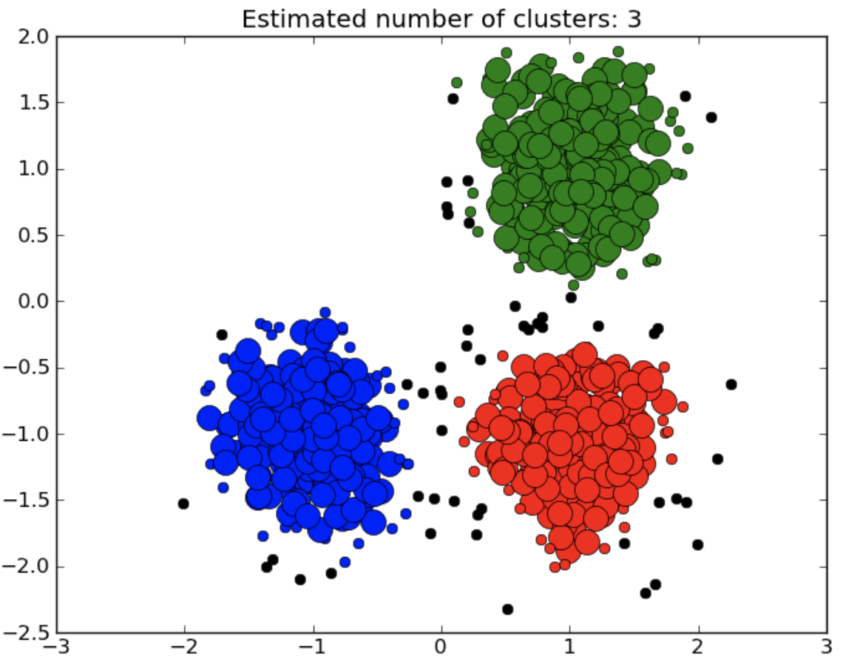
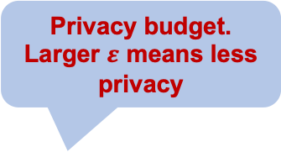
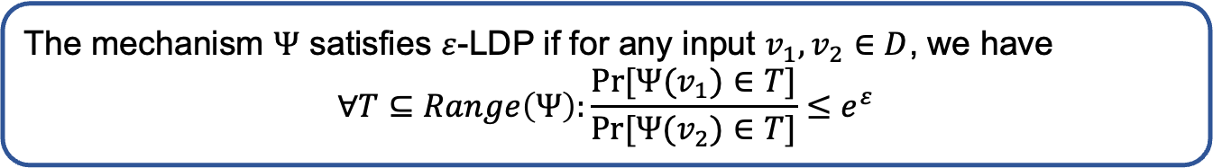



Data Collection: Local Differential Privacy
Perturbation
Mechanism $Ψ$
Perturbation
Mechanism $Ψ$
Perturbation
Mechanism $Ψ$
Data Center
Privacy budget.
Larger $ε$ means less privacy
The mechanism $Ψ$ satisfies $ε$-LDP if for any input $v_{1},v_{2}∈D$, we have
$$∀T⊆Range\left(Ψ\right):\frac{Pr⁡[Ψ(v_{1})∈T]}{Pr⁡[Ψ(v_{2})∈T]}≤e^{ε}$$

Slide 6
Data Publication: Centralized Differential Privacy
Data Regulation Entities
Data
Consumption
Data
Publication
Medical Data
Data
Collection
Data Statistic Information
Social Data
Data
Analysis
Mobile Data
Data Source
Data Center
Machine Learning Models

Slide 7


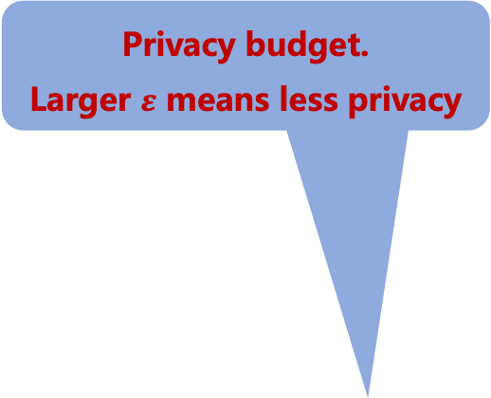
Data Publication: Centralized Differential Privacy
Privacy budget.
Larger $ε$ means less privacy
Randomization
Algorithm
Statistical result S satisfy
Dataset D
Dataset D’

Slide 8
Data Analysis: Risk Assessment of ML Models
Data Regulation Entities
Data
Consumption
Data
Publication
Medical Data
Data
Collection
Data Statistic Information
Social Data
Data
Analysis
Mobile Data
Data Source
Data Center
Machine Learning Models

Slide 9

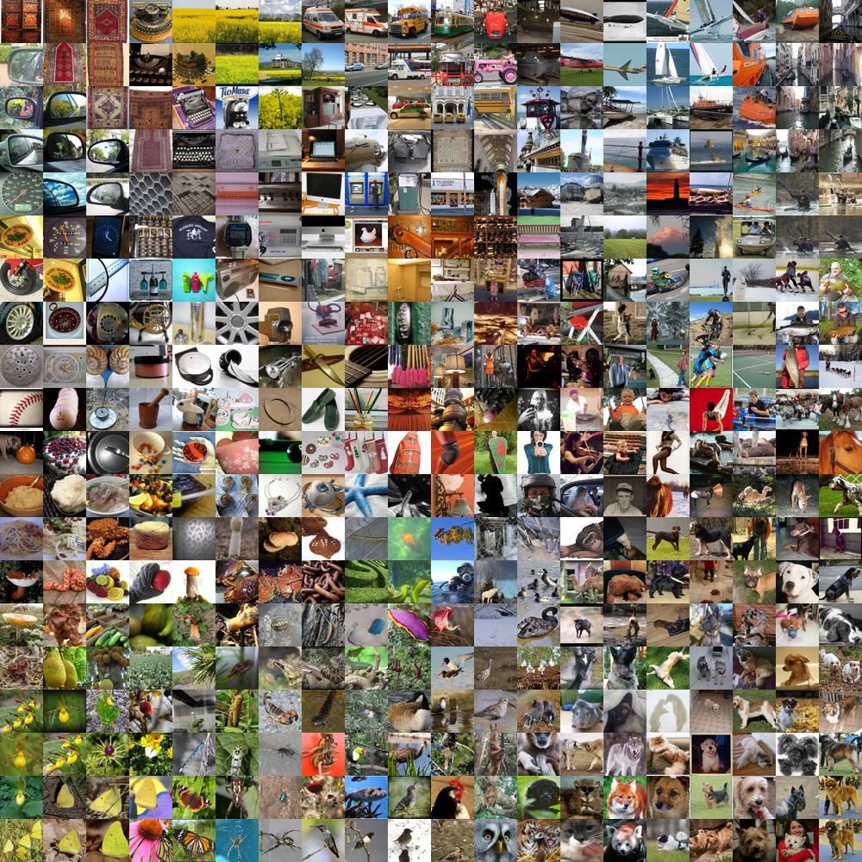


Data Analysis: Risk Assessment of ML Models
Model stealing
Model
Training
Model
Prediction
Membership inference
Property inference
Model inversion

Slide 10
Data Consumption: Machine Unlearning
Data Regulation Entities
Data
Consumption
Data
Publication
Medical Data
Data
Collection
Data Statistic Information
Social Data
Data
Analysis
Mobile Data
Data Source
Data Center
Machine Learning Models

Slide 11
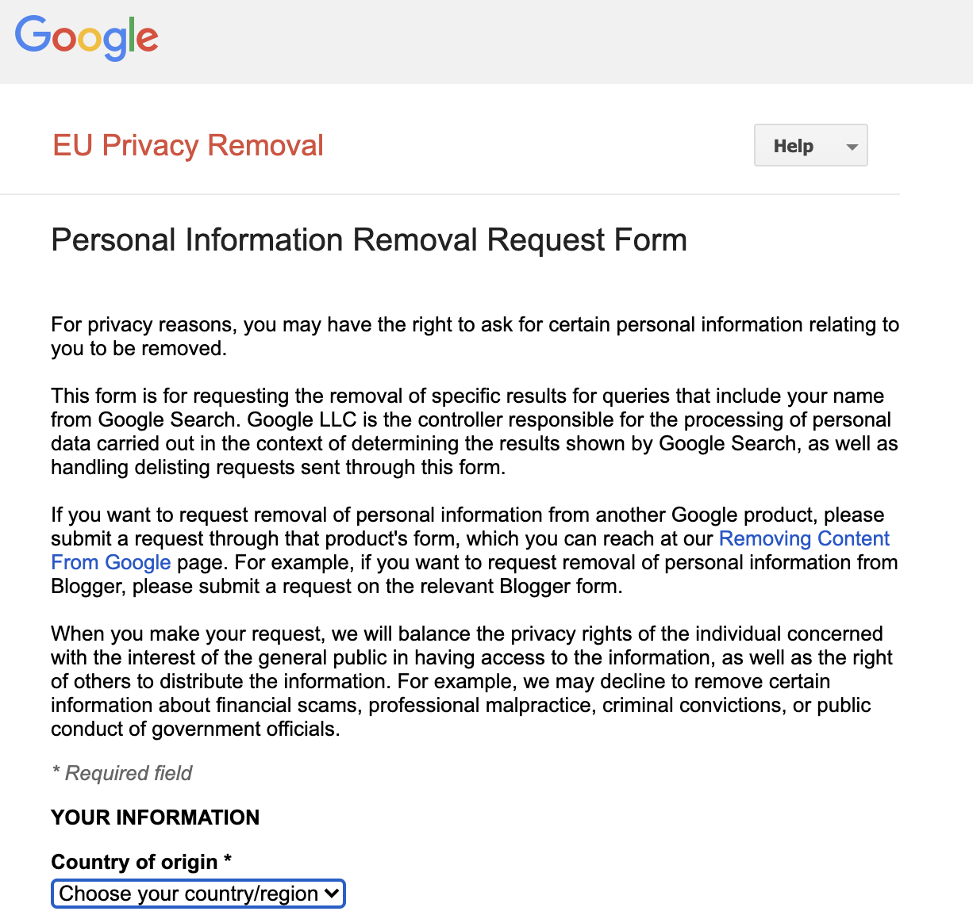
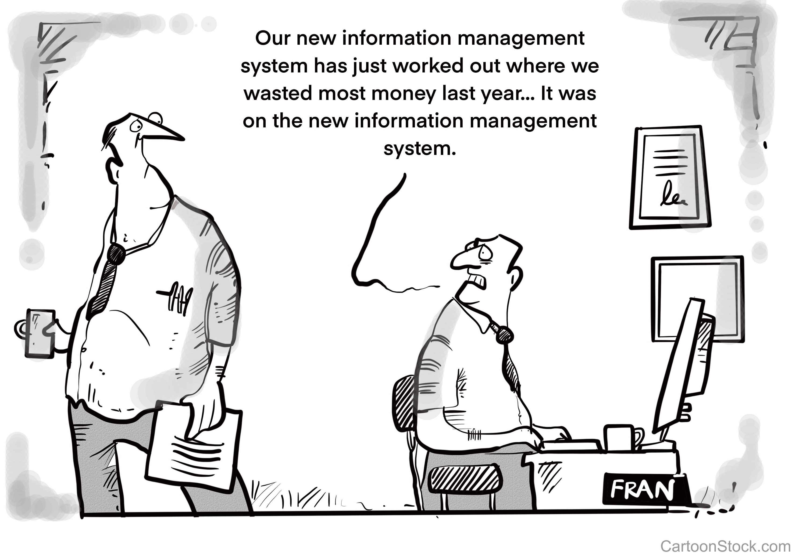
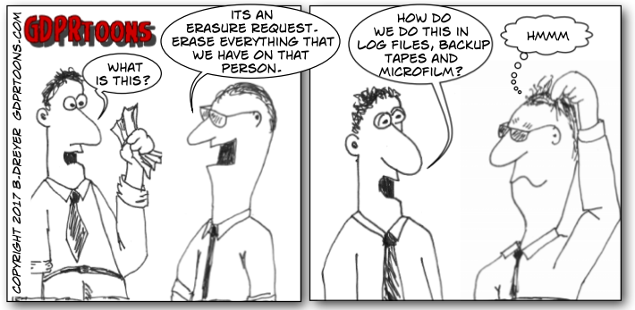
Data Consumption: Machine Unlearning
Regulations for Protecting Data Privacy
The right-to-be-forgotten
The right to rectification
The right to access
The right to data portability
The right to be forgotten
The right to object
……
https://www.adventuresincorporatecompliance.com/2020/02/complying-with-data-subject-requests-back-to-the-basics/
Source: http://www.gdprtoons.com/2017/09/right-to-erasure-right-to-be-forgotten.html
https://support.google.com/legal/answer/10769224?hl=en

Slide 12






Data Consumption: Machine Unlearning
The “Right-to-be-forgotten” in ML -> Machine Unlearning
How to efficiently conduct unlearning?
How to verify unlearning?
How to evaluate the potential risks of unlearning?
Deleting my data from your models

Slide 13
Current Research Achievements
Collection
Publication
Analysis
Consumption
Marginal release [CCS’18]
Range query [CCS’21a]
Stream data collection [CCS’21b]
Tabular data [Sec’21]
Graph data [Sec’23a]
Trajectory data [Sec’23b], [VLDB’23]
Graph neural networks [Sec’22b], [CCS’22a], [ICML’23]
Facial recognition systems [Sec’23c]
Neural architecture search [CCS’22c]
Reinforcement learning [NDSS’24a]
Language models [NDSS’24b]
Implementation [CCS’22b]
Vulnerability analysis [CCS’21c]

Slide 14
Current Research Achievements
Collection
Publication
Analysis
Consumption
Marginal release [CCS’18]
Range query [CCS’21a]
Stream data collection [CCS’21b]
Tabular data [Sec’21]
Graph data [Sec’23a]
Trajectory data [Sec’23b], [VLDB’23]
Graph neural networks [Sec’22b], [CCS’22a], [ICML’23]
Facial recognition systems [Sec’23c]
Neural architecture search [CCS’22c]
Reinforcement learning [NDSS’24a]
Language models [NDSS’24b]
Implementation [CCS’22b]
Vulnerability analysis [CCS’21c]

Slide 15
Current Research Achievements
Collection
Publication
Analysis
Consumption
Marginal release [CCS’18]
Range query [CCS’21a]
Stream data collection [CCS’21b]
Tabular data [Sec’21]
Graph data [Sec’23a]
Trajectory data [Sec’23b], [VLDB’23]
Graph neural networks [Sec’22b], [CCS’22a], [ICML’23]
Facial recognition systems [Sec’23c]
Neural architecture search [CCS’22c]
Reinforcement learning [NDSS’24a]
Language models [NDSS’24b]
Implementation [CCS’22b]
Vulnerability analysis [CCS’21c]

Slide 16
Tailored Algorithms
    Frequent itemset mining ^{[VLDB’12], [KDD’14], [ICDE’17]}
Marginal release ^{[PODS’07], [SIGMOD’14]}
Range query ^{[TKDE’10], [ICDE’12]}
Machine learning models ^{[CCS’16], [S&P’19]}
Time consuming.
Requires expertise knowledge.
Error-prone.
Notes:
Most of the previous studies on DP focus on designing tailored algorithms for specific data analysis tasks, such as frequent itemset mining, marginal release, range query and training machine learning models.
However, this paradigm is time consuming, requires a lot of expertise knowledge and error-prone.

Slide 17
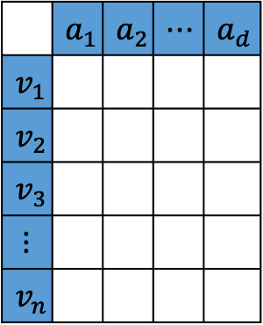

General Solution: Data Synthesis
 | $$a_{1}$$ | $$a_{2}$$ | $$⋯$$ | $$a_{d}$$
$$v_{1}$$
$$v_{2}$$
$$v_{3}$$
$$⋮$$
$$v_{n}$$
 | $$a_{1}$$ | $$a_{2}$$ | $$⋯$$ | $$a_{d}$$
$$v_{1}$$
$$v_{2}$$
$$v_{3}$$
$$⋮$$
$$v_{n}$$
Useful statistical information that satisfy DP
Original Dataset
Synthetic Dataset
Notes:
To address this problem, a promising solution is to generate a synthetic dataset in a differentially private manner. With the synthetic dataset, we can conduct any downstream data analysis tasks without consuming extra privacy budget and without modifying the existing algorithms.
The general idea of this paradigm is to first extract some useful statistical information from the original dataset that satisfy DP, and use this statistical information to generate the synthetic dataset.

Slide 18
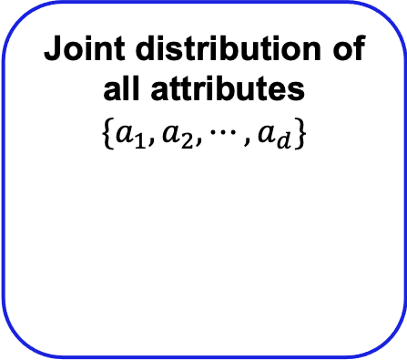
Naïve Method
 | $$a_{1}$$ | $$a_{2}$$ | $$⋯$$ | $$a_{d}$$
$$v_{1}$$
$$v_{2}$$
$$v_{3}$$
$$⋮$$
$$v_{n}$$
Joint distribution of all attributes
$$\{a_{1},a_{2},⋯,a_{d}\}$$
 | $$a_{1}$$ | $$a_{2}$$ | $$⋯$$ | $$a_{d}$$
$$v_{1}$$
$$v_{2}$$
$$v_{3}$$
$$⋮$$
$$v_{n}$$
Original Dataset
Synthetic Dataset
When the number of attributes is large, the domain of joint distribution is large, leading to prohibitive computational cost.
Notes:
The most straightforward method is to calculate the joint distribution of all attributes that satisfy DP. With this joint distribution, we can easily generate a synthetic dataset by directly sampling from it.
However, when the number of attributes is large, the domain of joint distribution is extremely large, leading to prohibitive computational cost.

Slide 19
Existing Method: Graphical Model
 | $$a_{1}$$ | $$a_{2}$$ | $$⋯$$ | $$a_{d}$$
$$v_{1}$$
$$v_{2}$$
$$v_{3}$$
$$⋮$$
$$v_{n}$$
 | $$a_{1}$$ | $$a_{2}$$ | $$⋯$$ | $$a_{d}$$
$$v_{1}$$
$$v_{2}$$
$$v_{3}$$
$$⋮$$
$$v_{n}$$
Original Dataset
Synthetic Dataset
Bayesian Network ^{[1]}: Can only exploit d-1 marginals, losing many correlation information.
Markov Random Field ^{[2]}: Some cliques can be very large when the number of marginals is large, leading to high storage cost.
[1] 2014 SIGMOD. PrivBayes: Private data release via Bayesian networks. Zhang et. al.
[2] 2019 ICML. Graphical model based estimation and inference for differential privacy. McKenna et. al.
Notes:
The state-of-the-art approach is to learn a graphical model from the original dataset in a differentially private manner, and generate the synthetic dataset from the graphical model. There are two widely used graphical models, one is Bayesian network, the other is Markov random field.
However, for the Bayesian network, it can only exploit d-1 marginals, which loses many correlation information.
For the Markov random field, some cliques can be very large when the number of marginals is large, which leads to high storage cost.

Slide 20
Existing Method: Generative Model
 | $$a_{1}$$ | $$a_{2}$$ | $$⋯$$ | $$a_{d}$$
$$v_{1}$$
$$v_{2}$$
$$v_{3}$$
$$⋮$$
$$v_{n}$$
 | $$a_{1}$$ | $$a_{2}$$ | $$⋯$$ | $$a_{d}$$
$$v_{1}$$
$$v_{2}$$
$$v_{3}$$
$$⋮$$
$$v_{n}$$
GAN
Original Dataset
Synthetic Dataset
Performs well on image datasets.
Cannot achieve satisfiable performance for high-dimensional tabular data. ^{[1]}
[1] https://www.challenge.gov/challenge/differential-privacy-synthetic-data-challenge/
Notes:
Another method is to train a deep generative model, such as GAN in a differentially private manner, and generate a synthetic dataset using this GAN.
GAN has shown to perform well on image dataset; however, through our experience in the “Differential Privacy Synthetic Data Challenge” hosted by NIST, the GAN-based method cannot achieve satisfiable performance for high-dimensional tabular data.

Slide 21




PrivSyn Overview
 | $$a_{1}$$ | $$a_{2}$$ | $$⋯$$ | $$a_{d}$$
$$v_{1}$$
$$v_{2}$$
$$v_{3}$$
$$⋮$$
$$v_{n}$$
$$a_{1}$$ | $$a_{2}$$ | $$a_{3}$$ | $$a_{4}$$
 | $$a_{1}$$ | $$a_{2}$$ | $$⋯$$ | $$a_{d}$$
$$v_{1}$$
$$v_{2}$$
$$v_{3}$$
$$⋮$$
$$v_{n}$$
$$a_{2}$$ | $$a_{4}$$ | $$a_{5}$$ | $$a_{6}$$
$$a_{4}$$ | $$a_{6}$$ | $$a_{7}$$ | $$a_{8}$$
$$a_{3}$$ | $$a_{5}$$ | $$a_{8}$$ | $$a_{9}$$
Original Dataset
Marginals
Synthetic Dataset
Challenge 1: How to choose a set of marginals that captures as much as correlation information and avoid excessive noise.
Challenge 2: How to generate a synthetic dataset from the selected marginals.
Notes:
The general idea of PrivSyn is extracting a set of low-dimensional marginal tables from the original dataset in a differentially private manner. The marginal tables can capture the joint distribution of a subset of the attributes. After obtaining these differentially private marginal tables, we can generate a synthetic dataset from them. Note that, different from the graphical model based methods, PrivSyn can support arbitrary number of marginal tables.
The design of PrivSyn has two challenges: The first challenge is how to choose a set of marginals that captures as much as correlation information and avoid excessive noise; the second challenge is how to generate a synthetic dataset from the selected marginals.

Slide 22
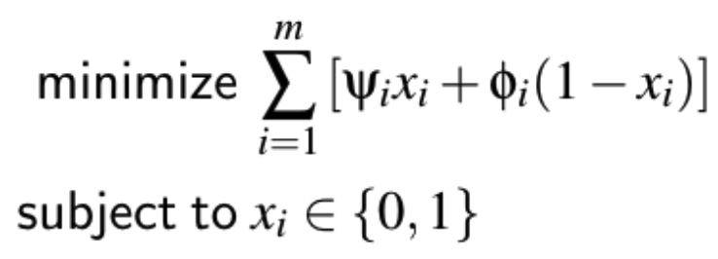
Marginal Selection: DenseMarg
Example
  Attributes: a b c d
  All two-way marginals: (a, b), (a, c), (a, d), (b, c), (b, d), (c, d)
Noise Error
Dependency Error
If a two-way marginal is chosen
  Add Gaussian noise to obtain the marginals
  Proportional to the number of cells
If a two-way marginal is not chosen
  Mutual information (high sensitivity)
  InDif (low sensitivity)
Optimization Problem Formulation:
Notes:
For marginal selection, we propose a new method called DenseMarg. It first considers all two way marginals. For instance, in this example, we have four attributes, and there are in total 6 two-way marginals, we need to determine which marginals to choose.
In this process, we need to consider two sources of error.
First, when a two-way marginal is chosen, we need to consider the noise error, since we need to add Gaussian noise to the marginal table to guarantee DP. The noise error is proportional to the number of cells in the marginal table.
On the other hand, when a two-way marginal is not chosen, we need to consider dependency error, since we cannot capture the correlation information of this marginal table. The most widely used metric to measure the correlation of two attributes is mutual information; however, the sensitivity of mutual information is high. To reduce the sensitivity, we propose a new metric named InDif, which calculates the L1 distance between the real two-way marginal and the two-way marginal generated assuming independency of the two attributes.
To strike the tradeoff between the noise error and the dependency error, we formulate an optimization problem to choose marginals. Here psi_i and phi_i represent the noise error and dependency error of marginal i, respectively. x_i is a binary value indicating whether marginal i is selected.

Slide 23
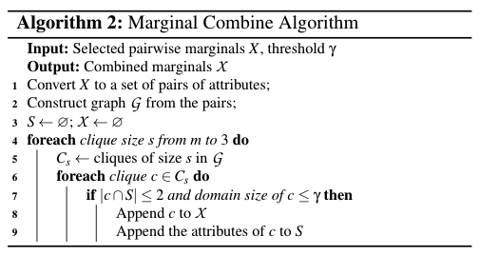
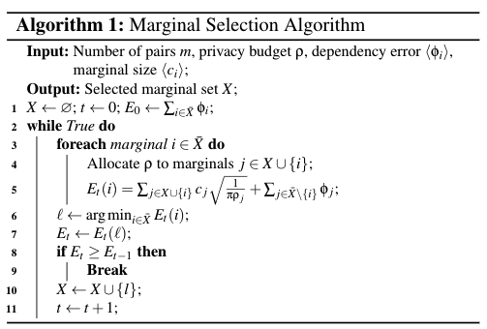
Marginal Selection: DenseMarg
Optimization Problem Formulation:
Combine small two-way marginals to larger marginals
Greedy algorithm to solve the optimization problem
Notes:
Since this optimization problem is NP-hard, we propose a greedy algorithm to select a set of near optimal marginals.
To reduce the number of marginals, we further propose an algorithm to combine small two-way marginals to larger marginals.

Slide 24
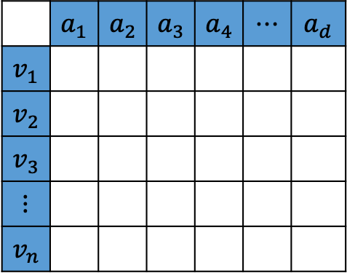




Dataset Generation: GUM
$$a_{3}$$ | $$a_{4}$$
$$a_{2}$$ | $$a_{3}$$
$$a_{1}$$ | $$a_{2}$$
 | $$a_{1}$$ | $$a_{2}$$ | $$a_{3}$$ | $$a_{4}$$ | $$⋯$$ | $$a_{d}$$
$$v_{1}$$
$$v_{2}$$
$$v_{3}$$
$$⋮$$
$$v_{n}$$
 | $$a_{1}$$ | $$a_{2}$$ | $$a_{3}$$ | $$a_{4}$$ | $$⋯$$ | $$a_{d}$$
$$v_{1}$$
$$v_{2}$$
$$v_{3}$$
$$⋮$$
$$v_{n}$$
Step I: Randomly generate dataset.
Step II: Using all marginals to update the randomly generated dataset.
Notes:
With the set of selected marginals, the next step is how to generate a synthetic dataset from them.
Our proposal consists of two steps: The first step is to randomly generate a dataset containing n samples and d attributes.
The second step is to update the randomly generated dataset to be consistent with all the selected marginals. For instance, if we select a marginal table containing attribute a_1 and a_2, we first update the records of the dataset to make its distribution consistent with the marginal table. Then for the selected marginal table a_2 a_3, we do the same thing, and so on so forth, until the distribution of the dataset is consistent with all marginals.
Note that, when we update marginal (a_2, a_3), it will inevitably destroy the consistency established by marginal (a_1, a_2). To address this problem, we propose to go over all marginals multiple times.
We have proposed many other techniques to improve the convergence, we refer the audience to our paper for more details.

Slide 25
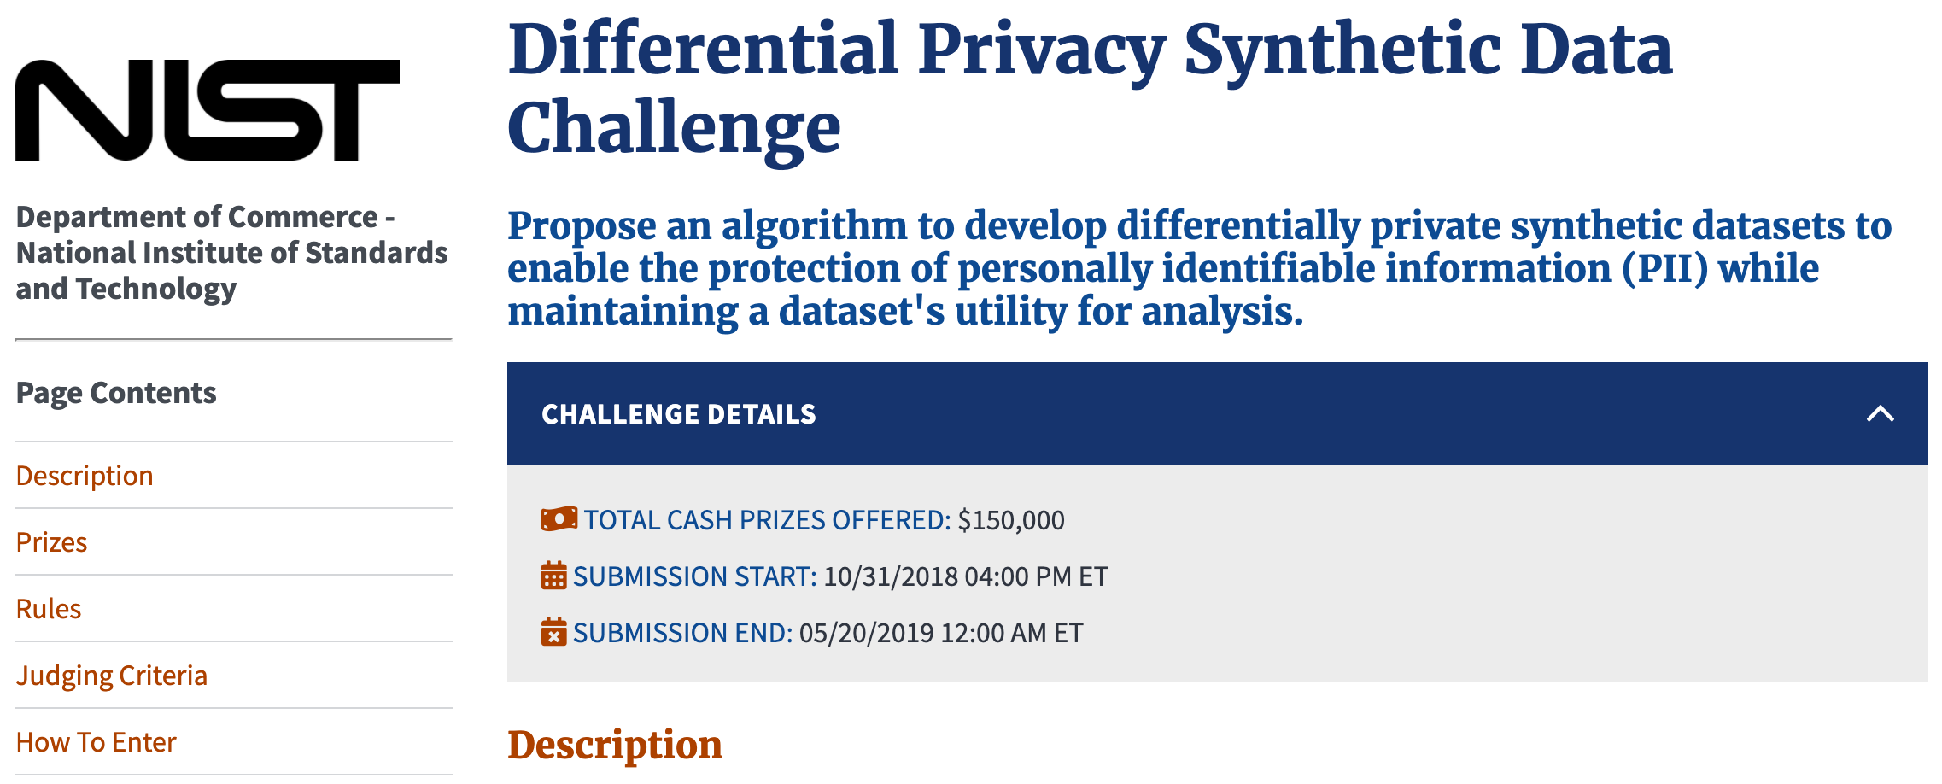
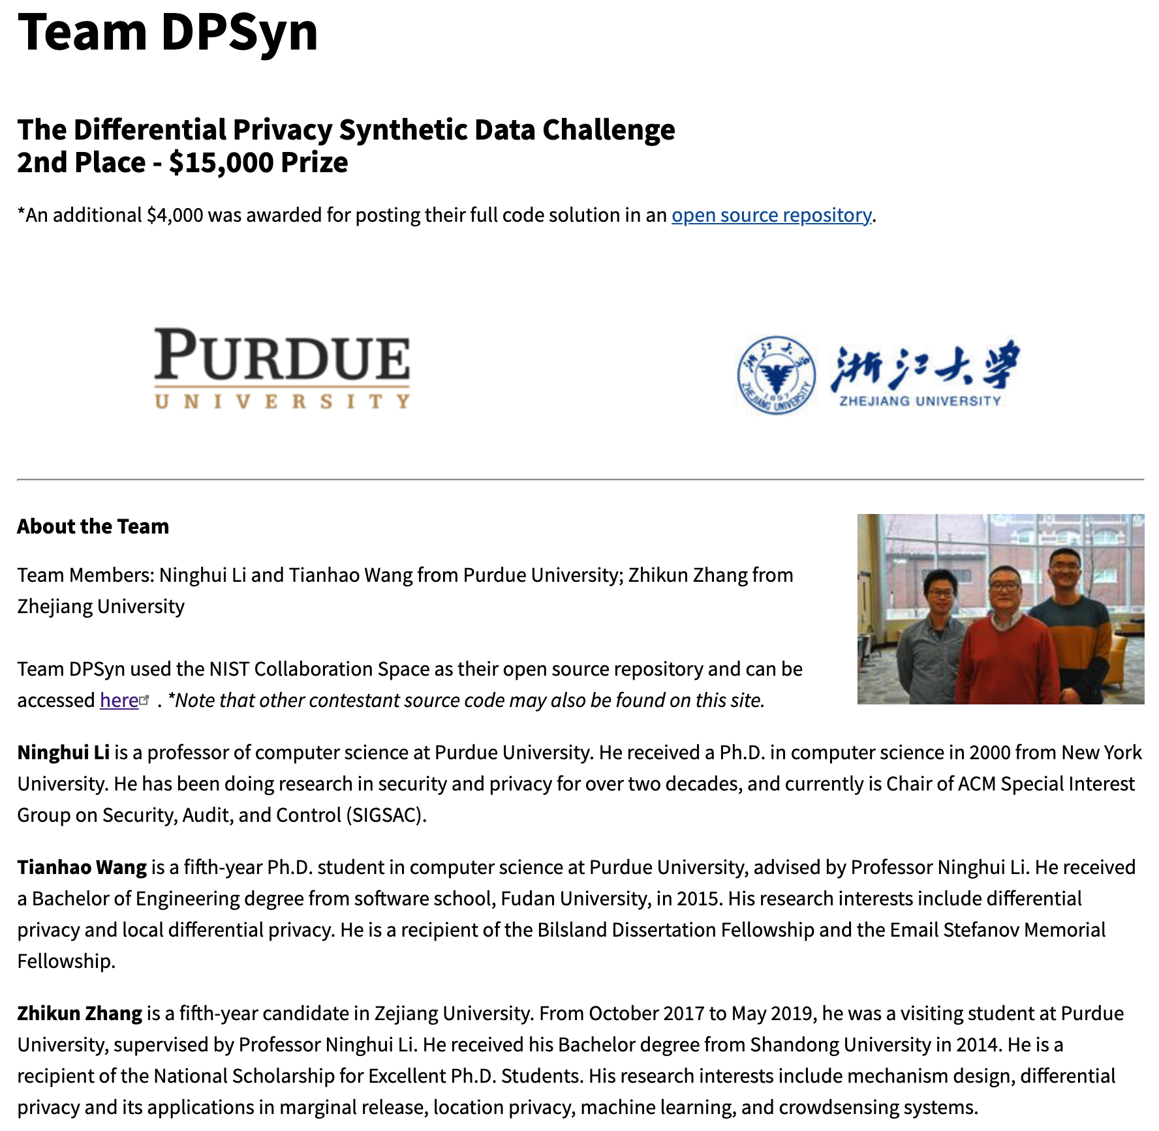
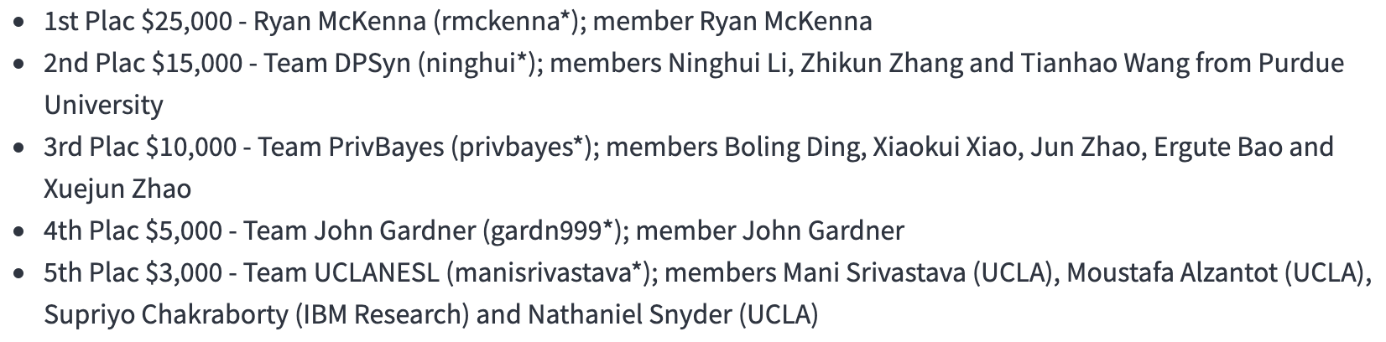
Won the NIST Differential Privacy Challenge
Notes:
Our proposed algorithm won the second place of the differential privacy synthetic data challenge hosted by NIST.

Slide 26
Experimental Setup
Tasks and Metrics
  Pair-wise marginals (Average L1 error)
  Range query (Average L1 error)
  Classification (Misclassification rate)
Competitors
  Bayesian network (PrivBayes)
  Markov random field (PGM)
  Game-based method (DualQuery)
Notes:
We use three downstream data analysis tasks and their commonly used metrics to measure the performance. They are pair-wise marginals, range query, and classification model.
We use two state-of-the-art graphical model based methods and one game-based method as our baseline.

Slide 27
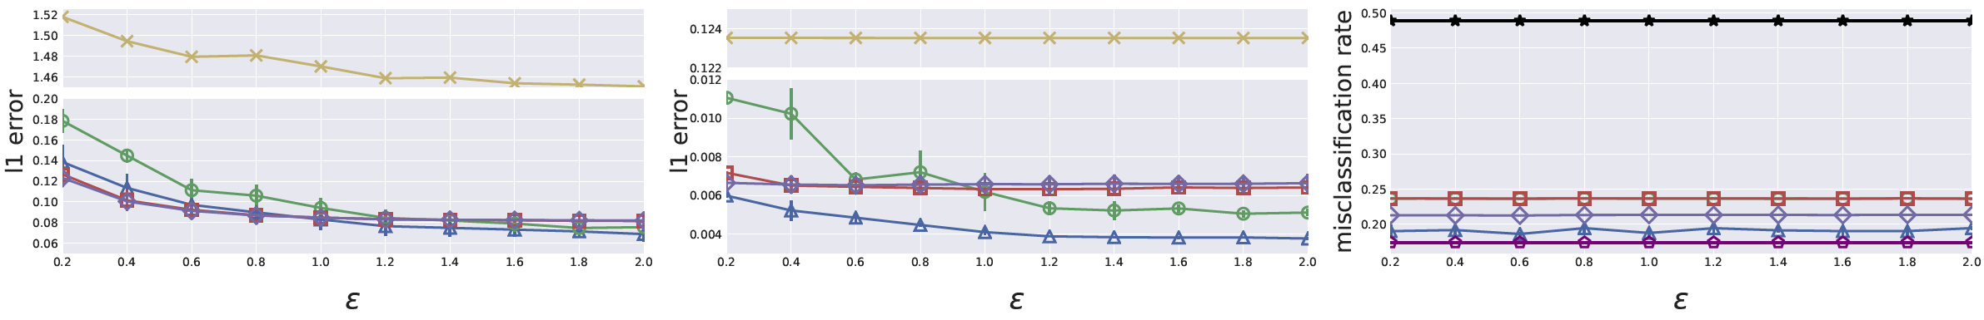
End-to-end Comparison
Pair-wise marginal
Range query
Classification
The performance of PrivBayes and PGM is close to PrivSyn for pair-wise marginal, meaning they can effectively capture low-dimensional correlation.
PrivSyn significantly outperforms others for range query and classification, meaning PrivSyn can also preserve high-dimensional correlation.
Notes:
This figure shows the end-to-end comparison of different dataset generation methods on the Colorado dataset.
We observe that the performance of PrivBayes and PGM is close to PrivSyn for pair-wise marginal, meaning they can effectively capture low-dimensional correlation. On the other hand, PrivSyn significantly outperforms others for range query and classification, meaning PrivSyn can also preserve high-dimensional correlation.

Slide 28
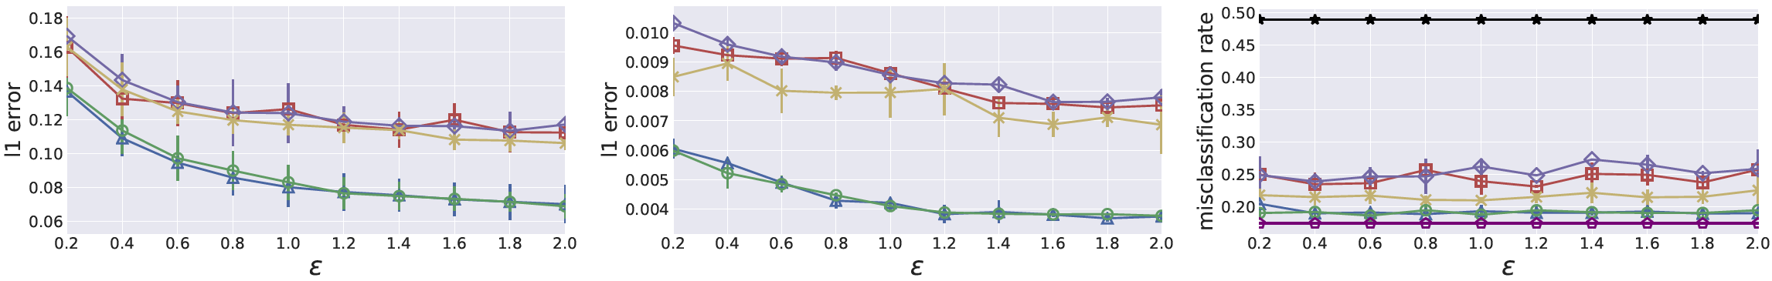
Marginal Selection Methods Comparison
Pair-wise marginal
Range query
Classification
DenseMarg consistently outperform PrivBayes (InDif) by exploiting more marginals.
DenseMarg performs similar in the private setting and non-private (do not add noise in the marginal selection phase) setting, indicating DenseMarg is robust to noise.
Notes:
This figure shows the comparison of different marginal selection methods.
We observe that our proposed method DenseMarg consistently outperforms PrivBayes (InDif) by exploiting more marginals. Furthermore, DenseMarg performs similar in the private setting and non-private setting that do not add noise in the marginal selection phase, which indicates DenseMarg is robust to noise.

Slide 29
Current Research Achievements
Collection
Publication
Analysis
Consumption
Marginal release [CCS’18]
Range query [CCS’21a]
Stream data collection [CCS’21b]
Tabular data [Sec’21]
Graph data [Sec’23a]
Trajectory data [Sec’23b], [VLDB’23]
Graph neural networks [Sec’22b], [CCS’22a], [ICML’23]
Facial recognition systems [Sec’23c]
Neural architecture search [CCS’22c]
Reinforcement learning [NDSS’24a]
Language models [NDSS’24b]
Implementation [CCS’22b]
Vulnerability analysis [CCS’21c]
Notes:
Machine learning models are widely deployed in the real world due to their powerful representation abilities.
For example, a disease diagnosis model can learns from the X-ray images and automatically predicts the lung disease given an X-ray image of an individual.
A facial recognition model learns from a large number of human faces and can discriminate different persons.
However, the machine learning models are often trained on sensitive personal data; thus, it is of significant importance to understand the privacy risks of different machine learning models, and deploy necessary defense mechanisms to mitigate these privacy risks.
A next word prediction model learns from personal keyboard input and predicts what is the next word.

Slide 30
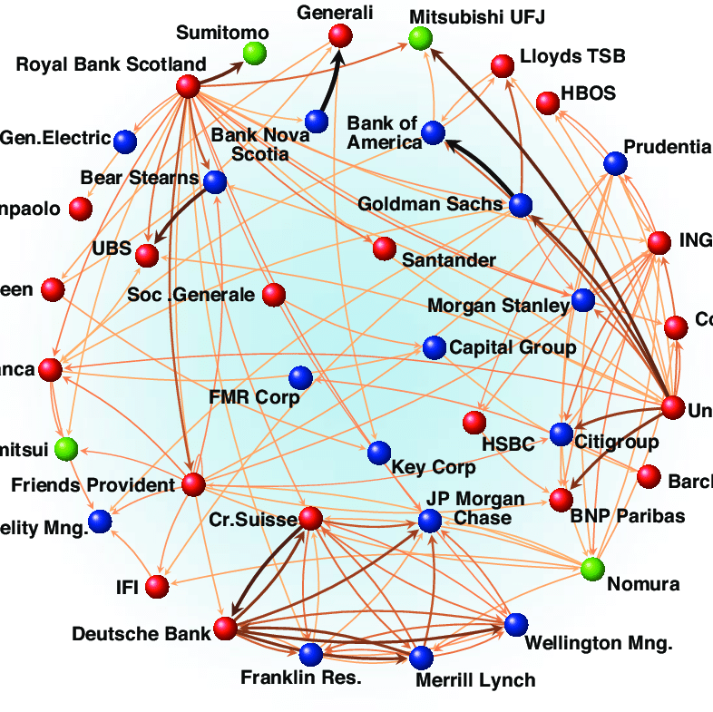
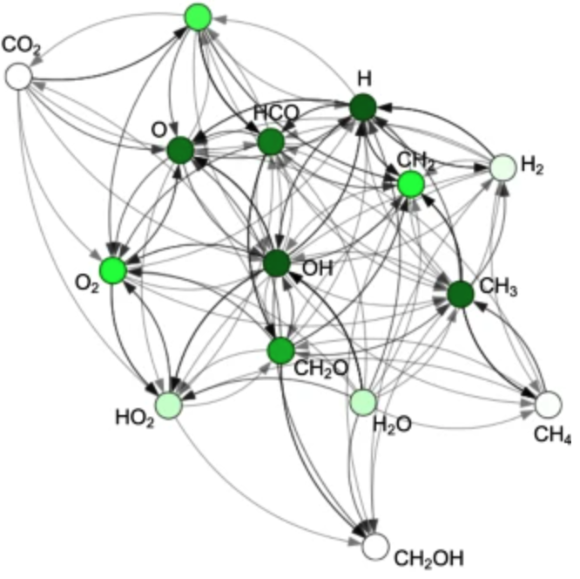
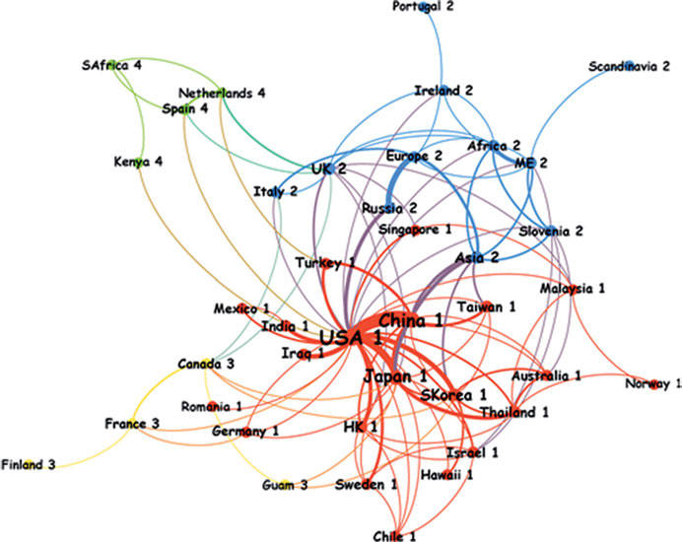
Graph Data
Many real world systems can be represented as graphs.
Social Network
Financial Network
Chemical Network
Transportation Network
Notes:
Many real world systems consist of nodes and edges, and thus can be represented as graphs.
For example, in the social network, the nodes represent users and edges represent the friendship between users.
In the chemical network, the nodes represent atoms and edges represent chemical bonds.
In the financial network, the nodes represent financial entities and edges represent the transaction relationship between entities.
In the transportation network, the nodes represent cities and edges represent roads connecting cities.

Slide 31
Graph Data
Node classification Vs. Graph classification
Node Classification
Graph Classification
Determine the label of each node in the graph
Determine the label of the whole graph
Category of each user
Toxicity of the molecular
Notes:
Node classification and graph classification are two widely investigated machine learning tasks for graph data.
The objective of the node classification is to determine the label of each node in the graph, for example, in the social network, determine the category of each user based on their profiles.
The objective of the graph classification is to determine the label of the whole graph, for example, in the chemical network, determine the toxicity of the molecular.

Slide 32
Naïve Method
B
B
A
A
MLP
C
C
Label of each node
F
F
D
D
E
E
Input Graph
Node Features
Cannot exploit information from neighboring nodes.
Notes:
The most straightforward method for node classification is to treat each node in the graph independently, and directly feed the node features to an MLP model to predict the label of the nodes.
However, this method cannot exploit information from the neighboring nodes, which has been shown to be important for the node classification.

Slide 33
Graph Neural Network
B
B
B
A
A
Node Classification
C
Aggregator
C
C
A
F
F
D
D
Link Prediction
E
D
E
Input Graph
Message Passing
Node Embeddings
Downstream Tasks
Graph Convolutional Network (GCN)
Graph Isomorphism Network (GIN)
Graph Attention Network (GAT)
Notes:
The general idea of graph neural network is to aggregate information from the neighboring nodes, and generate node embeddings for each node. The node embeddings are then used to conduct downstream tasks such as node classification and link prediction.
The core component of graph neural network is the message passing. There are multiple algorithms for aggregating information from the neighboring nodes, such as graph convolutional network, graph isomorphism network, and graph attention network.

Slide 34
Graph Pooling - Global
B
A
Mean pooling
Max pooling
Graph Classification
C
B
A
C
F
Graph Matching
D
D
E
F
Graph Visualization
E
Node Embeddings
Graph Embedding
Downstream Task
Notes:
The node embeddings can be further summarized as graph embedding for graph classification or graph matching.
The operation of summarizing the node embeddings to graph embedding is called graph pooling, there are two categories of graph pooling methods: Global pooling and hierarchical pooling.
The global pooling methods directly summarize all the node embeddings to a single graph embedding, such as take the average or take the maximum.

Slide 35
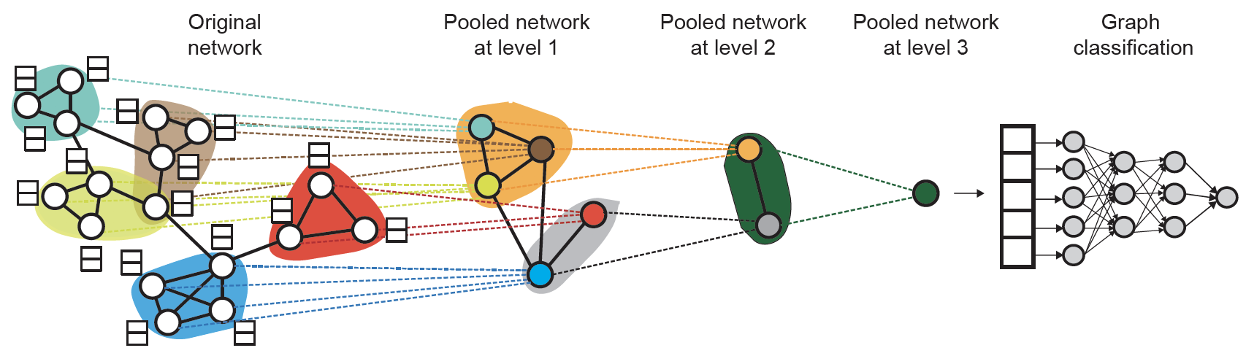
Graph Pooling - Hierarchical
[1] Hierarchical Graph Representation Learning with Differentiable Pooling. Ying et. al.
Notes:
The hierarchical methods generate the graph embedding hierarchically.
The general idea is to first obtain the node embeddings using message passing modules, and finds multiple clusters according to the node embeddings. Next, we treat each cluster as a node with features being the graph embedding of this cluster, then iteratively applying the message passing and clustering operations until there are only one graph embedding.

Slide 36
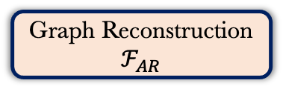
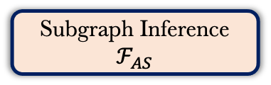

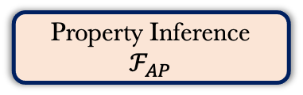

Threat Model and Attack Taxonomy
Downstream Tasks
Graph Classification
Graph Matching
Graph Visualization
……
Target Embedding Model $ℱ_{T}$
Target Graph Embedding $H_{𝒢_{T}}$
Target Graph $𝒢_{T}$
$$𝒢_{S}$$
Graph density
Number of nodes
Number of edges
……
Property Inference
$$ℱ_{AP}$$
Subgraph Inference
$$ℱ_{AS}$$
Graph Reconstruction
$$ℱ_{AR}$$
Is $𝒢_{S}$ in $𝒢_{T} ?$
Reconstruct $𝒢_{T}$
$$𝒢_{R}$$
Notes:
In this paper, we focus on the whole graph embedding, which is oftentimes computed on a sensitive graph. Such graph embedding is empirically considered sanitized since the whole graph is compressed to a single vector. In practice, it has been shared with third parties to conduct downstream graph analysis tasks. For example, the graph data owner can calculate the graph embeddings locally and upload them to the Embedding Projector service provided by Google to visually explore the properties of the graph embeddings.
However, we show in this paper that the graph embedding can leak much information about the target graph by conducting three new inference attacks: Property inference attack, subgraph inference attack, and graph reconstruction attack.

Slide 37

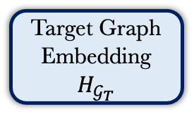

Property Inference Attack
Attack Goal
  Given the target graph embedding, infer the basic properties of the target graph, such graph density, number of nodes, and number of edges.
Attack Methodology
Graph Density
Target Graph Embedding $H_{𝒢_{T}}$
Number of Nodes
Number of Edges
......
Attack Model $ℱ_{AP}$
Notes:
The objective of the property inference attack is that, given the target graph embedding, infer the basic properties of the target graph, such as graph density, number of nodes, and number of edges.
To achieve this goal, we use a multi-output classifier as the attack model. The attack model consists of a feature extractor and multiple output layers, each output layer predict one target graph property.
To train the attack model, we can use a set of auxiliary graph that comes from either the same or different distributions as the target graph.

Slide 38
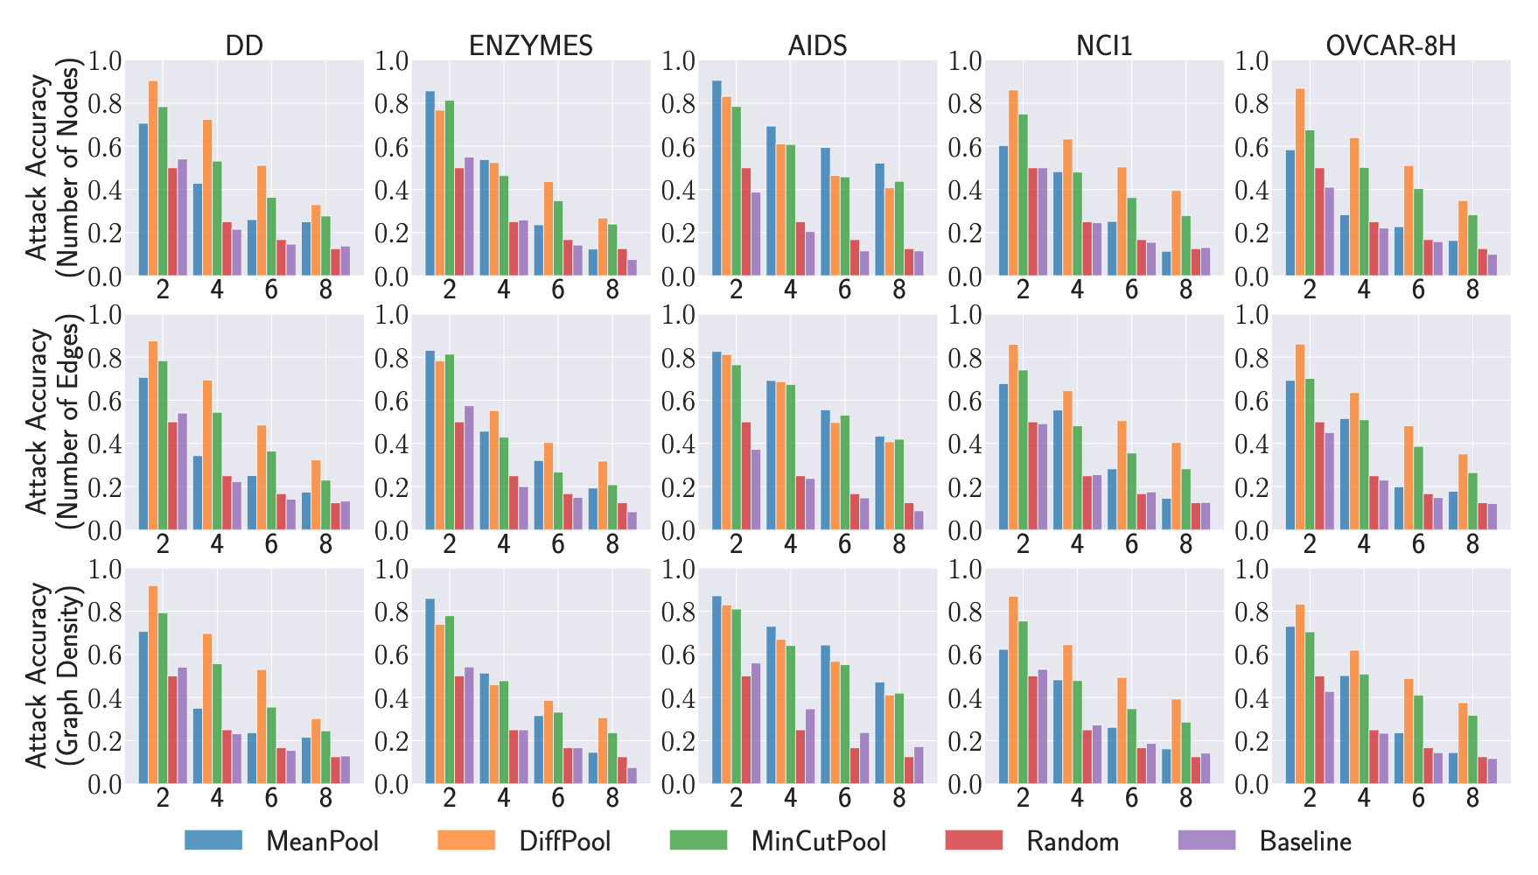
Property Inference Attack
Our proposed attack consistently outperform the baselines.
Larger bucketization leads to worse performance.
Attack accuracy on MeanPool is worse than other models in most of the cases.
Notes:
This is the attack performance. We first bucketize each property into multiple bins. In this paper, we consider four bucketization schemes.
We consider two baselines in our experiment. The first baseline is random guessing. The other baseline is to directly summarizing the properties from the auxiliary dataset instead of training a classifier. Concretely, we calculate the average property from the auxiliary dataset and use them for predicting the property of the target graph.
We also consider three pooling methods, where the MeanPool is global pooling, DiffPool and MinCutPool are hierarchical pooling.
The experimental results show that our proposed attack consistently outperform the baselines.
Further, we can observe that larger buketization leads to worse performance. This is expected because larger buketization requires higher granularity of graph structural information, and is more difficult for the classifier to distinguish.
In addition, the attack accuracy on MeanPool is worse than other models in most of the cases. This can be explained by the fact that the MeanPool model directly averages all the node embeddings, which might lose some graph structural information.

Slide 39
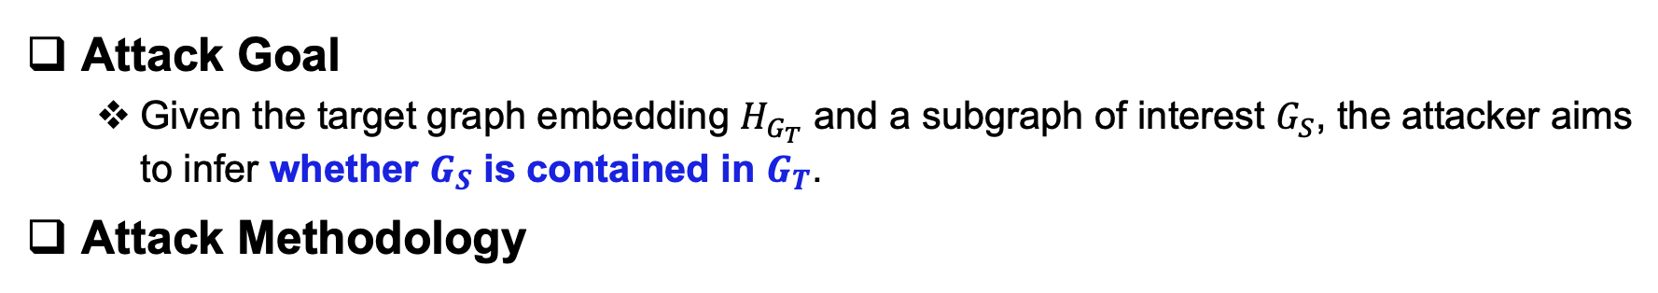
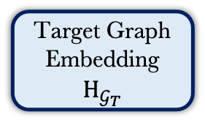
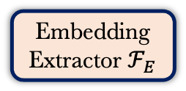
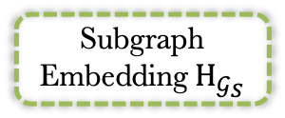

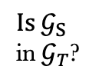
Subgraph Inference Attack
Attack Goal
  Given the target graph embedding $H_{G_{T}}$ and a subgraph of interest $G_{S}$, the attacker aims to infer whether $G_{S}$ is contained in $G_{T}$.
Attack Methodology
Target Graph
Embedding $H_{𝒢_{T}}$
$$Is{ 𝒢}_{S}$$
in${ 𝒢}_{T}$?
$$⊕$$
MLP
Embedding
Extractor $ℱ_{E}$
Subgraph
Embedding${ H}_{𝒢_{S}}$
$${ 𝒢}_{S}$$
Attack Model $ℱ_{AS}$
Notes:
The objective of the subgraph inference attack is that, given the target graph embedding and a subgraph of interest, the attacker aims to infer whether the subgraph of interest is contained in the target graph.
Since the target graph embedding and the subgraph of interest are in different formats, we cannot directly compare them.
To address this problem, we first use an embedding extractor to transform the subgraph of interest into the subgraph embedding.
We then merge the target graph embedding and the subgraph embedding and feed to an MLP model. The MLP model can tell whether the subgraph of interest is contained in the target graph or not.
The attack model consists of the embedding extractor and the MLP model, and they are trained simultaneously.

Slide 40
Subgraph Inference Attack
Attack Goal
  Given the target graph embedding $H_{G_{T}}$ and a subgraph of interest $G_{S}$, the attacker aims to infer whether $G_{S}$ is contained in $G_{T}$.
Attack Methodology
Graph Sampling
Positive Pair
Negative Pair
Graph Sampling
Notes:
To train the attack model, we need both positive pair that the subgraph is contained in the target graph, and negative pair that the subgraph is not contained in the target graph.
To generate the positive pair, we use graph sampling method such as random walk to generate a subgraph from the target graph.
To generate the negative pair, we randomly sample a graph from the auxiliary dataset that is different from the target graph, and sample a subgraph from it. The target graph and this sampled subgraph constitute the negative pair. If the sampling ratio is large enough, it is unlikely that the negative subgraph is contained in the target graph.

Slide 41
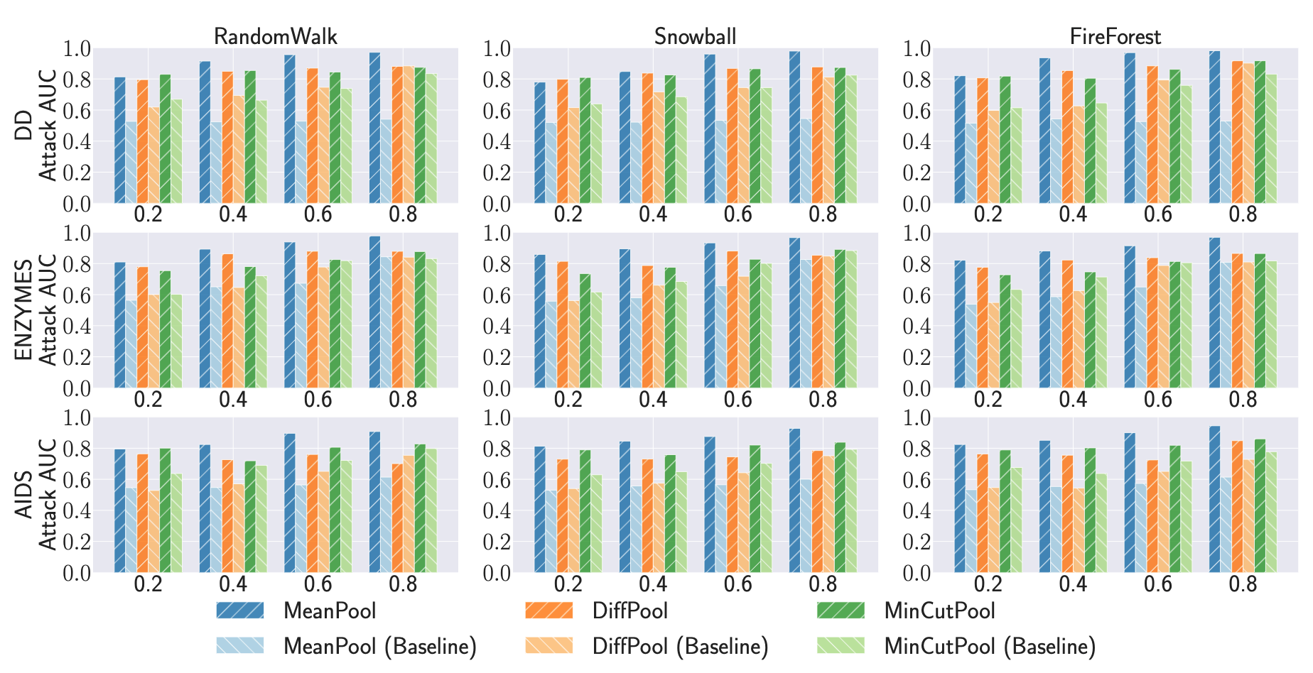
Subgraph Inference Attack
Our proposed attack consistently outperform the baseline.
Larger sampling ratio leads to better attack performance.
Attack accuracy on MeanPool is better than other models in most of the cases.
Notes:
This is the attack performance.
We consider four different sampling ratios, which indicates the proportion of the subgraph in the target graph.
To conduct the subgraph inference attack, the most straightforward method is to generate the subgraph embedding using the target model and only train the MLP as the attack model. We treat this method as our baseline.
The experimental results show that our proposed attack consistently outperform the baseline.
Furthermore, larger sampling ratio leads to better attack performance. This is expected as the positive samples and the negative samples tend to be more similar to each other on smaller subgraphs, making the attack model more difficult to distinguish between them.
In addition, the attack accuracy on MeanPool model is better than other models in most of the cases. We suspect this is because DiffPool and MinCutPool decompose the graph structure during their pooling process; thus, the subgraph as a whole might never be seen by the target model. This makes it harder for graph embedding matching to be effective.

Slide 42



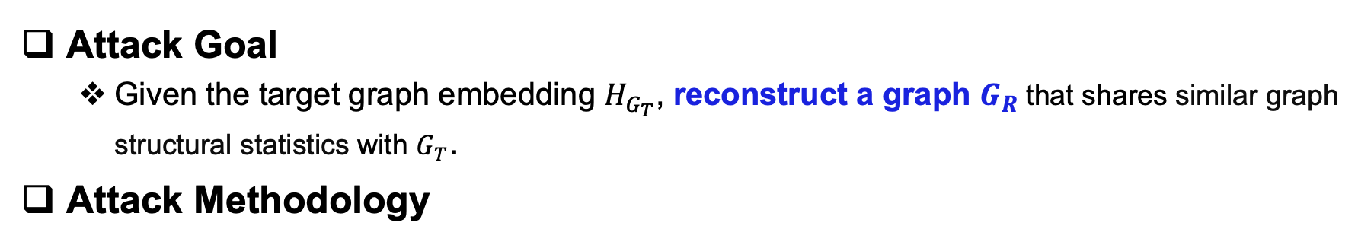

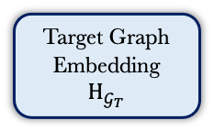
Graph Reconstruction Attack
Attack Goal
  Given the target graph embedding $H_{G_{T}}$, reconstruct a graph $G_{R}$ that shares similar graph structural statistics with $G_{T}$.
Attack Methodology
Graph Matching
E
H
D
$$𝒢_{AUX}$$
$$𝒢_{R}$$
Train
Attack Shadow Model
Inference
Target Graph Embedding $H_{𝒢_{T}}$
$$𝒢_{R}$$
Attack Model $ℱ_{AR}$
Notes:
The objective of the graph reconstruction attack is that, given the target graph embedding, reconstruct a graph that shares similar graph structural statistics with the target graph.
We use the graph autoencoder to serve as our attack model. Different from traditional autoencoder in image domain, the graph autoencoder has an additional graph matching component. The reason is that there is no explicit node ordering enforced in the graph. For the same graph, if their node orderings are different, the adjacency matrixs are completely different. We also use an auxiliary dataset to train the graph autoencoder.
After the autoencoder is trained, we use the decoder as our attack model. Give the target graph embedding, the decoder can reconstruct the graph.

Slide 43
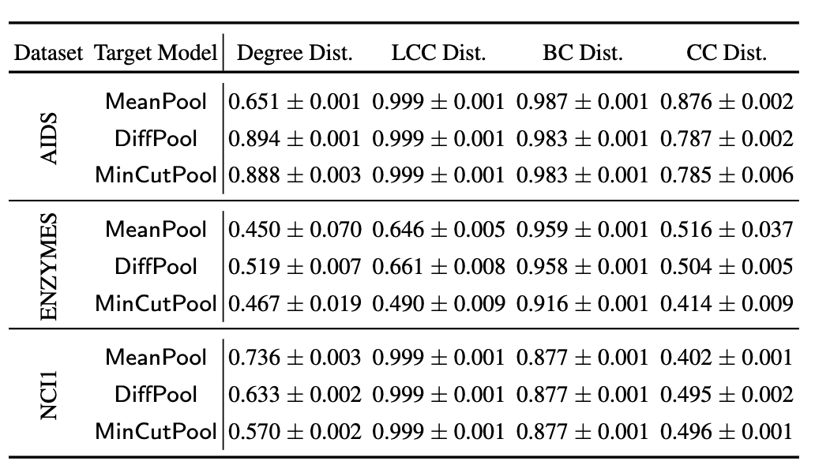
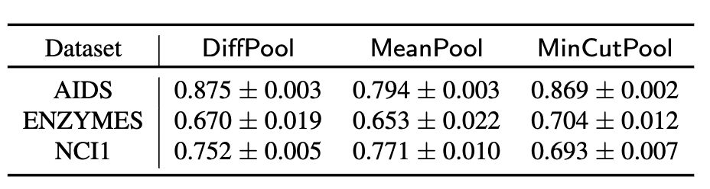
Graph Reconstruction Attack
Macro-level graph statistics (cosine similarity)
Graph isomorphism
Our proposed attack achieves good reconstruction performance regarding graph isomorphism and macro-level graph statistics.
Notes:
This is the experimental results.
We use two types of metrics to evaluate the attack performance. The first type is graph isomorphism. It directly compares two graphs using graph kernel. The graph isomorphism of 1.0 indicates two graphs are the same.
The other type is the macro-level graph statistics, such as degree distribution, local clustering coefficient, betweenness centrality, and closeness centrality. We use the cosine similarity to measure the similarity between the target graph and the constructed graph. A cosine similarity of 1.0 indicates the two metrics are the same.
The experimental results show that our proposed attack achieves good performance for both of the metrics.

Slide 44
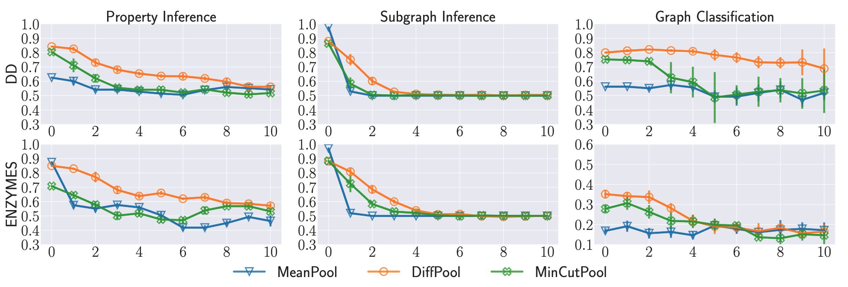
Defense
Methodology
  Perturb the graph embedding
The defense can effectively mitigate the attacks while maintaining acceptable accuracy for normal graph classification.
Notes:
We also investigate a simple defense mechanism. The general idea is to add random Laplacian noise to the graph embeddings.
The x-axis shows the standard deviation of the Laplacian noise. The experimental results show that The defense can effectively mitigate the attacks while maintaining acceptable accuracy for normal graph classification.

Slide 45
Current Research Achievements
Collection
Publication
Analysis
Consumption
Marginal release [CCS’18]
Range query [CCS’21a]
Stream data collection [CCS’21b]
Tabular data [Sec’21]
Graph data [Sec’23a]
Trajectory data [Sec’23b], [VLDB’23]
Graph neural networks [Sec’22b], [CCS’22a], [ICML’23]
Facial recognition systems [Sec’23c]
Neural architecture search [CCS’22c]
Reinforcement learning [NDSS’24a]
Language models [NDSS’24b]
Implementation [CCS’22b]
Vulnerability analysis [CCS’21c]
Notes:
Machine learning models are widely deployed in the real world due to their powerful representation abilities.
For example, a disease diagnosis model can learns from the X-ray images and automatically predicts the lung disease given an X-ray image of an individual.
A facial recognition model learns from a large number of human faces and can discriminate different persons.
However, the machine learning models are often trained on sensitive personal data; thus, it is of significant importance to understand the privacy risks of different machine learning models, and deploy necessary defense mechanisms to mitigate these privacy risks.
A next word prediction model learns from personal keyboard input and predicts what is the next word.

Slide 46


Machine Unlearning
$$z$$
Does machine unlearning indeed protect privacy of the data owners who revoke their data samples?
Original Model
$$z$$
Unlearned Model
Model Provider
Data Owner
Notes:
The most legitimate way to implement machine unlearning is to delete the revoked data sample from the training set, and retrain the original model from scratch. This generates a second version of the model, we call it unlearned model.
Machine unlearning is designed to protect the privacy of the users who revoke their data; however, it is unclear whether the machine unlearning indeed protect privacy of the data owners who revoke their data samples.
In this work, we show that machine unlearning will unintendedly leak more information about the revoked sample by conducting a membership inference attack.

Slide 47



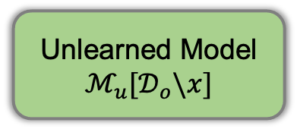



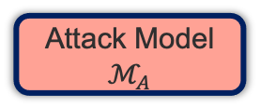

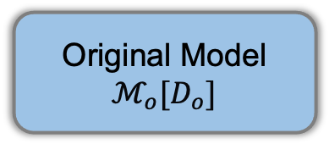
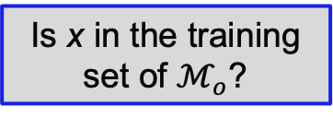

Attack Pipeline
Attack Goal: Given a target sample x, infer whether it is a member of the Original Model, but revoked in the Unlearned Model.
Is x in the training set of $ℳ_{o}$?
Original Model
$$ℳ_{o}[D_{o}]$$
Query
Posterior $ℙ_{o}$
Attack Model
$$ℳ_{A}$$
Target Sample x
Unlearned Model $ℳ_{u}[𝒟_{o}\backslash x]$
Posterior $ℙ_{u}$
1. Posterior Generation
2. Feature Construction
3. Inference
Notes:
Our attack goal is that, given a target sample x, infer whether it is a member of the Original Model, but revoked in the Unlearned Model.
We assume the attacker has black-box access to both the original model and the unlearned model.
As such, we can obtain the posteriors of the target sample in both the original model and the unlearned model.
We can then merge these two posteriors with different strategies, and input the merged posterior to an attack model to predict the membership status of the target sample.
The next question is, how do we train the attack model?

Slide 48
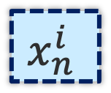
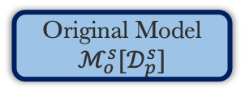
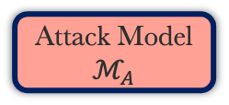







Attack Model Training
Original Model
$$ℳ_{o}^{s}{[𝒟}_{p}^{s}]$$
Q
Negative
Shadow Negative
$$𝒟_{n}^{s}$$
$$x_{n}^{i}$$
Unlearned Model
$ℳ_{u}^{s,i}$ ${[𝒟}_{p}^{s}\backslash x_{p}^{i}]$
F
Shadow Dataset
$$𝒟^{s}$$
T
Attack Model
$$ℳ_{A}$$
S
Original Model
$$ℳ_{o}^{s} {[𝒟}_{p}^{s}]$$
Q
Shadow Positive
$$𝒟_{p}^{s}$$
$$x_{p}^{i}$$
Unlearned Model
$ℳ_{u}^{s,i}$ ${[𝒟}_{p}^{s}\backslash x_{p}^{i}]$
F
Positive
S
Disjointly Split
Q
Model Query
F
Feature Construction
T
Model Train
1. Split shadow dataset
2. Train shadow model pairs
3. Query and label posteriors
4. Train attack model
Notes:
In this paper, we use the shadow model paradigm to train the attack model.
We assume the adversary is able to gather some local auxiliary datasets that comes from either the same or different distribution as the target model.
We first split the shadow dataset into two disjoint parts, namely shadow negative dataset and shadow positive dataset.
Then, we randomly sample k copies of data from the shadow positive datasets and train k original models.
For each original model, we randomly delete 1 data sample, retrain the model and get the corresponding unlearned model.
Next, we use the data samples from the shadow positive dataset to query both the original model and the unlearned model, get two posteriors, and use feature construction methods to combine them together. This serves as the positive or member sample for the attack model.
Besides, we use the data samples from the shadow negative datasets to query the same original model and unlearned model, and obtain the negative samples or non-member sample for the attack model.
With the positive and negative samples, we can train a binary classifier as the attack model.

Slide 49









Experimental Setup
Baseline membership inference attack
Is x in the training set of $ℳ_{o}$?
Original Model
$$ℳ_{o}[D_{o}]$$
Query
Posterior $ℙ_{o}$
Attack Model
$$ℳ_{A}$$
Target Sample x
Unlearned Model $ℳ_{u}[𝒟_{o}\backslash x]$
Posterior $ℙ_{u}$
1. Posterior Generation
2. Feature Construction
3. Inference
Notes:
To evaluate the effectiveness of our proposed attack, we first introduce a baseline membership inference attack that only has access to the original model.
By comparing with this baseline membership inference attack, we can know the privacy degradation level incurred by the machine unlearning process.

Slide 50


Experimental Setup
Datasets
  Categorical data, Image data
Target models
  Logistic Regression (LR), Decision Tree (DT), Random Forest (RF), Multi Layer Perceptron (MLP)
  2-layer Convolutional Neural Network (CNN), ResNet50, DenseNet121
Metrics
  AUC
  DegCount: Number of degrade cases.
  DegRate: Confidence values degradation Rate.
  UCI Adult
Instagram
CIFAR10
MNIST
Notes:
We evaluate our attack under multiple models and datasets. For dataset, we consider both categorical dataset and image dataset. For target model, we consider both simple classifiers such as logistic regression and decision tree, as well as CNN models such as ResNet and DenseNet.
We use three metrics to evaluate the attack performance of our attack.
AUC is a widely use metric to evaluate the performance of binary classification.
The DegCount and DegRate measure the extra privacy leakage of the machine unlearning process by comparing our proposed attack and the baseline membership inference attack.

Slide 51



Machine Unlearning Causes More Privacy Leakage
Categorical data
DegCount
Target model
Attack AUC
DegRate
Attack model
Baseline MIA
Our proposed attack consistently outperform the baseline.
DT is the most vulnerable model.
Notes:
This is the experimental results for the categorical datasets.
For the attack AUC, the group in the x-axis represent the target model,
different legend in different colors represent different attack models.
We use the shallow color bars to illustrate the attack performance of the basesline membership inference attack.
The experimental results show that our proposed attack consistently outperforms the baseline membership inference attack, which indicates the machine unlearning process indeed degrade privacy of the target sample.
We also observe that the decision is the most vulnerable model.

Slide 52

Machine Unlearning Causes More Privacy Leakage
Image data
Attack AUC
DegCount
DegRate
Attack model
Baseline MIA
Notes:
We obtain similar conclusions in the image datasets.

Slide 53






The Impacts of Overfitting
Training
(Seen)
Prediction
(Unseen)
$$z$$
Score
Decision
$$x$$
$$(Data, label)$$
  Overfitting is the key for membership inference attack
  [Shokri et al. 2017, Yeom et al. 2018, Salem et al. 2019]
Our attack is still effective in the well-generalized models.
Notes:
Previous studies have shown that overfitting is the key for classical membership inference attack. Concretely, traditional membership inference always perform bad in the well-generalized model.
This figures show the relationship between overfitting and the attack performance.
The experimental results show that our attack is still effective in the well-generalized models while the classical membership inference only performs good when the overfitting level is high.

Slide 54







Finding the Optimal Attack Features
DC
DD
SC
SD
Difference-based methods work well on the well-generalized models.
Concatenation-based methods work better on the overfitted models.
Sorting the posteriors further improves attack performance.
ED
Notes:
Next, we investigate the optimal way to merge the two posteriors obtained from the original model and the unlearned model.
We evaluate on five different methods, that is direct concatenation, direct difference, sorted concatenation, sorted difference, and Euclidean distance.
The experimental results show that, difference-based methods work better on the well-generalized models,
and concatenation-based methods perform better on the overfitted model.
Besides, sorting the posteriors further improves attack performance.

Slide 55

Defenses
Top-k defense cannot mitigate our attack.
Label-only defense can effectively mitigate our defense but might be vulnerable to adaptive attacks.
Temperature scaling can defend against our attack but only applicable to neural network based models.
DP can defend against our attack at the cost of model accuracy loss.
Notes:
Finally, we investigate possible defenses against our attack. We consider four different defense mechanisms in this work.
The first mechanism is only publish the top-k posterior value. The experimental results show that it cannot mitigate our attack. This result implies that the top few posterior values are the most informative for membership inference attack.
The second mechanism is only publish the label. The experimental results show that it can effectively mitigate our proposed attack; however, previous studies have shown that label-only defense is vulnerable to adaptive attacks in classical membership inference. It would be interesting to design label-only membership inference in the machine unlearning setting.
The third mechanisms is temperature scaling. The experimental results show that it can defend against our attack to some extent, but it is only applicable to neural network with softmax layer.
The last mechanism is to apply DP in the training process of both the original model and the unlearned model. The experimental results show that it can defend against our attack. However, It is worth noting that DP can inevitably degrade the target model's accuracy. We need carefully tune the privacy budget parameters to strike a trade-off between privacy and model utility in practice.

Slide 56

Thank you for your listening
Q & A
Email: zhikun@stanford.edu
Website: www.zhangzhk.com
Twitter: @ZhikunZhang5
Notes:
Thanks for your listening and thanks for all my collaborators!

Slide 57
More Information for CALM
Notes:
Thanks for your listening!

Slide 58


How to Construct All k-way Marginals
E.g.: required={a1, a2}, M1={a1, a3}, M2={a2, a4}
Solve the following equations set
Maximum entropy principle to determine unique solution
$$x_{00}+x_{01}=m_{00}^{1}+m_{01}^{1}$$
$$x_{10}+x_{11}=m_{10}^{1}+m_{11}^{1}$$
$$x_{00}+x_{10}=m_{00}^{2}+m_{01}^{2}$$
$$x_{01}+x_{11}=m_{10}^{2}+m_{11}^{2}$$
3 independent variables
2 independent constraints
Solution is not unique

Slide 59
How to Consist Between Noisy Marginals
What is inconsistency (example)
  Marginal M1 contains attributes {a1, a2}
  Marginal M2 contains attributes {a1, a3}
  a1, a2, a3 have 2, 2, 3 categories
  M1 and M2 have common attribute a1, but their projection on a1 is not the same
 |  | M1 (a2) |  |  | M2 (a3)
 |  | 0 | 1 |  | 0 | 1 | 2
a1 | 0 | 0.3 | 0.3 | 0.6 | 0.1 | 0.2 | 0.2 | 0.5
 | 1 | 0.2 | 0.2 | 0.4 | 0.2 | 0.1 | 0.2 | 0.5

Slide 60

How to Consist Between Noisy Marginals
Consistency step
  Compute the optimal estimation of the common attributes by
    $T_{A}\left(v\right)=\frac{\sum_{i}{\frac{1}{C_{i}}∙T_{A_{i}(v)}}}{\sum_{i}{\frac{1}{C_{i}}}}$ ---> $a_{1}\left(0\right)=\frac{0.6×2+0.5×3}{2+3}=0.54$ $a_{2}\left(0\right)=0.46$
  Update the inconsistent marginals by
    $T_{A_{i}}\left(v^{′}\right)←T_{A_{i}}\left(v^{′}\right)+\frac{1}{C_{i}}(T_{A}\left(v\right)−T_{A_{i}}\left(v\right))$
 |  | M1 |  |  | M2
 |  | 0 | 1 |  | 0 | 1 | 2
a1 | 0 | 0.27 | 0.27 | 0.54 | 0.113 | 0.213 | 0.213 | 0.54
 | 1 | 0.23 | 0.23 | 0.46 | 0.187 | 0.087 | 0.187 | 0.46

Slide 61
How to Choose A Set of Marginals
Error analysis
Noise Error
Reconstruct Error
Sampling Error

Slide 62

How to Choose A Set of Marginals
Error analysis
  Goal: determine marginal size $l$ and marginal number $m$
  Noise error (NE): $min⁡(\frac{4e^{ε}}{{\left(e^{ε}−1\right)}^{2}},\frac{2^{l}{−2+e}^{ε}}{{\left(e^{ε}−1\right)}^{2}})∙\frac{2^{l}}{l}∙\frac{d}{n}$
    Larger $l$ lead to larger NE
  Sampling error (SE): $\frac{m}{n}$
    Larger m lead to larger SE
  Reconstruction error (RE): have no analytical expression
    Larger $l$ and $m$ lead to smaller RE

Slide 63

How to Choose A Set of Marginals
Main idea
  Goal: ensure none of the three noise dominate the others
  Choose a target error threshold $θ$
    Empirically choose, in this paper we choose $θ={10}^{−3}$ in our experiment
  Compute the largest $l$, such that $k∙NE<θ$
  When $l<k$, choose $l$ and the largest $m$ such that $SE<θ$
  When $l≥k$, choose m and the largest $l_{t}∈[k,l]$ such that the maximum of NE and SE is minimized

Slide 64
More Information for PrivSyn
Notes:
Thanks for your listening!

Slide 65

GUM: Records Updating
Actual marginal
Target marginal
 | Income | Gender | Age
v¹ | high | male | teenager
v² | high | male | adult
v³ | high | male | adult
v⁴ | high | male | teenager
v⁵ | high | female | elderly
v | $$S_{\{I,G\}}$$ | $$T_{\{I,G\}}$$
<low, male, *> | 0.0 | 0.0
<low, female, *> | 0.0 | 0.0
<high, male, *> | 0.8 | 0.2
<high, female, *> | 0.2 | 0.8
 | Income | Gender | Age
v¹ | high | male | teenager
v² | high | male | adult
v³ | high | female | adult
v⁴ | high | female | teenager
v⁵ | high | female | elderly
Actual and target distribution for marginal {Income, Gender}
Dataset before updating
Dataset after updating
Notes:
The remaining thing I want to introduce is how to update the records in the dataset to make its distribution consistent with the marginal.
Here is an example. The left table is the dataset before updating, the middle table is the actual and target distribution for marginal {Income, Gender}. We change the value of record v3, v4, and v5 and obtain the right table. Note that we do not want to make the actual marginal fully consistent with the target marginal in one step, since we empirically observe that gradually update the records can achieve better convergence performance. Also note that we copy record v5 to v3, this is another trick to improve the convergence performance.
We have proposed many other techniques to improve the convergence, we refer the audience to our paper for more details.

Slide 66






Background
Big data era and machine learning
Notes:
Nowadays, data has become the most valuable resources in the world, and machine learning are widely used to analyze these data to provide better experiences for people.

Slide 67
More Information for GNN
Notes:
Thanks for your listening!

Slide 68
Graph Pooling - Hierarchical

Slide 69
More Information for Unlearning
Notes:
Thanks for your listening!

Slide 70


Relax the Attack Assumptions
Knowledge on the model structure
Knowledge on the data distribution
Data Distribution Transferability
#New York
#Los Angeles
Model Transferability
Notes:
In the previous experiment, we used the same distribution but disjoint data and same model structure to train shadow and target models separately.
However, in a realistic attack scenario, The attacker might not be able to collect the same distribution training data or know the architecture of the target model.
Thus, we conduct two transfer experiments to relax the assumptions of the adversary.
We transfer the Instagram check-in dataset from New York to Los Angeles, which means the target model and shadow model have different training data distributions.
We also transfer the target model and shadow model between the decision tree and logistic regression.
We could observe that our attack outperforms the baseline on both transfer attacks.
This means the unlearned model can leak even if the attacker does not know the original data distribution and target model architecture.

Slide 71






Multiple Intermediate Unlearned Models
Adversary does not know how many versions passed by.
Intermediate Models
$$z$$
$$z$$
$$z$$
Target Model
Target Model
Target Model
$$x$$
$$x$$
……
$$x$$
Consistent privacy degradation.
Attack AUC drops when the number of intermediate models increases.
Notes:
As discussed in the threat model part, the adversary gains access to the original and unlearned models by continuously querying the target model.
In practice, the unlearning can happen multiple times during the two observations,
and the adversary does not know the number of model versions passed.
We call these models between two observations intermediate models.
Here, we evaluate the effectiveness of our attack in this case.
The x-axis is the number of intermediate models.
We can first observe a consistent privacy degradation in all cases.
Secondly, we observe a decreasing trend of attack AUC with the increasing number of intermediate models.
This trend is evident since previously deleted instances mask the impact of the target sample.
Furthermore, the random forest model seems to get the most negligible effect on the variance of this number.
Note that the data samples are unlikely to be revoked frequently in practice.
The number of intermediate models is unlikely to be very large,
which means our attack is still effective in real-world settings.
For instance, our attack AUC can achieve at least 0.84 when the intermediate models are less than10 when the target model is LR.

Slide 72





Group Unlearning
Deletion and retrain happen periodically.
$$z$$
Original Model
Unlearned Model
$$z$$
$$x$$
$$x$$
Randomly delete k% records to train unlearned model
Consistent privacy degradation.
Group deletion averages the impact.
Notes:
In practice, the data controller might process the deletion requests at a particular period to save computation costs.
Thus we evaluate our attack when multiple data records are deleted at the same time.
The only difference from the previous experiment is that we randomly deleted a percentage of records to train the unlearned model for each original model.
And, here is the result.
We could observe a drop in the attack performance, but we still achieved higher than baseline.
This implies, group deletion averages the impact of the deletion, but extra privacy leakage always exists.

Slide 73



Online Unlearning
Both deletion and insertion happen in the same time.
Unlearned Model
Original Model
$$z$$
$$z$$
$$x$$
$$x$$
Adding samples in the unlearning process slightly impacts our attack.
Notes:
In real-world deployments, ML models are often updated with new samples, which is known as online learning or incremental learning.
We further evaluate the performance of our attack in an online learning setting where multiple samples are deleted and added simultaneously.
To set up the experiment, we delete a group of target samples from the original dataset and add the same number of new samples; then, we retrain the model from scratch to obtain the unlearned model.
We conduct experiments on Insta-NY with different target models and use LR as the attack model.
When we increase the number of modified data samples, our attack and baseline are less effective.
This figure shows that adding samples to the target model in the unlearning process slightly impacts our attack.

Slide 74










Approximate Machine Unlearning - SISA
Evaluation on SISA Method
Original Model
$$ℳ_{1}[𝒟^{1}]$$
$$𝒟^{1}$$
Original Model
$$ℳ_{2}[𝒟^{2}]$$
$$𝒟^{2}$$
Training Dataset
$$𝒟^{train}$$
Aggregator
$$……$$
$$……$$
Original Model
$$ℳ_{n}[𝒟^{n}]$$
$$𝒟^{n}$$
Aggregation reduces the influence of single sample.
﻿Sharded, Isolated, Sliced, and Aggregated
[Bourtoule, Lucas, et al. 2021]
Notes:
The unlearning algorithm we have focused on so far is retraining from scratch,
which can become computationally prohibitive for large datasets and complex models.
Several approximate unlearning algorithms have been proposed to accelerate the training process.
Take a general approximate unlearning algorithm SISA as an example,
The SISA works in a divide-and-conquer manner.
It splits the original dataset into $n$ disjoint shards and trains $n$ sub-models, respectively.
In the inference phase, the model aggregates the outputs of each sub-model and produces the global prediction.
In this experiment, we set $n=5$ and use the posterior average as an aggregation algorithm.
This figure illustrates the attack AUC on the Insta-NY dataset.
Compared with previous results, the improvement in attack performance is not as significant.
So, SISA-based machine unlearning can achieve higher efficiency and privacy balance.

Slide 75




Defense (Limit the Output Information)
Top-k posteriors
Label only
$$z$$
$$z$$
$$x$$
$$x$$
Target Model
Target Model
Notes:
Finally, we evaluate our attack on four types of defense.
One defense direction is to limit the output information since the adversary directly uses this.
For the Top-k posterior publish, the target model only outputs the top-3 2 1 predict probability of the query data record.
While the label posterior publish target model only gives the predicted label.

Slide 76







Defense (Limit the Output Information)
Temperature scaling
DP-SGD
$$z$$
Original Model
$$x$$
DP-SGD
Add Noise
Clip Gradients
Temperature T
Compute Gradient $∇L(θ_{t})$
SGD
Update Gradient
$θ_{t+1} =θ_{t }−η∇L(θ_{t}$)
Back Propagation
Notes:
The second defense direction is to perturb the target model during training to make the model more robust.
Temperature scaling is a postprocessing method that divides the logits vector by a learned scaling parameter, which is a simple yet effective approach to eliminate the over-confident problem of the neural networks.
DP-SGD adds a differential-private gaussian noise on the clipped gradient during the model training phase, reducing the impact of a single sample on the output posteriors.
To validate whether DP can prevent our membership inference attack in the machine unlearning setting, we train both the original model and unlearned model in a differentially private manner.

