Slide 1
Tyrants on Twitter: Protecting Democracies from Information Warfare
Friday, May 27, 2022

Slide 2
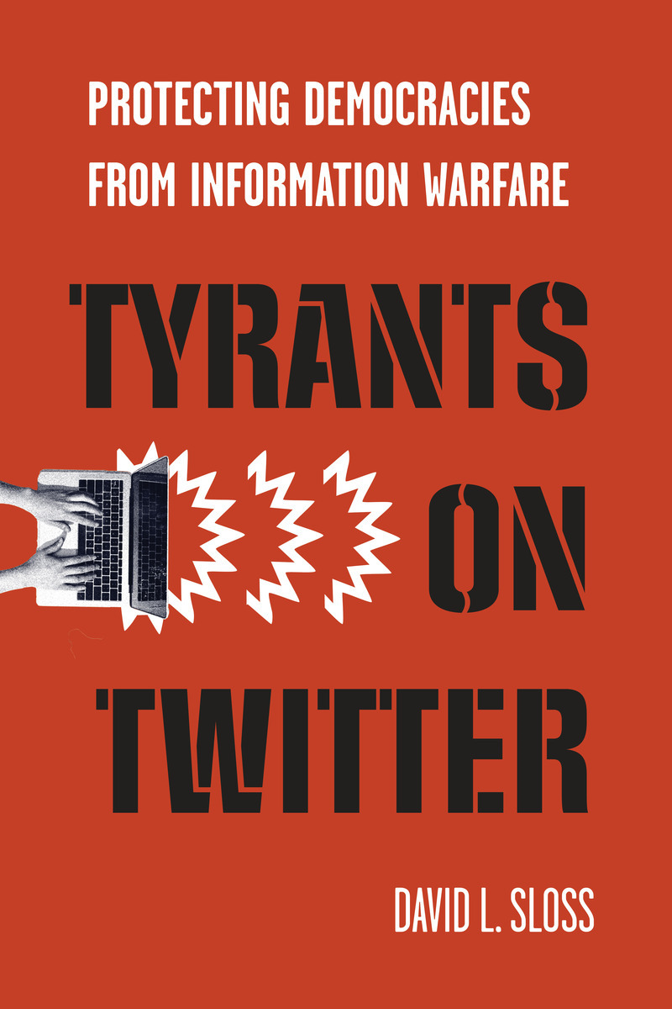

Slide 3
Central Argument
New Cold War with China
Compete in three areas
Military
Economic
Information Competition (need to win this)
US is subsidizing Chinese/Russian information warfare on social media
Major strategic mistake

Slide 4
Central Argument (cont.)
Chinese/Russian information warfare poses a significant threat to Western democracies.
Contributes to problem of democratic decay
Need to regulate social media to protect democracies.
Need regulatory harmonization among leading Western democracies.
Power to regulate is a strategic asset. We are squandering that asset.

Slide 7
What is Information Warfare?
Organized
Social Media Manipulation
Foreign Influence Operations
Information Warfare

Slide 8
Info War Tactics
Russia is a hurricane. China is climate change.
Russia – primarily negative and destructive.
China – more positive. Slow and gradual. Reshape liberal international order.

Slide 9
Russian Interference
2016 US election
Mueller: “Sweeping and systematic”
May have swung outcome.
At least 20 other EU/NATO countries since 2014.
Goal is to weaken both NATO and the EU.
Partial success.

Slide 10
Likes on Facebook
Chinese Companies | US Companies
CGTN, 105 million | CNN, 33.5 million
China Daily, 94 million | Fox, 18.6 million
People’s Daily, 84 million | NYT, 17.4 million
Xinhua, 80 million | WSJ, 6.5 million
Global Times, 57 million

Slide 11
WeChat
China uses WeChat for surveillance and censorship in Western democracies.
China censors communications between Western politicians and their ethnic Chinese constituents.

Slide 12
Asymmetric Warfare
Russia/China exploit information warfare to undermine democracy and promote autocracy.
We can’t do to them what they do to us:
Closed information environments
No free and fair elections
Need better defenses

Slide 13
Shift the Attack-Defense Ratio
Right now, foreign agents can create ten new fake accounts in less time and for less cost than it takes for companies to block one fake account.
Goal is to shift the attack-defense ratio:
Make it much more costly and time-consuming to create new fake accounts
Make it cheaper and easier to detect and block fake accounts

Slide 14
Regulatory Proposal
Create an Alliance for Democracy (35-40 states)
Free speech for nationals of Alliance states
Ban Chinese and Russian agents from major social media platforms
Exemption for benign state agents
Disclaimer rules – warn citizens of Alliance states when source is national of non-member state
Social media registration system
Exemption for private accounts
Safeguards to protect privacy and data security

Slide 15
Registration System
Require all social media users to register public accounts.
Declare nationality and other identifying information.
Home gov’t confirms that declared nationality is true and accurate.
Coordination with other democratic governments.

Slide 16
Weighing Costs and Benefits
Benefits
Tactical – make it more costly & time-consuming for foreign agents to create fake accounts
Tactical – limit spread of propaganda/disinfo
Strategic – halt or reverse democratic decay
Costs
Administrative costs and burdens
Privacy/anonymity
Chilling effect on free speech

Slide 17
Conclusion
Adopt seemingly “illiberal” policies to defend liberal values.
Ban and registration requirement are not actually illiberal.
Government regulation is necessary to protect democracy.

