Slide 1
Samsung Research Overview & Trusted Location Based Authentication
Jun Ho Huh
Principal Engineer, Samsung Research
junho.huh@samsung.com

Slide 2
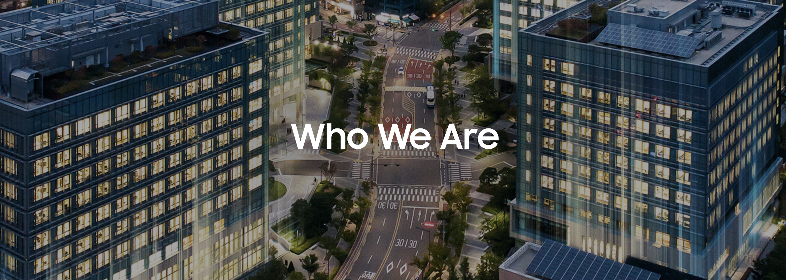
Samsung Research (SR) is leading R&D center for Samsung Mobile & Consumer Electronics
There are more than 10,000 researchers around the world (14 overseas centers in 12 countries)
SR HQ is based in Seoul (near Gangnam area) – about 2,000 researchers
Core research topics include AI, next-generation communications, robots, Tizen, and cybersecurity

Slide 3
Threat analysis
Building usable tools and services that can help business units to build secure products
Developing tools that can automate some of the threat analysis processes
Credential scanner: automatically scans for misuse of credential information in codes
Threat intelligence system: automatically scans security news, forums, social networks for newly emerging threats, and timely informs developers (Twiti: Social Listening for Threat Intelligence, WWW ‘21)

Slide 4
Privacy
Trying to understand what types of privacy protection users are looking for while using Samsung products
Providing usable automated tools that will provide more privacy-preserving experiences
E.g., building privacy solutions for smartphones to automatically detect images that contain private info

Slide 5
Authentication
Goal is to develop usable and secure authentication schemes for smartphones and other wearables
Developing context- and behavior-based authentication solutions for smartphones
Using trustworthy location information to unlock phones automatically
Training users’ daily typing behaviors and detecting anomalous use
Checking for proximity between smartphones and other trustworthy devices
Developing biometric authentication systems for newly emerging devices without any physical input display

Slide 6
Towards Usable and Secure Location-based Smartphone Authentication
(SOUPS 2021)
Geumhwan Cho, Sungsu Kwag, Jun Ho Huh, Bedeuro Kim, Choog-Hoon Lee, Hyoungshick Kim
Samsung Research & Sungkyunkwan University

Slide 7
Understanding users’ expectations and perceptions
on location-based smartphone authentication (identifying design requirements)
Understanding security issues and usability benefits
through a real-world field study

Slide 8
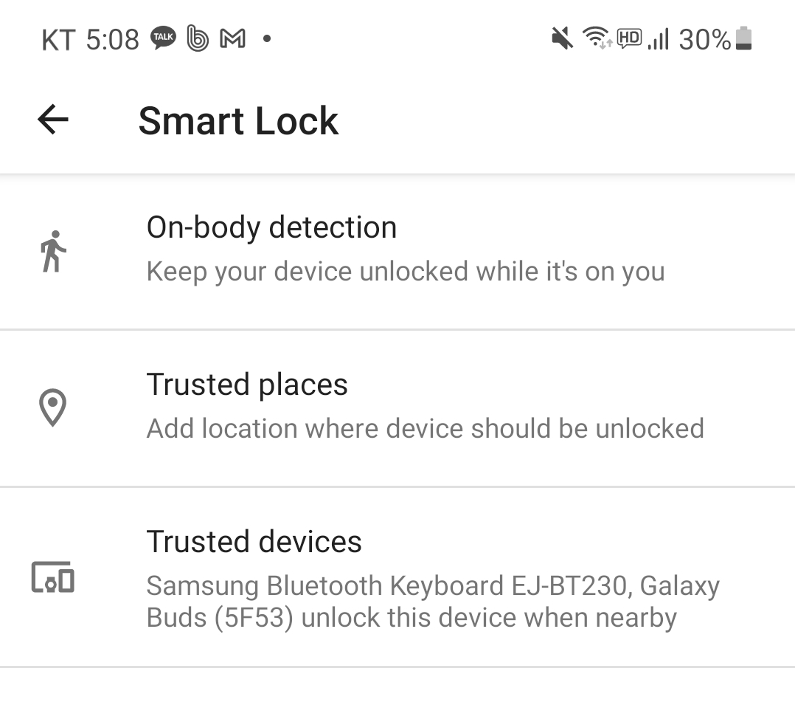
Have you heard about Google Smart Lock?

Slide 9
Some issues with Google Smart Lock
Users often have difficulty understanding smart lock semantics
Unable to judge when their phones would be locked or unlocked
Users are confused about the interoperation of many authentication factors (on-body, location, device)
On Smartphone Users’ Difficulty Understanding Implicit Authentication (Koushki et al. CHI 2021)

Slide 10
Security issues with “Trusted Places”
Smart Lock’s trusted places feature relies on GPS to detect locations
“Phones may remain unlocked within a radius up to about 80 meters”
Specifying fine-grained indoor location area is not possible
Users cannot customize trusted location sizes
No option to increase or decrease coverage area
Such security issues discourage people from adopting it (“Is implicit authentication on smartphones really popular?” Koushki et al. MobileHCI 2020)

Slide 11
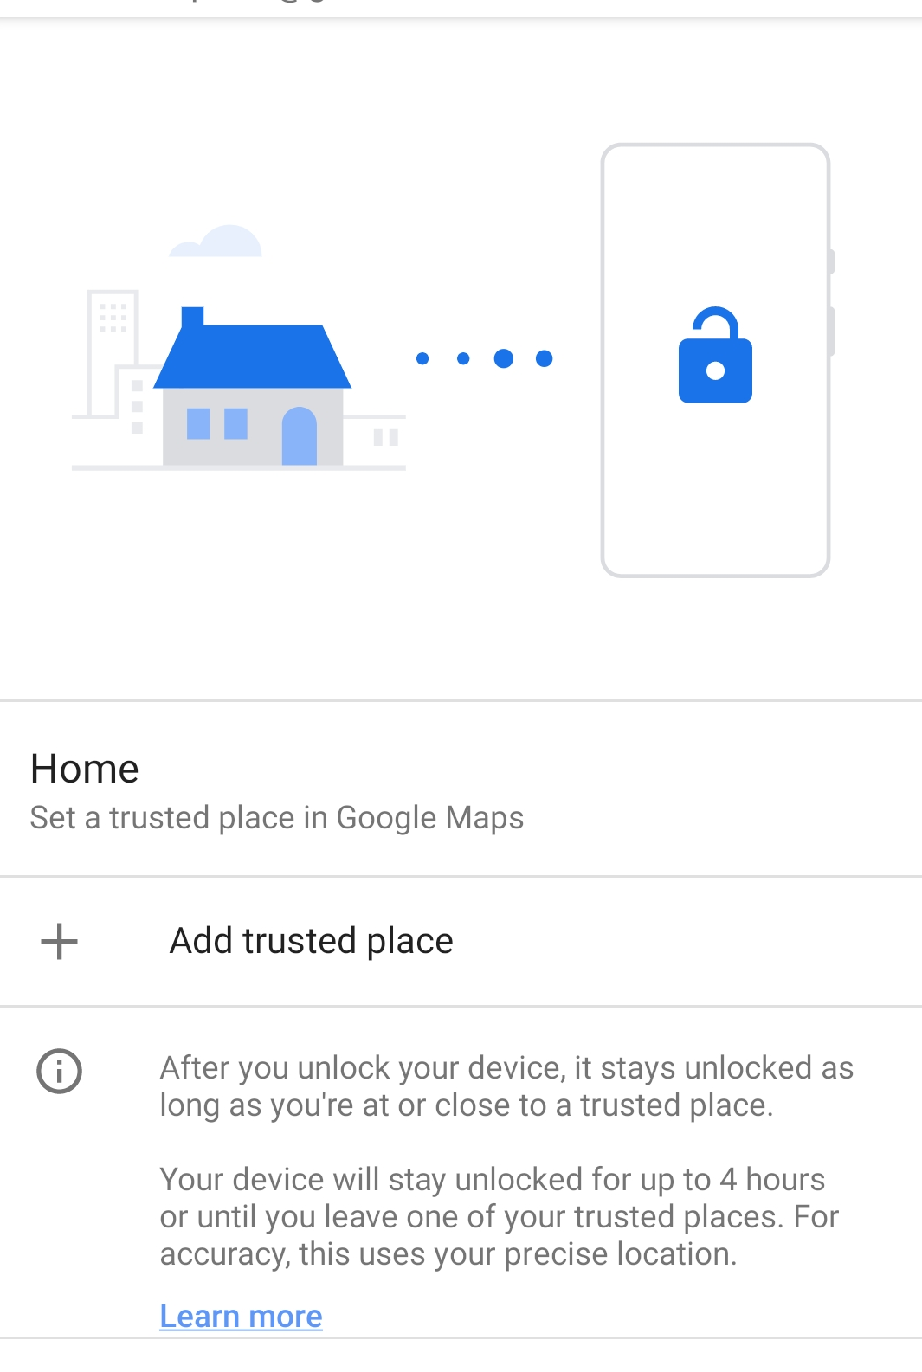
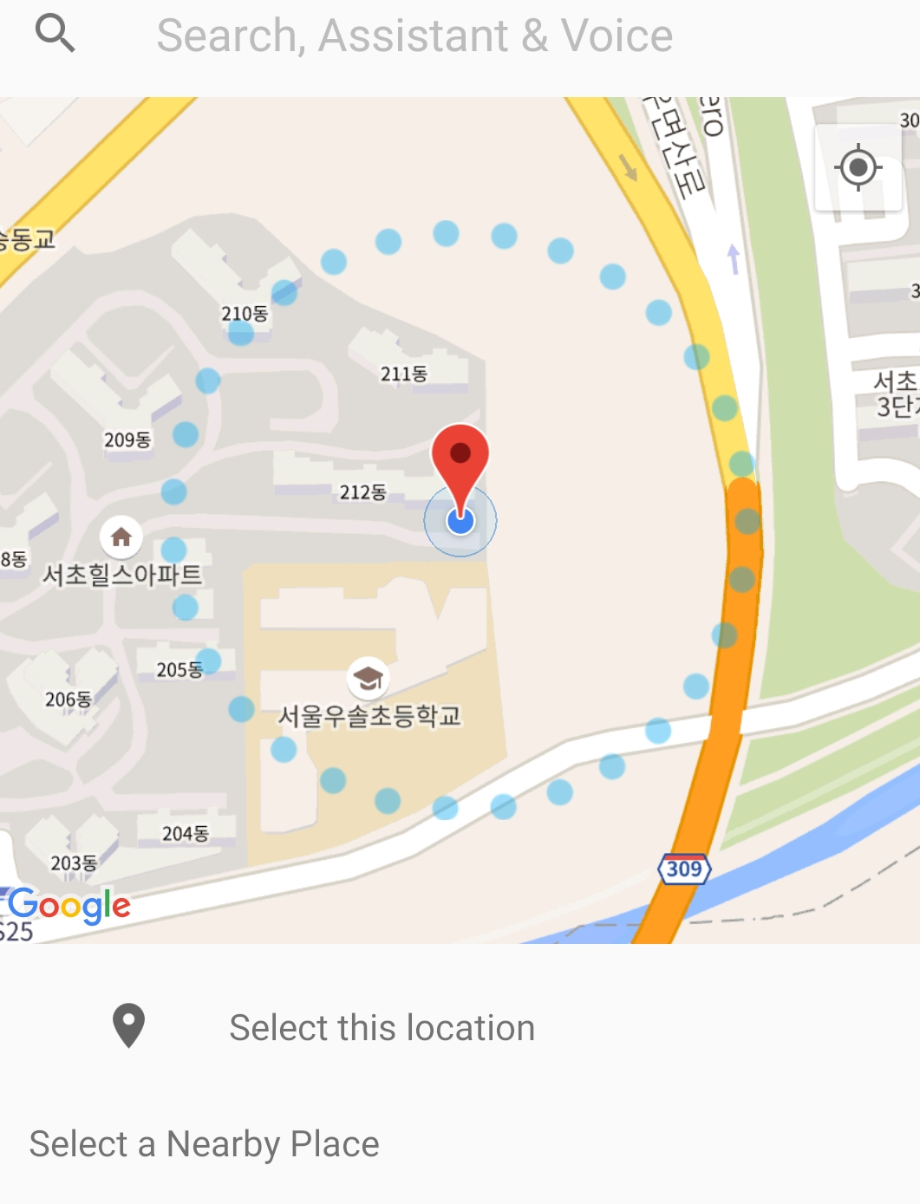

Slide 12
Threat model:
A user might register public locations such as café for convenience. An adversary who manages to steal that phone would be able to unlock it by just going near those locations

Slide 13
Identifying design requirements
As the first step toward building usable and secure system we identified design requirements
To understand users’ expectations and needs, we conducted an interview study with 18 participants in Korea
First, we explained basic concepts of registering trusted locations, and using them to unlock phones
(Q1) “Provide a list of places that you would register as a trusted location”
(Q2) “Select a size (area in which phones would remain unlocked) for each of your trusted location”
(Q3) “What would be a tolerable setup time?”

Slide 14
(Q1) Select trusted locations
#Locations (#Participants) | One (3) | Two (9) | Three (6) | Total (18)
Home | 3 | 8 | 5 | 16
Office | 0 | 7 | 3 | 10
My room | 0 | 1 | 4 | 5
Office desk | 0 | 1 | 1 | 2
Lecture room | 0 | 0 | 2 | 2
Church | 0 | 1 | 0 | 1
Bathroom | 0 | 0 | 1 | 1
Café | 0 | 0 | 1 | 1
Gym | 0 | 0 | 1 | 1
Total | 3 | 18 | 18 | 39

Slide 15
Indoor locations: Participants expressed their preferences to register indoor locations like rooms and offices
Requirement 1: A service should allow users to register indoor locations
Multiple locations: All but one participant preferred to register two or more locations
Requirement 2: A service should allow users to register more than one location

Slide 16
(Q2) Select a preferred size (radius size)
Location | 1-3m | 4-6m | 7-9m | 10-12m | 13-15m
Home | 2 | 2 | 4 | 8 | 0
Office | 1 | 6 | 2 | 1 | 0
My room | 3 | 2 | 0 | 0 | 0
Office desk | 2 | 0 | 0 | 0 | 0
Lecture room | 0 | 0 | 0 | 1 | 1
Church | 0 | 0 | 0 | 0 | 1
Bathroom | 1 | 0 | 0 | 0 | 0
Café | 0 | 0 | 0 | 0 | 1
Gym | 0 | 0 | 0 | 0 | 1
Total | 9 | 10 | 6 | 10 | 4

Slide 17
Adjustable location sizes: Participants expressed different location coverage size preferences
Requirement 3: A service should allow users to choose different location coverage sizes and adjust them individually

Slide 18
(Q3) Tolerable setup time
What do you consider to be an adequate time taken to register one trusted location?
Average setup time the participants were willing to tolerate was 3.2 minutes (SD = 2.5)
7 participants emphasized that the setup times need to be short
Requirement 4: Users should be able to register a single location within 3.2 minutes

Slide 19
Field study application design
To conduct a field study, we developed a fully functional location-based authentication app
Designed based on the 4 requirements (from interview study)
To support “indoor locations” requirement, we also used WiFi information
We collected signal strength information (WiFi RSSI) from nearby access points, and created fingerprints for indoor locations
To support “adjustable location size” requirement, we designed it to support 3 different coverage sizes
0—5 meters, 5—10 meters, 10 or more meters
We adjusted threshold values to support coverage size changes

Slide 20
Field study
Conducted a 3-week field study to investigate
What type of trusted locations are registered in the real world
Gauge how useful application is in reducing users’ manual unlock attempts
Recruited 29 participants from Korea
Asked them to install our app on their own phones, and use it for 3 weeks
Explained that their phones would be automatically unlocked when they move to registered trusted locations
Explained how locations can be added, removed, and modified (size changes)
Asked to register and remove locations freely, and select and adjust location sizes based on their needs

Slide 21
Field study
After 3 weeks, we invited the participants back for a post interview
Asked reasons for registering or removing locations, and selecting location sizes
Asked a scenario-based question to categorize whether a selected location is secure from unauthorized access
“Think about who could access your phone if it was left unattended for 10 minutes in that registered location. Is there someone who should not have access?”
If they said yes, we classified it as an insecure place
Otherwise, we classified it as a secure place

Slide 22
Registered locations
#Locations (#Participants) | Zero (1) | One (7) | Two (13) | Three (3) | Four (3) | Five(1) | Six(1) | Total (29)
Home | 0 | 0 | 10 | 2 | 2 | 1 | 0 | 15
Office | 0 | 3 | 5 | 2 | 2 | 1 | 0 | 13
My room | 0 | 3 | 4 | 1 | 1 | 0 | 0 | 9
Church | 0 | 0 | 4 | 2 | 0 | 0 | 0 | 6
Sports facility | 0 | 0 | 1 | 1 | 1 | 2 | 1 | 6
Living room | 0 | 1 | 2 | 1 | 1 | 0 | 0 | 5
Lecture room | 0 | 0 | 0 | 0 | 1 | 0 | 2 | 3
Bathroom | 0 | 0 | 0 | 0 | 2 | 0 | 0 | 2
Café | 0 | 0 | 0 | 0 | 0 | 1 | 1 | 2
Hospital | 0 | 0 | 0 | 0 | 1 | 0 | 0 | 1
Kitchen | 0 | 0 | 0 | 0 | 1 | 0 | 0 | 1
Library | 0 | 0 | 0 | 0 | 0 | 0 | 1 | 1
Subway station | 0 | 0 | 0 | 0 | 0 | 0 | 1 | 1
Total | 0 | 7 | 26 | 9 | 12 | 5 | 6 | 65

Slide 23
Location sizes for each location type
Locations | 0—5m | 5—10m | >10m
Home | 0 | 6 | 9
Office | 0 | 6 | 7
My room | 1 | 7 | 1
Church | 0 | 2 | 4
Sports facility | 0 | 4 | 2
Living room | 0 | 5 | 0
Lecture room | 0 | 0 | 3
Bathroom | 0 | 1 | 1
Café | 0 | 2 | 0
Hospital | 0 | 1 | 0
Kitchen | 0 | 1 | 0
Library | 0 | 0 | 1
Subway station | 0 | 0 | 1
Total | 1 (2%) | 35 (54%) | 29 (45%)

Slide 24
Reduction in manual unlock attempts
Participants tried to unlock phones 45 times a day
Counted number of times a phone screen was turned on while phone was unlocked by our app
We show ratio of phones being unlocked automatically
Our app reduced manual unlock attempts by 36%

Slide 25
Security of registered locations
Locations | Secure | Insecure | Total
Home | 3 | 12 | 15
Office | 1 | 12 | 13
My room | 5 | 4 | 9
Church | 1 | 5 | 6
Sports facility | 0 | 6 | 6
Living room | 3 | 2 | 5
Lecture room | 0 | 3 | 4
Bathroom | 0 | 2 | 2
Café | 0 | 2 | 2
Hospital | 0 | 1 | 1
Kitchen | 0 | 1 | 1
Library | 0 | 1 | 1
Subway station | 0 | 1 | 1
Total | 13 | 52 | 65
Based on the unauthorized access scenario question:
A location was labeled “insecure” if participant said her phone can be accessed by unwanted individuals
Otherwise we labeled it as “secure”

Slide 26
Security concerns
People tend to add a variety of insecure locations (52 out of 65 were considered insecure), and are willing to continue to use them
Significant proportion of insecure locations are added with largest coverage areas (larger than 10 meters)
Some added locations where they spend a small amount of time (many of them being public places)
Such real-world behaviors can expose new threats that adversaries may exploit

Slide 27
Mitigation strategies
Needs to be designed to help users understand security risks associated with adding locations or choosing large sizes
Asking similar scenario based questions to improve users’ security awareness levels
Security risks related to insider threats (homes, offices) should be conveyed
More protective measures can also be designed
Phones must be unlocked first with an explicit unlock scheme
Only allow homes and offices to be added
Infrequently visited locations can be deleted automatically

Slide 28
Location-based authentication systems can be immensely helpful in reducing users’ manual unlock attempts (36% on average)
However, it may also expose new security threats (like users frequently adding insecure locations with large sizes) that may allow attackers to easily bypass dominant phone lock schemes
Hence, it is important to implement adequate security controls to help users improve security awareness levels and select secure locations all the time

Slide 29
We are looking for security engineers!
If you’re interested in working at Samsung Research please do not hesitate to contact me at junho.huh@samsung.com

