Slide 1
Behavioural Cybersecurity– Human Centric AI and Beyond
Alana Maurushat
Professor of Cybersecurity and Behaviour
Director Western Centre for Cybersecurity Aid and Community Engagement (WCACE)
Acting Director Global Engagement International Centre for Neuromorphic Systems

Slide 3
Psychology Law Artificial Network Industry Trust and
and policy intelligence security standards governance
Social engineering
Hacker motivation
Cognitive memory
Neuroscience
Autism and cyber
Cybersecurity investigations
Privacy by Design
Data & privacy (GDPR)
Dark net markets
Organised online fraud
Corporate hackback
Data breach notification
Board of directors’ cyber duties and training
Virtual agent gamification simulation
Intelligent and
Immersive big data
Enabling human decisions through enhanced visualisation
AI mimicking human behaviour
IoT network robustness
Smart grids
Fuzzy logic and AI
Applied to network
Security
Distributed micro-satellite clusters (Space Cloud)
Industry standards expertise (ERM, Cobit, ISO027, ASD, ISMS, ITGC …)
Cyber risk management
Security & privacy for BYOD devices and networks
Privacy by design
(differencial privacy and homomorphic
encryption frameworks for GDPR)
Community and consumer trust in technologies
Data governance
Standards developments for emerging technologies
Algorithmic approaches to braids
Novel methods in anonymisation of confidential data
Alana Maurushat

Slide 4
Behaviour Data Engineering and Cybersecurity
“Behaviour Data Engineering plays an important role in intelligence creation under the fourth paradigm, the data-intensive scientific discovery. By collecting, aggregating, and analysing behaviour patterns of an entity (including human, things, events, …, etc.) together, deeper insights, from correlation to causations, can be possible through domain knowledge driven prescriptive analytics.”

Slide 5
Payment Diversion Fraud Small to Medium Size Accounting Firm Annual Turnover $2 million USD Lost $20,000 USD

Slide 6
What is Behavioural Research?
Psychology
Social sciences
Artificial Intelligence
Neuromorphic Engineering
Criminology
Policing
Intelligence
Behavioural Economics

Slide 10
Parliamentary Security Service Anti-Terrorism Training

Slide 11
Our experiment

Slide 13
Name a Vegetable?

Slide 14
Safest mobile phone is?

Slide 15
Microsoft Phone because no one uses it

Slide 16
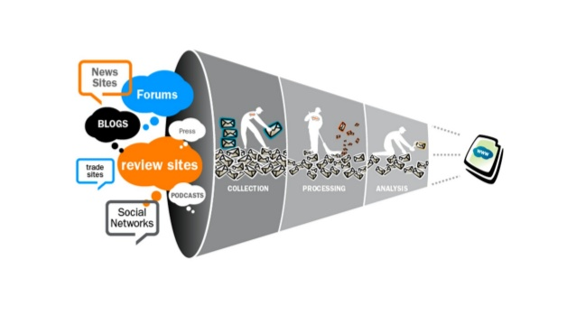
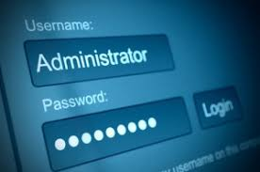
+

Slide 17
Cognitive Cyber Funded Projects
AI Enabled Cybercrime
Cryptocurrency Tracing
Social Engineering Payment Diversion Fraud
Social Engineering Ransomware
Ethical Hacking Mining Dark Web (AI Cyberlabs University of Arizona)
EDSS with First.org (RAND, Fortinet and 50 other partners) replacing CVE scores

Slide 18
Funded through the Cyber Security Business Connect and Protect Grants Program, Western Sydney University has received $745,920 from the federal government to establish the cybersecurity aid centre. Located in Parramatta, Western CACE a will be a ISO 127001 compliant secure facility where students will be trained to assist small businesses with cyber incident response.
WESTERN CACE will facilitate small businesses to respond to cyber incidences through a call centre with a focus on data breach, business email compromise, ransomware, and malware.

Slide 19
Behavioural Change Activation
1. Cognitive Dissonance
2. Behaviour Change Theory
3. Applied Field (Eg. Security Controls)
Cognitive Resilience & Hardening
Behavioural Data Engineering

Slide 20
Cognitive AI for Information Warfare and Disinformation
Cognitive AI for creation of optimal Disinformation Campaigns
Cognitive AI for Optimisation of Cyber Incident Response
Essential Aspects of Design to enable Trust
Is Zero Trust an environment that we want to live in?

Slide 21
Drunk Tank Pink

Slide 22
Alana Maurushat
a.Maurushat@westernsydney.edu.au

