Slide 1
Security Standards and Frameworks for IoT-Based Smart Environments: State-of-the-Art
Presented by: Dr Nickson M. Karie
Date: 09/11/2021 Location: Online

Slide 2
Authors and Contributors
Dr Nickson M. Karie
Dr Nor Masri Sahri
Dr Wencheng Yang
Dr Victor R. Kebande
Prof. Craig Valli

Slide 3
AGENDA
1
Introduction and Research Problem
The need for Security Standards and Frameworks for IoT Bases Smart Environment
2
Motivation and Background
Why this study ….
3
Existing Research
Conventional Security Standards and Frameworks
What is the State of the Art
4
Findings and Conclusion
What's next for the Future of IoT and Smart Environments?

Slide 4
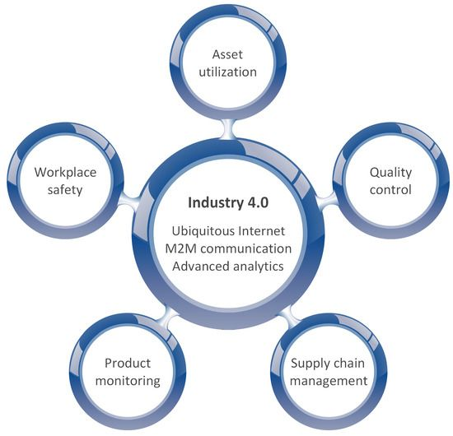
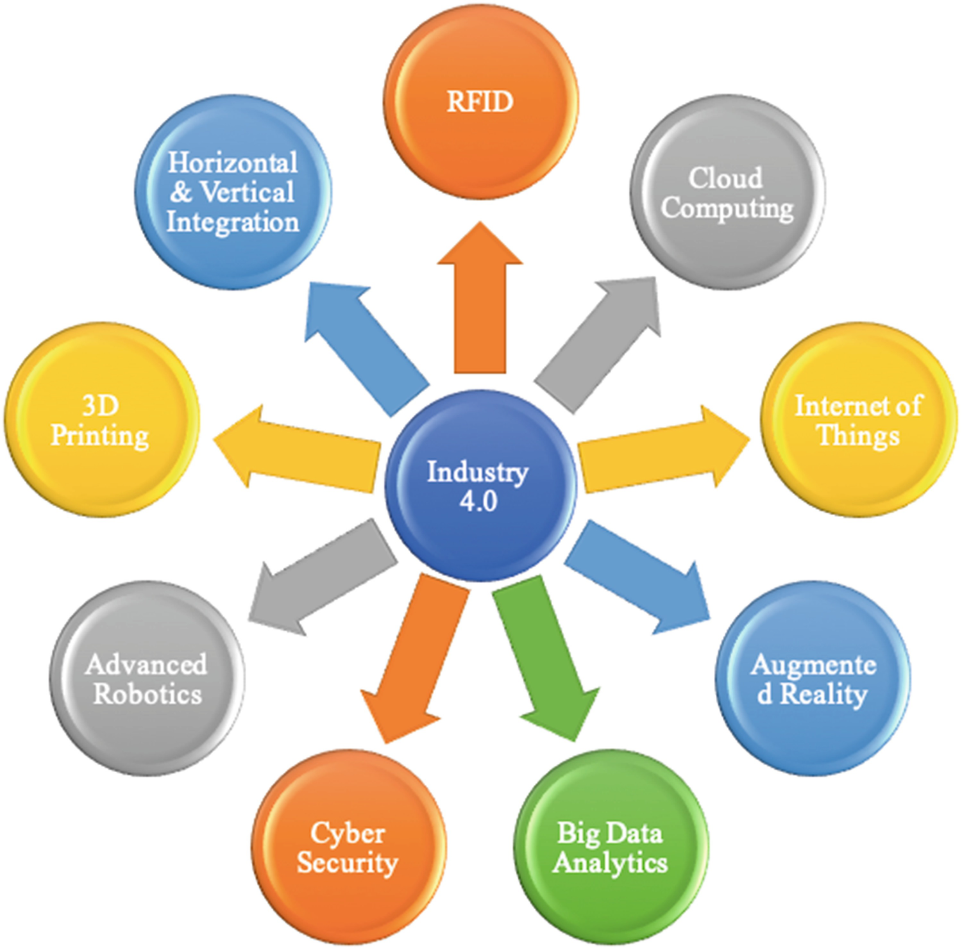
Introduction
The Fourth Industrial Revolution (Industry 4.0)

Slide 5
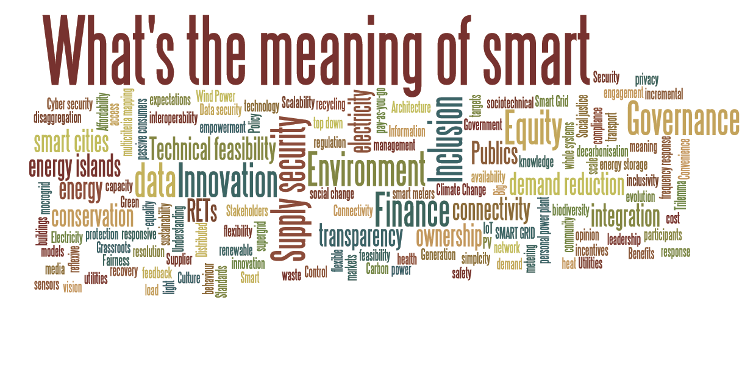
Introduction --- Cont..
With the Explosion of Smart Technologies
Assessing the security of IoT-based smart environments such as smart homes and smart cities…etc. is becoming fundamentally essential.
Security Assessment is specifically important in implementing the correct control measures as well as reducing security threats and risks brought about by deploying IoT-based smart technologies.

Slide 6
A Problem, A Research gap or Both?
The problem, however, is in finding security standards and assessment frameworks that best meets the security requirements as well as comprehensively assesses and exposes the security posture of IoT-based smart environments.
In this study we explored this gap and investigated existing security standards and assessment frameworks which also included NIST special publications on security techniques focusing on those that can potentially address some of the security needs of IoT-based smart environments.

Slide 7
Motivation
This study was motivated by the understanding that conventional security standards and assessment frameworks meant for use in non-IoT environments are very different and many may not directly address the needs of IoT-based smart environments.
Moreover, there is also a deficiency of specialized security standards and assessment frameworks that are primarily inclined to IoT-based smart environments.

Slide 8
Background
Security and Privacy Concerns In IoT-Based Smart Environments
Security Concerns
Privacy Concerns
Existing Research Work

Slide 9
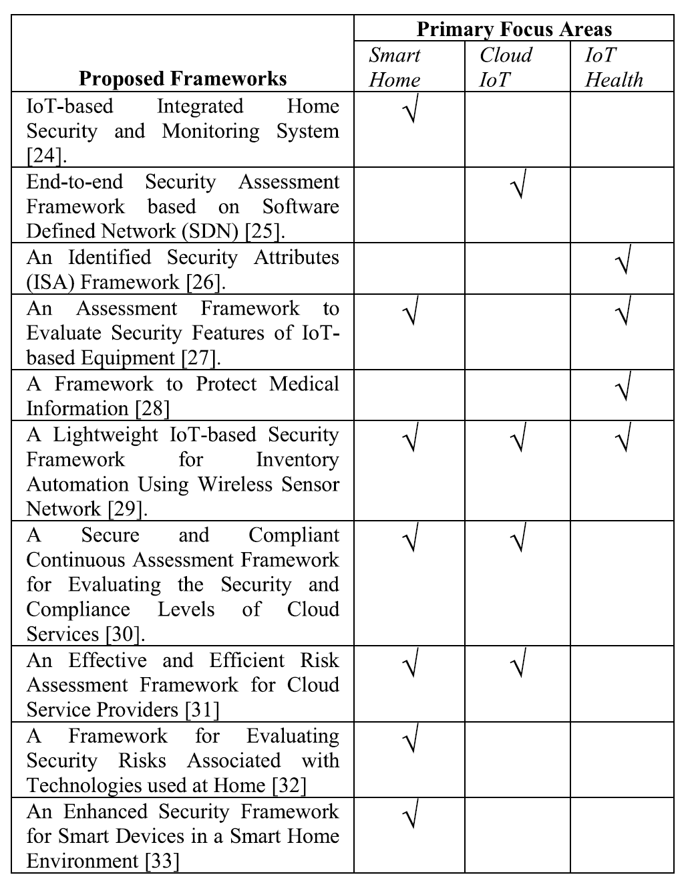
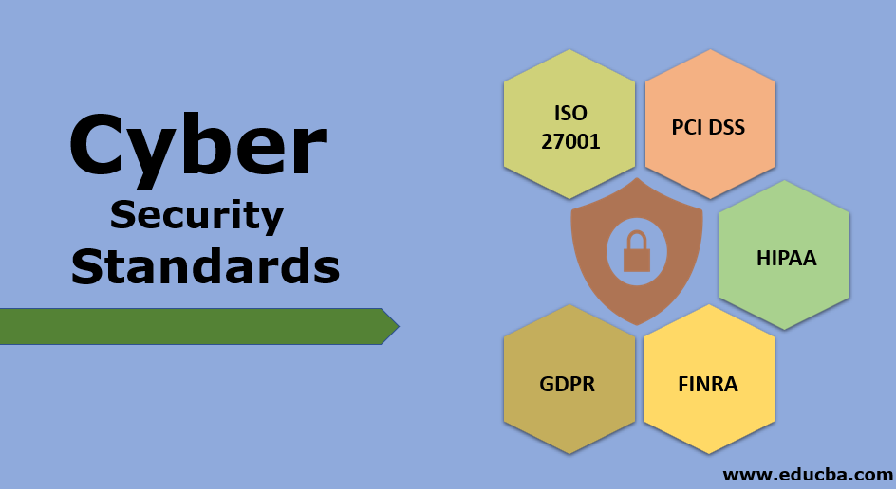
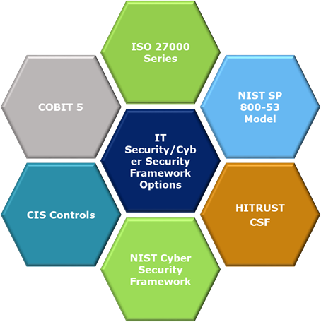
Existing Research

Slide 10
So what did we do in this study…
1) We reviewed existing security standards and assessment frameworks which include NIST special publications on security techniques, uncovered their primary areas of focus and exposed the state-of-the-art of the domain.
2) We Identified and discussed open problems and challenges related to IoT-based smart environment security concerns.
3) We proposed and discussed a taxonomy of challenges for IoT-based smart environment, drawn from the extensive literature examined during this study, that also maps potential solutions to the identified challenges and other future IoT security issues.

Slide 11
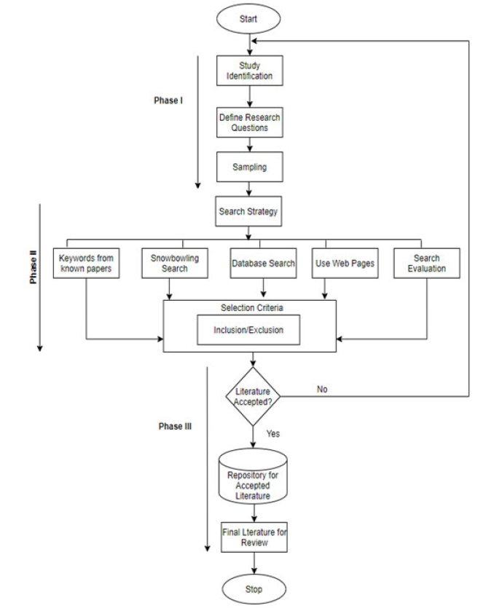
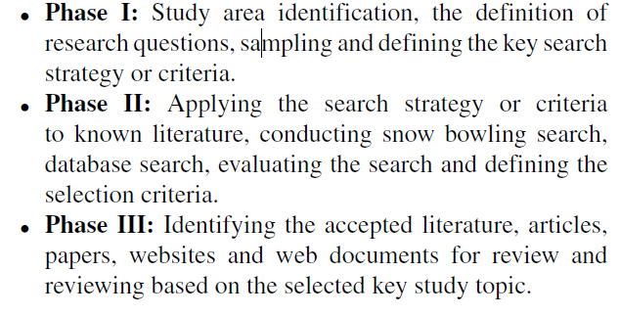
Methodology (Systematic Review)

Slide 12
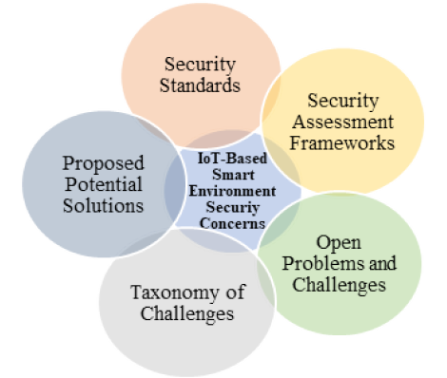
Areas of Interest in this study…
80 ISO/IEC Security Standards
32 ETSI Standards
37 Different Conventional Security Assessment Frameworks
7 NIST Special Publications on Security Techniques.
Both published security standards and assessment frameworks as well as those under development were considered.

Slide 13
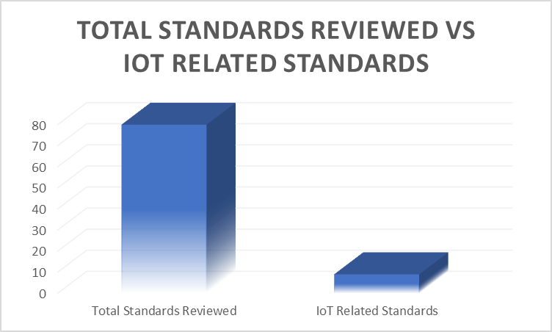
Analysis

Slide 14
Open Problems and Challenges
Lack Of Standardization
Technology Evolution
Security And Privacy
Connectivity
Law Enforcement and Regulations
Etc

Slide 15
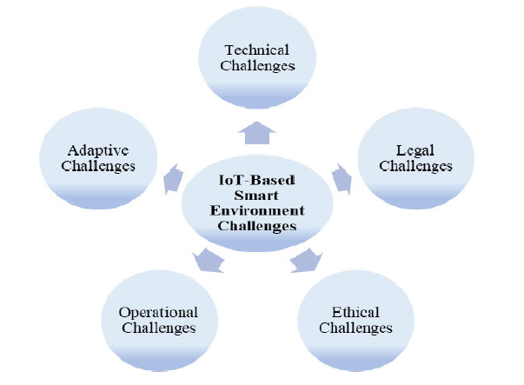
Taxonomy of Challenges

Slide 16
Proposed Potential Solutions to the Identified Challenges
Developing security assessment frameworks for IoT-based smart environments to secure the IoT network.
Developing IoT device-specific monitoring tools.
Implementing secure authentications for all IoT devices.
Encrypting IoT data moving in and out of IoT-based networks (Encrypted communication).
Testing all IoT hardware before, during and after deployment (Testing IoT hardware).
Use public key infrastructure security methods for IoT devices and smart environments.
Developing and deploying only secure and trusted IoT applications.
Implementing identity management.
Trust establishment for secure data transmission and object authentication.
Hardening the security of the IoT networks including the use of strong login credentials.
Regulating and certifying IoT devices before use to avoid launching IoT devices in a rush.

Slide 17
What we Found ....
Most conventional security standards and assessment frameworks do not directly address the security needs of IoT-based smart environments but have the potential to be adapted into IoT-based smart environments.
The need to develop new security standards and assessment frameworks that will address future IoT-based smart environments security concerns is now inevitable.

Slide 18
Conclusion
Most conventional security standards and assessment frameworks do not directly address the security needs of IoT-based smart environments but have the potential to be adapted into IoT-based smart environments.
Again, Security standards and assessment frameworks that can be deployed in IoT-based smart environments are quite different from those that can be used in non-IoT domains.
This is because IoT-based smart environment security is dependent on a wide range of security checks which many existing (conventional) security standards and assessment frameworks may not directly address.
The need to develop new and effective security standards and assessment frameworks that will address current and future IoT-based smart environments security concerns is now inevitable.
This research work revealed the lack of security standards and assessment frameworks that directly addressed the security requirements and needs of IoT-based smart environments.

Slide 19
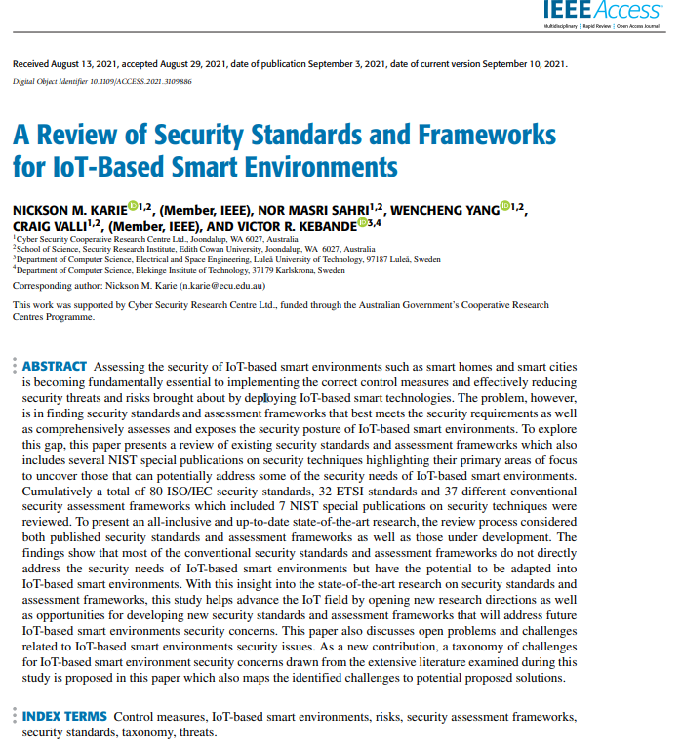
Reference

Slide 20
n.karie@ecu.edu.au
Thank You!!

