Slide 1
Threat Hunting in Industrial Control Systems Dr. Zahra Jadidi, CSCRC Research Fellow, QUT Professor Colin Fidge, Theme Leader, QUT
Theme 1.1: Resilient Systems

Slide 2
Project creation and management
The “Threat Hunting in ICS” project started in September 2019 in collaboration with The Australian Cyber Security Centre (ACSC). WA DGov joined the project in 2020 and extended the project for three months until December 2020.
People involved: Dr. Yi Lu (project leader QUT) and Dr. Zahra Jadidi (postdoctoral researcher QUT), ACSC and WA DGov,
The original aim was providing a framework for industrial companies to implement an open-source threat hunting in their ICS networks.
The project will be extended for one year and it aims to involve two full-time researchers and more industry partners in the next phase.

Slide 3
Threat Hunting in Industrial Control Systems
“Cyber threats to a control system refer to persons who attempt unauthorized access to a control system device and/or network using a data communications pathway. This access can be directed from within an organization by trusted users or from remote locations by unknown persons using the Internet. Threats to control systems can come from numerous sources, including hostile governments, disgruntled employees, and malicious intruders.”
https://encrypted-tbn0.gstatic.com/images?q=tbn:ANd9GcT8yRkH3I6uBABfVT6ho2FGs4ilsIcVA7AcCT0MFQlWMbXCxeJb

Slide 4
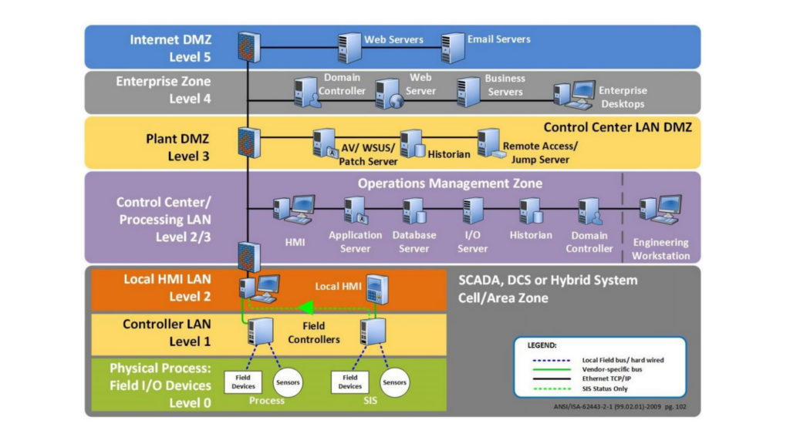
Difference between ICS and Enterprise networks
https://dale-peterson.com/2019/02/11/is-the-purdue-model-dead/

Slide 5
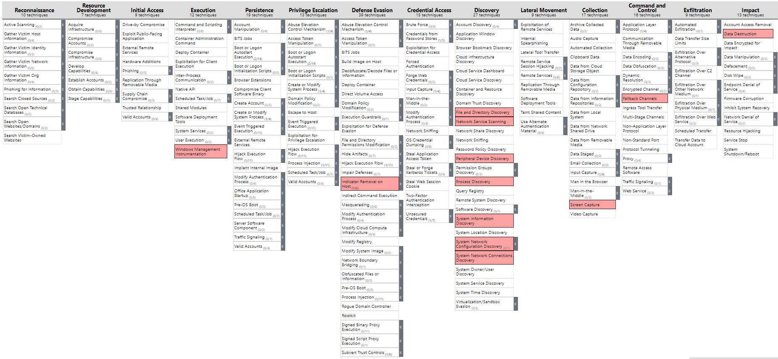
Enterprise MITRE ATT&CK

Slide 6
ICS MITRE ATT&CK
BlackEnergy 3 is a malware toolkit that has been used by threat actors.
The attackers caused significant disruption to the Ukrainian power grid in 2015 utilising the Black Energy 3 malware toolkit. In 2014, attackers started deploying SCADA-related plugins used in Black Energy 3 against victims in energy markets. Since 2015, spear-phishing emails with embedded malicious Excel or Word documents with macros have been used by the Black Energy APT group. These attachments contained macros to trigger Black Energy 3 malware infection. Different plug-ins including various KillDisk were supported by Black Energy 3 malware.

Slide 7
Threat Hunting in Industrial Control Systems
Threat hunting is a proactive opportunity in industrial control systems to discover hidden attackers and evaluate and improve the security of systems.
This project aimed to develop an effective way of threat hunting in industrial control systems by providing a threat hunting framework to maximise the chance of adversary detection success.
https://encrypted-tbn0.gstatic.com/images?q=tbn:ANd9GcT8yRkH3I6uBABfVT6ho2FGs4ilsIcVA7AcCT0MFQlWMbXCxeJb

Slide 8
Threat Hunting in ICS networks
Visibility: Visibility can also be used for health monitoring of ICS devices, and monitor ICS network traffic for cybersecurity. After generating a hypothesis, a threat hunter can examine the hypothesis based on the existing data sources and recommend additional data required for the validation of the hypothesis. Therefore, deep visibility of the ICS network can ensure that the hunter can receive the data needed.
Periodic testing: Threat landscape in ICS network is growing rapidly. Therefore, hunters should regularly explore and analyse the network and threat Tactics Techniques and Procedures (TTPs) to provide information about network operations and guidance for future hunts.
Threat intelligence: It should be ingested in threat hunting.
Staff training: Threat hunting needs trained analysts to generate a hypothesis and look for threat actions and TTPs.
Data collection: For threat hunting, you need to capture the right data. Therefore, you should decide what types of threats you are looking for. Then, you can select the right data.
As visibility and threat intelligence in ICS are very poor, other methods like documenting assets, risk assessment, and threat modelling can help to perform more efficient threat hunting.

Slide 9
Threat Hunting Stages
Triggers: Threat hunting is triggered by external sources such as an article, a piece of news, etc. Some threat hunting triggers are:
Abnormal behaviour detected by Security analysts. An analyst may detect a sudden spike in traffic created by an unknown port or protocol.
Cyber Threat Intelligence providing information about new classes of vulnerabilities, or new actions of threat actors.
A new article that shows a new class of attack. This is a trigger for the threat hunting team to assess the risk of this attack against their network and determine tactics for defending against the attack.
Threat hunting
Threat intelligence

Slide 10
Threat hunting framework
Threat hunting means to proactively search the networks and devices to detect and investigate threats which may have evaded existing security mechanisms.
The threat hunting process shows four major phases of a hunt. The goal of these four phases is finding patterns and Indicators of Compromise (IOCs) including Tactics, Techniques and Procedures (TTPs) of an adversary. This project developed a framework to apply these four phases to industrial control systems.
Threat Hunting Process
Create Hypotheses
Investigate Via Tools and Techniques
Uncover New Patterns and TTPs
Inform and enrich IOCs
Figure 1. Threat Hunting Process

Slide 11
Diamond Model of Intrusion Analysis
The Diamond model is the framework used for the analysis of intrusion events. This model describes the four core features of an intrusion event, infrastructure, adversary, capability, and victim.
The Adversary is the entity responsible for the intrusion.
Capability shows the tools and methods which may be used in the event.
Infrastructure means the resources used by the adversary to execute the event.
The victim is the target of the intrusion event.
A Diamond model also uses meta-features to be able to model further details of an intrusion event.
Meta features
Timestamp
Required resource
Attack phase
…
Adversary
Persona
IP address
…
Infrastructure
Network devices
Email addresses
…
Capability
Malware
Exploits
…
Victim
Personas
Network Assets
…

Slide 12
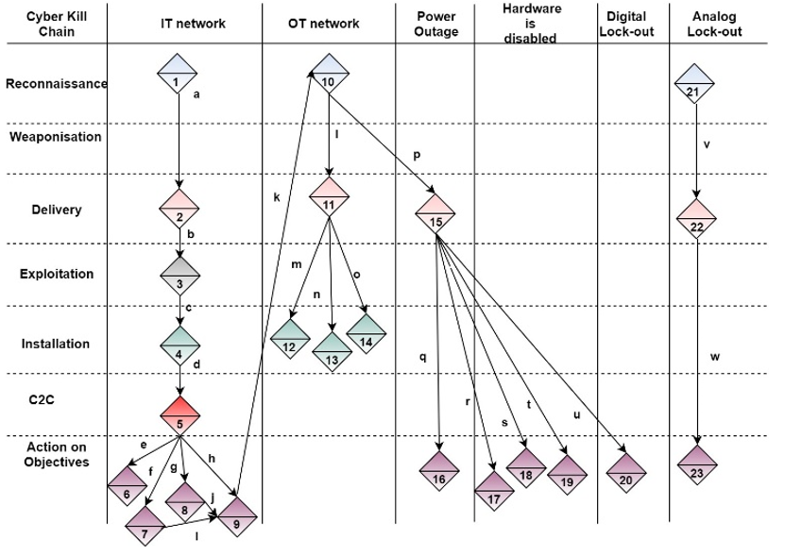
Diamond Model of Intrusion Analysis
Activity threads created by the Diamond model can develop potential attack paths prior to the detected intrusion. Using this graph model, a threat hunter can understand the alternative paths that could be used by an attacker to get the same outcomes.
Diamond model for each adversary can provide information about the capabilities and methods of the adversary, the infrastructure used by the adversary to deliver these capabilities, and their target victim. Therefore, it can give insights into the types of adversarial capabilities you should protect against.

Slide 13
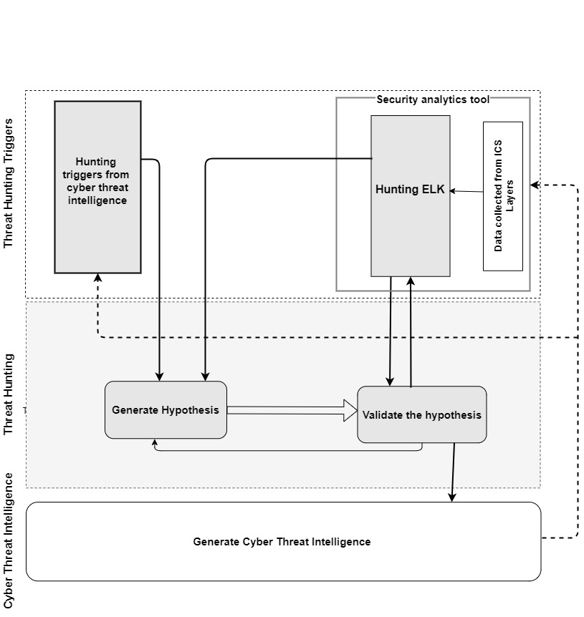
Proposed Framework for Threat Hunting in Industrial Control Systems
Cyber threat intelligence can be received from external open-source threat intelligence, or it can be extracted from adversarial activities in our networks.
- In the cyber threat intelligence stage, the generation of IoCs is performed by the hunters. These IoCs of the detected adversary are processed and distributed by a sharing tool like MISP.
MISP allows hunters to use cyber threat intelligence from other companies and share back their IoCs with other partners. These shared IoCs can be used to update detection rules and blacklists in security devices like firewalls.

Slide 14
Open Source Threat Hunting Platform
An open-source Hunting Elastic Stack (HELK) is used as a central data analytics tool. The outputs of the HELK feed hunting trigger phase.
In this project, HELK is used to monitor network traffic and device logs, detect anomalies and their correlated components, detect MITRE ATT&CK TTPS, and trigger the threat hunting phase.

Slide 15
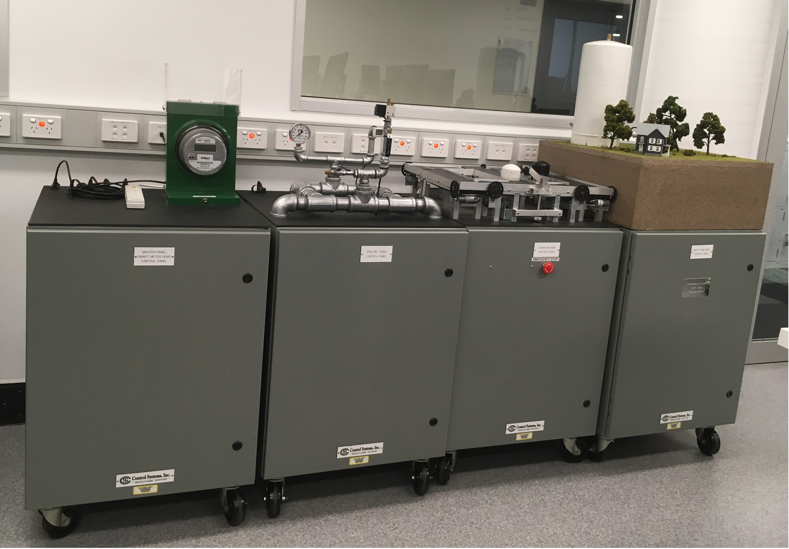
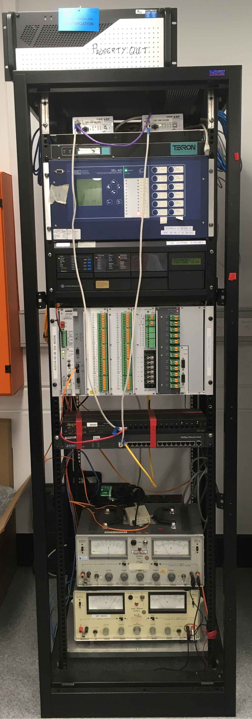
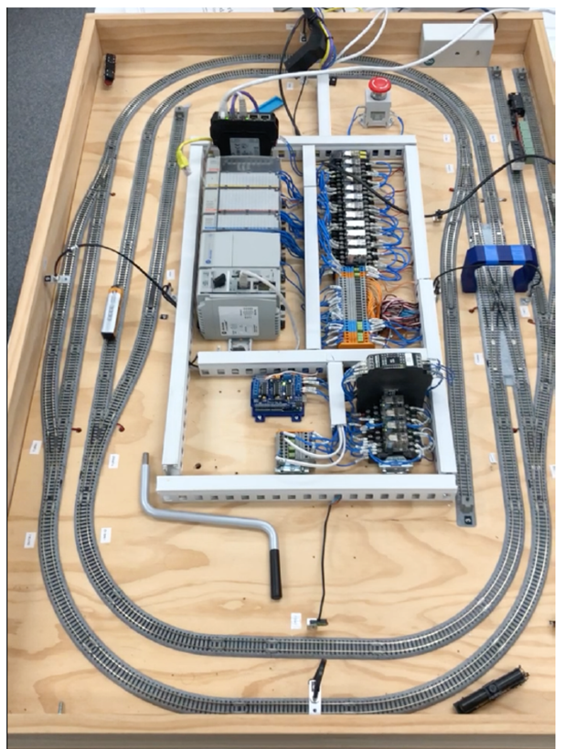
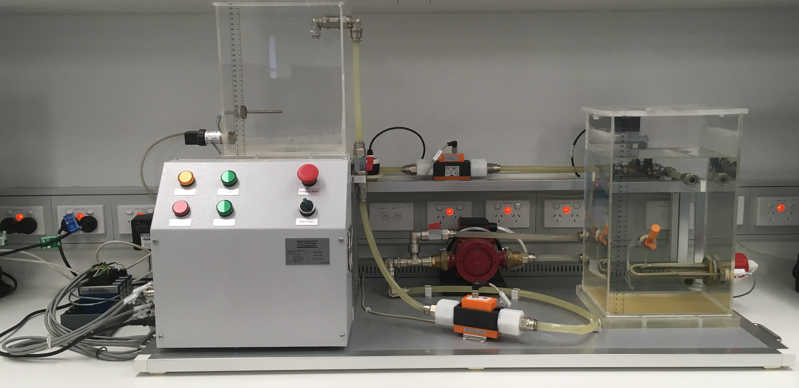
Dataset generation
Equipment in the SCADA Cyber Security Laboratory:
A Siemens testbed
A Train Controller testbed
A National Instruments Modbus testbed
A Powerlink testbed

Slide 16
Project extension
CSCRC intends to extend this project for one year and involve more researchers and industry partners.
The second phase aims to improve the accuracy and the speed of the proposed threat hunting framework in ICSs. Automation of the proposed framework will also be considered in the second phase of the project.
Datasets will be generated as part of the second phase.

