Slide 1



End-to-End Evaluation of Federated Learning and Split Learning
for Internet of Things
Yansong Gao∗†, Minki Kim†‡, Sharif Abuadbba∗†, Yeonjae Kim†‡, Chandra Thapa†,Kyuyeon Kim†‡, Seyit A. Camtepe†, Hyoungshick Kim†‡, and Surya Nepal
∗Cyber Security Cooperative Research Centre, Australia
†Data61, CSIRO, Syndey, Australia.
‡Sungkyunkwan University, Suwon, Republic of Korea.

Slide 2
Centralized Machine Learning
Collect Data into a Centralized Server

Slide 3
Centralized Machine Learning
Collect Data into a Centralized Server
Train the model in the Centralized Server

Slide 4

Centralized Machine Learning
Collect Data into a Centralized Server
Train the model in the Centralized Server
Data privacy concern (bank, medical, type input)

Slide 5
Centralized Machine Learning
Collect Data into a Centralized Server
Train the model in the Centralized Server
Data privacy concern (bank, medical, type input)
General Data Protection Regulation

Slide 6
Decentralized Machine Learning
Data is resided at the user side, not seen by server

Slide 7
Decentralized Machine Learning
Data is resided at the user side, not seen by server
Server coordinates among users to train the model

Slide 8
Decentralized Machine Learning
Data is resided at the user side, not seen by server
Server coordinates among users to train the model
Data privacy concern is greatly mitigated

Slide 9
Decentralized Machine Learning
Data is resided at the user side, not seen by server
Server coordinates among users to train the model
Data privacy concern is greatly mitigated
Model accuracy is still good by harvesting rich data

Slide 10
Decentralized Machine Learning
Federated Learning

Slide 11
Decentralized Machine Learning
Federated Learning
Split Learning (Split neural network)

Slide 12


Decentralized Machine Learning: Federated learning

Slide 13
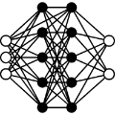
Decentralized Machine Learning: Federated learning

Slide 14
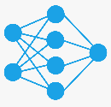
Decentralized Machine Learning: Federated learning

Slide 15
Decentralized Machine Learning: Federated learning
One round is finished

Slide 16
Decentralized Machine Learning: Federated learning
Server does not need to access the localized data

Slide 17
Decentralized Machine Learning: Split Learning

Slide 18
Decentralized Machine Learning: Split Learning
Activation

Slide 19
Decentralized Machine Learning: Split Learning
Activation
Gradient

Slide 20
Decentralized Machine Learning: Split Learning
Activation
Gradient

Slide 21
Decentralized Machine Learning: Split Learning
Activation
Gradient

Slide 22
Decentralized Machine Learning: Split Learning
Activation
Gradient

Slide 23
Decentralized Machine Learning: Split Learning
Activation
Gradient
One round is finished

Slide 24
Decentralized Machine Learning
Federated Learning
Entire model is trained by the client
Client access the entire model architecture
Clients train the model in parallel
Can apply to any model architecture, e.g., CNN, RNN, LSTM

Slide 25
Decentralized Machine Learning
Federated Learning
Entire model is trained by the client
Client access the entire model architecture
Clients train the model in parallel
Can apply to any model architecture, e.g., CNN, RNN, LSTM
Split Learning (Split neural network)
Sub-network is trained by the client
Client does not need to have knowledge of the other network part
Client train the model in sequential
Currently only applicable to Vertical splitble model architecture, e.g., CNN

Slide 26
Training on Internet of Thing Devices
High-end IoT device
Low-end IoT device
Arslan Musaddiq, Yousaf Bin Zikria, Oliver Hahm, Heejung Yu,Ali Kashif Bashir, and Sung Won Kim. A survey on resource man-agement in IoT operating systems.IEEE Access, 6:8459–8482, 2018.

Slide 27
Training on Internet of Thing Devices
High-end IoT device
Smart phone
Raspberry Pi
Low-end IoT device
RFID card
Sensors
Arslan Musaddiq, Yousaf Bin Zikria, Oliver Hahm, Heejung Yu,Ali Kashif Bashir, and Sung Won Kim. A survey on resource man-agement in IoT operating systems.IEEE Access, 6:8459–8482, 2018.

Slide 28
Training on Internet of Thing Devices
Rich data are generated by IoT devices
Various data are privacy concerned, e.g, medical, voice
iasi Chen and Xukan Ran. Deep Learning With Edge Computing: AReview.Proceedings of the IEEE, 107(8):1655–1674, 2019.

Slide 29

Training on Internet of Thing Devices
Rich data are generated by IoT devices
Various data are privacy concerned, e.g, medical, voice
Distributed Machine Learning Technique
iasi Chen and Xukan Ran. Deep Learning With Edge Computing: AReview.Proceedings of the IEEE, 107(8):1655–1674, 2019.

Slide 30
Current Status
There is very few empirical evaluations on distributed machine learning training mounted on real IoT devices?
Jiasi Chen and Xukan Ran. Deep Learning With Edge Computing: A Review.Proceedings of the IEEE, 107(8):1655–1674, 2019.

Slide 31
Current Status
There is very few empirical evaluations on distributed machine learning training mounted on real IoT devices.
For FL and SplitNN, which one is more suitable? There is no any empirical comparison yet.

Slide 32
Our Main Considerations
Research Question 1: What is the learning performance of FL and SplitNN under realistic IoT applications such as resembling imbalanced data distribution and non uniform data distribution.

Slide 33
Our Main Considerations
Research Question 1: What is the learning performance of FL and SplitNN under realistic IoT applications such as resembling imbalanced data distribution and non uniform data distribution.
Research Question 2: What is the overhead of FL and SplitNN by implementing them on Raspberry Pi to assess such as training time, amount of memory used, amount of power consumed, communication overhead.

Slide 34
Experiment Setting
Dataset | Num of Labels | Input Size | Num of Samples | Model architecture | Total Parameters | Total Model Accuracy
ECG | 5 | 124 | 26,490 | 4conv+2dense | 68,901 | 97.78%
Speech Command (SC) | 10 | 8,000 | 32,187 | 4conv+2dense | 522,586 | 85,29%

Slide 35
Experiment Setting
Dataset | Num of Labels | Input Size | Num of Samples | Model architecture | Total Parameters | Total Model Accuracy
ECG | 5 | 124 | 26,490 | 4conv+2dense | 68,901 | 97.78%
Speech Command (SC) | 10 | 8,000 | 32,187 | 4conv+2dense | 522,586 | 85,29%
CIFAR10 dataset with MobileNetv1(20conv2D layers with 3,228,170 model parameters in total) takes 8 hours 41 minutes for FL per round with 1 local epoch. 2.5 hours for SplitNN (two layers on Raspberry Pi)

Slide 36
Experiment Setting
Dataset | Num of Labels | Input Size | Num of Samples | Model architecture | Total Parameters | Total Model Accuracy
ECG | 5 | 124 | 26,490 | 4conv+2dense | 68,901 | 97.78%
Speech Command (SC) | 10 | 8,000 | 32,187 | 4conv+2dense | 522,586 | 85,29%
CIFAR10 dataset with MobileNetv1(20conv2D layers with 3,228,170 model parameters in total) takes 8 hours 41 minutes for FL per round with 1 local epoch. 2.5 hours for SplitNN (two layers on Raspberry Pi). Run across 5 devices.
ResNet20 (20 Conv2D layers, 269,766 parameters). FL takes 35 minutes while SplitNN takes about 1 hour.

Slide 37
Experiments: Learning Performance
RQ1: What factors/settings (e.g., number of clients, non-IID data, and imbalanced data) affect SplitNN learning performance?

Slide 38
Experiments: Learning Performance
RQ1: What factors/settings (e.g., number of clients, non-IID data, and imbalanced data) affect SplitNN learning performance?
IID means each client has samples from all classes. Otherwise, Non-IID. Resembling scenario where data is personalized.

Slide 39
Experiments: Learning Performance
RQ1: What factors/settings (e.g., number of clients, non-IID data, and imbalanced data) affect SplitNN learning performance?
IID means each client has samples from all classes. Otherwise, Non-IID. Resembling scenario where data is personalized.
Balance means each client has equal number of samples. Otherwise, imbalanced. Resembling scenario where some sensors are more active.

Slide 40
Experiments: Learning Performance
RQ1: What factors/settings (e.g., number of clients, non-IID data, and imbalanced data) affect SplitNN learning performance?
IID means each client has samples from all classes. Otherwise, Non-IID. Resembling scenario where data is personalized.
Balance means each client has equal number of samples. Otherwise, imbalanced. Resembling scenario where some sensors are more active.
RQ2: Which setting will the SplitNN learning performance outperform FL?

Slide 41
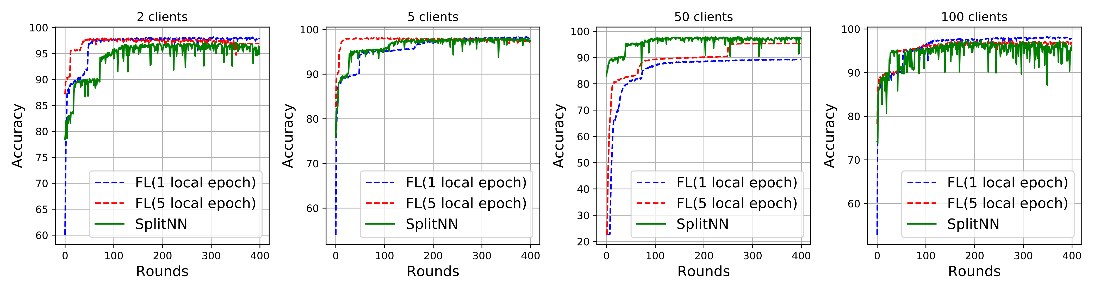
Experiments: Learning Performance

Slide 42
Experiments: Learning Performance
IID and Balanced Data Distribution (ECG data)

Slide 43
Experiments: Learning Performance
IID and Balanced Data Distribution (ECG data)

Slide 44
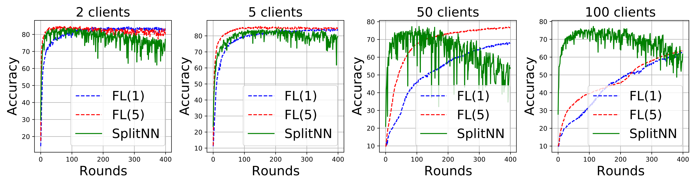
Experiments: Learning Performance
IID and Balanced Data Distribution (ECG data)
IID and Balanced Data Distribution (SC data)

Slide 45
Experiments: Learning Performance
IID and Balanced Data Distribution (ECG data)
IID and Balanced Data Distribution (SC data)

Slide 46
Experiments: Learning Performance
IID and Balanced Data Distribution (ECG data)
IID and Balanced Data Distribution (SC data)

Slide 47
Experiments: Learning Performance
IID and Balanced Data Distribution (ECG data)
IID and Balanced Data Distribution (SC data)

Slide 48
Experiments: Learning Performance
For RQ1, SplitNN learning performance is affected by the number of clients. Accuracy cannot achieve the same accuracy as centralized learning when number of clients increase (same apply to FL).
For RQ2, SplitNN always outperforms the FL in terms of convergence speed in our experiments.

Slide 49
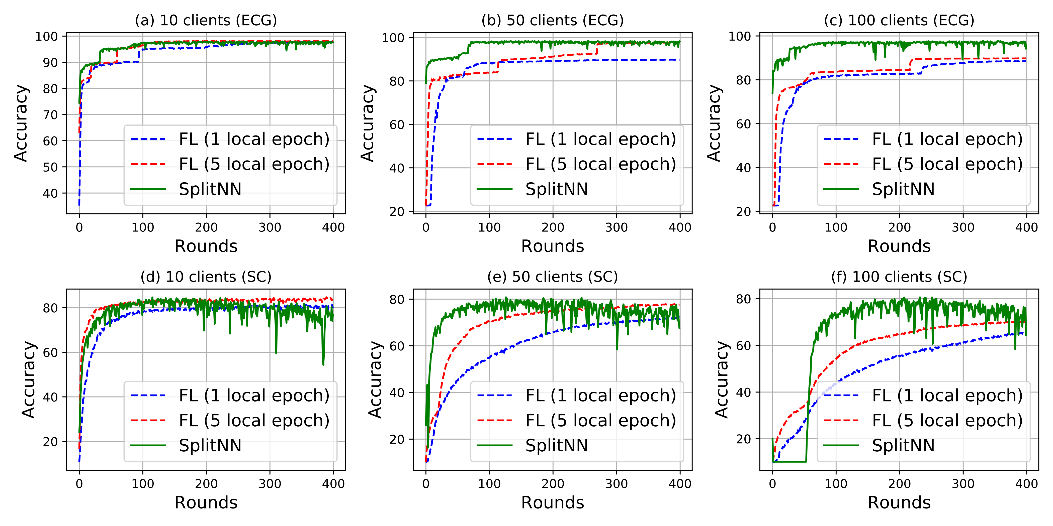
Experiments: Learning Performance
Imbalanced Data Distribution

Slide 50
Experiments: Learning Performance
Imbalanced Data Distribution

Slide 51
Experiments: Learning Performance
For RQ1, the SplitNN learning performance is affected by both the number of clients and imbalanced data distribution.
For RQ2, SplitNN converges faster than FL in our experiments.

Slide 52
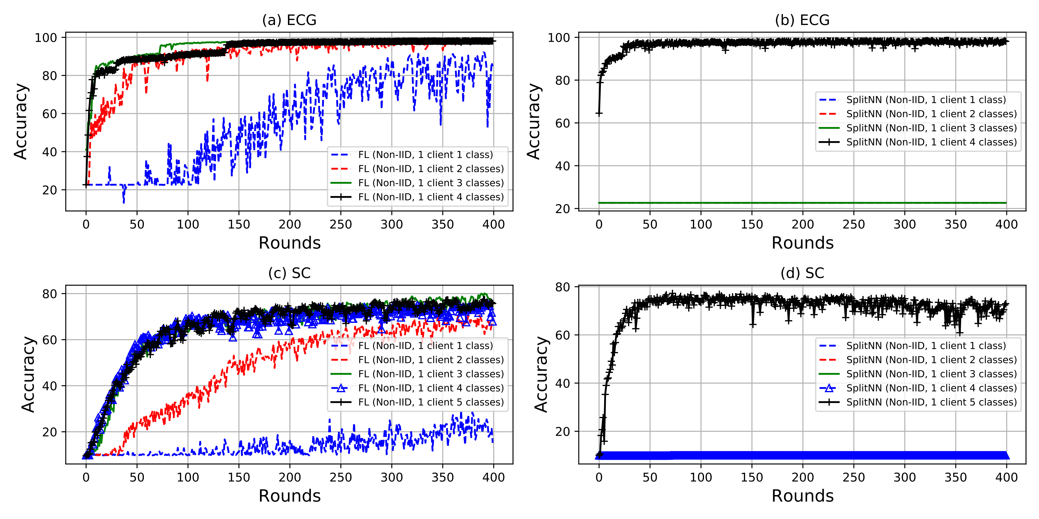
Experiments: Learning Performance
Non-IID Data Distribution

Slide 53
Experiments: Learning Performance
Non-IID Data Distribution

Slide 54
Experiments: Learning Performance
For RQ1, SplitNN is very sensitive to non-IID data. In fact, for both FL and SplitNN, there are knowledge forgetting when trained on the non-IID settings.

Slide 55
Experiments: Learning Performance
For RQ1, SplitNN is very sensitive to non-IID data. In fact, for both FL and SplitNN, there are knowledge forgetting when trained on the non-IID settings.
For RQ2, FL outperforms SplitNN under non-IID data setting, especially extreme cases

Slide 56
Experiments: Learning Performance
For RQ1, SplitNN is very sensitive to non-IID data. In fact, for both FL and SplitNN, some extend of knowledge forgetting while learning is evident when trained on the non-IID settings.
For RQ2, FL outperforms SplitNN under non-IID data setting, especially extreme cases
The possible reason lies in the approach of model training. FL aggregates (averages) the local model strained on the local data present at each client. The aggregated model usually has more knowledge of the data classes even though there is one class per client than the cases where the model is sequentially learned over the clients without aggregation, such as in SplitNN.

Slide 57
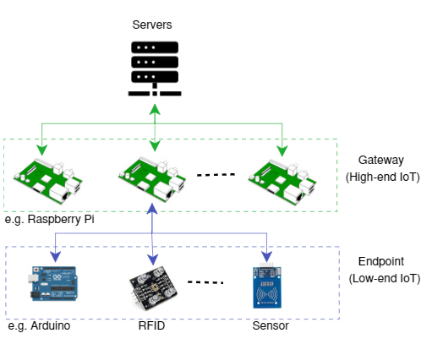
Experiments: Raspberry Pi Setup

Slide 58
Experiments: Raspberry Pi Setup
Raspberry Pi 3 model BV1.2.
Server (laptop) with CPU i7-7700HQ, GPU GTX 1050.

Slide 59
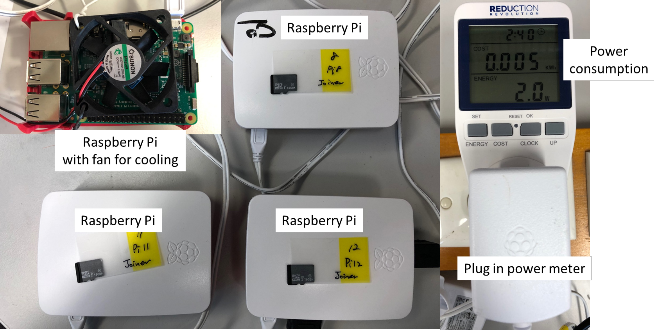
Experiments: Raspberry Pi Setup

Slide 60
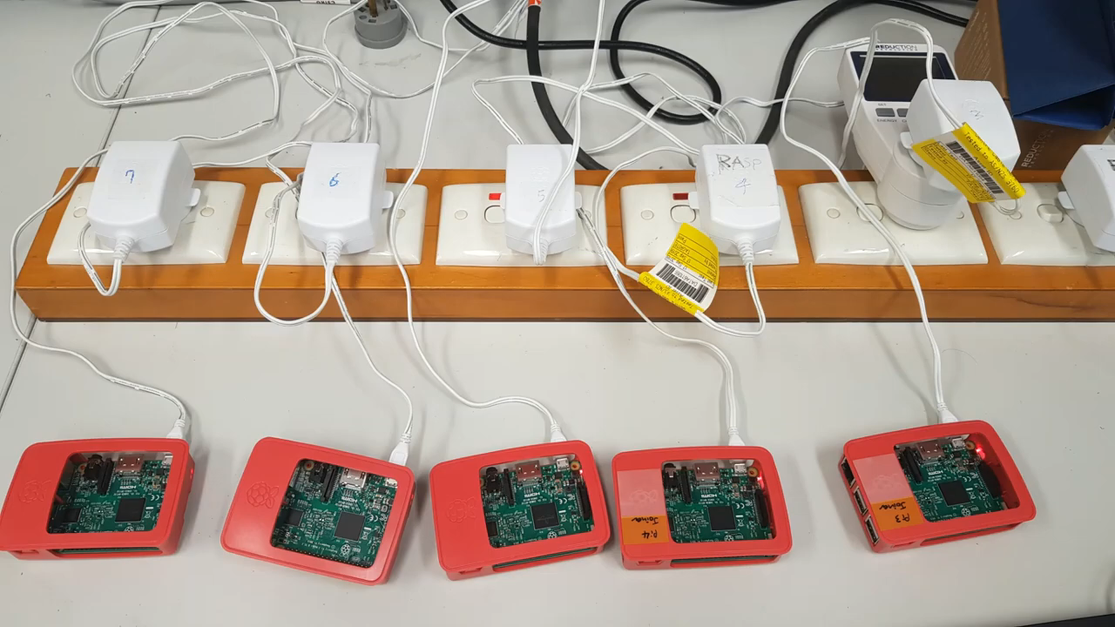
Experiments: Demo

Slide 61
Experiments: Overhead with Raspberry Pi
Running Time

Slide 62
Experiments: Overhead with Raspberry Pi
Running Time
Memory Usage

Slide 63
Experiments: Overhead with Raspberry Pi
Running Time
Memory Usage
Power Consumption

Slide 64
Experiments: Overhead with Raspberry Pi
Running Time
Memory Usage
Power Consumption
Temperature

Slide 65
Experiments: Overhead with Raspberry Pi
Running Time
Memory Usage
Power Consumption
Temperature
Communication Overhead

Slide 66
Experiments: Overhead with Raspberry Pi
Running Time
Memory Usage
Power Consumption
Temperature
Communication Overhead

Slide 67
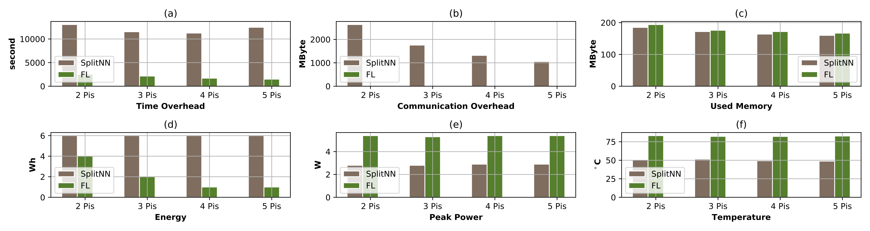
Experiments: Overhead with Raspberry Pi
Number of Raspberry Pi varies from 2 to 5

Slide 68
Experiments: Overhead with Raspberry Pi
FL uses much less training time

Slide 69
Experiments: Overhead with Raspberry Pi
FL has extremely reduced communication overhead

Slide 70
Experiments: Overhead with Raspberry Pi
SplitNN has relatively less memory usage (only train on a subnet)

Slide 71
Experiments: Overhead with Raspberry Pi
FL uses less energy, SplitNN trains sequentially (waiting devices can be switched off in practice to save energy when waiting)

Slide 72
Experiments: Overhead with Raspberry Pi
FL has higher peak power, thus higher temperature (may need fan to cool it down in practice)

Slide 73
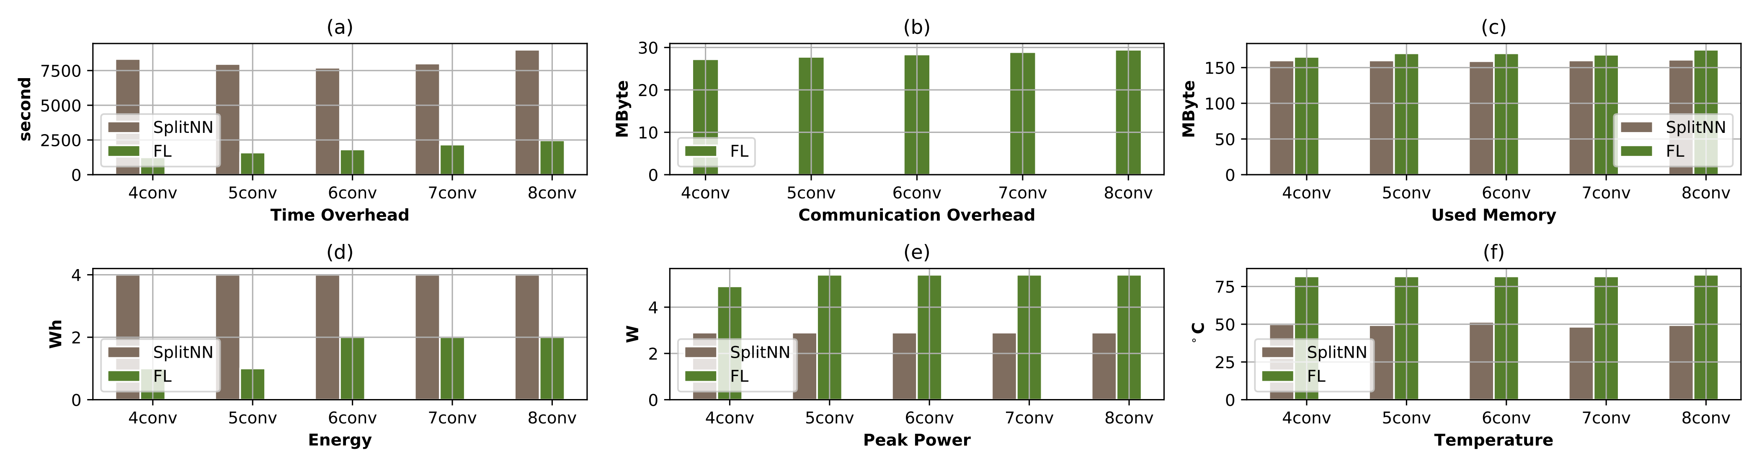
Experiments: Overhead with Raspberry Pi
Number of conv layers varies from 4 to 8

Slide 74
Experiments: Overhead with Raspberry Pi
Overhead of FL increases, while SplitNN remains unchanged

Slide 75
Experiments: Overhead with Raspberry Pi
Takeaway:
FL is able to train in parallel, the training time is short in comparison with SplitNN.

Slide 76
Experiments: Overhead with Raspberry Pi
Takeaway:
FL is able to train in parallel, the training time is short in comparison with SplitNN. However, it needs to train the entire model on device with higher computational overhead

Slide 77
Experiments: Overhead with Raspberry Pi
Takeaway:
FL is able to train in parallel, the training time is short in comparison with SplitNN. However, it needs to train the entire model on device with higher computational overhead
SplitNN has lower computational overhead on device.

Slide 78
Experiments: Overhead with Raspberry Pi
Takeaway:
FL is able to train in parallel, the training time is short in comparison with SplitNN. However, it needs to train the entire model on device with higher computational overhead
SplitNN has lower computational overhead on device. But its training is in sequetual manner, resulting in longer training time

Slide 79
SplitFed
Combine SplitNN and FL to exploit the advantage of each.

Slide 80
SplitFed
Combine SplitNN and FL to exploit the advantage of each.
SplitFed

Slide 81
SplitFed: Example

Slide 82
SplitFed: Example

Slide 83
SplitFed: Example
Activation
Gradient

Slide 84
SplitFed: Example
Activation
Gradient

Slide 85
SplitFed: Example
Activation
Activation
Gradient
Gradient

Slide 86
SplitFed: Example
Activation
Activation
Activation
Activation
Gradient
Gradient
Gradient
Gradient

Slide 87
SplitFed: Example
Activation
Activation
Activation
Activation
Gradient
Gradient
Gradient
Gradient
Train in parallel

Slide 88
SplitFed: Example
Aggregate

Slide 89
SplitFed: Example
Aggregate

Slide 90
SplitFed: Example
Activation
Activation
Activation
Activation
Gradient
Gradient
Gradient
Gradient

Slide 91
SplitFed: Example
Activation
Activation
Gradient
Gradient

Slide 92
SplitFed: Example
Activation
Activation
Gradient
Gradient

Slide 93
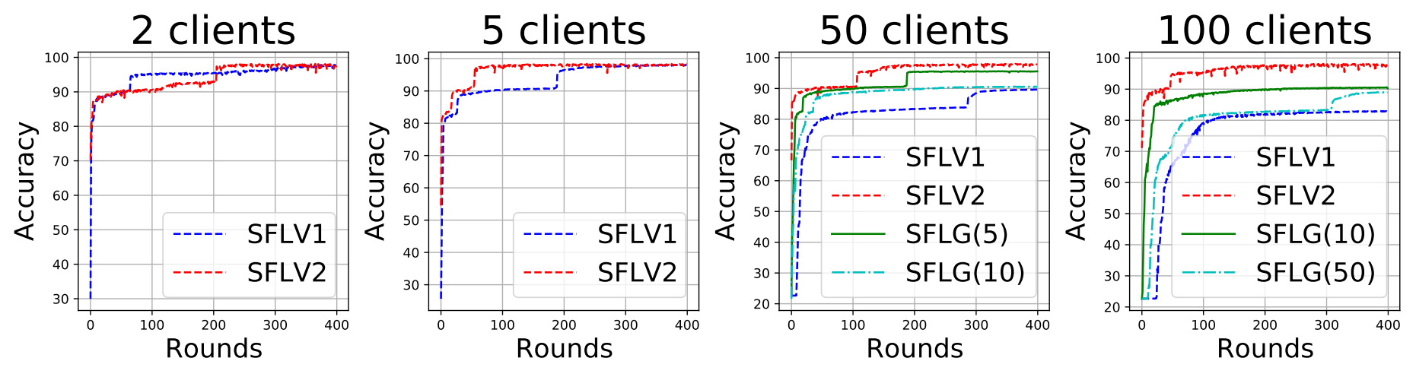
SplitFed: Performance

Slide 94
SplitFed: Performance
SFLV1: Copy number is 50, same to FL

Slide 95
SplitFed: Performance
SFLV2: Copy number is 1, same to SplitNN

Slide 96
SplitFed: Performance
SFLG(5): Copy number is 5, close to SplitNN

Slide 97
SplitFed: Performance
SFLG(10): Copy number is 10, close to FL

Slide 98
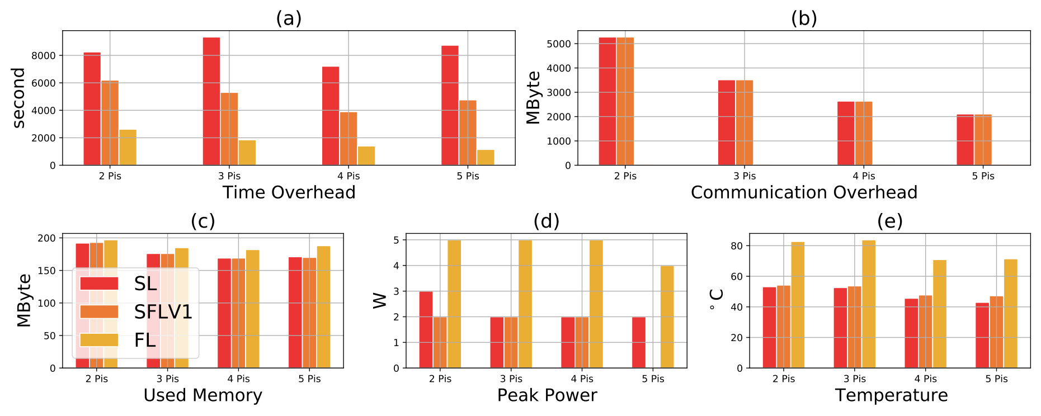
SplitFed: Performance

Slide 99
SplitFed: Performance

Slide 100
SplitFed: Performance

Slide 101
Artifact
Other experimental settings and results are referred to our paper. Source code is released at https://github.com/Minki-Kim95/Federated-Learning-and-Split-Learning-with-raspberry-pi (Including a guide how to configure Raspberry Pi, which we take a bit time to make it correct.)

Slide 102
Experiments: Overhead with Raspberry Pi
Other experimental settings and results are referred to our paper. Source code is released at https://github.com/Minki-Kim95/Federated-Learning-and-Split-Learning-with-raspberry-pi (Including a guide how to configure Raspberry Pi, which we take a bit time to make it correct.)
SplitFed is under review, its code is released at https://github.com/garrisongys/SplitFed

Slide 103
Thank you!

Slide 104
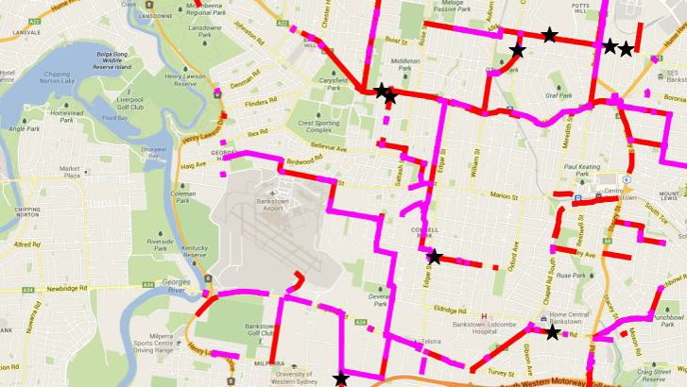
CASE STUDY
Transport and Logistics : ADAIT Platform
Data61 is building the ADAIT Platform as part of its work with Transport for NSW.
The Platform will provide a complete and holistic data reservoir to the State’s transport cluster, enabling real time decision making for congestion management.
The platform will become scalable across multi-modal transport and will be built to enable other developers to build specific purpose applications on the platform under open data frameworks.
The ADAIT Platform and the ecosystem that will surround it is potentially replicable across multiple Australian cities and exportable across the world, enabling the global move towards Smart Cities.

