Slide 1
AI for Cybersecurity Innovation
Prof. Pete Burnap
Academic Centre of Excellence in Cyber Security Research

Slide 2
The cyber security landscape
“Our vision for 2021 is that the UK is secure and resilient to cyber
threats…”
“commercialise our world leading science base”
“build on our areas of competitive advantage, and help new sectors to flourish…” – Artificial Intelligence Core Theme →
“Helping to make the UK the safest place to live and do business online”
Active Cyber Defence
(at Cardiff we use AI for Threat Intel & Situational Awareness)
Notes:
Cyber security analytics is both the left and right image – need algorithms, data – but this should be driven by and interpreted through theory and understanding of underlying processes. Detecting attacks is only really useful if we can understand motivations, actions, outcomes, and impact.

Slide 3
Cyber Security Analytics
Addressing emerging challenges to cyber security by combining:
computational and mathematical methods, drawing on our technical expertise in machine learning, artificial intelligence & big data analytics
criminological expertise in cyber crime
psychology expertise in susceptibility to cyber threat and decision making
international relations expertise in communication and governance
Notes:
Cyber security analytics is both the left and right image – need algorithms, data – but this should be driven by and interpreted through theory and understanding of underlying processes. Detecting attacks is only really useful if we can understand motivations, actions, outcomes, and impact.

Slide 4
50 Researchers:
17 academic staff
9 Post Docs
24 PhDs
Human Factors inc. susceptibility, motivations, dynamics and social factors of cyber
Risk assessment & modelling
Risk communication, governance and collective decision making
Artificial Intelligence for Data-driven human & software behavioural analytics & threat intelligence
Computer Science
Criminology
Psychology
Law & Politics
Privacy & Emerging Tech (e.g. IoT, Cloud, Automotive)
Airbus Centre of Excellence in Cyber Security Analytics
Airbus Human Centric Cyber Security Accelerator
>£14m external competitive grant income since 2012
> £7m for 2017-21 (plus £3.75m Data Innovation Accelerator)
Centre for Internet & Global Politics (CIGP)
Human Factors Excellence (HuFEx) Research Group

Slide 5
AI & Cybersecurity Case Study: Advanced Security Operations Centre (SOC) @ Airbus

Slide 6
The Problem
Network Intrusion Detection Systems = fine-grained network data & protocol-level inspection
Anti-virus tools = attempt to match code signatures to a list of known malicious code bases
However…Attackers are developing increasingly sophisticated methods to avoid detection
Notes:
Critical infrastructures are built on these

Slide 7
print(here is some fake code)
for i in list <0,f,g,h,6,a> {
element * next_element
return another_element
}
if a + b != 7:
MV AX+1_068373
wh4T El - se _0_IS There “to_
take on this machine”
p_word = “PASSWORD”
u_name = “ADMIN”
.EXE
APTs are becoming more sophisticated and able to obfuscate
much of their identifiable features through encryption, custom code bases and in-memory execution…

Slide 8
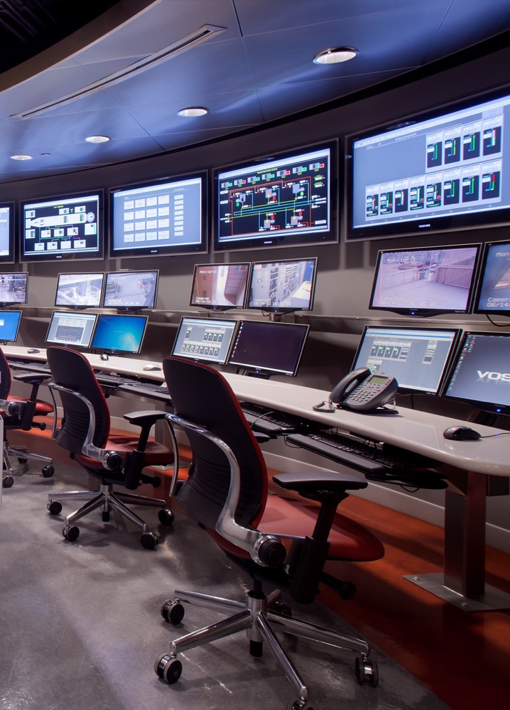
What does next-generation SOC look like?
Security Operations Centres (SOC) are the front line detection and analysis environments for many corporate and safety-critical systems
Commonly use off-the-shelf anti-virus or high-end behaviour analysis tools…most of which are vulnerable to obfuscation
So how do we enabling the SOC to ‘learn’ what is malicious in this context?
Notes:
Critical infrastructures are built on these

Slide 9
What can we learn that is difficult to hide?
System-level activity metrics - by executing samples of malicious and trusted executables in a Sandbox environment (Cuckoo)
Train a machine classifier to distinguish malicious from trusted executables using `low severity events' - inevitably generated while the executable is running
CPU User Use (percentage), CPU System Use (percentage), RAM use (count), SWAP use (count), received packets (count), received bytes (count), sent packets (count), sent bytes (count), number of processes running (count) - just 9 metrics in total.
Adversary’s
database
Create_admin
Target’s
database
.EXE
Extract_data
Access_data
Target’s
network
Notes:
Critical infrastructures are built on these

Slide 10
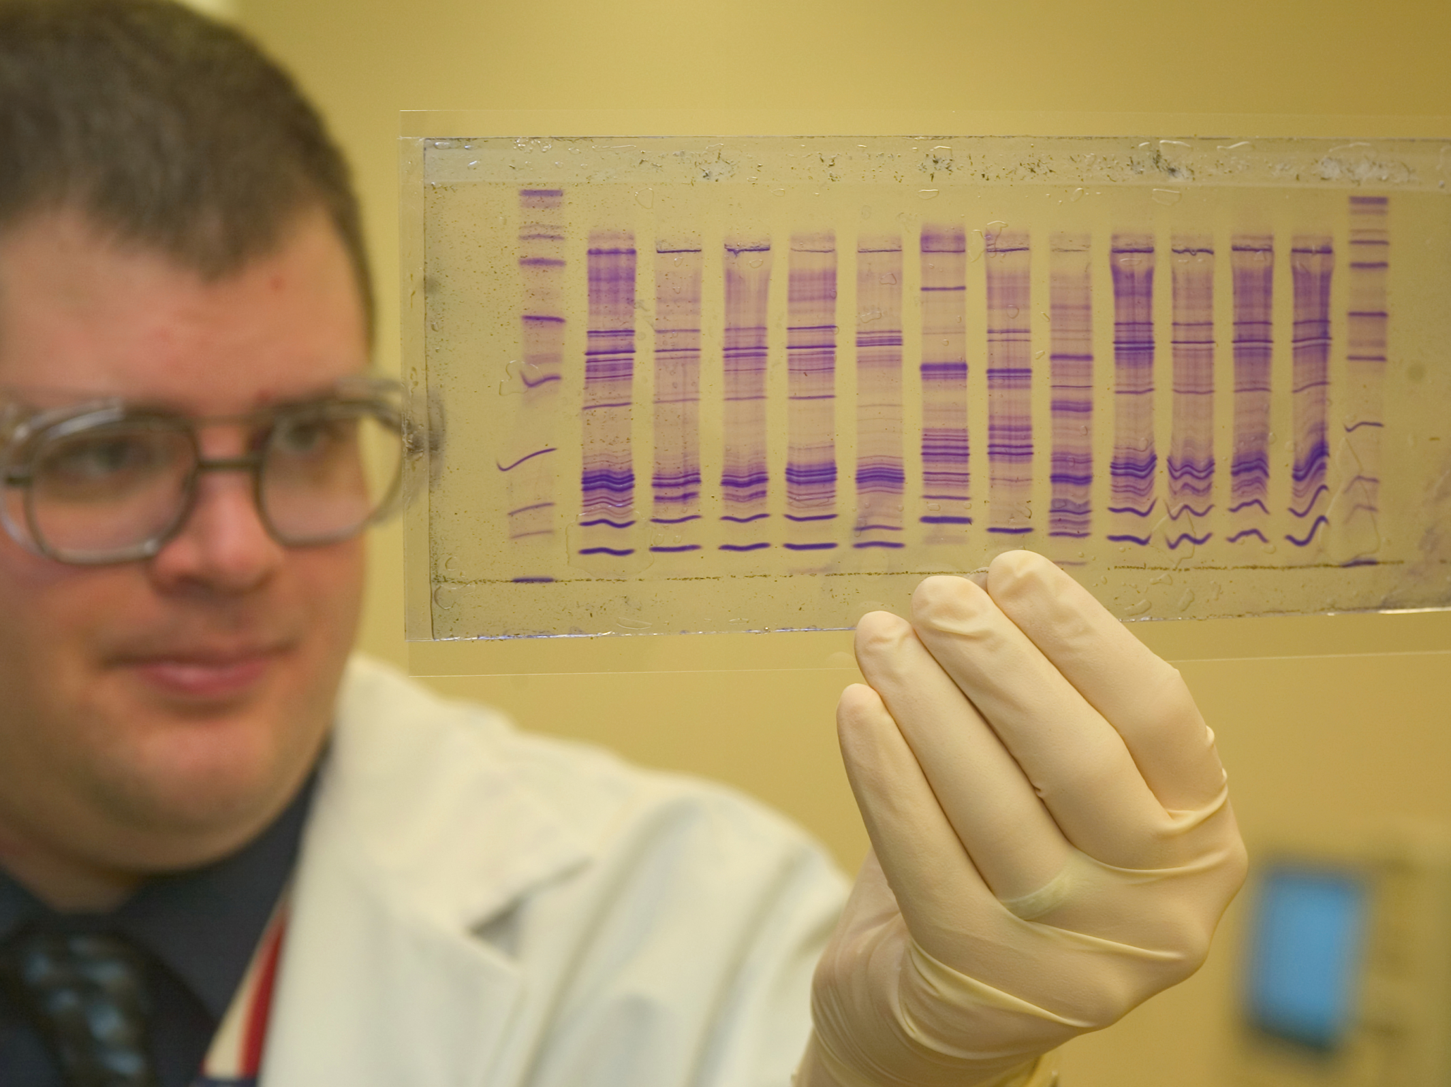
How does this help?
Attacks vary in their execution but theoretically exhibit similar behaviour overall
Supposing we can capture a range of malicious behaviour, can we represent these in such a way that we can identify ‘similar’ activity?
Think of DNA…parent/child similarity can be identified by putting a bunch of characteristic ‘features’ together and overlaying them…
Adversary’s
database
Create_admin
Target’s
database
.EXE
Extract_data
Access_data
Target’s
network
Notes:
Critical infrastructures are built on these

Slide 11
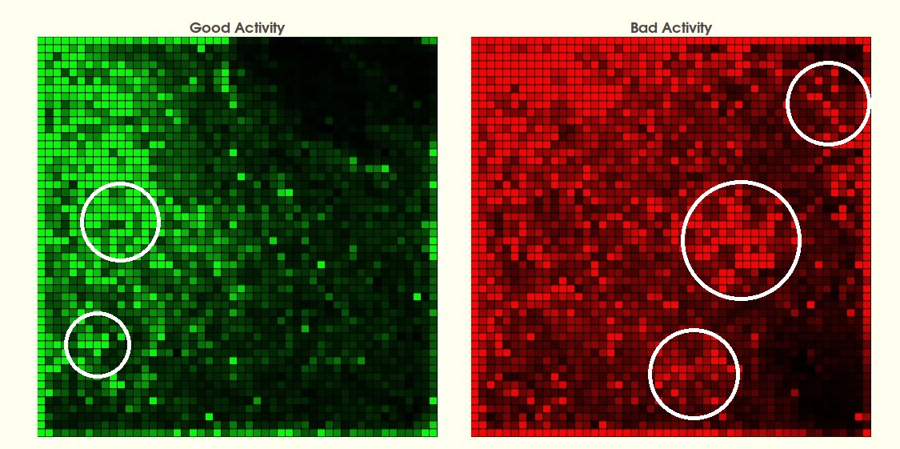
A DNA profile for software executables…reducing 9 dimensions to 2…
“More similar models will be associated with nodes that are closer in the grid, whereas less similar models will be situated gradually farther away in the grid.”
APTs are becoming more sophisticated and able to obfuscate
much of their identifiable features through encryption, custom code bases and in-memory execution…
total # processes
CPU user
CPU system
memory use
swap use
packets received
packets sent
bytes received
bytes sent

Slide 12
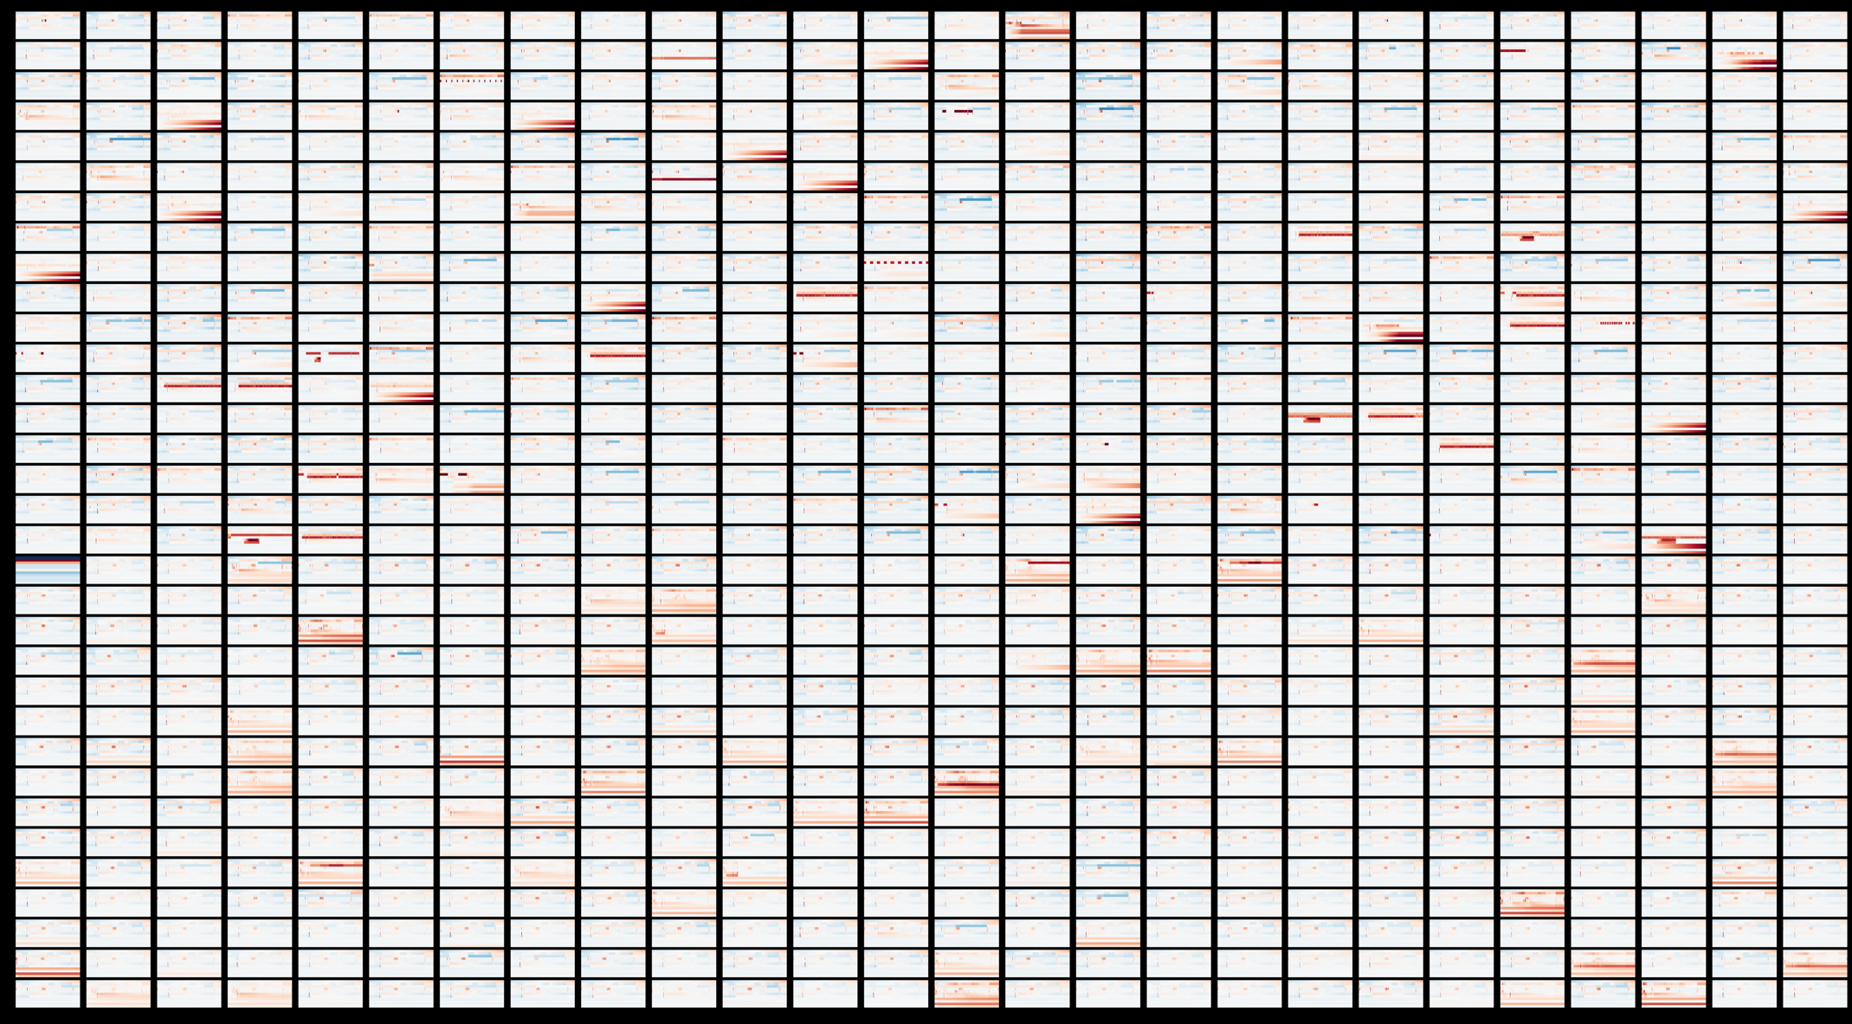
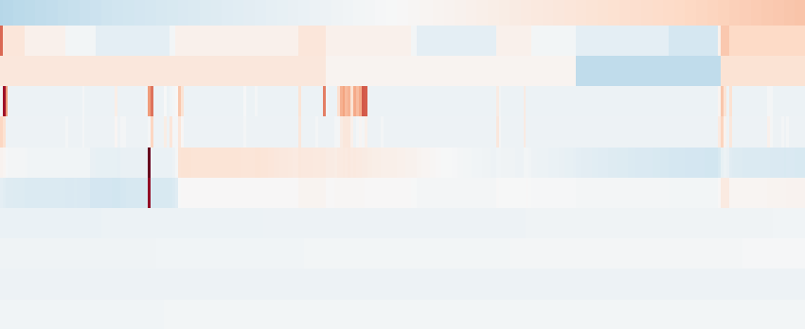
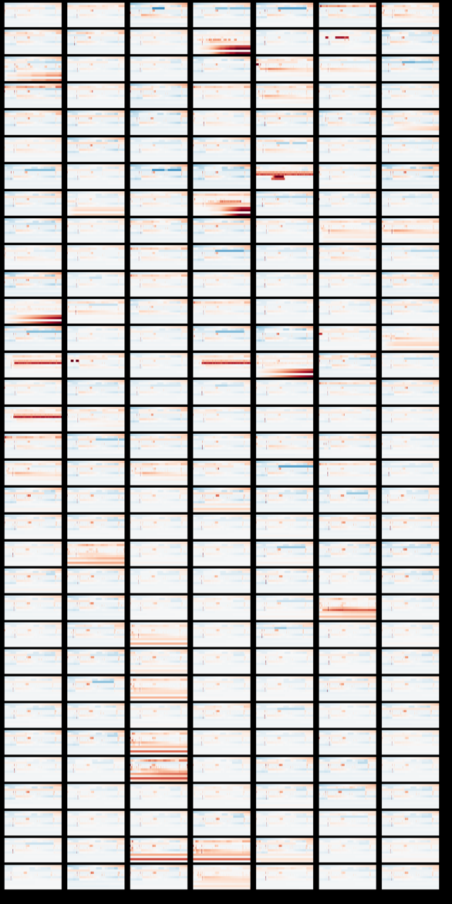
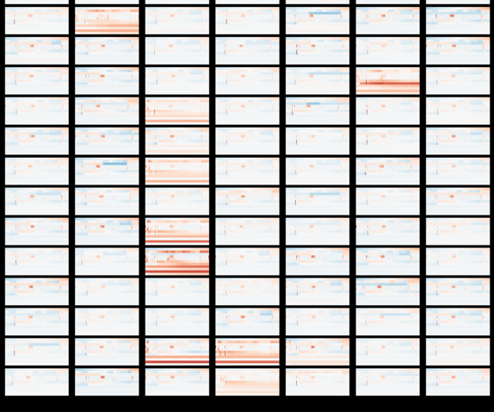
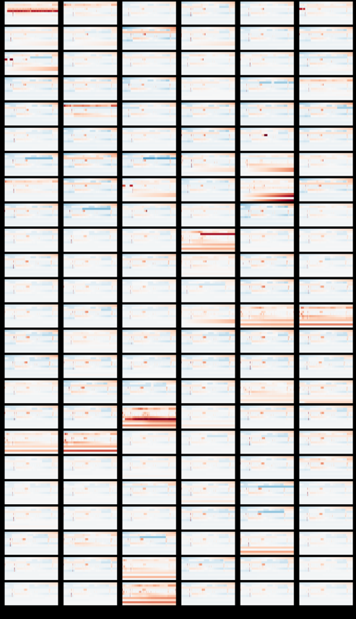
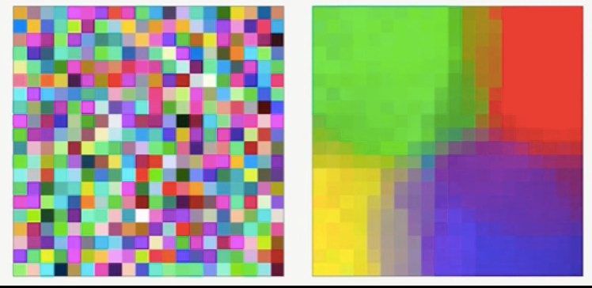
Looking at the system interactions instead of the code we can detect malware even if code/API call/network traffic obfuscation is being used to evade detection
Machine activity data for one piece of malware over 5 minutes
time
total # processes
max process ID
CPU user
CPU system
memory use
swap use
packets received
packets sent
bytes received
bytes sent
x ‘000s =
APTs are becoming more sophisticated and able to obfuscate
much of their identifiable features through encryption, custom code bases and in-memory execution…
time (s)
Self organising feature maps tranform the training sample data (system interaction) into a 2D space and uses a competitive learning algorithm to re-organise this space so that similar behaviours are close to one another
The system can be used for mass-classification (~95% accurate) or for in depth analysis of individual samples.

Slide 13
Add a logistic
Regression at
the end…
Classification
94% accuracy
The SOM
Reframes the
behaviour to
better suit
classification
methods…
Provides
“fuzzy
neighbour
-hoods” of
behaviour
APTs are becoming more sophisticated and able to obfuscate
much of their identifiable features through encryption, custom code bases and in-memory execution…

Slide 14
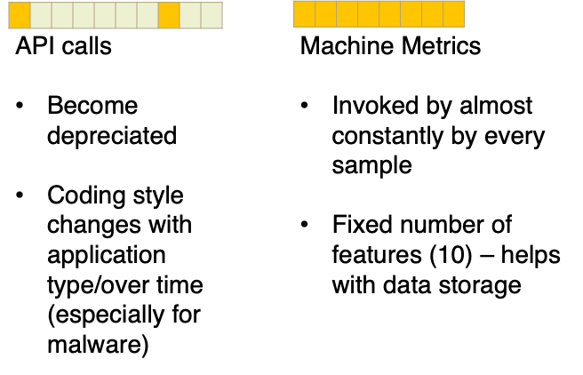
Lab2Soc: Data robustness for ML-based malware detection
API calls are the most commonly used dynamic data feature for ML malware detection
The system can be used for mass-classification (~95% accurate) or for in depth analysis of individual samples.

Slide 15
Lab2Soc: Data robsutness for ML-based malware detection
API calls are the most commonly used dynamic data feature for ML malware detection
Different ways they can be represented
Machine activity metrics show better consistency for detection accuracy acrosss datasets from different sources
The system can be used for mass-classification (~95% accurate) or for in depth analysis of individual samples.

Slide 16
Early Stage malware detection
APTs are becoming more sophisticated and able to obfuscate
much of their identifiable features through encryption, custom code bass and in-memory execution…

Slide 17
Q: So post attack classification is good, but can we do this is ‘real-time’ and ‘predict’ an attack?
A: Yup, prediction accuracy 94% @ 4sec…using recurrent neural nets to learn sequences of activity
5 minutes: 98% accuracy
20 seconds: 98% accuracy
5 seconds: 94% accuracy
99% ransomware detected within 1 second of execution

Slide 18
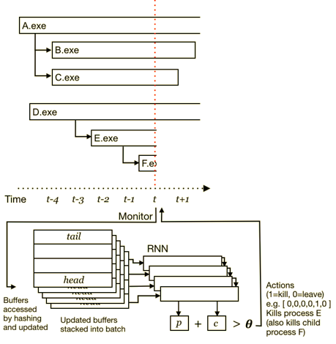
Detecting malicious processes
and automatically killing them
What does this mean for a user?
Preliminary results:
50% fewer files encrypted by fast-acting (starts encryption within first 5 seconds of launching)
90% ransomware samples detected
Notes:
Critical infrastructures are built on these

Slide 19
Goal oriented models…
Identifying dependencies within complex systems is challenging
Quantifying the risks associated with system components, and determining all attack paths is prone to error (Unknown Unknowns).
Typical risk assessments are failure-oriented (fault tree, attack path etc.)
System owners (arguably) tend to know more about what they depend on for success within their own system
Can we capture that and use cyber analytics to support impact analysis?

Slide 20
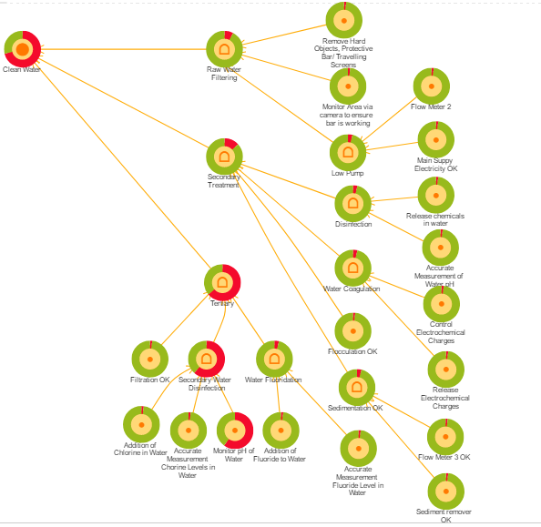
Impact of attack
Attack on IoT Device

Slide 21
High memory use
Low CPU use
High bytes out
Putting this to use…
Within the SOC we can do both post-attack classification and predict at ~94% accuracy
Being integrated into Airbus SOC – key feature is interpretability
The SOM provides an intuitive and explanatory interface to mine the features leading to a malicious outcome
P Burnap, R French, F Turner, K Jones (2017) ‘Malware classification using self organising feature maps and machine activity data’. Computers & Security 73, 399-410
Rhode, P Burnap, K Jones (under revised review) ‘Early Stage Malware Prediction Using Recurrent Neural Networks’.
arXiv preprint arXiv:1708.03513
Notes:
Critical infrastructures are built on these

Slide 22
Thanks.

