Slide 1
Inspecting TLS Anytime Anywhere: A New Approach to TLS Inspection
Joonsang Baek
Institute of Cybersecurity and Cryptology
School of Computing and Information Technology
University of Wollongong
Notes:
This is a joint work with my collegues at UOW, Jongkil Kim and Willy Susilo.

Slide 2
Contents
Introduction to TLS
TLS Inspection
Previous TLS Inspection Approaches
Our Approach to TLS Inspection: IA2-TLS
IA2-TLS: Benefits, Features, Analysis and Applications
Conclusion
Notes:
I’m going to talk features of IA2-TLS in very detail.

Slide 3
Introduction to TLS
Primary goals of TLS: To provide a secure channel between a client and a server.
Handshake Protocol
Responsible for authenticating communicating parties, negotiating cryptographic modes and parameters and establishing shared key.
Record Protocol
Uses the parameters established by the handshake protocol to protect traffic between the communicating peers by providing data confidentiality and integrity.

Slide 4
Introduction to TLS
Data encryption over the network is almost a “must”
The percentage of HTTPS page loadings (in the Chrome browser) increases from 67% in May 2017 to 90% in May 2019 in the US.
Now, among the top 100 non-Google sites on the Internet, 96 websites support HTTPS and 90 websites set HTTPS as default.
Transport Layer Security (TLS) or SSL is the standard protocol for HTTPS to provide confidentiality and authentication services.
Notes:
Recently, we have seen dramatic increase in use of TLS. This is according to the Google transparency report

Slide 5
TLS Inspection
Needs
Not only regular users but also threat actors can get benefit from TLS by hiding their activities using it.
More and more organizations are interested in setting up security controls over TLS traffic to conduct activities such as intrusion detection, filtering and enforcing compliance with corporate policies.

Slide 6
TLS Inspection
Because TLS provides an end-to-end encrypted channel by nature, it is impossible to implement such controls along the path of the network.
Solution
TLS Inspection

Slide 7
Previous Approaches to TLS Inspection
TLS (Inspection) Proxy
MITM (Man-In-The-Middle) style inspection
Decrypt
Encrypted traffic
Encrypted traffic
Encrypted traffic
Encrypted traffic
TLS Proxy
Client
Server
Notes:
First, the middlebox or tls proxy intercepts the incoming traffic and decrypts HTTPS sessions between clients and servers.
Once the traffic has been decrypted, the middlebox inspects the content through antivirus scanning, web filtering, etc.
Then the interceptor encrypts the traffic and forwards it to the destination, in this case the web server.

Slide 8
Previous Approaches to TLS Inspection
What are the problems?
Management of TLS proxy certificate
This makes it possible for the client to establish an encrypted connection to the proxy rather than the intended web site.
Need to distribute TLS proxy certificate to all users
However, this can be a source of other problems.

Slide 9
Previous Approaches to TLS Inspection
The proxy needs to decrypt and re-encrypt the traffic in real time to conduct the MITM attack
Performance degradation in terms of computation and communication is always expected.
If a non-real time inspection such as post-incident review (PIR) is required, a completely different method should be employed.

Slide 10
Previous Approaches to TLS Inspection
Other middlebox approaches:
Deep Packet Inspection (DPI) over encrypted traffic
Matching keywords (detection rules) without decrypting the whole traffic → User privacy retained!
However, the problem is that heavy computations are required in the setup stage or it has a long detection time.
Notes:
But this is a very interesting approach

Slide 11
Yet Other Approaches
Alternative methods without depending on middleboxes
In an extreme case, there was an attempt to obtain the server’s private key.
Downgrading cryptographic components in TLS such as forcing the peers to agree on weak TLS cryptographic primitives such as “Dual_EC_DRBG”, a weakedn PRG.
.

Slide 12
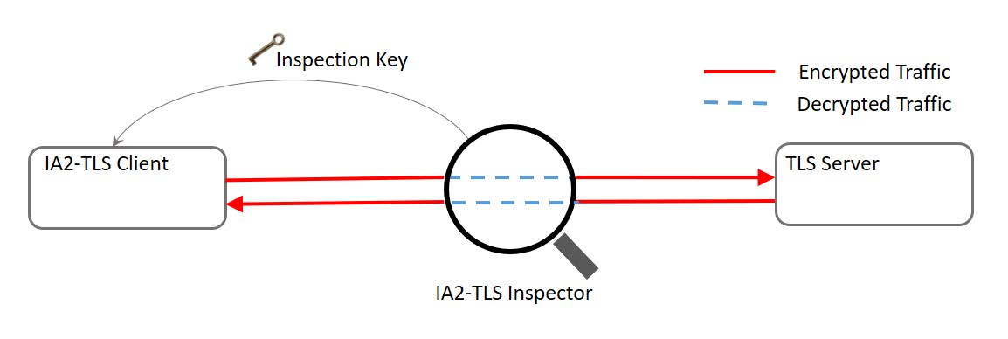
Our Approach: IA2-TLS
IA2-TLS makes the encrypted traffic transparent (i.e., decrypted) to the network node acting as an IA2- TLS Inspector.

Slide 13
Our Approach: IA2-TLS
The possession of inspection key guarantees the inspection capability.
As long as this key is kept secret, the encrypted traffic will not be compromised.

Slide 14
IA2-TLS Benefits
Efficient inspection
No degradation of performance
Not depending on the MITM-style TLS proxy
No need to worry about how the TLS proxy handle certificates of the servers: In the TLS proxy inspection, the client has no visibility into what CAs the TLS proxy trusts.
Offline (as well as online) inspection

Slide 15
Design Principles of IA2-TLS
Minimal modification
We wanted to avoid a dramatic modification of the TLS protocol to keep all its functionality.
IA2-TLS only slightly modifies the handshake protocol, and the rest of the protocol is identical to those of TLS.
IA2-TLS is based on TLS 1.2 (Possible to be extended to TLS 1.3)
Notes:
We wanted to avoid

Slide 16
Design Principles of IA2-TLS
Inspection key
The inspector creates a uniform “inspection key”.
We combine it together with the random nonces generated by the client and the server( at the beginning of the TLS handshake protocol) to generate a random coin, which will be used to create a pre-master secret (PMS) in the TLS protocol.

Slide 17
Design Principles of IA2-TLS
The inspection key has the capacity to recover the PMS without using the server’s private key.
The size of the inspection key should reflect the security level the most of modern symmetric key cryptosystems should provide: 128 bits or 256 bits.
The lifetime of the inspection key depends on the policy, but it should not be used for an extended period.

Slide 18
Design Principles of IA2-TLS
PMS recovery through a random ephemeral value (REV)
Key Encapsulation Mechanism (KEM): An essential cryptographic primitive used in TLS to generate the PMS, which the client and server will use to derive subsequent (symmetric) keys to encrypt their application data after a handshake.
Notes:
I already talked about this, but I need to be more precise on this.

Slide 19
Design Principles of IA2-TLS
For example, the Diffie-Hellman key exchange used in TLS can be described as a KEM scheme that encapsulates the server’s public key y=g^{x} into a PMS, y^{r} for the REV r, and a corresponding ciphertext (CT), g^{r}, which should be contained in ClientKeyExchange.

Slide 20
Design Principles of IA2-TLS
As said earlier, we generate a REV used for randomization using the inspection key together with the client and server’s random nonces.
If the randomized KEM scheme has the property that the key generated by its encapsulation algorithm can also be recovered using the REV only (not through the decpaulation algorithm), the inspector will be able to obtain the same PMS.

Slide 21
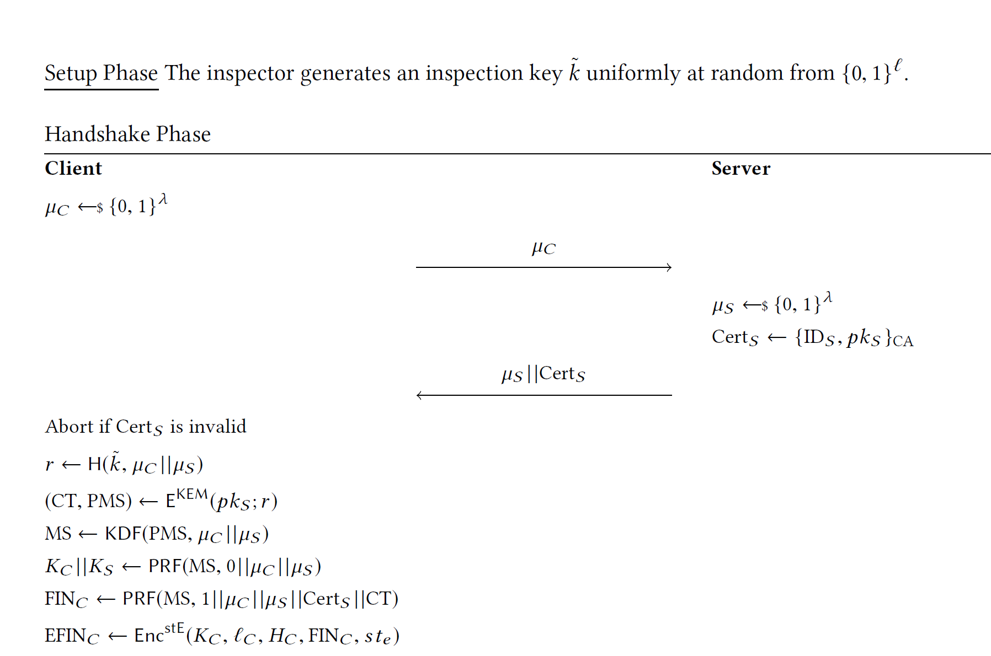
Our Protocol: IA2-TLS

Slide 22
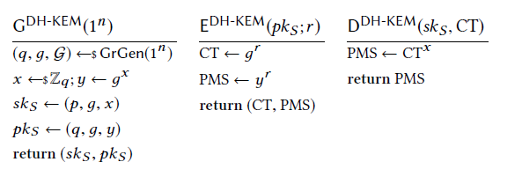
Instantiation; DH-Based Encryption

Slide 23
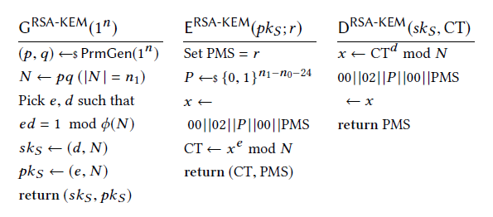
Instantiation: RSA Encryption
Notes:
Here in RSA, PMS is the random coin r itself

Slide 24
Threat Model
Adversary A
A aims to obtain any information about the target client and server’s PMS or master secret (MS).
A does not have access to the current inspection key nor the private key of the server.
The adversary is an intruder to the client’s browser, which is known to run IA2-TLS. By making the browser choose a static (not freshly random) value for μ_{C}, the adversary may get some information about PMS.

Slide 25
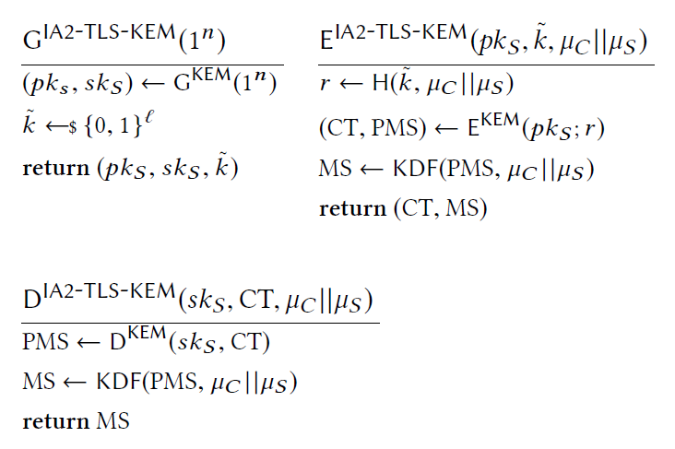
Security Model
IA2-TLS-KEM
A KEM scheme extracted from the IA2-TLS handshake
Notes:
We extracted

Slide 26
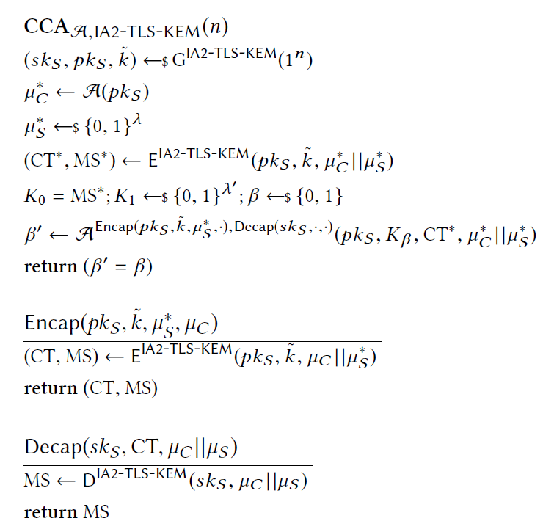
Security Model
CCA notion
Here, the adversary A is very powerful:
We allow A to access to decapsulation oracle.
We allow A to choose any client random nonce μ_{C} and query it to the encapsulation oracle.
This notion reflects the threat model.

Slide 27
Security Analysis
Security Result:
The IA2-TLS-KEM scheme is IND-CCA secure if the underlying randomized KEM scheme is OW-PCA secure, and H and KDF are random oracles.
Implication
As long as the server (honestly) generated its random nonce μ_{S} and H is a random oracle, the PMS from IA2-TLS does not leak any information to the adversary.

Slide 28
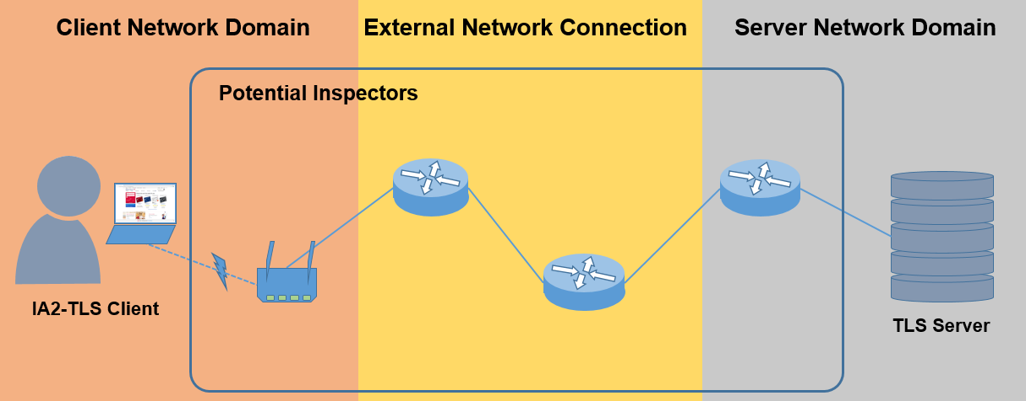
Implementation
System overview

Slide 29
Implementation
Implementation of IA2-TLS Client
We implemented IA2-TLS Client on the Google Chromium browser (Version 76.0.3782.0, Developer Build, 64-bit).
For SSL/ TLS communication, the Chromium browser uses BoringSSL, which is a fork of OpenSSL.
We modified the generation of PMS in BoringSSL to implement IA2-TLS Client.
Notes:
Chromium is a Base for the Chrome browser.

Slide 30
Implementation
PMS for the RSA-KEM
This is generated by calling RAND_bytes function from BoringSSL.
We replaced this function with a PRF which takes the inspection key , the client random μ_{c} and the server random μ_{S} as input.
That is, PMS = PRF($\tilde{k}$, μ_{c}|| μ_{s})

Slide 31
Implementation
PMS for the ECDHE
The function Offer is a function that generates a REV for the client, which is the exponent r of client’s CT value, i.e. g^{r}.
We modified the Offer function to take hs->ssl, which contains all the necessary values including client random and server random as input.
We used a PRF function (tls1_prf) to generate the client private random value r, i.e., r= PRF ($\tilde{k}$, μ_{c}|| μ_{s})
Notes:
Hs->ssl is a (class) object

Slide 32
Implementation
Implementation of IA2-TLS Inspector
The aim of IA2-TLS Inspector is to enable an inspector to decrypt and look into the TLS traffic without receiving any auxiliary information from the client or the server.
In order to achieve this, the inspector should be able to produce the same PMS (and hence MS) by applying the inspection key to the captured TLS traffic.

Slide 33
Implementation
We implemented IA2-TLS Inspector using the BoringSSL library.
IA2-TLS Inspector can be a non-real-time or real-time agent, which needs functionalities of capturing and analzying the TLS traffic.
We used tshark to capture the TLS traffic.
Notes:
WE implemented non-real-time inspector

Slide 34
IA2-TLS Compliance
Situation: When IA2-TLS is deployed in IDS to inspect the organizational network, the company may want to know whether their employees access to HTTPS websites using the browsers that support IA2-TLS before they connect.

Slide 35
IA2-TLS Compliance
Naturally, IA2- TLS offers this capacity as follows.
Note that the TLS handshake is completed after client and server exchange Finished messages.
The IDS can capture those messages and check whether the key used to encrypt the Finished messages is equal to the key derived from the IA2-TLS protocol using the inspection key, and the client and server random nonces.
If the equality does not hold, the IDS can terminate the connection to protect the system from unmonitored traffic.

Slide 36
IA2-TLS Compliance
When the ECDHE is used, the IDS can verify the user’s noncompliant behavior by observing the CT-value (g^{r}), which is included in ClientKeyExchange, instead of decrypting the Finished message.
This reduces the computational overhead required to detect the monitoring bypass.

Slide 37
Support for TLS 1.3
Question: Can IA2-TLS be extended to TLS 1.3?
Possible because
1) the client random nonce is produced;
2) the ephemeral DH (DHE) key encapsulation is still supported.

Slide 38
Support for TLS 1.3
TLS v1.3 handshake protocol (in a nutshell)
The client sends the ClientHello message to the server, which includes:
client random nonce μ_{C}.
a list of cipher suites that the client supports
key_share g^{r}

Slide 39
Support for TLS 1.3
Upon receiving the ClientHello message, the server responds with the following ServerHello message, which includes
server random nonce μ_{S};
a selected cipher suite; and
key_share g^{s}
After the client and the server have exchanged the key_share value, both parties can come up with
traffic key= HKDF(g^{rs}, aux…)

Slide 40
Support for TLS 1.3
Our observation
The client should send key_share g^{r} to the server before it receives the server’s random nonce μ_{S} in TLS 1.3.
We cannot make use of μ_{S} but can use only the client nonce μ_{C} to generate the REV r.
We should compute r ← H($\tilde{k}$, μ_{C}), where $\tilde{k}$is the inspection key. → As the inspector can recover r, it can also reconstruct the traffic key. → Inspection is possible!

Slide 41
Support for TLS 1.3
The effect of the absence of the server random nonce
This will make the adversary A in the IND-CCA notion for IA2-TLS-KEM weaker as now, the adversary might control the generation of r somewhat more easily. (For example, A can choose non-uniform μ_{C}.)
Therefore, we should make the attack game in such a way that A has no longer has the ability to choose the client random nonce and fix it as a uniform random string.

Slide 42
Support for TLS 1.3
We proved that the IND-CCA security of the above KEM (IA2-TLS1.3-KEM) under this weakened security model.
Remark:
Nevertheless, IA2-TLS based on RSA will no longer be possible as RSA-KEM is not supported in TLS 1.3.

Slide 43
Future Work
Implementation of the IA2-TLS 1.3
Implementation of a real-time inspector that integrates the inspector program into an IDS
IA2-TLS plug-in for the browser

Slide 44
Controversy Rather Than Conclusion
Is TLS inspection good?
We embrace the controversy:
There is a privacy concern for the TLS inspection.
Do we have to sacrifice user privacy for safety or security?
How much do we trust the “admin” that does inspection?

Slide 45
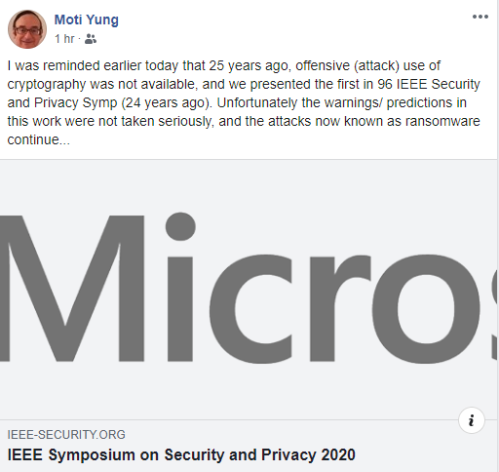
Controversy Rather Than Conclusion
Is it another example of “offensive use of cryptography – Moti’s comment on Test of Time Award he received from S&P: Cryptovirology: Extortion-Based Security Threats and Countermeasures Adam L. Young, Moti Yung, 1996

Slide 46
Controversy Rather Than Conclusion
But still…it’s much better for the research community to publish the result on TLS inspection than some agency or a private company does it secretly.
Notes:
I would like to emphasize the transparency is the key.

