Slide 1
Propagation of Malicious Attacks and Identification of their Sources*
Professor Wanlei Zhou
Head, School of Software
University of Technology Sydney
Sydney, Australia
wanlei.zhou@uts.edu.au
https://www.uts.edu.au/staff/wanlei.zhou
* Work is carried out in collaboration with many colleagues (the key publications page).

Slide 2
Outline
Current Methods in Sources Identification
Comparative Studies
Our Work in Propagation Modelling and Source Identification
Future Work & Discussion

Slide 3
Key Publications
This presentation is based on following publications by my research group:
Jiaojiao Jiang, Sheng Wen, Shui Yu, Bo Liu, Yang Xiang, Wanlei Zhou: Malicious Attack Propagation and Source Identification. Advances in Information Security 73, Springer 2019, ISBN 978-3-030-02178-8, pp. 1-181.
Jiaojiao Jiang, Sheng Wen, Shui Yu, Yang Xiang, Wanlei Zhou: Rumor Source Identification in Social Networks with Time-Varying Topology. IEEE Trans. Dependable Sec. Comput. 15(1): 166-179 (2018).
Bo Liu, Wanlei Zhou, Longxiang Gao, Haibo Zhou, Tom H. Luan, Sheng Wen: Malware Propagations in Wireless Ad Hoc Networks. IEEE Trans. Dependable Sec. Comput. 15(6): 1016-1026 (2018).
Jiaojiao Jiang, Sheng Wen, Shui Yu, Yang Xiang, Wanlei Zhou: Identifying Propagation Sources in Networks: State-of-the-Art and Comparative Studies. IEEE Communications Surveys and Tutorials 19(1): 465-481 (2017).
Chao Chen, Yu Wang, Jun Zhang, Yang Xiang, Wanlei Zhou, Geyong Min: Statistical Features-Based Real-Time Detection of Drifted Twitter Spam. IEEE Trans. Information Forensics and Security 12(4): 914-925 (2017).
Mohammad Sayad Haghighi, Sheng Wen, Yang Xiang, Barry G. Quinn, Wanlei Zhou: On the Race of Worms and Patches: Modeling the Spread of Information in Wireless Sensor Networks. IEEE Trans. Information Forensics and Security 11(12): 2854-2865 (2016).
Sheng Wen, Mohammad Sayad Haghighi, Chao Chen, Yang Xiang, Wanlei Zhou, Weijia Jia: A Sword with Two Edges: Propagation Studies on Both Positive and Negative Information in Online Social Networks. IEEE Trans. Computers 64(3): 640-653 (2015).
Jiaojiao Jiang, Sheng Wen, Shui Yu, Yang Xiang, Wanlei Zhou: K-Center: An Approach on the Multi-Source Identification of Information Diffusion. IEEE Trans. Information Forensics and Security 10(12): 2616-2626 (2015).

Slide 4
Current Methods in Sources Identification
Background:
We live in a world of networks, e.g., social networks, computer networks, transportation networks, biological networks, etc.
Any complex system can be modeled as a network, where nodes are the elements of the system and edges represent the interactions between them.
The ubiquity of networks has made us vulnerable to various network risks.

Slide 5
Current Methods in Sources Identification
Significances of source identification in social networks:
Identifying propagation sources as quickly as possible can help people find the causation of risks, and therefore, diminish the damages.
It is important to accurately identify the ‘culprit’ of the propagation for forensic purposes.
Understanding the propagation mechanisms will help us to design defense measures.
Question:
How can we identify propagation sources in social networks, a type of complex networks?

Slide 6
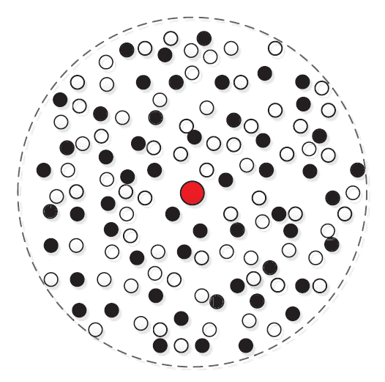
Current Methods in Sources Identification
Three categories of network observations:
(i) Complete Observation: The exact state of each node is observed in a network.
Suitable for small-scale networks.

Slide 7
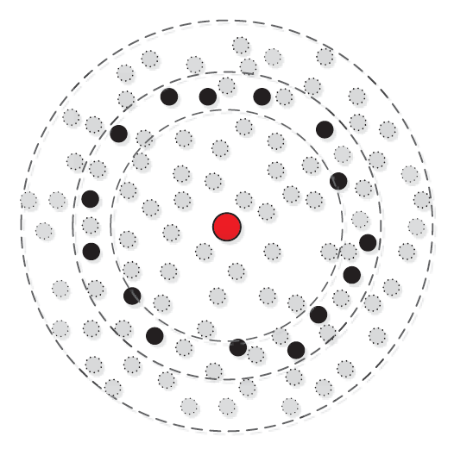
Current Methods
(ii) Snapshot: A portion of nodes are observed in a network. It only provides partial knowledge of a network status.
Much more usual in the real world.

Slide 8
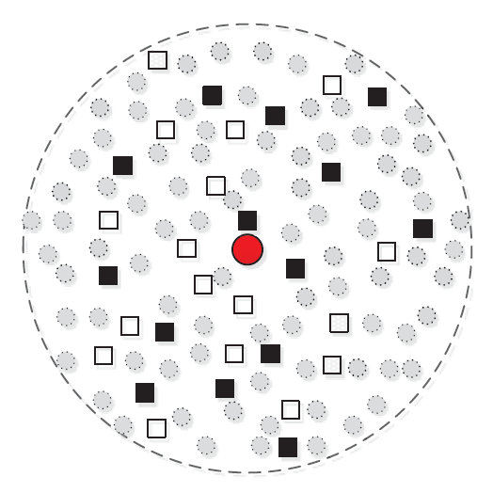
Current Methods
(iii) Sensor Observation: Sensors record the propagation dynamics over them.
Sensors need be chosen very carefully.

Slide 9
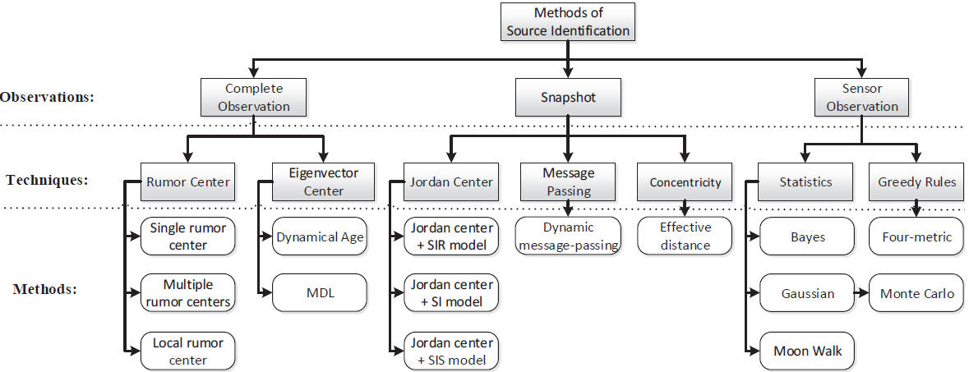
Current Methods
Current methods of source identification can be categorized into three categories according to three different types of network observations.
Taxonomy of current source identification methods

Slide 10
Outline
Current Methods in Sources Identification
Comparative Studies
Our Work in Propagation Modelling and Source Identification
Future Work & Discussion

Slide 11
Comparative Studies
Crosswise comparison
Comparison from seven features.
Most of current methods are based on tree networks.
Most of them can only be used to identify single source.
Most of them are very computationally complex.

Slide 12
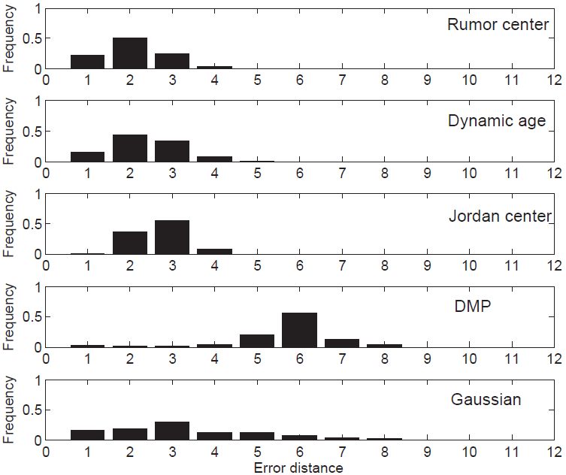
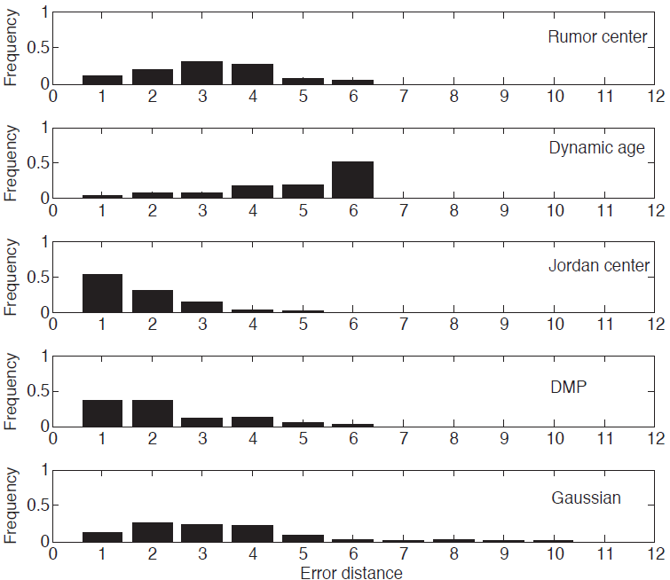
Comparative Studies
Crosswise comparison of typical methods in two real networks
Evaluated by error distance: the number of hops between the real sources and the estimated sources.
The performances vary in different networks. Therefore, we are inspired to investigate the factors which may impact source identification methods.
Enron Email
Power Grid

Slide 13
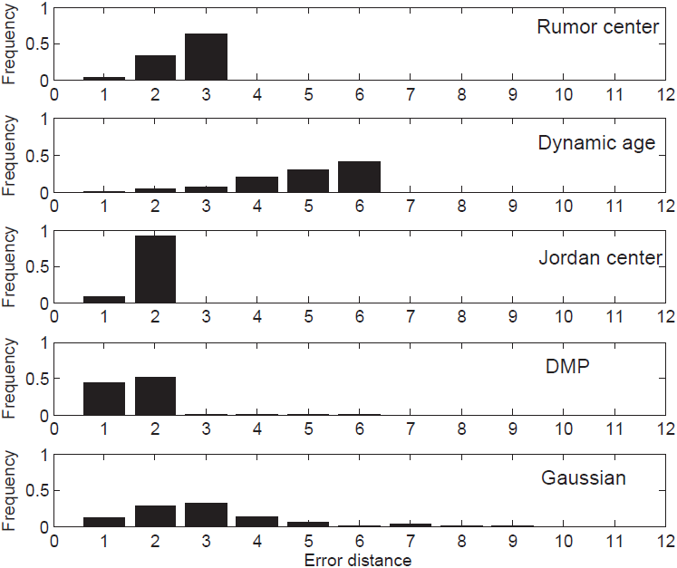
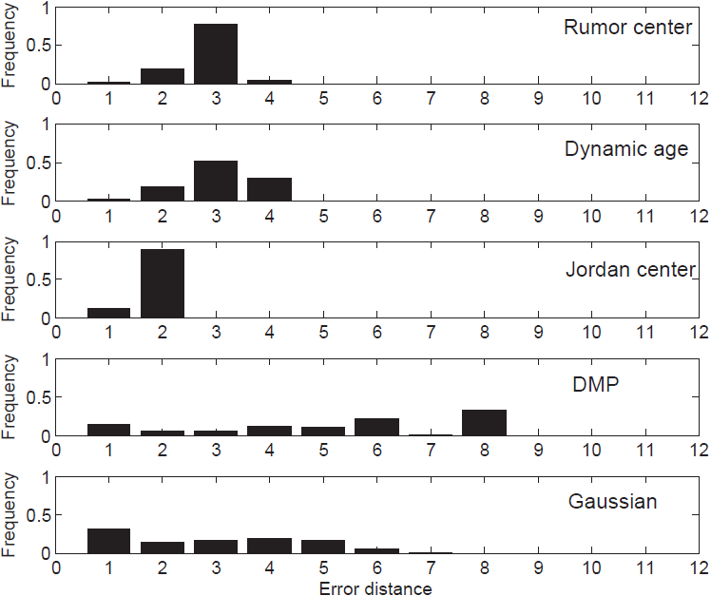
Comparative Studies
Factors that may impact source identification methods
(i) Network Topologies
Regular tree and Random tree.
Regular tree
Random tree

Slide 14
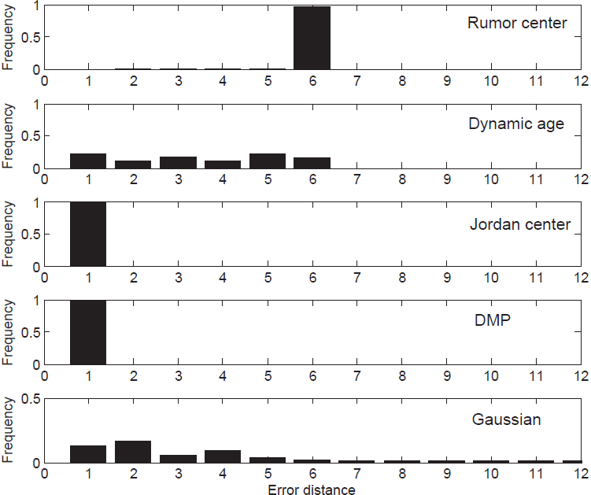
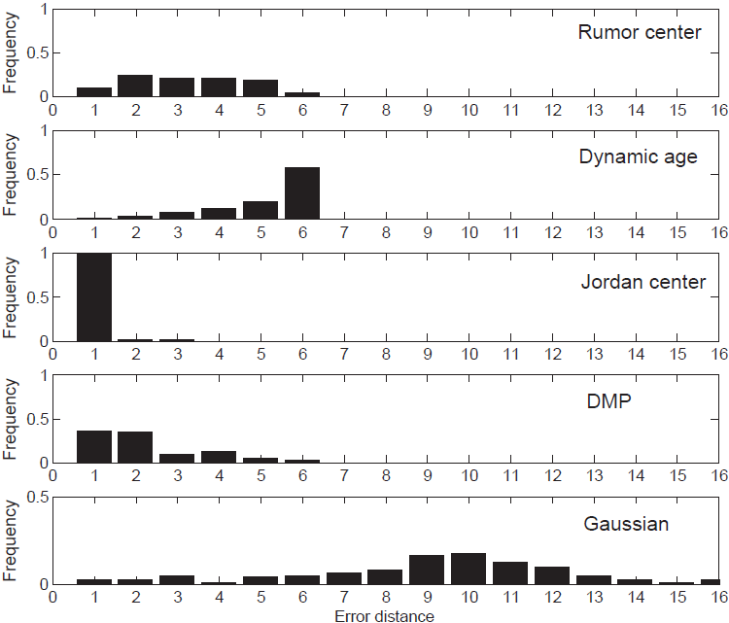
Comparative Studies
(i) Network Topologies
Regular networks and Small-world networks
Conclusion: Current methods are sensitive to network topologies.
Regular graph
Small-world network

Slide 15
Comparative Studies
(ii) Propagation Schemes
Random walk
Contact-process (unicast)
Snowball propagation schemes (broadcast)

Slide 16
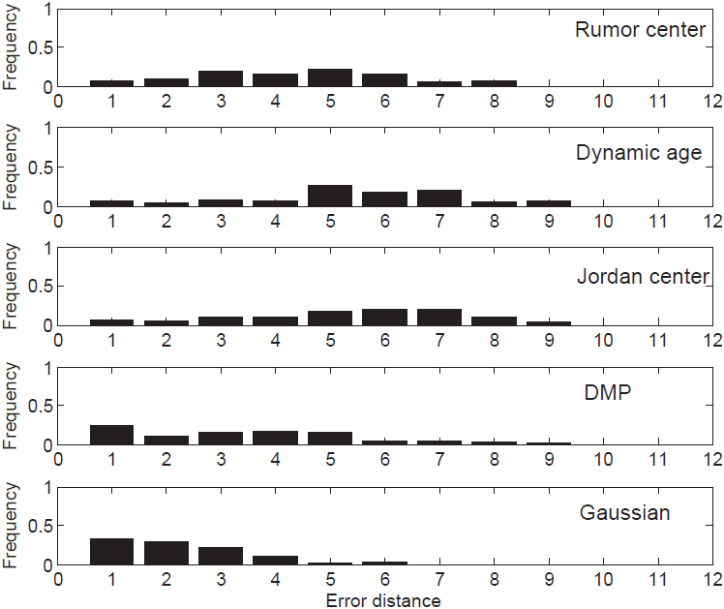
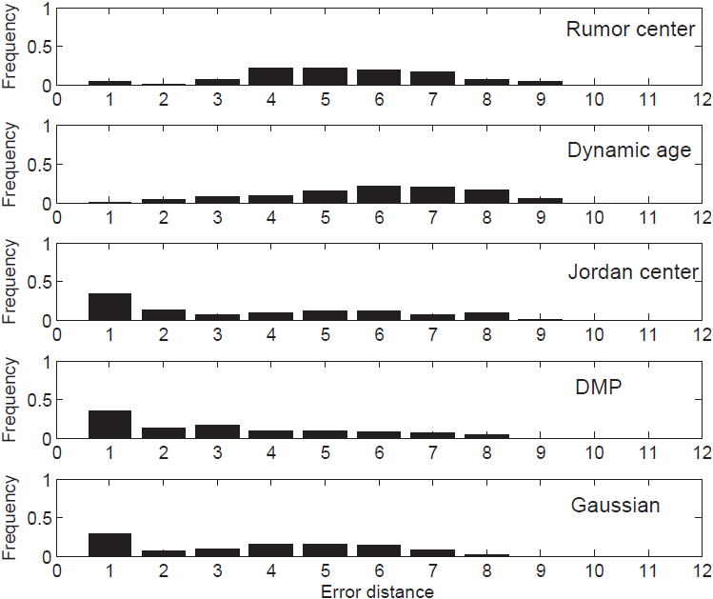
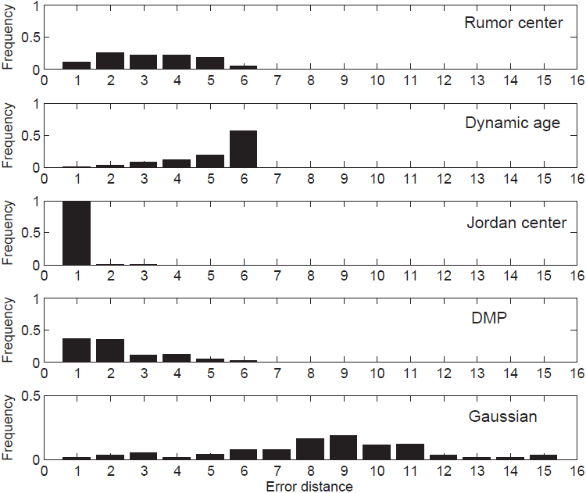
Comparative Studies
(ii) Propagation Schemes
Conclusion: Current methods are sensitive to different propagation schemes.
Random-walk
Contact-process
Snowball

Slide 17
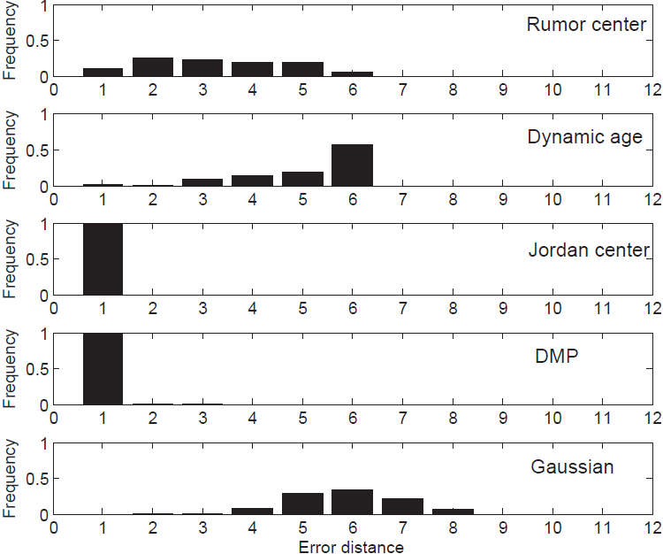
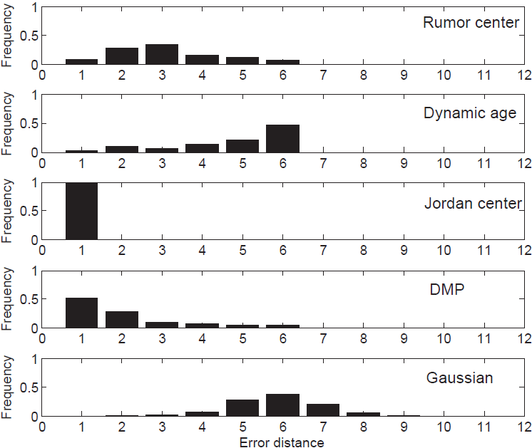
Comparative Studies
(iii) Infection Probabilities (q = 0.5 and q = 0.95)
Conclusion: Current methods are not very sensitive to infection probabilities.
q = 0.5
q = 0.95

Slide 18
Outline
Current Methods in Sources Identification
Comparative Studies
Our Work in Propagation Modelling and Source Identification
Future Work & Discussion

Slide 19
Our Work in Propagation Modelling and Source Identification
Dealing with worms
Mohammad Sayad Haghighi, Sheng Wen, Yang Xiang, Barry Quinn, and Wanlei Zhou, "On the Race of Worms and Patches: Modeling the Spread of Information in Wireless Sensor Networks". IEEE Transactions on Information Forensics & Security. Volume 11, Issue 12, pp. 2854-2865, DECEMBER.2016.
Yini Wang, Sheng Wen, Yang Xiang, and Wanlei Zhou, "Modeling the Propagation of Worms in Networks: A Survey", IEEE Communications Surveys and Tutorials, Volume:16, Issue: 2, 2014, pp 942-960.
Sheng Wen, Wei Zhou, Jun Zhang, Yang Xiang, Wanlei Zhou, and Weijia Jia, "Modeling Propagation Dynamics of Social Network Worms", IEEE Transactions on Parallel and Distributed Systems, vol. 24, no. 8, pp. 1633-1643, Aug. 2013.
Dealing with propagation sources
Jiaojiao Jiang, Sheng Wen, Shui Yu, Yang Xiang, Wanlei Zhou, and Ekram Hossain, "Identifying Propagation Sources in Networks: State-of-the-Art and Comparative Studies", IEEE Communications Surveys and Tutorials. Vol. 19, No. 1, pp. 465-481, First Quarter 2017.
Jiaojiao Jiang, Sheng Wen, Shui Yu, Yang Xiang, and Wanlei Zhou, "K-center: An Approach on the Multi-source Identification of Information Diffusion", IEEE Transactions on Information Forensics & Security, Volume:10, Issue: 12, pp. 2616-2626. December 2015.
Dealing with rumors
Jiaojiao Jiang, Sheng Wen, Shui Yu, Yang Xiang, and Wanlei Zhou, "Rumor Source Identification in Social Networks with Time-varying Topology", IEEE Transactions on Dependable and Secure Computing, 15(1): 166-179 (2018).
Sheng Wen, Mohammad Sayad Haghighi, Chao Chen, Yang Xiang, Wanlei Zhou, and Weijia Jia, "A Sword with Two Edges: Propagation Studies on Both Positive and Negative Information in Online Social Networks", IEEE Transactions on Computers, Vol. 64, No. 3, pp. 640-653, March 2015.
Sheng Wen, Jiaojiao Jiang, Yang Xiang, Shui Yu, Wanlei Zhou and Weijia Jia, "To shut them up or to clarify: restraining the spread of rumours in Online Social Networks", IEEE Transactions on Parallel and Distributed Systems, Vol. 25, No. 12, pp. 3306-3316, 2014.
Dealing with malware
Bo Liu, Wanlei Zhou, Longxiang Gao, Haibo Zhou, Tom Luan, and Sheng Wen, "Malware Propagations in Wireless Ad Hoc Networks". IEEE Transactions on Dependable and Secure Computing, 15(6): 1016-1026 (2018).
Sheng Wen, Wei Zhou, Jun Zhang, Yang Xiang, Wanlei Zhou, Weijia Jia, and Cliff C.Zou "Modeling and Analysis on the Propagation Dynamics of Modern Email Malware", IEEE Transactions on Dependable and Secure Computing, VOL. 11, NO. 4, JULY/AUGUST 2014, pp. 361-374.
Silvio Cesare, Yang Xiang, and Wanlei Zhou, "Control Flow-based Malware Variant Detection", IEEE Transactions on Dependable and Secure Computing, VOL. 11, NO. 4, JULY/AUGUST 2014, pp. 304-317.
Silvio Cesare, Yang Xiang, and Wanlei Zhou, "Malwise - An Effective and Efficient Classification System for Packed and Polymorphic Malware", IEEE Transactions on Computers, Vol. 62, Issue 6. pp.1193-1206, June 2013.

Slide 20
Modelling the Propagation of Rumours and Truths in Online Social Networks
How Rumours and Truths Spread in OSNs
Modelling the Spread of Rumours and Truths
Results Exhibition of the Modelling
Defense Measures in Online Social Networks

Slide 21
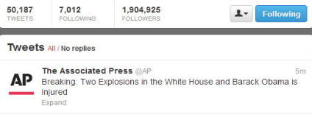
How Rumours and Truths Spread in OSNs
Case 1 (23/04/13): Market chaos after fake Obama explosion tweet
Negative Information
Positive Information
Hackers took control of the Associated Press Twitter account overnight and sent a false tweet about two explosions at the White House that briefly sent US financial markets reeling.
The White House quickly issued a statement saying the report of explosions was not correct.
Negative Results
Technical Perspective (optimistic choices)
Reuters data showed the tweet briefly wiped out $US136.5 billion of the S&P 500 index's value before markets recovered.
The probabilities of people believing positive information (a) and negative information (b), we have 0<a<1, b=0. We let a+b<1 since they can contradict both kinds of information like “there was an explosion in White House but Obama was not injured”.
21

Slide 22
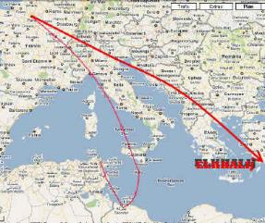
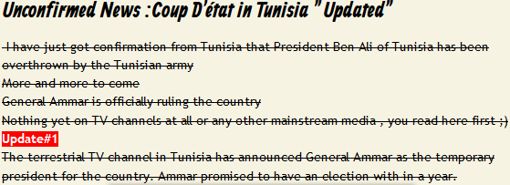
How Rumours and Truths Spread in OSNs
Case 2 (11/01/11): Coup in Tunisia - the fall of president Ben Ali
Negative Information
Positive Information
A rumor from tweeters went round that the army has seized power and ousted the Tunisia president.
The coup story was later suggested to be untrue by Egyptian Chronicles etc.
Technical Perspective (preferable choices or Minority being subordinate to majority)
Negative Results
The probabilities of people believing positive information (a) and negative information (b), we have 0<b<a<1, a+b<1. On the contrary, if people prefer negative information, we have 0<a<b<1, a+b<1. People can contradict both positive and negative information.
22

Slide 23
How Rumours and Truths Spread in OSNs
Case 3 (19/06/13): R.I.P. Jackie Chan Dead
Negative Information
Positive Information
The action star Jackie Chan was reported to be dead in Facebook sending thousands of his devout fans into shock.
Jackie Chan posted to Facebook a photo of himself with a newspaper.
Technical Perspective (alternative choices)
People making alternative choices is people answering “yes-or-no” questions. People must take one side. They cannot say Jackie Chan is neither dead nor alive. If people believe Jackie Chan has died with probability (a), there must be a probability (b) that people believe he is still alive and we have 0<a, b<1, a+b=1. People cannot refute both of the information.
Negative Results
23

Slide 24
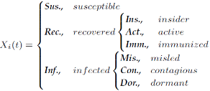
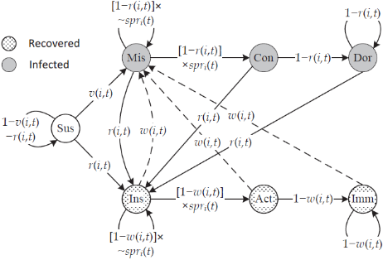
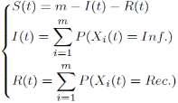
Modelling the Spread of Rumours and Truths
Susceptible-X-X
Susceptible-X-Recovered
Modelling nodes, topology and social events
SXX and SXR
Modelling propagation dynamics
24

Slide 25
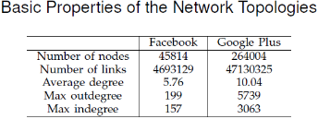
Correctness
Validation
Fig1. Optimistic choices (FB)
Fig2. Optimistic choices (G+)
Fig3. Preferable choices (FB & G+)
Fig4. Alternative choices (FB &G+)
25

Slide 26
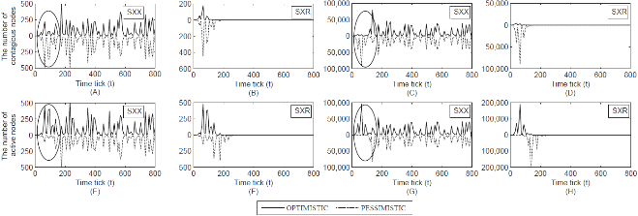
Results Exhibition of the Modelling
Optimistic and Pessimistic
We find that the propagation is mainly decided by the early spreading dynamics if people make optimistic or pessimistic choices on their receiving.
26

Slide 27
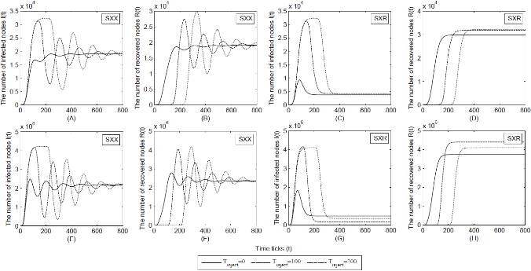
Results Exhibition of the Modelling
Impact of the start time of positive information
Firstly, the propagation under different settings will finally become steady even though there are oscillations. The final results will be approximately equal to a constant. Secondly, we can observe that the spread of negative information reaches the largest scale at the early time stage.

Slide 28
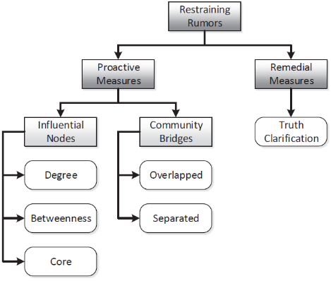
Defense Measures in Online Social Networks
Take the methods of restraining rumors as an example.
Degree: “Error and attack tolerance of complex networks,” Nature, Jul. 2000.
Betweenness: “Controllability of complex networks,” Nature, 2011.
Core: “Identification of influential spreaders in complex networks,” Nature, Aug 2010.
Overlapped: “Uncovering the overlapping community structure of complex networks in nature and society,” Nature, 2005.
Separated: “A social network based patching scheme for worm containment in cellular networks,” in INFOCOM, Proceedings IEEE, 2009
Terminology of Immunization Techniques
28

Slide 29
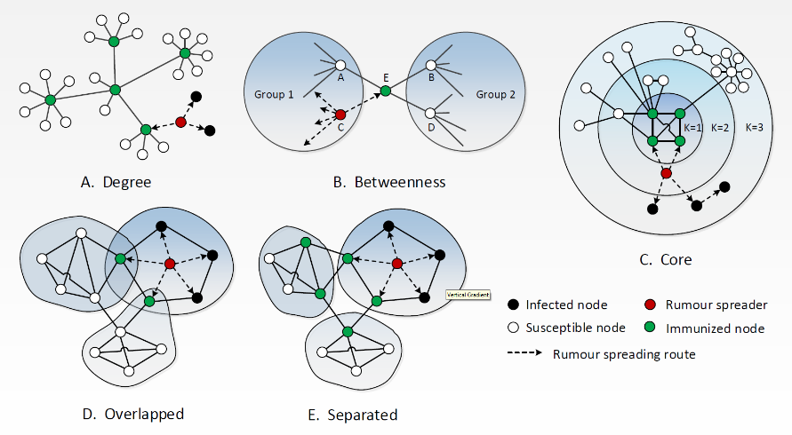
Illustration of Various Proactive Measures

Slide 30
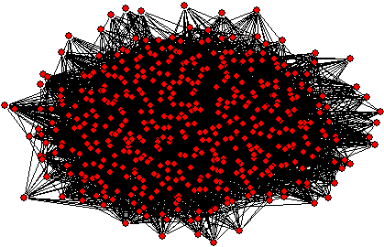
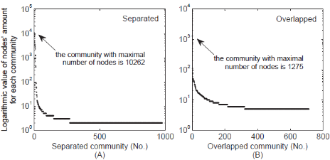
Important Users in OSNs
Facebook Topology
Just an example.

Slide 31
Why is the Truth Spread Necessary?
Case 1: The place of birth of Obama
Case 2: Free press and human right
Case 3: Uncontrollable deceptive reporter
Fake photo report
Actually accident in Hangzhou
The question is whether truth propaganda can
outperform traditional controlling techniques?
31

Slide 32
Maximal Infected Users and Final Infected Users
Maximal infected users: stay almost constant when using truth clarification.
Final infected users: decrease gradually when people are more likely to believe truths.

Slide 33
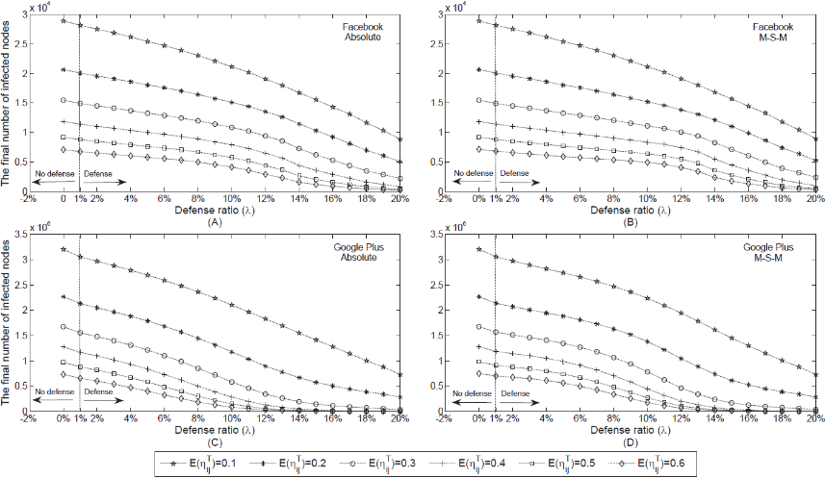
The Equivalence between Blocking Rumors and Spreading Truth
33

Slide 34
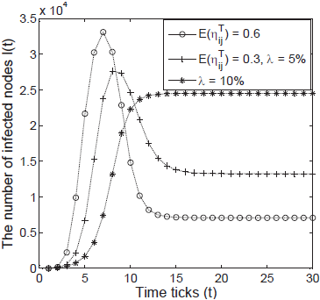
Put Eggs in Different Baskets
A Case Study: Both the maximal infected users and the final infected users decrease.
The exact equivalence: Two methods working together.
34

Slide 35
Outline
Current Methods in Sources Identification
Comparative Studies
Our Work in Propagation Modelling and Source Identification
Future Work & Discussion

Slide 36
Future Work & Discussion
Research problems:
Analyze the factors that may affect the process of identifying propagation sources.
Factors like types of network topologies, propagation schemes, propagation models, etc.
Identifying Propagation Sources in Mobile Networks.
Identifying Multiple Propagation Sources.
Identifying Propagation Sources in interconnected Networks.

Slide 37
Acknowledgement
The research is partially supported by the following ARC grants:
ARC Discovery Project DP180102828, 2018-2020, Wanlei Zhou and Shui Yu, "Enhancing information credibility using mathematical prediction".
ARC Linkage Project LP170100924, 2017-2020, Yang Xiang; Jun Zhang; Wanlei Zhou; Sheng Wen; Shigang Liu, “Developing an effective defence to cyber-reputation manipulation attacks”.
ARC Discovery Project DP140103649, 2014-2016, Wanlei Zhou and Yang Xiang, "Modelling and defence against malware propagation".
ARC Linkage Project LP120200266, 2012-2015, Yang Xiang, Wanlei Zhou, Vijay Varadharajan, and Jonathan Oliver, "Developing an active defence system to identify malicious domains and websites".
ARC Discovery Project DP1095498, 2010-2012, Yang Xiang, Wanlei Zhou, and Yong Xiang, "Tracing real Internet attackers through information correlation".
ARC Linkage Project LP100100208, 2010-2012, Wanlei Zhou and Yang Xiang, "An active approach to detect and defend against peer-to-peer botnets".
ARC Discovery Project DP0773264: 2007-2009, Wanlei Zhou and Yang Xiang, "Development of methods to address internet crime"..

Slide 38
Thank you!

