Slide 1



Adversarial Machine Learning:
Concepts, Techniques and Challenges
UNCLASSIFIED
“If you know the enemy and know yourself, you need not fear the result of a hundred battles”
Sun Tzu 500BC
(source EA)
Olivier de Vel, PhD
Principal Scientist
CEWD, DST Group

Slide 2

Strategic Context
Defence applications of AI and ML will become increasingly common.
Examples include:
  Predictive platform maintenance
  Predictive battlefield tracking
  Autonomous cyber operations
  Software vulnerability discovery
  UAV swarm coordination
  etc.

Slide 3

Strategic Context
Defence applications of AI and ML will become increasingly common.
AI/ML increases the attack surface of the applications.
Why does it matter? Why is it important?
  Security & Safety – algorithms can make mistakes & report incorrect results; currently much is broken…
  Poor understanding of failure modes, robustness etc.

Slide 4

Strategic Context
Defence applications of AI and ML will become increasingly common.
AI/ML increases the attack surface of the applications.
New ML security challenges include:
  Robust ML attacks and defences
  Verification and validation of ML algorithms
  ML supply chains (algorithms, models, data, APIs)
  End-to-end ML security, Security of system-of-ML-systems

Slide 5
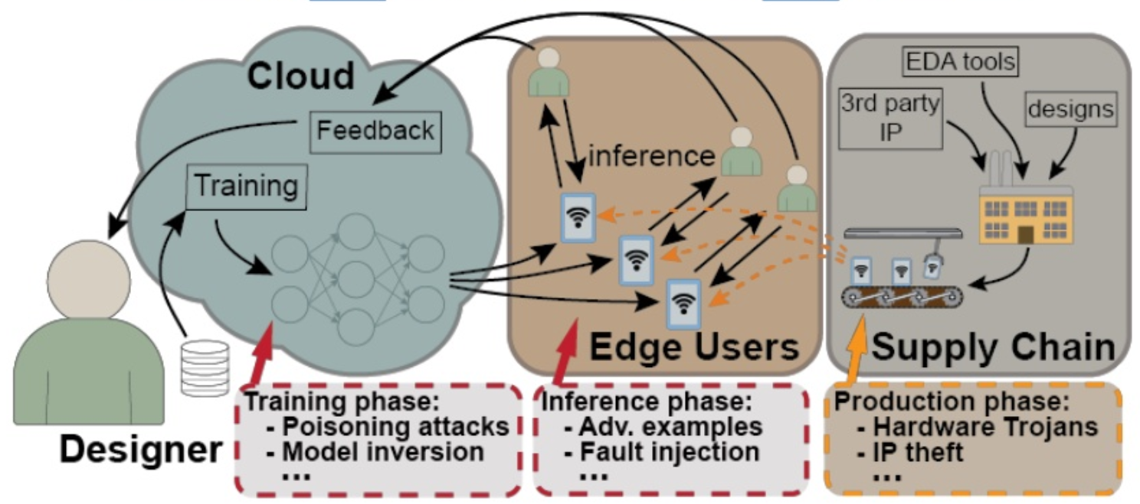
Security Context
Example: Security issues ‘at the core’ and ‘on the edge’
(source: J. Clements CAAD@DEFCON 26-2018)

Slide 6
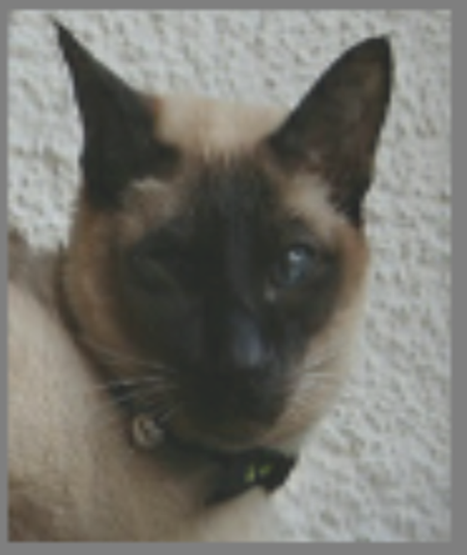
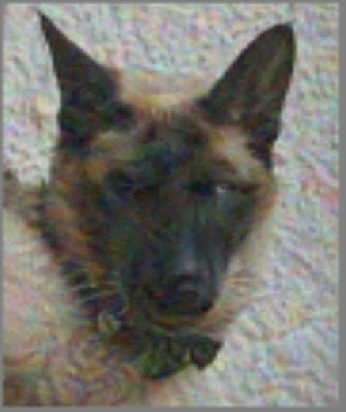

Humans are Vulnerable to Adversarial Examples
e.g. Human perception attacks
Attack on human vision
‘cat’
‘cat’ + noise $⇒$ ‘dog’
(source: Elsayed et al, arXiv:1802.08195v3)

Slide 7
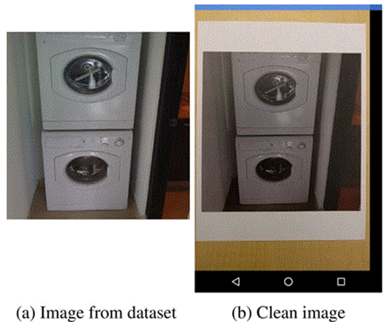
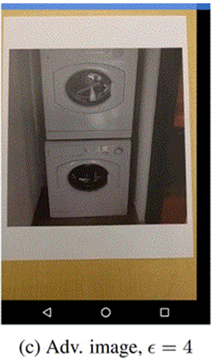
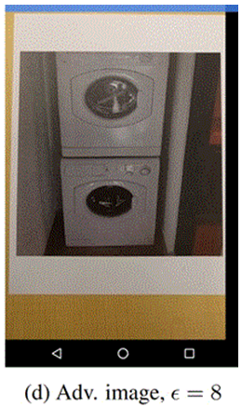
Adversarial ML – Example of Digital Attack
classifier can report incorrect
results with high confidence
(source Kurakin et al, 2016)

Slide 8
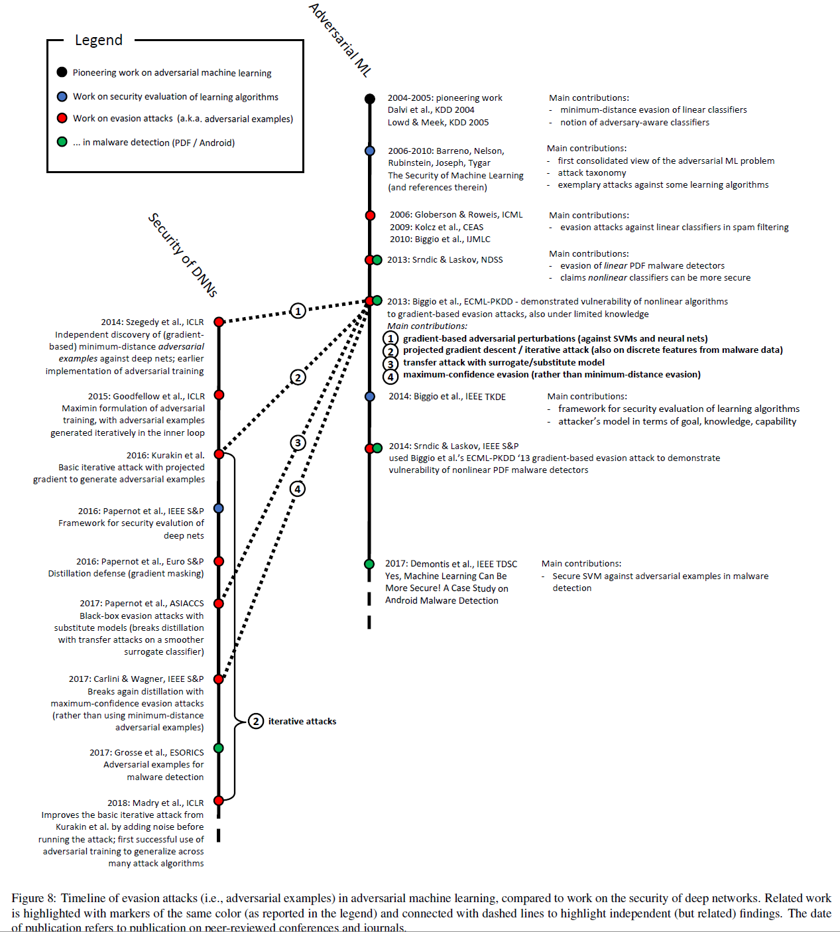

A Brief History of AdvML/AdvDL
(source Biggio and Roli, arXiv:1712.03141v2)
A. Wald (1945) – loss, cost, risk functions
‘adversarial learning’ concept introduced
‘AML’ concept introduced
attacks against SVMs
‘small imperceptible perturbations’ against DNNs
We do this!
Han et al “Reinforcement learning for autonomous defence in SDNs” GameSec 2018

Slide 9

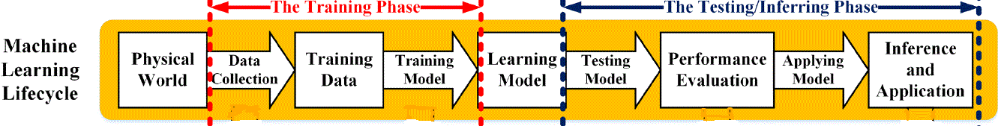
Recap of ML (supervised)
(source “Survey on Security Threats and Defensive Techniques of Machine Learning”, Qiu et al, 2018)

Slide 10
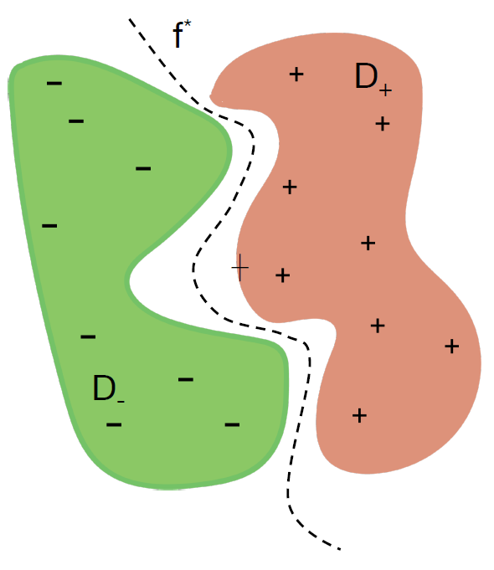
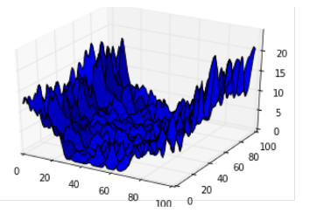

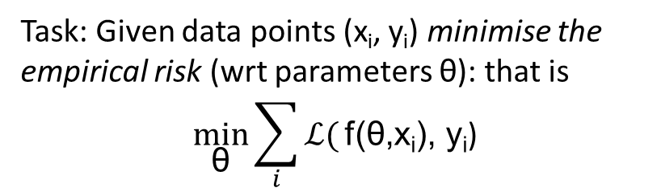
Recap of ML (supervised)
Goal of learning: find a model which delivers good generalisation performance over an underlying distribution of the data.
f* $=$ concept to learn (e.g. classifier function)
Training: Obtain approx. of f*, the parametric classifier f(θ), by finding parameters θ such that f(θ) fits the training data.
Choice of the family f(.) is crucial.
Task: Given data points (x_{i}, y_{i}) minimise the empirical risk (wrt parameters θ): that is
$$\min_{\text{θ}}{\sum_{i}{ℒ(}\text{f}\text{(}\text{θ}\text{,}\text{x}\text{i}\text{), }\text{y}\text{i}\text{)}}$$
If risk is continuous and differentiable then we can use gradient descent.
but often very non-convex…
(source Madry, 2018)

Slide 11
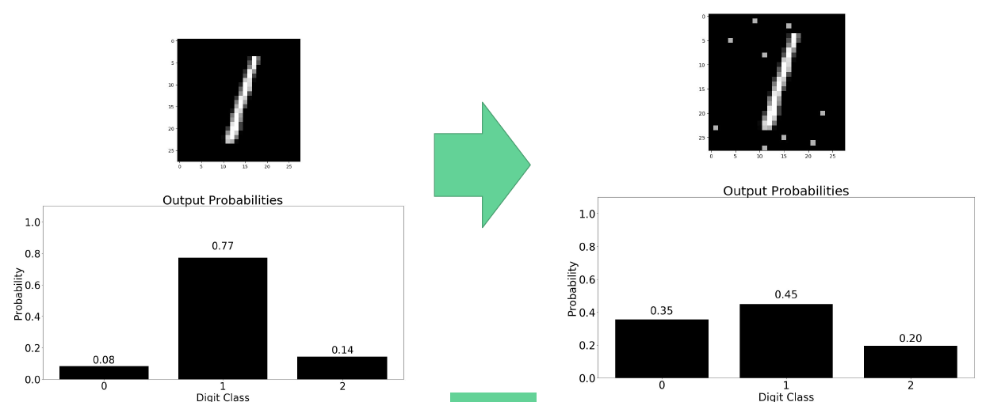
Know Your Adversary
Adversary’s Goals
…to reduce confidence in a system’s capability
…to cause a security incident/violation
e.g. Availability attacks: e.g. DoS attacks due to misclassifications
e.g. Confidentiality attacks: e.g. queries to reveal information
(source Biggio, 2018)
Notes:
Adversary’s goal – what behaviour is the adversary trying to elicit?

Slide 12

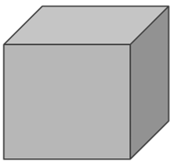
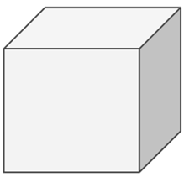

Know Your Adversary
Kerckhoff’s Defence Principle
Adversary’s knowledge
black-box attack
grey-box attack
white-box attack
Training data, defender cost, feature set, ML algorithm, architecture, hyper-parameters, outputs (labels or probabilities) etc.
(source Team Panda, 2018)

Slide 13
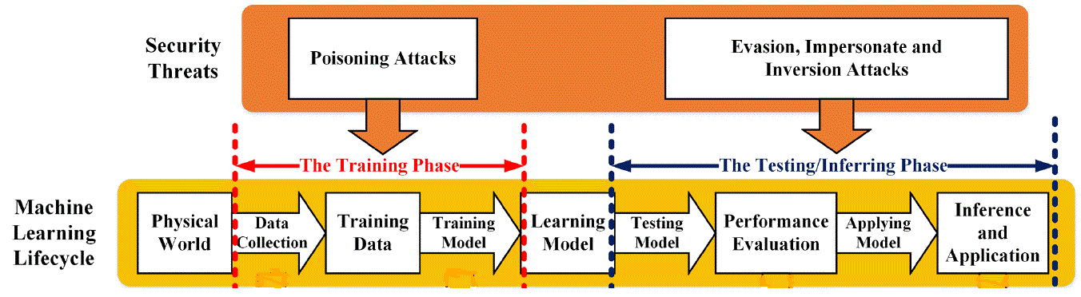
Know Your Adversary
Adversary’s capabilities
(source “Survey on Security Threats and Defensive Techniques of Machine Learning”, Qiu et al, 2018)

Slide 14
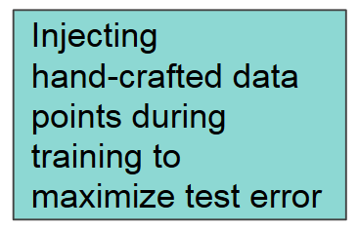
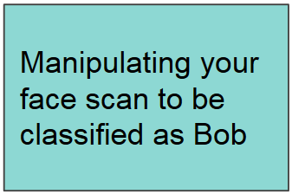
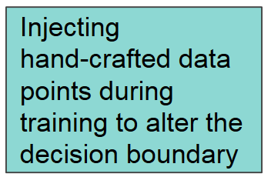
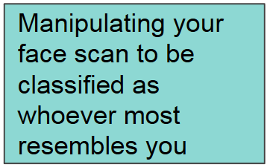
Know Your Adversary
Adversary’s capabilities
Error-generic
Error-specific
Poisoning attack
Evasion attack
(e.g. adversarial examples)
(source Team Panda, 2018)

Slide 15
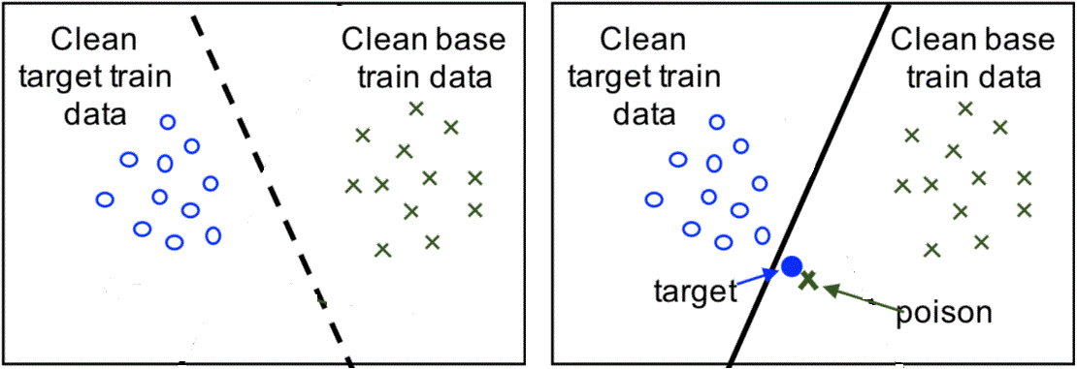
Poisoning the Training Set
Injecting a poisoned data point: clean label attack
(source Biggio and Roli, arXiv:1712.03141v2)

Slide 16
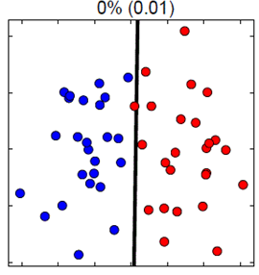
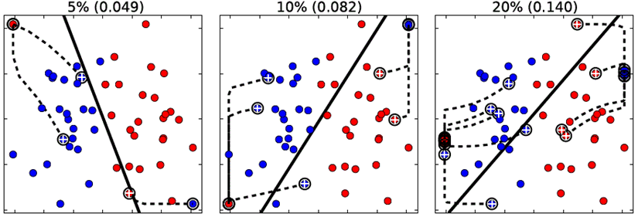

Poisoning the Training Set
Injecting poisoned data points by flipping a fraction of class labels:
increasing # of class label flips
test error
Generally by means of bi-level max-min optimisation:
maximise the attacker’s objective on (untainted) test set
Learn the classifier on the poisoned data p
(source Biggio and Roli, arXiv:1712.03141v2)

Slide 17
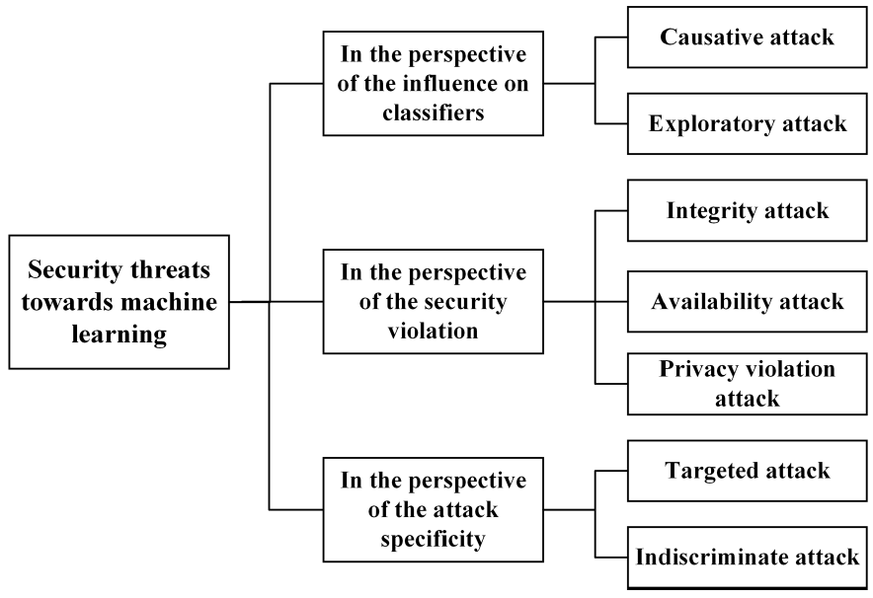
Summary Taxonomy of ML Security Threats
Influence training data to mislead learning
Poisoning attack
Attack test time data to evade detection
Evasion attack
Results in poor decisions on attack data (FN )
DoS attacks against legitimate data (FP )
Adversary obtains sensitive and confidential data
Cause specific errors
Maximise test error rate
Attack at certain times to e.g. minimise detection prob.
Timing attack
(source “Survey on Security Threats and Defensive Techniques of Machine Learning”, Qiu et al, 2018)

Slide 18

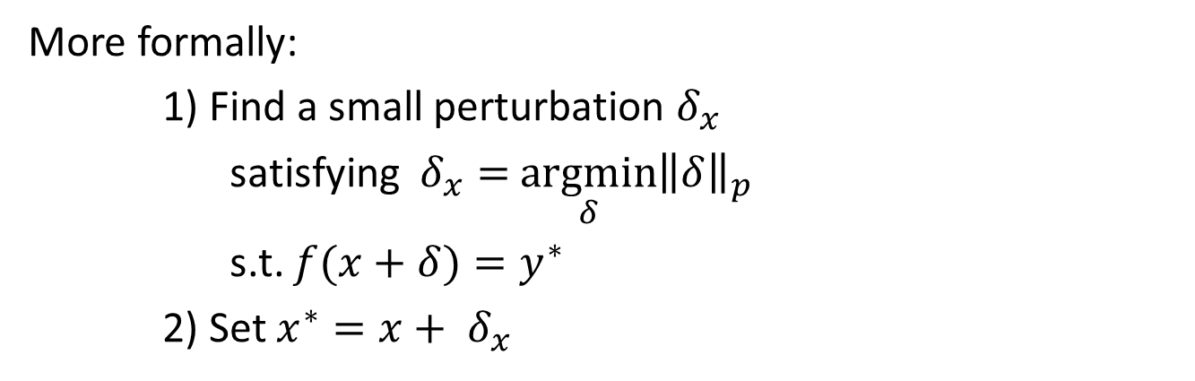
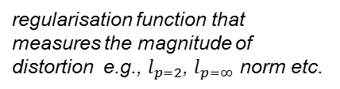
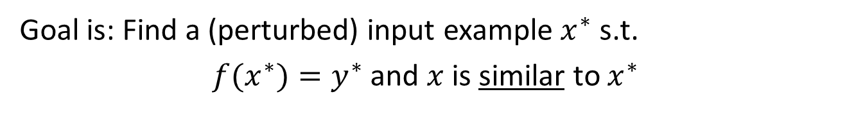

Attack Strategy – Adversarial Examples:
Formal ‘Perturbation’ Problem Statement
Given a trained classifier ${{f: ℝ}^{Data }⟶ℝ}^{Class }$
and given a training example $x$ and a target label $y^{∗}$
Goal is: Find a (perturbed) input example $x^{∗}$ s.t.
        $f(x^{∗})=y^{∗}$ and $x$ is similar to $x^{∗}$
$𝒟\left(x, x^{∗}\right)$‘distance’ metric
e.g. visual similarity for images
More formally:
1) Find a small perturbation $δ_{x}$
      satisfying $δ_{x}=$ $\underset{δ}{argmin}{{\left\|δ\right\|}_{p}}$
      s.t. $f(x+δ)=y^{∗}$
    2) Set $x^{∗}=x+ δ_{x}$
regularisation function that measures the magnitude of distortion e.g., $l_{p=2}$, $l_{p=∞}$ norm etc.
But…
attacker needs to know
model f (white-box)
and… optimisation is non-convex
Ǝ many attack scenarios for neural networks
e.g., L-BFGS, FGSM, C&W, JSMA etc.
(source Papernot et al, 2018)

Slide 19
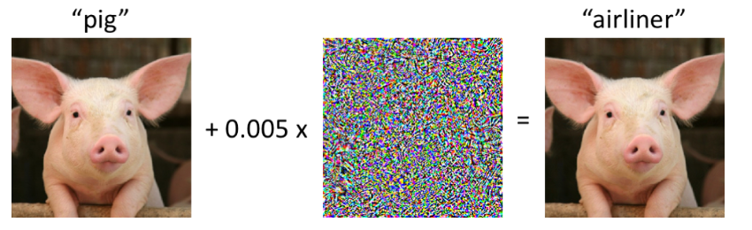
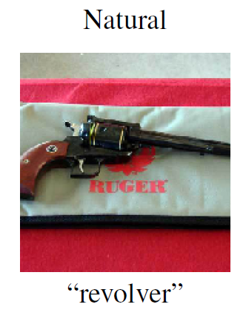
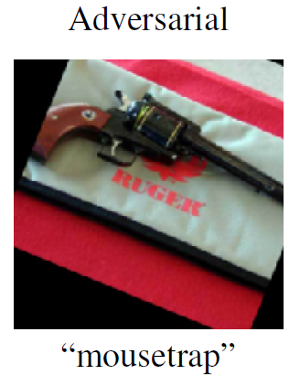



Attack Strategy - Examples
‘additive pixel-wise noise’ FGSM FGSMFGSM
$$x$$
$$δ_{x}= ε sign\left(∇_{x}ℒ\left(θ, x, y\right)\right)$$
$$x^{∗}$$
‘rotation attack’

Slide 20
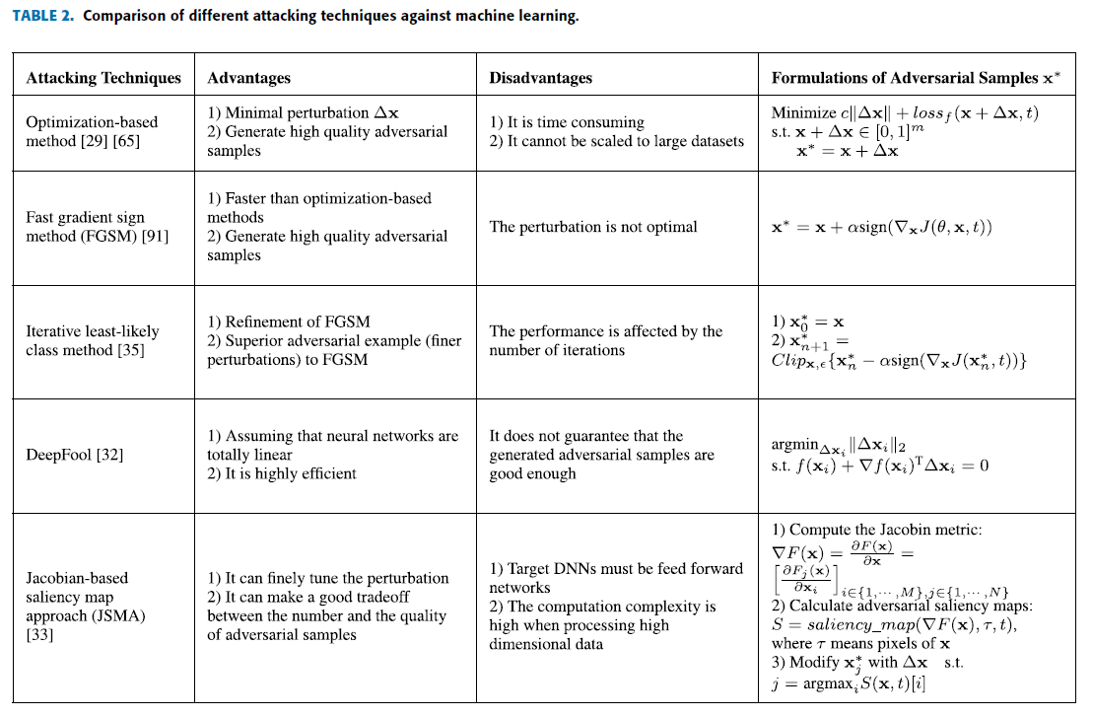
Attack Strategy – Summary Attack Types
We do this!
(source “Survey on Security Threats and Defensive Techniques of Machine Learning”, Qiu et al, 2018)

Slide 21
Attack Strategy – Black-box Attacks
BB attacks are possible with query access:
Query-based Attacks
  Finite difference gradient estimation
  Query reduced gradient estimation
Zero-Query Attacks
  Random perturbation
  Difference of means
  Transferability-based attacks
(source “Secure Learning in Adversarial Deep Neural Networks”, B. Li, 2018)

Slide 22
Attack Strategy – Using Transferability for Black-box Attacks
Adversary
Model B
(Black-Box System)
Model A
(White-Box Model)
Adversarial Examples
transfer to
Samples crafted to mislead a model A are likely to mislead a model B
(source “Secure Learning in Adversarial Deep Neural Networks”, B. Li, 2018)

Slide 23
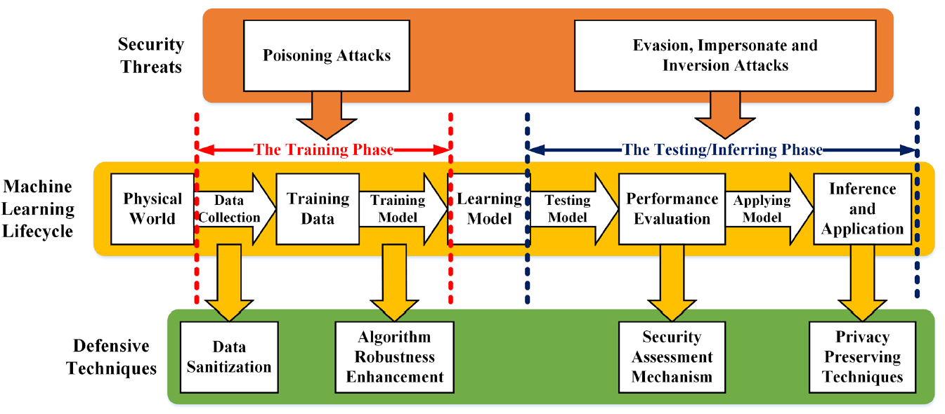
Defence Strategy
(source “Survey on Security Threats and Defensive Techniques of Machine Learning”, Qiu et al, 2018)

Slide 24
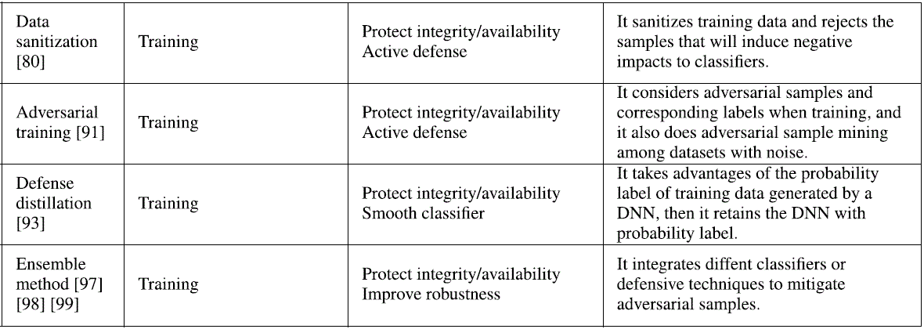
Defence Strategies - Examples
We do this!
(source “Survey on Security Threats and Defensive Techniques of Machine Learning”, Qiu et al, 2018)

Slide 25
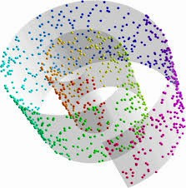
Defence Strategy: Adversarial Training
Goal of adversarial examples:
alter the data distribution of the testing data, resulting in a deviation from the training data manifold and thus creating test-time errors.
Adversarial Training
Intuition:
Inject adversarial examples during training with correct labels.
Goal:
reduce the test error rate and thus improve model generalisation outside the training manifold. This will lead to a more robust model and forms the basis for model-based optimisation.

Slide 26
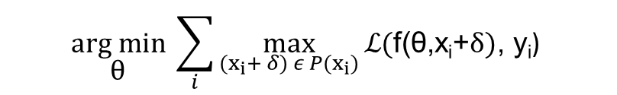
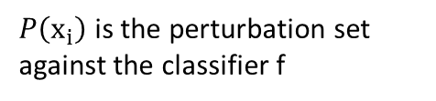

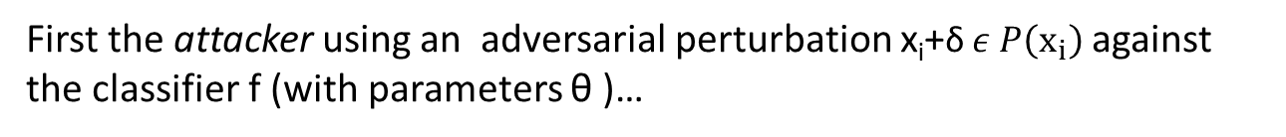
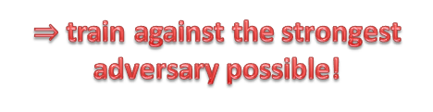
Defence Strategy: Adversarial Training
Now… two ‘players’ – attacker and defender… (Madry et al 2018)
First the attacker using an adversarial perturbation $\text{x}\text{i}\text{+}$δ $ε P\left(x_{i}\right)$against the classifier f (with parameters θ )…
$$\max_{{(x}_{i}+ δ) ε P(x_{i})}{ℒ\text{(}\text{f}\text{(}\text{θ}\text{,}\text{x}\text{i}\text{+}δ)\text{, }\text{y}\text{i}\text{)}}$$
$P\left(x_{i}\right)$ is the perturbation set against the classifier f
This finds the perturbation $\text{x}\text{i}\text{+}δ$ that maximises the loss
Then, as before, the defender attempts to minimise the classifier loss and seeks
$$\underset{\text{θ}}{arg min} \sum_{i}{\max_{{(x}_{i}+ δ) ε P(x_{i})}}{ℒ\text{(}\text{f}\text{(}\text{θ}\text{,}\text{x}\text{i}\text{+}δ)\text{, }\text{y}\text{i}\text{)}}$$
$⇒$train against the strongest adversary possible!
The outer minimisation portion attempts to mitigate loss due to the perturbation by optimising the classifier parameters θ
(source Papernot, 2018)

Slide 27
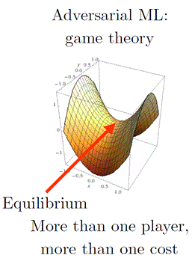
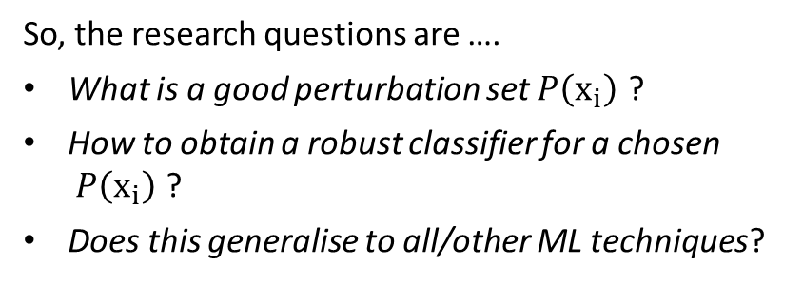
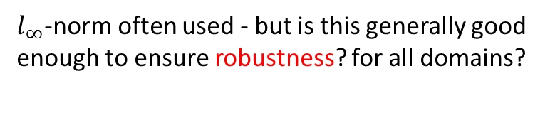
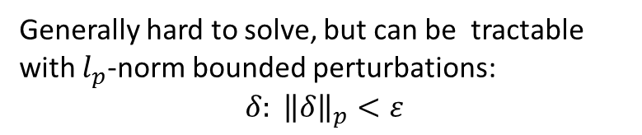

Defence Strategy: Adversarial Training
This mini-max problem corresponds to a saddle point optimisation problem!
Generally hard to solve, but can be tractable with $l_{p}$-norm bounded perturbations:
$$δ: {\left\|δ\right\|}_{p}<ε$$
norm ball
$l_{∞}$-norm often used - but is this generally good enough to ensure robustness? for all domains?
So, the research questions are ….
What is a good perturbation set $P\left(x_{i}\right)$ ?
How to obtain a robust classifier for a chosen $P\left(x_{i}\right)$ ?
Does this generalise to all/other ML techniques?
$$\underset{\text{θ}}{arg min} \sum_{i}{\max_{δ: {\left\|δ\right\|}_{p}<ε}}{ℒ\text{(}\text{f}\text{(}\text{θ}\text{,}\text{x}\text{i}\text{+}δ)\text{, }\text{y}\text{i}\text{)}}$$
(source Papernot, 2018)

Slide 28
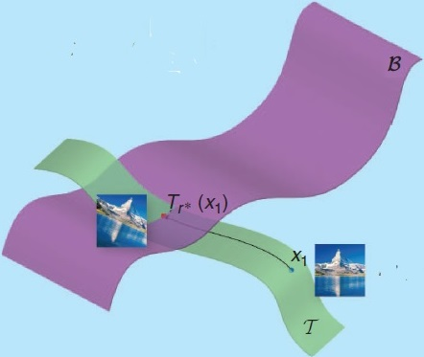
Defence Strategy – It’s an Arms Race
Currently much is broken and not well understood…
Most defensive techniques have been broken (including ensemble methods)
Example - on the issue of (deep) neural network classifier linearity:
Szegedy (2013) suggested that adversarial examples can be explained due to the excessive non-linearity of NN decision boundary.
Goodfellow (2014) concluded that adversarial examples can be explained as a result of too much linearity.
Moosavi-Dezfooli et al (2018) suggested that adversarial examples could be due to excessive curvature regions on the decision boundary.
(source Fawzi et al, 2017)

Slide 29
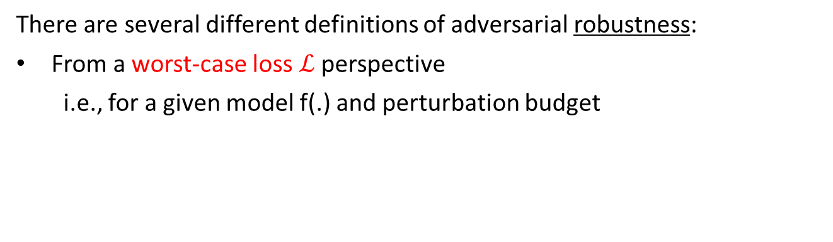

Adversarial Robustness
We do this!
There are several different definitions of adversarial robustness:
From a worst-case loss $ℒ$ perspective
  i.e., for a given model f(.) and perturbation budget
$$\sum_{i}{\max_{δ: {\left\|δ\right\|}_{p}<ε}}{ℒ\text{(}\text{f}\text{(}\text{x}\text{i}\text{+}δ)\text{, }\text{y}\text{i}\text{)}}$$
robustifies the ML algorithm
From a robust statistics perspective
  i.e., how an algorithm behaves under a small perturbation of the statistics model (e.g., influence function approach)
measures the robustness of the ML algorithm
From a stability perspective
  i.e., how the output function f(.) changes under a specific perturbation such as deleting one sample from training set.

Slide 30
Other Application Domains of ML Security
Robotics
Malware detection
Natural language processing
Decision-making
etc.
What About Other ML Algorithms?
Clustering
Reinforcement learning
Evolutionary algorithms
etc.

Slide 31
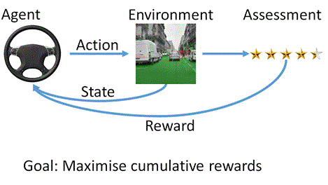
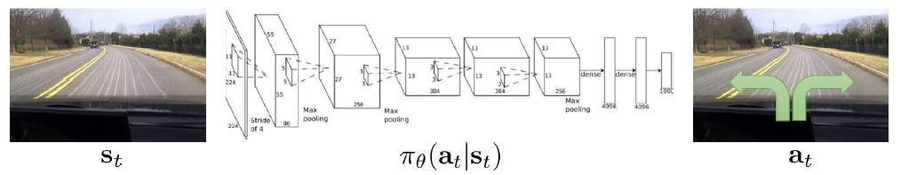

Automated Decision-making: Using RL
We do this!
Can be framed as a
Markov Decision Process (MDP)
reward
learn the policy $π_{ }: s_{t }→ a_{t}$
Environment
that maximises the expected total reward
state
action
(source Levine “CS-294 Deep RL”)
Notes:
RL = agent-oriented learning by interacting with an environment to achieve a goal.
The agent learns a policy mapping states to actions, seeking to maximise its cumulative reward. The environment may be unknown, nonlinear, stochastic and complex.
Policy $π$ is a behaviour function selecting actions a given states s.
RL learns by trial and error, with only delayed evaluative feedback (reward). It’s the beginnings of a ‘science of mind’ that is neither natural science nor applications technology.
RL can model sequential decision-making.
Other RL approaches include genetic (e.g. mutation of learning parameters)

Slide 32
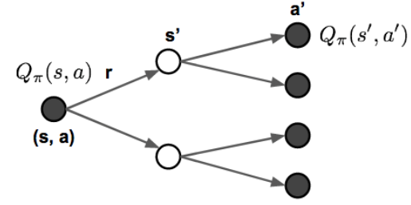

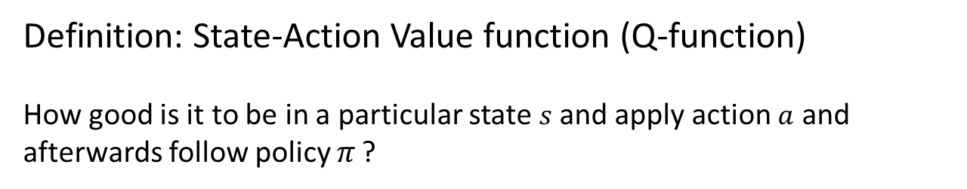

Anatomy of an RL Algorithm - MDP
Definition: State-Action Value function (Q-function)
How good is it to be in a particular state $s$ and apply action $a$ and afterwards follow policy $π_{ }$?
Q: expected total reward under policy $π$
$Q^{π}\left(s,a\right)= 𝔼_{π} \left[r_{0}+ γr_{1}+ γ^{2}r_{2}+ …| s_{0}=s,a_{0}=a\right]$
$γ$: discount factor
which, more generally, can be unrolled recursively:
$Q^{π}\left(s,a\right)= 𝔼_{{ s}^{′}\sim P} \left[r\left(s,a\right)+ γ{𝔼_{{ a}^{′}\sim π}[Q}^{π}\left(s^{′},a^{′}\right)] | s,a\right]$
(on-policy Bellman expectation equation)

Slide 33
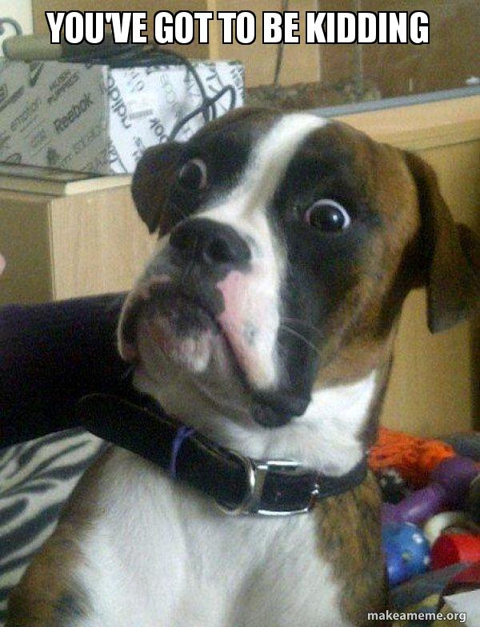


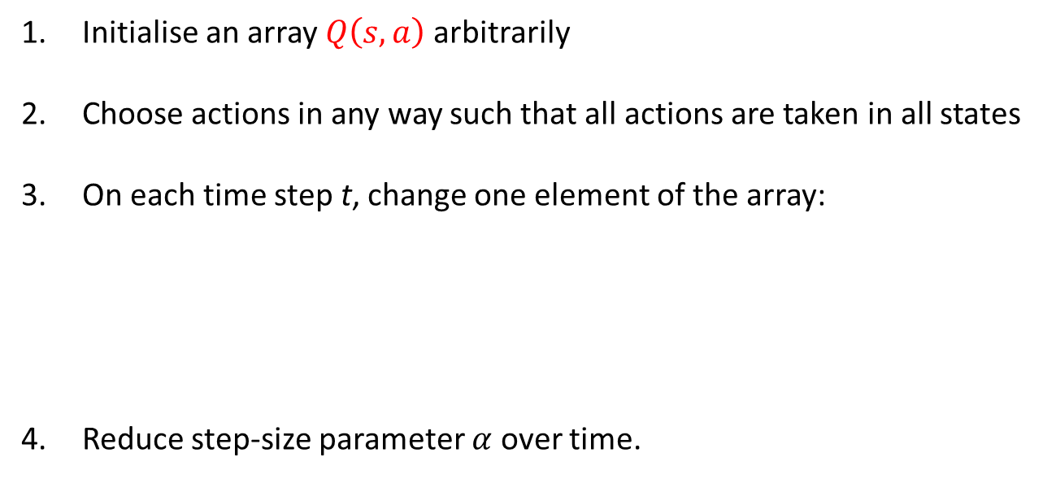



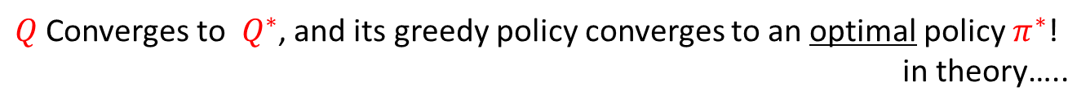


The Simplest RL Algorithm: Q-learning
$$Q\left(s_{t+1},a^{′} \right)$$
$a^{′}$
$$Q\left(s_{t},a_{1}\right)$$
$$r_{t+1}$$
$$a_{1}$$
$$a_{2}$$
Initialise an array $Q\left(s,a\right)$arbitrarily
Choose actions in any way such that all actions are taken in all states
On each time step t, change one element of the array:
Reduce step-size parameter $α$ over time.
$$Q\left(s_{t},a_{2}\right)$$
$$∆Q\left(s_{t},a_{t}\right)= α\left(r_{t+1}+ γ\max_{a}{Q\left(s_{t+1},a\right) − }Q\left(s_{t},a_{t}\right)\right)$$
estimate of optimal future Q value
old Q value
$Q$ Converges to${ Q}^{∗}$, and its greedy policy converges to an optimal policy $π^{∗}$!
in theory…..
(source R. Sutton NIPS2015)

Slide 34


RL Algorithms
Approaches to RL
Value-based RL
    Estimate the optimal state-action value function $Q^{∗}\left(s,a\right)$
Policy-based RL
    Search directly for the optimal policy $π^{∗}$ e.g. policy gradient method
Actor-Critic RL
  Estimate the value of the current policy by Q-learning (critic), then updates the policy in direction that improves Q (actor)
Model-based RL
  Build a transition model of the environment & plan (look-ahead) using model

Slide 35


Taxonomy of RL Algorithms
‘on-policy’
‘off-policy’
(source OpenAI SpinningUp)

Slide 36
Known Problems with RL Algorithms
The Exploration-Exploitation Dilemma
The Deadly Triad Issue – the risk of divergence arises when we combine all three of the following:
  Function approximation
  Bootstrapping bias – learning value estimates from other estimates
  Off-policy learning – learning about a policy from data not due to that policy
(source R. Sutton NIPS2015)

Slide 37

Automated Decision-making: Using Deep RL
reward
Environment
state
DNN learns the policy $π_{θ }: s_{t }→ a_{t}$
action
(source Levine “CS-294 Deep RL”)

Slide 38







Deep Q-Learning: Game Architecture
deep $Q$- network
state $s$
(pixel frame)
action $a$
reward $r$
environment

Slide 39





Deep Q-Learning (DQN)
Q-network: As an approximation, parametrise the state-action value function
  That is, represent $Q$ function by a Q-network with weights $θ_{i}$:
$$Q\left(s,a, θ_{i}\right)≈Q^{π}\left(s,a\right)$$
$$Q(s,a,θ_{i})$$
could be a:
DNN
decision tree
etc.
$$θ_{i}$$
$$s$$
(source: Salakhutdinov 2017)

Slide 40

Deep Q-Learning (DQN)
Q-network: As an approximation, parametrise the state-action value function
Define a loss function as an $l_{2}$-norm
and minimise using the Q-learning gradient
Optimise loss end-to-end by SGD etc.
Periodically update the fixed parameters $θ_{i−1}←θ_{i}$
$$Q\left(s,a,θ_{i}\right)≈Q^{π}\left(s,a\right)$$
target value
$$ℒ\left(θ_{i},𝒟\right)= 𝔼_{(s,a,r,s^{′})\sim 𝒟}\left[{\left({r\left(s,a\right)}_{ }+ γ\max_{a^{′}}{Q\left(s^{′},a^{′},θ_{i−1}\right) − }Q\left(s,a,θ_{i}\right)\right)}^{2}\right]$$
$${\frac{∂ℒ\left(θ_{i},𝒟\right)}{∂θ_{i}}=𝔼}_{\left(s,a,r,s^{′}\right)\sim 𝒟}\left[\left({r\left(s,a\right)}_{ }+ γ\max_{a^{′}}{Q\left(s^{′},a^{′},θ_{i−1}\right) − }Q\left(s,a,θ_{i}\right)\right)\frac{∂Q\left(s,a,θ_{i}\right)}{∂θ_{i}}\right]$$

Slide 41

What Can RL (and DNNs) Do Well Now?
Acquires a high degree of proficiency in domains governed by simple, known rules
Learns simple skills with raw sensory inputs, given enough experience
Learns from imitating enough human-provided expert behaviour
(source Levine “CS-294 Deep RL”)

Slide 42
RL - What has Proven Challenging So Far?
Humans are able to learn incredibly quickly
  Deep RL methods are usually (very) slow
Human can re-use past knowledge
  Transfer learning in deep RL not well understood
Not clear what the reward function should be
Not clear what the role of prediction should be
e.g., predict the consequences of an action? predict total reward from any state?
(source Levine “CS-294 Deep RL”)

Slide 43


Attacks against Deep RL: Adversarial Perturbation
Manipulate states or state channels
Perturbation${ {x_{}^{∗}=x}_{reward}+δ}_{reward}$
Manipulate rewards
Choose timing (perturbing subset of states/rewards)
Environment
Perturbation ${{x_{}^{∗}= x}_{state}+δ}_{state}$
Example: add “invisible” perturbations to the state channel (e.g. readings) so that a different action is taken
e.g. take ‘worst possible’ action
We do this!

Slide 44


Example Deep RL Attack – DDQN Evasion Attack
attacker generates FP readings on adjacent nodes
Attacker no longer able to propagate
Critical server saved by defender
but…
mission severely compromised
critical server node
attacker-compromised node
isolated node
migration node

Slide 45
AML Challenges
A classifier that is robust against many (weak) perturbations, may not be good at finding stronger (worst-case) perturbations. This could be catastrophic in some domains.
Robustness comes at a cost – need better adversarial training (eg use GANs) ? need more training data? more training time? more network capacity? etc.
Is there a trade-off between classifier accuracy (CA) and adversarial accuracy (AA)? Note: humans have both high CA and AA…

Slide 46
AML Challenges (cont)
Attacks are often transferable between different architectures and different ML methods. Why?
Defences don’t generalise well out of the norm ball. Consider other attack models. Understand the complexity of the data manifold.
Certificates of robustness – e.g., produce models with provable guarantees, verification of neural networks etc.. However, guarantees may not scale well due to blind spots in high dimensionality and limited training data.
Obtain more knowledge about the learning task
  Properties of the different data types (eg spatial consistency)
  Properties of the different learning algorithms

Slide 47


Slide 48



2019 Cyber Security Summer School, Adelaide
Day 2 - Friday 22 March 2019
9:00am - 9:15am | Rachael Falk, Cybersecurity CRC Research with impact in the cyber ecosystem
9:15am - 10:15am | Keynote: Prof Wenke Lee, Georgia Tech User interface and security: Two sides of the story
10:15am - 10:45am | Prof. Ryan Ko, University of Queensland Returning data control to users
10:45am - 11:00am | Break
11:00am – 12:00pm | Keynote 5: Prof Vitaly Shmatikov, Cornell Tech What are machine learning models hiding?
12:00pm - 12:45pm | Dr. Olivier de Vel, Defence Science & Technology Group Adversarial Machine Learning
12:45pm - 1:45pm | Lunch
1:45pm - 2:15pm | Prof. Sanjay Jha, University of New South Wales Security challenges in internet of things
2:15pm - 3:15pm | Panel Discussion: Prof. Ali Babar – University of Adelaide Prof. RK Shyamasundar – IIT-Bombay Dr. Jackie Craig – Independent Consultant Prof. Vallipuram Muthukkumarasamy – University of Griffith Prof. Anton Van Den Hengel – Australian Institute for Machine Learning
3:15pm - 3:30pm | Break
3:30pm - 4:00pm | Prof. Willy Susilo, University of Wollongong Securing Cloud Storage: Challenge and Research Directions
4:00pm - 4:30pm | Dr. Jin-Song Dong, Griffith University Formal analysis in security
Proudly hosted and sponsored by

